Slide 1
Recitation 10: Malloc Lab
Your TAs
Monday, October 26th, 2020

Slide 2
Administrivia
Malloc checkpoint due Thursday, October 29! yeeT
Malloc final due Tuesday, November 10! yooT

Slide 3
Checkpoint Submission
Style Grading
We will grade your checkheap with your checkpoint submission!
Things to Remember:
Document checkheap
See writeup for what to include in checkheap

Slide 4
Git Reminders
Points may be deducted for style on Git usage
Please use detailed commit messages – things like “DONE” or “did a thing” aren’t enough
You should be committing often as you work on your code
Especially for malloc: git diff can show what you changed since your last working commit
Also allows you to restore your hard work in case your file gets deleted accidentally…
Commit early, commit often 😤
Remember to git push your commits, or else we can’t grade them :(

Slide 5
Outline
Concept
How to choose blocks
Metadata
Debugging / GDB Exercises

Slide 6
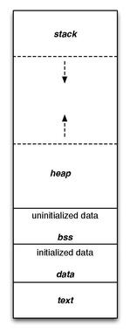
What is malloc?
A function to allocate memory during runtime (dynamic memory allocation).
More useful when the size or number of allocations is unknown until runtime (e.g., data structures)
The heap is a segment of memory addresses reserved almost exclusively for malloc to use.
Your code directly manipulates the bytes of memory in this section.

Slide 7
Concept
Overall, malloc does three things:
Organizes all blocks and stores information about them in a structured way.
Uses the structure made to choose an appropriate location to allocate new memory.
Updates the structure when the user frees a block of memory.
This process occurs even for a complicated algorithm like segregated lists.

Slide 8
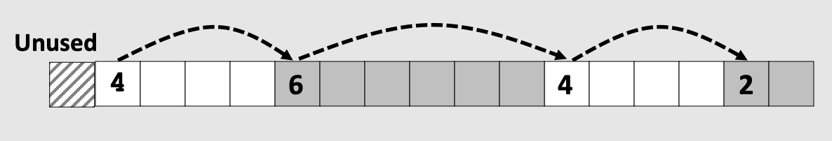
Concept (Implicit list)
Connects and organizes all blocks and stores information about them in a structured way, typically implemented as a singly linked list
Notes:
add image from lecture

Slide 9
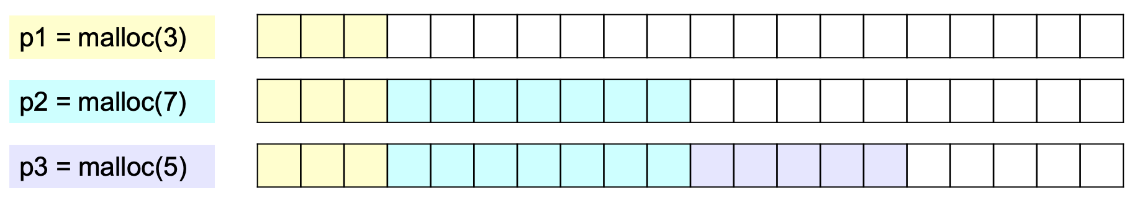
Concept (Implicit list)
Uses the structure made to choose an appropriate location to allocate new memory.

Slide 10
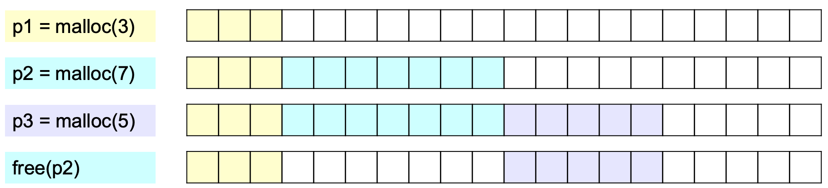
Concept (Implicit list)
Updates the structure when the user frees a block of memory.
Notes:
Go through the processes of 3 cases of allocating/freeing (related to coalesce) - do it on board

Slide 11
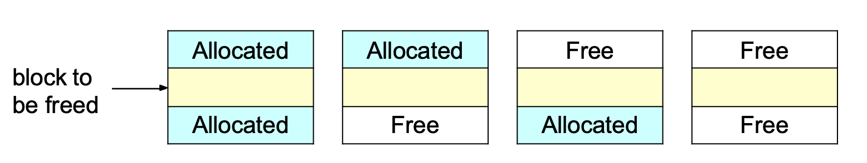
Concept (Implicit list)
Updates the structure when the user frees a block of memory.
Notes:
Go through the processes of 3 cases of allocating/freeing (related to coalesce) - do it on board

Slide 12
Coalesce: Case 1
A
B
C
Result:
A
Free
B
C

Slide 13
Coalesce: Case 2
Free
A
Block to be freed
Allocated
B
Allocated
C
Result:
Free
Combined A+B
Allocated
C

Slide 14
Coalesce: Case 3
Coalesce: Case
Allocated
A
Block to be freed
Allocated
B
Free
C
Result:
Allocated
A
Free
Combined B+C

Slide 15
Coalesce: Case 4
Free
A
Block to be freed
Allocated
B
Free
C
Result:
Free
Combined A+B+C

Slide 16
Goals
Run as fast as possible
Waste as little memory as possible
Seemingly conflicting goals, but with the library malloc call cleverness you can do very well in both areas!
The simplest implementation is the implicit list. mm.c uses this method.
Unfortunately…

Slide 17
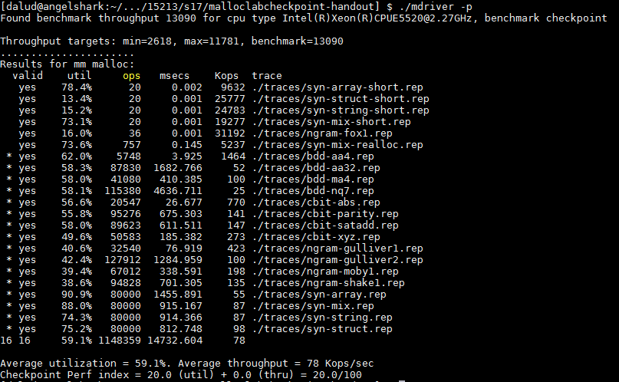
This is pretty slow… most explicit list implementations get above 2000 Kops/sec

Slide 18
Allocation methods in a nutshell
Implicit list: a list is implicitly formed by jumping between blocks, using knowledge about their sizes.
Explicit list: Free blocks explicitly point to other blocks, like in a linked list.
Understanding explicit lists requires understanding implicit lists
Segregated list: Multiple linked lists, each containing blocks in a certain range of sizes.
Understanding segregated lists requires understanding explicit lists
Allocated | Free | Allocated | Free | Allocated
 | Free |  | Free
 | Free |  | Free
Notes:
Monday TA Notes: Explicit lists and segregated lists have not been covered in detail at this point (will cover on Tuesday)

Slide 19
Choices
What kind of implementation to use?
Implicit list, explicit list, segregated lists, binary tree methods, etc.
You can use specialized strategies depending on the size of allocations
Adaptive algorithms are fine, though not necessary to get 100%.
Don’t hard-code for individual trace files - you’ll get no credit/code deductions!
What fit algorithm to use?
Best fit: choose the smallest block that is big enough to fit the requested allocation size
First fit / next fit: search linearly starting from some location, and pick the first block that fits.
Which is faster? Which uses less memory?
“Good enough” fit: a blend between the two
This lab has many more ways to get an A+ than, say, Cache Lab Part 2

Slide 20
Finding a Best Block
Suppose you have implemented the explicit list approach
You were using best fit with explicit lists
You experiment with using segregated lists instead. Still using best fits.
Will your memory utilization score improve? Note: you don’t have to implement seglists and run mdriver to answer this. That’s, uh, hard to do within one recitation session.
What other advantages does segregated lists provide?
Losing memory because of the way you choose your free blocks is called external fragmentation.
Notes:
Memory util is the same, but throughput may be faster.
If you decide to switch to a “good enough” fit policy, you may be able to get an increase on both fronts.

Slide 21
Metadata
All blocks need to store some data about themselves in order for malloc to keep track of them (e.g. headers)
This takes memory too…
Losing memory for this reason is called internal fragmentation.
What data might a block need?
Does it depend on the malloc implementation you use?
Is it different between free and allocated blocks?
Can we use the extra space in free blocks?
Or do we have to leave the space alone?
How can we overlap two different types of data at the same location?
Notes:
Yes, yes, yes (can use the space)
Unions! (See textbook)

Slide 22
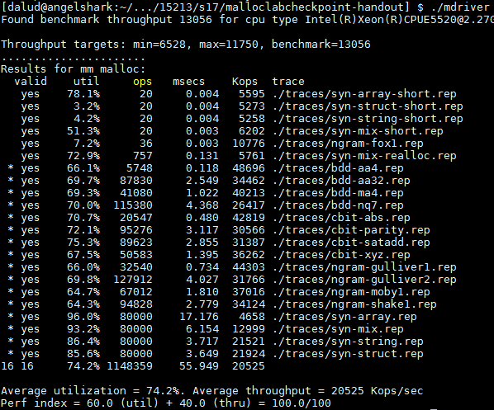
In a perfect world…
Setting up the blocks, metadata, lists… etc (500 LoC)
+ Finding and allocating the right blocks (500 LoC)
+ Updating your heap structure when you free (500 LoC) =

Slide 23

In reality…
Setting up the blocks, metadata, lists… etc (500 LoC)
+ Finding and allocating the right blocks (500 LoC)
+ Updating your heap structure when you free (500 LoC)
+ One bug, somewhere lost in those 1500 LoC =

Slide 24


Slide 25
Common errors you might see
Garbled bytes
Problem: overwriting data in an allocated block
Solution: remembering data lab and the good ol’ days finding where you’re overwriting by stepping through with gdb
Overlapping payloads
Problem: having unique blocks whose payloads overlap in memory
Solution: literally print debugging everywhere finding where you’re overlapping by stepping through with gdb
Segmentation fault
Problem: accessing invalid memory
Solution: crying a little finding where you’re accessing invalid memory by stepping through with gdb

Slide 26


Try running $ make
If you look closely, our code compiles your malloc implementation with the -O3 flag.
This is an optimization flag. -O3 makes your code run as efficiently as the compiler can manage, but also makes it horrible for debugging (almost everything is “optimized out”).
For malloclab, we’ve provide you a driver, mdriver-dbg, that not only enables debugging macros, but compiles your code with -O0. This allows more useful information to be displayed in GDB

Slide 27
Debugging Strategies
Write a heap checker!
Checks the invariants of your heap to make sure everything is well-formed
If you write detailed error messages, you can see exactly why your heap is incorrectly formed
Use assertions in your functions!
122 style contracts can also help you catch where things go amiss
Gives more information than a segfault
Import
Use a debugger!

Slide 28
Debugging Guidelines
If you have this problem...
You might want to...
Ran into segfault
Trace results don’t match yours
Don’t know what trace output should be
Locate a segfault
run
<>
backtrace
list
Reproduce results of a trace
Run with gdb
gdb args

Slide 29
What’s better than printf? Using GDB
Carnegie Mellon
Use GDB to determine where segfaults happen!
gdb mdriver will open the malloc driver in gdb
Type run and your program will run until it hits the segfault!
step/next - (abbrev. s/n) step to the next line of code
next steps over function calls
finish - continue execution until end of current function, then break
print <expr> - (abbrev. p) Prints any C-like expression (including results of function calls!)
Consider writing a heap printing function to use in GDB!
x <expr> - Evaluate <expr> to obtain address, then examine memory at that address
x /a <expr> - formats as address
See help p and help x for information about more formats

Slide 30
Debugging mdriver
(gdb) x /gx block
Shows the memory contents within the block
In particular, look for the header.
(gdb) print *block
Alternative: (gdb) print *(block_t *) <address>
Shows struct contents

Slide 31
Using GDB - Fun with frames
Carnegie Mellon
backtrace - (abbrev. bt) print call stack up until current function
backtrace full - (abbrev. bt full) print local variables in each frame
(gdb) backtrace #0 find_fit (...)
#1 mm_malloc (...)
#2 0x0000000000403352 in eval_mm_valid (...) #3 run_tests (...)
#4 0x0000000000403c39 in main (...)
frame 1 - (abbrev. f 1) switch to mm_malloc’s stack frame
Good for inspecting local variables of calling functions

Slide 32
Using GDB - Setting breakpoints/watchpoints
Carnegie Mellon
break mm_checkheap - (abbrev. b) break on “mm_checkheap()”
b mm.c:25 - break on line 25 of file “mm.c” - very useful!
b find_fit if size == 24 - break on function “find_fit()” if the local variable “size” is equal to 24 - “conditional breakpoint”
watch heap_listp - (abbrev. w) break if value of “heap_listp” changes - “watchpoint”
w block == 0x80000010 - break if “block” is equal to this value
w *0x15213 - watch for changes at memory location 0x15213
Can be very slow
rwatch <thing> - stop on reading a memory location
awatch <thing> - stop on any memory access

Slide 33
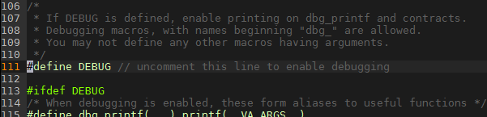
Heap consistency checker
mm-2.c activates debug mode, and so mm_checkheap runs at the beginning and end of many of its functions.
*Even though the checker in mm-2.c is short and buggy

Slide 34
Heap Checker
Carnegie Mellon
int mm_checkheap(int verbose);
critical for debugging
write this function early!
update it when you change your implementation
check all heap invariants, make sure you haven't lost track of any part of your heap
check should pass if and only if the heap is truly well-formed
should only generate output if a problem is found, to avoid cluttering up your program's output
meant to be correct, not efficient
call before/after major operations when the heap should be well-formed

Slide 35
Heap Invariants (Non-Exhaustive)
Carnegie Mellon
Block level
What are some things which should always be true of every block in the heap?

Slide 36
Heap Invariants (Non-Exhaustive)
Carnegie Mellon
Block level
header and footer match
payload area is aligned, size is valid
no contiguous free blocks unless you defer coalescing
List level
What are some things which should always be true of every element of a free list?

Slide 37
Heap Invariants (Non-Exhaustive)
Carnegie Mellon
Block level
header and footer match
payload area is aligned, size is valid
no contiguous free blocks unless you defer coalescing
List level
next/prev pointers in consecutive free blocks are consistent
no allocated blocks in free list, all free blocks are in the free list
no cycles in free list unless you use a circular list
each segregated list contains only blocks in the appropriate size class
Heap level
What are some things that should be true of the heap as a whole?

Slide 38
Heap Invariants (Non-Exhaustive)
Carnegie Mellon
Block level
header and footer match
payload area is aligned, size is valid
no contiguous free blocks unless you defer coalescing
List level
next/prev pointers in consecutive free blocks are consistent
no allocated blocks in free list, all free blocks are in the free list
no cycles in free list unless you use a circular list
each segregated list contains only blocks in the appropriate size class
Heap level
all blocks between heap boundaries, correct sentinel blocks (if
used)
29

Slide 39
Strategy - Suggested Plan for Completing Malloc
0. Start writing your checkheap!
1. Implement coalescing
2. Get an explicit list implementation to work with proper coalescing and splitting
3. Get to a segregated list implementation to improve utilization
4. Work on optimizations (each has its own challenges!)
- Remove footers
- Decrease minimum block size
- Reduce header sizes
Notes:
Add animations - “Make sure your checkheap is working”
“Git commit”
“Valgrind”

Slide 40
Strategy - Suggested Plan for Completing Malloc
0. Start writing your checkheap!
1. Get an explicit list implementation to work with proper coalescing and splitting
3. Get to a segregated list implementation to improve utilization
4. Work on optimizations (each has its own challenges!)
- Remove footers
- Decrease minimum block size
- Reduce header sizes
Keep writing your checkheap!
Keep writing your checkheap!
Keep writing your checkheap!
Keep writing your checkheap!
Notes:
Add animations - “Make sure your checkheap is working”
“Git commit”
“Valgrind”

Slide 41


MallocLab Checkpoint
Due next Thursday!
Checkpoint should take a bit less than half of the time you spend overall on the lab.
Read the write-up. Slowly. Carefully.
Use GDB - watch, backtrace
Ask us for debugging help
Only after you implement mm_checkheap though! You gotta learn how to understand your own code - help us help you!
please write checkheap or we will scream

Slide 42
Appendix: Advanced GDB Usage
backtrace: Shows the call stack
up/down: Lets you go up/down one level in the call stack
frame: Lets you go to one of the levels in the call stack
list: Shows source code
print <expression>:
Runs any valid C command, even something with side effects like mm_malloc(10) or mm_checkheap(1337)
watch <expression>:
Breaks when the value of the expression changes
break <function / line> if <expression>:
Only stops execution when the expression holds true
Ctrl-X Ctrl-A or cgdb for visualization

