Slide 1
Recitation 12: Tshlab + VM
Instructor: Your TAs
213: Nov 16, 2020

Slide 2
Outline
Logistics
Signals
IO
Virtual Memory
Notes:
mention status of regrade requests

Slide 3
tshlab and proxylab
tshlab due Monday Nov 23!
2 late days available
Proxylab is released after
Checkpoint due Dec 3
Final due Dec 10

Slide 4
Signals
Parent process sends SIGINT to a child process. What is the behavior of the child?
What is the default?
What else could the child do?
Notes:
Default behavior is to terminate.
Child can block / ignore this signal. Keep this in mind for tshlab.

Slide 5
More Signals
Parent process sends SIGKILL to a child process. What is the behavior of the child?
What is the default?
What else could the child do?
Notes:
SIGKILL cannot be blocked. Child is (eventually) terminated.

Slide 6
Sending Signals
Parent sends SIGKILL to a child process.
...
pid_t pid = ...; // child pid
kill(pid, SIGKILL);
// At this point, what could have // happened to the child process?
Notes:
Answer: we don’t know. Perhaps SIGKILL has been delivered, or it might not have been delivered.

Slide 7
Blocking Signals
The shell is currently running its handler for SIGCHLD.
What signals can it receive?
What signals can it not receive (i.e., blocked)?
Notes:
When the handler for a particular signal is invoked, that signal is automatically blocked until the handler returns.
Other signals can arrive and interrupt the handler

Slide 8
Errno
In shell lab, your signal handlers must preserve errno
Only contains useful value if just returned error
Consider successfully opening a file “temp.txt”. What is the value of errno?
Notes:
Elaborate a little bit on what “preserve errno” means and tell the students your favorite error number to build rapport

Slide 9
IO functions
Needed for tshlab
int open(const char *pathname, int flags,
mode_t mode);
Can pass bitwise-or of flags:
File Creation: O_CREAT, O_TRUNC, etc.
File Status
Access Modes (must include at least one): O_RDONLY, O_WRONLY, O_RDWR
Mode: specifies what permission is associated with file when creating one
int close(int fd);
int dup2(int oldfd, int newfd);

Slide 10
Permissions for open()
 | Read (R) | Write (W) | Executable (X) | All (RWX)
User (USR) | S_IRUSR | S_IWUSR | S_IXUSR | S_IRWXU
Group (GRP) | S_IRGRP | S_IWGRP | S_IXGRP | S_IRWXG
Other (OTH) | S_IROTH | S_IWOTH | S_IXOTH | S_IRWXO
These constants can be bitwise-OR’d and passed to the third argument of open()
What does S_IRWXG | S_IXUSR | S_IXOTH mean?
How to create a file which everyone can read from but only the user can write to it or execute it?
Notes:
S_IRWXG: read/write/search/execute permission bit for group owner of file.
S_IXUSR: Execute (for ordinary files) or search (for directories) permission bit for the owner of the file
S_IXOTH: Execute/search permission bit for other users

Slide 11
STD File Descriptors
stdin, stdout, stderr are opened automatically and closed by normal termination or exit()
fd
0
1
2
STDIN_FILENO
STDOUT_FILENO
STDERR_FILENO
open file table
stdin
stdout
stderr
Notes:
STDIN_FILENO corresponds to the file descriptor (type int)
stdin corresponds to a FILE*

Slide 12
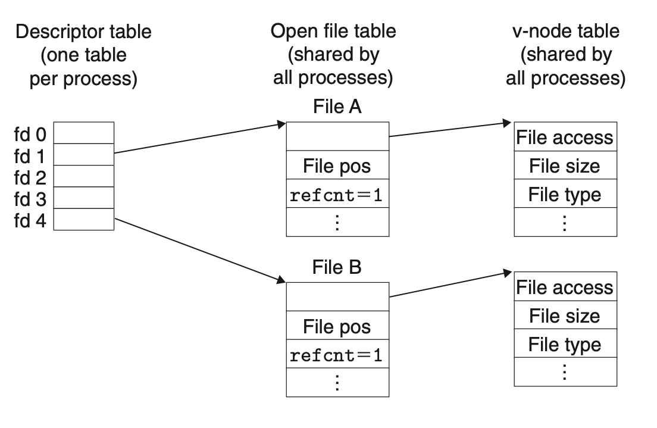
File descriptors (File A != File B)
“foo.txt”
“bar.txt”
Notes:
open called twice on two different files:
open(“foo.txt”);
open(“bar.txt”);

Slide 13
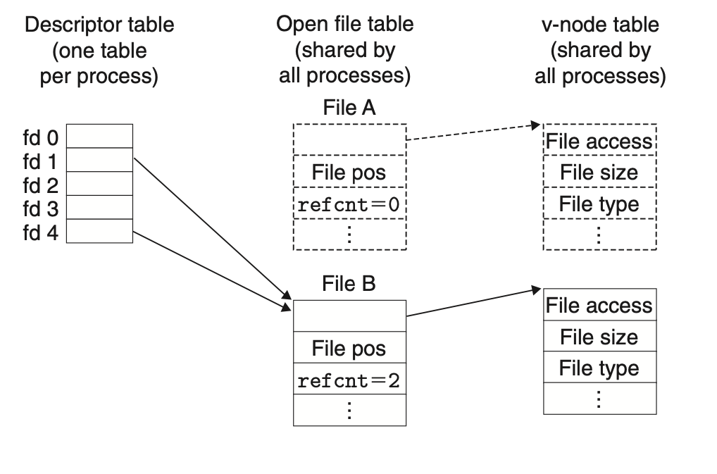
File descriptors after dup2(4,1);
Closed silently
“foo.txt”
“bar.txt”

Slide 14
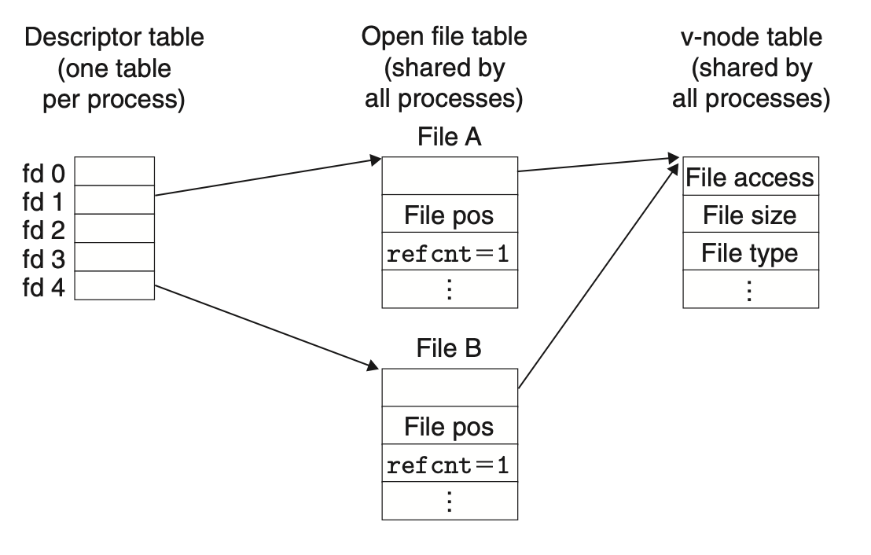
File Descriptors (File A == File B)
“foo.txt”
“foo.txt”
Notes:
result of calling open twice on the same file
open(“foo.txt”);
open(“foo.txt”);

Slide 15
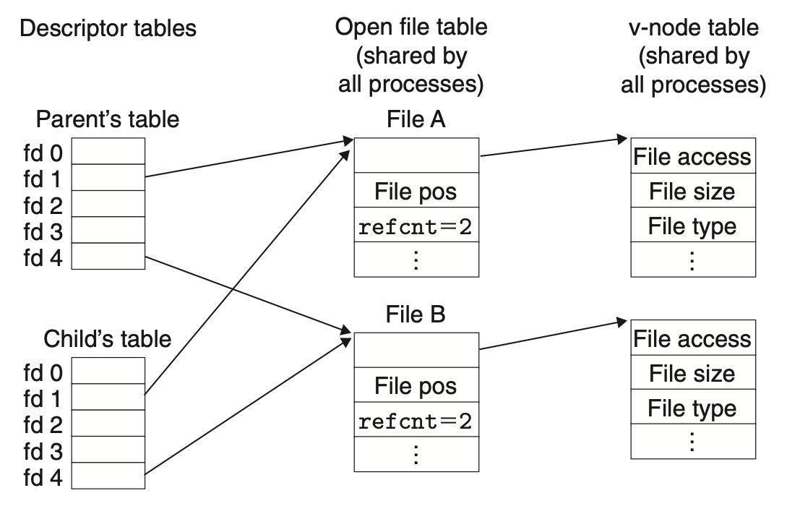
File Descriptors after a fork()
“foo.txt”
“bar.txt”
Notes:
descriptor tables are initially the same (but are not shared)
open file table is shared across all process
file pos change in child will affect parent file pos
opening in

Slide 16
IO and Fork()
File descriptor management can be tricky.
How many file descriptors are open in the parent process at the indicated point?
How many does each child have open at the call to execve?
int main(int argc, char** argv)
{
int i;
for (i = 0; i < 4; i++)
{
int fd = open(“foo”, O_RDONLY);
pid_t pid = fork();
if (pid == 0)
{
int ofd = open(“bar”, O_RDONLY);
execve(...);
}
}
// How many file descriptors are open in the parent?
Notes:
child inherits copy of parent’s file descriptor table, but they share open file table
parent: 4 + 3 = 4 (foo) + 3 (std)
+3 std for all children as well
child 0: 2
child 1: 2
child 2: 2
child 3: 2
open file table contains 11 entries = 3 (std) + 4 (foo) + 4 (bar)

Slide 17
Redirecting IO
At the two points (A and B) in main, how many file descriptors are open?
int main(int argc, char** argv)
{
int i, fd;
fd = open(“foo”, O_WRONLY);
dup2(fd, STDOUT_FILENO);
// Point A
close(fd);
// Point B
...
Notes:
initially 4 after the open
A: 3 b/c dup2 would cause refcnt for stdout to go to 0, kernel would close stdout
B: 2
Some thoughts that have not been approved yet: At point A, 4 file descriptors (0, 1, 2, fd) are available. And 3 file table entries are open (for stdin, stderr, the fd “foo” entry)
At point B, 3 file descriptors (0, 1, 2) are available. And 3 entries (stdin, stderr, “foo”) are still open. Because close only reduced the refcnt of “foo” entry. Did not completely close it.

Slide 18
Redirecting IO
File descriptors can be directed to identify different open files.
int main(int argc, char** argv) {
int i;
for (i = 0; i < 4; i++)
{
int fd = open(“foo”, O_RDONLY);
pid_t pid = fork();
if (pid == 0)
{
int ofd = open(“bar”, O_WRONLY);
dup2(fd, STDIN_FILENO);
dup2(ofd, STDOUT_FILENO);
execve(...);
}
}
// How many file descriptors are open in the parent?
}
Notes:
Bonus question: how many fds are open in the last forked child?
parent: 7 = 4(foo) + 3(std)
last forked child has 2 fds (nothing is closed b/c the ref counts for stdin and stdin are both > 0)

Slide 19
Sample Exam Question
What is the possible output given contents of foo.txt are “ABCDEFG”?
int main(int argc, char *argv[]) {
int fd1 = open("foo.txt", O_RDONLY);
int fd2 = open("foo.txt", O_RDONLY);
read_and_print_one(fd1);
read_and_print_one(fd2);
if(!fork()) {
read_and_print_one(fd2);
read_and_print_one(fd2);
close(fd2);
fd2 = dup(fd1);
read_and_print_one(fd2);
} else {
wait(NULL);
read_and_print_one(fd1);
read_and_print_one(fd2);
printf("\n");
}
close(fd1);
close(fd2);
return 0;
}
void read_and_print_one(int fd) {
char c;
read(fd, &c, 1);
printf("%c", c);
fflush(stdout);
}
Notes:
AABCBCD

Slide 20
Sample Exam Question
What is the possible output given contents of foo.txt are “ABCDEFG”?
int main(int argc, char *argv[]) {
int fd1 = open("foo.txt", O_RDONLY);
int fd2 = open("foo.txt", O_RDONLY);
read_and_print_one(fd1);
read_and_print_one(fd2);
if(!fork()) {
read_and_print_one(fd2);
read_and_print_one(fd2);
close(fd2);
fd2 = dup(fd1);
read_and_print_one(fd2);
} else {
wait(NULL);
read_and_print_one(fd1);
read_and_print_one(fd2);
printf("\n");
}
close(fd1);
close(fd2);
return 0;
}
void read_and_print_one(int fd) {
char c;
read(fd, &c, 1);
printf("%c", c);
fflush(stdout);
}
AABCBCD
Notes:
AABCBCD

Slide 21
Memory Access
The processor tries to write to a memory address.
List different steps that are required to complete this operation.

Slide 22
Memory Access
The processor tries to write to a memory address.
List different steps that are required to complete this operation. (non exhaustive list)
Virtual to physical address conversion (TLB lookup)
TLB miss
Page fault, page loaded from disk
TLB updated, check permissions
L1 Cache miss (and L2 … and)
Request sent to memory
Memory sends data to processor
Cache updated

Slide 23
Address Translation with TLB
Translate 0x15213, given the contents of the TLB and the first 32 entries of the page table below.
1MB Virtual Memory 256KB Physical Memory 4KB page size
VPN | PPN | Valid | VPN | PPN | Valid
00 | 17 | 1 | 10 | 26 | 0
01 | 28 | 1 | 11 | 17 | 0
02 | 14 | 1 | 12 | 0E | 1
03 | 0B | 0 | 13 | 10 | 1
04 | 26 | 0 | 14 | 13 | 1
05 | 13 | 0 | 15 | 18 | 1
06 | 0F | 1 | 16 | 31 | 1
07 | 10 | 1 | 17 | 12 | 0
08 | 1C | 0 | 18 | 23 | 1
09 | 25 | 1 | 19 | 04 | 0
0A | 31 | 0 | 1A | 0C | 1
0B | 16 | 1 | 1B | 2B | 0
0C | 01 | 0 | 1C | 1E | 0
0D | 15 | 0 | 1D | 3E | 1
0E | 0C | 0 | 1E | 27 | 1
0F | 2B | 1 | 1F | 15 | 1
Index | Tag | PPN | Valid
0 | 05 | 13 | 1
 | 3F | 15 | 1
1 | 10 | 0F | 1
 | 0F | 1E | 0
2 | 1F | 01 | 1
 | 11 | 1F | 0
3 | 03 | 2B | 1
 | 1D | 23 | 0
Notes:
Make a joke about how despite the speech bubble TLBs can’t talk
4KB = 2^12
last 3 hex digits: page offset
page # (VPN) = 0x15
4 things in TLB => lower 2 bits of VPN form the index => lower bits of 5 => that’s just 1
So look for set index 1
Tag: 000101-> 5
But you don’t find the matching tag, so look at the page table for VPN 0x15
valid bit is 1, so we take the PPN, which is 18
page offset is constant
the answer (physical address) is 18213
haha hilarious 15213 => 18213

Slide 24
man wait
Taken from http://man7.org/linux/man-pages/man2/wait.2.html
WAIT(2) Linux Programmer's Manual WAIT(2)
NAME
wait, waitpid, waitid - wait for process to change state
SYNOPSIS
#include <sys/types.h>
#include <sys/wait.h>
pid_t wait(int *wstatus);
pid_t waitpid(pid_t pid, int *wstatus, int options);
int waitid(idtype_t idtype, id_t id, siginfo_t *infop, int options);
/* This is the glibc and POSIX interface; see
NOTES for information on the raw system call. */

Slide 25
man pages (probably) cover all you need
What arguments does the function take?
read SYNOPSIS
What does the function do?
read DESCRIPTION
What does the function return?
read RETURN VALUE
What errors can the function fail with?
read ERRORS
Is there anything I should watch out for?
read NOTES
Different categories for man page entries with the same name
Looking up man pages online is not an academic integrity violation

Slide 26
Function arguments
Should I do dup2(old, new) or dup2(new, old)?
Read the man page:
$ man dup2
SYNOPSIS
#include <unistd.h>
int dup(int oldfd);
int dup2(int oldfd, int newfd);

Slide 27
Function behavior
How should I write my format string when I need to print a long double in octals with precision 5 and zero-padded?
Read the man page:
$ man printf
DESCRIPTION
Flag characters
The character % is followed by zero or more of the following flags:
# The value should be converted...
0 The value should be zero padded...
- The converted value is to be left adjusted...
' ' (a space) A blank should be left before...
+ A sign (+ or -) should always ...

Slide 28
Function return
What does waitpid() return with and without WNOHANG?
Read the man page:
$ man waitpid
RETURN VALUE
waitpid(): on success, returns the process ID of the child whose
state has changed; if WNOHANG was specified and one or more
child(ren) specified by pid exist, but have not yet changed state,
then 0 is returned. On error, -1 is returned.
Each of these calls sets errno to an appropriate value in the case of
an error.

Slide 29
Potential errors
How should I check waitpid for errors?
Read the man page:
$ man waitpid
ERRORS
ECHILD (for waitpid() or waitid()) The process specified by pid
(waitpid()) or idtype and id (waitid()) does not exist or is
not a child of the calling process. (This can happen for
one's own child if the action for SIGCHLD is set to SIG_IGN.
See also the Linux Notes section about threads.)
EINTR WNOHANG was not set and an unblocked signal or a SIGCHLD was
caught; see signal(7).
EINVAL The options argument was invalid.

Slide 30
Get advice from the developers
I sprintf from a string into itself, is this okay?
Read the man page:
$ man sprintf
NOTES
Some programs imprudently rely on code such as the following
sprintf(buf, "%s some further text", buf);
to append text to buf. However, the standards explicitly note that
the results are undefined if source and destination buffers overlap
when calling sprintf(), snprintf(), vsprintf(), and vsnprintf().
Depending on the version of gcc(1) used, and the compiler options
employed, calls such as the above will not produce the expected
results.
The glibc implementation of the functions snprintf() and vsnprintf()
conforms to the C99 standard, that is, behaves as described above,
since glibc version 2.1. Until glibc 2.0.6, they would return -1
when the output was truncated.

Slide 31
If you get stuck on tshlab
Read the writeup!
Do manual unit testing before runtrace and sdriver!
Post private questions on piazza!
Read the man pages on the syscalls.
Especially the error conditions
What errors should terminate the shell?
What errors should be reported?

