Slide 1
Recitation 13: ProxyLab Part 1
Instructor: Your TA(s)

Slide 2
Outline
Proxies
Networking
PxyDrive Demo

Slide 3
Proxy Lab
Checkpoint is worth 2%, due Thursday, December 3rd
Final is worth 6%, due Thursday, December 10th
Current situation w/ grace / late days:
1 grace / late day allowed for checkpoint
1 grace/ late day allowed for final
You are submitting an entire project
Modify the makefile
Split source file into separate pieces
Submit regularly to verify proxy builds on Autolab
Your proxy is a server, it should not crash!

Slide 4
Why Proxies?
Proxies are both clients and servers
Can perform useful functions as requests and responses pass by
Examples: Caching, logging, anonymization, filtering, transcoding
Client
A
Request foo.html
Request foo.html
foo.html
Proxy
cache
Origin
Server
Request foo.html
foo.html
Client
B
foo.html

Slide 5
2. Start client
1. Start server
Client
Server
open_clientfd
open_listenfd
Echo
Server
+ Client
Structure
Connection
request
Await connection
request from client
accept
3. Exchange
data
Client / Server
Session
fgets
rio_writen
rio_readlineb
rio_readlineb
fputs
rio_writen
4. Disconnect client
EOF
5. Drop client
close
rio_readlineb
close

Slide 6
Transferring HTTP Data
If something requests a file from a web server,
how does it know that the transfer is complete?
A) It reads a NULL byte.
B) The connection closes.
C) It reads a blank line.
D) The HTTP header specifies the number of bytes to receive.
E) The reading function receives EOF.
Notes:
Answer is D.
A blank line separate the response header from the rest of the response, which can be binary data full of null bytes or line feed characters.
Normally in HTTP/1.0 the connection is closed after, so the client would indeed see EOF. The connection can close for other reasons though, and one can’t tell if this was due to an abnormal cause unless the response length is specified.

Slide 7



Slide 8
Introducing PxyDrive¹
A REPL for testing your proxy implementation
We also grade using this
Typical pre-f18 proxy debugging experience:
Open up three terminals: for Tiny server, gdb proxy and curl
Can make multiple requests, but need more terminals for multiple instances of the Tiny server
If the data is corrupted, need to manually inspect lines of gibberish binary data to check error
Not anymore with PxyDrive!
¹ Not typing PxyDrive in small-caps is a style violation.

Slide 9
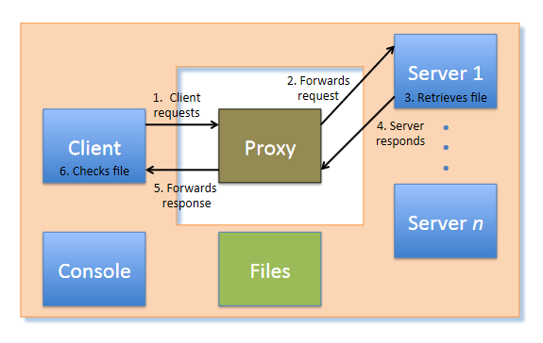
Introducing PxyDrive
General workflow
Generate text and binary data to test your proxy with
Create (multiple) server
Make transactions
Trace transactions to inspect headers and response data
Transaction

Slide 10
Some practice
Get the tarball
$ wget http://www.cs.cmu.edu/~213/activities/pxydrive-tutorial.tar
$ tar –xvf pxydrive-tutorial.tar
$ cd pxydrive-tutorial

Slide 11
Trying out PxyDrive
It’s a REPL: the user can run commands
$ ./pxy/pxydrive.py
Just starts PxyDrive
Try entering commands:
>help
>help help help help help help...
>quit
$ ./pxy/pxydrive.py –p ./proxy-ref
Starts PxyDrive and specifies a proxy to run
Proxy set up at <someshark>:30104
Picks the right port and starts the proxy
./proxy-ref is the reference proxy

Slide 12
PxyDrive Tutorial 1
Introducing basic procedures: generate data, create server, fetch / request file from server, trace transaction
Open s01-basic-fetch.cmd

Slide 13
PxyDrive Tutorial 1
>generate data1.txt 1K
Generates a 1K text file called data1.txt
>serve s1
Launches a server called s1
>fetch f1 data1.txt s1
Fetches data1.txt from server s1, in a transaction called f1
>wait *
Waits for all transactions to finish
Needed in the trace, not in the command-line
>trace f1
Traces the transaction f1
>check f1
Checks the transaction f1

Slide 14
PxyDrive Tutorial 1
Run trace with –f option:
$ ./pxy/pxydrive.py –p ./proxy-ref –f s01-basic-fetch.cmd

Slide 15
Look at the trace of the transaction!
Identify:
GET command
Host header
Other headers
Request from client to proxy
Request from proxy to server
Response by server to proxy
Response by proxy to client

Slide 16
PxyDrive Tutorial 2
Run a different trace
$ ./pxy/pxydrive.py –p ./proxy-ref –f s02-basic-request.cmd
You should get a different output from the first trace
Why? Let’s look at this trace...

Slide 17
PxyDrive Tutorial 2
>generate data1.txt 1K
>serve s1
>request r1 data1.txt s1
Requests data1.txt from server s1, in a transaction called r1
>wait *
>trace r1
>respond r1
Allow server to respond to the transaction r1
>wait *
>trace r1
>check f1
Checks the transaction f1

Slide 18
PxyDrive Tutorial 2
The fetch command makes the server immediately respond to a request.
All steps of a transaction are complete after a fetch.
The request command does not complete a transaction.
A request needs a respond to complete its transaction.
fetch
Client
Proxy
Server
request
Client
Proxy
Server
respond

Slide 19
PxyDrive Tutorial 2
Debugging a proxy that clobbers responses
Run the same trace but with a faulty proxy
$ ./pxy/pxydrive.py –f s01-basic-fetch.cmd –p ./proxy-corrupt

Slide 20
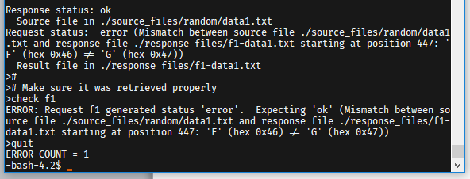
What went wrong?
Notes:
Answer: Response was clobbered.

Slide 21
PxyDrive Tutorial 3
Debugging a proxy that clobbers headers
Run the same trace but with another faulty proxy
$ ./pxy/pxydrive.py –f s01-basic-fetch.cmd –p ./proxy-strip –S 3
-S specifies strictness level

Slide 22
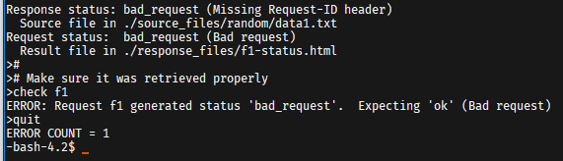
What went wrong?
Notes:
Answer: The header “Request-ID” is missing.

Slide 23
PxyDrive Tutorial 4
Debugging a proxy that crashes
Run the same trace but with yet another faulty proxy
$ ./pxy/pxydrive.py –f s03-overrun.cmd –p ./proxy-overrun
Is the error message helpful?

Slide 24
PxyDrive Tutorial 4
We resort to multi-window debugging
Set up another window and run GDB in one:
$ gdb ./proxy-overrun
(gdb) run 15213
In the other window, run PxyDrive:
$ ./pxy/pxydrive.py –P localhost:XXXXX –f s03-overrun.cmd
-P specifies the host and port the proxy is running on
./port-for-user.pl <andrewID> Run this to get your unique port!

Slide 25
Reminders
Read the writeup
One grace / late day allowed!
So you really have to start early
Come to office hours this week, before it gets crowded!
Work incrementally and take breaks
Simpler tests should be completed in the first week!

Slide 26
Appendix on
Echoserver, Echoclient

Slide 27
Echo Demo
See the instructions written in the telnet results to set up the echo server. Get someone nearby to connect using the echo client.
What does echoserver output? (Sample output:)
$ ./echoserver 10101
Accepted connection from hammerheadshark.ics.cs.cmu.edu:46422
hammerheadshark.ics.cs.cmu.edu:46422 sent 6 bytes
Disconnected from hammerheadshark.ics.cs.cmu.edu:46422
Server
listening port
Client
port
Client
host

Slide 28

Echo Demo
Look at echoclient.c
Opens a connection to the server
Reads/writes from the server
Look at echoserver output
Why is the printed client port different from the server’s listening port?
Server opens one “listening” port
Incoming clients connect to this port
Once server accepts a connection, it talks to client on a different “ephemeral” port
Listening port
Client connects to server
Ephemeral port
GET /~213/recitations/rec12.html HTTP/1.0
HTTP/1.1 200 OK Content-Type: text/html…

Slide 29
Echo Demo
Try to connect two clients to the same server.
What happens?
Second client has to wait for first client to finish!
Server doesn’t even accept second client’s connection
Where/why are we getting stuck?
Because we’re stuck in echo() talking to the first client, echoserver can’t handle any more clients
Solution: multi-threading

Slide 30
Echo Server Multithreaded
How might we make this server multithreaded?
(Don’t look at echoserver_t.c)
while (1) {
// Allocate space on the stack for client info
client_info client_data;
client_info *client = &client_data;
// Initialize the length of the address
client->addrlen = sizeof(client->addr);
// Accept() will block until a client connects to the port
client->connfd = Accept(listenfd,
(SA *) &client->addr, &client->addrlen);
// Connection is established; echo to client
echo(client);
}

Slide 31
Echo Server Multithreaded
echoserver_t.c isn’t too different from echoserver.c
To see the changes: `diff echoserver.c echoserver_t.c`
Making your proxy multithreaded will be very similar
However, don’t underestimate the difficulty of addressing race conditions between threads!
Definitely the hardest part of proxylab
More on this next time...

