Slide 1
Recitation 15: Final Review
Instructor: TA(s)

Slide 2
Outline
Proxylab
Study Advice
Final Exam
TA Applications
Signals
Thread Synchronization
Q&A

Slide 3
Proxylab
Proxylab is due Thursday (or late by Friday)
No submissions will be accepted after Friday!
Submit something, even if doesn’t pass everything
Worth almost a letter grade
Submit early
Autolab may compile / run differently if you have undefined behavior or race conditions

Slide 4
Final Exam Logistics
Final Exam details can be found in Piazza post @3198
Final Exam Review
Dec 13, 2020 (Sunday)
Time: 6-8 pm EST
213/513/613 Fall 2020 Final Exam
Dec 17, 2020 (Thursday)
Time: Should be your first choice time slot
Monitor Piazza for more information about the final exam

Slide 5
Study Advice
For revising topics on the final, we would suggest you review topics from the following resources:
Lecture Slides
Midterm Review Recitation (Recitation 8 at https://www.cs.cmu.edu/~213/schedule.html): Assembly, Stack, Ints/Floats, Structs
Final Review Recitation: Signals, Thread Synchronization
Final Review Bootcamp: Malloc, VM, IO, Processes
Past Exams
Written Assignments
Textbook

Slide 6
So you wanna TA for 213
What qualifications are we looking for?
Decent class performance, but also critical thinking skills
Like computer systems + want to help others like systems!
Have a reasonable ability to gauge your schedule + responsibilities
Leadership potential! Take initiative, we love to see it 😌
Ability to tell students:
“Did you write your heap checker”
“Run backtrace for me”
rinse and repeat, it’s mouthwash baby
Apply at https://www.ugrad.cs.cmu.edu/ta/S21/

Slide 7
Signals and Handling Reminders
Signals can happen at any time
Control when through blocking signals
Signals also communicate that events have occurred
What event(s) correspond to each signal?
Write separate routines for receiving (i.e., signals)
What can you do / not do in a signal handler?

Slide 8
Signal Blocking
We need to block and unblock signals. Which sequence?
pid_t pid; sigset_t mysigs, prev;
sigemptyset(&mysigs);
sigaddset(&mysigs, SIGCHLD);
sigaddset(&mysigs, SIGINT);
// need to block signals. what to use?
// A. sigprocmask(SIG_BLOCK, &mysigs, &prev);
// B. sigprocmask(SIG_SETMASK, &mysigs, &prev);
if ((pid = fork()) == 0) {
// need to unblock signals. what to use?
/* A. sigprocmask(SIG_BLOCK, &mysigs, &prev);
* B. sigprocmask(SIG_UNBLOCK, &mysigs, &prev);
* C. sigprocmask(SIG_SETMASK, &prev, NULL);
* D. sigprocmask(SIG_BLOCK, &prev, NULL);
* E. sigprocmask(SIG_SETMASK, &mysigs, &prev);
Notes:
/* A. sigprocmask(SIG_BLOCK, &mysigs, &prev); <- this one!
* B. sigprocmask(SIG_SETMASK, &mysigs, &prev); <- exclusively blocks mysigs!
*/
/* A. sigprocmask(SIG_BLOCK, &mysigs, &prev); <- does nothing
* B. sigprocmask(SIG_UNBLOCK, &mysigs, &prev); <- not quite, dangerous - removes all signals in the set
* C. sigprocmask(SIG_SETMASK, &prev, NULL); <- this one! restores to original set of signals
* D. sigprocmask(SIG_BLOCK, &prev, NULL); <- doesn't account for mysigs
* E. sigprocmask(SIG_SETMASK, &mysigs, &prev) <- blocks mysigs exclusively
SIG_UNBLOCK (B.) explanation ->
UNBLOCK will remove mysigs signals from blocking set. What we really want to do is restore to previous mask. It is possible that previous (prev) mask had one of the mysigs already blocked. So, we do not want to go ahead and unblock that too

Slide 9
Signal Blocking
We need to block and unblock signals. Which sequence?
pid_t pid; sigset_t mysigs, prev;
sigemptyset(&mysigs);
sigaddset(&mysigs, SIGCHLD);
sigaddset(&mysigs, SIGINT);
// need to block signals. what to use?
// A. sigprocmask(SIG_BLOCK, &mysigs, &prev);
// B. sigprocmask(SIG_SETMASK, &mysigs, &prev);
if ((pid = fork()) == 0) {
// need to unblock signals. what to use?
/* A. sigprocmask(SIG_BLOCK, &mysigs, &prev);
* B. sigprocmask(SIG_UNBLOCK, &mysigs, &prev);
* C. sigprocmask(SIG_SETMASK, &prev, NULL);
* D. sigprocmask(SIG_BLOCK, &prev, NULL);
* E. sigprocmask(SIG_SETMASK, &mysigs, &prev);
Notes:
/* A. sigprocmask(SIG_BLOCK, &mysigs, &prev); <- this one!
* B. sigprocmask(SIG_SETMASK, &mysigs, &prev); <- exclusively blocks mysigs!
*/
/* A. sigprocmask(SIG_BLOCK, &mysigs, &prev); <- does nothing
* B. sigprocmask(SIG_UNBLOCK, &mysigs, &prev); <- not quite
* C. sigprocmask(SIG_SETMASK, &prev, NULL); <- this one!
* D. sigprocmask(SIG_BLOCK, &prev, NULL); <- doesn't account for mysigs
* E. sigprocmask(SIG_SETMASK, &mysigs, &prev) <- blocks mysigs exclusively

Slide 10
Signal Blocking
We need to block and unblock signals. Which sequence?
pid_t pid; sigset_t mysigs, prev;
sigemptyset(&mysigs);
sigaddset(&mysigs, SIGCHLD);
sigaddset(&mysigs, SIGINT);
// need to block signals. what to use?
// A. sigprocmask(SIG_BLOCK, &mysigs, &prev);
// B. sigprocmask(SIG_SETMASK, &mysigs, &prev);
if ((pid = fork()) == 0) {
// need to unblock signals. what to use?
/* A. sigprocmask(SIG_BLOCK, &mysigs, &prev);
* B. sigprocmask(SIG_UNBLOCK, &mysigs, &prev);
* C. sigprocmask(SIG_SETMASK, &prev, NULL);
* D. sigprocmask(SIG_BLOCK, &prev, NULL);
* E. sigprocmask(SIG_SETMASK, &mysigs, &prev);
Notes:
/* A. sigprocmask(SIG_BLOCK, &mysigs, &prev); <- this one!
* B. sigprocmask(SIG_SETMASK, &mysigs, &prev); <- exclusively blocks mysigs!
*/
/* A. sigprocmask(SIG_BLOCK, &mysigs, &prev); <- does nothing
* B. sigprocmask(SIG_UNBLOCK, &mysigs, &prev); <- not quite
* C. sigprocmask(SIG_SETMASK, &prev, NULL); <- this one!
* D. sigprocmask(SIG_BLOCK, &prev, NULL); <- doesn't account for mysigs
* E. sigprocmask(SIG_SETMASK, &mysigs, &prev) <- blocks mysigs exclusively

Slide 11
Signal Blocking cont.
Someone implemented the wrong choices. Which signals are now blocked?
pid_t pid; sigset_t mysigs, prev;
sigemptyset(&mysigs);
sigaddset(&mysigs, SIGCHLD);
sigaddset(&mysigs, SIGINT);
sigprocmask(SIG_SETMASK, &mysigs, &prev);
// What is blocked?
if ((pid = fork()) == 0) {
sigprocmask(SIG_BLOCK, &prev, NULL);
// What is blocked?
Notes:
first: blocks exclusively signals in mysigs, think of setmask as replacing current mask
second: blocks mysigs and also anything blocked before (union of prev and mysigs), think of sig_block as a “bitwise or”

Slide 12
Signal Queuing
How many times is the handler invoked?
void handler(int sig)
{ ...}
...
sigset_t mysigs, prev;
signal(SIGUSR1, handler);
sigemptyset(&mysigs);
sigaddset(&mysigs, SIGUSR1);
sigprocmask(SIG_BLOCK, &mysigs, &prev);
kill(getpid(), SIGUSR1);
kill(getpid(), SIGUSR1);
sigprocmask(SIG_SETMASK, &prev, NULL);
Notes:
1 b/c signals don’t queue

Slide 13
Signal Delivery
What can be printed?
When is a blocked signal delivered?
sigset_t mysigs, prev;
sigemptyset(&mysigs);
sigaddset(&mysigs, SIGINT);
sigprocmask(SIG_BLOCK, &mysigs, &prev);
pid_t pid = fork();
if (pid > 0) {
kill(pid, SIGINT);
sigprocmask(SIG_SETMASK, &prev, NULL);
printf(“A");
} else {
kill(getppid(),SIGINT);
sigprocmask(SIG_SETMASK, &prev, NULL);
printf(“B");
}
Notes:
A, B, nothing
Won’t print both A and B b/c signal will be delivered when setmask happens
Some possible orderings:
Prints nothing ->
in parent - kill(pid, SIGINT)
in child - kill(getppid, SIGINT)
in parent - sigprocmask (here sigint received and terminates)
in child - sigprocmask (here sigint received and terminates)
Prints A ->
in parent, all statements execute -> prints A
in child, all statements execute -> terminates on sigprocmask before printing B
Prints B -> similar to case (2)
Why can’t it print both A and B?
SIGINT will always get received by the process being executed before print statements. Since both processes send SIGINT to the other before reaching their print statements, it is not possible for none of them to terminate before printing.
Remember that sigprocmask is a system call requiring a context switch and the return from kernel-mode checks for pending and unblocked signals.

Slide 14
Signal Delivery
Child calls kill(parent, SIGUSR{1,2}) between 2-4 times. What sequence of kills may print 1? Can you guarantee printing 2? What is the range of values printed?
int counter = 0;
void handler (int sig) {
atomically {counter++;}
}
int main(int argc, char** argv) {
signal(SIGUSR1, handler);
signal(SIGUSR2, handler);
int parent = getpid(); int child = fork();
if (child == 0) {
/* insert code here */
exit(0);
}
sleep(1); waitpid(child, NULL, 0);
printf("Received %d USR{1,2} signals\n", counter);
}
See http://www.cs.cmu.edu/~213/oldexams/final-s07.pdf
Notes:
SIMILAR, not identical to previous exam. See TA guide for detailed explanation.

Slide 15
Signal Delivery
Suppose the program is currently inside the signal handler, which signals are blocked?
int counter = 0;
void handler (int sig)
{
counter++;
}
int main(int argc, char** argv)
{
signal(SIGUSR1, handler);
signal(SIGUSR2, handler);
}
Notes:
signal which the handler is for
the handler is not safe, since count++ can be interrupted

Slide 16
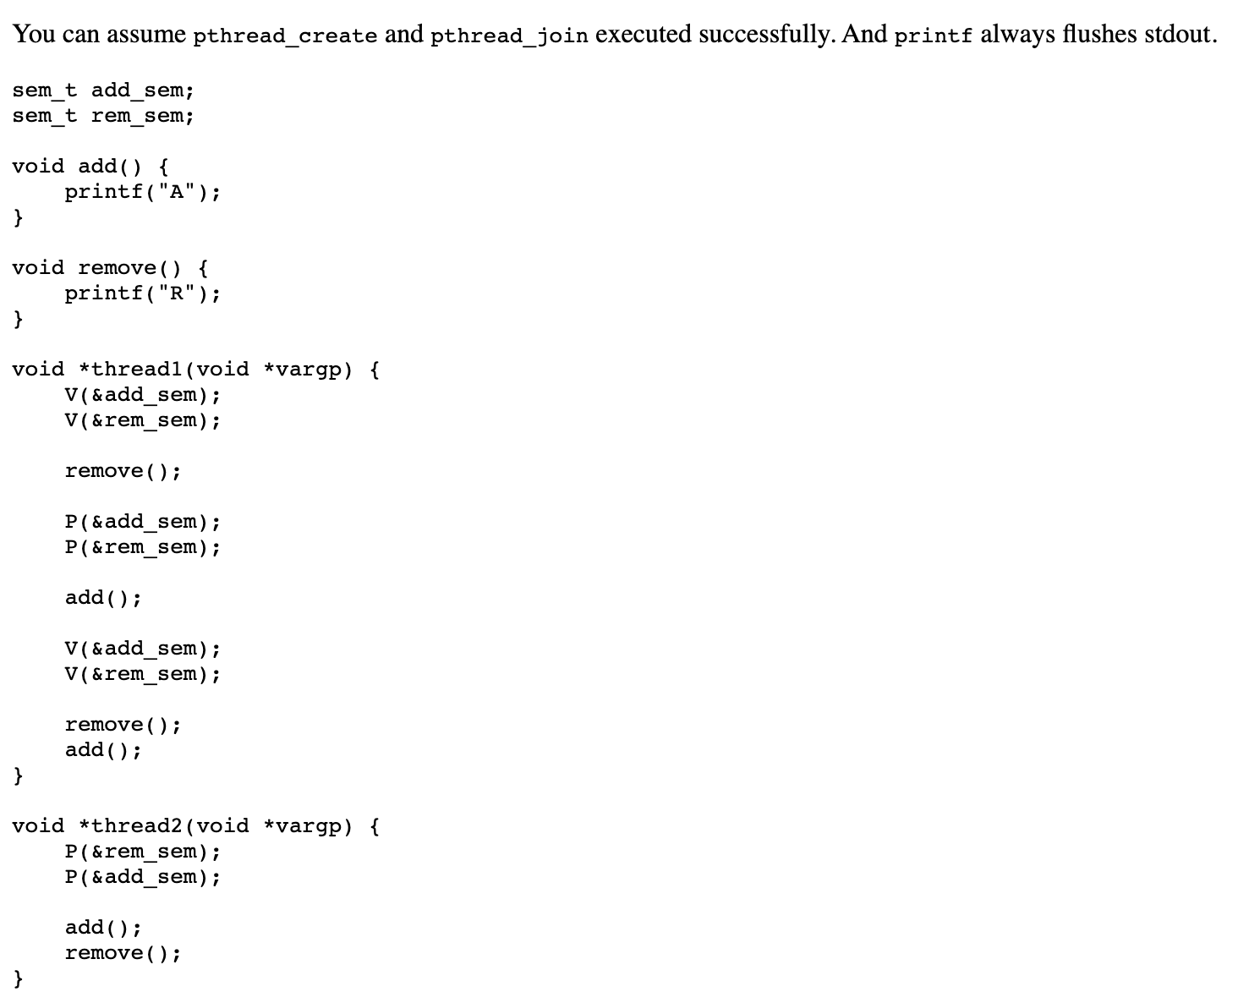
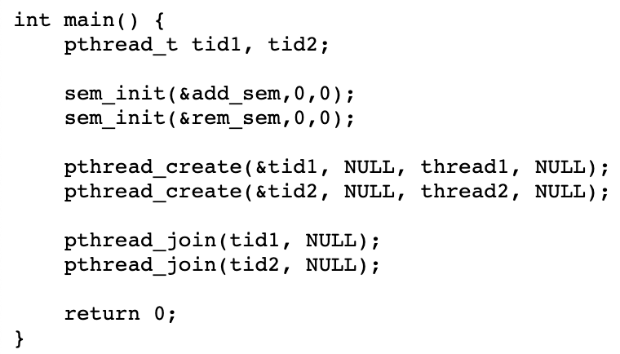
Thread Synchronization
Notes:
2
0: None, 1: 1, 2: None, 3: 2, 4: None, 5: None, 6: 4. The possible outputs are: R, RAR, ARR, RAARRA, RARAAR, RARARA, RAARAR

Slide 17
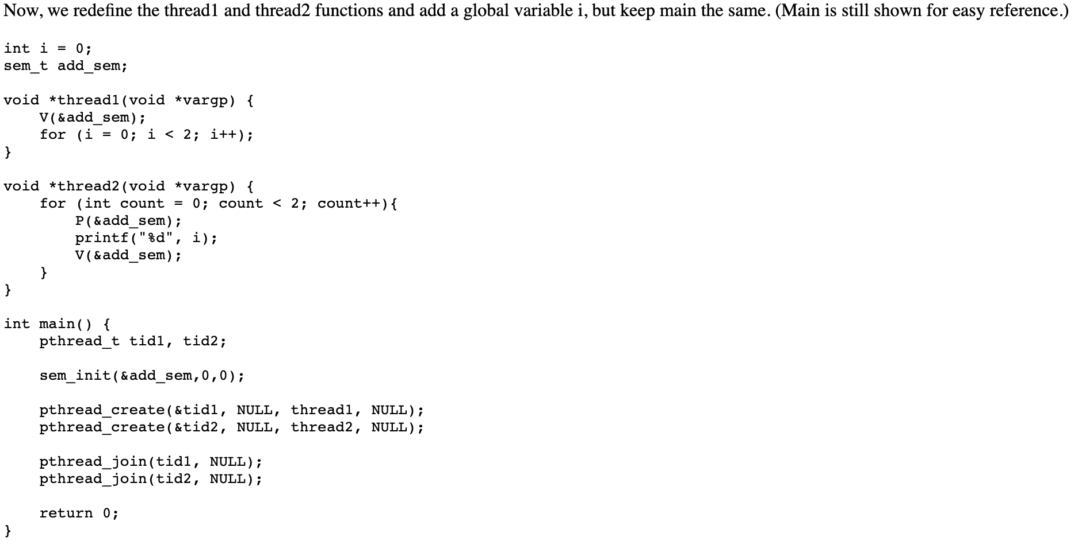
Thread Synchronization (Contd.)
Notes:
3. 6. The possible outcomes are 00, 01, 02, 11, 12, 22

Slide 18
Final Exam Q&A

