Slide 1

Module 5: Resampling Methods
Lecture 11
Feb 6th , 2023
Ch 5.1.1-2:

Slide 2
Recap
Validation Set

Slide 3
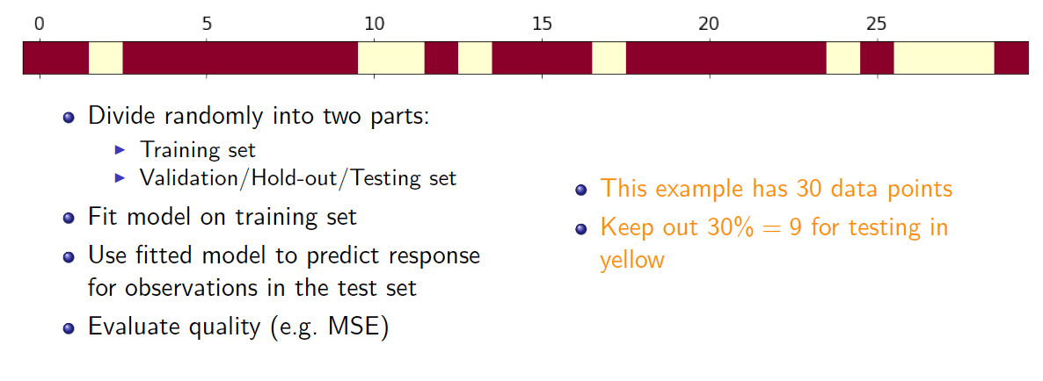
Validation-set Approach

Slide 4
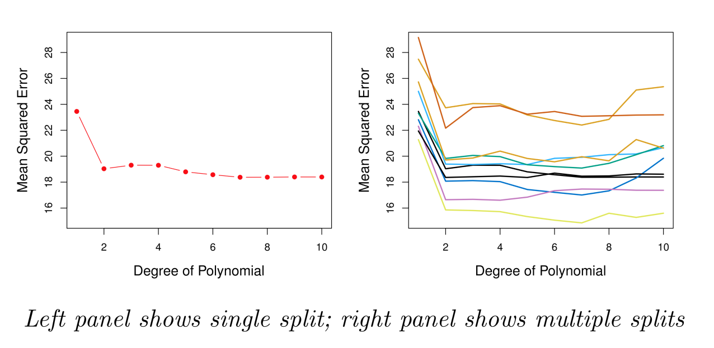
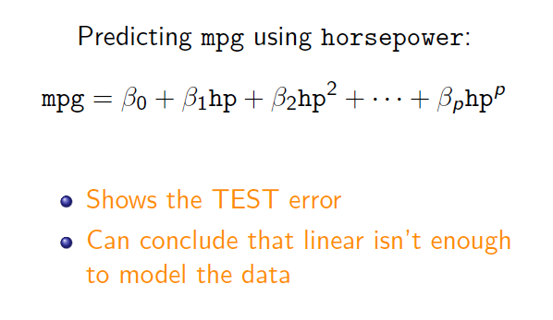
Example: Automobile Data
Sample size n = 392. Training set 196 obs, and validation set 196 obs.
Linear or higher-order polynomial term?

Slide 5
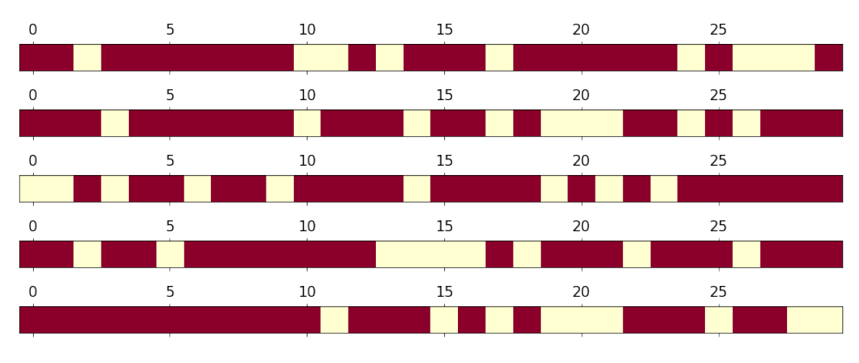
Rinse and repeat

Slide 6
Example: Automobile Data

Slide 7
Coding example in Jupyter Notebook

Slide 8
Drawbacks of Validation Set Approach
Highly variable (imprecise) estimates : Each line shows validation error for one possible division of data
Only subset of data is used (validation set is excluded – only about half of data is used)
This suggests that the validation set error may tend to overestimate or underestimate? the test error for the model ﬁt on the entire data set. Why?

Slide 9
Leave-One-Out Cross-Validation (LOOCV)

Slide 10
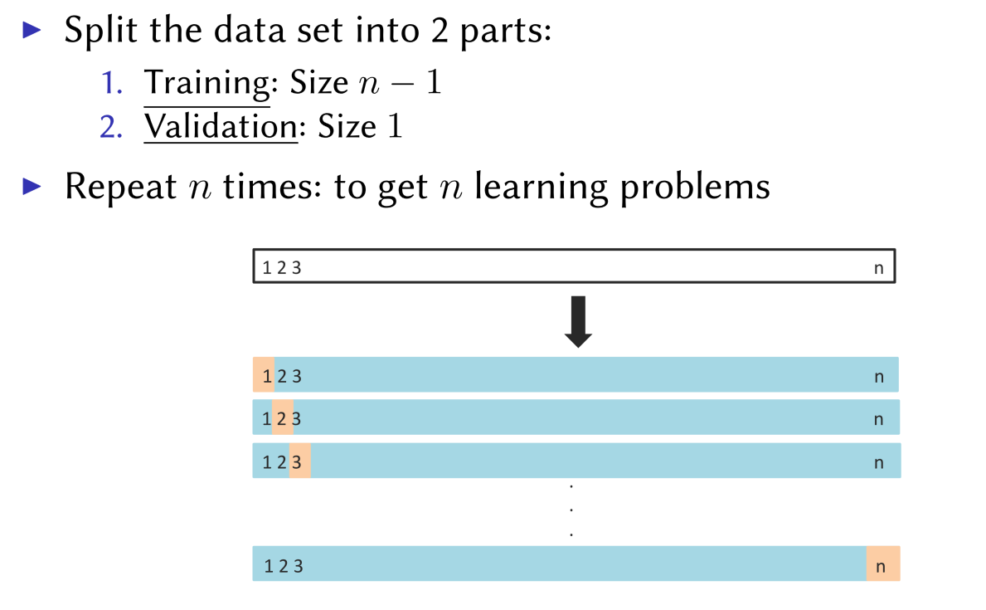
Leave-One-Out Cross-Validation (LOOCV)

Slide 11
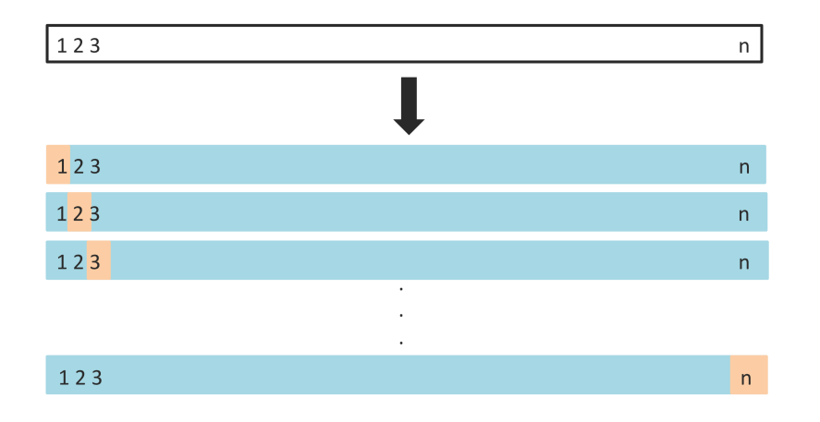

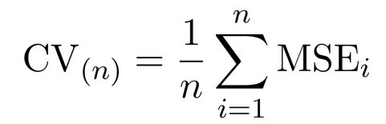
Leave-one-out
Get n learning problems
Train on n-1 instances (blue)
Test on 1 instance (orange)
LOOCV estimate

Slide 12
Leave-one-out vs Validation Set
Advantages
Using almost all data not just half
Stable results
Evaluation is performed with more testing data
Disadvantages
Can be very computationally expensive: fit the model n times
LOOCV typically doesn’t shake up the data enough. The estimates from each fold are highly correlated.

Slide 13
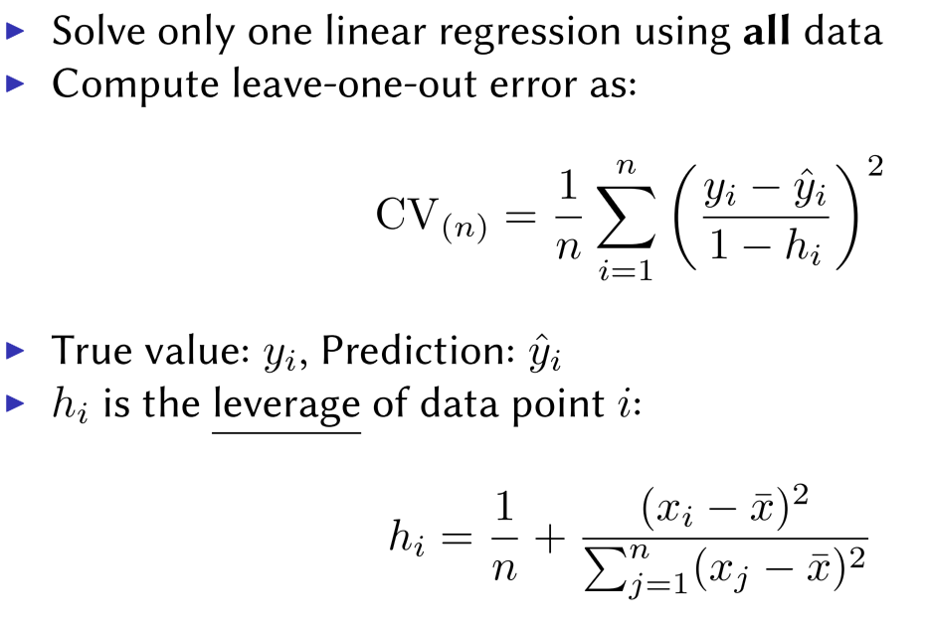
Speeding Up Leave-One-Out
Solve each fit independently and distribute the computation.
Linear regression

Slide 14
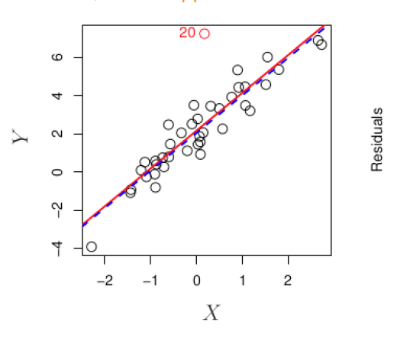
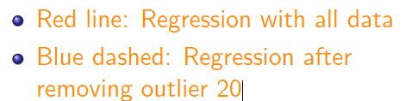
Outliers
An outlier is a point for which y_{i} is far from the value predicted by the model.

Slide 15
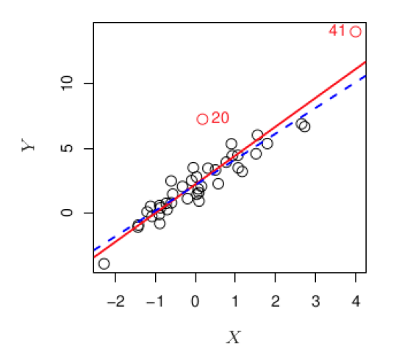
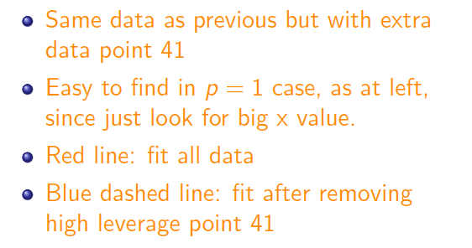
High Leverage
Observations with high leverage have an unusual value for x.

Slide 16
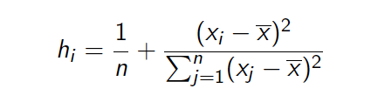
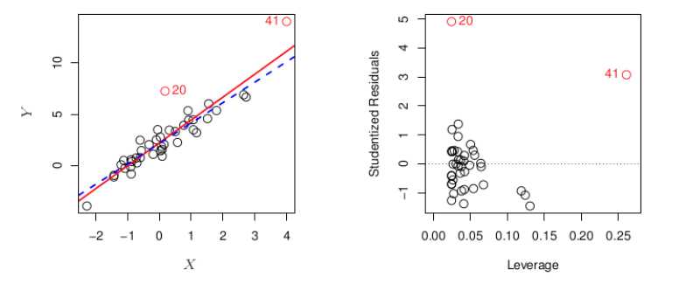
How to measure Leverage
Observations with high leverage have an unusual value for x.

Slide 17
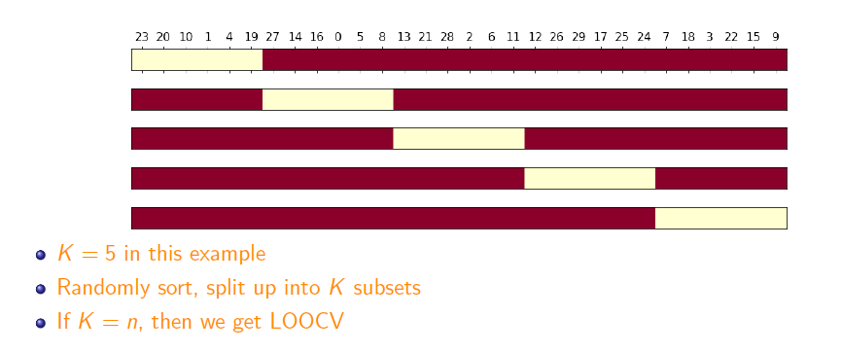
K-fold Cross-validation
Hybrid between validation set and LOOCV

Slide 18
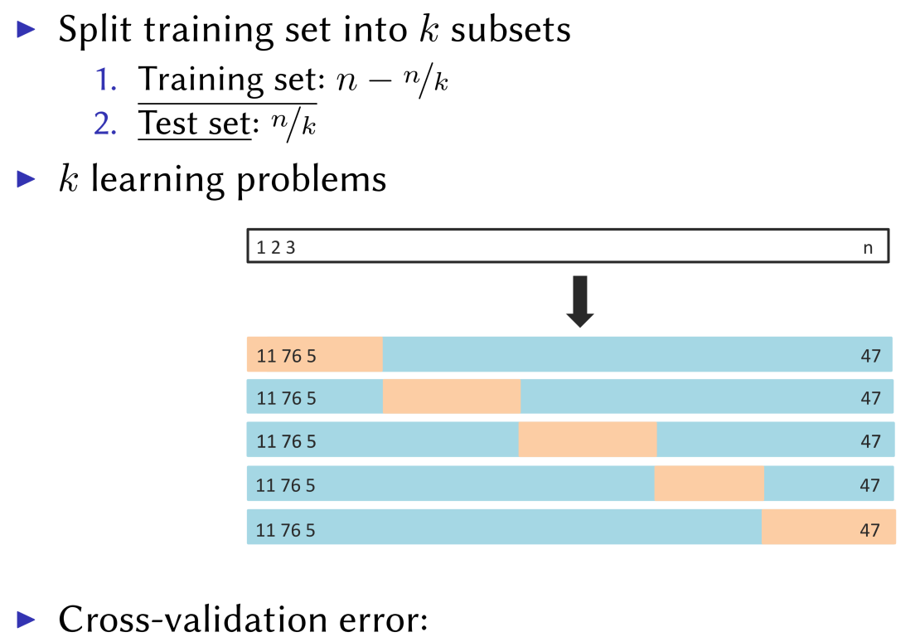
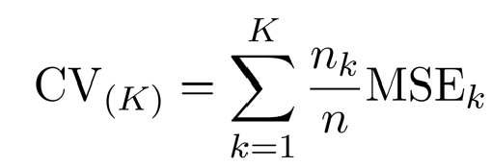
K-fold Cross-validation
Hybrid between validation set and LOOCV

Slide 19
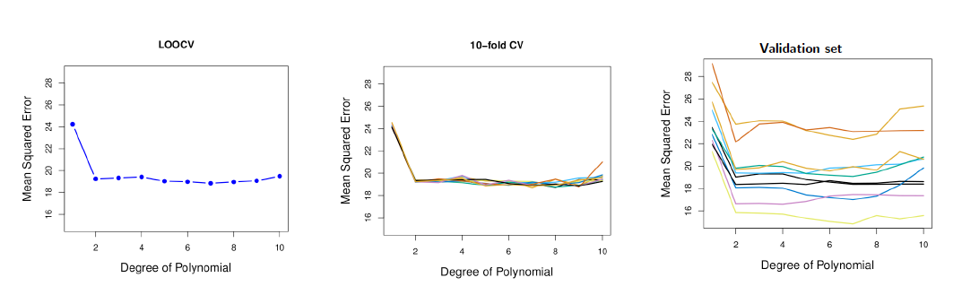
Comparison

Slide 20
Coding – Building k-fold CV

