Slide 1

Module 5: Resampling Methods
Lecture 11
Feb 8th, 2023
Ch 5.1.3-4:

Slide 2
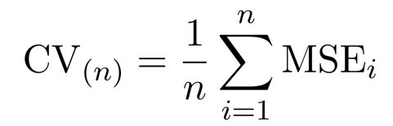
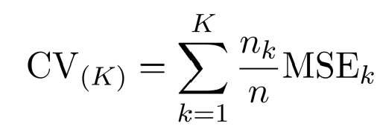
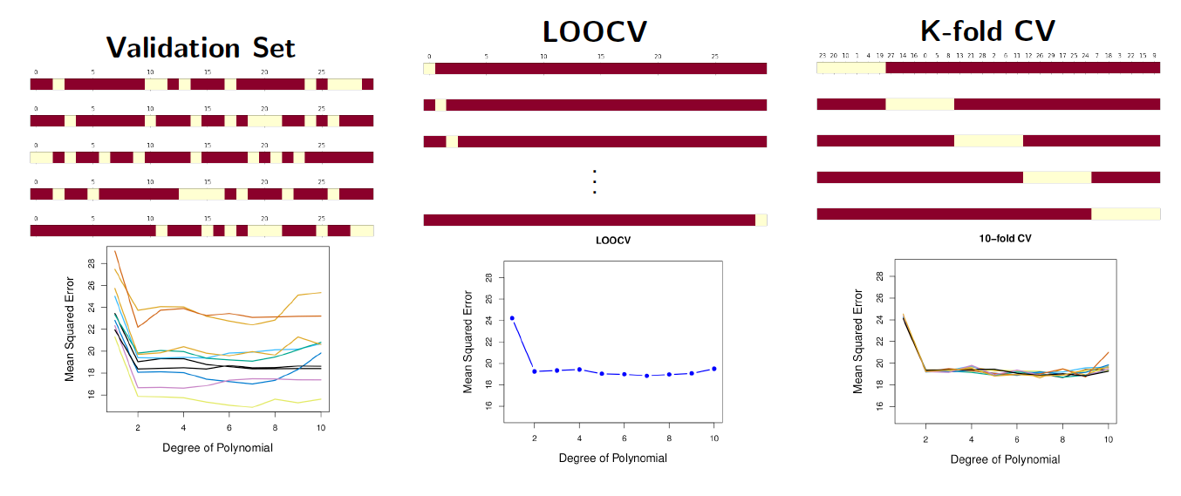
Recap
LOOCV
Leverage
K-fold CV

Slide 3
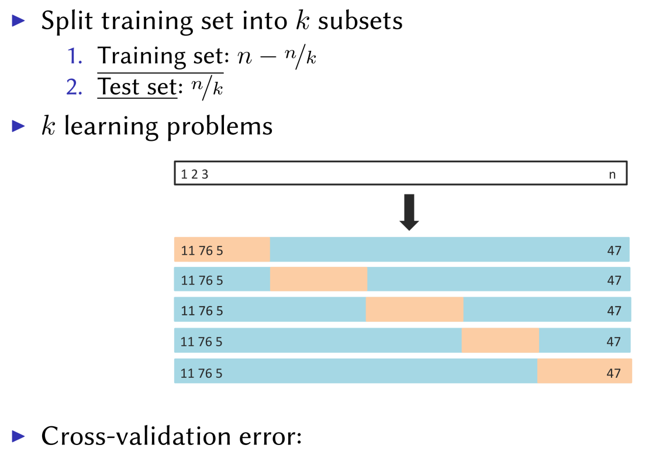
K-fold Cross-validation
Hybrid between validation set and LOOCV

Slide 4
Coding – Building k-fold CV

Slide 5
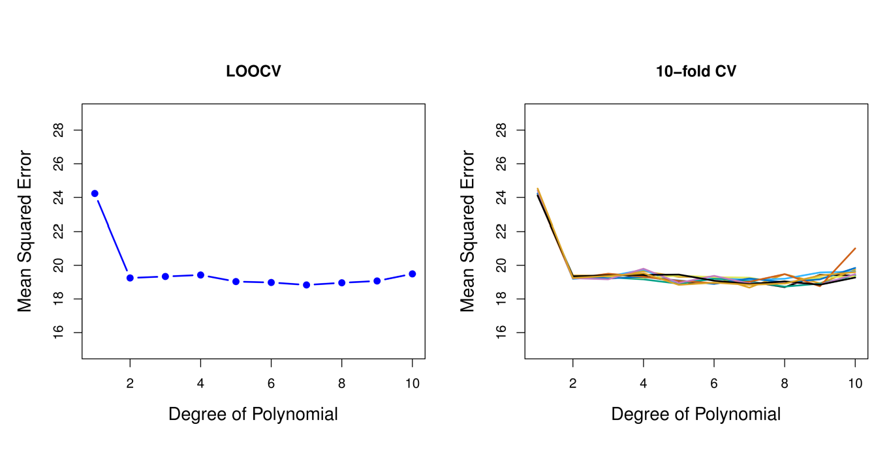
Cross-validation vs LOOCV

Slide 6
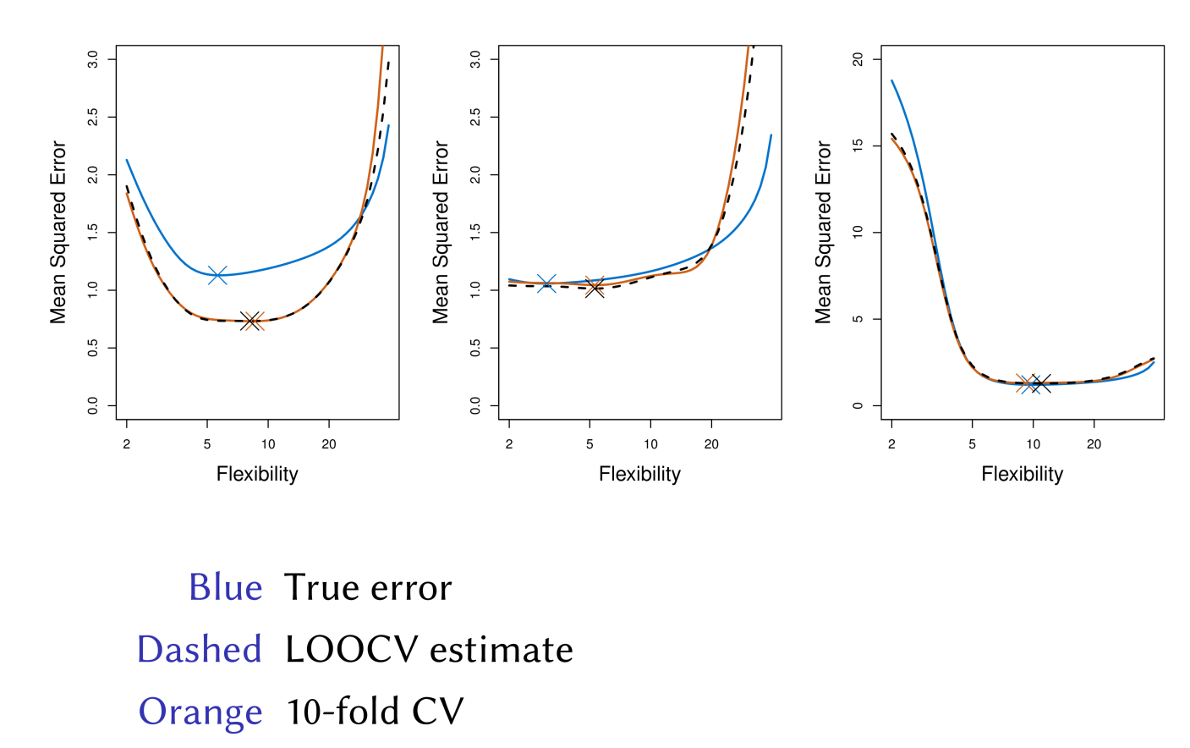
Simulated Results

Slide 7
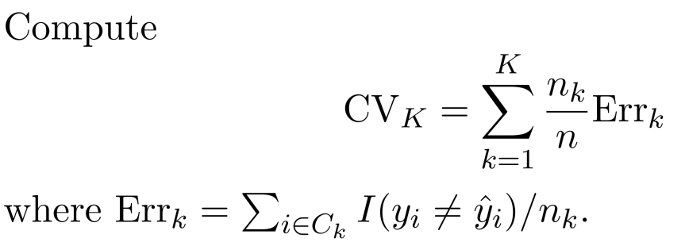
CV for Classification
We divide the data into K roughly equal-sized parts

Slide 8
Example: GWAS
Sample size n = 50, number of predictors (SNPs) p = 5000; Predictor heart attach after age of 60.
Step 1: Select the top 100 predictors having the largest correlation with the class labels
Step2: We then apply a classifier (logistic regression) using only these 100 predictors
How do we estimate the test set performance of this classifier?

Slide 9
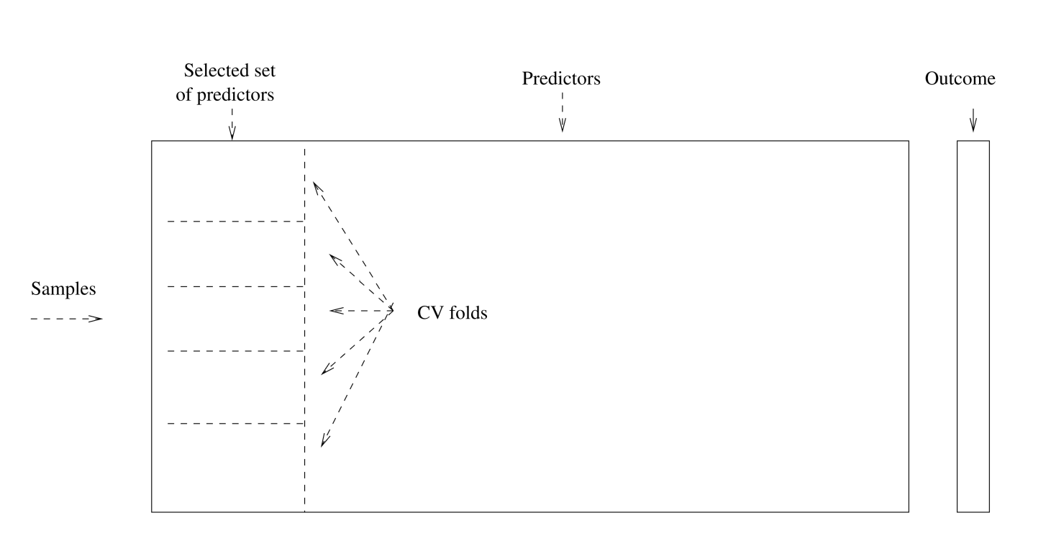
Example: GWAS
No ！！！

Slide 10
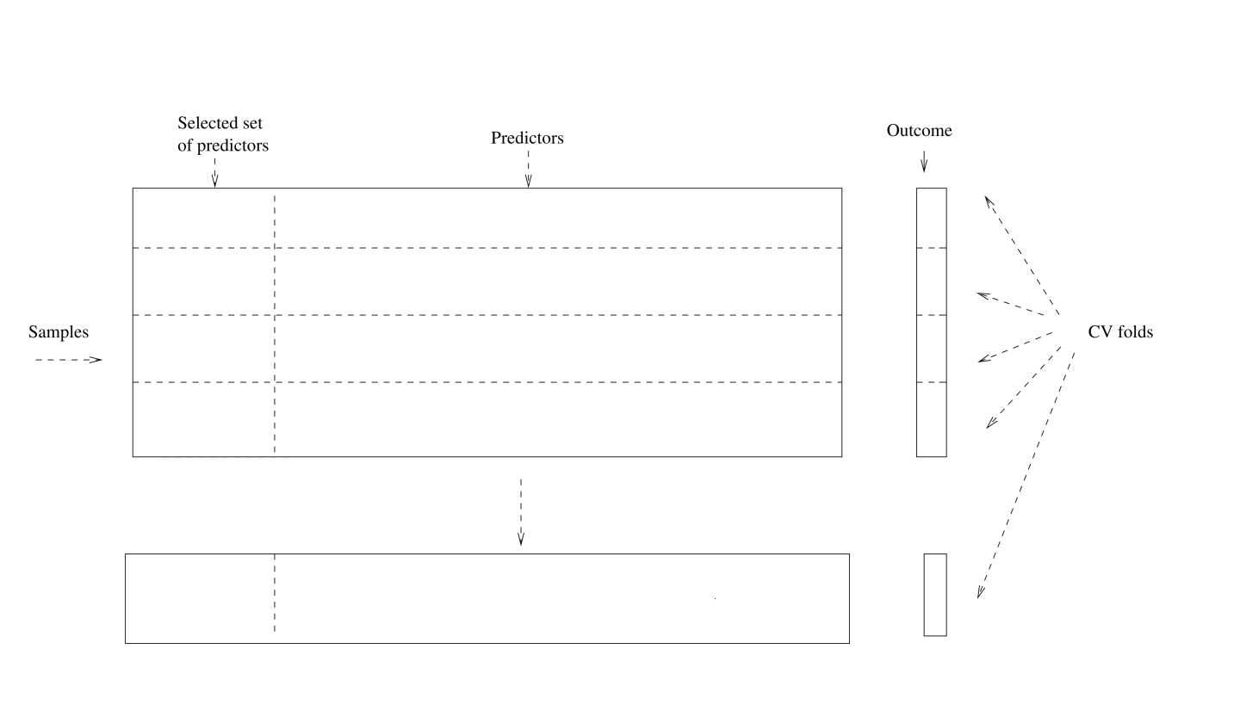
Example: GWAS ------Right Way

Slide 11
Coding

Slide 12
Bootstrap is used to quantify the uncertainty associated with an estimator or machine learning method. It can provide an estimate of the standard error of a coefficient. Then we can du hypothesis test and confidence interval.
Bootstrap

Slide 13

Bootstrap： Finance Example
To invest two stocks that yield return of X and Y, where X and Y are random.
We will invest a fraction of our money in X and the rest in Y.
Assume both stock have the same average return over the years. What criteria should we use for allocate the investment?

Slide 14

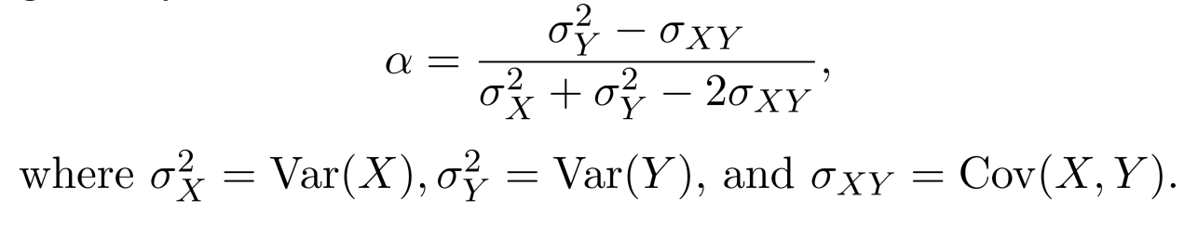
Bootstrap： Finance Example
We want to minimize the total risk or variance of our investment.
The solution is

Slide 15
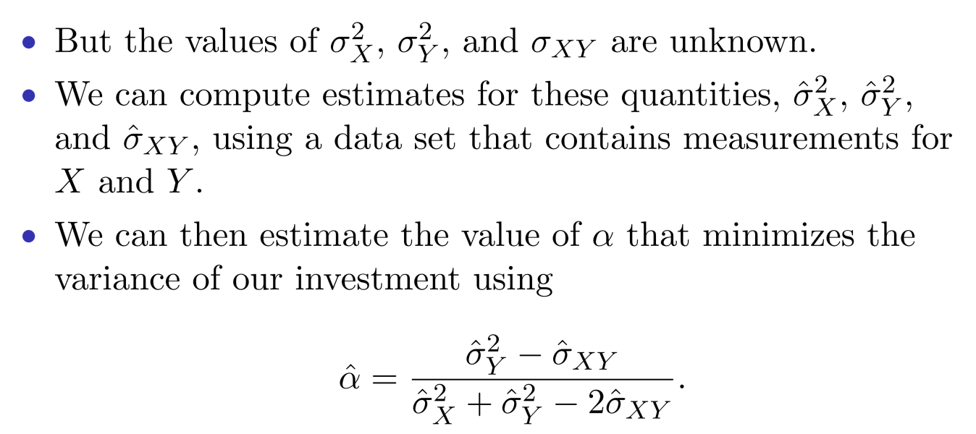
Finance Example: Simulations

Slide 16
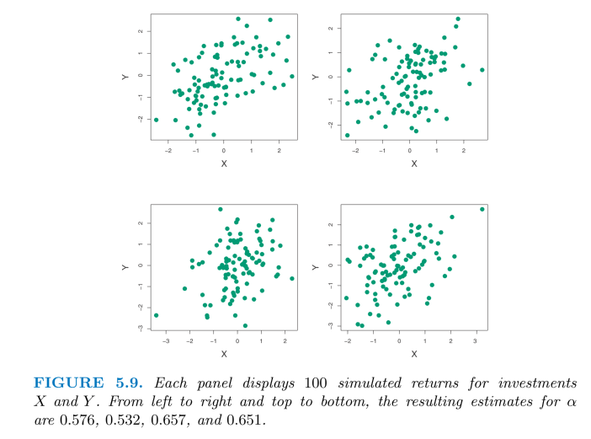
Finance Example: Simulations

Slide 17
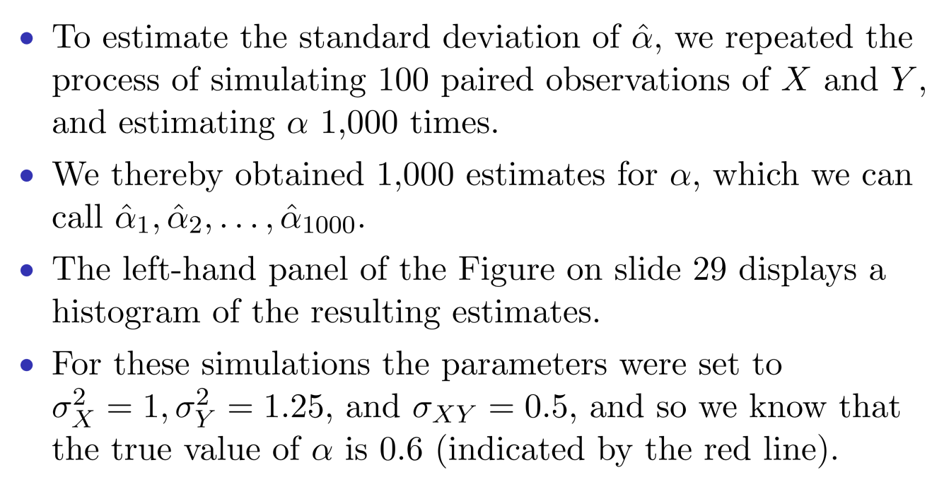
Finance Example: Simulations

Slide 18
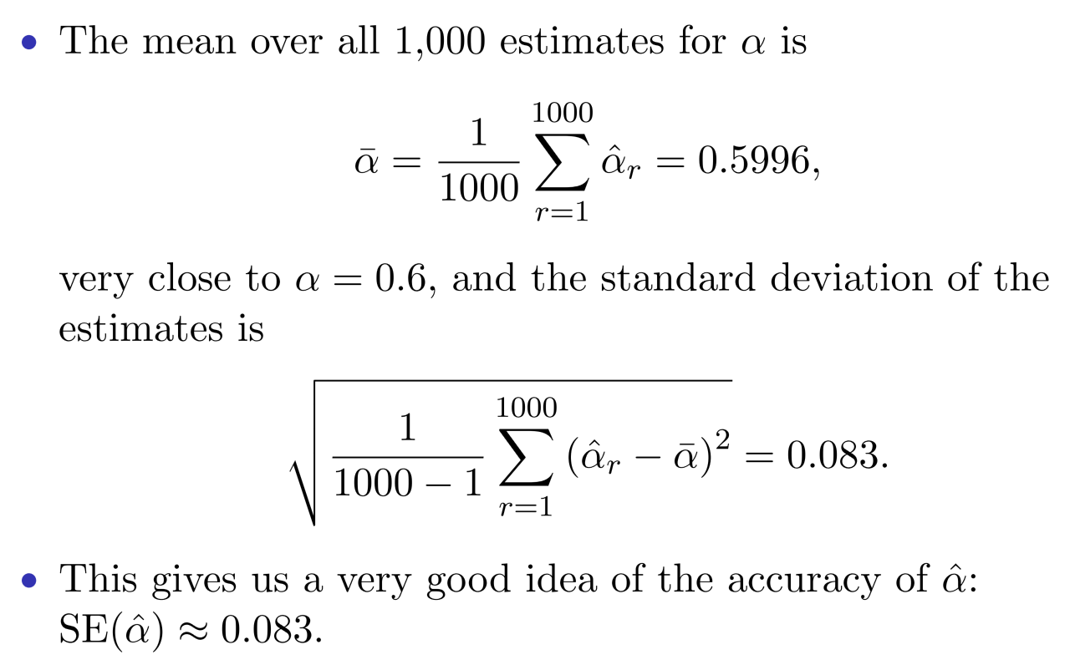
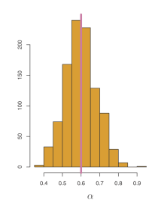

Slide 19
Finance Example: Reality
The procedure outlined above cannot be applied, because for real data we cannot generate new samples from the original population.
The bootstrap approach allows us to use a computer to mimic the process of obtaining new data sets.
Rather than repeatedly sampling from the population, we instead obtain distinct data sets by repeatedly sampling observations from the original data set with replacement.
Each of these “bootstrap data sets” is created by sampling with replacement, and is the same size as our original dataset. Some observations may appear more than once in a given bootstrap data set and some not at all.

Slide 20
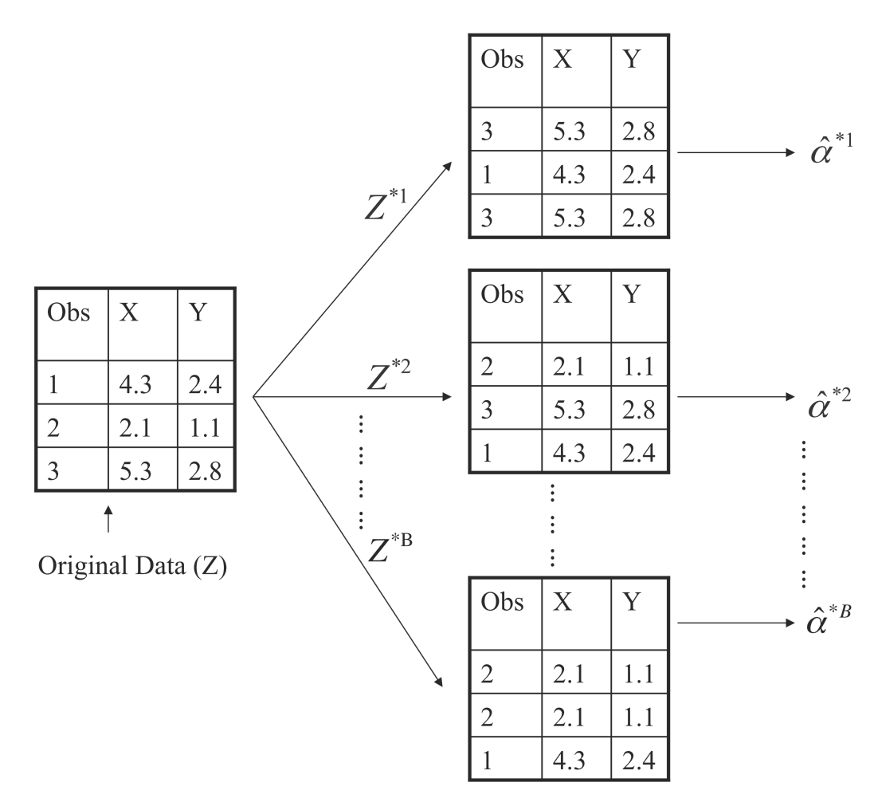
Boostrap Illustration

Slide 21
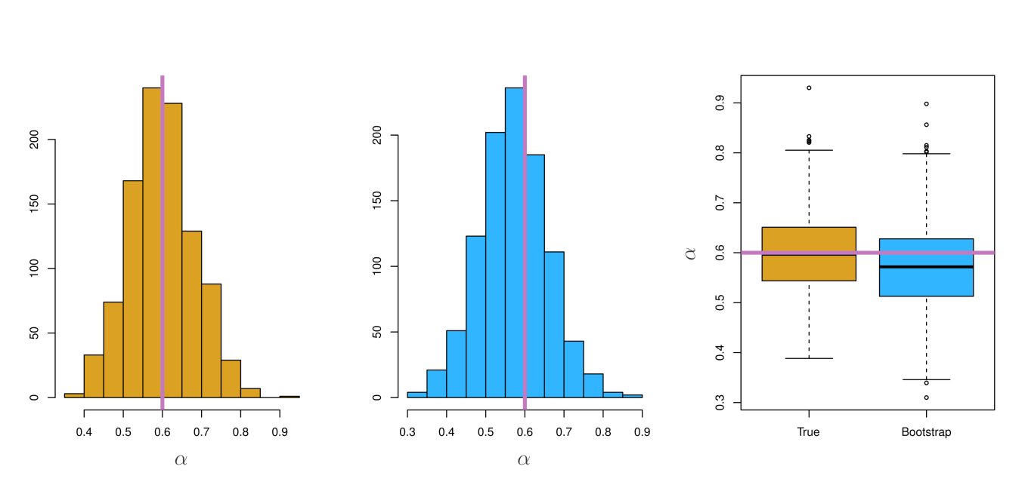
Boostrap Results

Slide 22
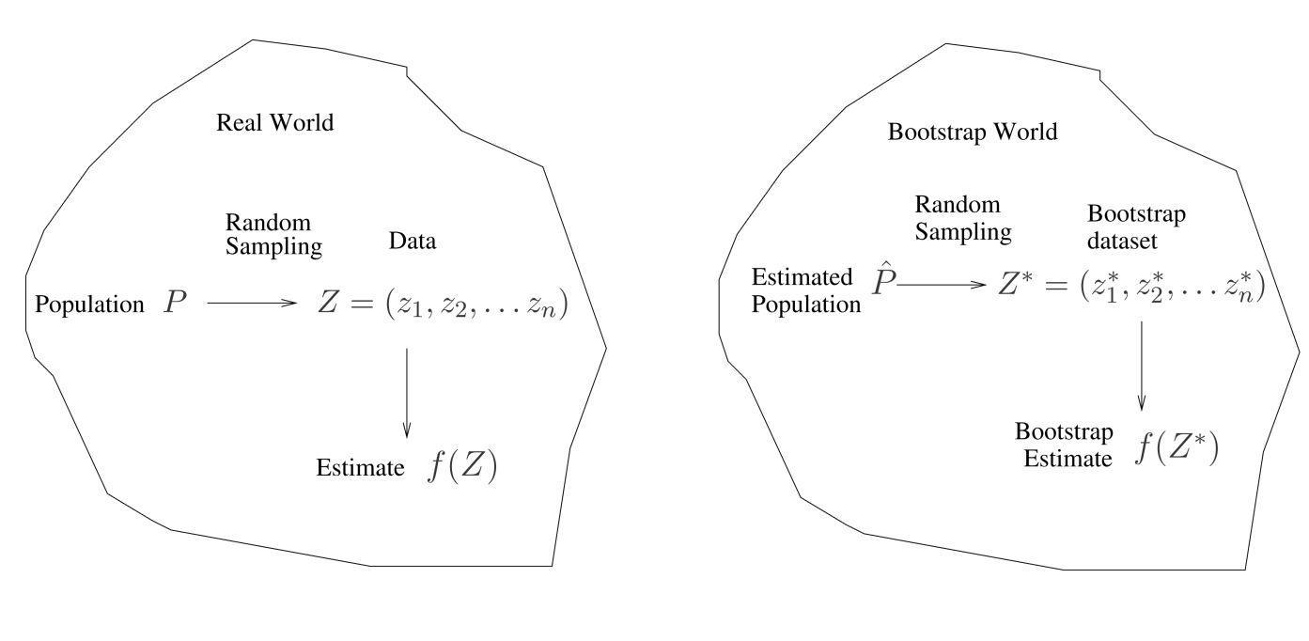
A General Picture for the Bootstrap

Slide 23
Boostrap for Prediction Error?
Can we use one boostrap dataset as training and the original data set as test set?

Slide 24
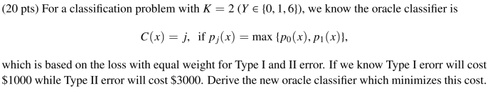
Bonus Quiz 13

Slide 25
Bonus Quiz 15
When sample size n is large，we know a bootstrap dataset will contain 1 – e⁻¹ = 63.2% of original data. Write a code to demonstrate it using n = 1000000

