Slide 1

Module 5: Resampling Methods
Lecture 11
Feb 8th, 2023
Ch 5.2

Slide 2
Bootstrap The goal: quantify the uncertainty associated with a given estimator or statistical learning method.
Recap

Slide 3
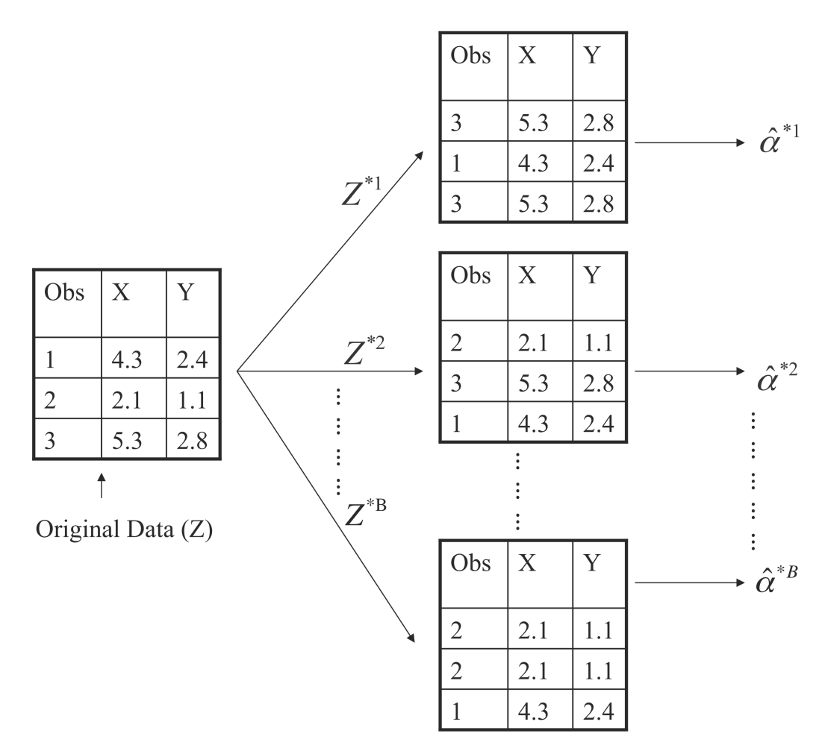
Boostrap Illustration

Slide 4

Bootstrap on a simple modeling problem
To invest two stocks that yield return of X and Y, where X and Y are random.
We will invest a fraction of our money in X and the rest in Y.
Assume both stock have the same average return over the years. What criteria should we use for allocate the investment?

Slide 5
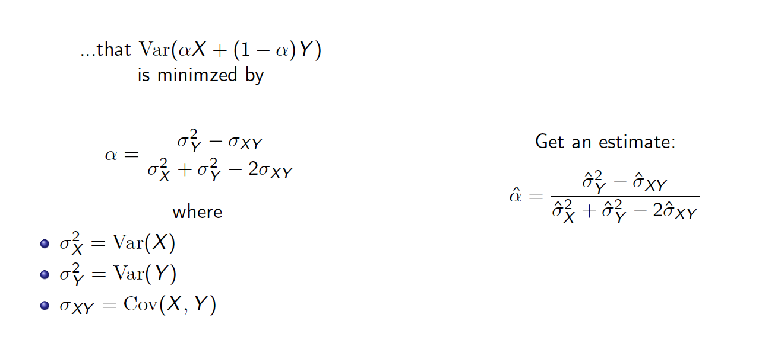
Bootstrap on a simple modeling problem

Slide 6
Bootstrap on a simple modeling problem
Best scenario
The second best scenario
Reality

Slide 7
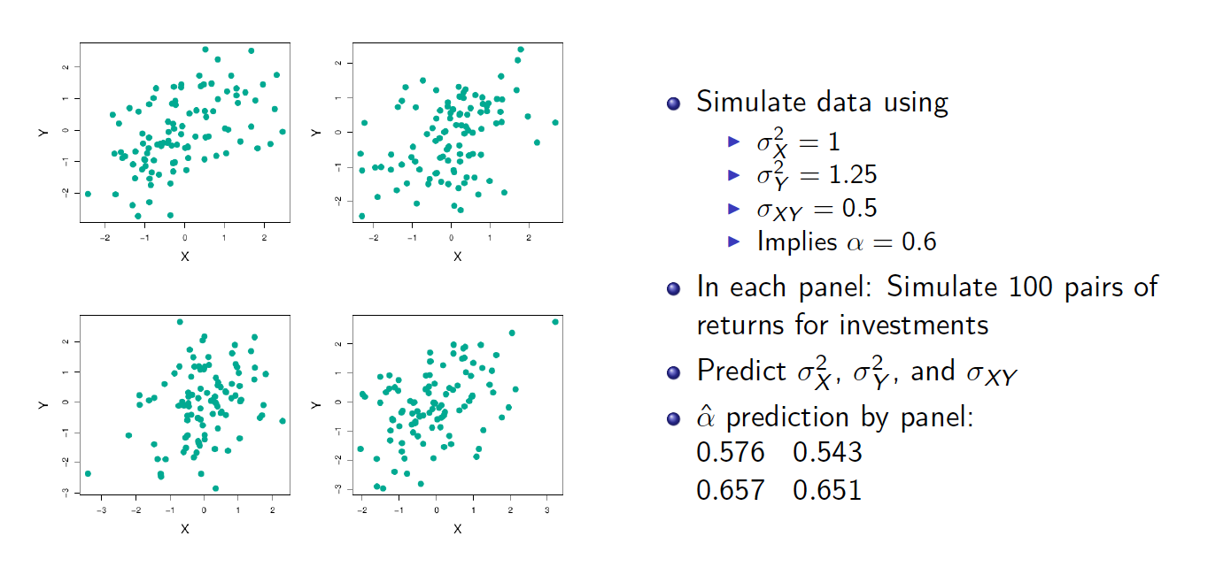
One set of data

Slide 8
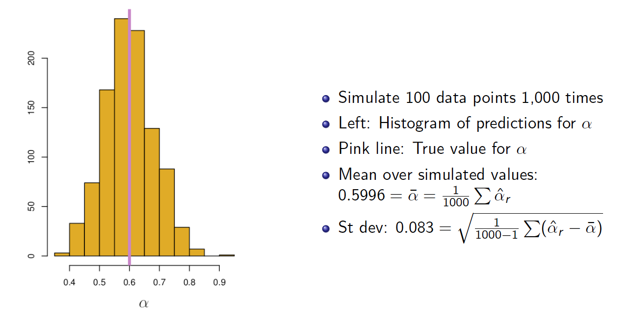
The second best thing you can dream of

Slide 9
Coding for The second best scenario

Slide 10
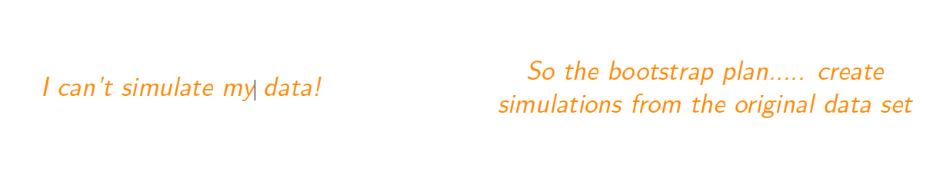
Time to face reality

Slide 11
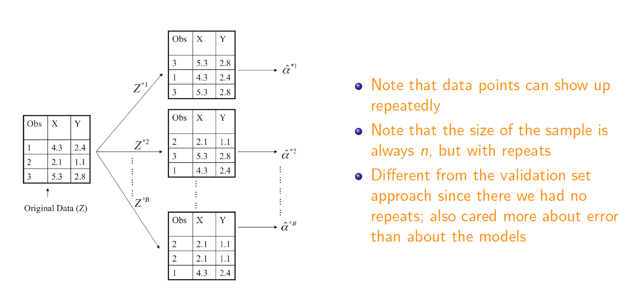
Solution: Sample the data with replacement

Slide 12
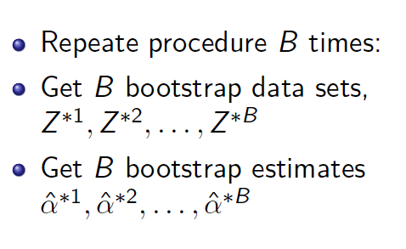
Solution: Sample the data with replacement

Slide 13
Coding part2: Resampling data

Slide 14
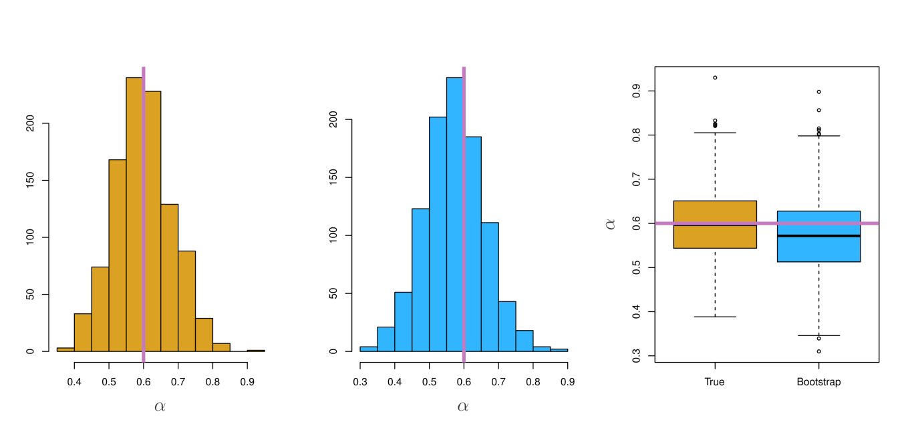
Boostrap Results

Slide 15
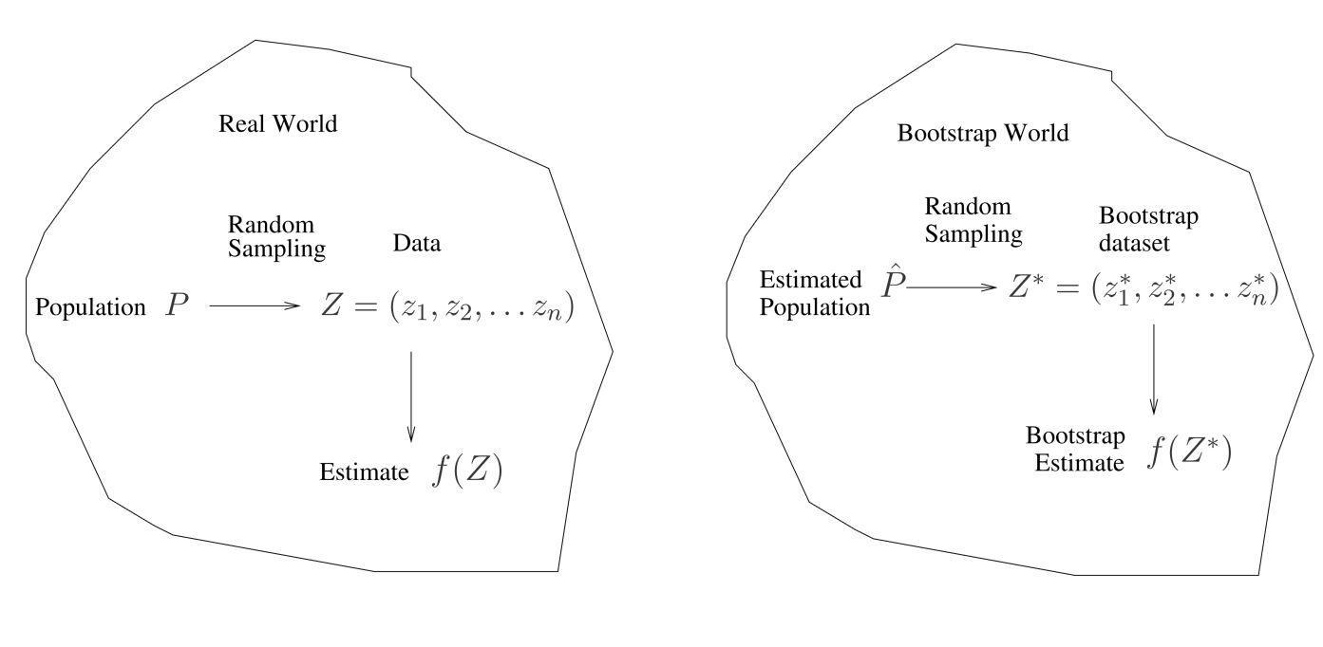
A General Picture for the Bootstrap

Slide 16
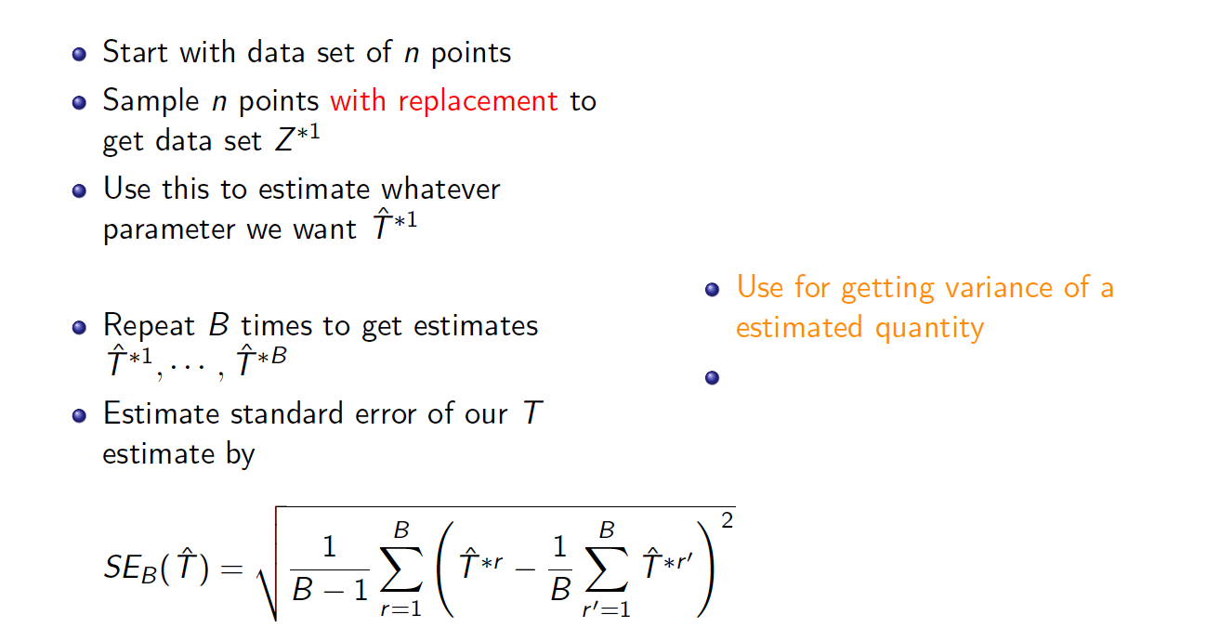
A General Picture for the Bootstrap

Slide 17
Boostrap vs Cross-Validation

Slide 18
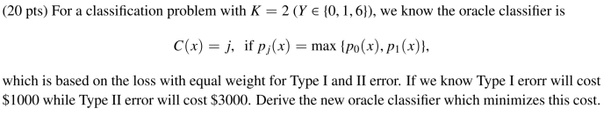
Bonus Quiz 10

