Slide 1

Module 3: Linear Regression
Lecture 3
Jan 19th, 2023

Slide 2
Recap
Estimating f: non-parametric vs parametric
Assessing Model Accuracy: Training MSE and Test MSE
Bias-Variance Trade-off

Slide 3
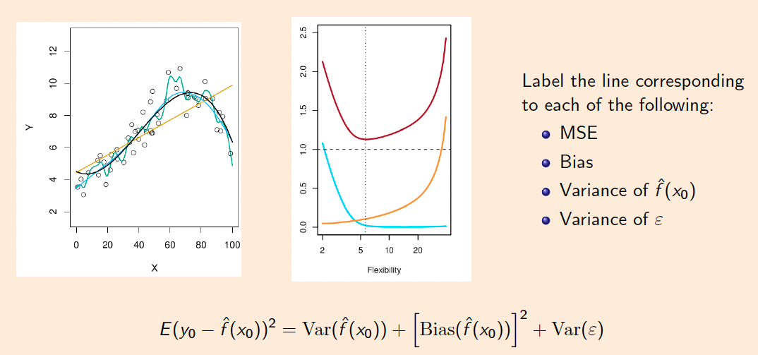
Recap
Estimating f: non-parametric vs parametric
Assessing Model Accuracy: Training MSE and Test MSE
Bias-Variance Trade-off

Slide 4
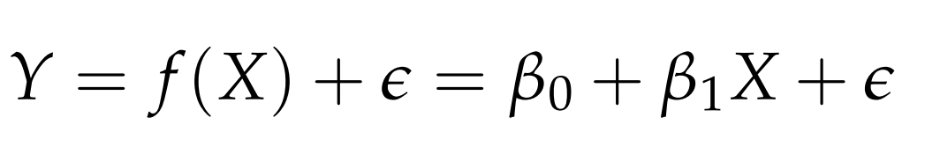


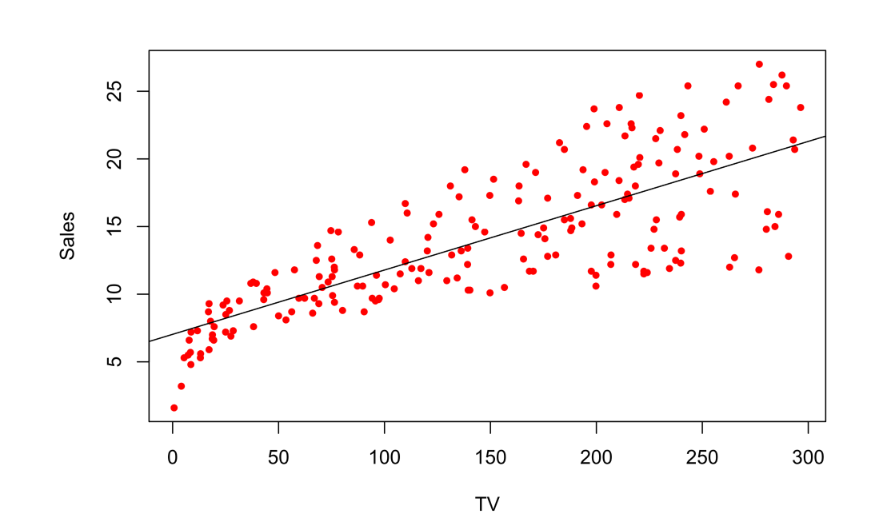

Simple Linear Regression
We have only one feature
Where and are two unknown constants also known as coefficient or parameters.
Example:

Slide 5
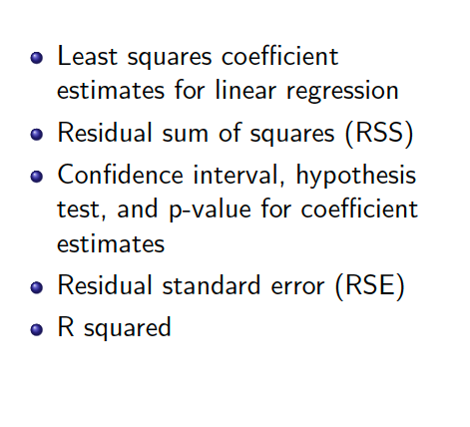
Topics

Slide 6




Simple Linear Regression
We have only one feature
Where and are two unknown constants also known as coefficient or parameters.
Given the training data, we can estimate and for the model coefficients and predict future Y using
Where indicates a prediction of Y on the basis of X = x. The hat symbol denotes an estimated value.

Slide 7
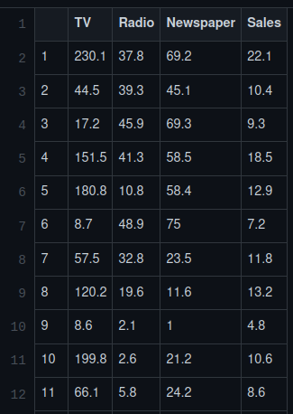
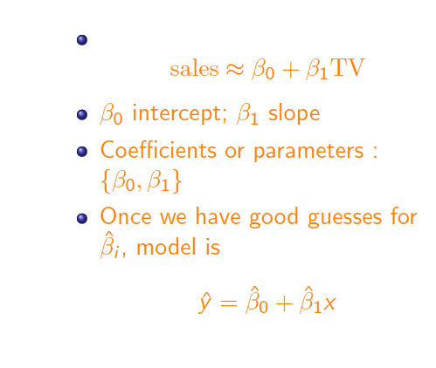
Example

Slide 8


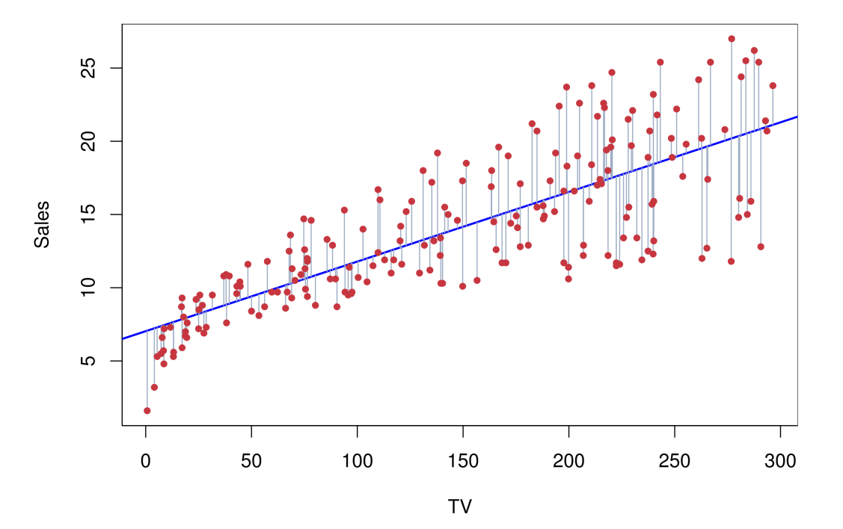
How to estimate?
Let be the prediction of Y based on the ith value of X.
Errors：

Slide 9
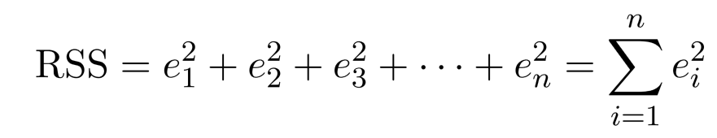
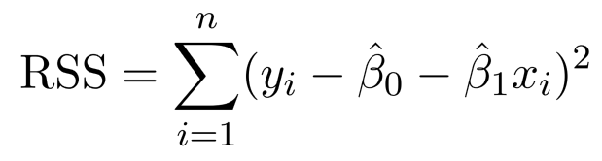
How to estimate?
Residual Sum of Squares
Equivalently：

Slide 10
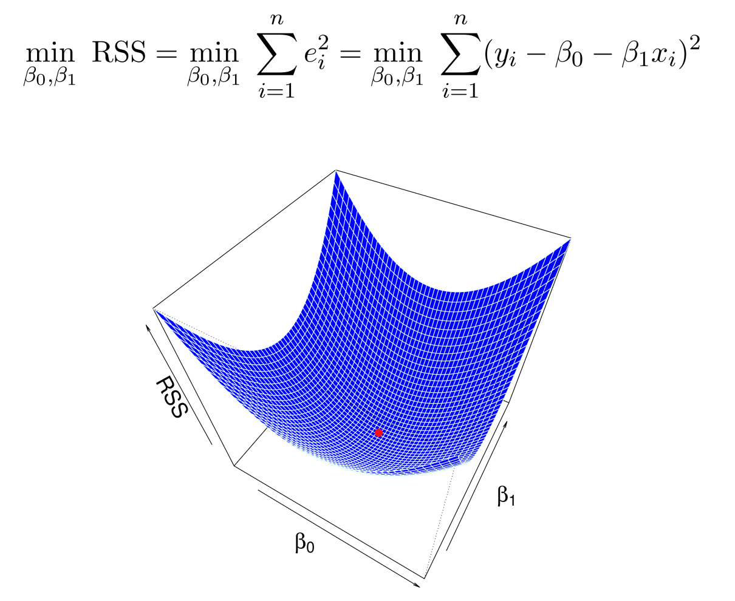
How to estimate?
Minimizing RSS to find the best estimates.

Slide 11
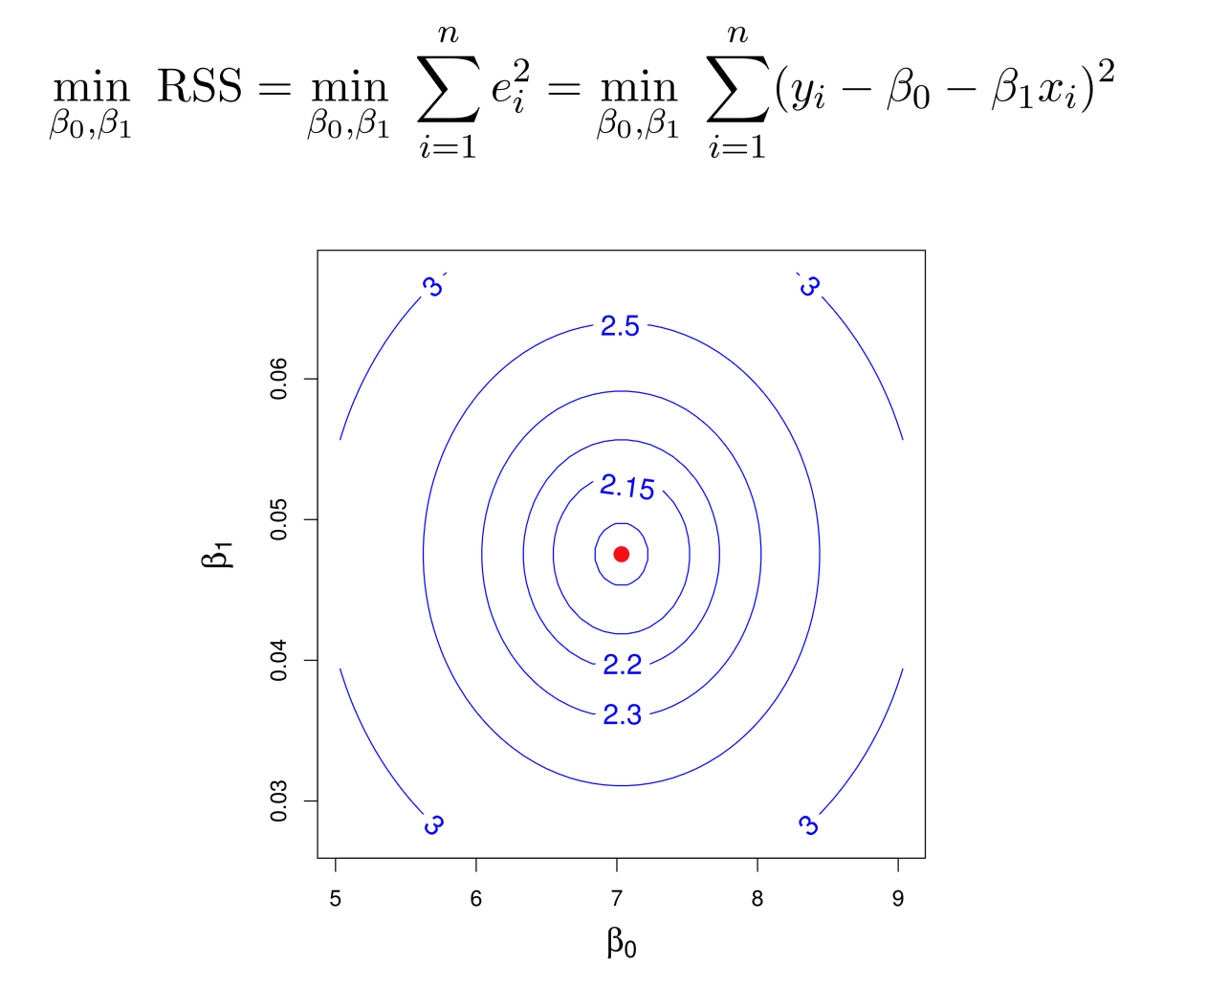

Slide 12
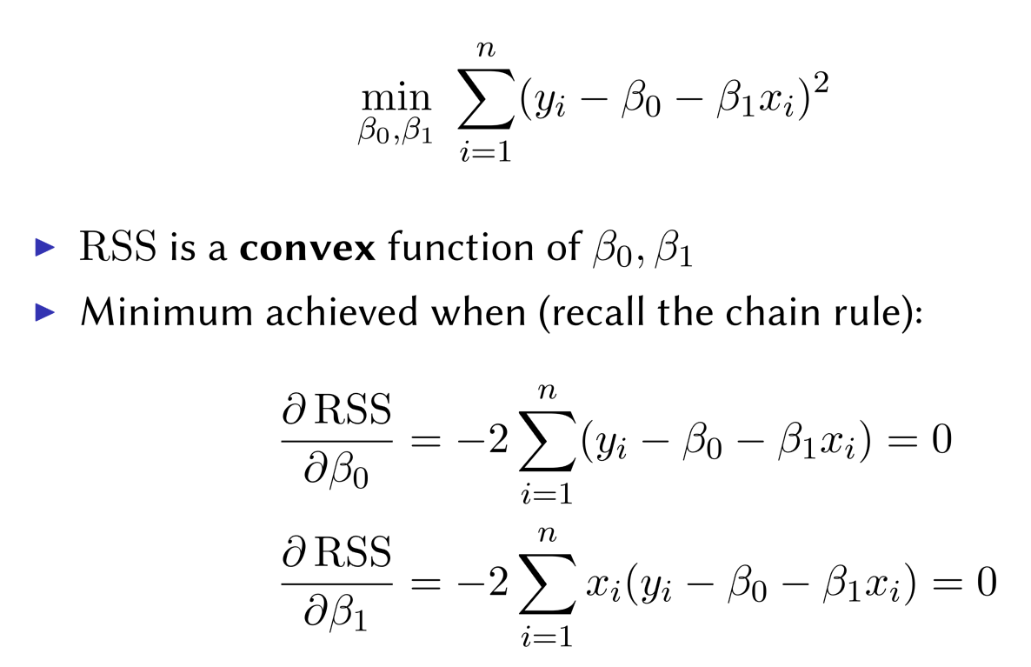
Solving for minimal RSS

Slide 13
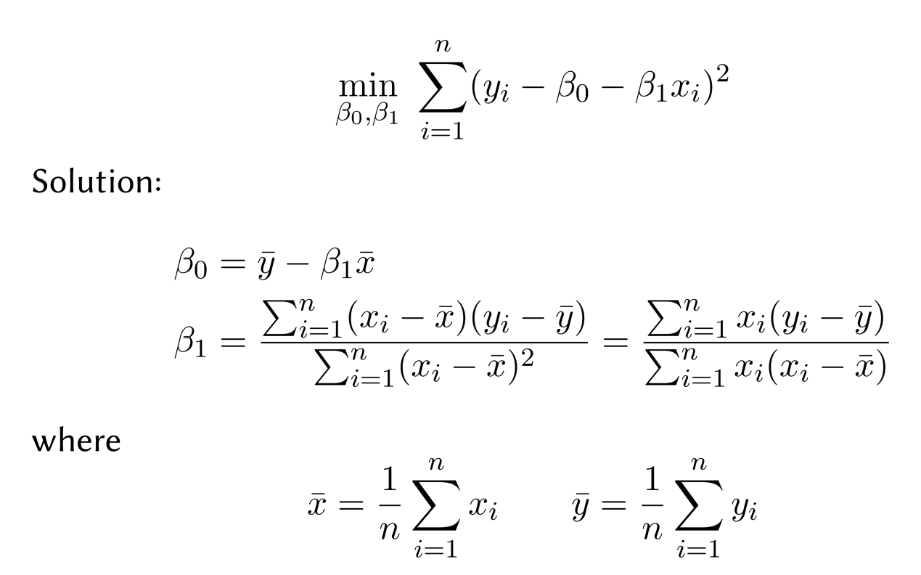
Linear Regression Coefficients

Slide 14


Why Minimizing RSS?
It has closed form!!
Maximize likelihood when , when
Best Linear Unbiased Estimator (BLUE): Gauss-Markov Theorem.

Slide 15



Bias in Estimation
Assume a true value
An estimate from training data
The estimate is unbiased if E( ) =
Sample mean is unbiased for population mean
Standard variance estimate is biased

Slide 16
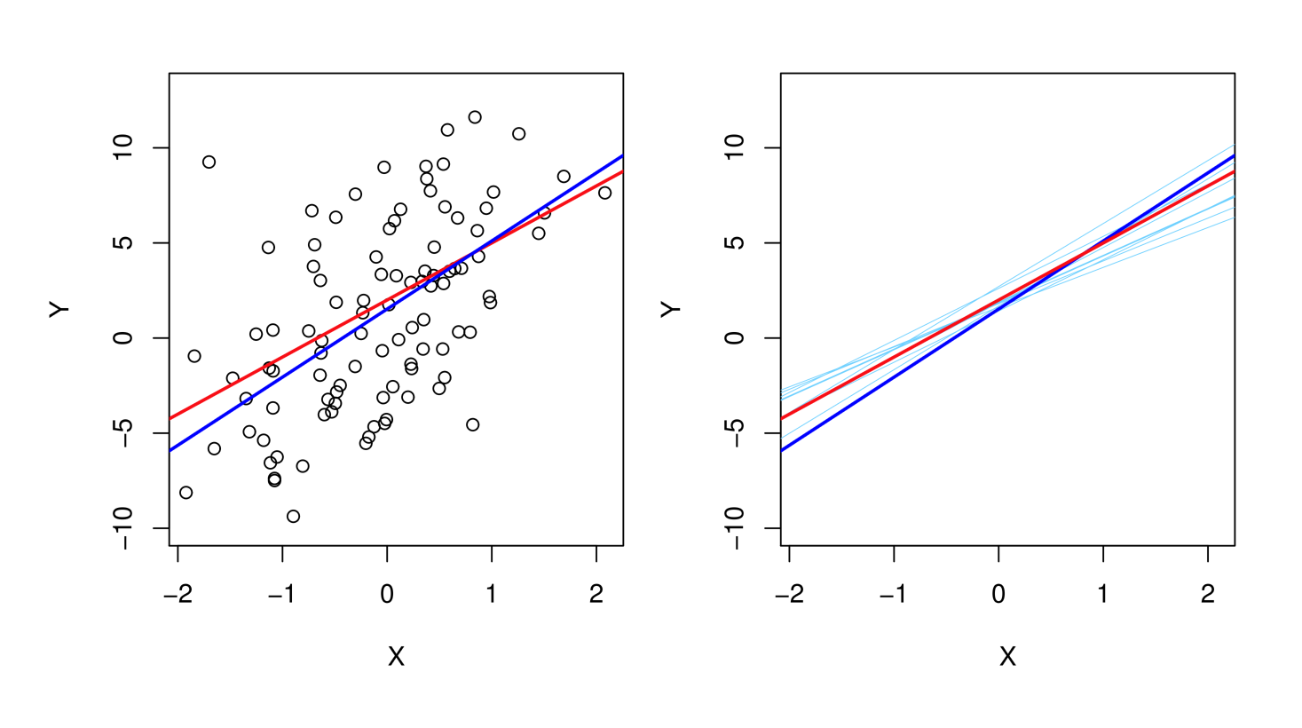
Linear Regression is Unbiased

Slide 17

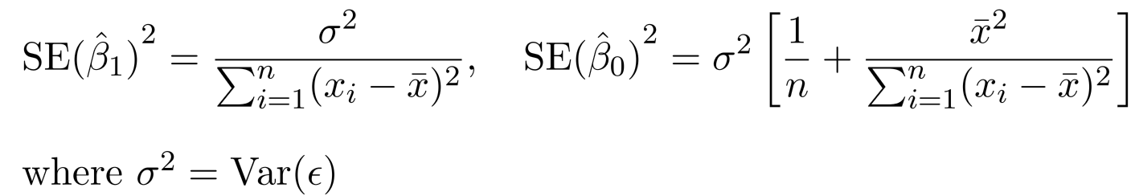



Variance of the estimates
Assume a true value
An estimate from training data
The variance of sample mean is:
The variances of the linear regression estimates are
We then can calculate the confidence intervals. The 95% confidence interval for approximately takes the form

Slide 18
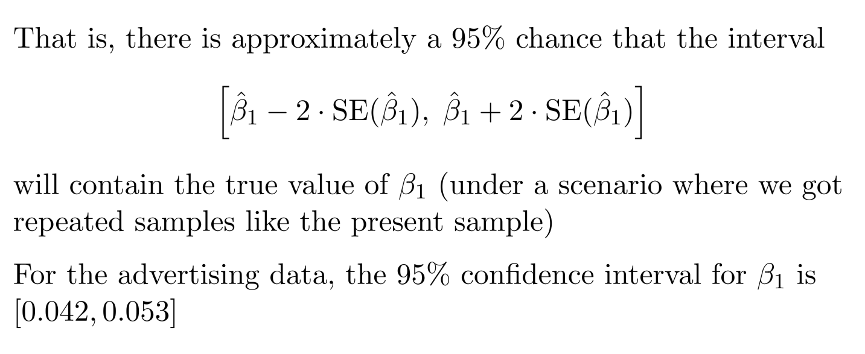
Confidence Interval

Slide 19
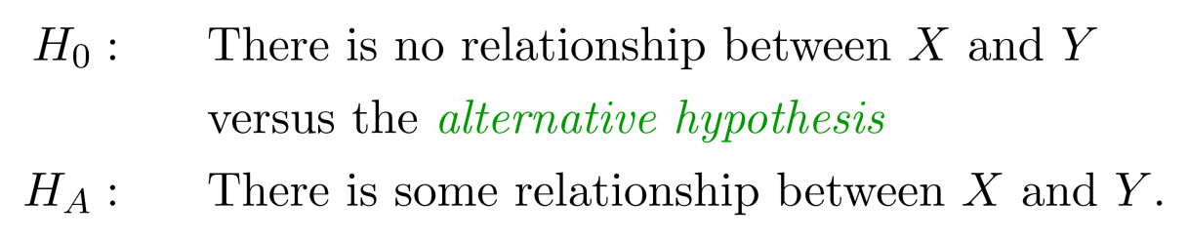
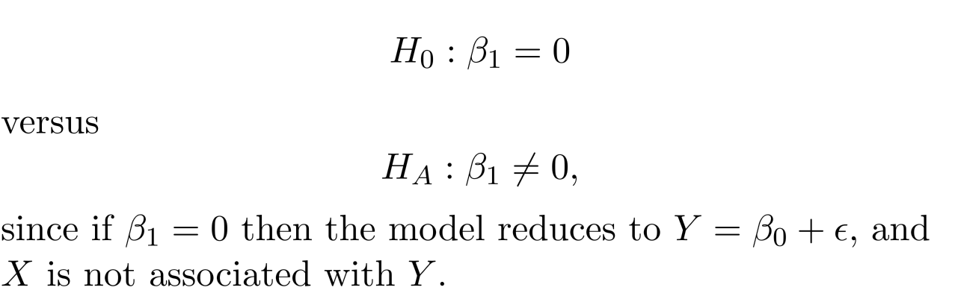
Hypothesis Testing
Standard errors can also be used to perform hypothesis
tests on the coeﬃcients. The most common hypothesis test
involves testing the null hypothesis of
Mathematically, it is

Slide 20

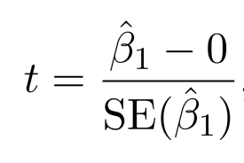

Hypothesis Testing
Mathematically, it is
We have from data and want to test whether it is far from 0. But how far?
This will have a t-distribution with n-2 degrees of freedom, assuming
Using statistical software, it is easy to compute the probability of observing any value equal to |t| or larger. We call this probability the p-value.
We will specify an alpha value (0.05) before Hypothesis testing. If p-value less than the alpha value, we will reject the null hypothesis.

Slide 21
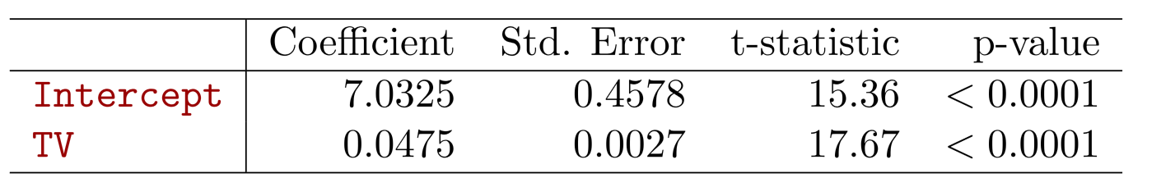
Results for the Advertising Data
Since p-value < 0.05, we reject the null hypothesis and conclude that TV is related to sale.

Slide 22
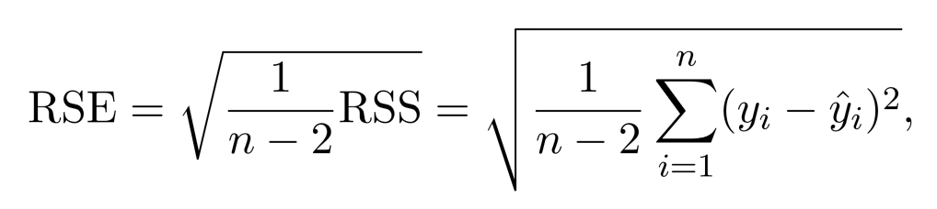
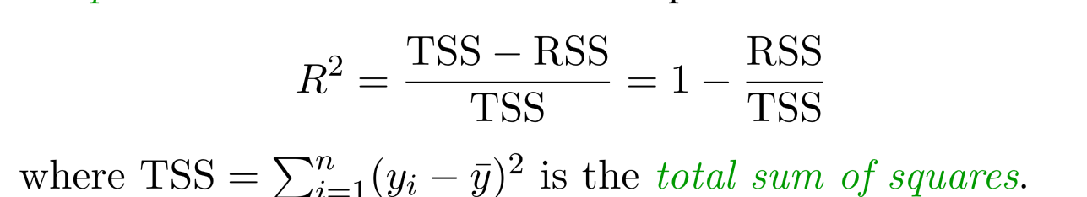

Assessing the Accuracy of the Model
Residual Standard Error
R-square: fraction of variance explained by the linear model
where is the total sum of squares

Slide 23
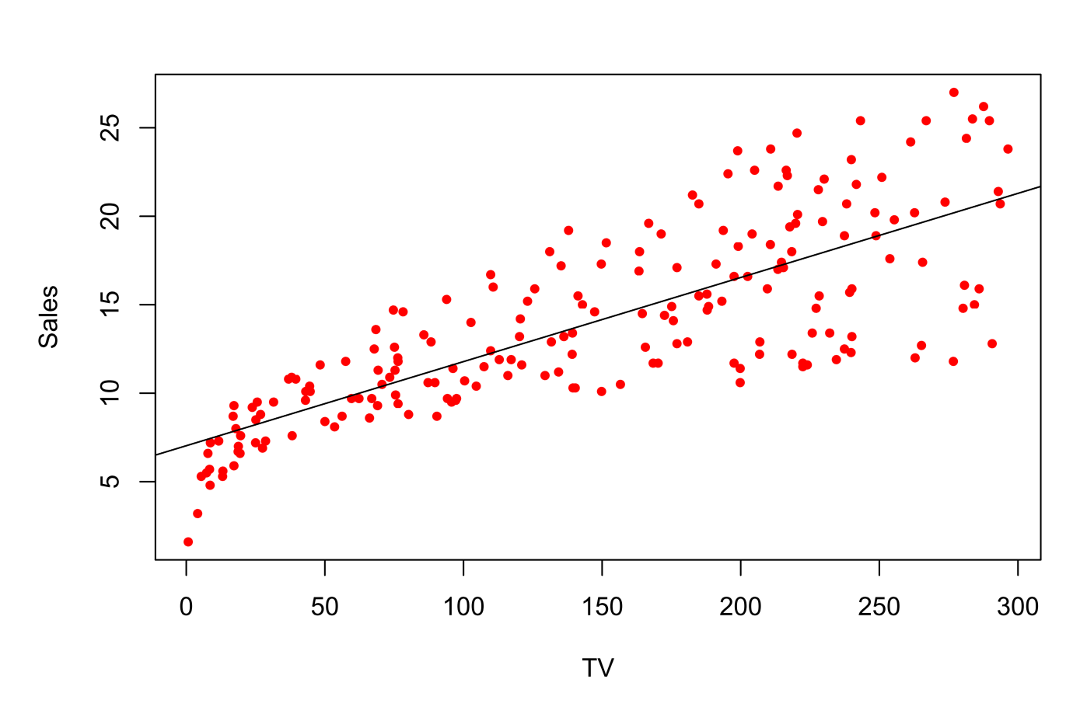
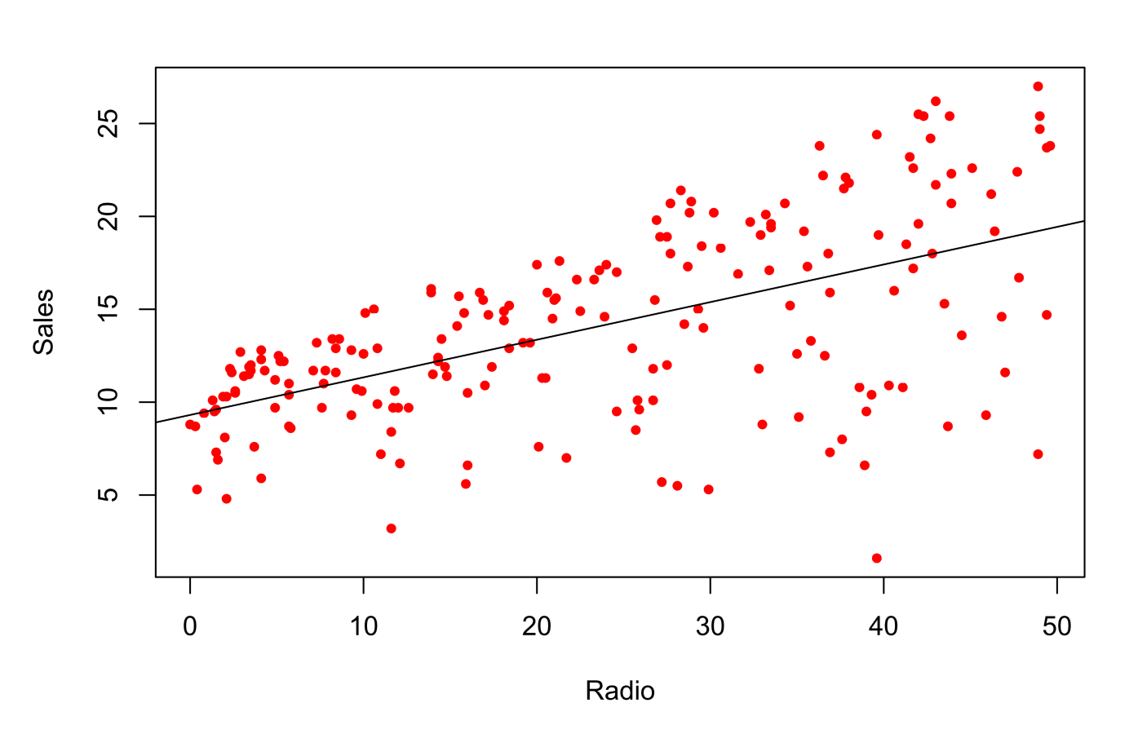
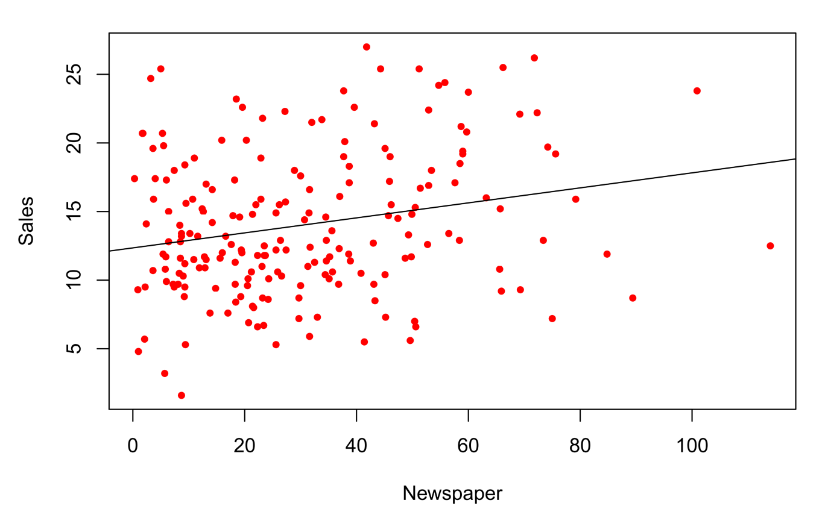
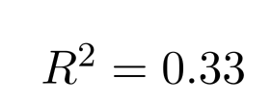


Advertisement Data

Slide 24
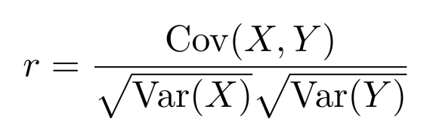
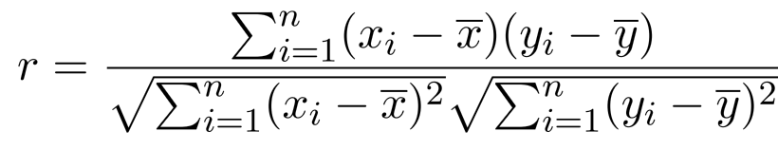

Correlation Coefficient
Measures dependence between two random variables X and Y
Correlation coefficient r is between [-1, 1]
0: Variables are not linearly related
1: Variables are perfectly related (same)
-1: Variables are negatively related (different)

Slide 25
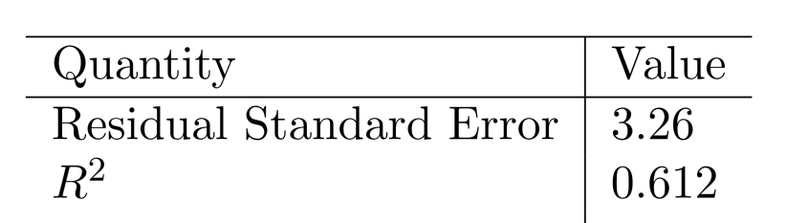
Advertising data results

Slide 26



Multiple Linear Regression
Usually more than one feature is available
In general
We interpret as the average eﬀect on Y of a one unit increase in,
holding all other predictors ﬁxed.
Claims of causality should be avoided for observational data.

Slide 27



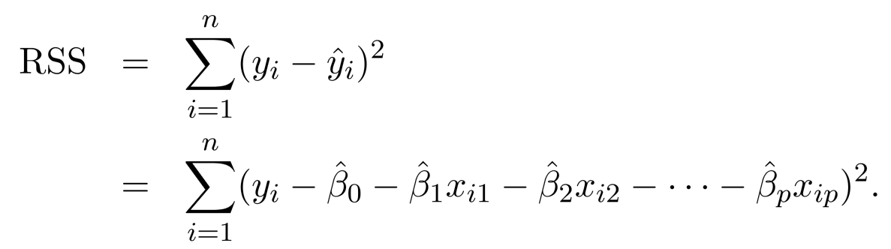
Estimation and Prediction
Given estimates we can make predictions using
We estimate by minimizing the sum of squared residuals

Slide 28
Estimation and Prediction
Linear algebra to derive it

Slide 29
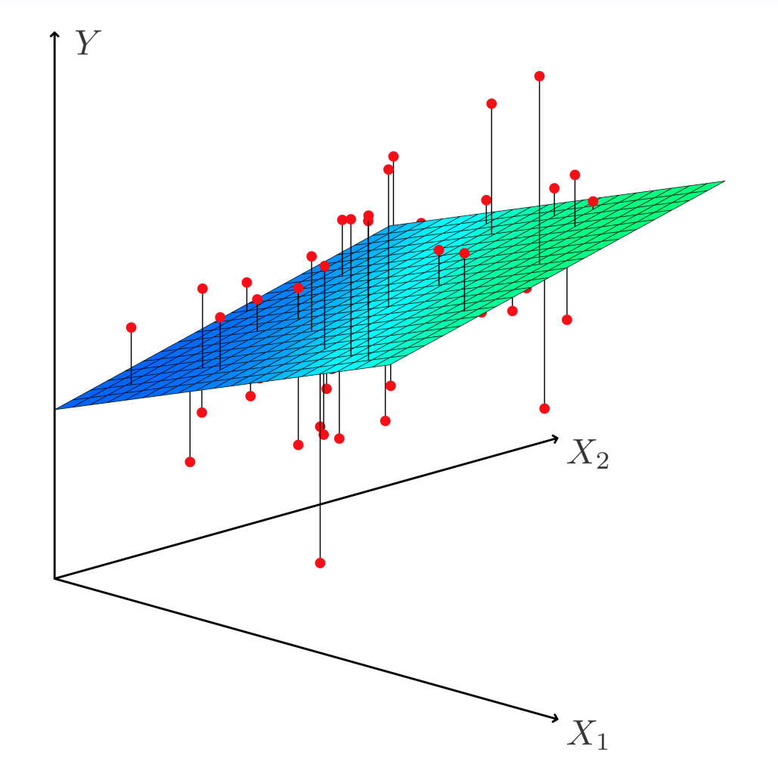
Estimation and Prediction

Slide 30
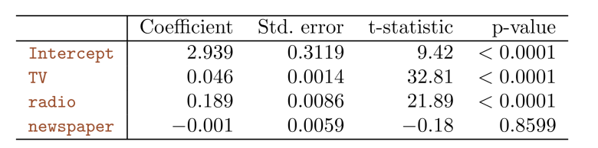
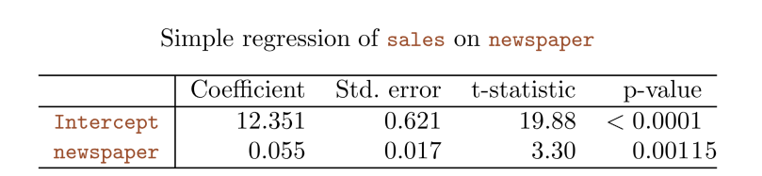
Results for Ad. Data

Slide 31
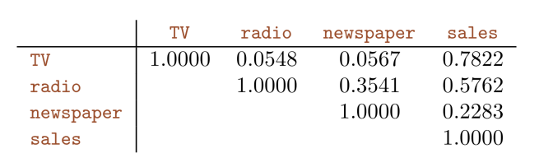
Results for Ad. Data

Slide 32
Some Important Questions
Is at least one of the predictors useful in predicting the response?
Do all the predictors help to explain Y, or is only a subset of the of the predictors useful?
How well does the linear model fit the data?
Given a set of predictor values, what response value should we predict, and how accurate is our prediction?

Slide 33
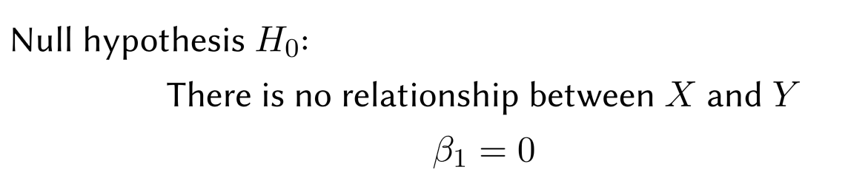

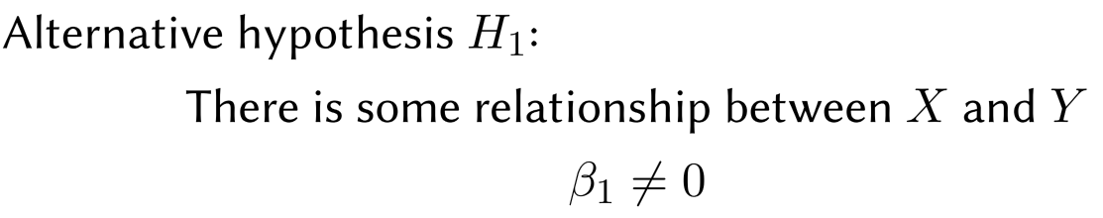

Inference 1
Is at least one of the predictors useful in predicting the response?
Seek to reject hypothesis H₀ with small p-value

Slide 34
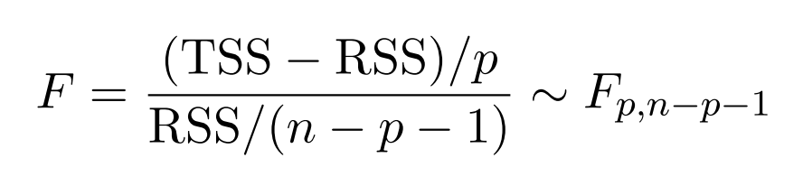
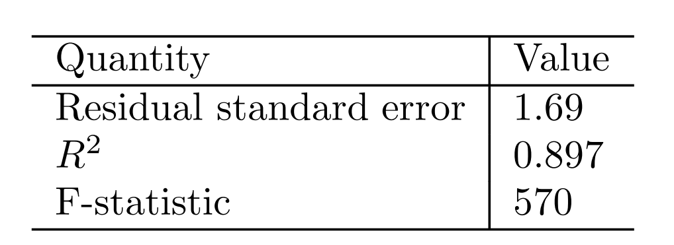
Inference 1
We will use the following random variable

Slide 35
Inference 2:Deciding on the important variables
The most direct approach is called all subsets or best subsets regression: we compute the least squares ﬁt for all possible subsets and then choose between them based on some criterion that balances training error with model size.
However, we often can’t examine all possible models, since they are xxx of them; for example, when p = 40 there are over a billion models!
Instead，we need an automated approach that searches through a subset of them. We discuss two commonly use approaches next.

Slide 36
Forward selection
Begin with the null model — a model that contains an intercept but no predictors.
Fit p simple linear regressions and add to the null model the variable that results in the lowest RSS.
Add to that model the variable that results in the lowest RSS amongst all two-variable models.
Continue until some stopping rule is satisﬁed, for example when all remaining variables have a p-value above some threshold.

Slide 37
Backward selection
Start with all variables in the model.
Remove the variable with the largest p-value — that is, the variable that is the least statistically signiﬁcant.
The new (p − 1)-variable model is ﬁt, and the variable with the largest p-value is removed.
Continue until a stopping rule is reached. For instance, we may stop when all remaining variables have a signiﬁcant p-value deﬁned by some signiﬁcance threshold.

Slide 38
Model selection
Other methods including Mallow C_{p}, AIC, BIC, adjust R2 and Cross-validation (CV)

Slide 39
Confidence Interval and Prediction Interval

Slide 40
Other Considerations
Qualitative Predictors
Some predictors are not categorical predictors or factor variables.
For example: gender, student (student status), status (marital status), and ethnicity (Caucasian, African American (AA) or Asian).

Slide 41
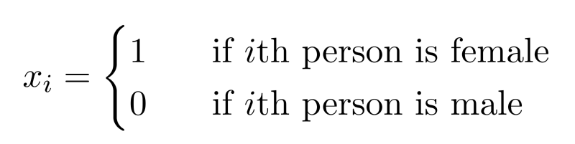
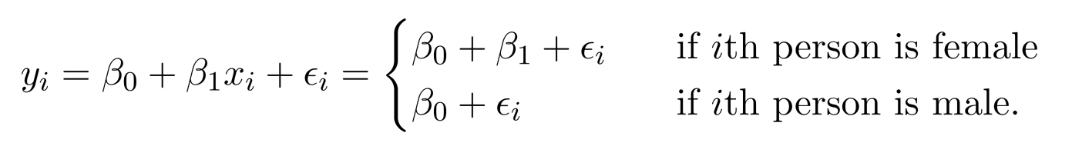
Qualitative Predictors
Example: investigate diﬀerences in credit card balance between males and females, ignoring the other variables.
We create a new variable
Resulting model:
Interpretation?

Slide 42
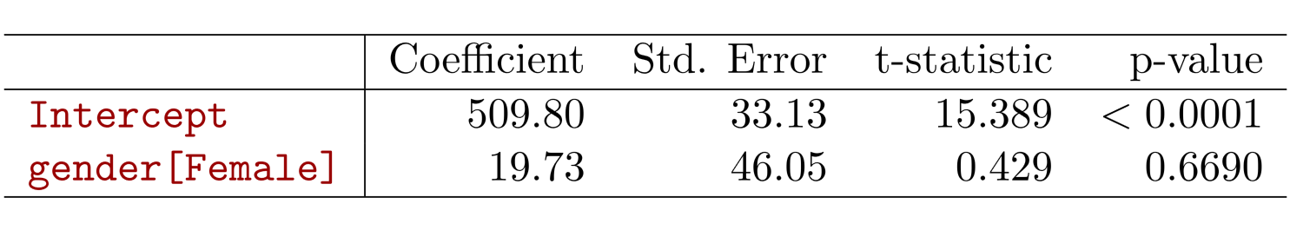
Credit card data

Slide 43
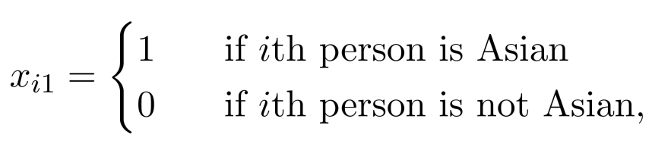
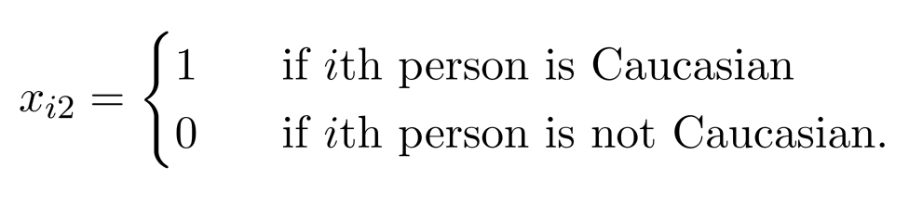
More than two levels?
For the ethnicity: Asian, Caucasian, African American
We will create two dummy variables.

Slide 44
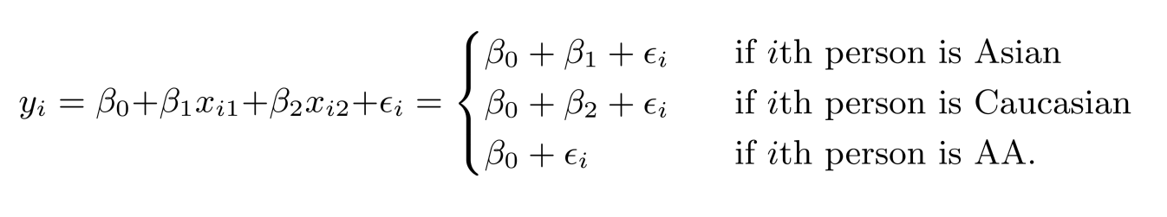
More than two levels?
Then we have the following model
There will always be one fewer dummy variable than the number of levels. The level with no dummy variable African American in this example — is known as the baseline.

Slide 45
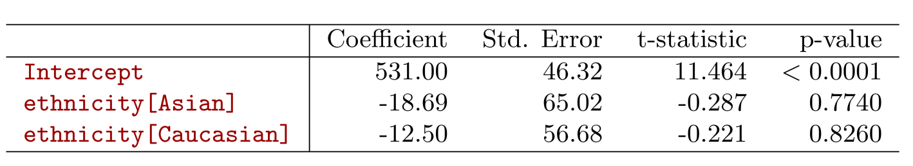
More than two levels?

Slide 46

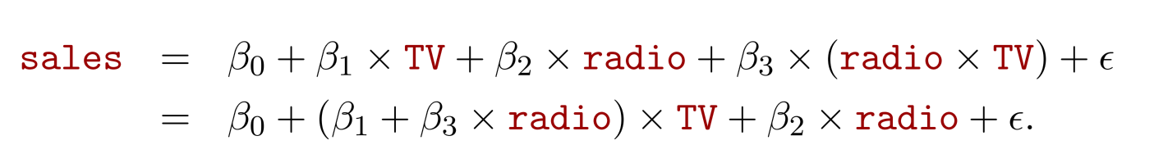
Extensions of the Linear Model
Interactions
In the advertising data, we assume the effect on sales of increasing one medium is independent of other media.
But suppose that spending money on radio advertising increases the effectiveness of TV advertising. How to model it?
This is called an interaction effect.

Slide 47
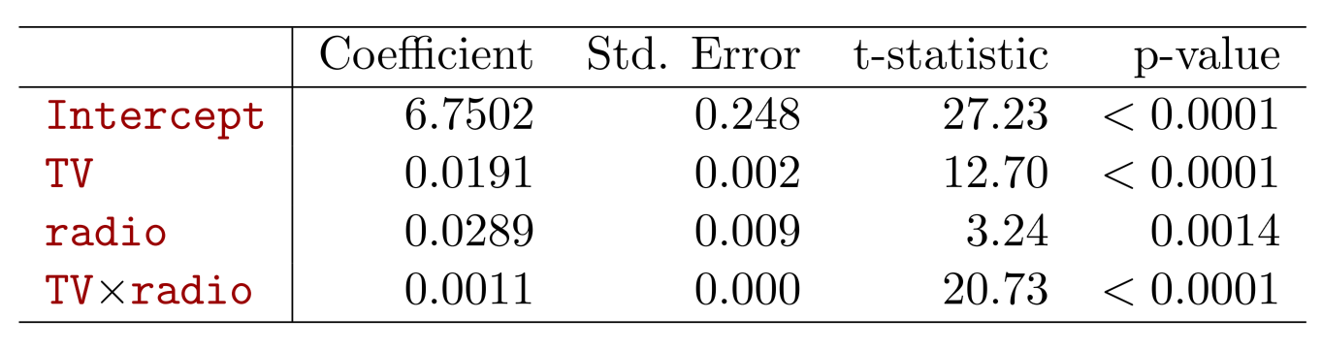

Interpretation
The p-value for the interaction term TV × radio is extremely low, indicating that there is strong evidence for
The R² for the interaction model is 96.8%, compared to only 89.7% for the model that predicts sales using TV and radio without an interaction term.
This means that (96.8 − 89.7)/(100 − 89.7) = 69% of the variability in sales that remains after ﬁtting the additive model has been explained by the interaction term.

Slide 48
Interpretation
The coeﬃcient estimates in the table suggest that an increase in TV advertising of $1, 000 is associated with increased sales of
An increase in radio advertising of $1, 000 will be associated with an increase in sales of

Slide 49
Hierarchy
Sometimes it is the case that an interaction term has a very small p-value, but the associated main eﬀects (in this case, TV and radio) do not.
The hierarchy principle:
If we include the interaction term, we should include the main effects no matter what!

Slide 50
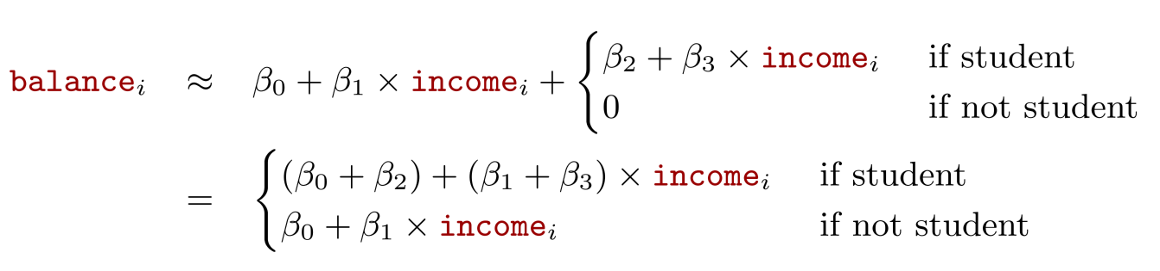
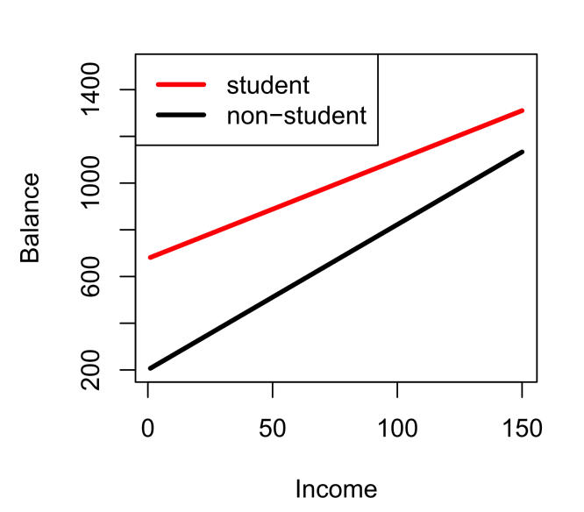
Qualitative and quantitative variables?
Consider the Credit data set, and suppose that we wish to predict balance using income (quantitative) and student (qualitative). With interactions, we have

Slide 51
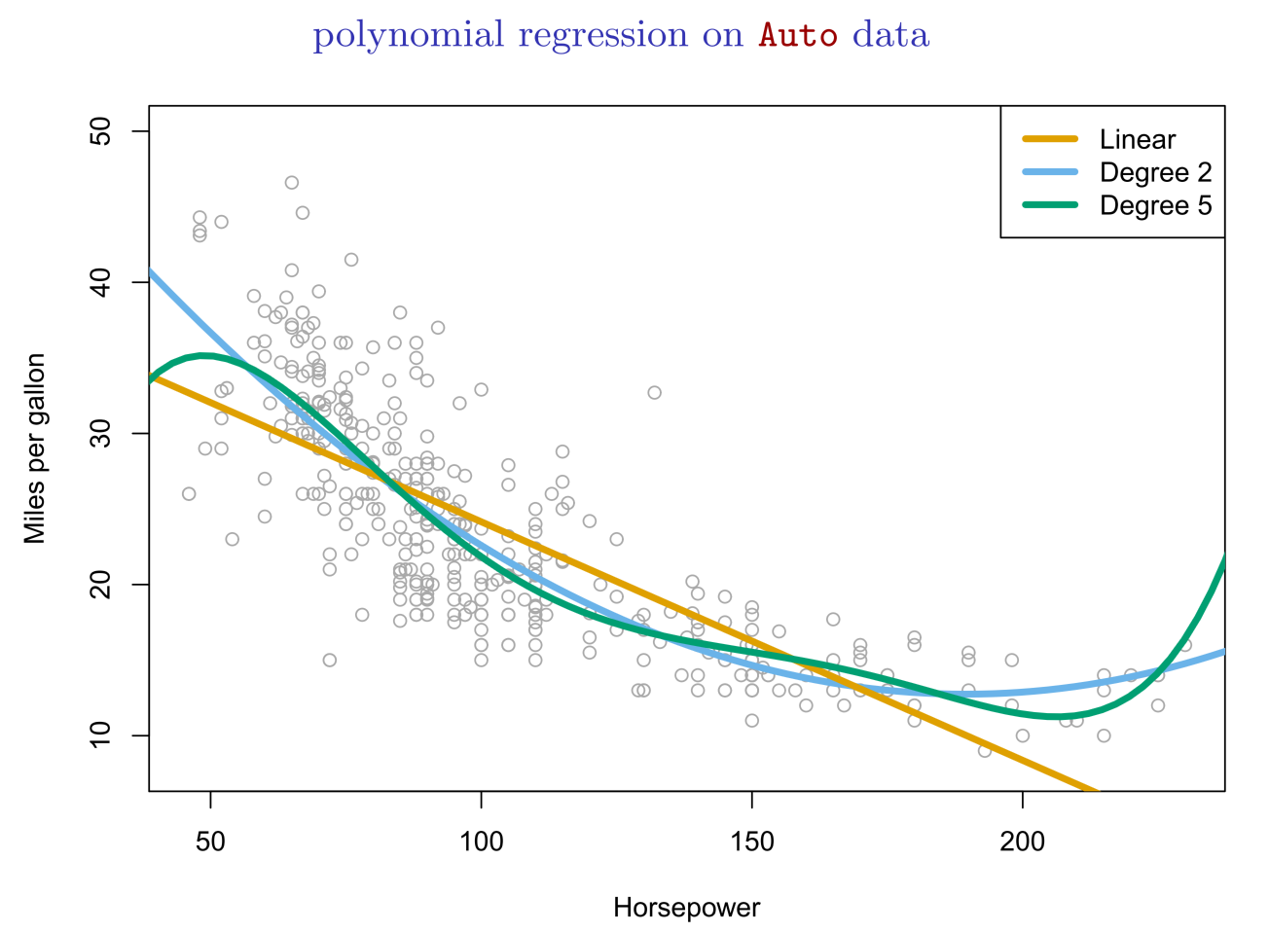

Non-linear eﬀects of predictors

Slide 52

Non-linear eﬀects of predictors

Slide 53

Bonus Quiz 6

Slide 54
Bonus Quiz 7
Given n = 100 and the following table, what is the TSS?

