Slide 1

Module 6: Model Selection and Regularization
Lecture 14
Feb 20th, 2023
Ch 6.1- 6.2

Slide 2
You can leave when and if you need to Nothing on the syllabus is as important as your well-beings. It is important to ask for help in this class and beyond We should prioritize flexibility, grace, and care for each other
Feeling Sharing

Slide 3
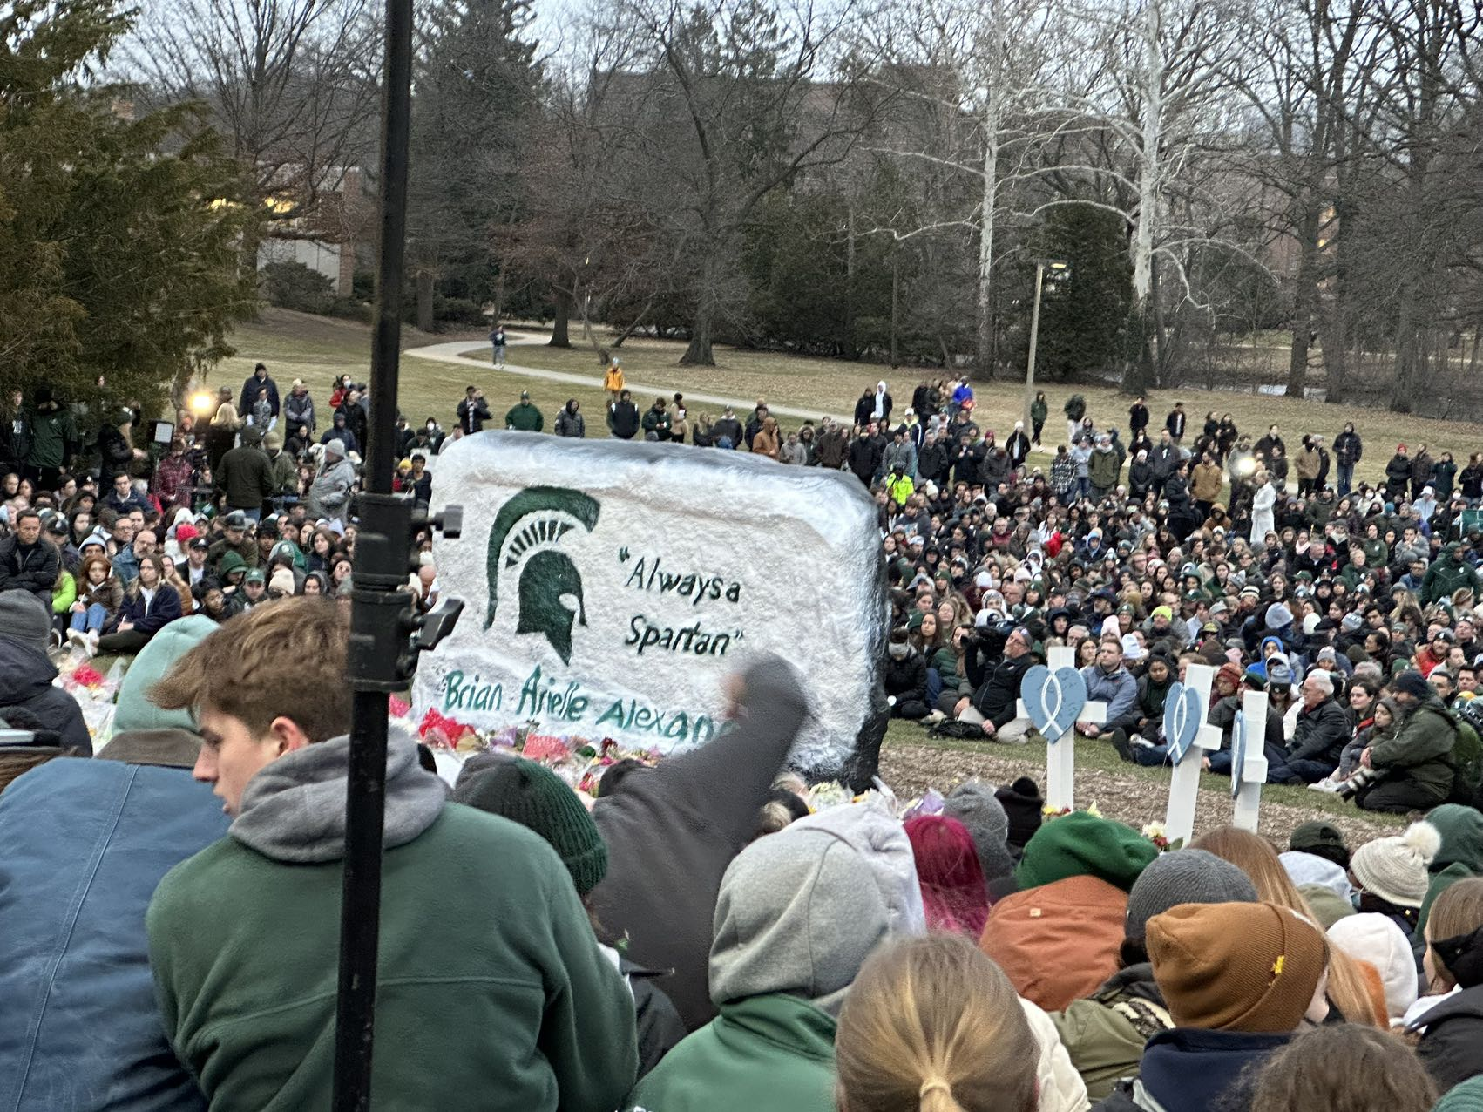

Feeling Sharing

Slide 4

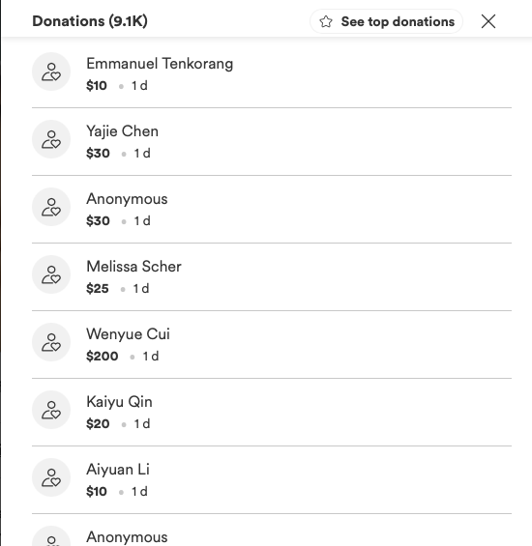
Feeling Sharing

Slide 5







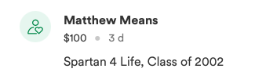
Feeling Sharing

Slide 6

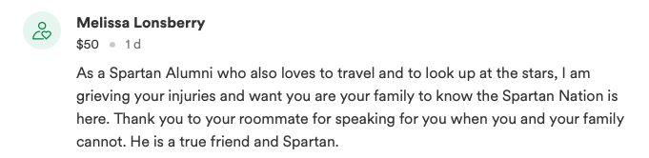



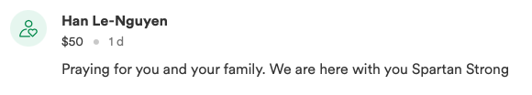



Feeling Sharing

Slide 7
Feeling Sharing

Slide 8
Bootstrap The goal: quantify the uncertainty associated with a given estimator (model) or statistical learning method.
Recap

Slide 9
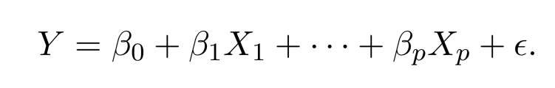
Linear Models
The linear model has advantages in terms of its interpretability and often shows good predictive performance.
How to improve linear model? Beyond Ordinary Least Square(OLS)

Slide 10
Why Consider Alternatives to OLS?
Prediction Accuracy: especially when p > n. Need to control variance
Model Interpretability: Small number of features are easier to understand and design experiment.

Slide 11
Three Classes of Methods
Subset Selection. We identify a subset of the p predictors then ﬁt a model using least squares on the reduced set of variables.
Shrinkage. We ﬁt a model involving all p predictors, but the estimated coeﬃcients are shrunken towards zero relative to the OLS estimates. This shrinkage (also known as regularization) has the eﬀect of reducing variance and can also perform variable selection.
Dimension Reduction.

Slide 12
Subset Selection
Best subset selection
Stepwise selection

Slide 13
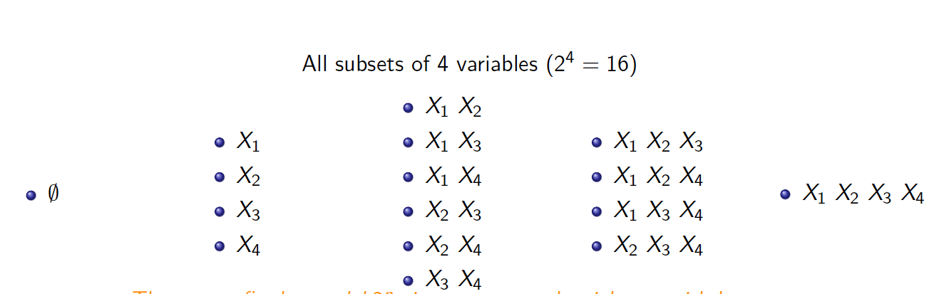
Too many possible models

Slide 14
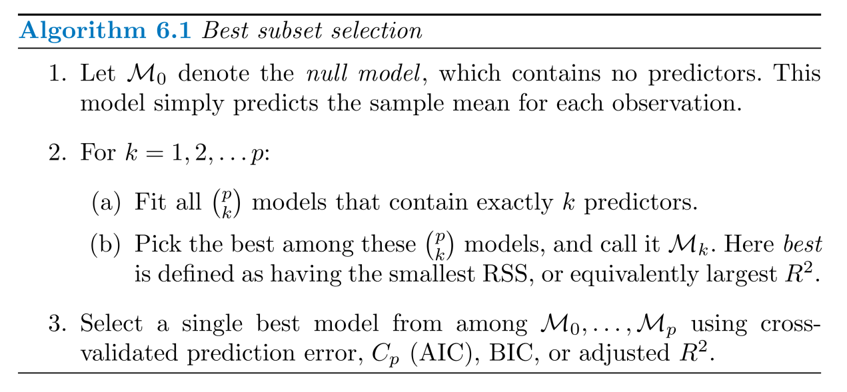
Best Subset Selection

Slide 15
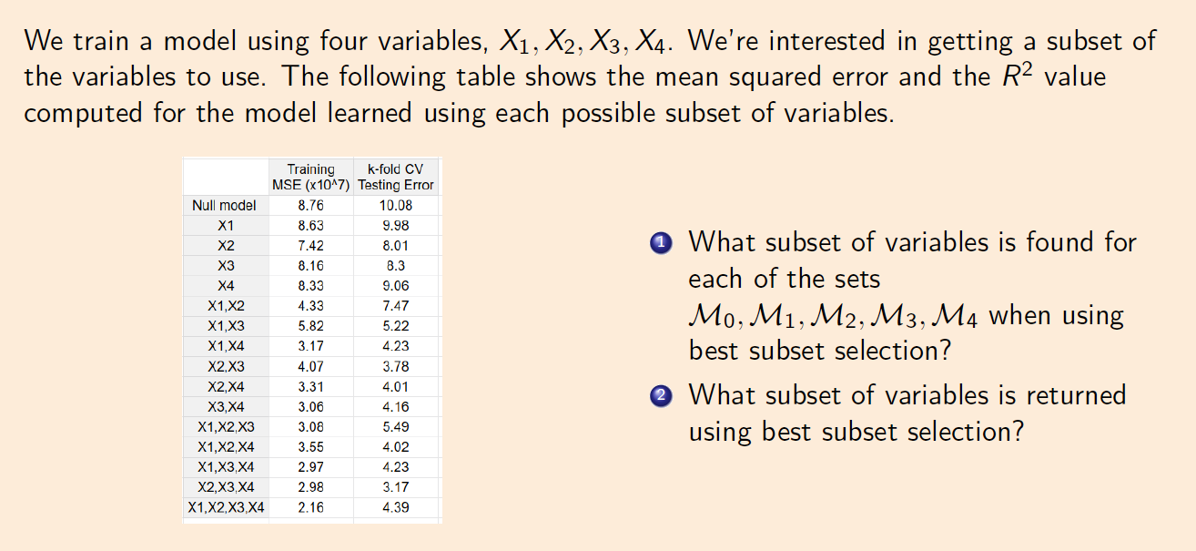
Group work:

Slide 16
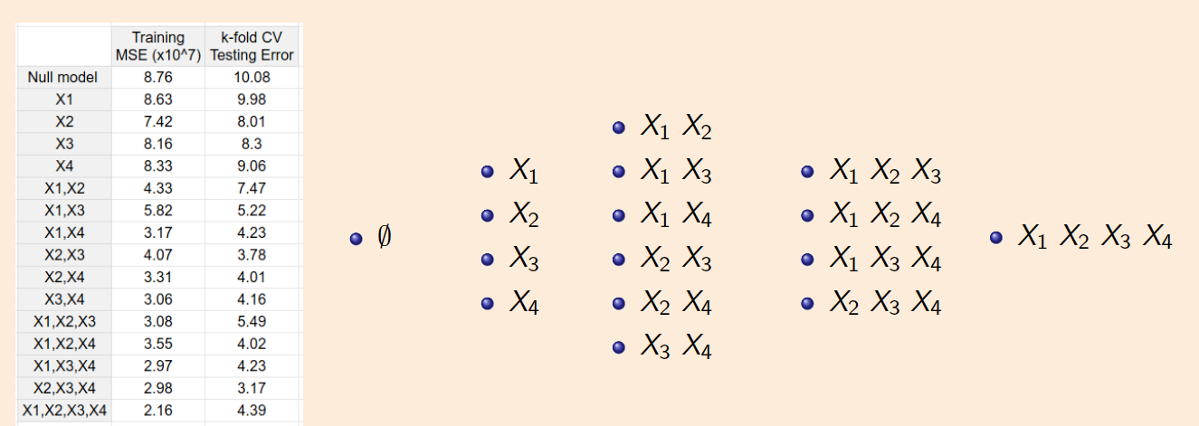
Group work:

Slide 17
Challenges for Best Subset selection

Slide 18
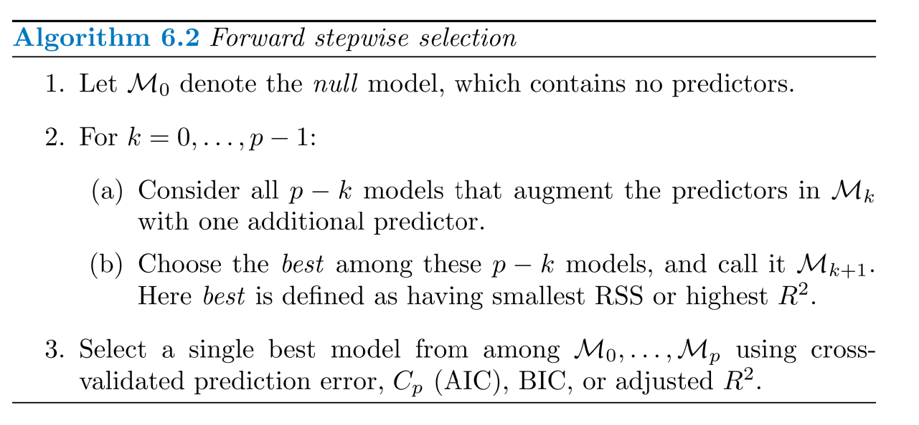
Forward Stepwise Selection

Slide 19
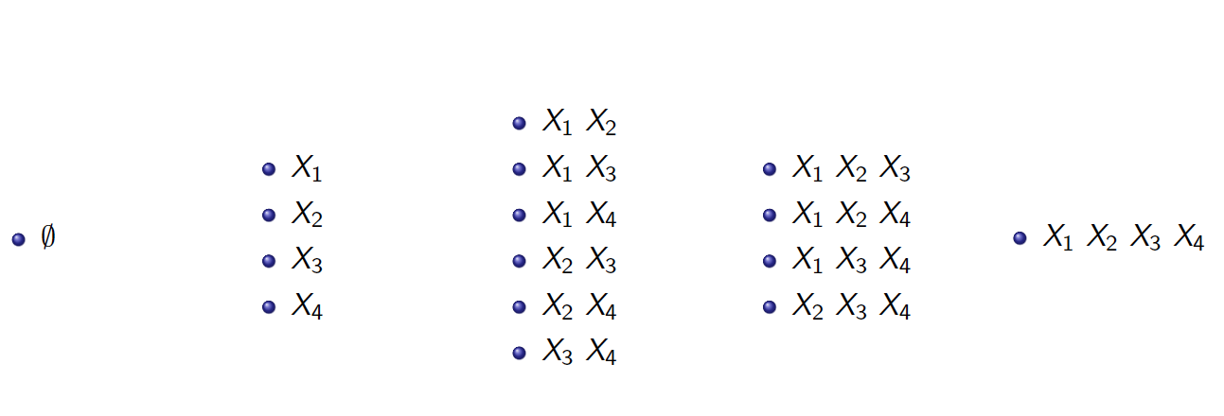
An Example for Forward Stepwise Selection

Slide 20
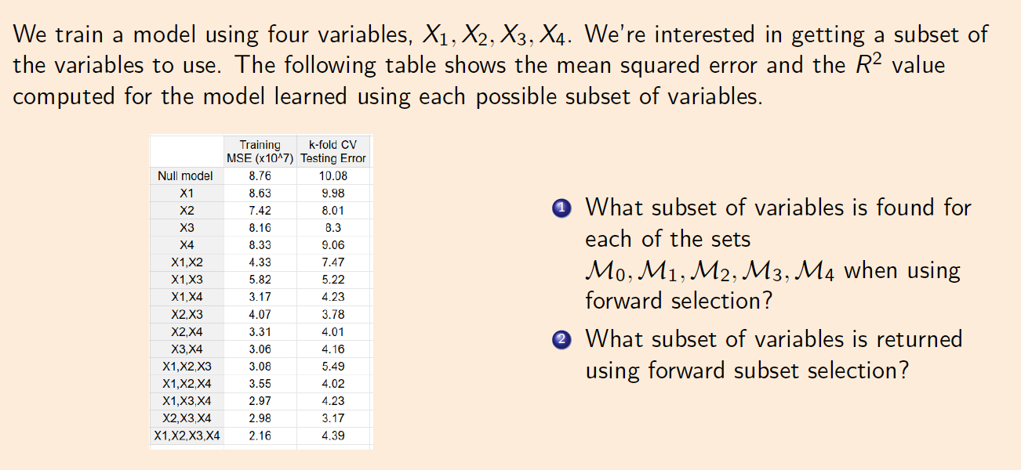
Group Work

Slide 21
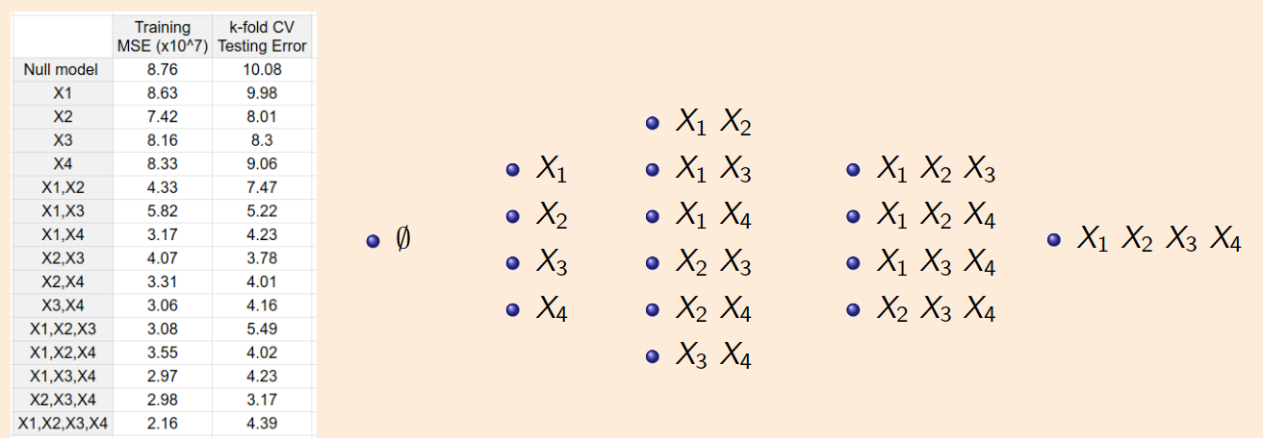
Group Work

Slide 22
Pros and Cons of Forward Selection

Slide 23
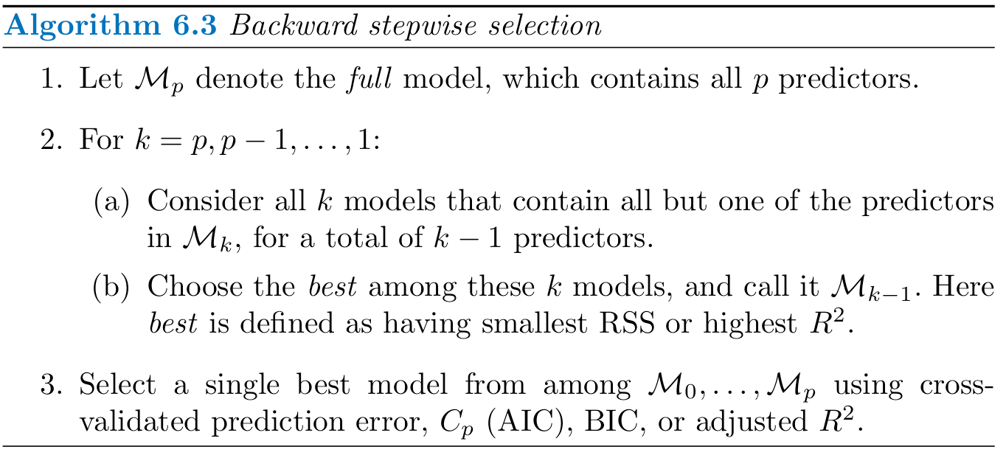
Backward Stepwise Selection

Slide 24
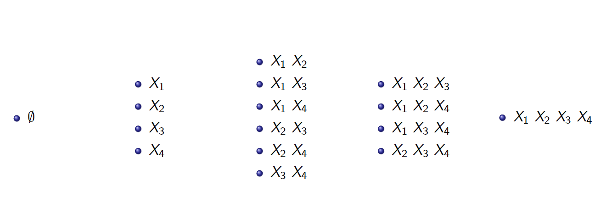
An example for Backward Stepwise Selection

Slide 25
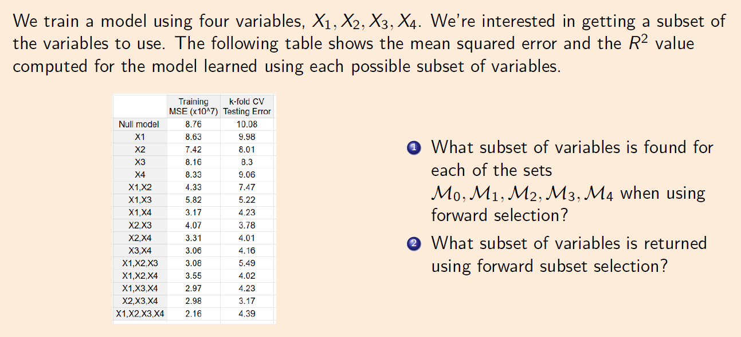
Group work

Slide 26
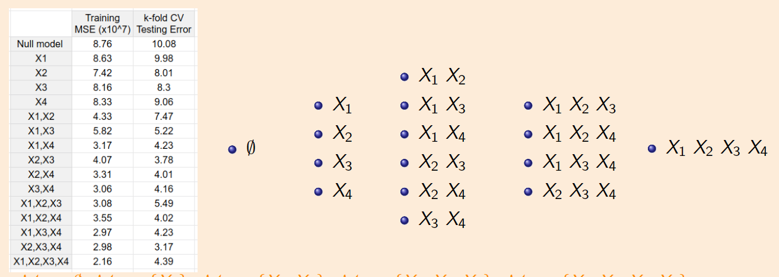
Group work

Slide 27
Pros and Cons of Backward Selection

Slide 28
Alternatives for Approximating Test Error

Slide 29
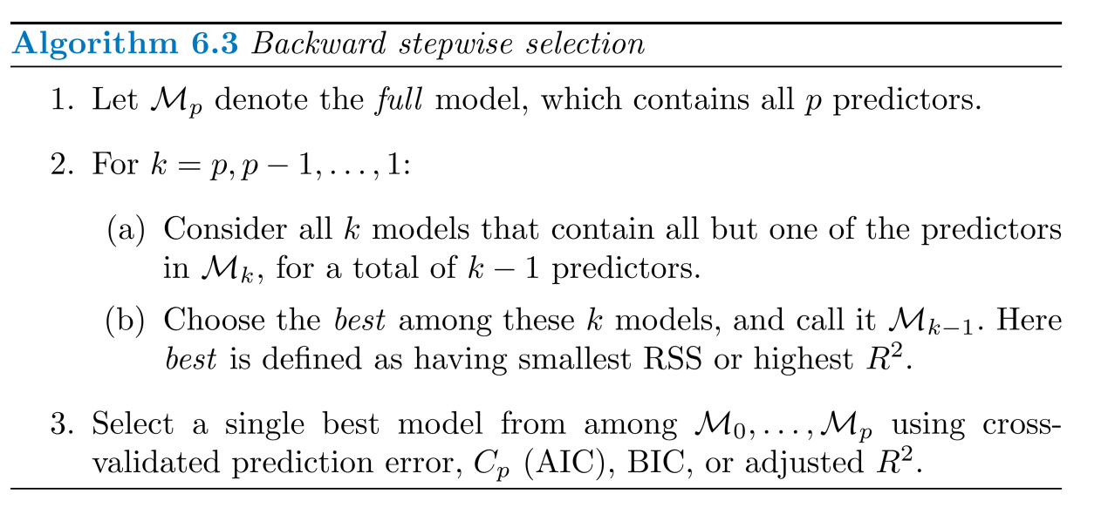
Estimating Test Error
CV is good but very time consuming.
We can indirectly estimate test error by making an adjustment to the training error to account for the bias due overfitting

Slide 30
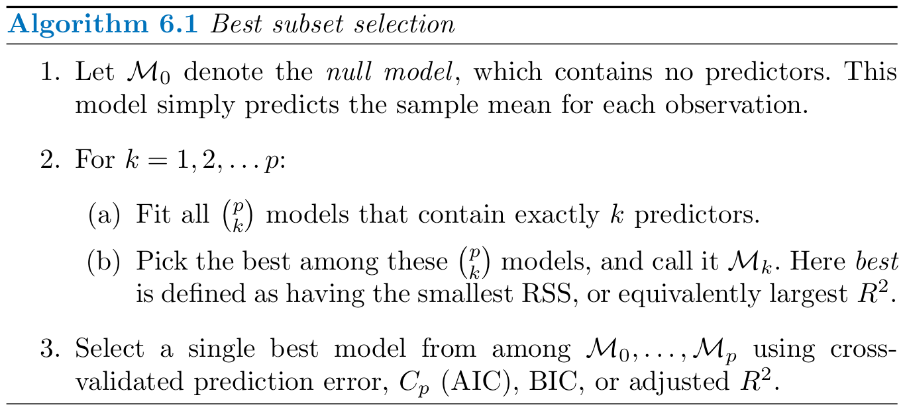
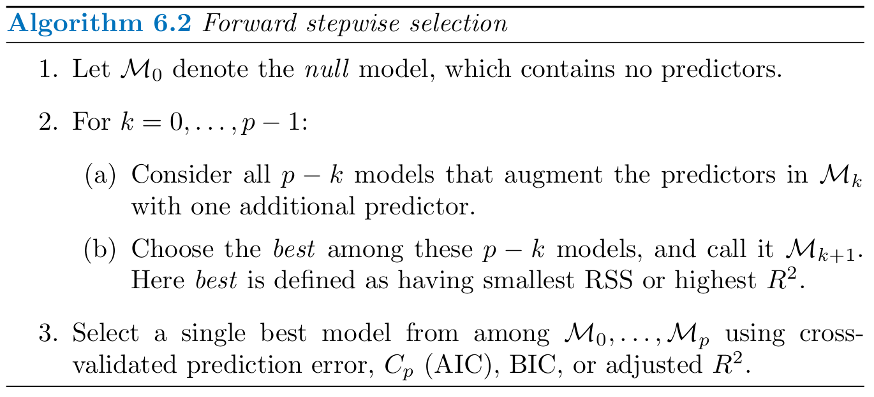
Estimating Test Error

Slide 31
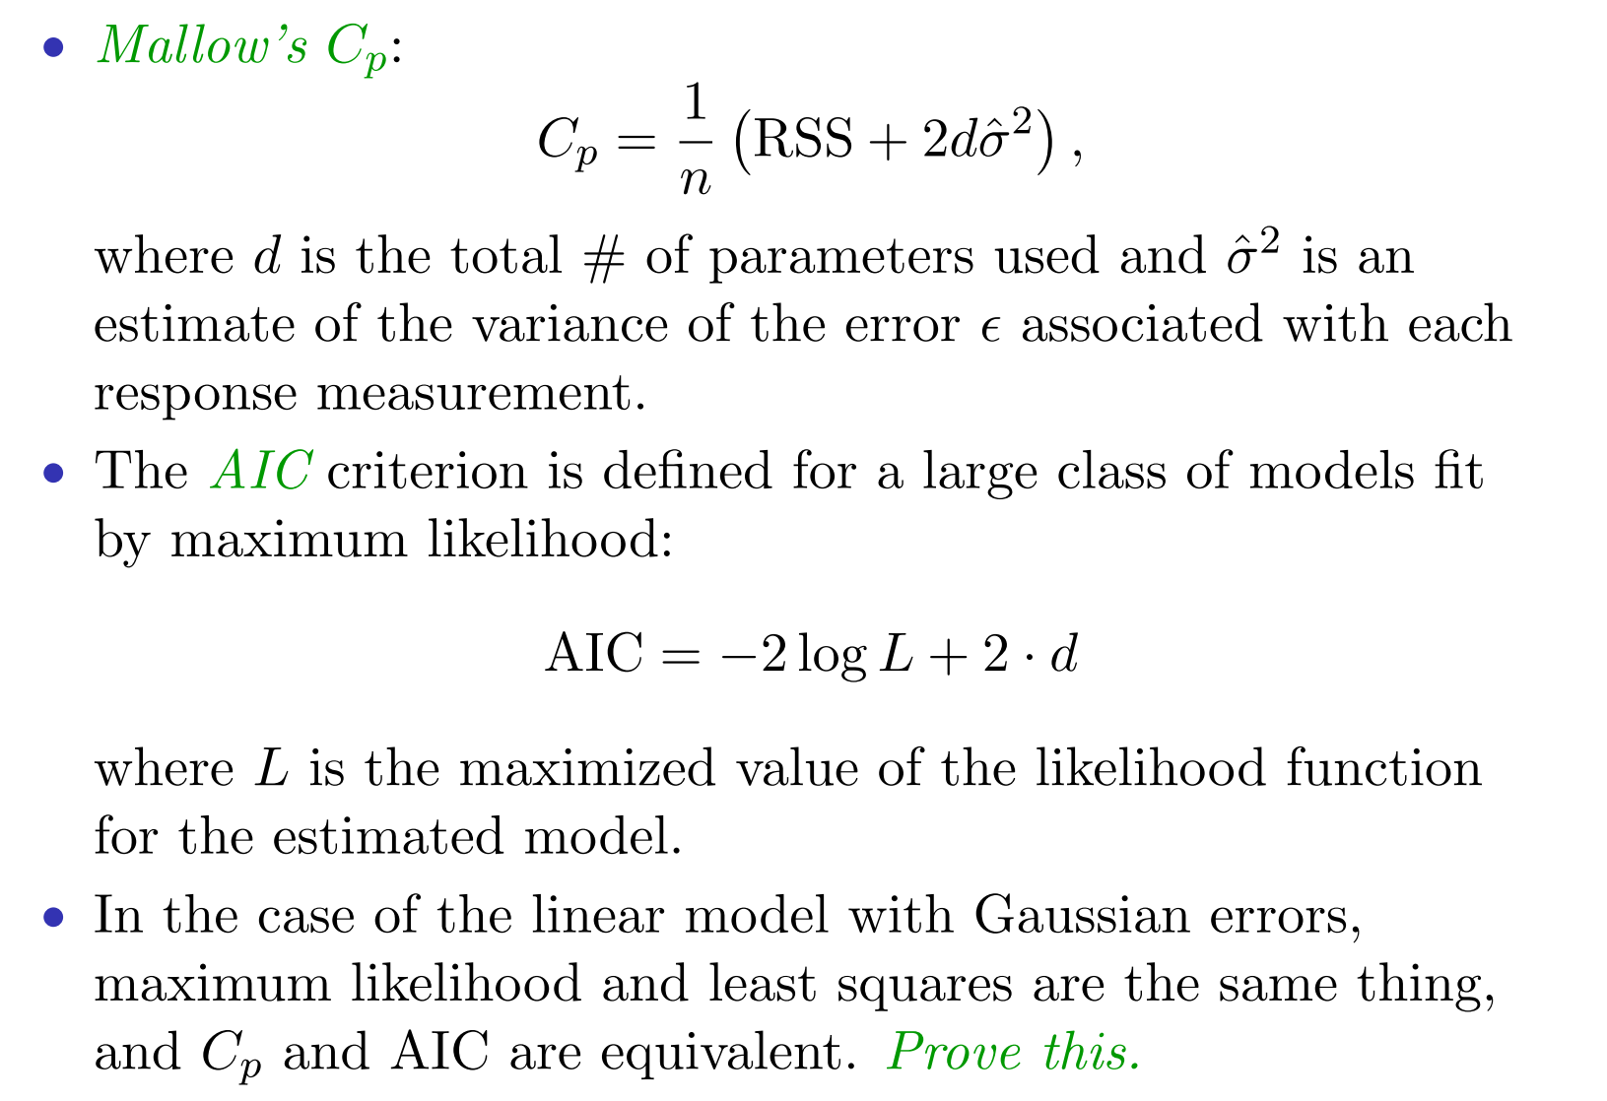
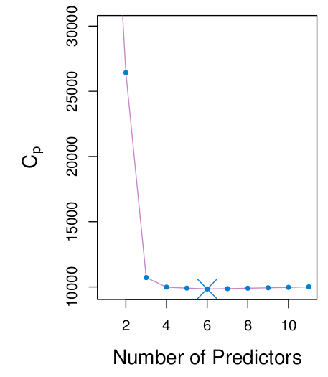
C_{p}

Slide 32
AIC

Slide 33
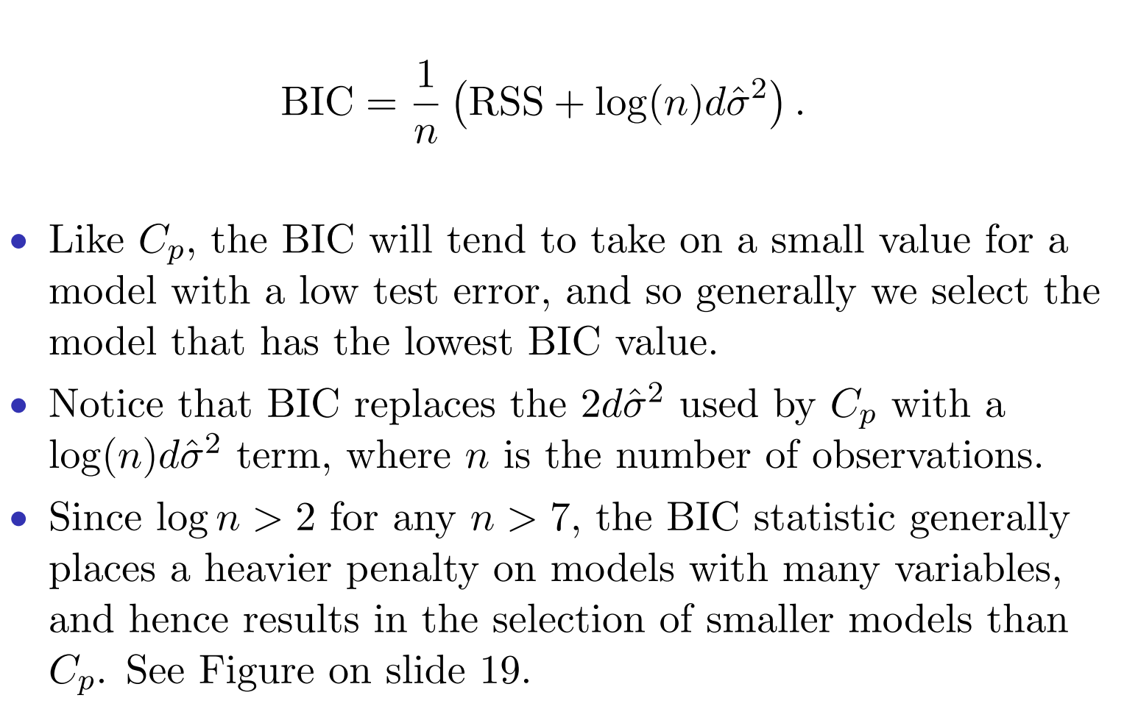
BIC

Slide 34
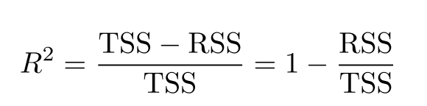
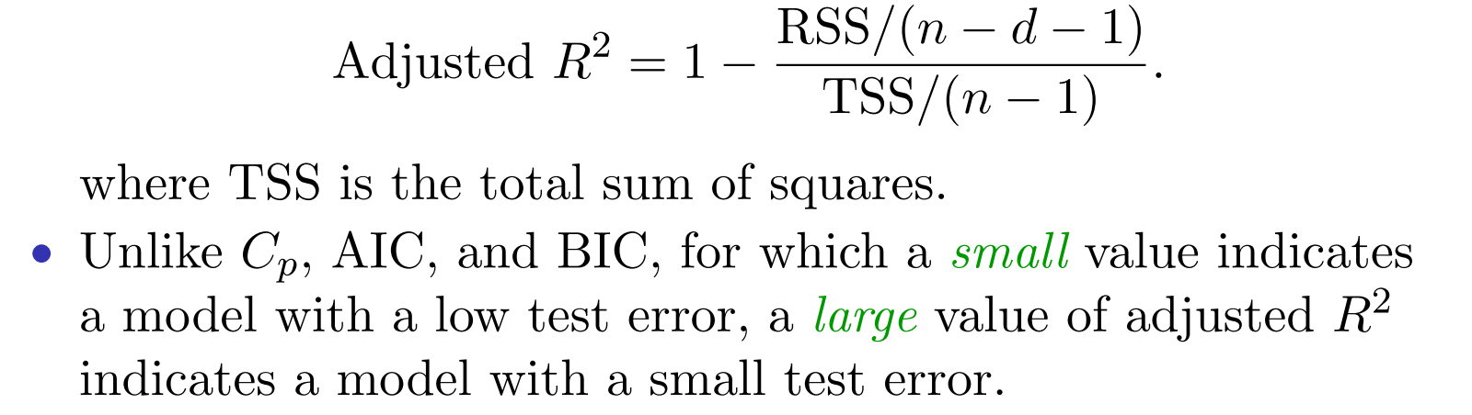
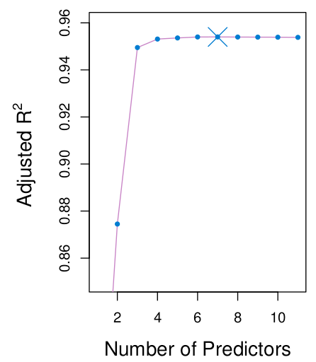
Adjusted R²

Slide 35
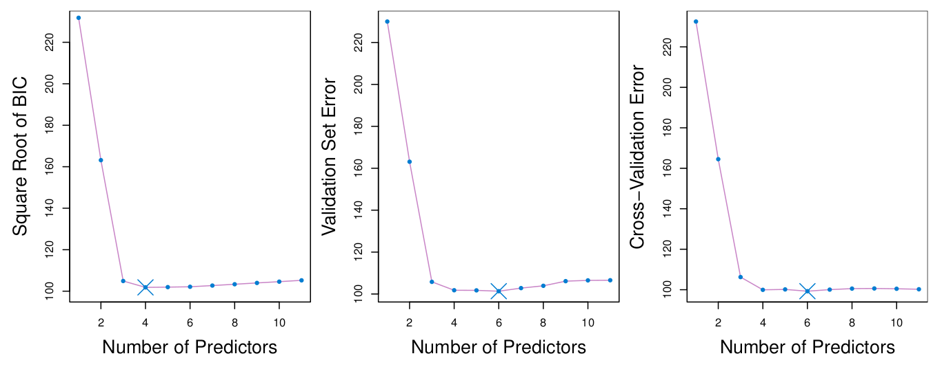
Comparisons

Slide 36
Bonus Quiz 11
We have two training points (x1 = 1, x2 = 1, y = 1) and (x1 = 2, x2 = 3, y = 2). We want to fit a linear model to minimize the MSE
What is the minimun MSE? What is the corresponding model?

