Slide 1

Module 5: Resampling Methods
Lecture 10
Feb 1st, 2023
Ch 5.1.1-2:

Slide 2
Recap
Logistic Regression
How to estimate Logistic Regression Model?
Confusion Matrix

Slide 3
Problems
1. How well is the machine learning method doing? (model assessment)
2. Which method is the best for our data?
3. How many features (which ones) to use？ （model selection）
4. What is the uncertainty in the learned parameters?
Methods;
Cross-validation and Bootstrap

Slide 4
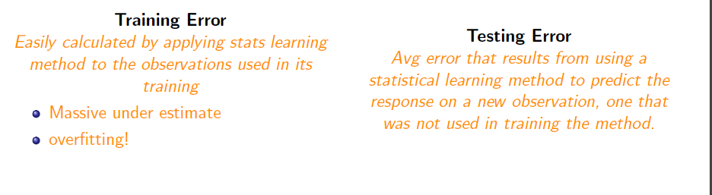
Training Error vs Test Error

Slide 5
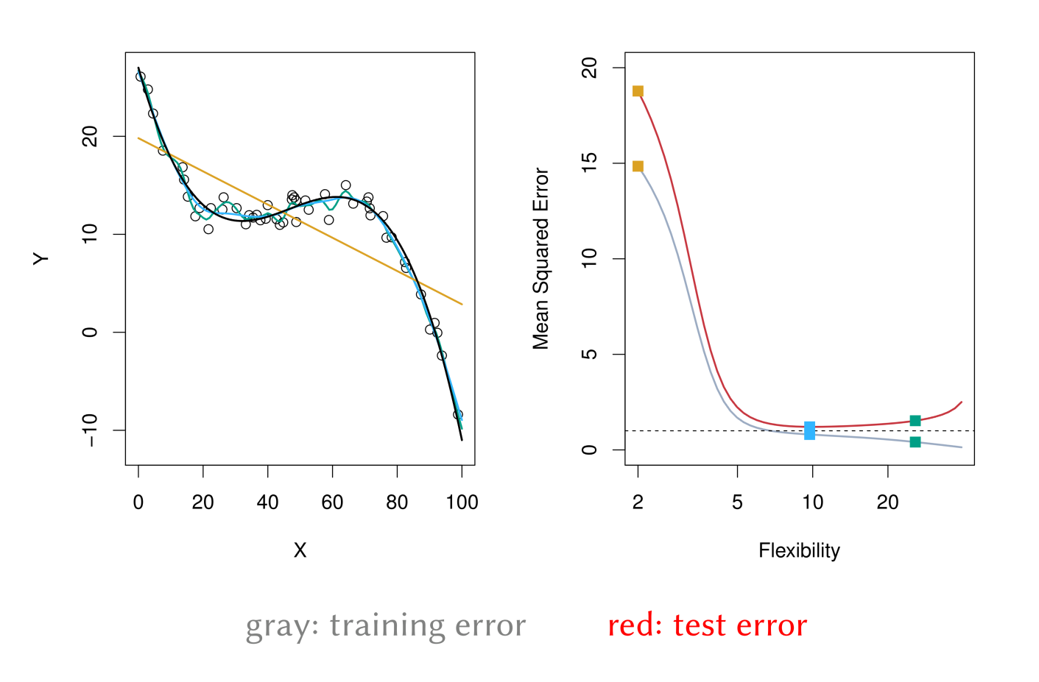
Training Error versus Test Error

Slide 6
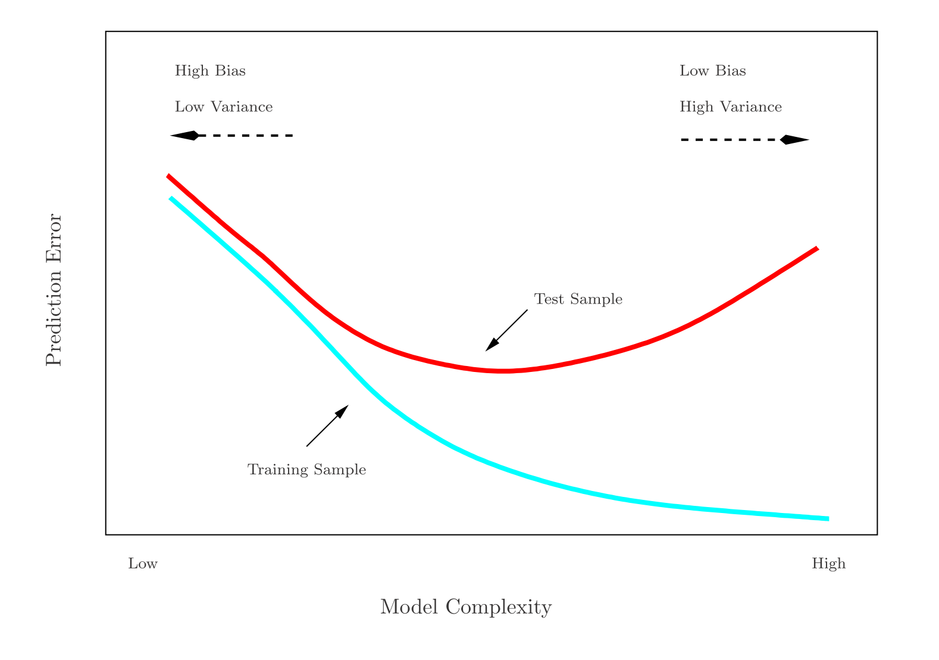
Training- versus Test-Set Performance

Slide 7
Estimate Prediction-error
Best: a large test set. If …, but..
Some methods make a mathematical adjustment to the
training error rate in order to estimate the test error rate.
These include the Cp statistic, AIC and BIC.
Estimate the test error by holding out a subset of the training observations from the ﬁtting process, and then applying the statistical learning method to those held out observations

Slide 8
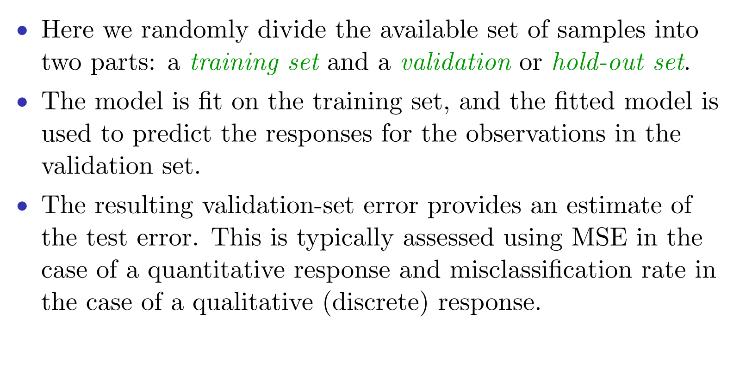
Validation-set Approach

Slide 9
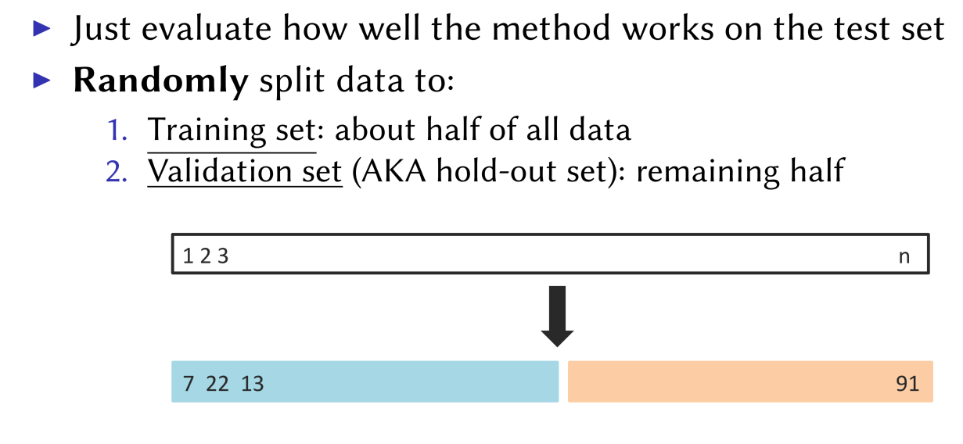
The Validation Process

Slide 10
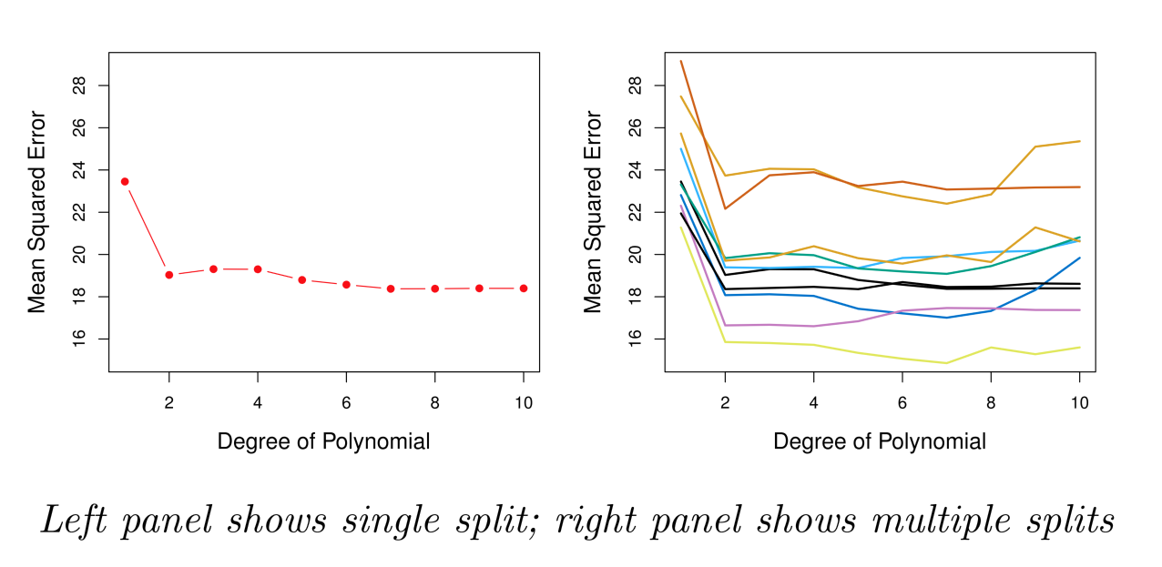
Example: Automobile Data
Sample size n = 392. Training set 196 obs, and validation set 196 obs.
Linear or higher-order polynomial term?

Slide 11
Example: Automobile Data
Sample size n = 392. Training set 196 obs, and validation set 196 obs.
Linear or higher-order polynomial term?

Slide 12
Drawbacks of Validation Set Approach
Highly variable (imprecise) estimates : Each line shows validation error for one possible division of data
Only subset of data is used (validation set is excluded – only about half of data is used)
This suggests that the validation set error may tend to overestimate the test error for the model ﬁt on the entire data set. Why?

Slide 13
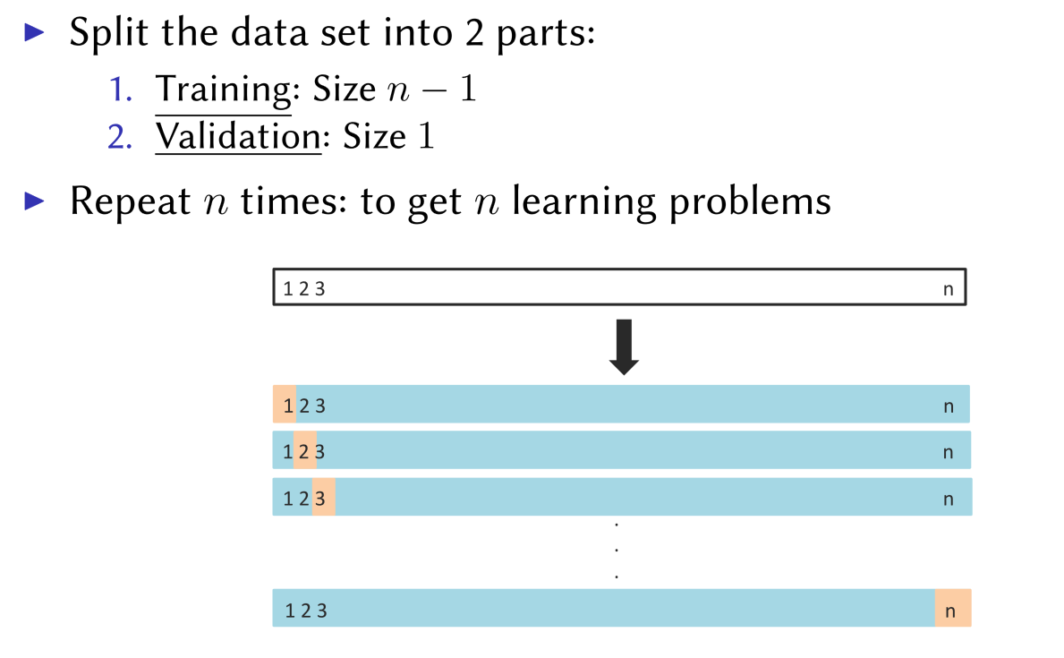
Leave-One-Out Cross-Validation (LOOCV)

Slide 14
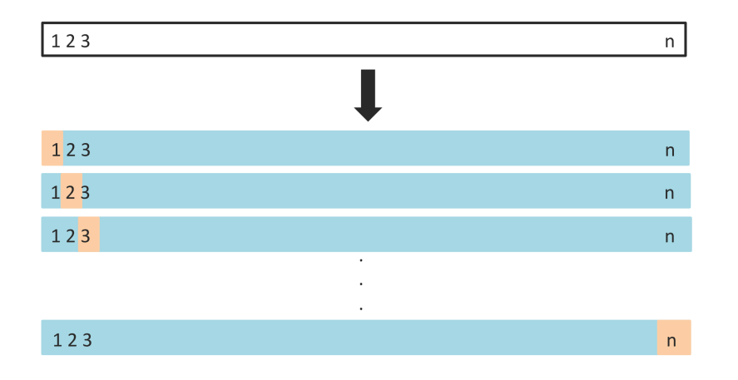

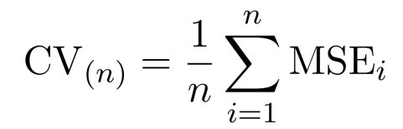
Leave-one-out
Get n learning problems
Train on n-1 instances (blue)
Test on 1 instance (orange)
LOOCV estimate

Slide 15
Leave-one-out vs Validation Set
Advantages
Using almost all data not just half
Stable results: No randomness
Evaluation is performed with more testing data
Disadvantages
Can be very computationally expensive: fit the model n times
LOOCV typically doesn’t shake up the data enough. The estimates from each fold are highly correlated and hence their average can have high variance.

Slide 16
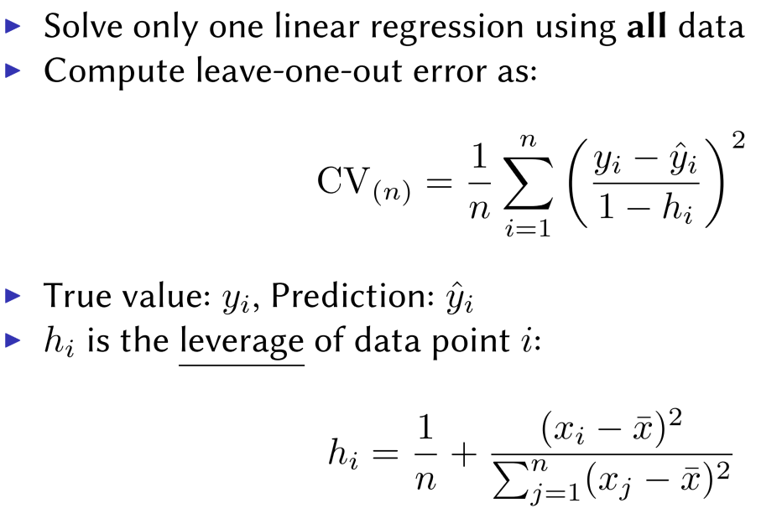
Speeding Up Leave-One-Out
Solve each fit independently and distribute the computation.
Linear regression

Slide 17
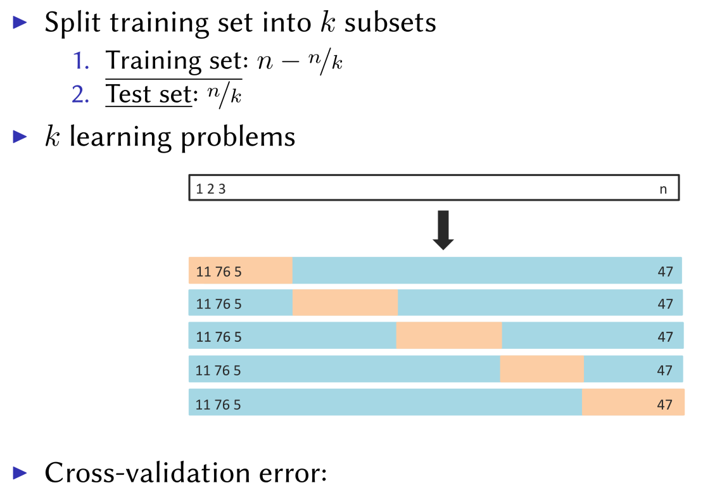
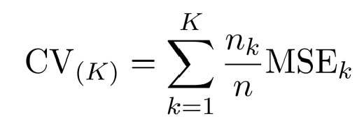
K-fold Cross-validation
Hybrid between validation set and LOOCV

Slide 18
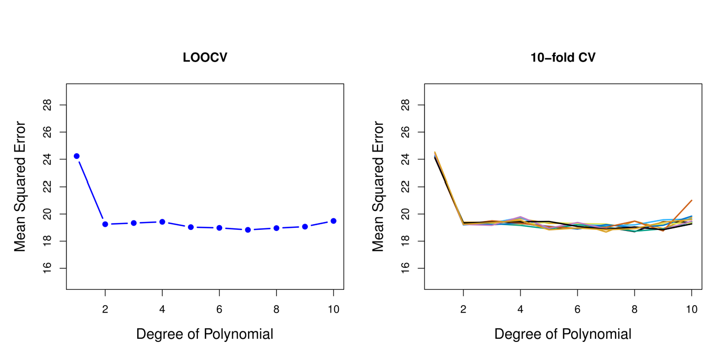
Cross-validation vs LOOCV

Slide 19
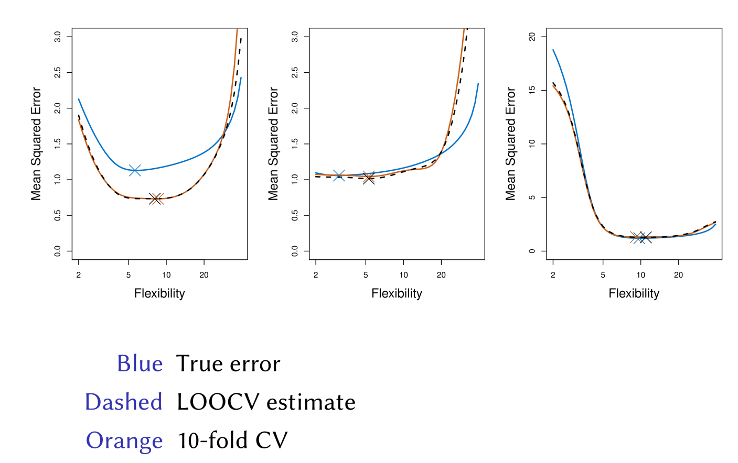
Simulated Results

Slide 20
Other Issues with Cross-validation
Since each training set is only (K − 1)/K as big as the original training set, the estimates of prediction error will typically be biased upward. Why?
This bias is minimized when K = n (LOOCV), but this estimate has high variance.
K = 5 or 10 are common choices

Slide 21
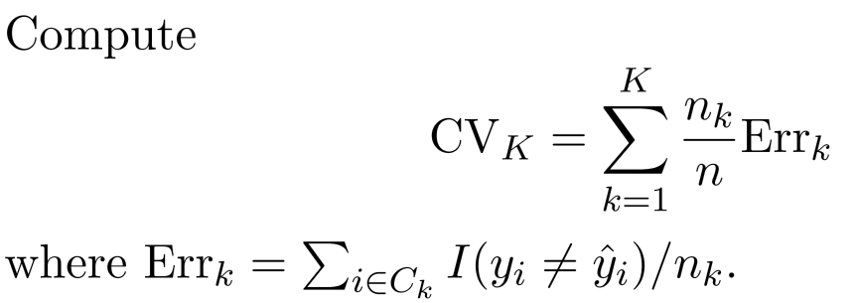
CV for Classification
We divide the data into K roughly equal-sized parts

Slide 22
Example: GWAS
Sample size n = 50, number of predictors (SNPs) p = 5000; Predictor heart attach after age of 60.
Step 1: Select the top 100 predictors having the largest correlation with the class labels
Step2: We then apply a classifier (logistic regression) using only these 100 predictors
How do we estimate the test set performance of this classifier?

Slide 23
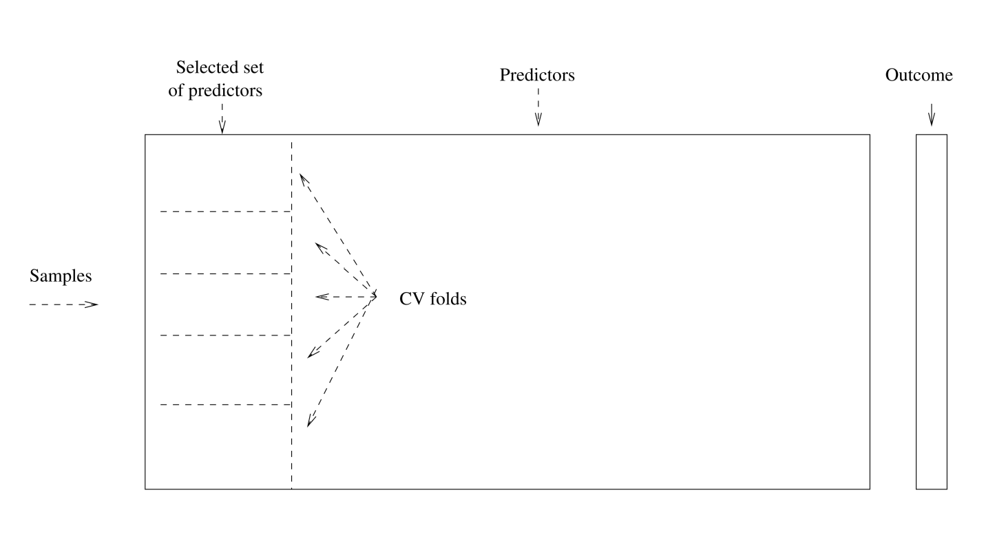
Example: GWAS
No ！！！

Slide 24
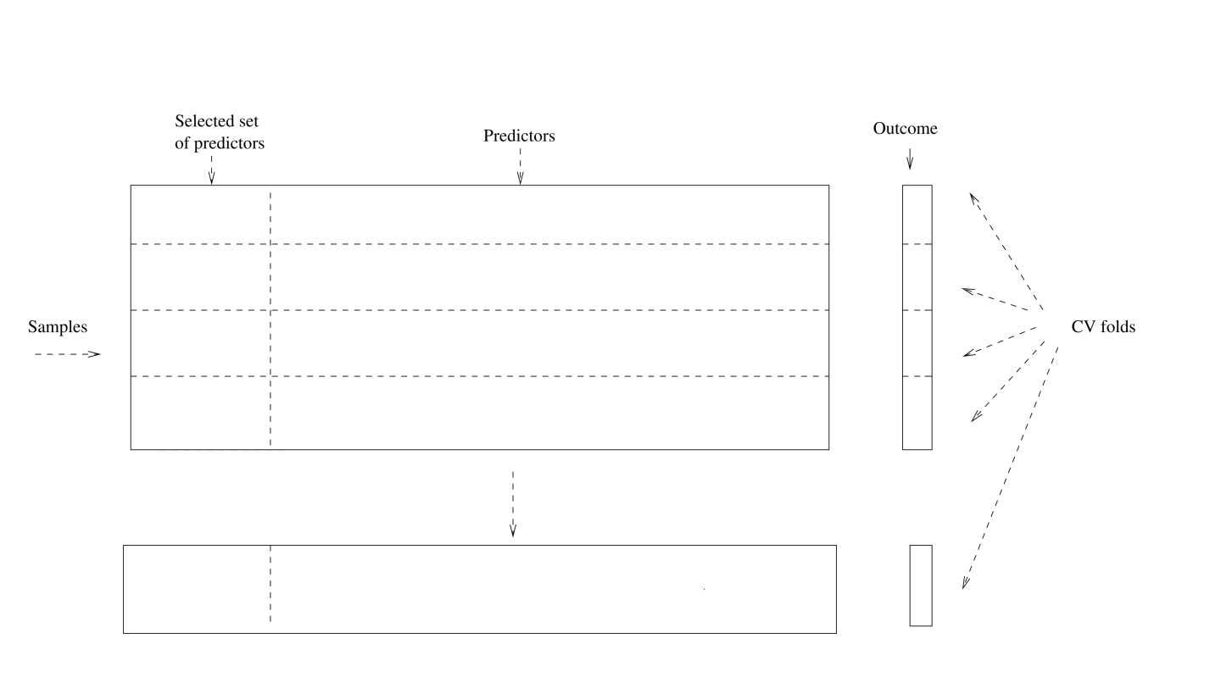
Example: GWAS ------Right Way

Slide 25
Bootstrap is used to quantify the uncertainty associated with an estimator or machine learning method. It can provide an estimate of the standard error of a coefficient. Then we can du hypothesis test and confidence interval.
Bootstrap

Slide 26

Bootstrap： Finance Example
To invest two stocks that yield return of X and Y, where X and Y are random.
We will invest a fraction of our money in X and the rest in Y.
Assume both stock have the same average return over the years. What criteria should we use for allocate the investment?

Slide 27

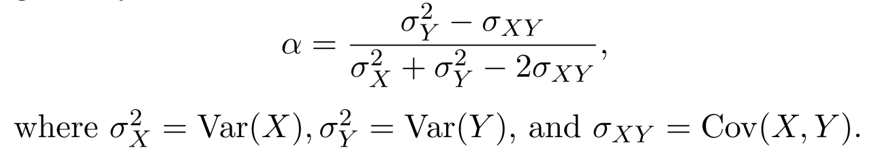
Bootstrap： Finance Example
We want to minimize the total risk or variance of our investment.
The solution is

Slide 28
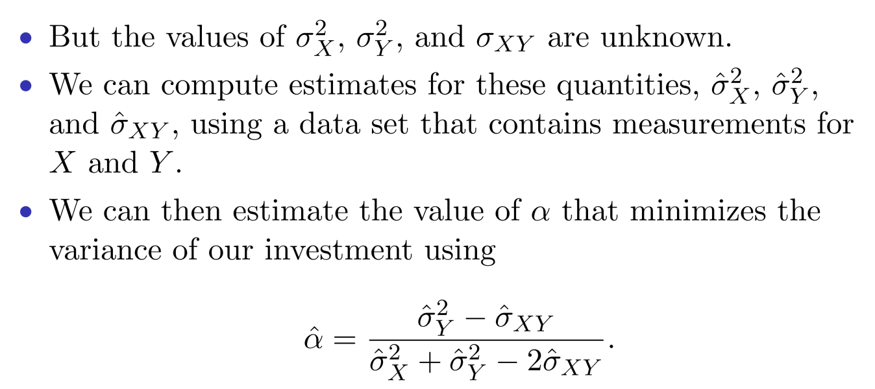
Finance Example: Simulations

Slide 29
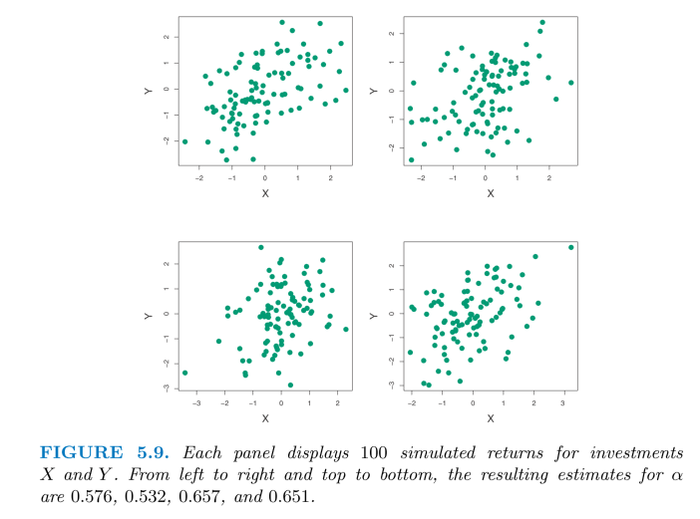
Finance Example: Simulations

Slide 30
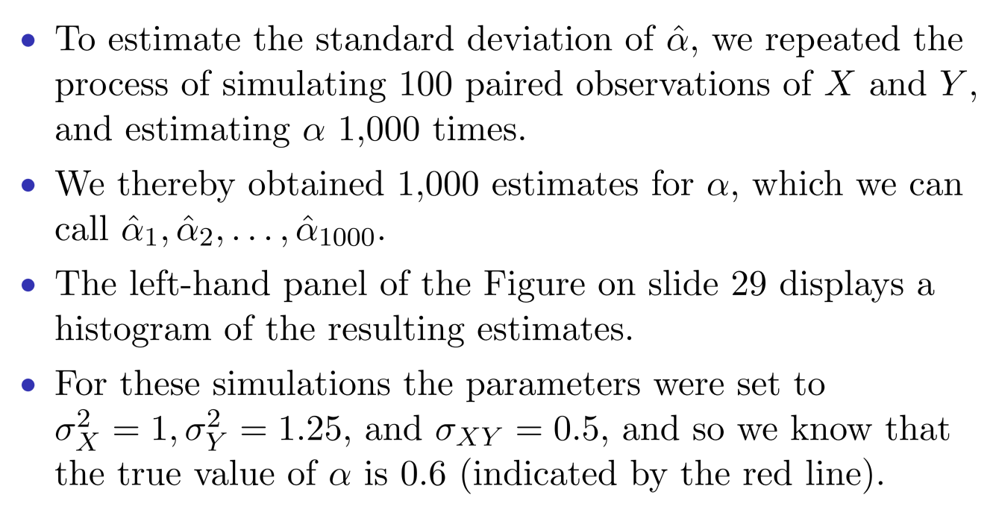
Finance Example: Simulations

Slide 31
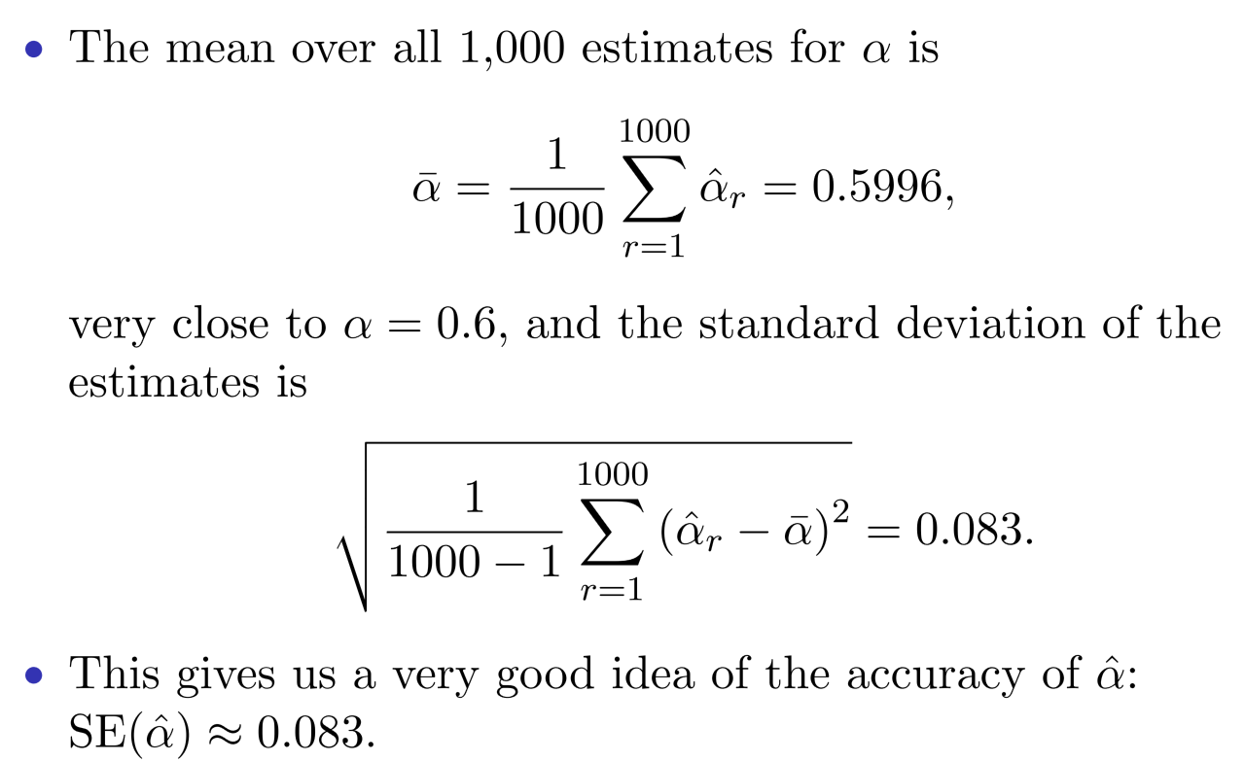
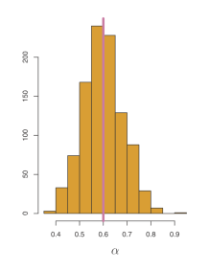

Slide 32
Finance Example: Reality
The procedure outlined above cannot be applied, because for real data we cannot generate new samples from the original population.
The bootstrap approach allows us to use a computer to mimic the process of obtaining new data sets.
Rather than repeatedly sampling from the population, we instead obtain distinct data sets by repeatedly sampling observations from the original data set with replacement.
Each of these “bootstrap data sets” is created by sampling with replacement, and is the same size as our original dataset. Some observations may appear more than once in a given bootstrap data set and some not at all.

Slide 33
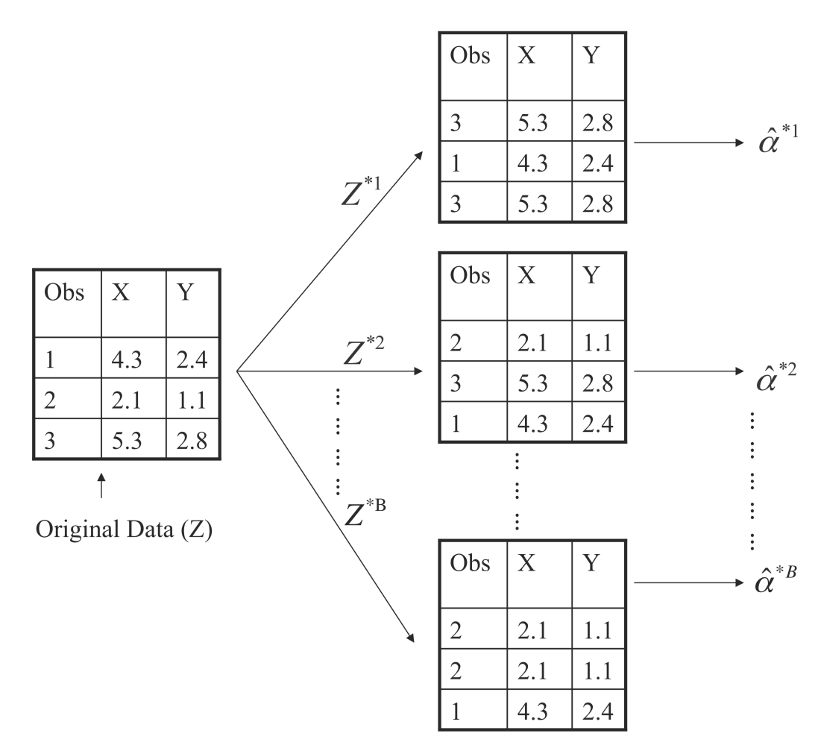
Boostrap Illustration

Slide 34
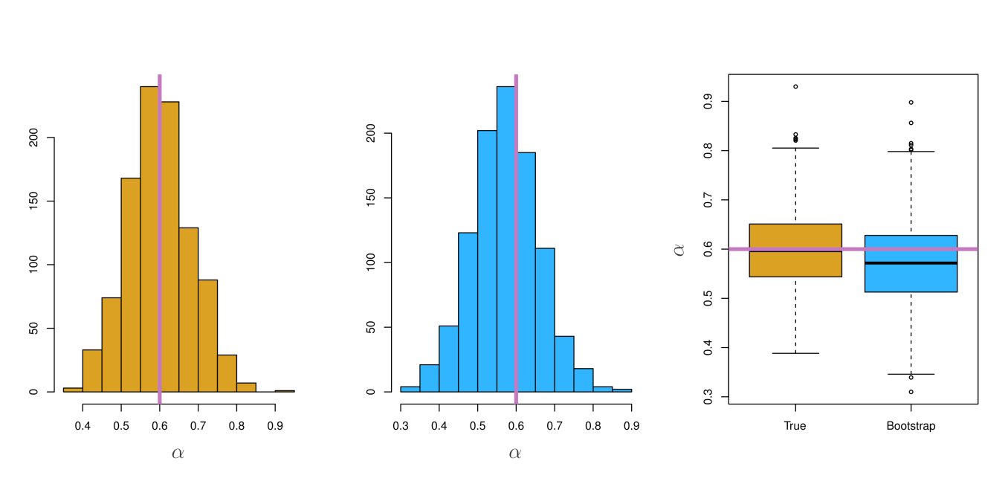
Boostrap Results

Slide 35
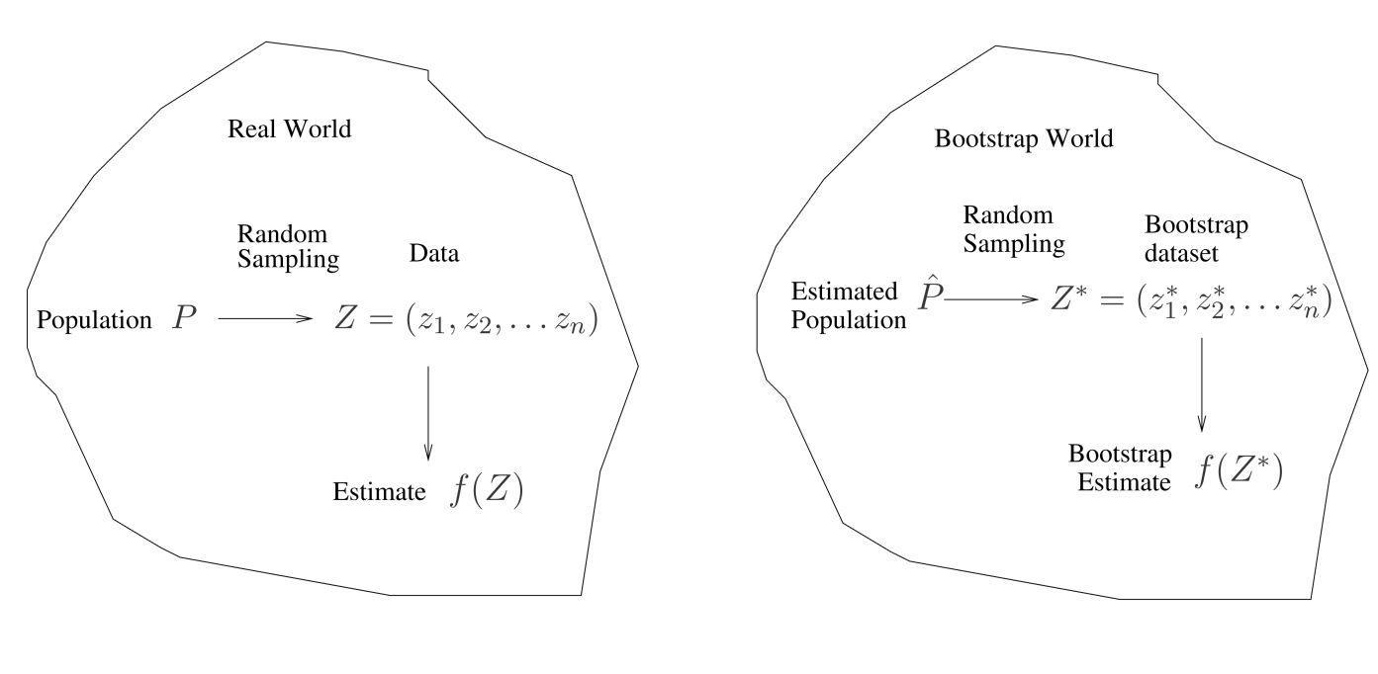
A General Picture for the Bootstrap

Slide 36
Boostrap for Prediction Error?
Can we use one boostrap dataset as training and the original data set as test set?

Slide 37
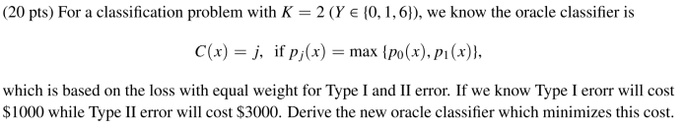
Bonus Quiz 13

Slide 38
Bonus Quiz 15
When sample size n is large，we know a bootstrap dataset will contain 1 – e⁻¹ = 63.2% of original data. Write a code to demonstrate it using n = 1000000

