Slide 1

Module 3: Linear Regression
Lecture 7
Jan 25th, 2023

Slide 2
Some Important Questions
Is at least one of the predictors useful in predicting the response?
Do all the predictors help to explain Y, or is only a subset of the of the predictors useful?
Given a set of predictor values, what response value should we predict, and how accurate is our prediction?

Slide 3
Confidence Interval and Prediction Interval
Confidence interval for a fixed x: a random interval which can cover f(x) with probability 95%
Prediction interval for a fixed x : a random interval which can cover a new random responds Y with probability 95%

Slide 4
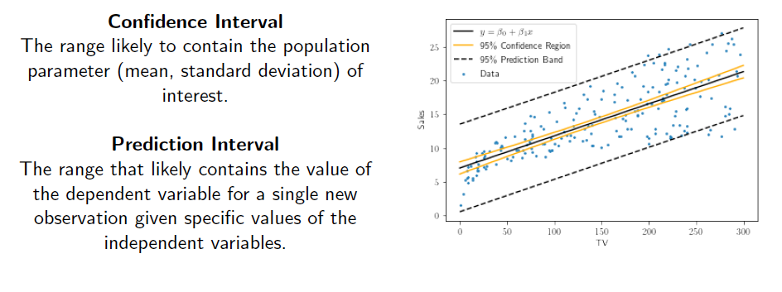
Confidence Interval and Prediction Interval
Confidence interval for a fixed x: a random interval which can cover f(x) with probability 95%
Prediction interval for a fixed x : a random interval which can cover a new random responds Y with probability 95%

Slide 5
Other Considerations
Quantitative Qualitative Predictors

Slide 6
Other Considerations
Qualitative Predictors
Some predictors are not categorical predictors or factor variables.
For example: gender, student (student status), status (marital status), and ethnicity (Caucasian, African American (AA) or Asian).

Slide 7
Qualitative Predictors
Example: investigate diﬀerences in credit card balance between males and females, ignoring the other variables.

Slide 8
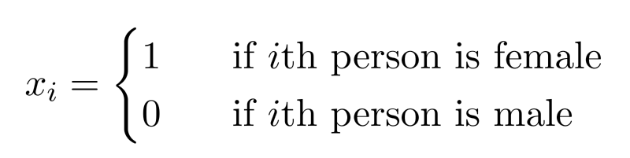
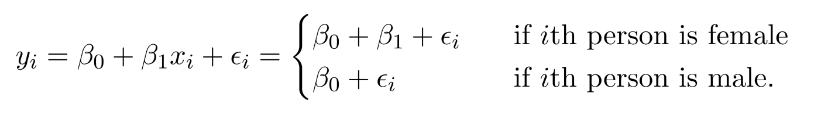
Qualitative Predictors
Example: investigate diﬀerences in credit card balance between males and females, ignoring the other variables.
We create a new variable
Resulting model:
Interpretation?

Slide 9
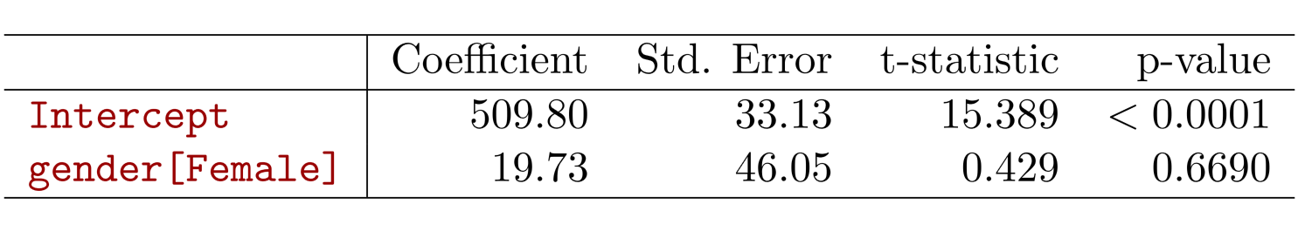
Credit card data

Slide 10
More than two levels?
For the ethnicity: Asian, Caucasian, African American

Slide 11
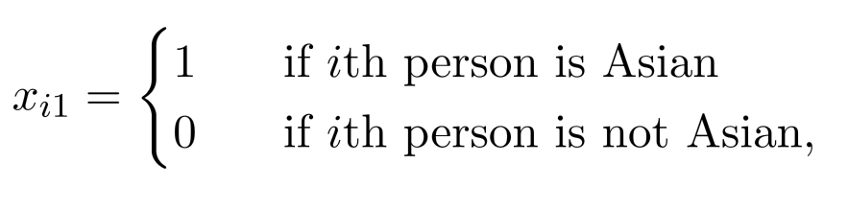
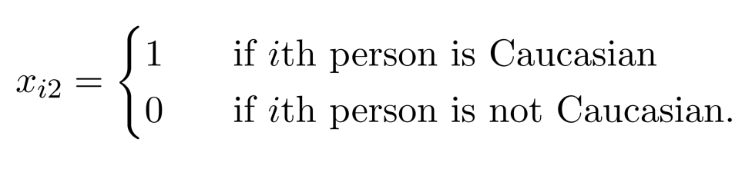
More than two levels?
For the ethnicity: Asian, Caucasian, African American
We will create two dummy variables.

Slide 12
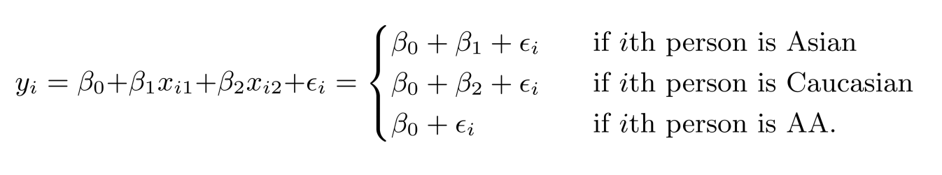
More than two levels?
Then we have the following model
There will always be one fewer dummy variable than the number of levels. The level with no dummy variable African American in this example — is known as the baseline.

Slide 13
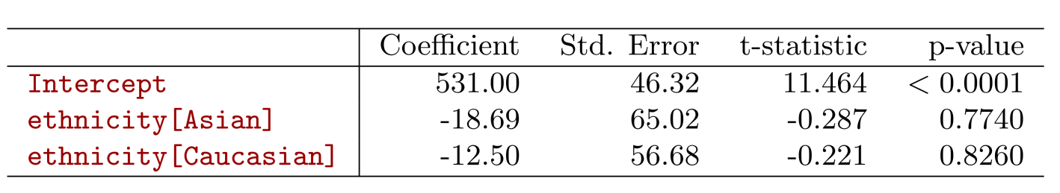
More than two levels?

Slide 14

Extensions of the Linear Model
Interactions
In the advertising data, we assume the effect on sales of increasing one medium is independent of other media.
But suppose that spending money on radio advertising increases the effectiveness of TV advertising. How to model it?

Slide 15
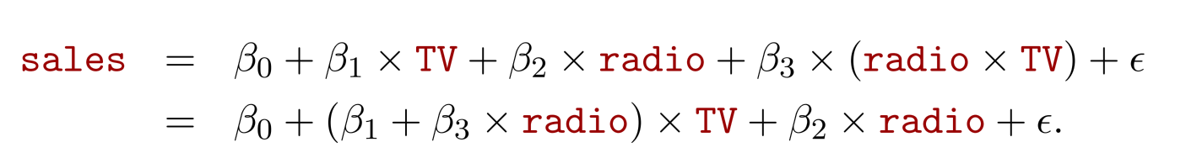
Extensions of the Linear Model
Interactions
In the advertising data, we assume the effect on sales of increasing one medium is independent of other media.
But suppose that spending money on radio advertising increases the effectiveness of TV advertising. How to model it?
This is called an interaction effect.

Slide 16
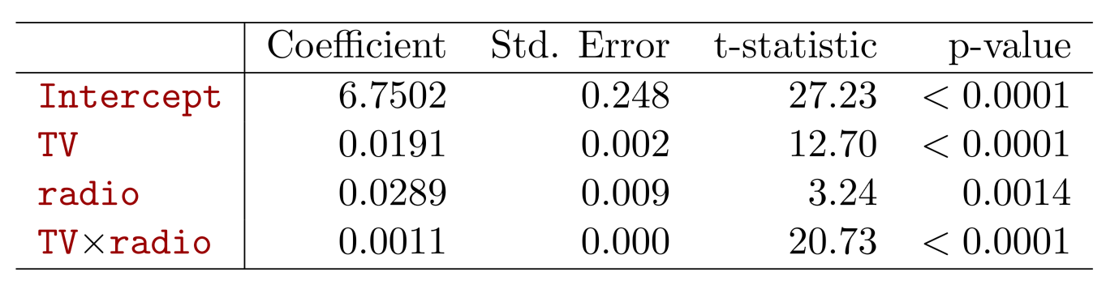

Interpretation
The p-value for the interaction term TV × radio is extremely low, indicating that there is strong evidence for
The R² for the interaction model is 96.8%, compared to only 89.7% for the model that predicts sales using TV and radio without an interaction term.
This means that (96.8 − 89.7)/(100 − 89.7) = 69% of the variability in sales that remains after ﬁtting the additive model has been explained by the interaction term.

Slide 17
Interpretation
The coeﬃcient estimates in the table suggest that an increase in TV advertising of $1, 000 is associated with increased sales of
An increase in radio advertising of $1, 000 will be associated with an increase in sales of

Slide 18
Hierarchy
Sometimes it is the case that an interaction term has a very small p-value, but the associated main eﬀects (in this case, TV and radio) do not.
The hierarchy principle:
If we include the interaction term, we should include the main effects no matter what!

Slide 19
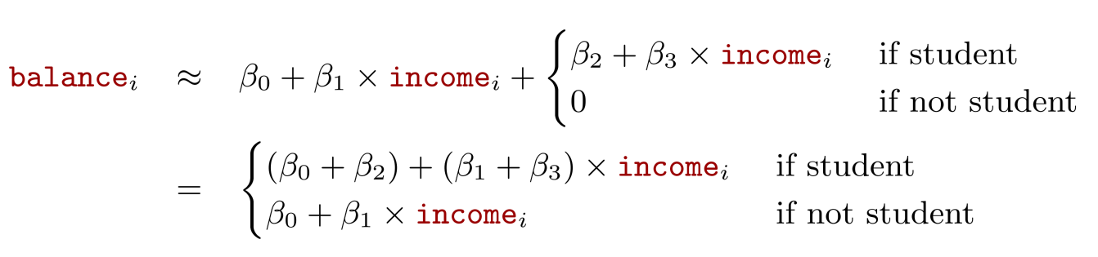
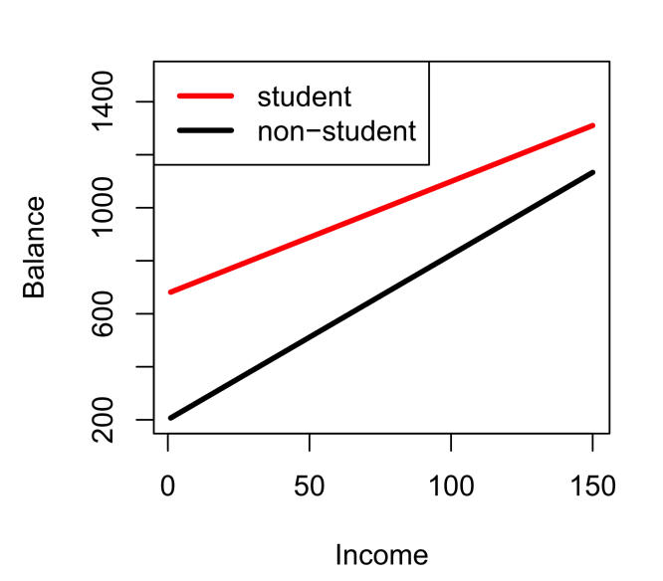
Qualitative and quantitative variables?
Consider the Credit data set, and suppose that we wish to predict balance using income (quantitative) and student (qualitative). With interactions, we have

Slide 20
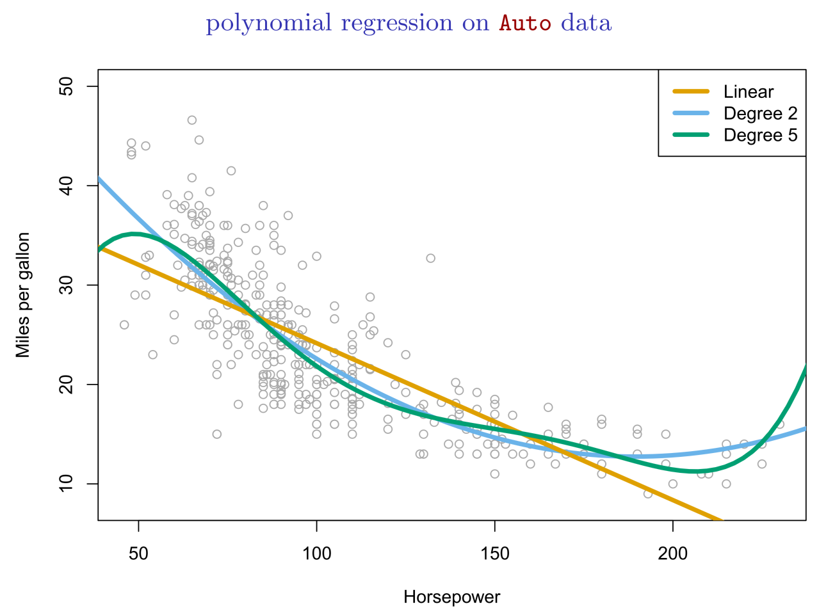
Non-linear eﬀects of predictors

Slide 21
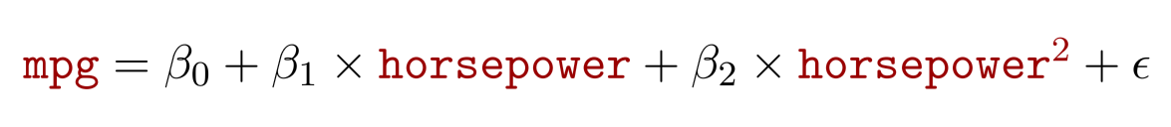
Non-linear eﬀects of predictors

Slide 22
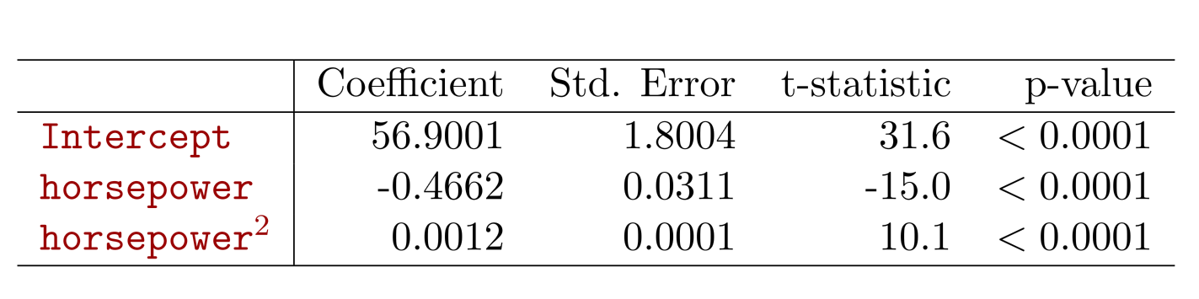
Non-linear eﬀects of predictors

Slide 23



Bonus Quiz 8
Assume we have the following model
Here X is height with unit of meter.
Now we can have another model
Here X* is also height with unit of centimeter. What is the relationship between

