Slide 1

Module 4: Classification
Lecture 8
Jan 27th, 2023

Slide 2
Recap
Qualitative Predictors (One-hot encoding)
Interactions (Hierarchy Principle)
Beyond linearity

Slide 3
Classification Problems
Here the response variable Y is qualitative.

Slide 4



Classification Problems
Here the response variable Y is qualitative — e.g. email is one of
(ham=good email), digit class is one of . Our goals are to:
Build a classifier C(X) that assigns a class label to a feature unlabeled observation X.
Assess the uncertainty in each classification.
Understand the roles of the different predictors among

Slide 5

Classification: some details
How to measure the performance of a classifier in a training dataset Tr?

Slide 6
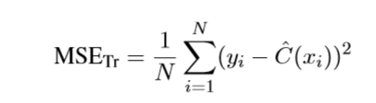
Classification: some details
How to measure the performance of a classifier in a training dataset Tr?
Can we define it as ? ?

Slide 7
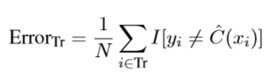




Classification: some details
How to measure the performance of a classifier in a training dataset Tr? We use the misclassification error rate:
where is an indicator variable that equals 1 if and 0 otherwise
As in the regression setting, we are most interested in the testing errors associated
with a testing set :
.

Slide 8

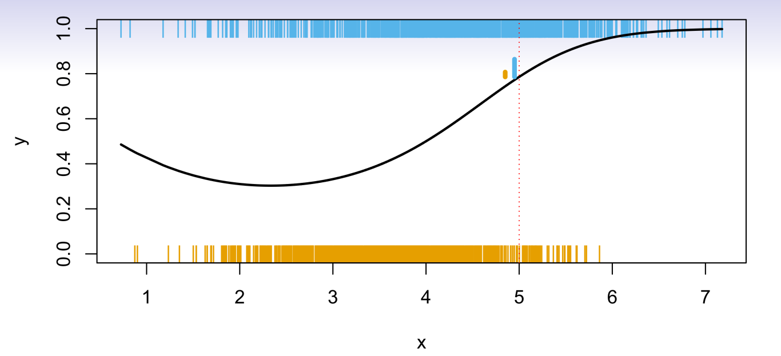
Ideal Classifier
Is there an ideal C(X)?
Suppose the K elements in are numbered 1, 2, …, K. Let
These are the conditional class probabilities at x;
Then the Bayes classifier at x is
, which is the optimal classifier.

Slide 9
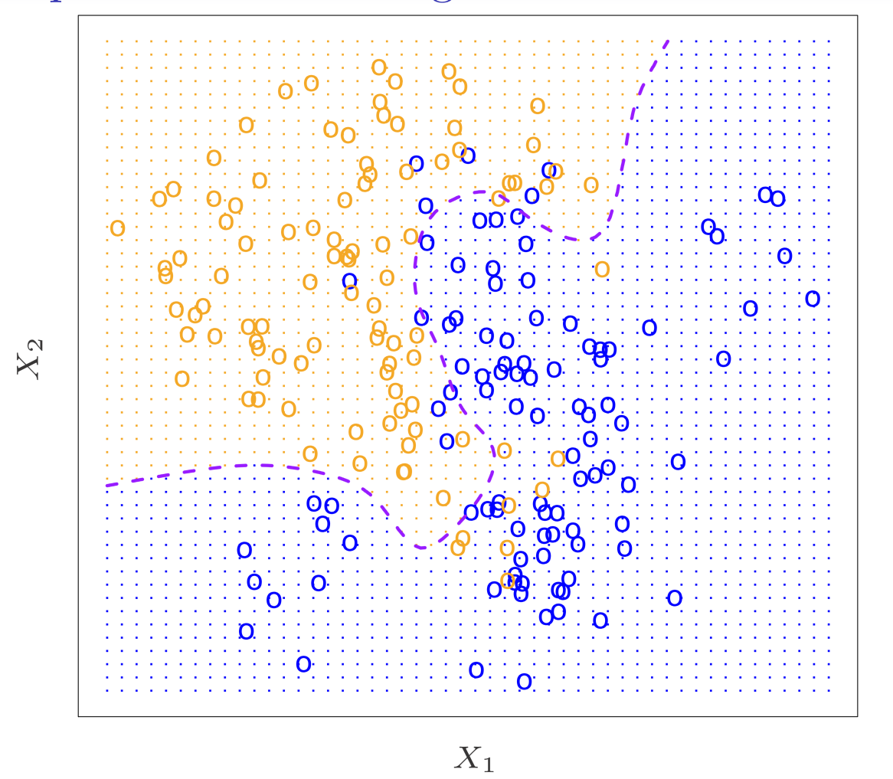
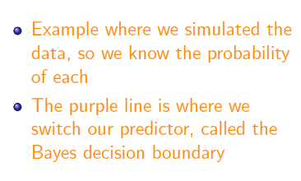
Bayes decision Boundary

Slide 10
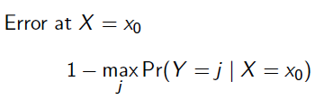
Bayes Error rate

Slide 11
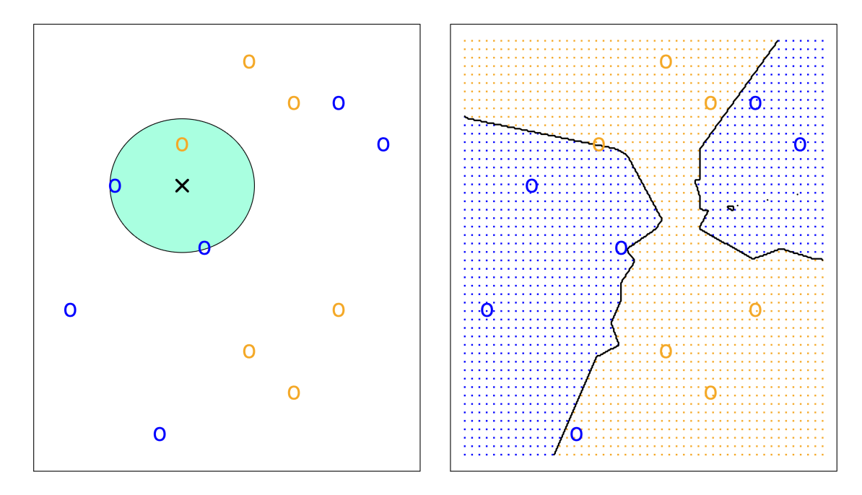
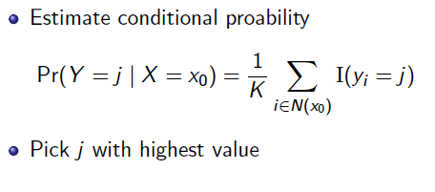
K-nearest neighbors Classifier
Idea: Use similar training points when making predictions
What is/are the parameters?
Is it parametric or non-parametric?

Slide 12
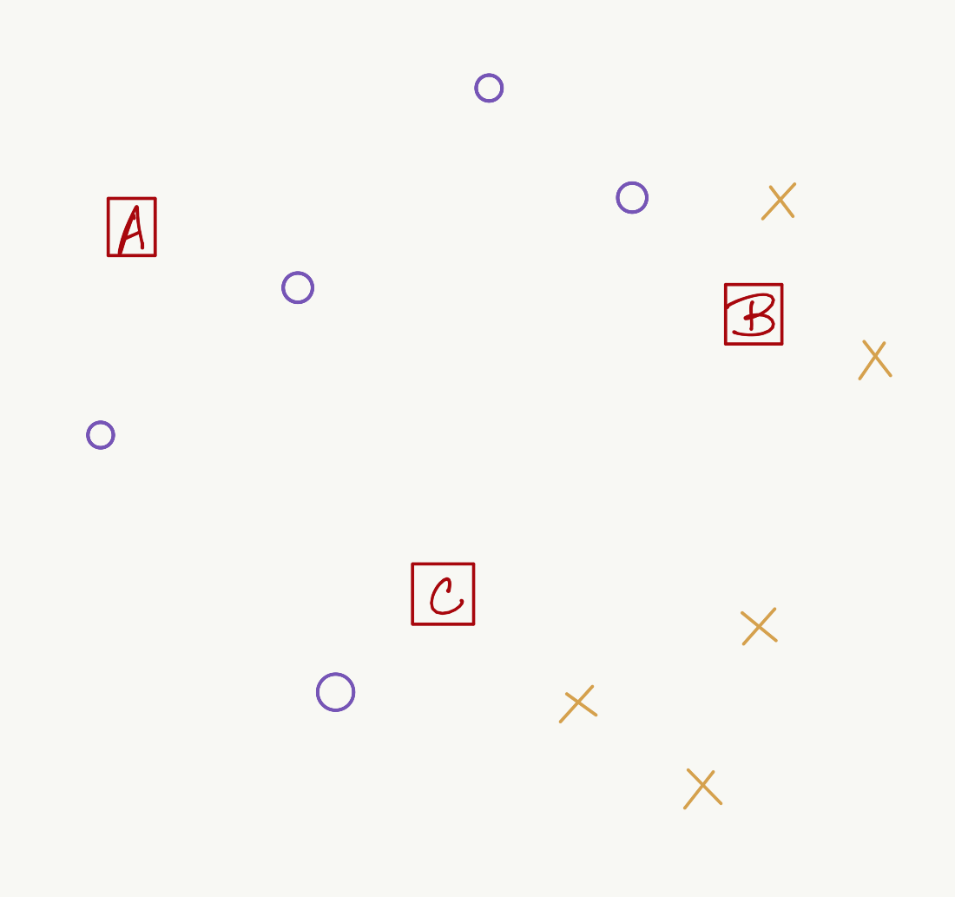
Example
Here label is shown by O vs X. What are the knn predictions for points A, B and C for k = 1
or k = 3?

Slide 13
Example
Here label is shown by O vs X. What are the knn predictions for points A, B and C for k = 1
or k = 3?

Slide 14
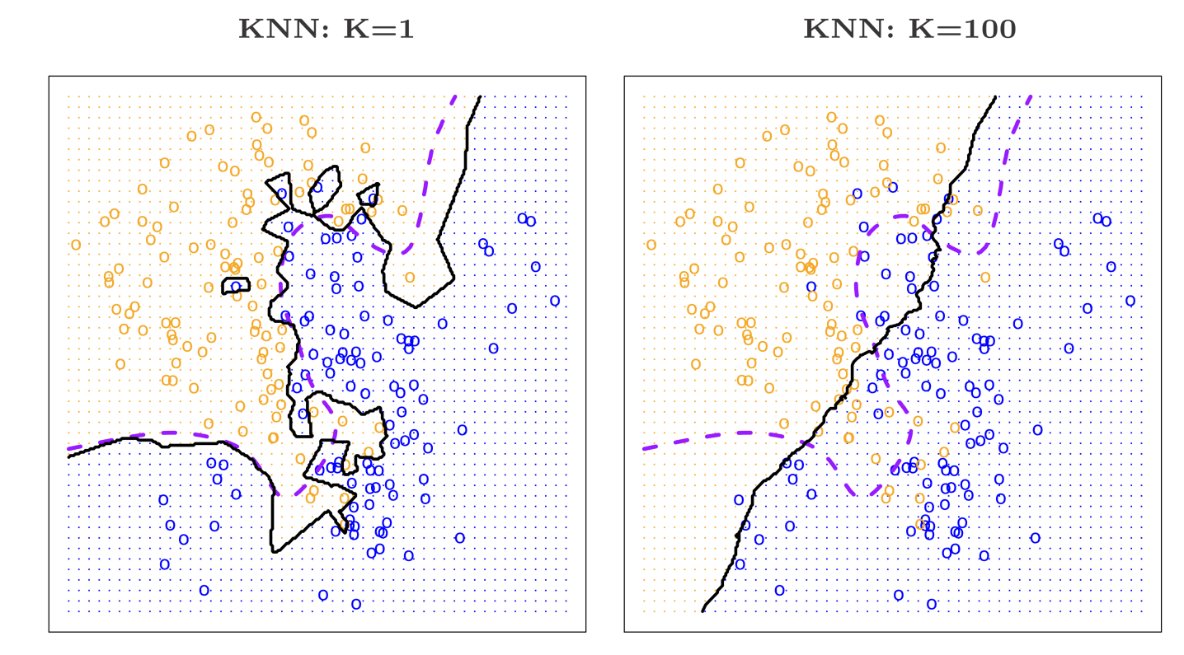
Tradeoff

Slide 15
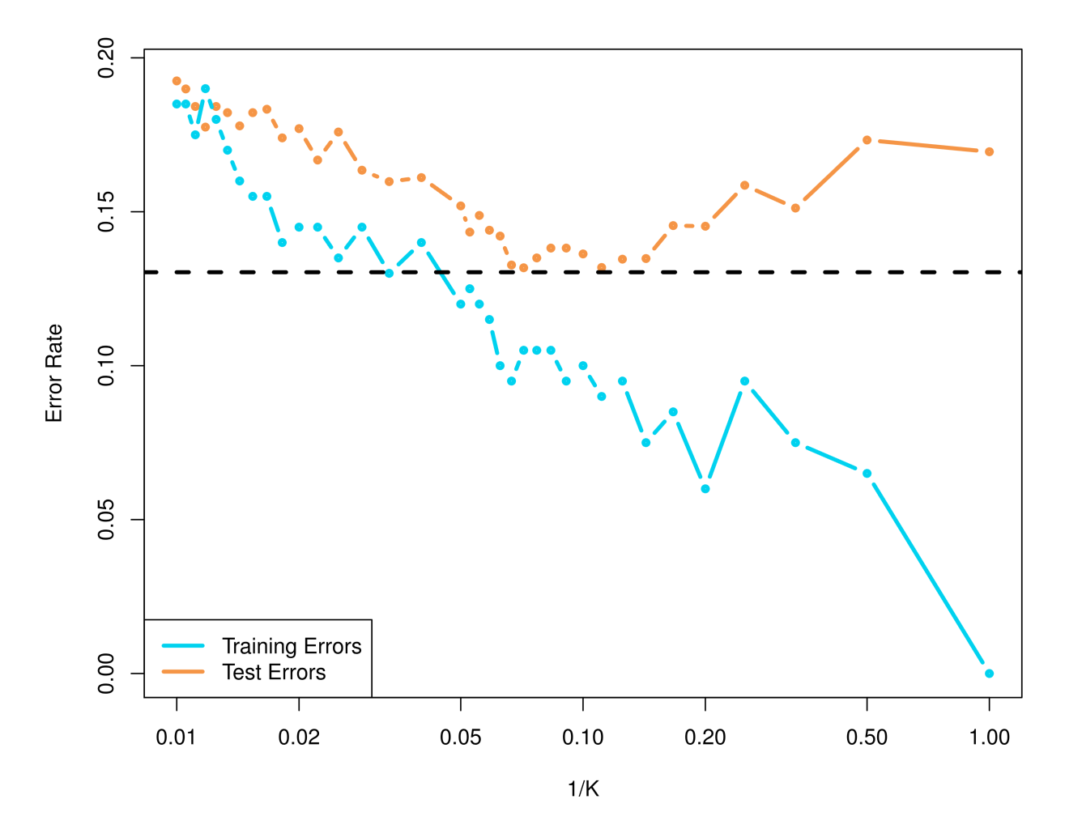
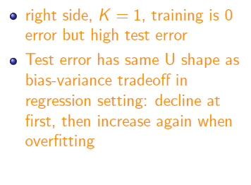
KNN: Training and Test Errors

Slide 16
Logistic Regression

Slide 17
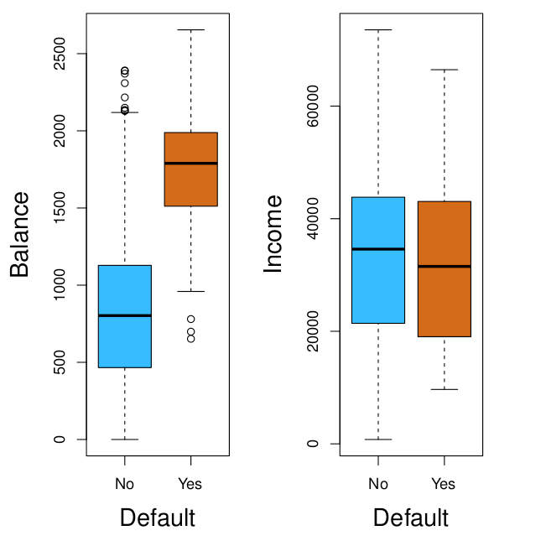
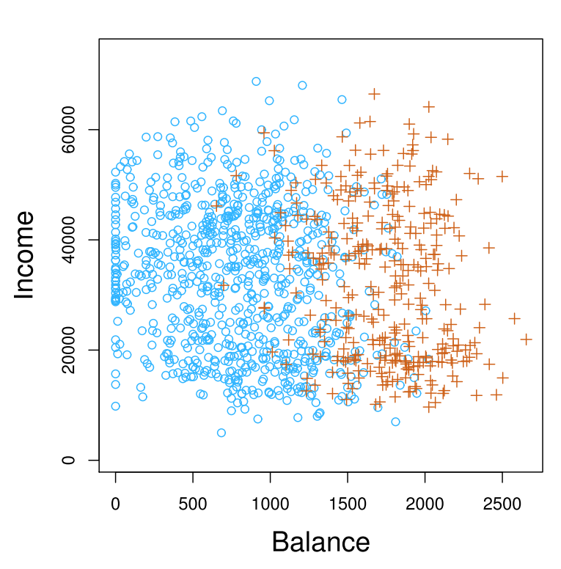

Example: Predicting Default

Slide 18
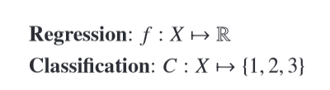
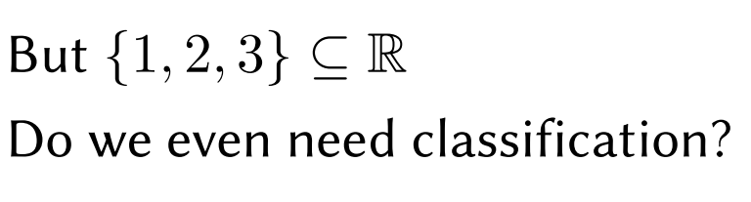
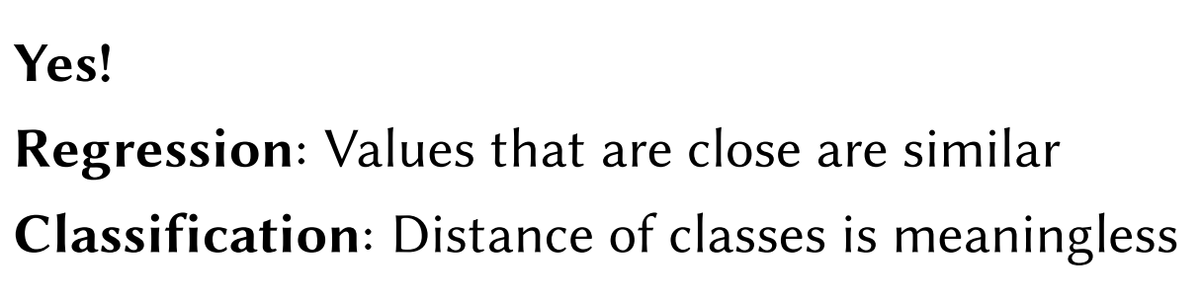
Can we use regression?

Slide 19
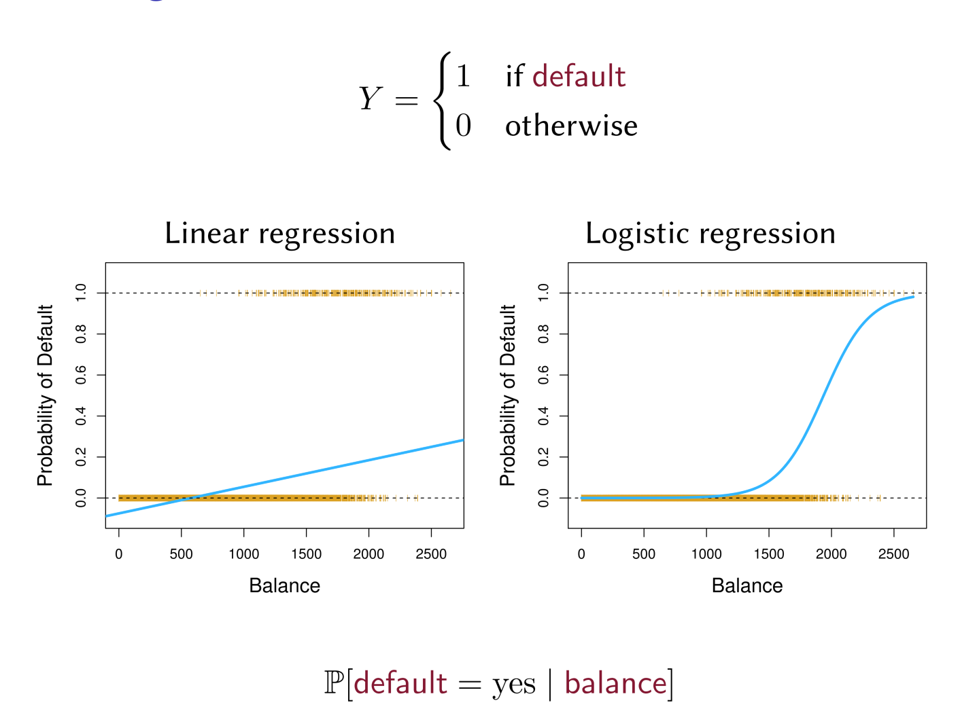

Linear Regression for 2-class Classification ?

Slide 20
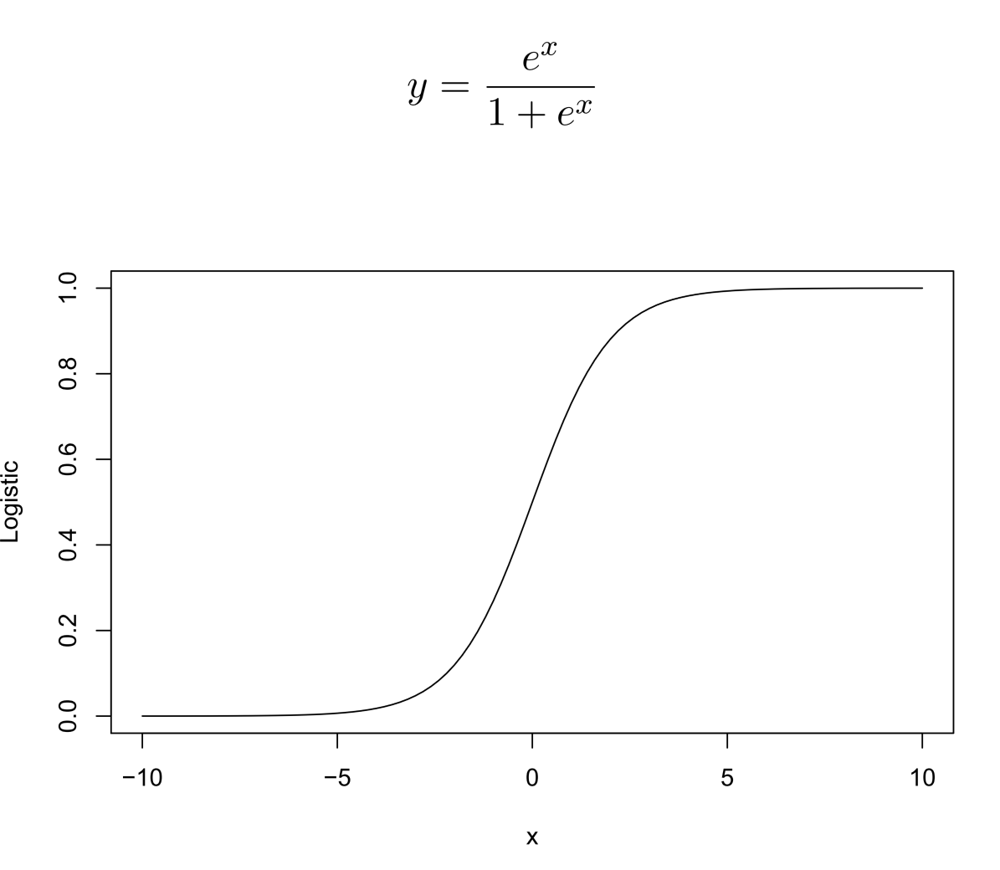
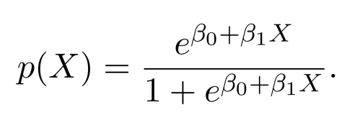
Logistic Function

Slide 21
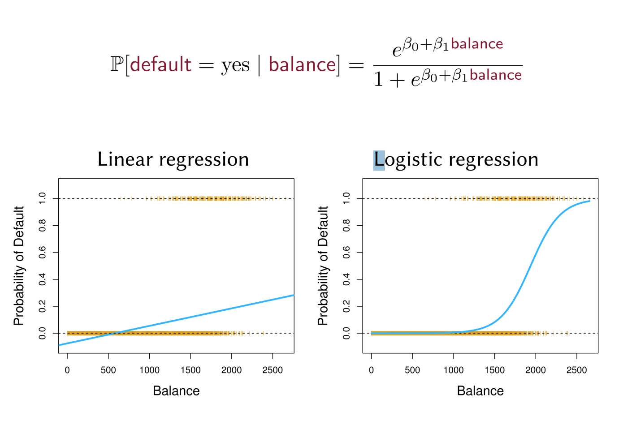
Logistic Regression

Slide 22
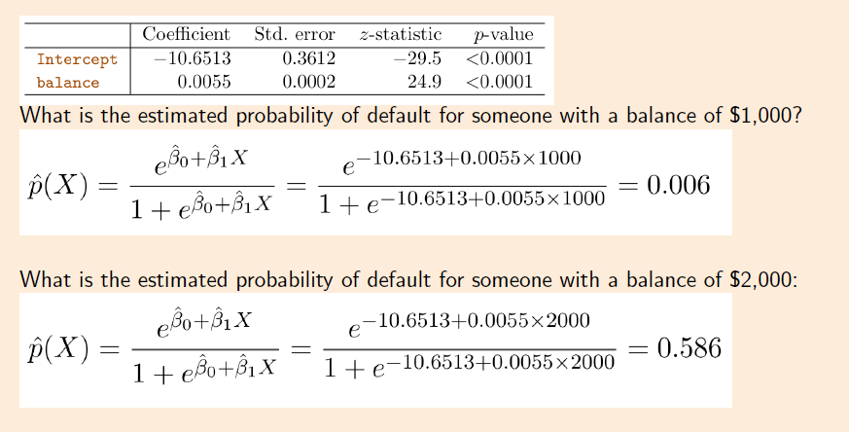
Using Coefficient to predict

