Slide 1

Module 4: Classification
Lecture 9
Jan 30th, 2023

Slide 2
Recap
Classification
Error for classification
KNN classifier
Logistic Regression

Slide 3
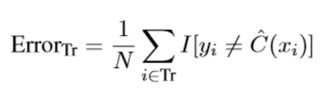
Recap
Classification
Error for classification
Bayes classifier
KNN classifier
Logistic Regression (Y can be either 0 or 1)

Slide 4
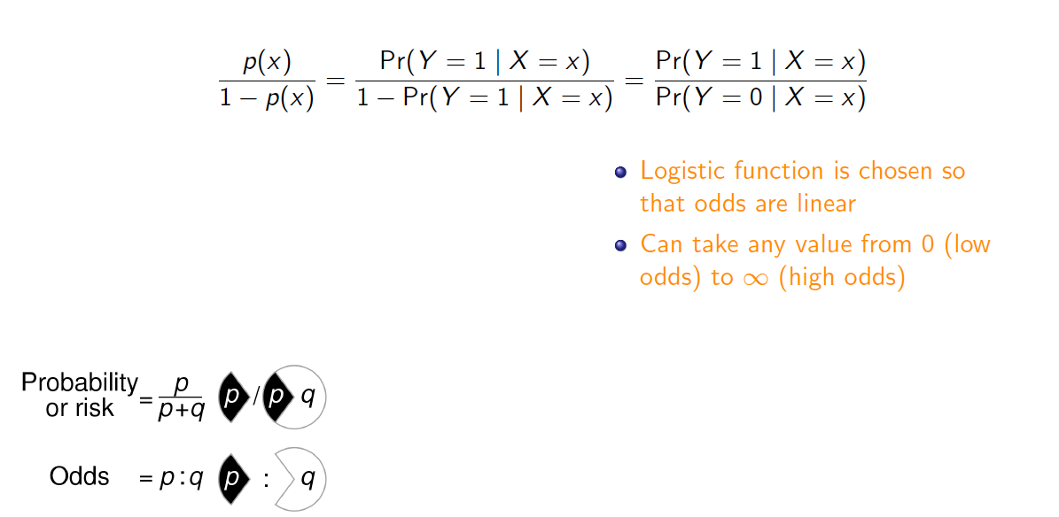
Odds

Slide 5
Odds
If the probability of default is 90%, what is the odds?
If the odds is 1/3, what is the probability of default?

Slide 6

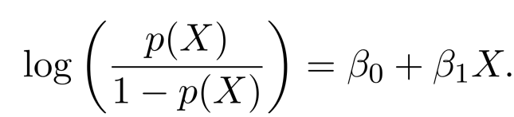
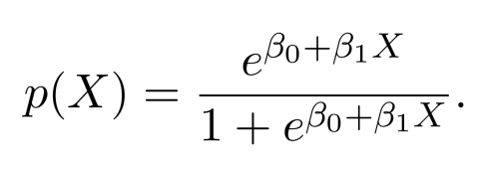
Logistic Regression
Let . How can we turn this to something range of a real line?
This monotone transformation is called the log odds or logit
Logistic regression uses the form

Slide 7
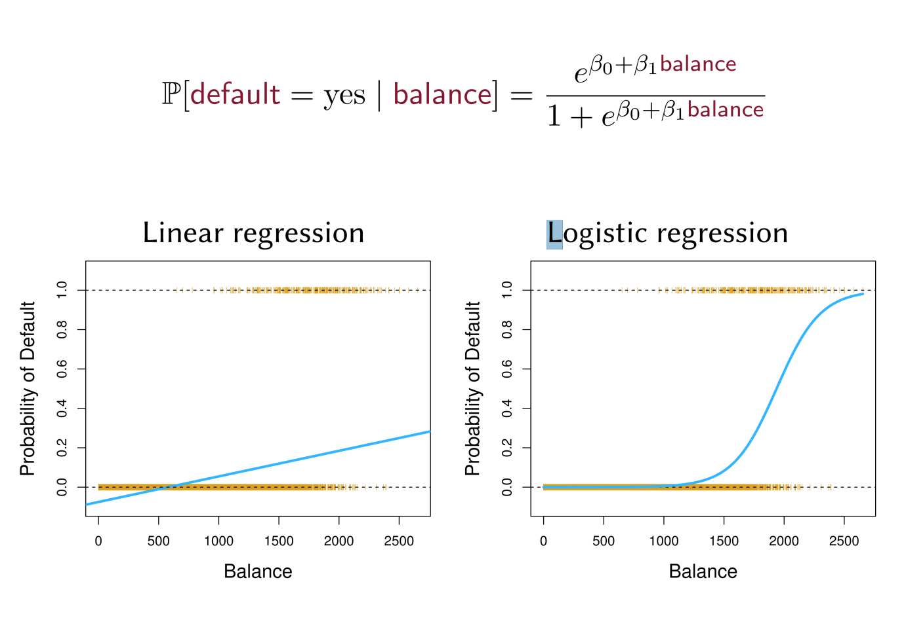
Logistic Regression

Slide 8
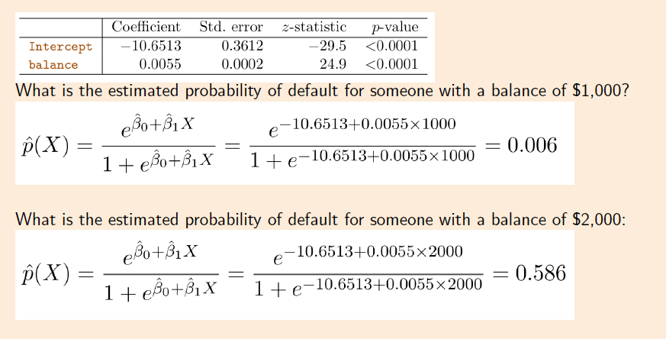
Using Coefficient to predict

Slide 9
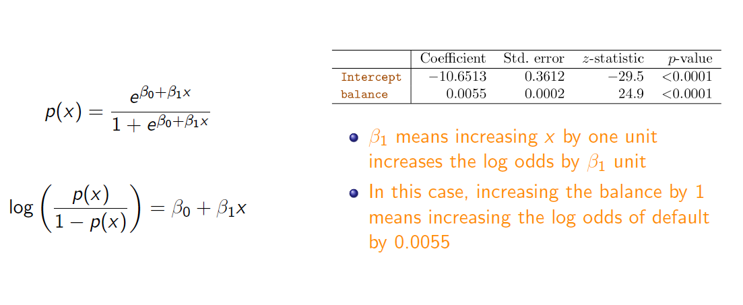
Interpreting the Coefficient

Slide 10
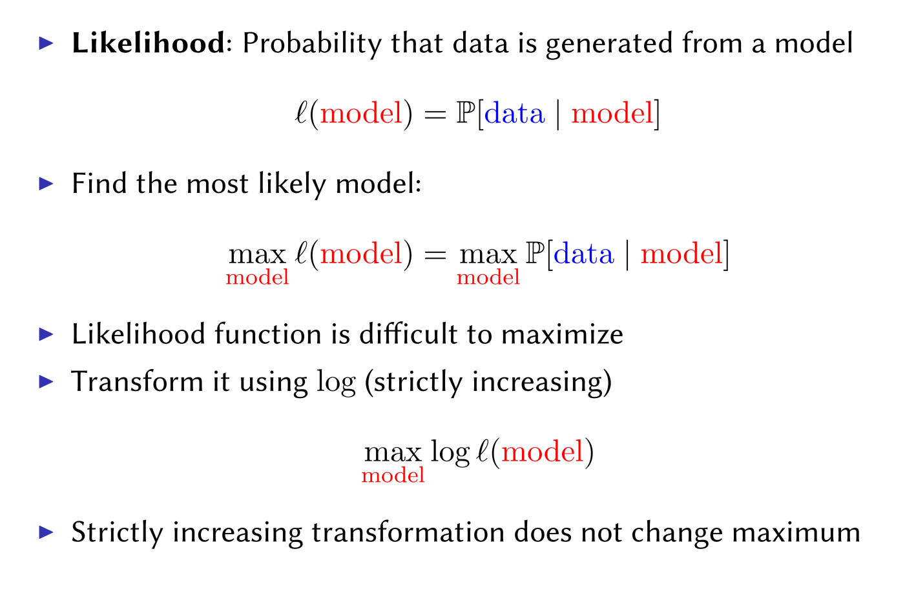
Estimating Coefficients: Maximum Likelihood

Slide 11
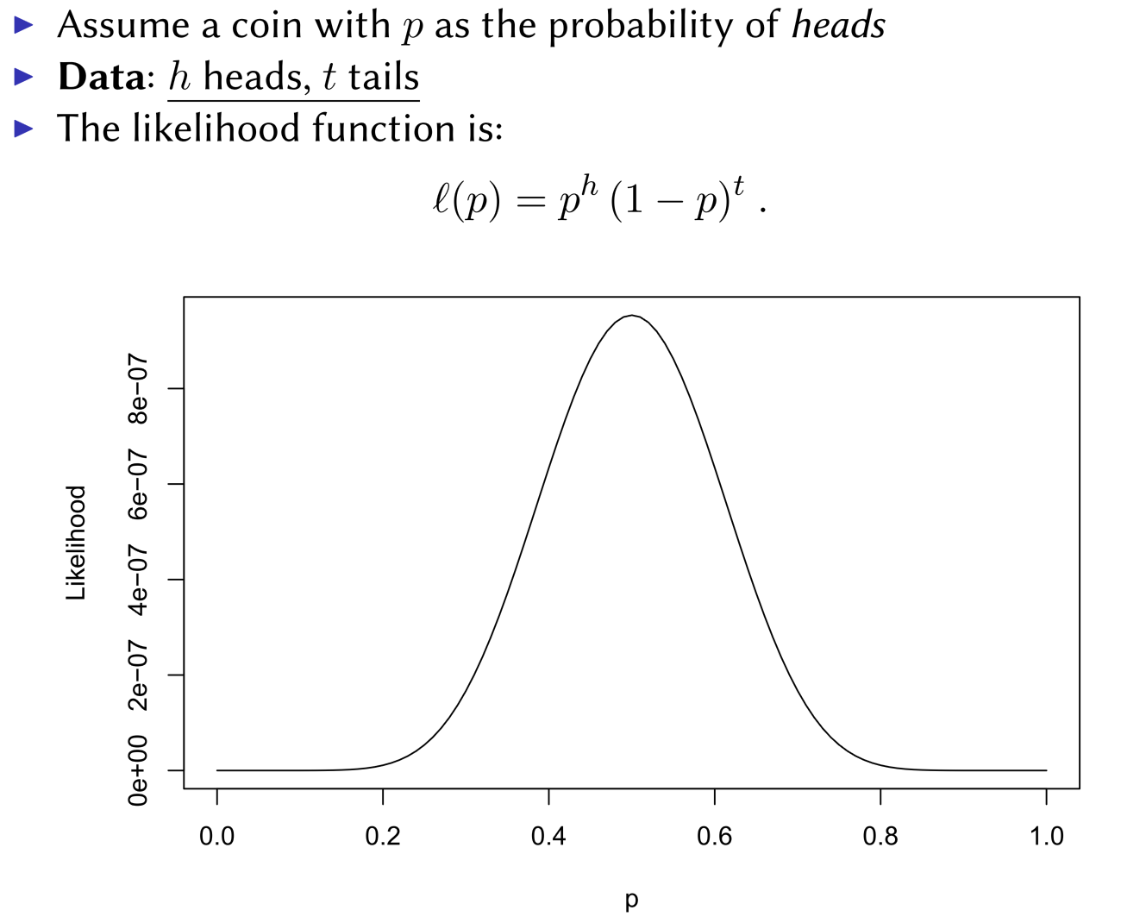
Maximum Likelihood

Slide 12
Maximum Likelihood

Slide 13
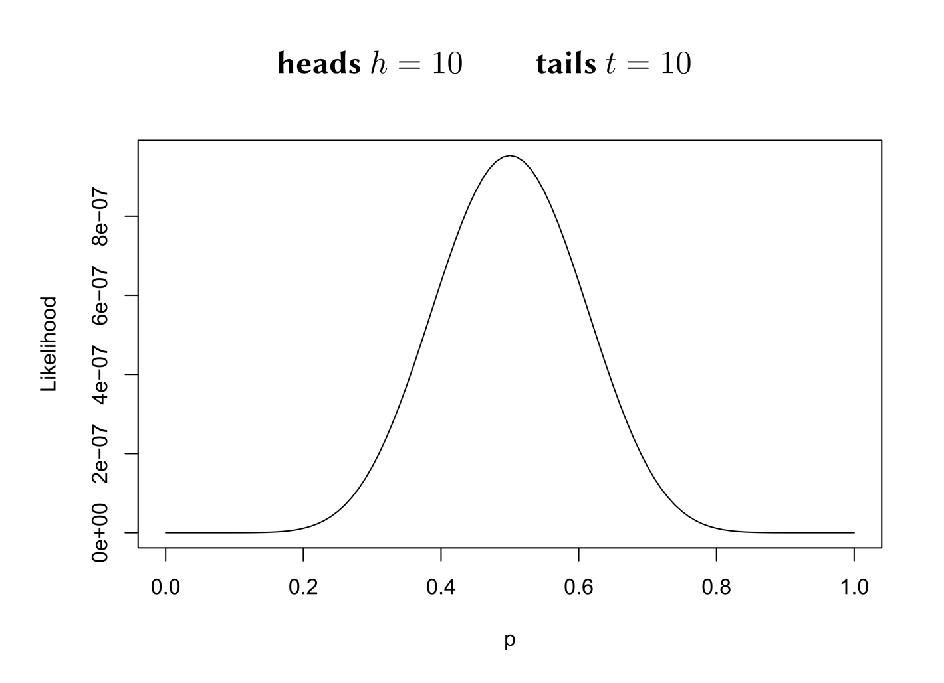
Maximum Likelihood

Slide 14
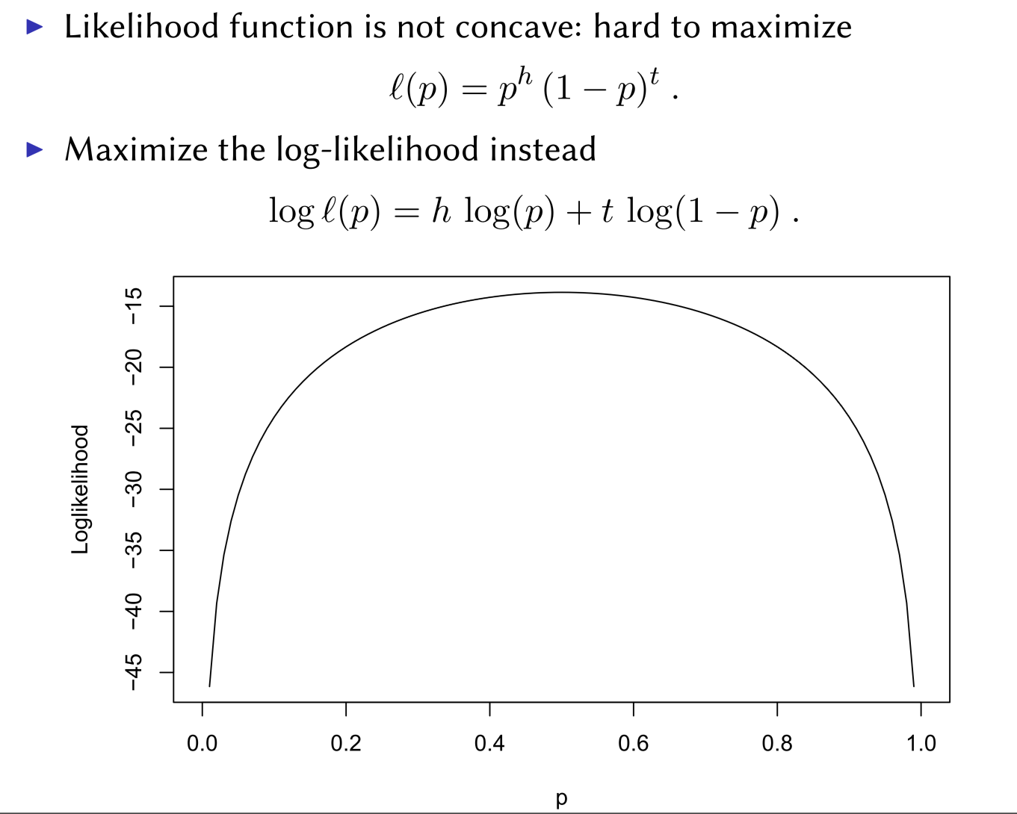
Maximum Likelihood

Slide 15
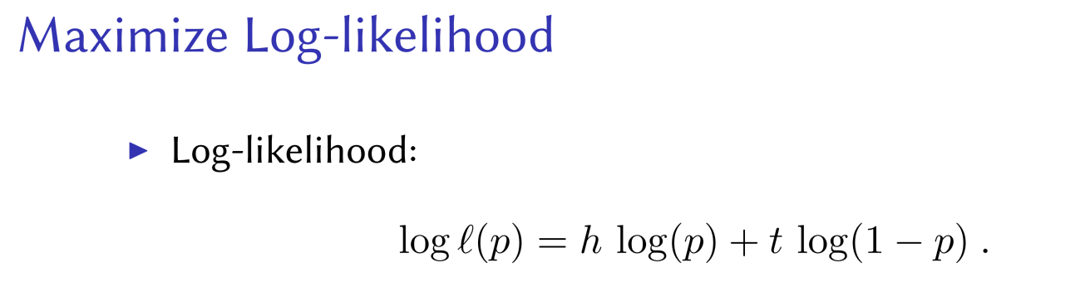

Slide 16
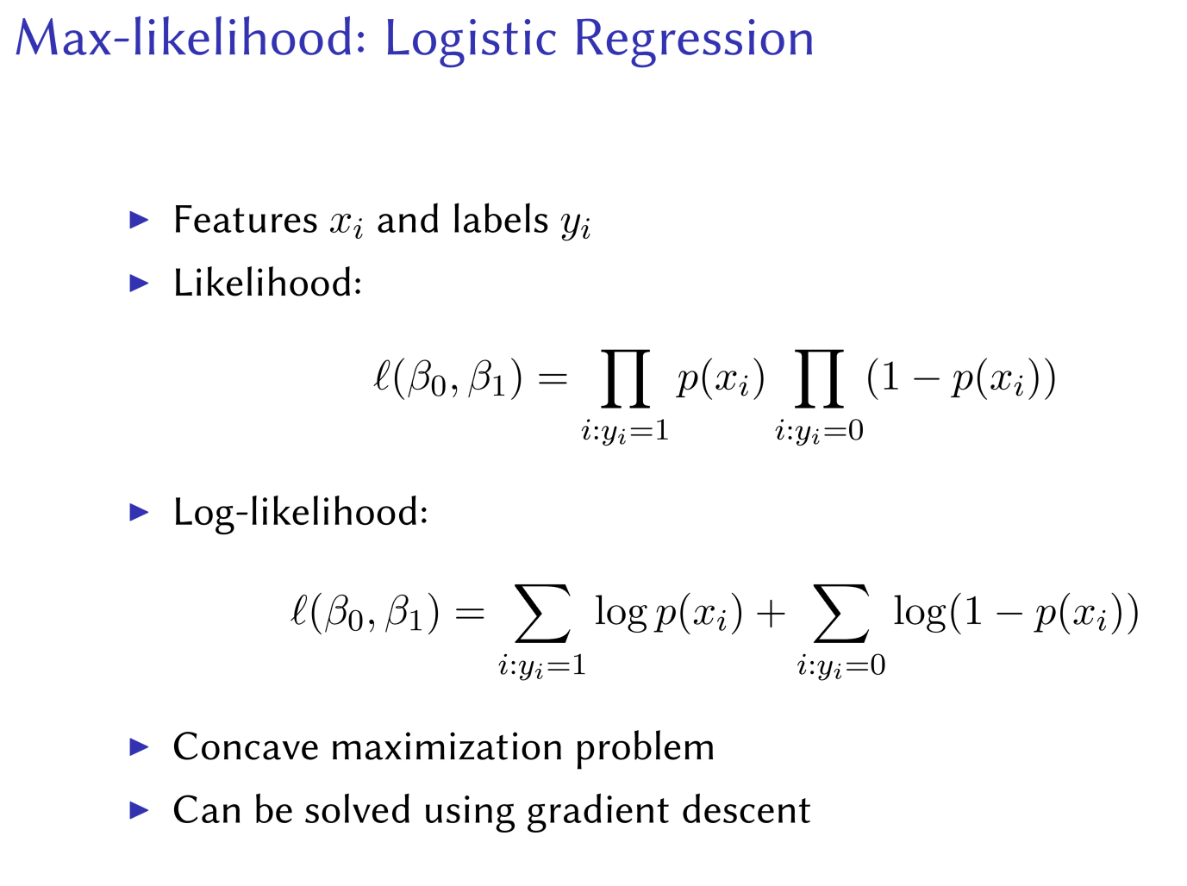

Slide 17
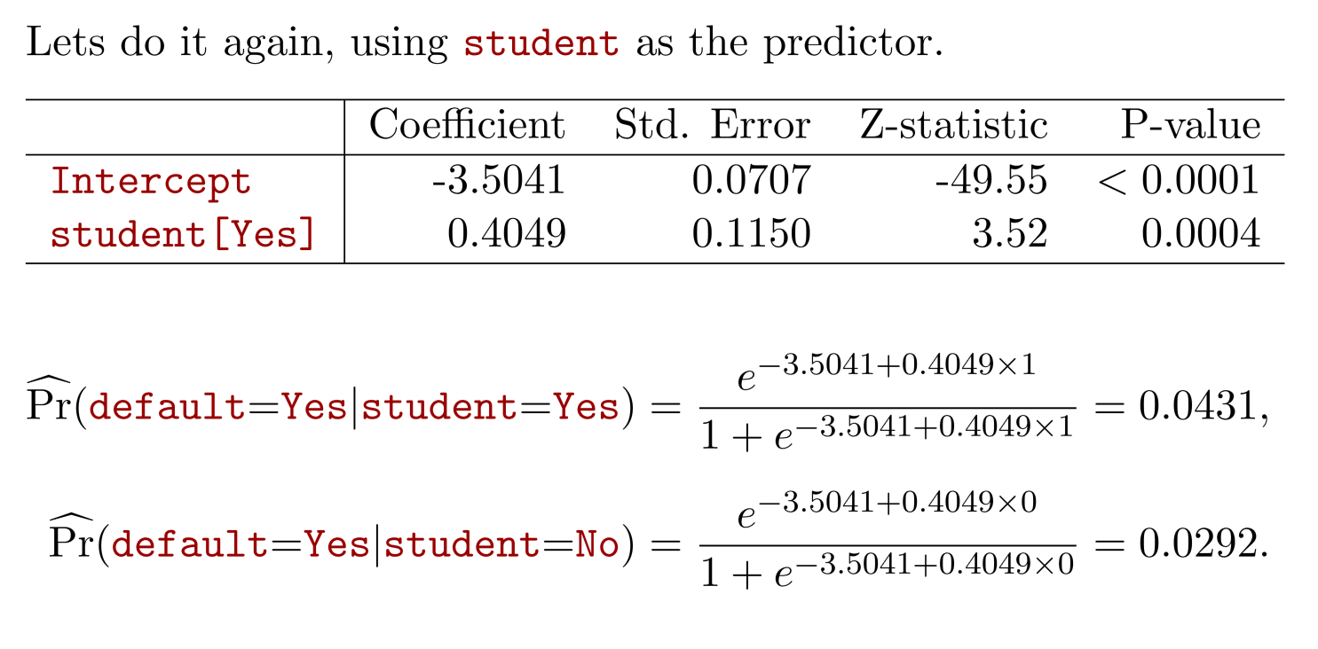
Maximum Likelihood: Default Example

Slide 18
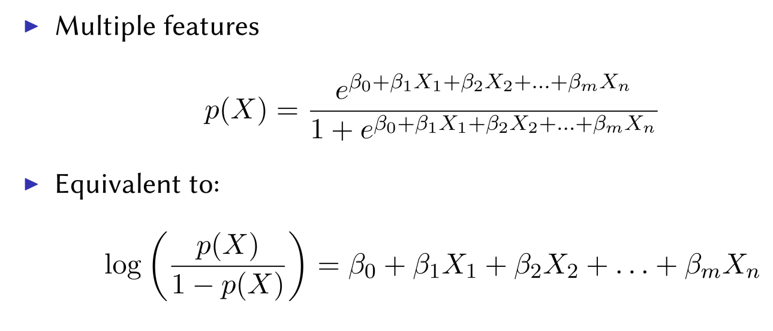
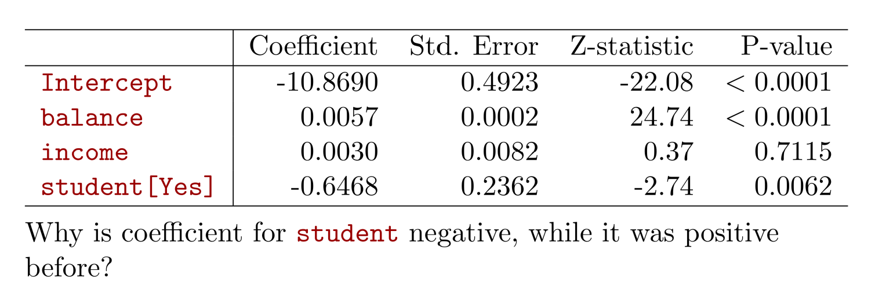
Multiple Logistic Regression

Slide 19
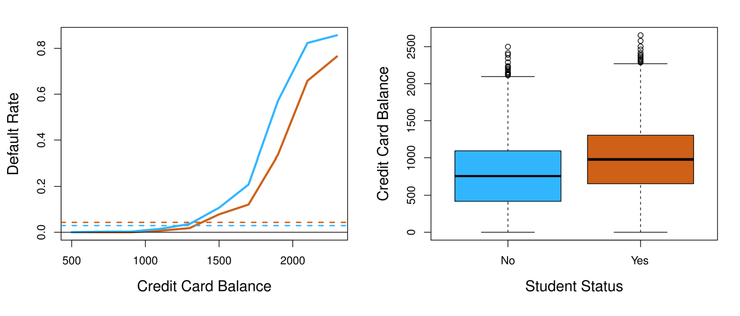
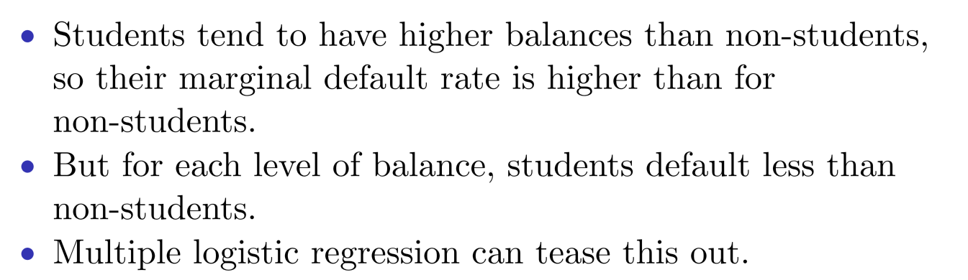
Confounding

Slide 20
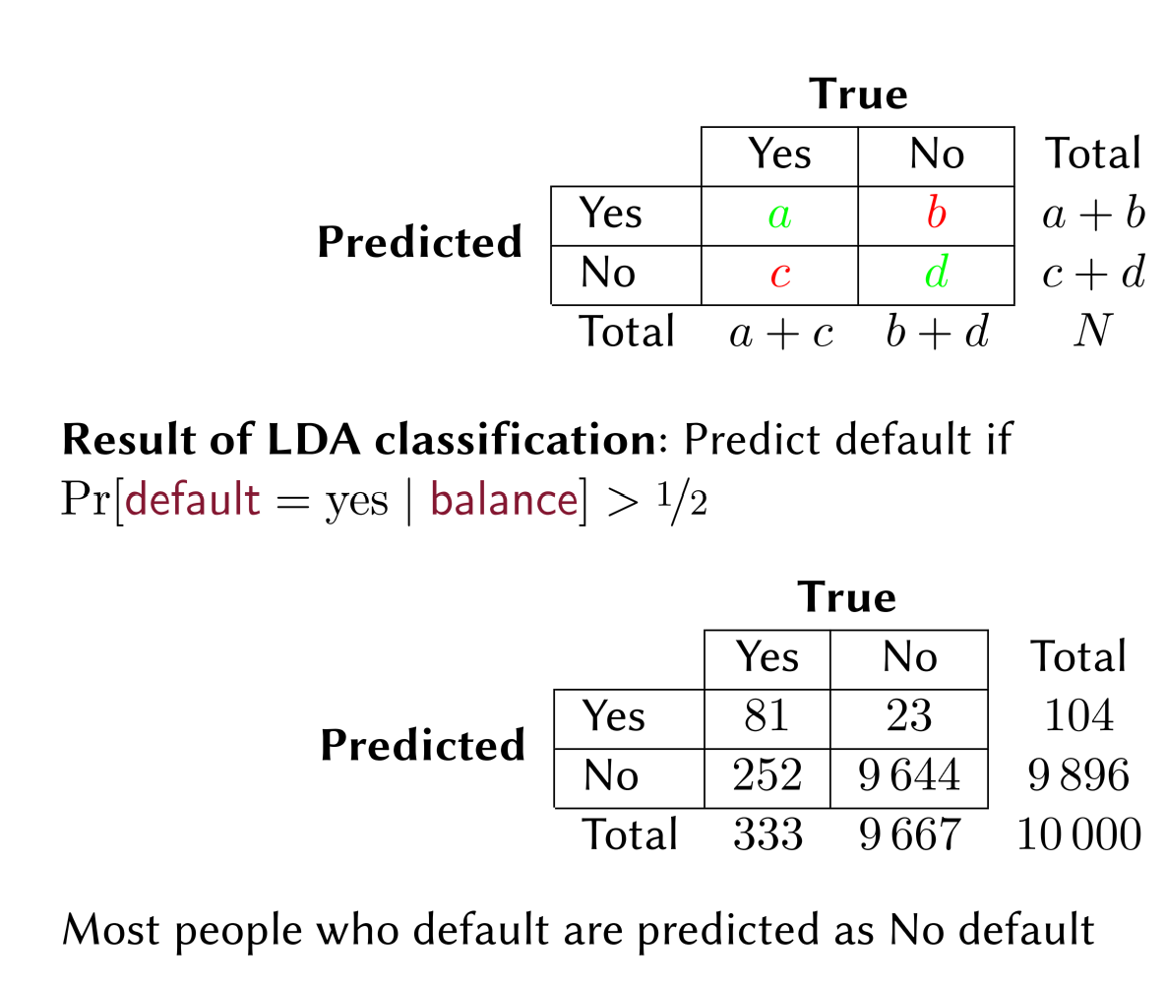
Confusion Matrix: Predict default

Slide 21
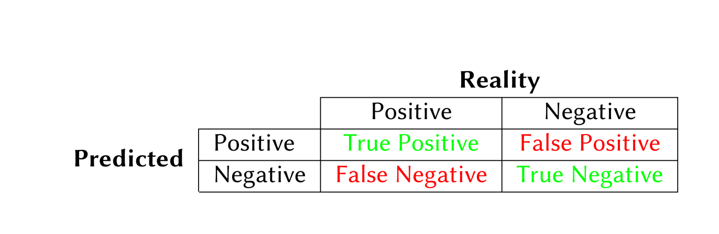
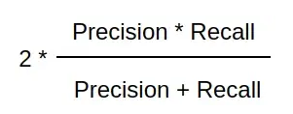
False Positive rate: FP/(TN + FP) Type I error
True Positive rate (Recall, sensitivity): TP/ (TP + FN) 1 – Type II error
Precision: TP/(TP + FP)
F1 score:

Slide 22
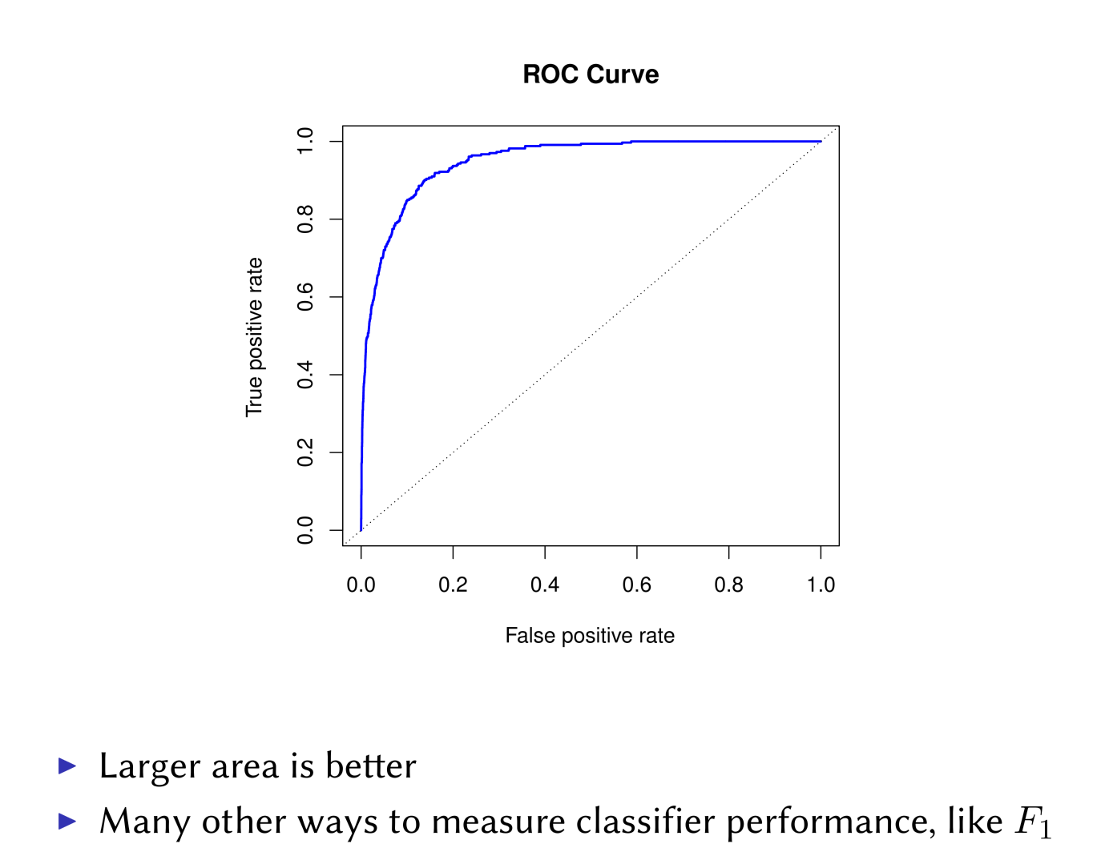
Area Under the ROC Curve (AUC)

