Slide 1
ECE 884 Deep Learning
Lecture 22: GAN
04/15/2021

Slide 2
Review of last lecture
Autoregressive Model
Autoencoder
Variational Autoencoder

Slide 3
Today’s lecture
Generative Adversarial Networks (GANs)

Slide 4
GAN: Main Idea
Generator: generates fake images to fool the discriminator.
Discriminator: tries to distinguish between real and fake images.
Train them against each other.
Finally, the discriminator cannot distinguish between real and fake.
It means the fake images look like real.

Slide 5
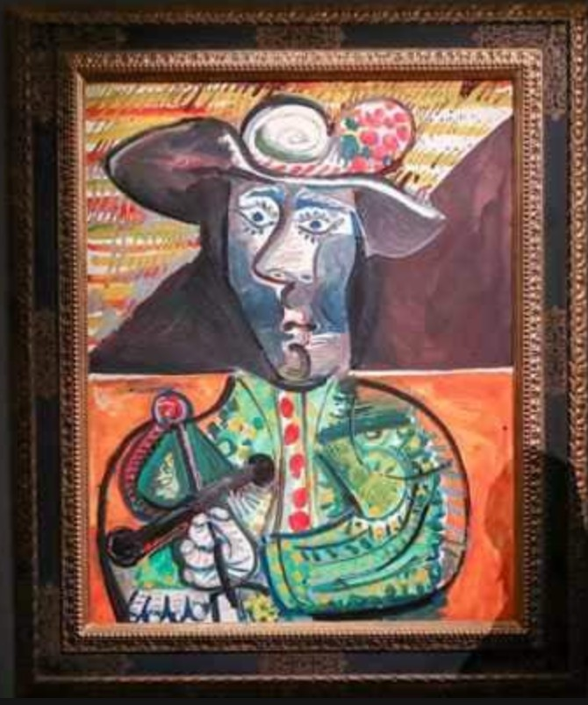
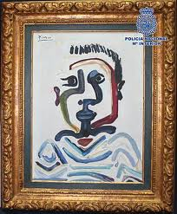
GAN: Main Idea
Generator: a forger who wants to create a fake Picasso painting.
Discriminator: an art dealer.
Which is real?

Slide 6
GAN: Main Idea
Generator: a forger who wants to create a fake Picasso painting.
Discriminator: an art dealer.
Train them against each other.
Forger mixes his fake with authentic paintings and ask art dealer to assess them.
Art dealer gives feedback about what makes a Picasso look like a Picasso.
Forger improves his competence at imitating the style of Picasso.
Art dealer improves his competence at distinguishing real and fake Picasso.
Finally, the art dealer cannot distinguish between real and fake.

Slide 7
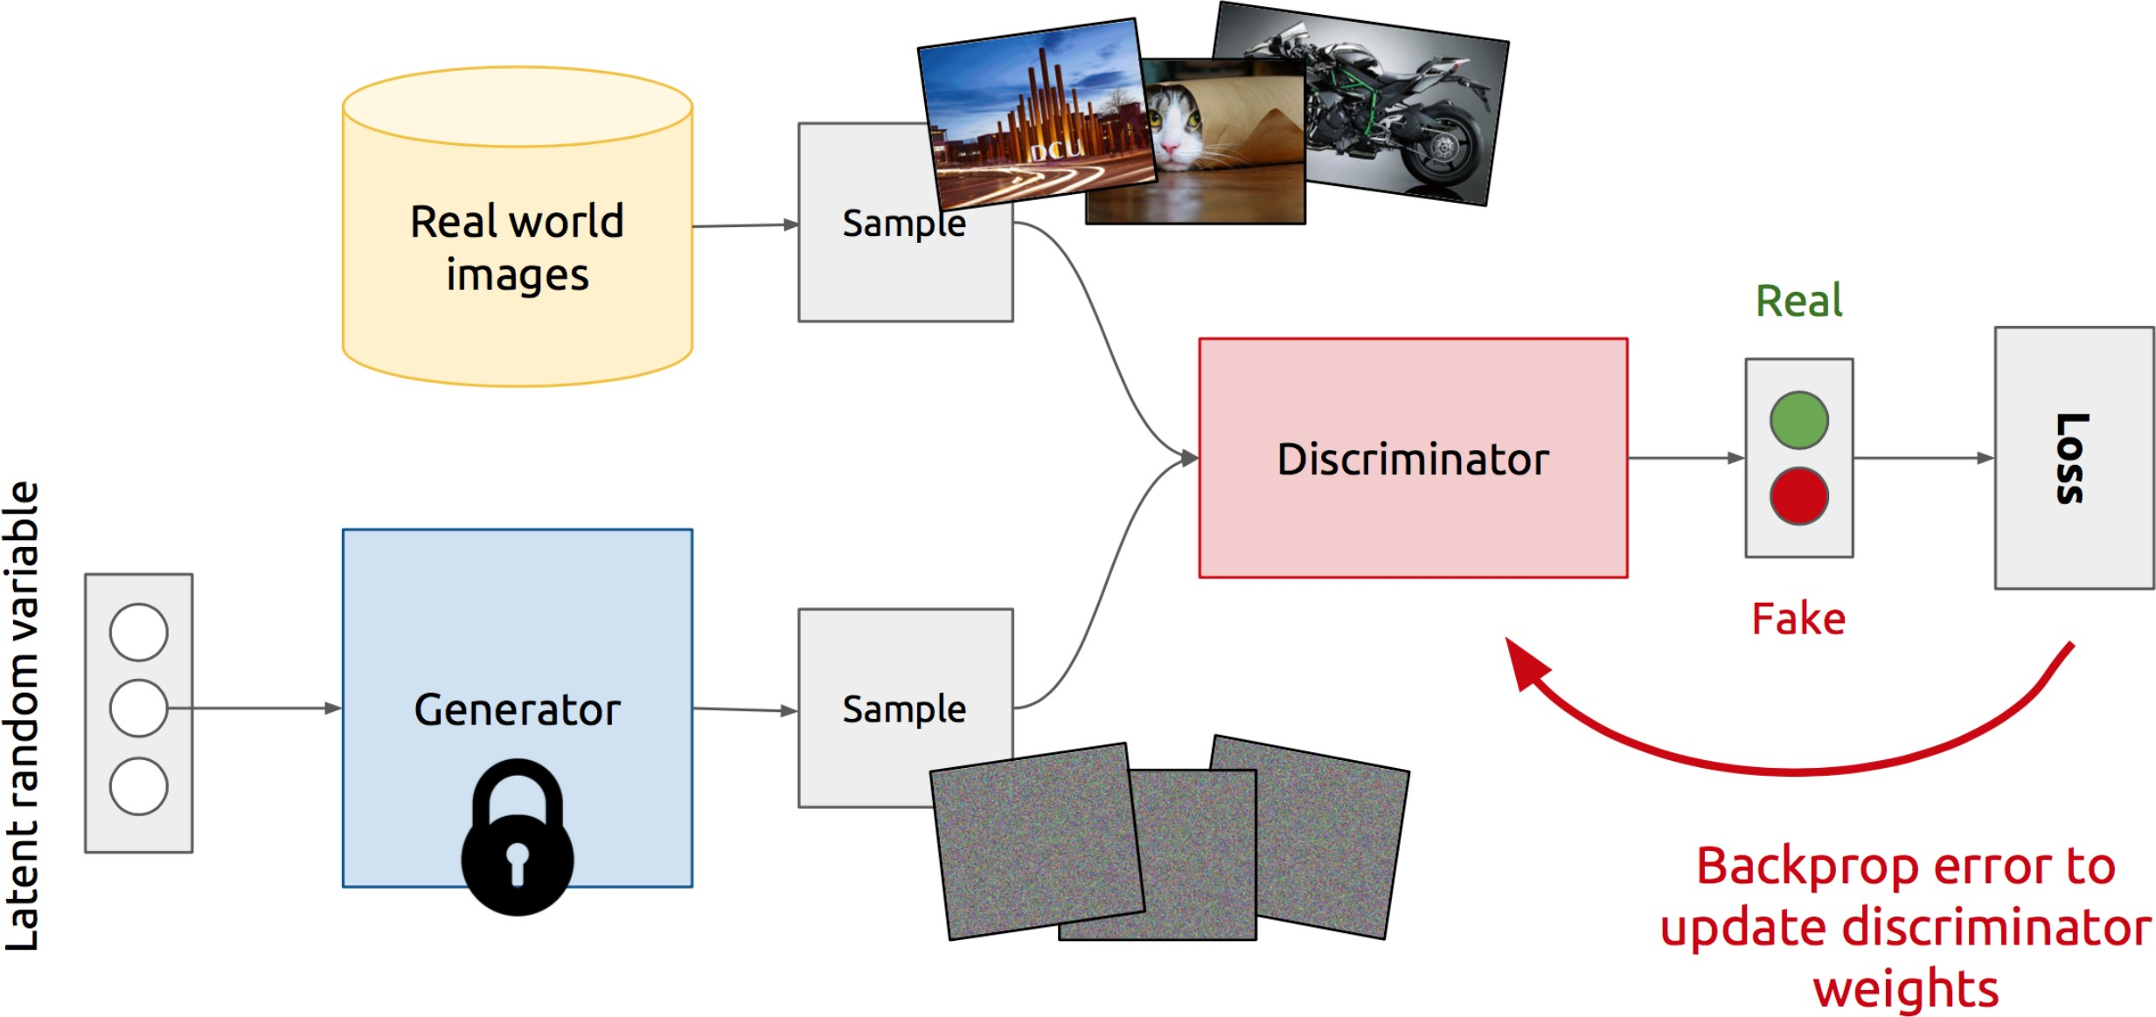
GAN: Model Overview

Slide 8
Training of GAN
Alternating minimization
Repeat the 2 steps:
Update the discriminator network;
Update the generator network.

Slide 9
Update the Discriminator
Train a classifier
Generate a batch of fake images by the generator;
Randomly sample a batch of real images;
Inputs: 𝐗 = [real_images, fake_images];
Targets: 𝐲 = [True, ⋯ , True, False, ⋯ , False];
Update the discriminator network using 𝐗 and 𝐲.

Slide 10
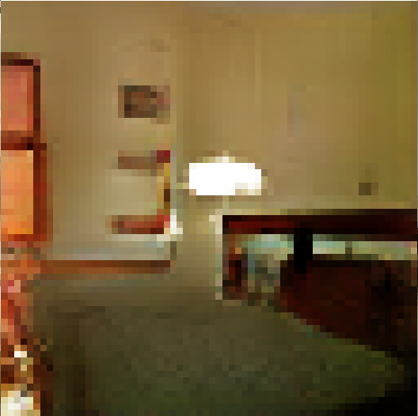
Update the Generator
Connect the generator and discriminator (freeze discriminator’s parameters).
Trainable
Freeze
𝑓
∈ (0, 1)
Random Vector
Fake Image
Generator
Discriminator
Prediction

Slide 11
Update the Generator
Connect the generator and discriminator (freeze discriminator’s parameters).
Minimize Loss = Dist True, 𝑓 w.r.t. generator. (Encourage 𝑓 be True.)
Trainable
Freeze
𝑓
Loss
Random Vector
Fake Image
Generator
Discriminator
Prediction

Slide 12
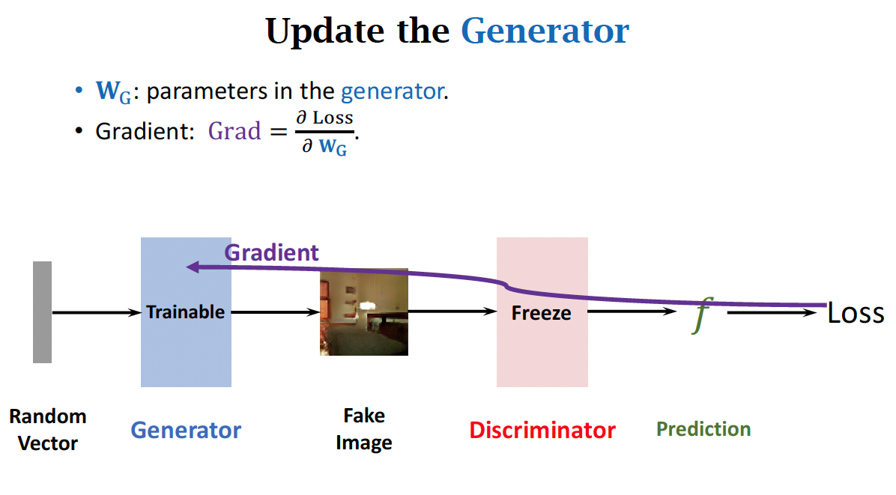

Slide 13
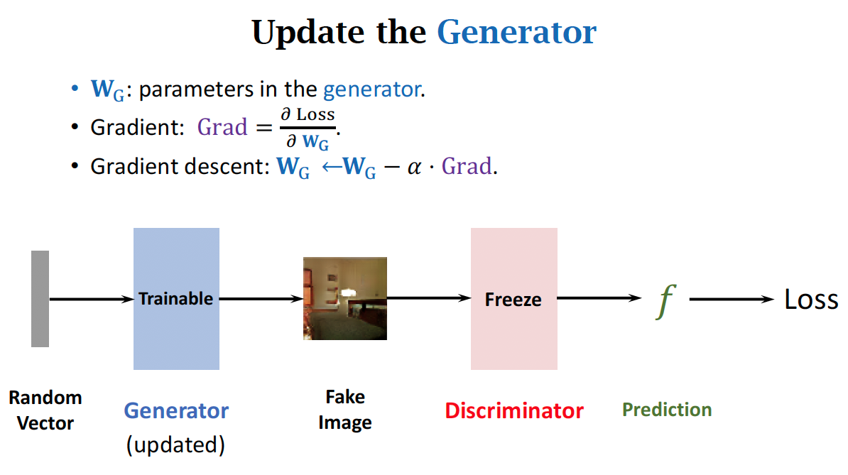

Slide 14
Difficulties in Training GAN

Slide 15
Discriminator Shouldn’t Be Too Good
Generator: a forger who wants to create a fake Picasso painting.
Discriminator: an art dealer providing feedbacks.
What if the art dealer is 100% correct at judging Picasso painting?

Slide 16
Discriminator Shouldn’t Be Too Good
Generator: a forger who wants to create a fake Picasso painting.
Discriminator: an art dealer providing feedbacks.
What if the art dealer is 100% correct at judging Picasso painting?
Whatever forged painting sent to the art dealer is recognized as fake.
The forger cannot learn anything from the feedback.
No positive case to follow.
The forger need some success.
So he will know what kind of fake painting can fool the dealer.

Slide 17
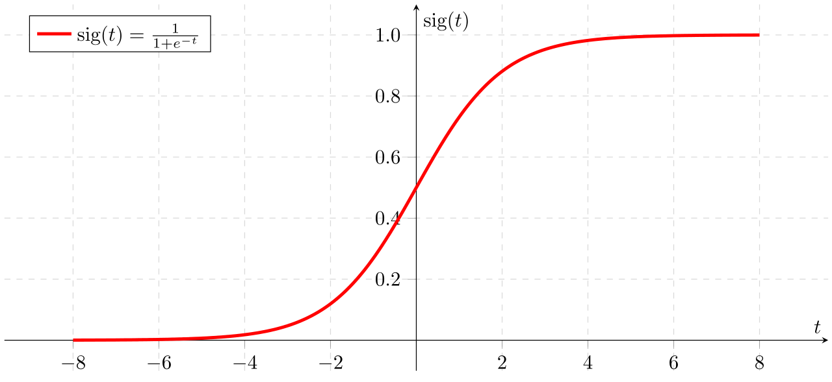
Discriminator Shouldn’t Be Too Good
Explanation: vanishing gradient
Suppose the discriminator is perfect.
Whatever the generators forged is recognized fake by the discriminator.
The gradient is near zero.
Prediction = False

Slide 18
Discriminator Shouldn’t Be Too Bad
Generator: a forger who wants to create a fake Picasso painting.
Discriminator: an art dealer providing feedbacks.
What if the art dealer cannot distinguish between real and fake paintings?
The art dealer’s judgement is almost random guess.
The forger cannot learn anything from the feedback.
When the forger’s skill is good, getting amateurish art dealer’s feedback is a not helpful.

Slide 19
Useful Tricks
Carefully tune the learning rates.
If the discriminator improves too fast, -classification accuracy can be 100%, -vanishing gradient,
-the generator is dead.
If the discriminator improves too slowly,
-the discriminator cannot provide useful feedback,
-the generator has to wait for the discriminator,
-slow convergence.

Slide 20
Useful Tricks
Many other tricks…
Further reading:
https://github.com/soumith/ganhacks

Slide 21
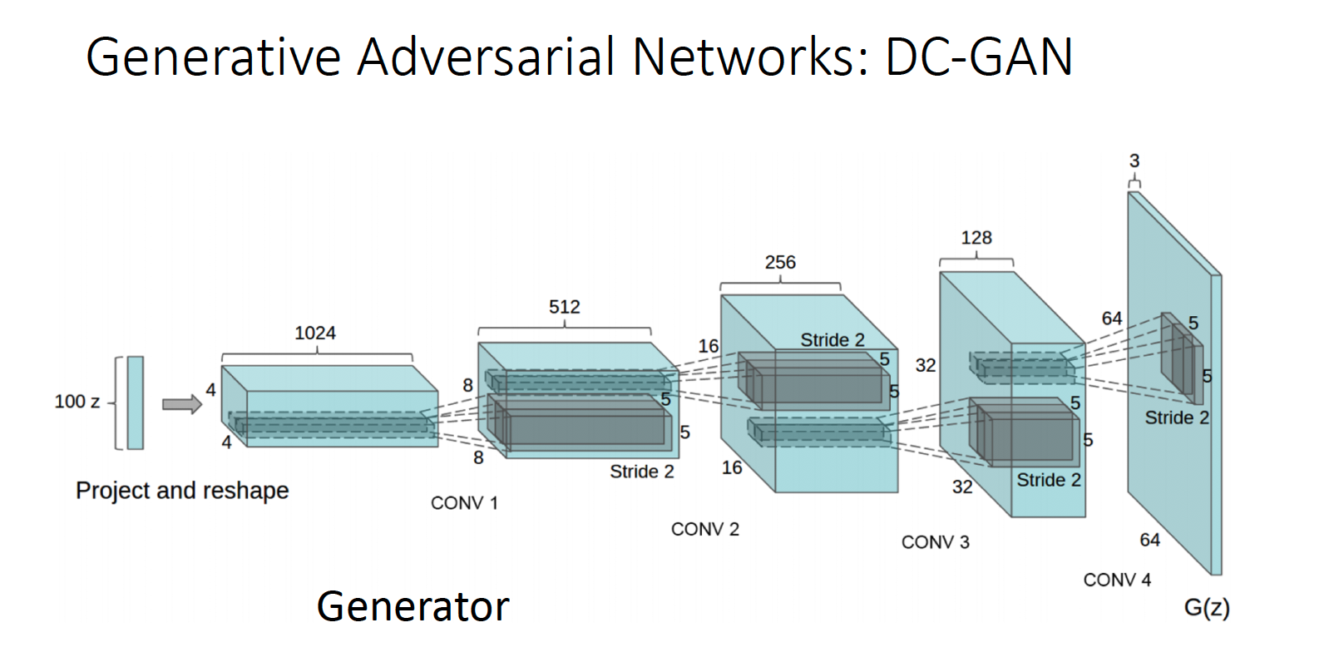

Slide 22
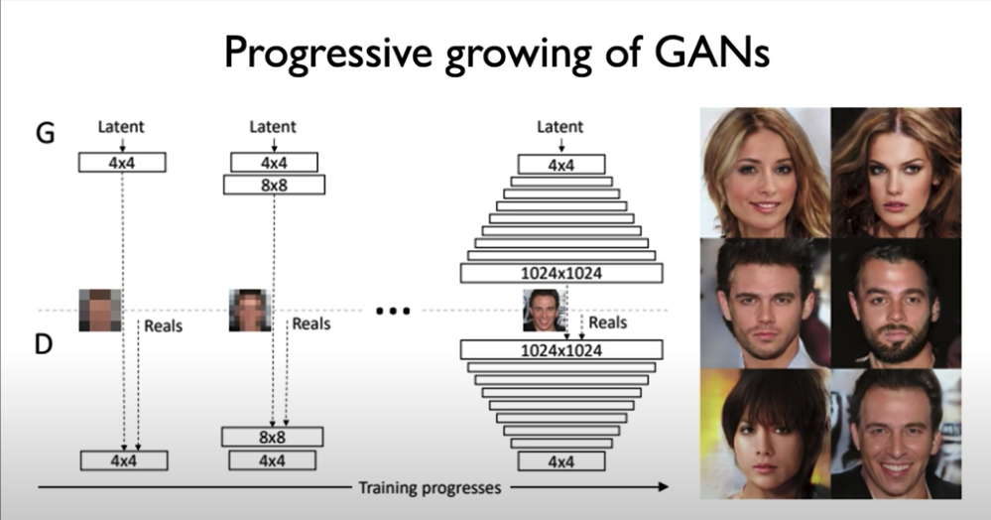

Slide 23
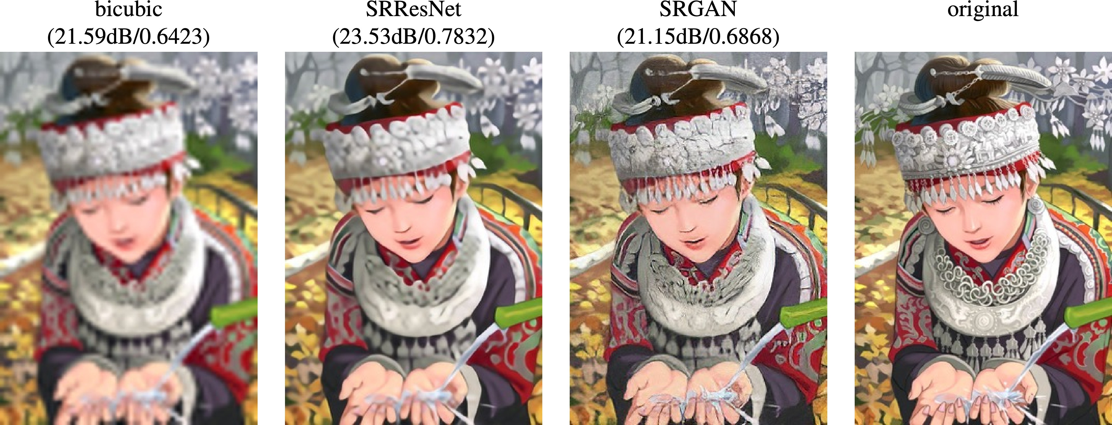
Image Super-Resolution: Low-Res to High-Res
Ledig et al, “Photo-Realistic Single Image Super-Resolution Using a Generative Adversarial Network”, CVPR 2017

Slide 24
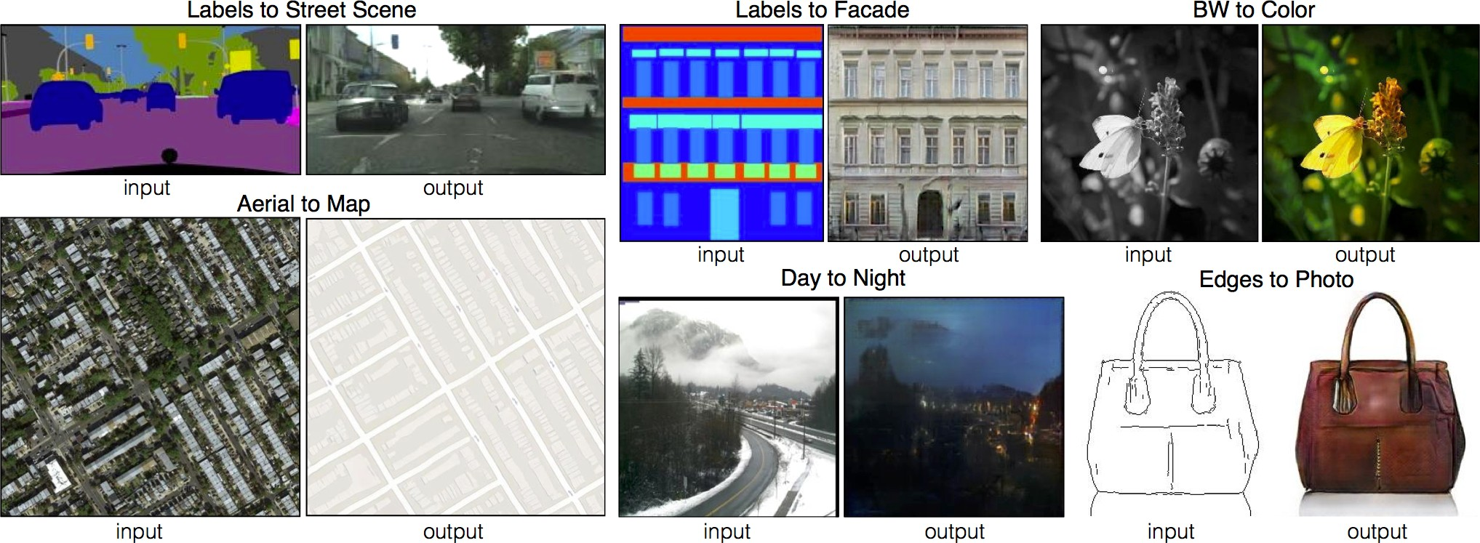
Image-to-Image Translation: Pix2Pix
Isola et al, “Image-to-Image Translation with Conditional Adversarial Nets”, CVPR 2017

Slide 25
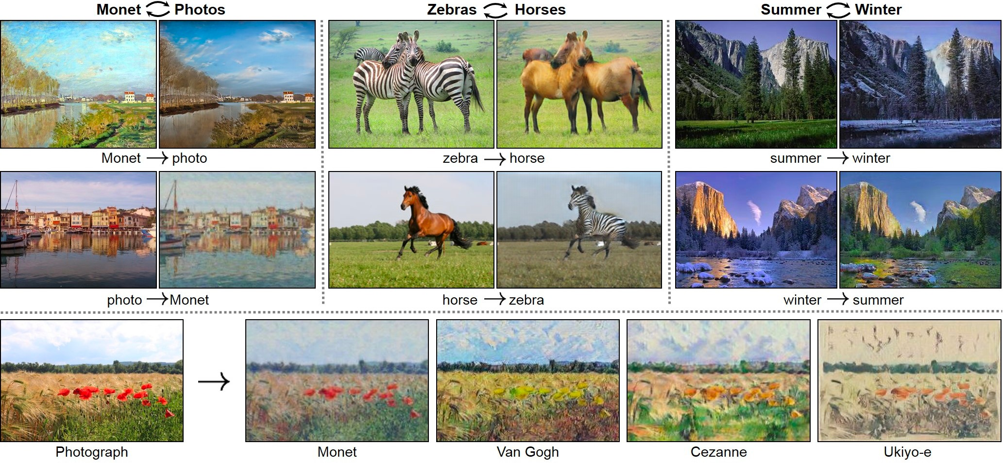
Unpaired Image-to-Image Translation: CycleGAN
Zhu et al, “Unpaired Image-to-Image Translation using Cycle-Consistent Adversarial Networks”, ICCV 2017

Slide 26
Any Question ?

