Slide 1

Module 3: Linear Regression
Jan 29th, 2021

Slide 2
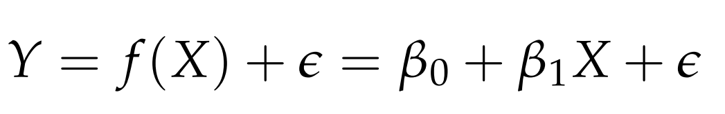


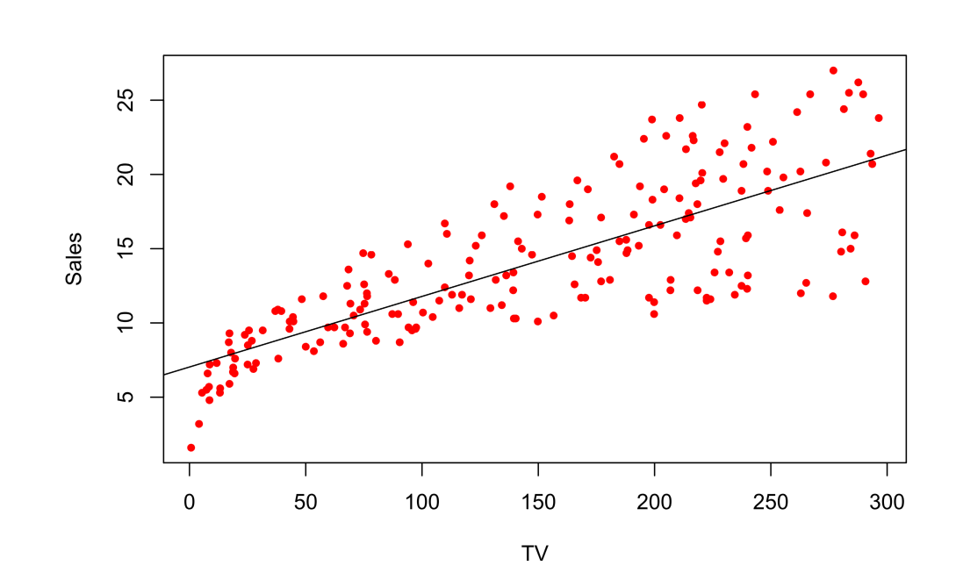

Simple Linear Regression
  We have only one feature
  Where and are two unknown constants also known as coefficient or parameters.
  Example:

Slide 3




Simple Linear Regression
  We have only one feature
  Where and are two unknown constants also known as coefficient or parameters.
  Given the training data, we can estimate and for the model coefficients and predict future Y using
  Where indicates a prediction of Y on the basis of X = x. The hat symbol denotes an estimated value.

Slide 4


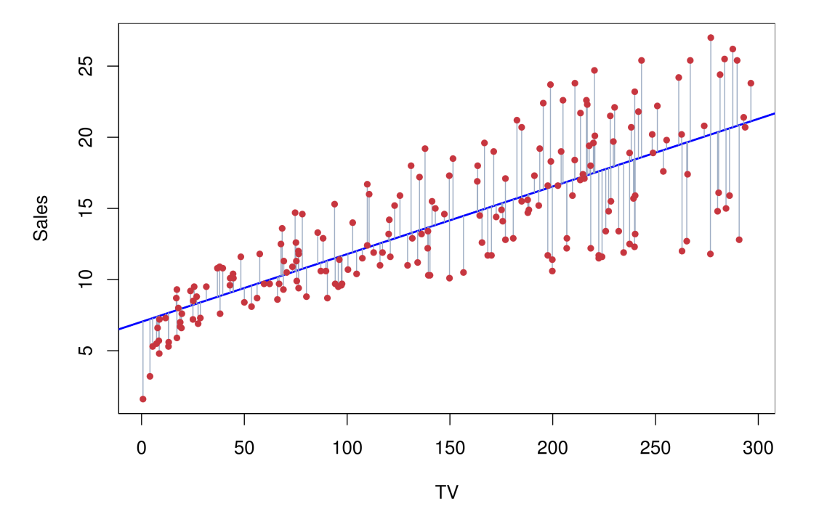
How to estimate?
  Let be the prediction of Y based on the ith value of X.
  Errors：

Slide 5
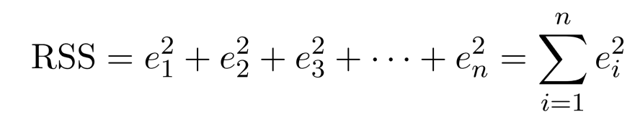
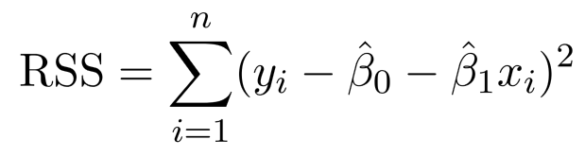
How to estimate?
  Residual Sum of Squares
  Equivalently：

Slide 6
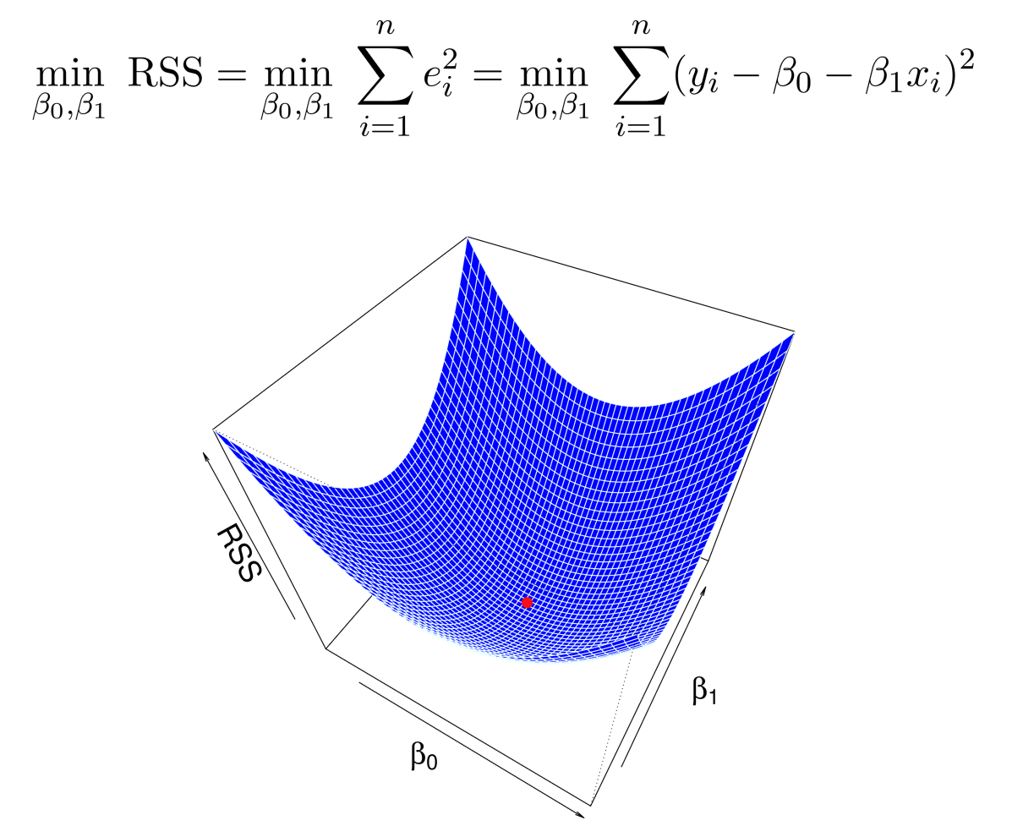
How to estimate?
  Minimizing RSS to find the best estimates.

Slide 7
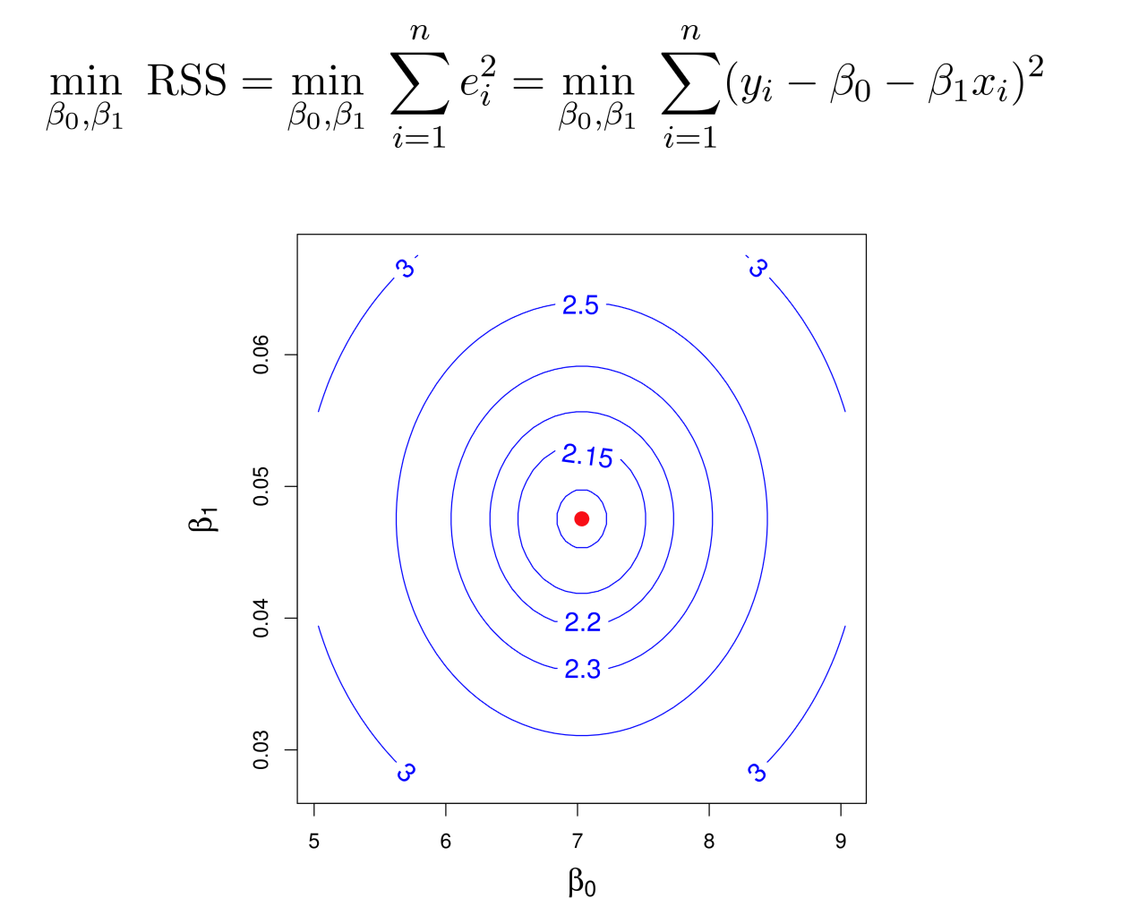

Slide 8
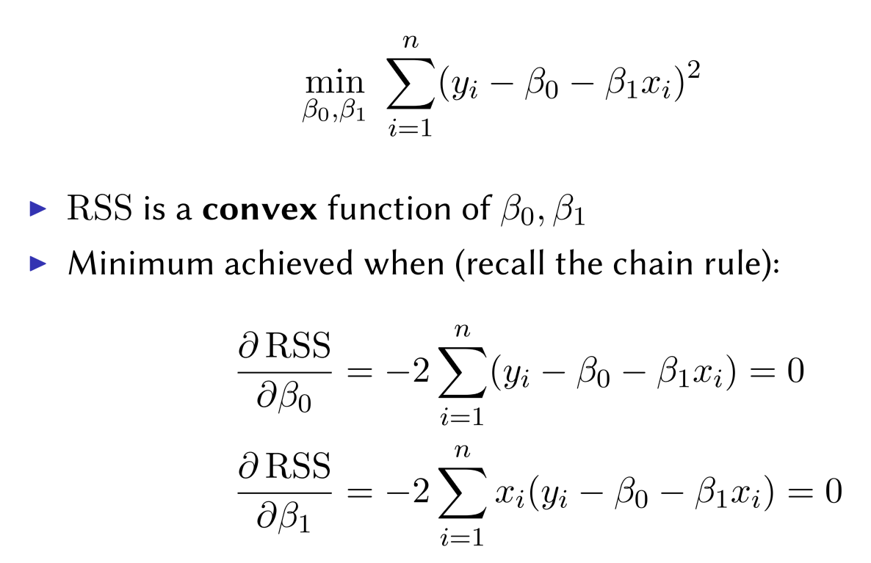
Solving for minimal RSS

Slide 9
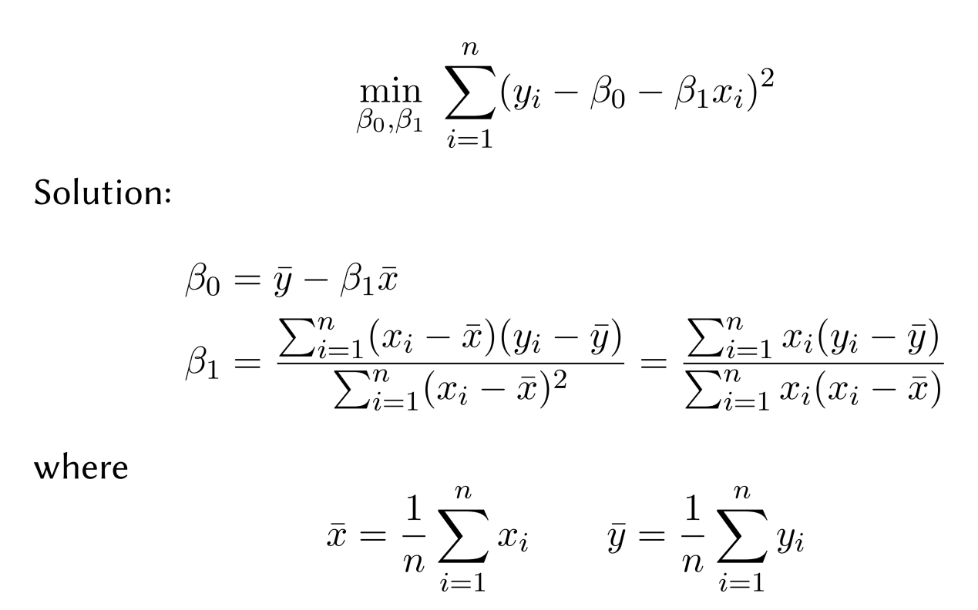
Linear Regression Coefficients

Slide 10


Why Minimizing RSS?
  It has closed form!!
  Maximize likelihood when , when
  Best Linear Unbiased Estimator (BLUE): Gauss-Markov Theorem.

Slide 11



Bias in Estimation
  Assume a true value
  An estimate from training data
  The estimate is unbiased if E( ) =
  Sample mean is unbiased for population mean
  Standard variance estimate is biased

Slide 12
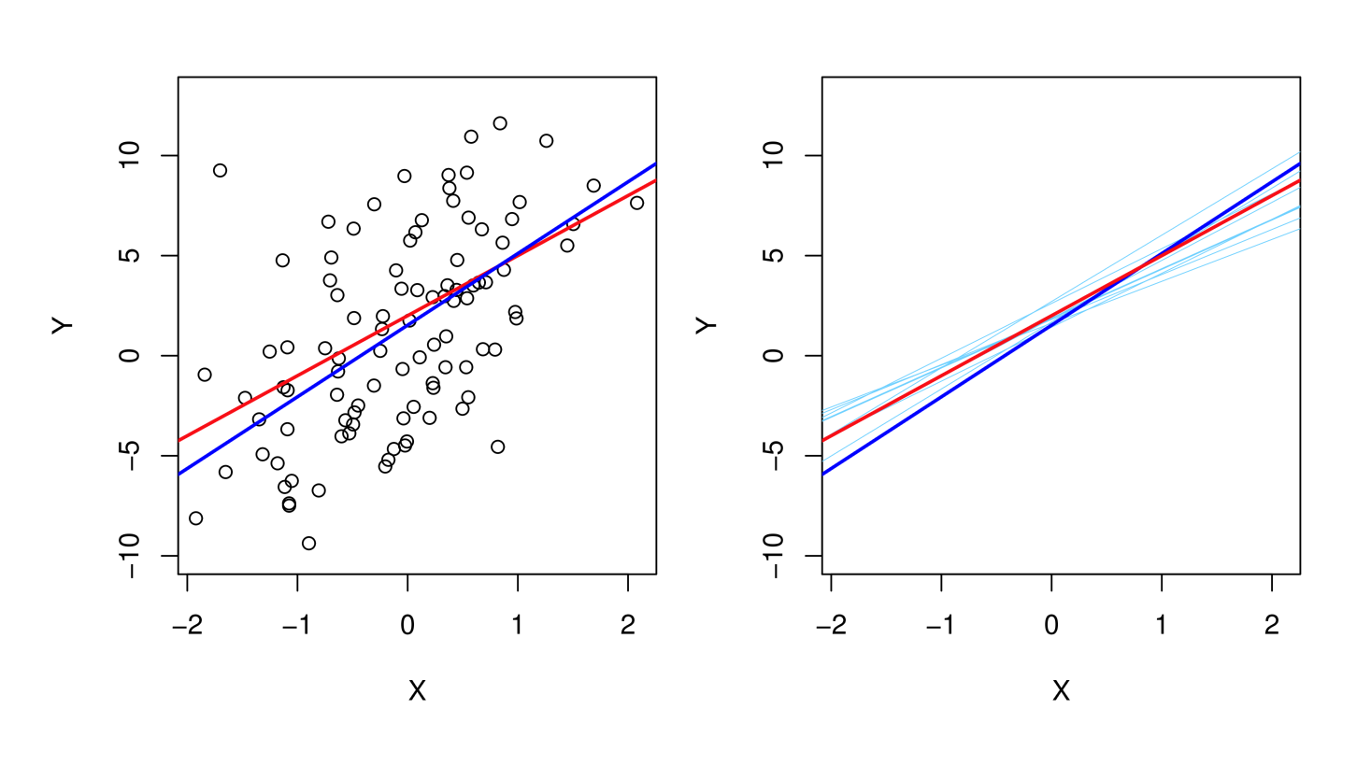
Linear Regression is Unbiased

Slide 13

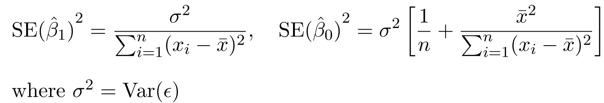



Variance of the estimates
  Assume a true value
  An estimate from training data
  The variance of sample mean is:
  The variances of the linear regression estimates are
  We then can calculate the confidence intervals. The 95% confidence interval for approximately takes the form

Slide 14
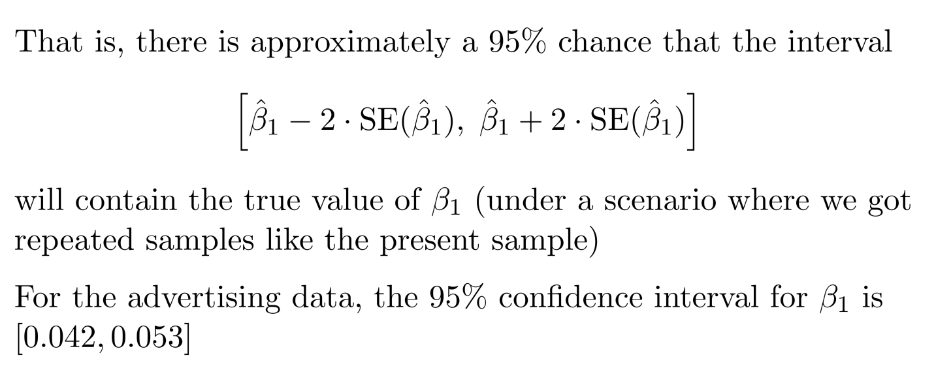
Confidence Interval

Slide 15
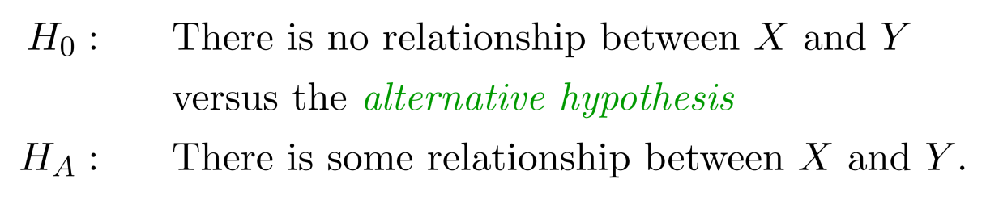
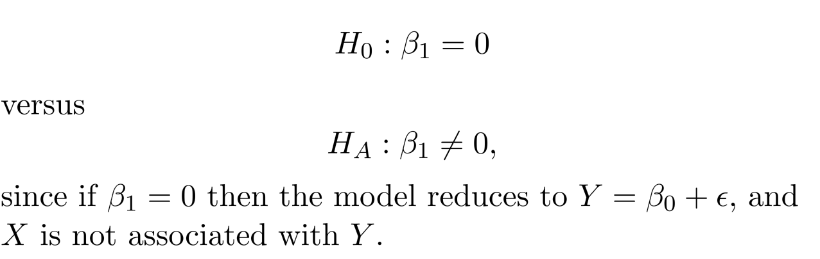
Hypothesis Testing
  Standard errors can also be used to perform hypothesis
  tests on the coeﬃcients. The most common hypothesis test
  involves testing the null hypothesis of
  Mathematically, it is

Slide 16

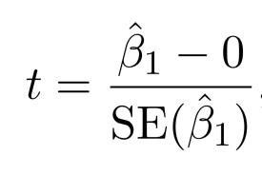

Hypothesis Testing
  Mathematically, it is
  We have from data and want to test whether it is far from 0. But how far?
  This will have a t-distribution with n-2 degrees of freedom, assuming
  Using statistical software, it is easy to compute the probability of observing any value equal to |t| or larger. We call this probability the p-value.
  We will specify an alpha value (0.05) before Hypothesis testing. If p-value less than the alpha value, we will reject the null hypothesis.

Slide 17
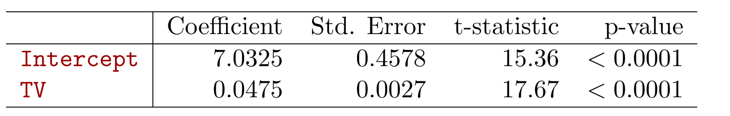
Results for the Advertising Data
  Since p-value < 0.05, we reject the null hypothesis and conclude that TV is related to sale.

Slide 18
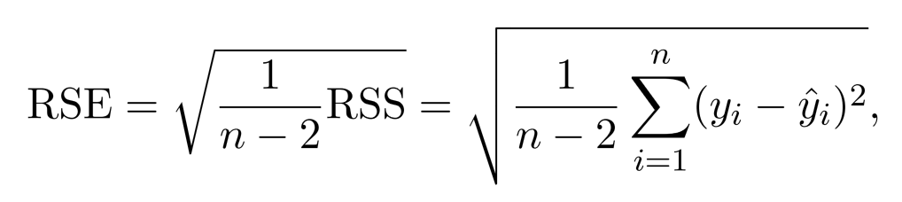
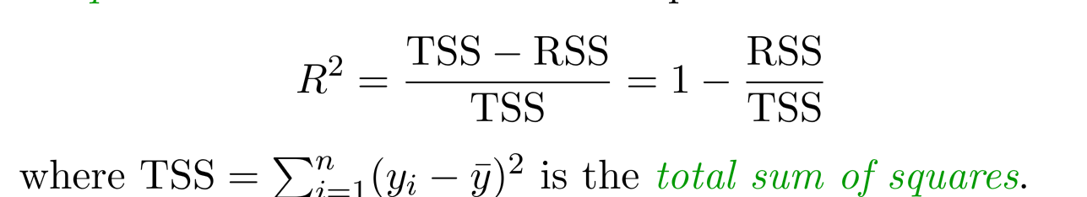

Assessing the Accuracy of the Model
  Residual Standard Error
  R-square: fraction of variance explained by the linear model
  where is the total sum of squares

Slide 19
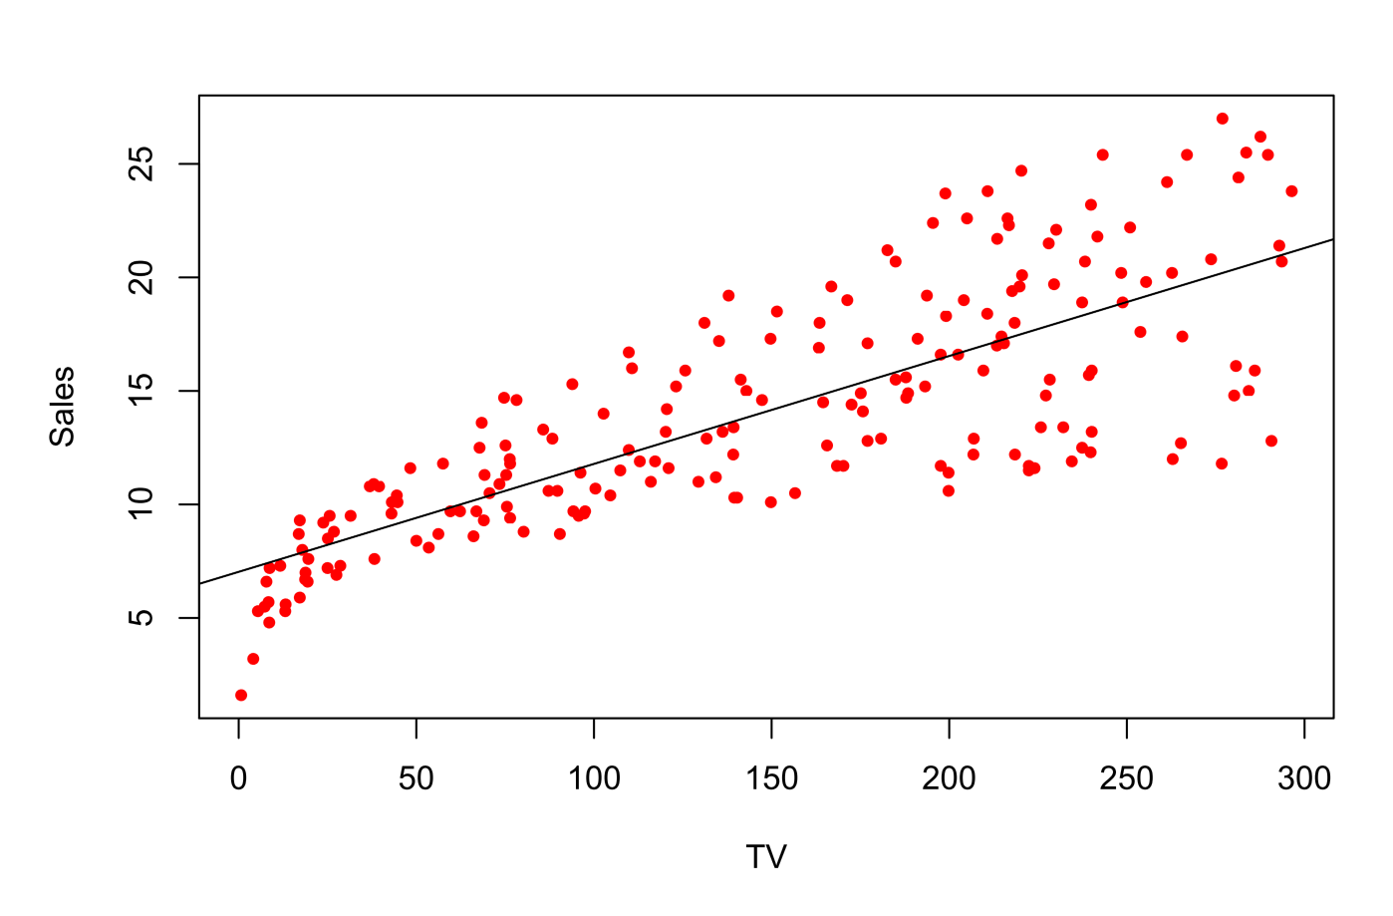
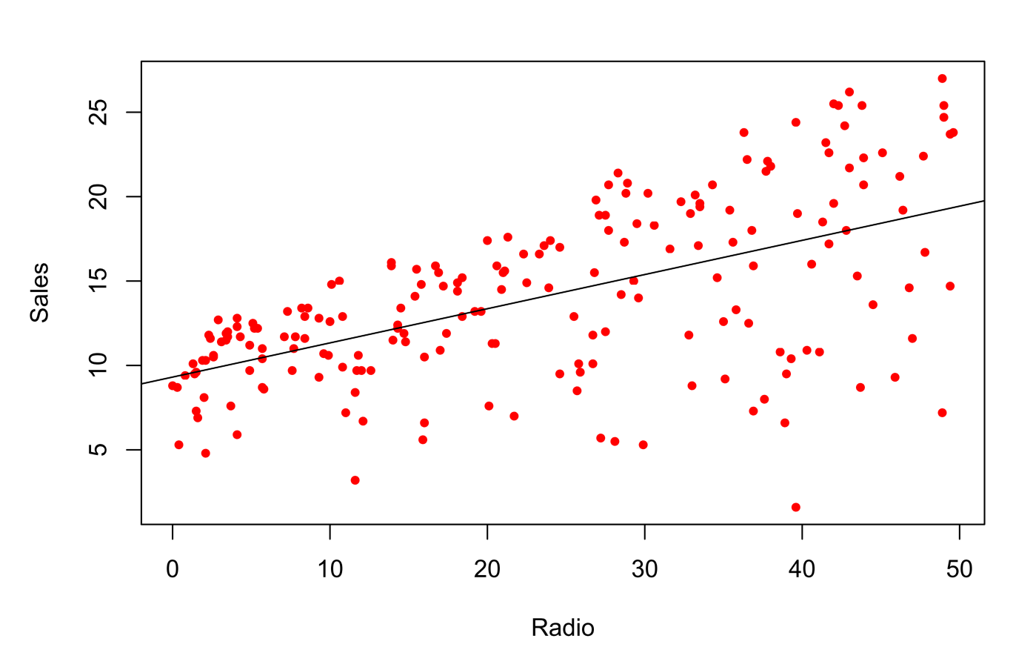
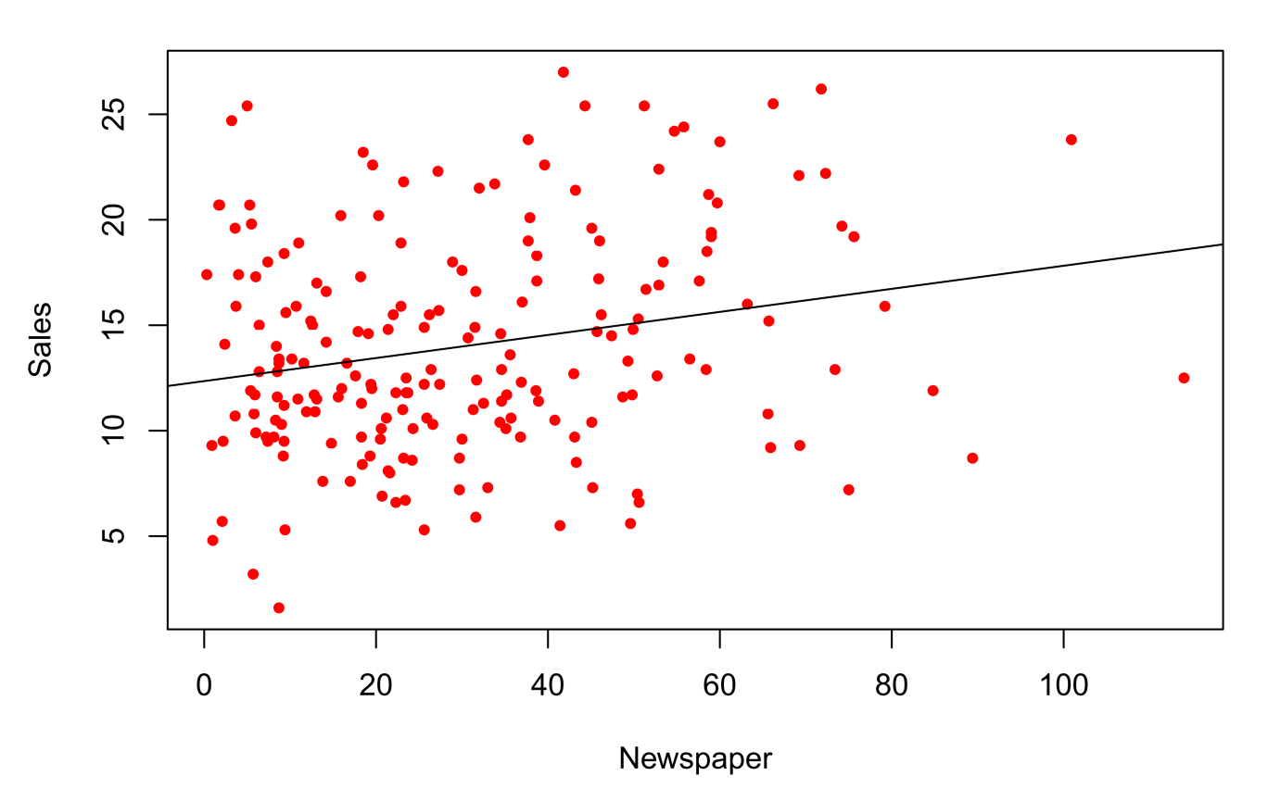
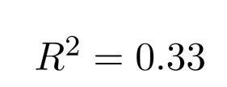


Advertisement Data

Slide 20
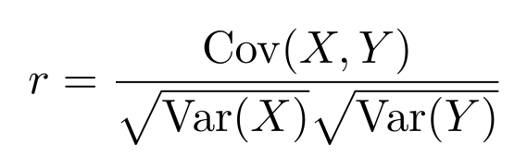
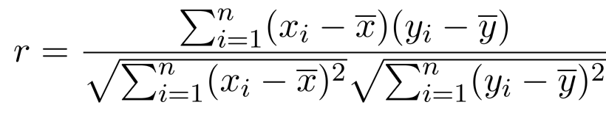

Correlation Coefficient
  Measures dependence between two random variables X and Y
  Correlation coefficient r is between [-1, 1]
    0: Variables are not linearly related
    1: Variables are perfectly related (same)
    -1: Variables are negatively related (different)

Slide 21
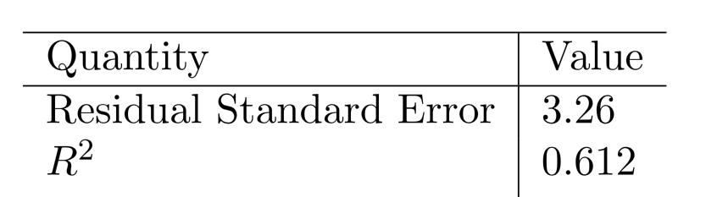
Advertising data results

Slide 22



Multiple Linear Regression
  Usually more than one feature is available
  In general
  We interpret as the average eﬀect on Y of a one unit increase in,
  holding all other predictors ﬁxed.
  Claims of causality should be avoided for observational data.

Slide 23



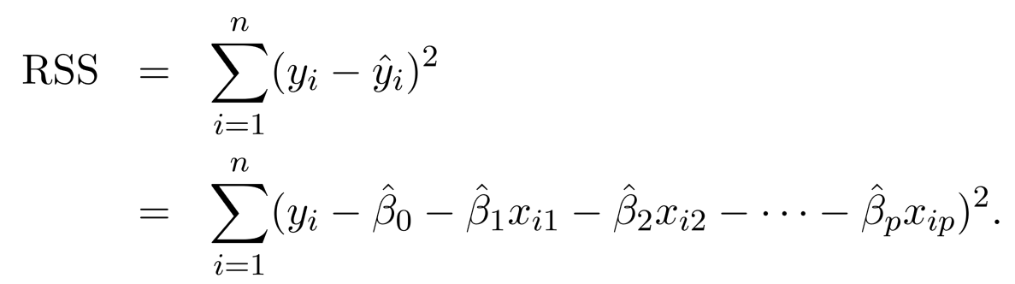
Estimation and Prediction
  Given estimates we can make predictions using
  We estimate by minimizing the sum of squared residuals

Slide 24
Estimation and Prediction
  Linear algebra to derive it

Slide 25
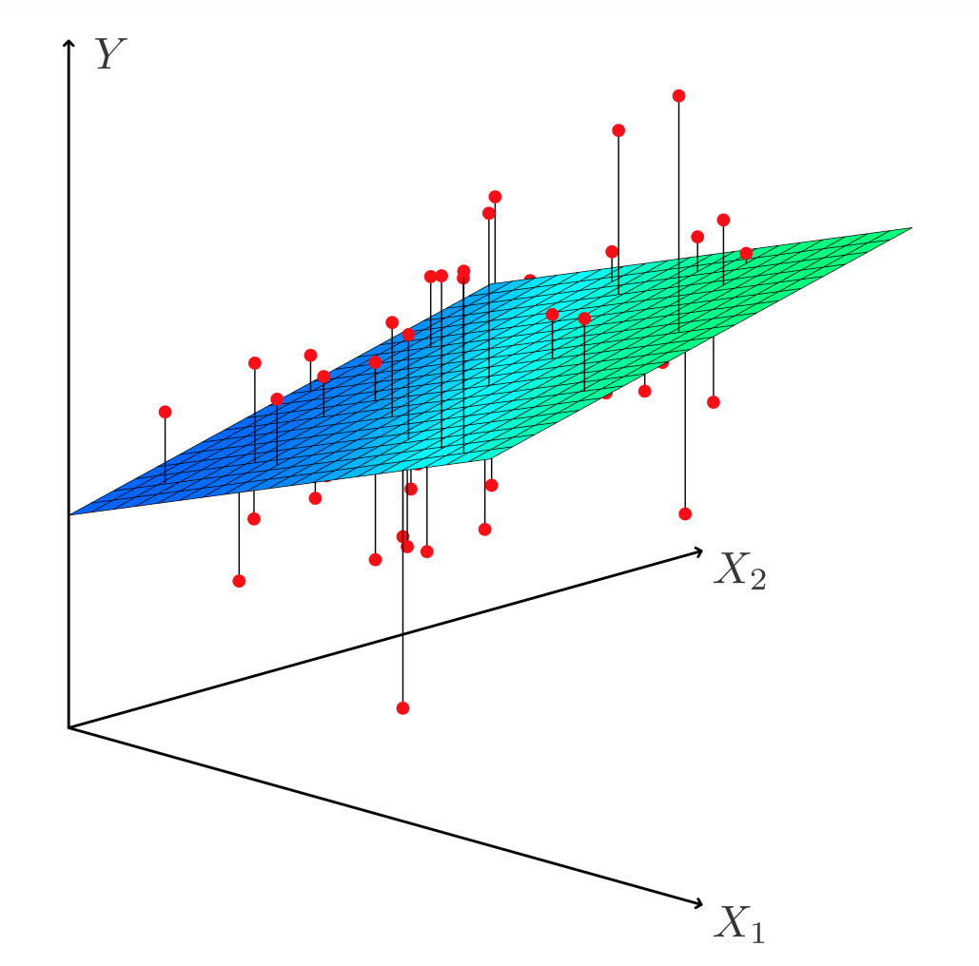
Estimation and Prediction

Slide 26
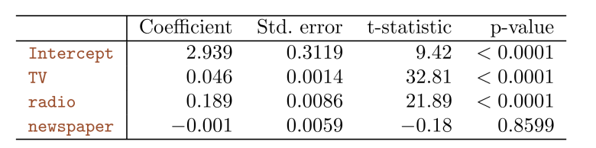
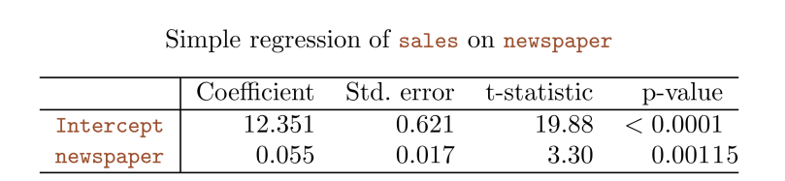
Results for Ad. Data

Slide 27
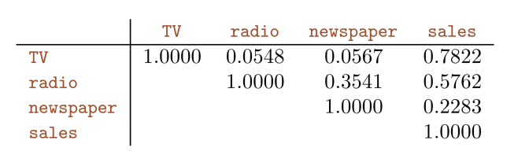
Results for Ad. Data

Slide 28
Some Important Questions
  Is at least one of the predictors useful in predicting the response?
  Do all the predictors help to explain Y, or is only a subset of the of the predictors useful?
  How well does the linear model fit the data?
  Given a set of predictor values, what response value should we predict, and how accurate is our prediction?

Slide 29
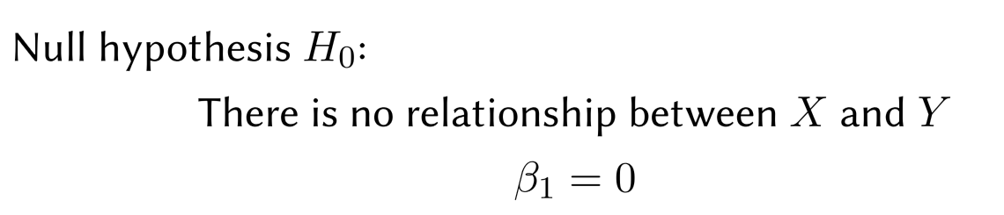

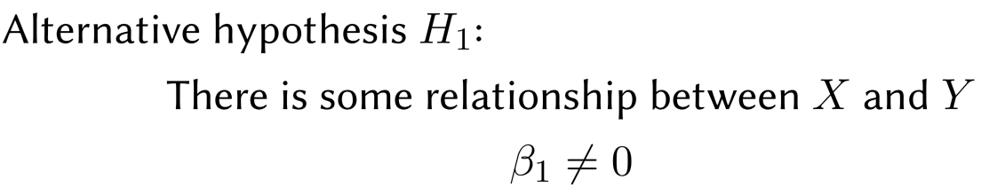

Inference 1
  Is at least one of the predictors useful in predicting the response?
  Seek to reject hypothesis H₀ with small p-value

Slide 30
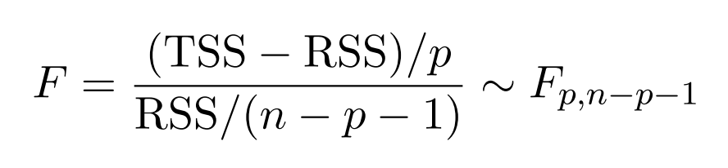
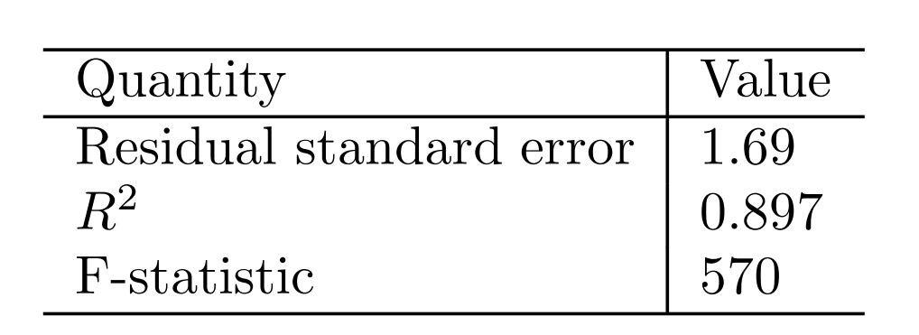
Inference 1
  We will use the following random variable

Slide 31
Deciding on the important variables
  The most direct approach is called all subsets or best subsets regression: we compute the least squares ﬁt for all possible subsets and then choose between them based on some criterion that balances training error with model size.
  However, we often can’t examine all possible models, since they are xxx of them; for example, when p = 40 there are over a billion models!
  Instead we need an automated approach that searches through a subset of them. We discuss two commonly use approaches next.

Slide 32
Forward selection
  Begin with the null model — a model that contains an intercept but no predictors.
  Fit p simple linear regressions and add to the null model the variable that results in the lowest RSS.
  Add to that model the variable that results in the lowest RSS amongst all two-variable models.
  Continue until some stopping rule is satisﬁed, for example when all remaining variables have a p-value above some threshold.

Slide 33
Backward selection
  Start with all variables in the model.
  Remove the variable with the largest p-value — that is, the variable that is the least statistically signiﬁcant.
  The new (p − 1)-variable model is ﬁt, and the variable with the largest p-value is removed.
  Continue until a stopping rule is reached. For instance, we may stop when all remaining variables have a signiﬁcant p-value deﬁned by some signiﬁcance threshold.

Slide 34
Model selection
  Other methods including AIC, BIC, adjust R2 and Cross-validation (CV)

Slide 35
Confidence Interval and Prediction Interval

Slide 36
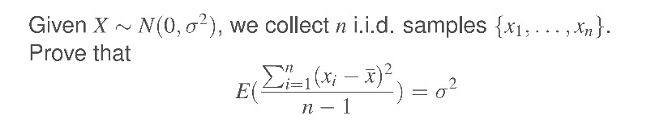
Bonus Quiz 6

Slide 37
Bonus Quiz 7
Given n = 100 and the following table, what is the TSS?

