Slide 1

Module 7: Non-Linear Model
Nov 1st, 2021

Slide 2
Moving Beyond Linearity
The truth is almost never linear.
Linear assumption is a good starting point
When it is not linear
Polynomials;
Step functions;
Splines;
Local regression

Slide 3
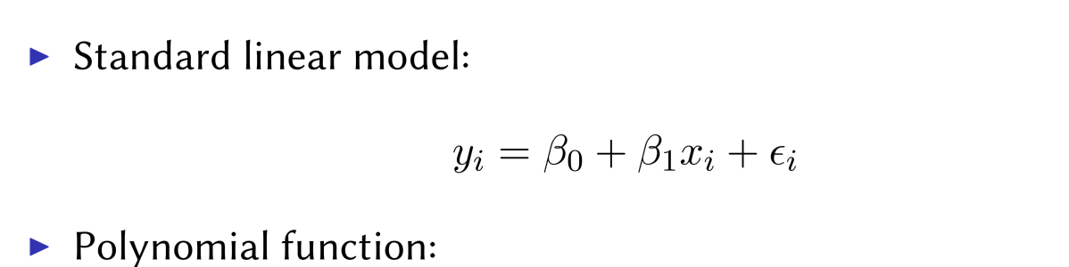
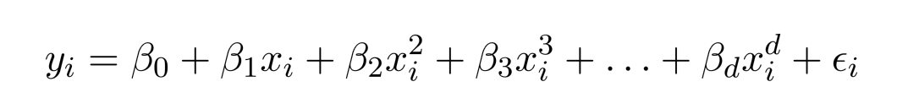
Polynomial Regression

Slide 4
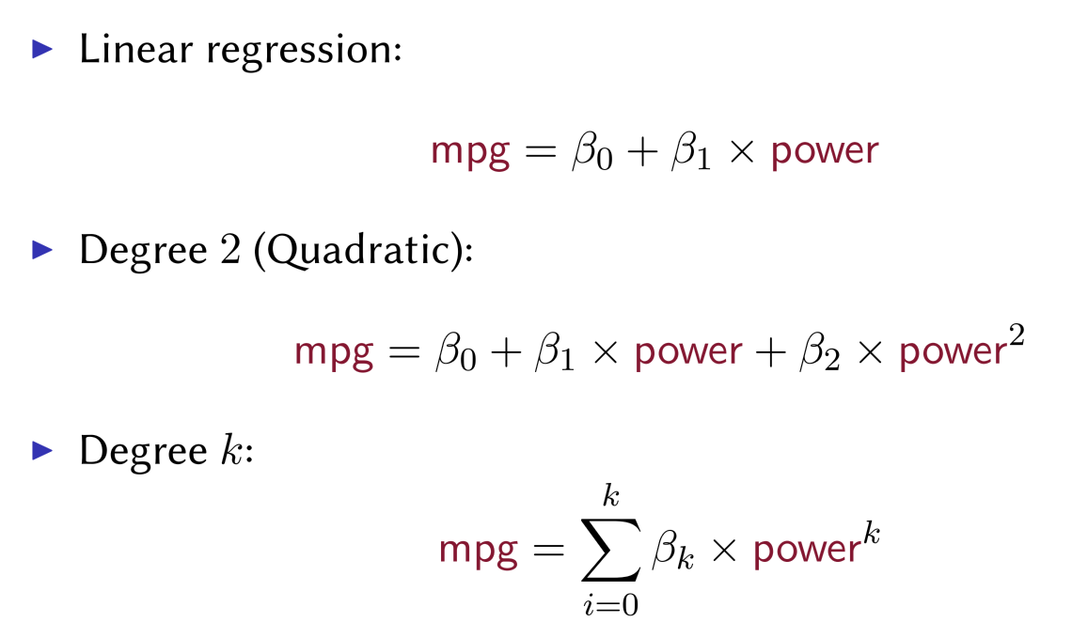
Example: Polynomial Regression

Slide 5
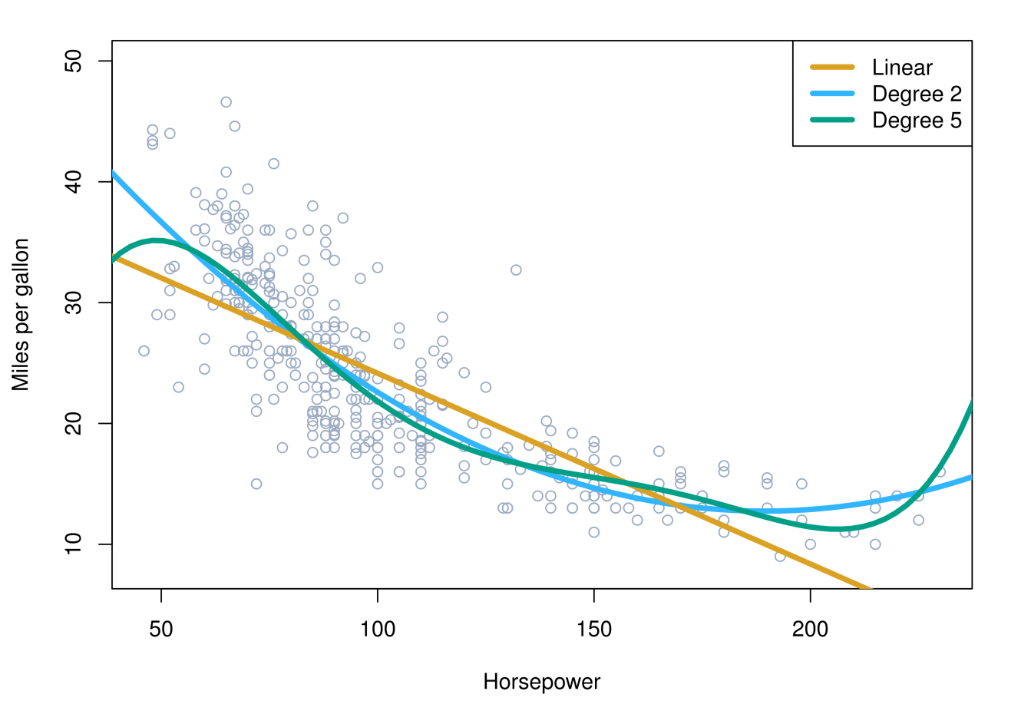
Example: Polynomial Regression

Slide 6
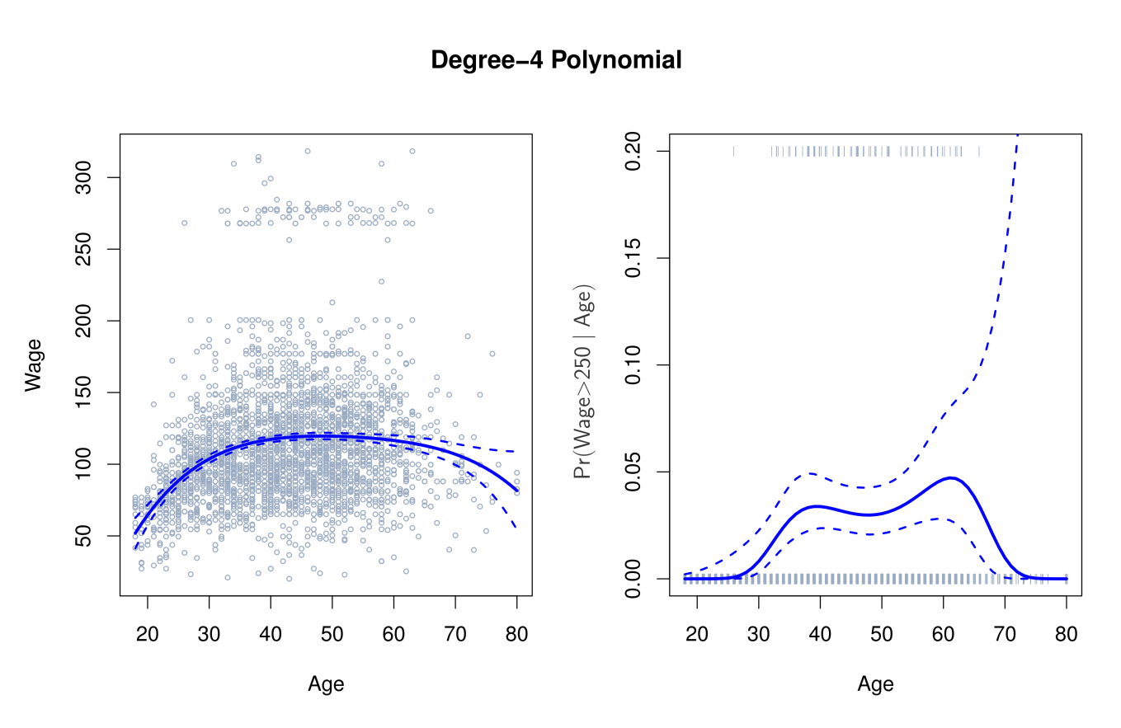
Polynomial Functions

Slide 7
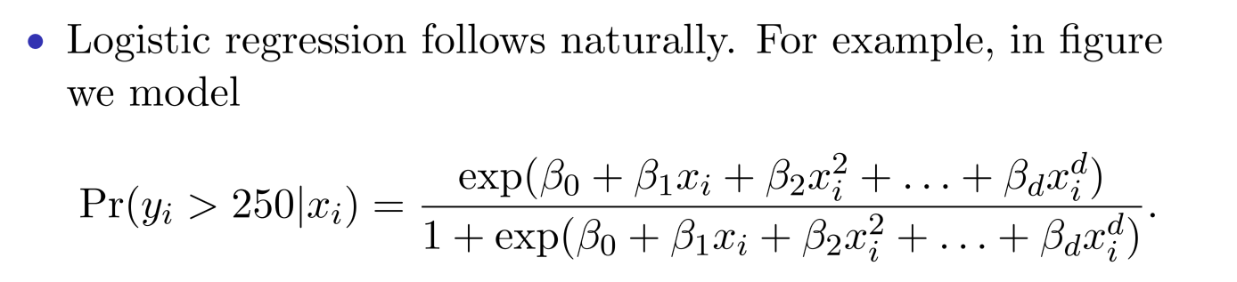
Polynomial Functions

Slide 8
Drawbacks for Polynomial Regression
Imposes a global structure.
Lack flexibility on local structure.
Unstable in extreme ranges

Slide 9
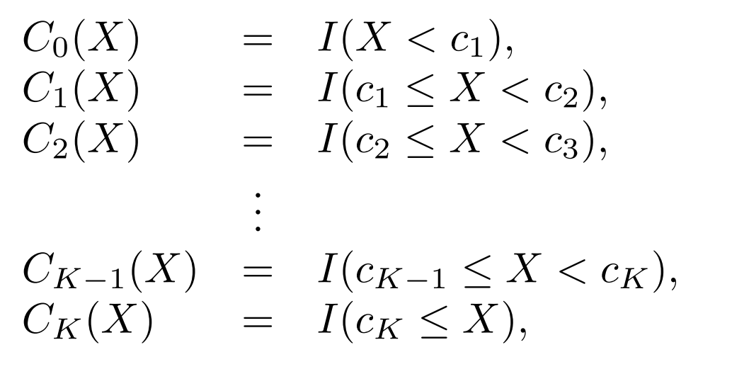
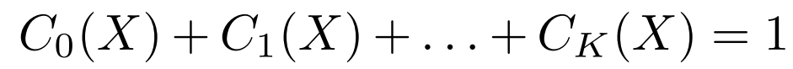
Step Functions
To impose local structure, we can transform a continuous variable by cut it into distinct regions.
For any X,
Then we can fit a linear model

Slide 10
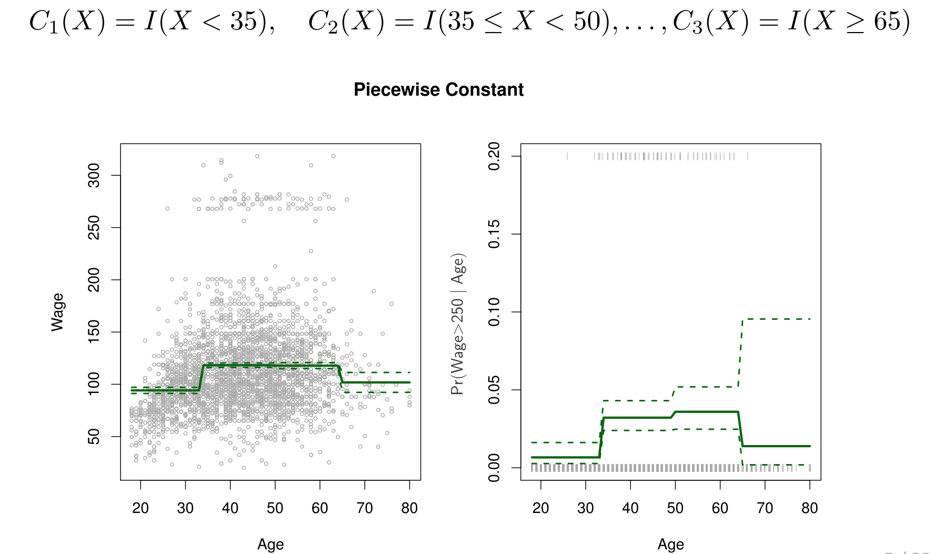
Step Functions
Step functions are not continuous!

Slide 11


Basis Functions
A set of functions can be applied to a variable X
Key thing here is those functions are given.
We then can fit a linear function
For polynomial regression, the bases are
For the step function regression, the bases are ?
Polynomials are not local
Step functions are not continuous or smooth
Regression Spline are local and smooth!

Slide 12

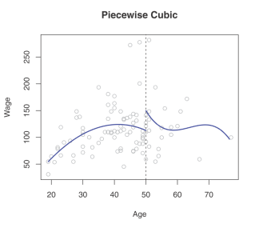
Regression Splines
To combine the flexibility of polynomial and locality of step function
How many parameters?

Slide 13
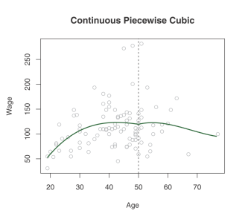
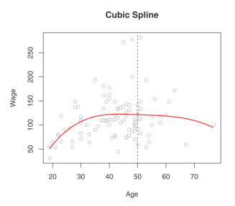
Regression Functions
To combine the flexibility of polynomial and locality of step function
How to impose continuity?

Slide 14
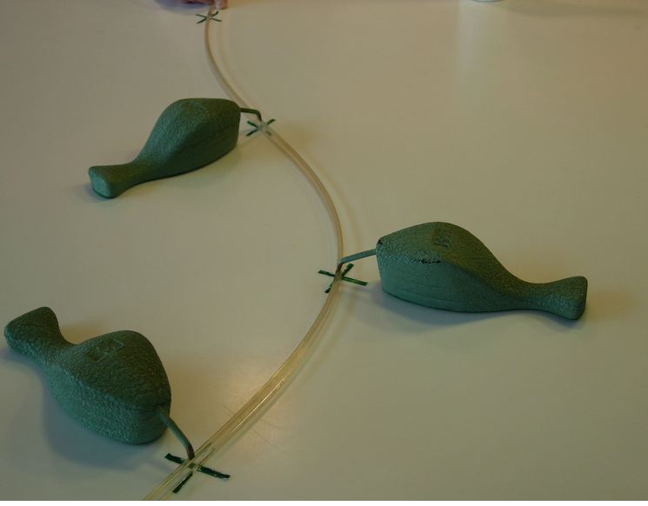
Splines
Spline: a curve formed by pasting several smaller pieces of curves together
Named after the draftman’s tool - spline, a thin ﬂexible rod made of metal, plastic or wood held in place by weights for drawing smooth curves that go through certain points
To define a spline, we need
Knots: locations where the joining occurs
Smaller curves: used to form the larger one

Slide 15
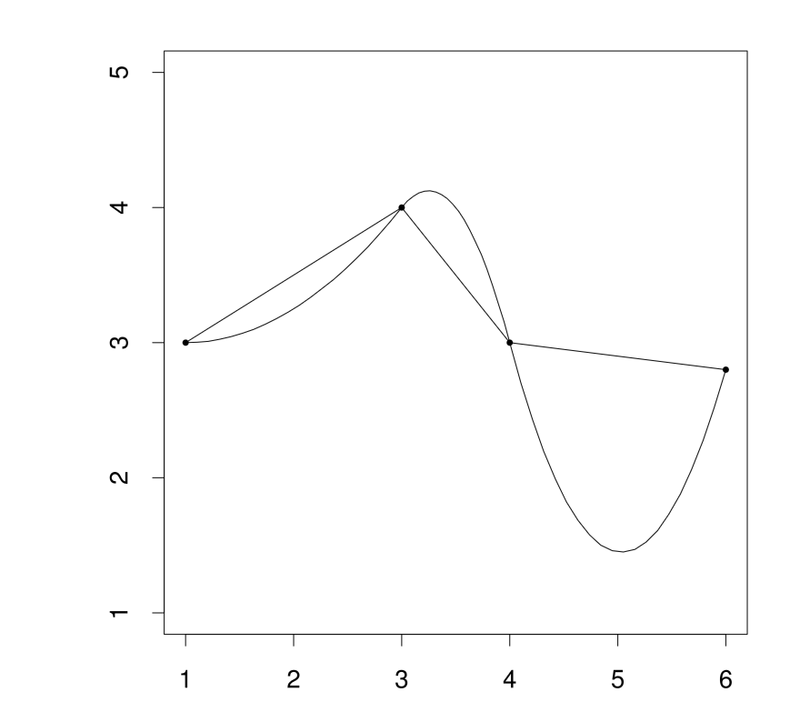
Linear and Quadratic Splines

Slide 16
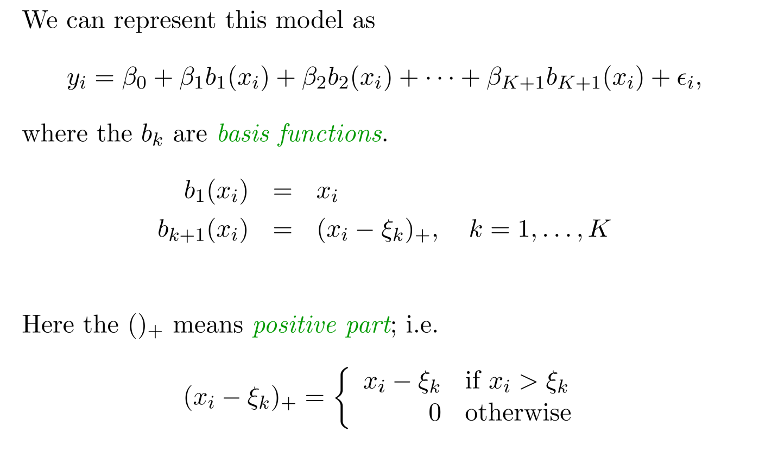
Linear Splines

Slide 17
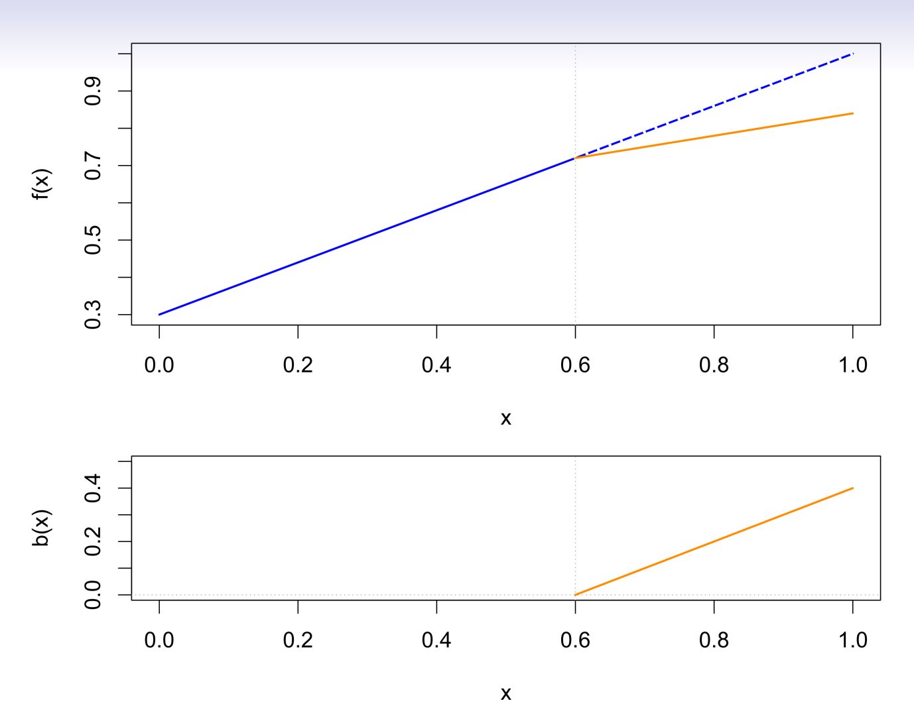
Linear Splines

Slide 18
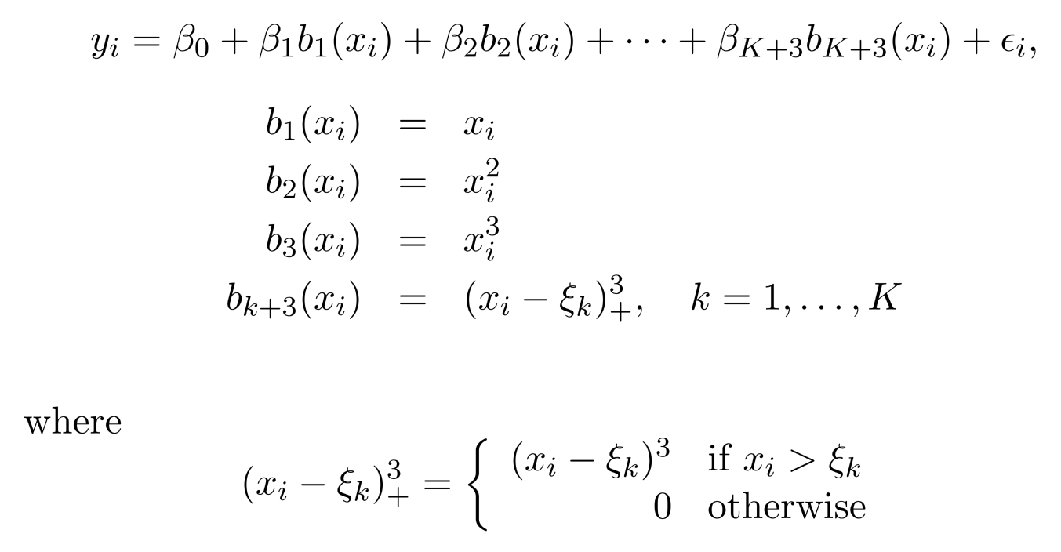
Cubic Splines

Slide 19
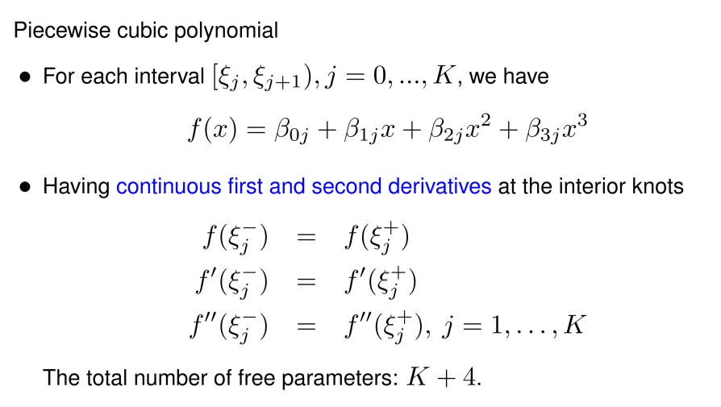
Cubic Splines

Slide 20
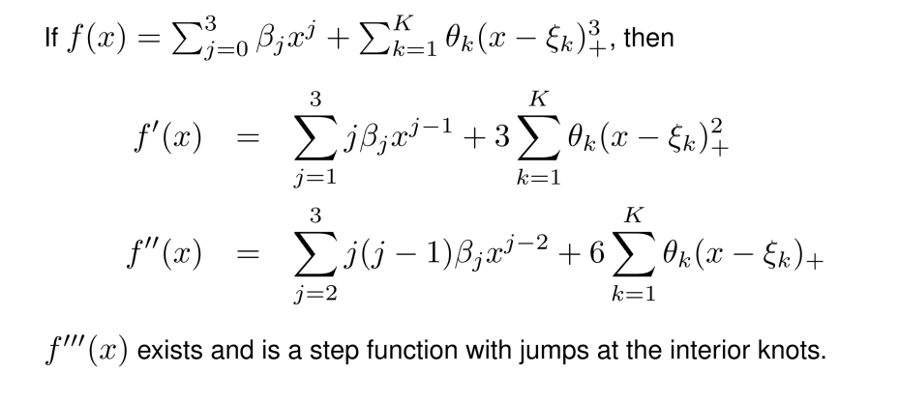
Cubic Splines

Slide 21
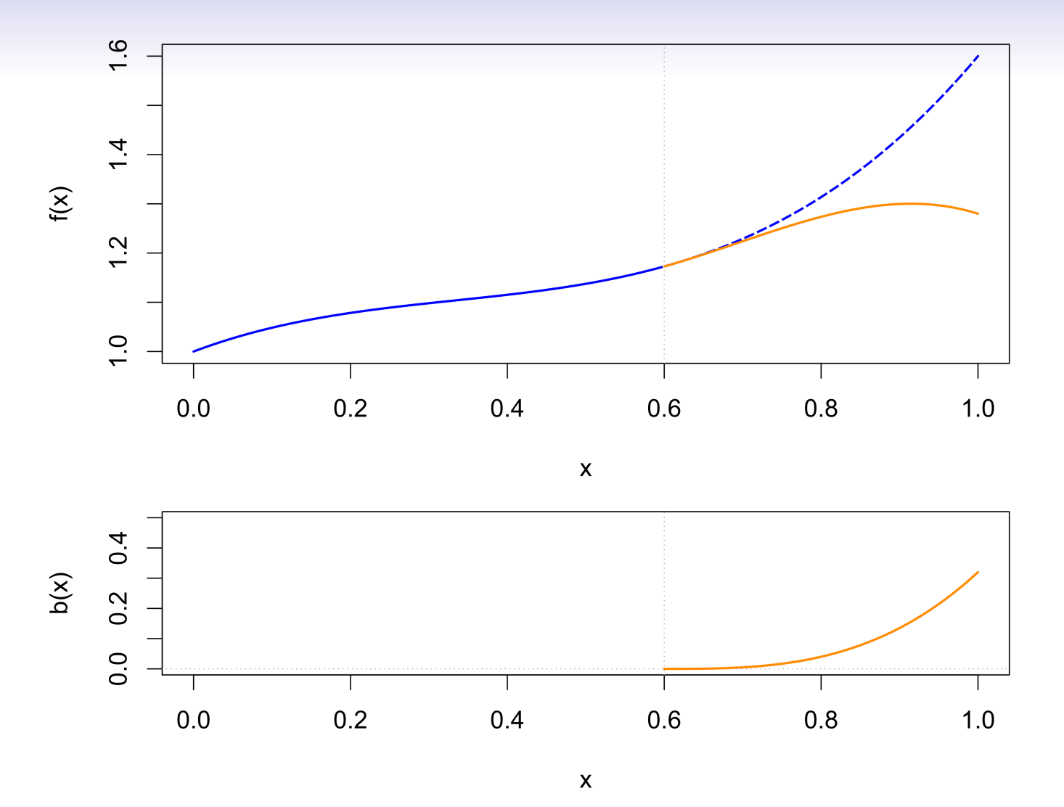

Slide 22
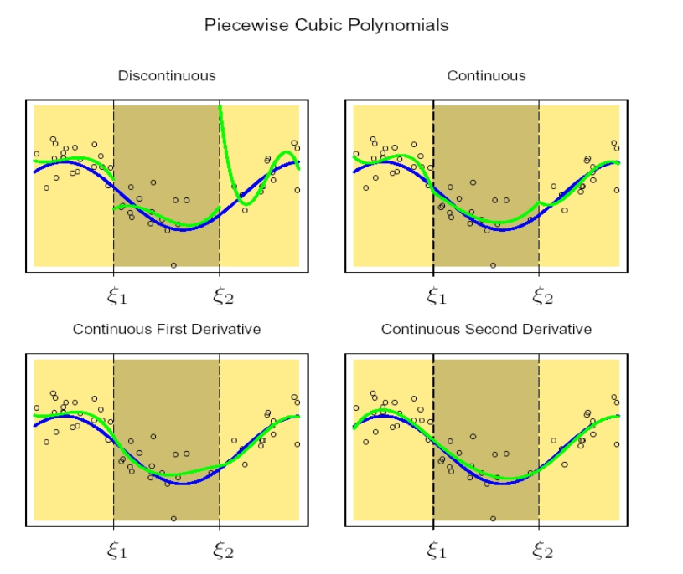

Slide 23
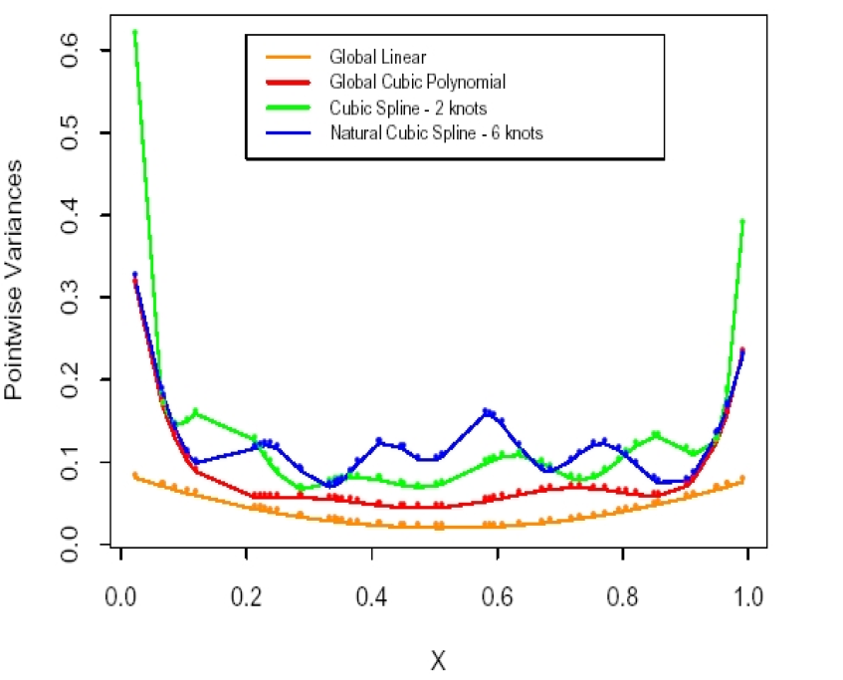
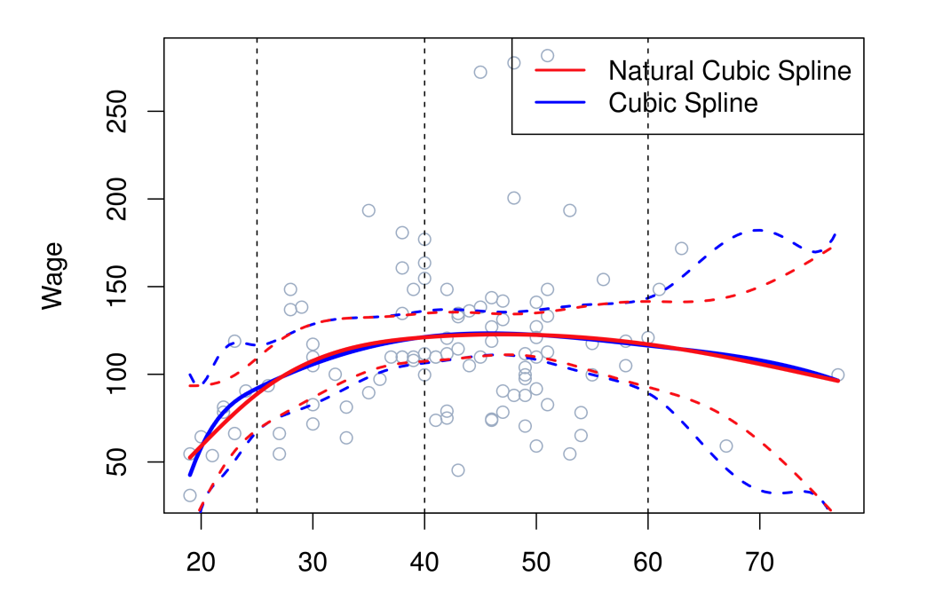
Natural Cubic Spline
Beyond the boundary, we have less data. Variance vs Bias
We will extrapolate. linearly beyond the boundary knots. Increase bias but decrease the variance

Slide 24
Choosing Knots
Change of mode (some natural cutoff, retirement, 21 yrs, 18 yrs?)
Number of knots (K) related to the degrees of freedom
Decide K, the number of knots first, and then place them at appropriate quantiles of the observed X.
A cubic spline with K knots has K + 4 parameters or degree of freedom
A natural spline with K knots has K df. Why?

Slide 25
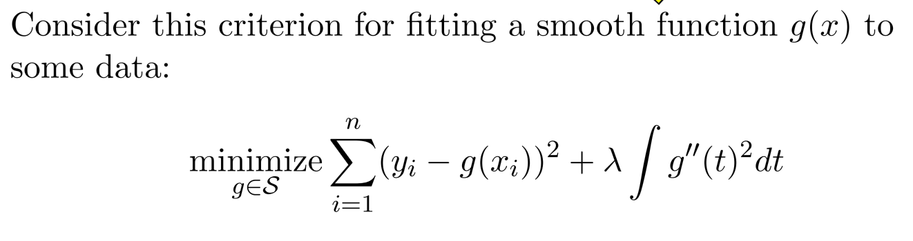
Smoothing Splines
Choosing knots are tedious and arbitrary. Can we skip this step?
Have knots at every unique value of x. (maximal set of knots)
Avoid the knot selection problem.
The first term measures the closeness of the model t the data.
The second term penalizes the roughness/curvature of the function.
The second term is called the roughness penalty

Slide 26
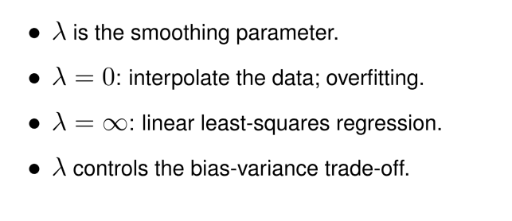
Role of the Tuning Parameter

Slide 27
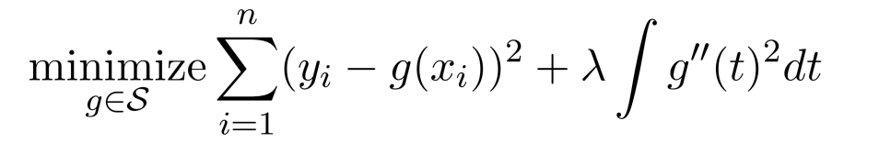
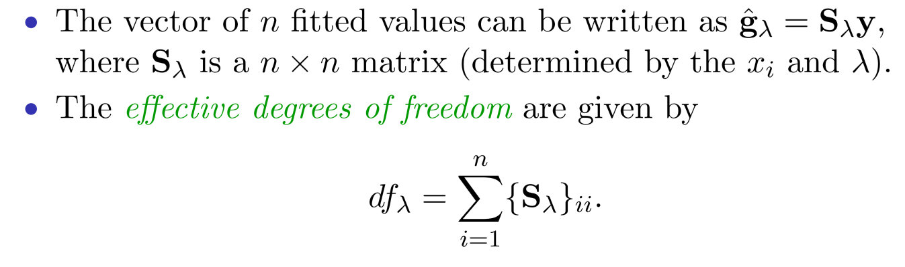
Connection to Natural Cubic Spline
The minimizer is a natural cubic spline, with a knot at every unique value of x.
We can select the tuning parameter by LOOCV.

Slide 28
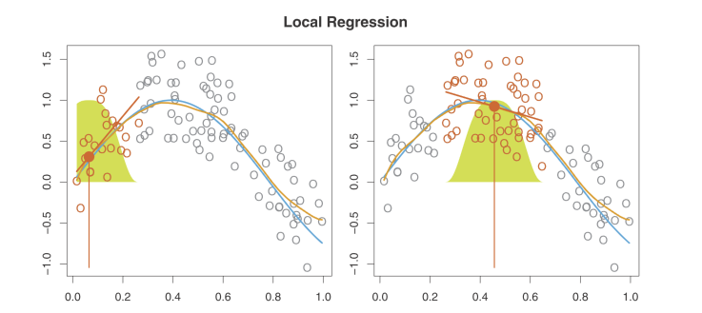
Local Regression
Using sliding window to fit weighted least squares

Slide 29
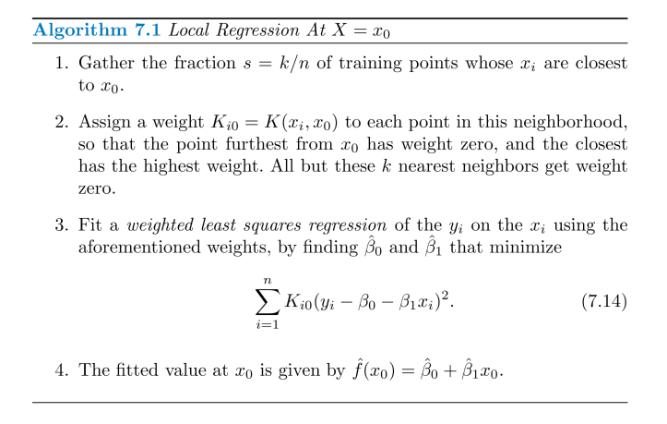
Local Regression

Slide 30
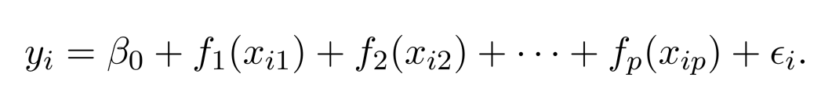
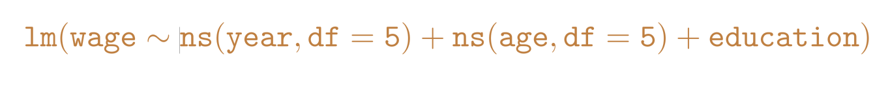
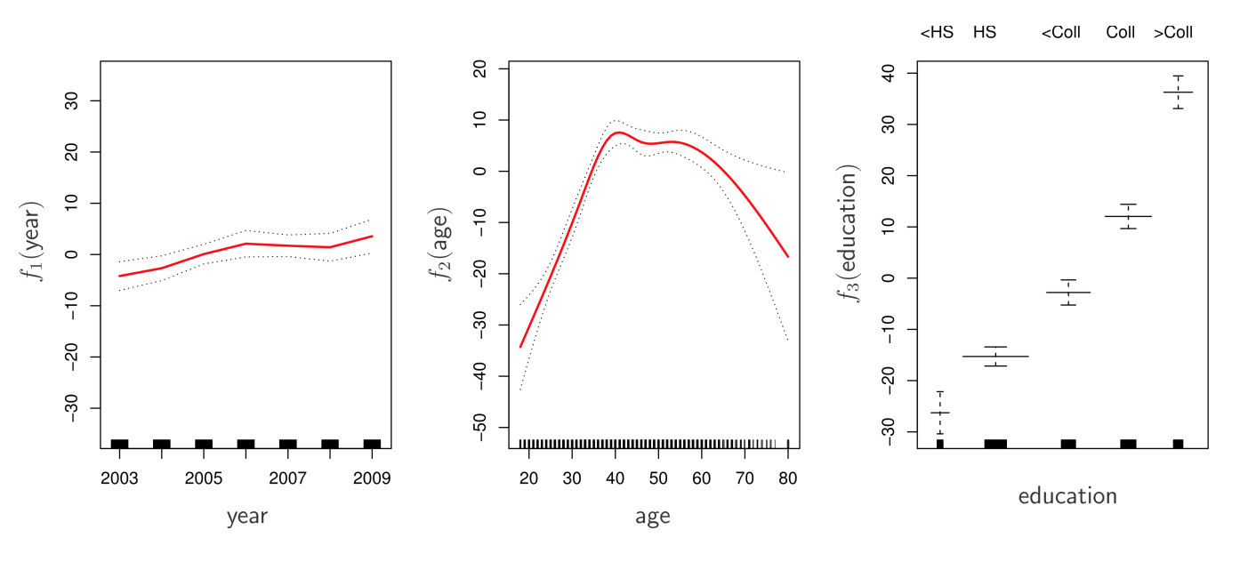
Generalized Additive Models
Previous methods only handle one predictor.
We can generalize it into multiple variables to allow nonlinearities.

Slide 31
Bonus Quiz 24
For a natural spline with K knots, how many parameters do we have?

