Slide 1

Module 9: Support Vector Machine
Nov 10th , 2021

Slide 2
Classifiers
How many classifiers do you learn?
A new classifier: Support Vector Machine (SVM)
Find a hyperplane that separate the classes in feature space

Slide 3
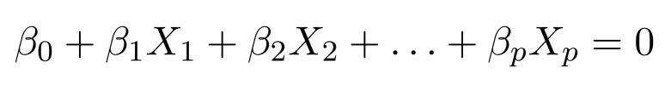

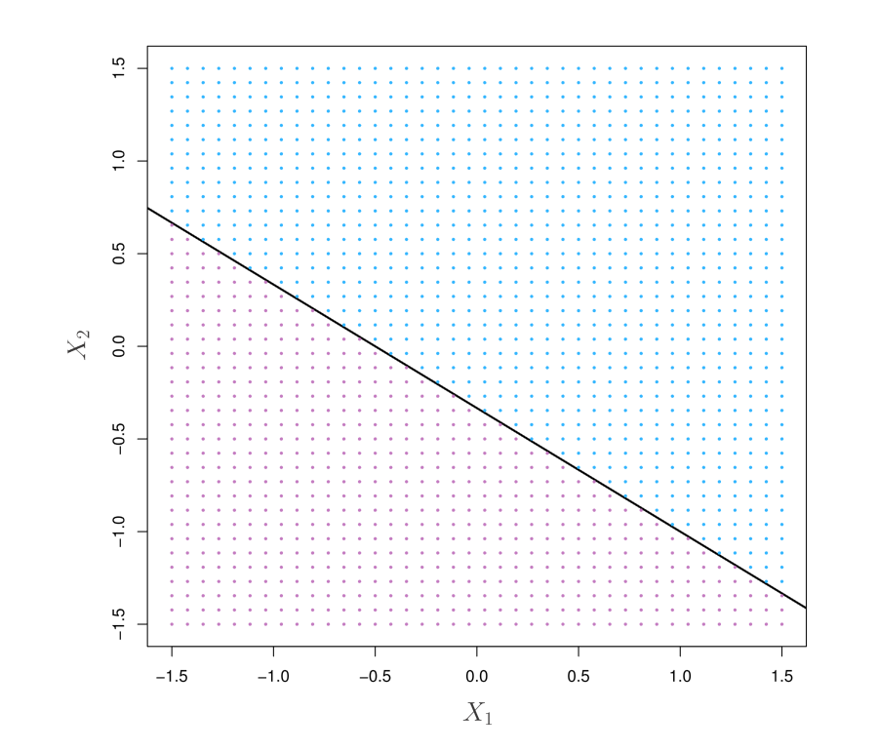
Hyperplane
In a p-dimensional space, a hyperplane is a ﬂat aﬃne subspace of
dimension p − 1.
A hyperplane has the form
The vector is called the normal vector. It points in a direction orthogonal t the surface of a hyperplane.

Slide 4
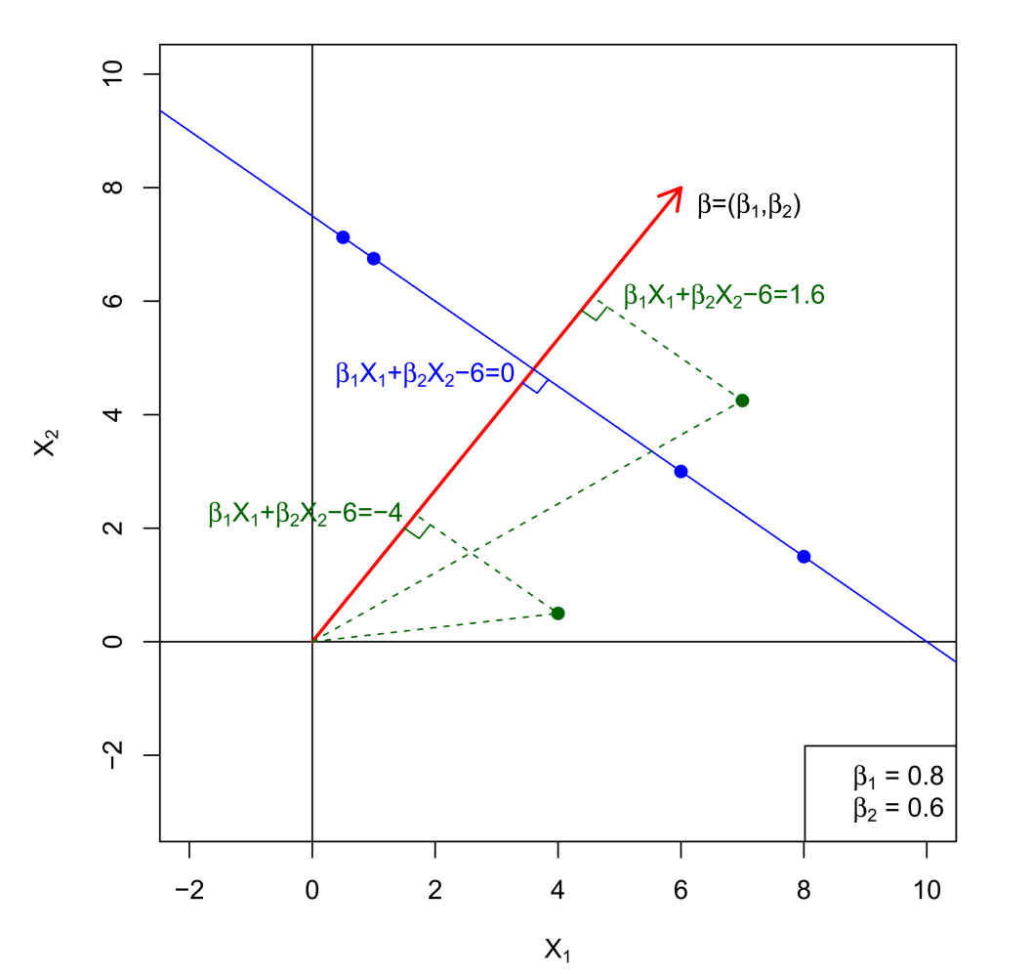


Hyperplane
When , then
is the distance from point X to the hyperplane.

Slide 5
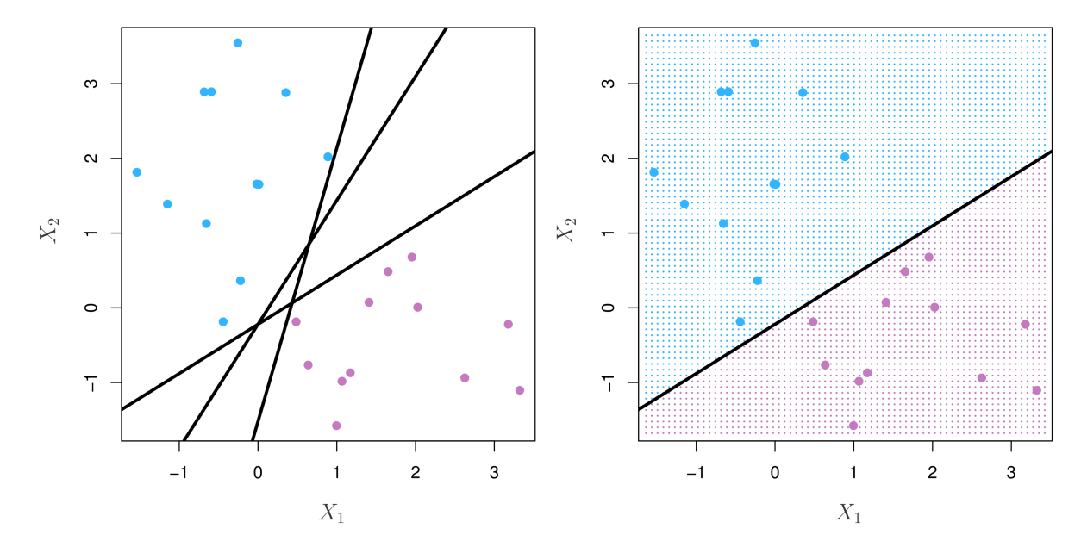

Separating Hyperplanes
If , then f(X) = 0 defines a separating hyperplane.

Slide 6
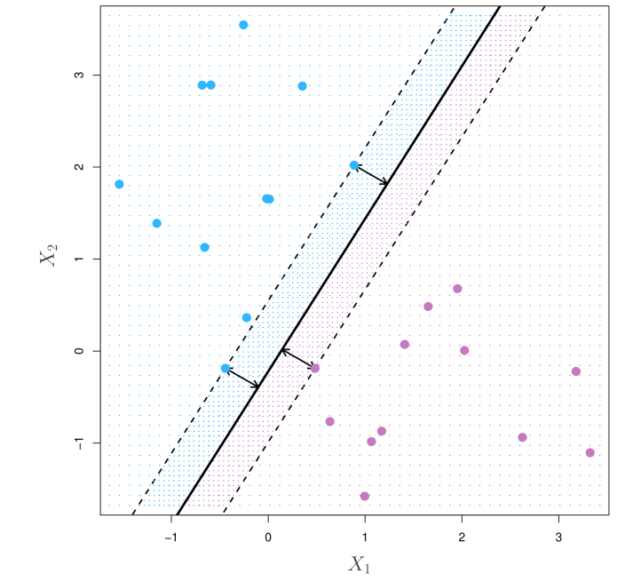
Maximal Margin Classifier
Among all separating hyperplanes, ﬁnd the one that makes the biggest gap or margin between the two classes.
The minimal distance from the training data to the hyperplane is known as the margin.
We want to find the hyperplane
with the largest margin.
We can then classify a test data
based on which side of the
maximal margin hyperplane it lies.

Slide 7
Maximal Margin Classifier
Points on the dashed lines have the same distance to the hyperplane and are called support vectors.

Slide 8
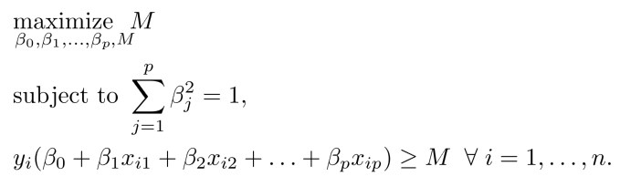
Separable Data
Here, M > 0

Slide 9
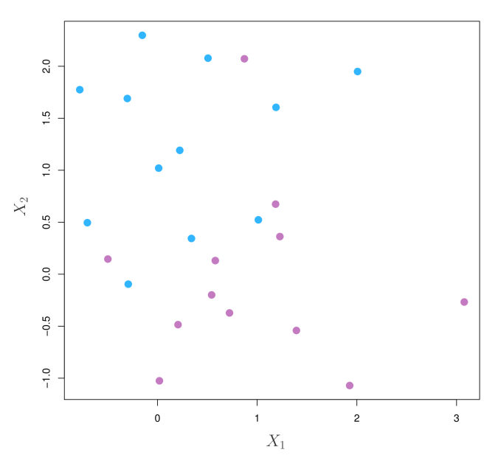
Non-Separable Data
Life is noisy. Rarely lucky enough to get separable classes

Slide 10
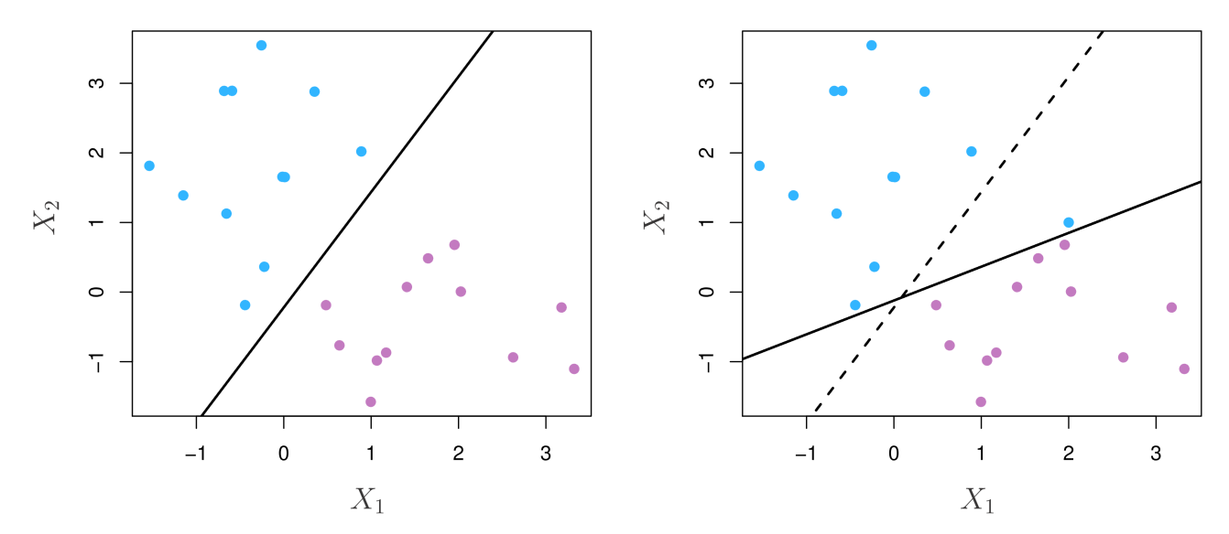
Almost Unseparable Data
Maximum Margin can be brittle even when classes are separable.
To robustify the classifier for most of the training observations.
Solution: A soft margin

Slide 11
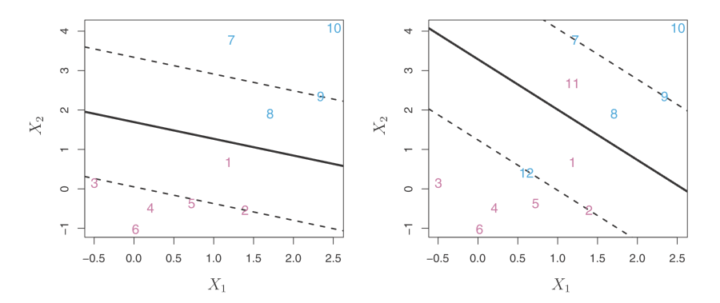
Support Vector Classifier
The support vector classifier: allow some observations to be on the wrong side of the hyperplane.

Slide 12
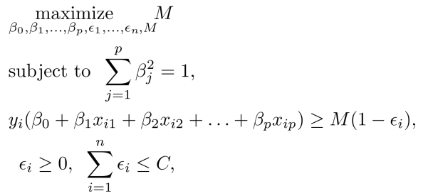

Support Vector Classifier

Slide 13
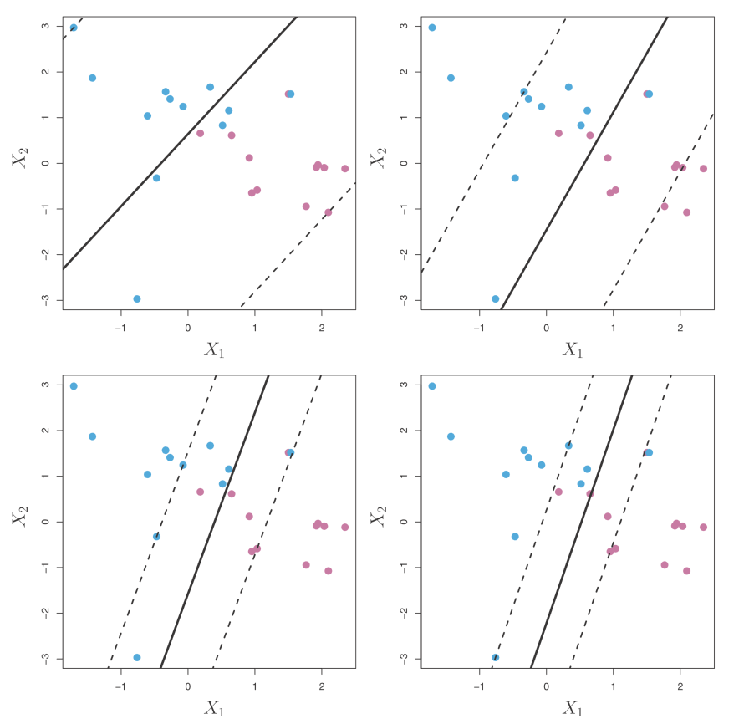
Effect of Decreasing Parameter C

Slide 14
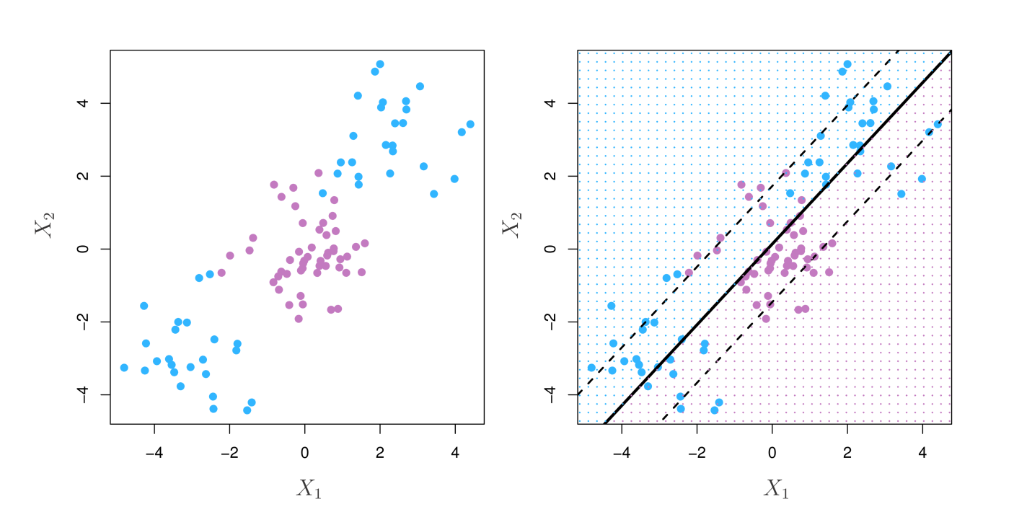
What About Nonlinear Data?

Slide 15
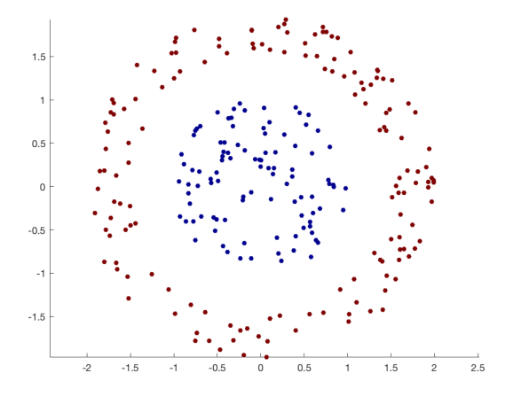
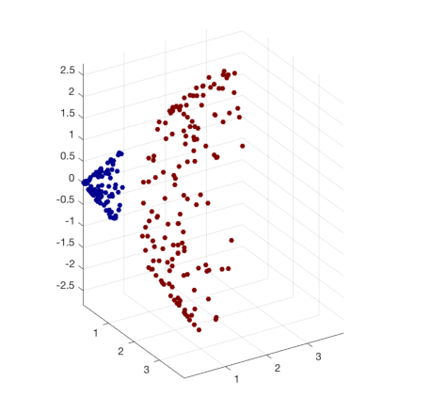
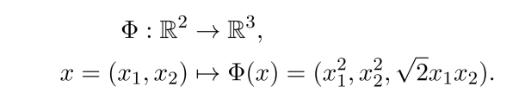
What About Nonlinear Data?

Slide 16
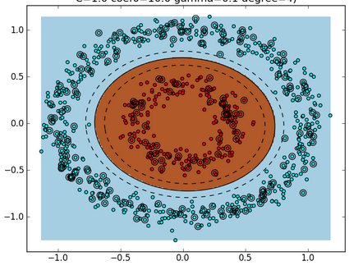
Kernel Trick: Feature Expansion
Enlarge the space of features.
Fit an SV classifier in the enlarged space
This leads to non-linear decision boundaries in the original space.

Slide 17
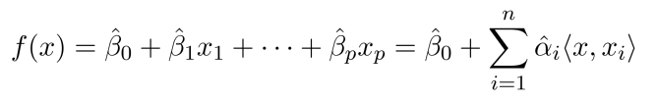
Inner Products and Kernel
After solving
The linear support vector classifier can be represented as

Slide 18


Inner Products and Kernel
The linear support vector classifier can be represented as
To estimate the parameters, all we need are the inner products
between all pairs of training data.
If we can compute inner-products between observations, we can fit a SV classifier. We can generalize inner-product to kernel

Slide 19
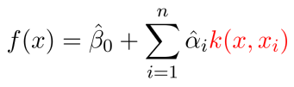

Inner Products and Kernel
The kernel version SV classifier can be represented as
To estimate the parameters, all we need are the inner products
between all pairs of training data.

Slide 20

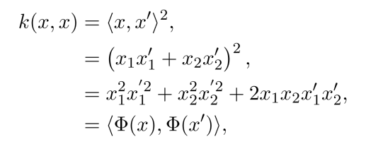
Kernel Trick

Slide 21
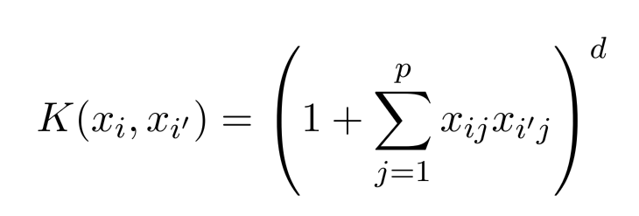
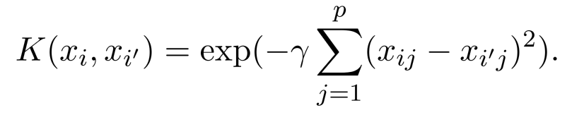
Kernels
Polynomial Kernel
Radial Kernel
And many more

Slide 22
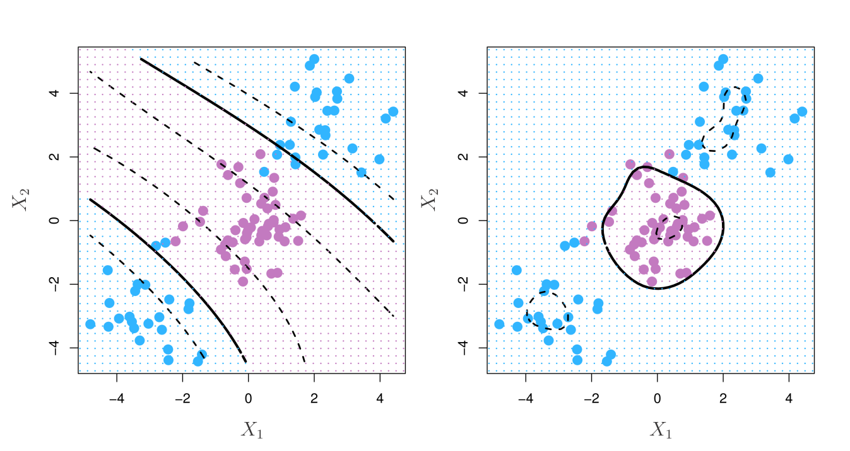
Polynomial and Radial Kernels

Slide 23
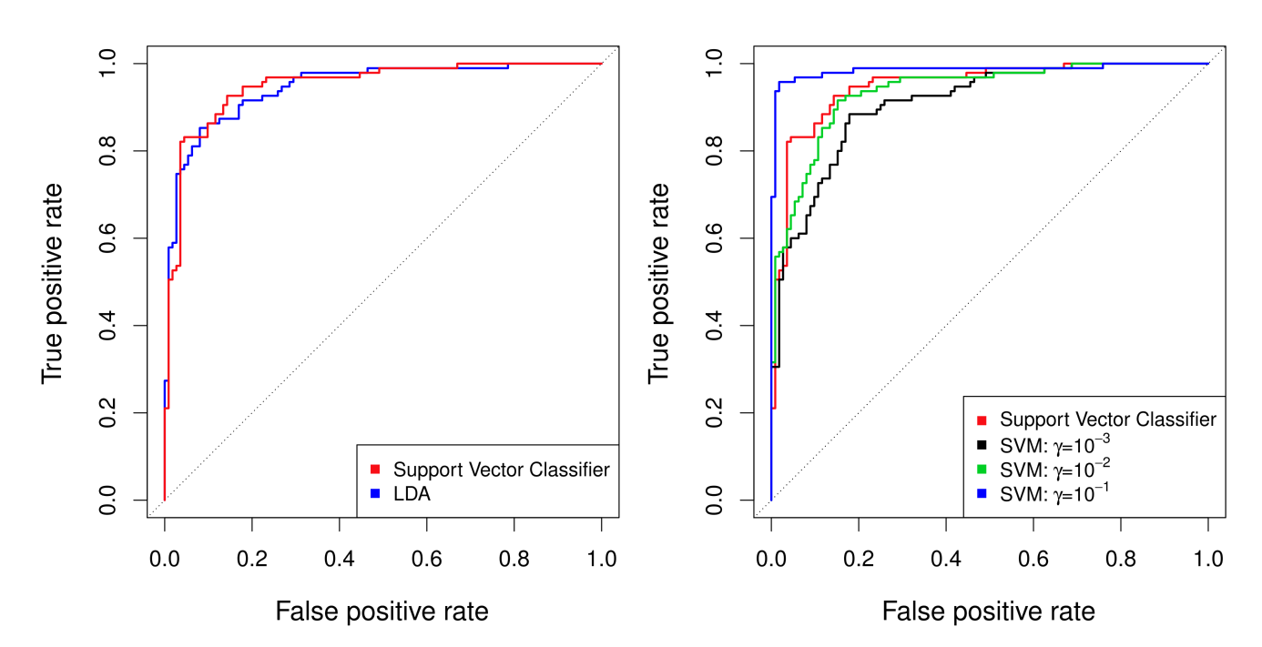
Example: Heart Data
For training data

Slide 24
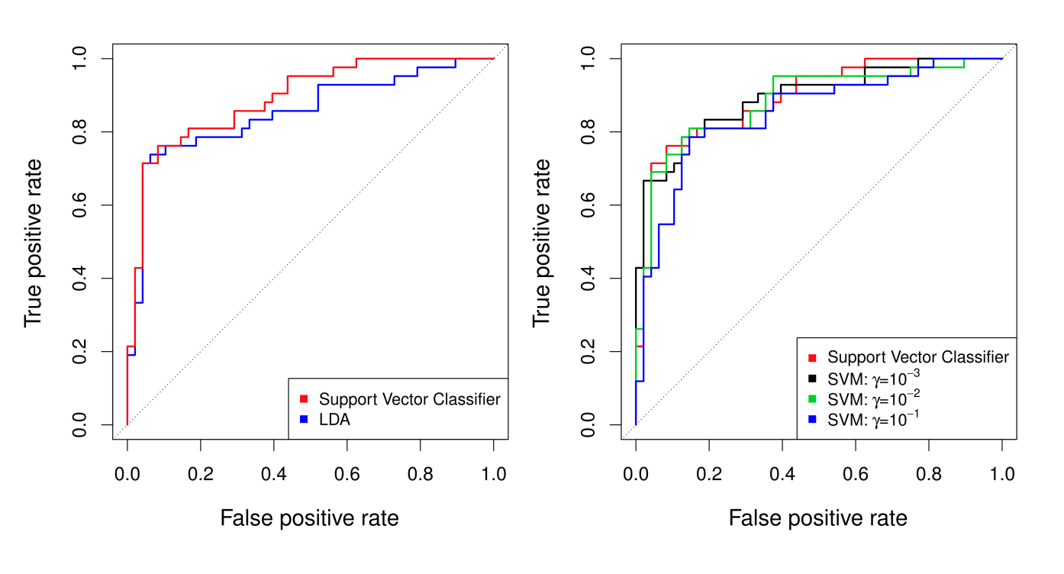
Example: Heart Data
For test data

Slide 25
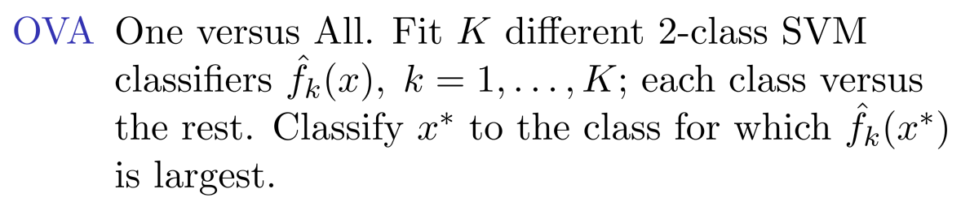
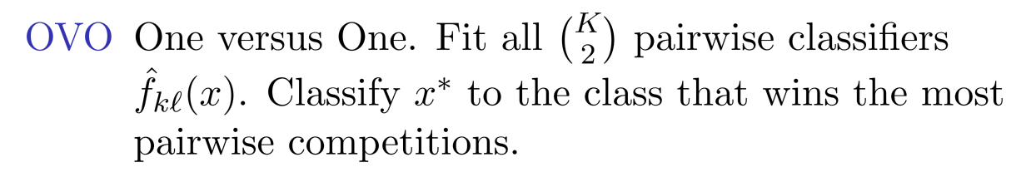
Multiple Classes
One-vs-all
One-vs-One

Slide 26
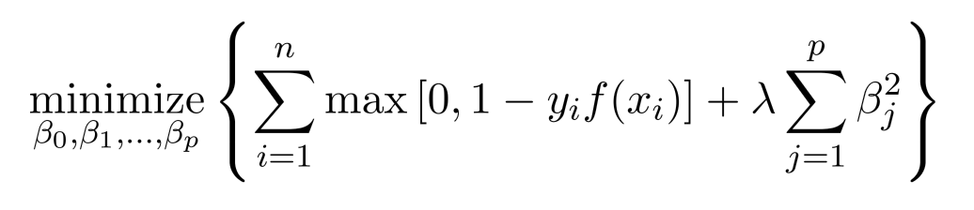
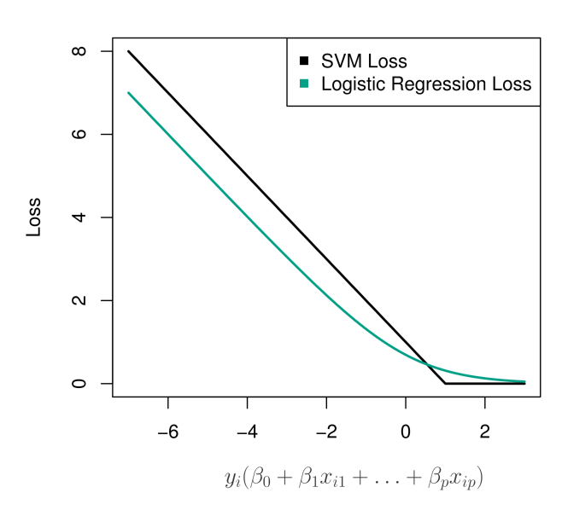
SVM vs Logistic Regression
Logistic regression: Minimize negative log likelihood
SVM: Minimize hinge loss

Slide 27
SVM vs Logistic Regression
When classes are well separable, SVM is preferred.
In more overlapping regimes, logistic regression is preferred
If you wish to estimate probability, logistic regression is the one
For nonlinear boundaries, kernel SVMs are preferred.

