Slide 1

Review
Feb 17, 2021

Slide 2
Supervised vs Unsupervised learning
Supervised learning

Slide 3
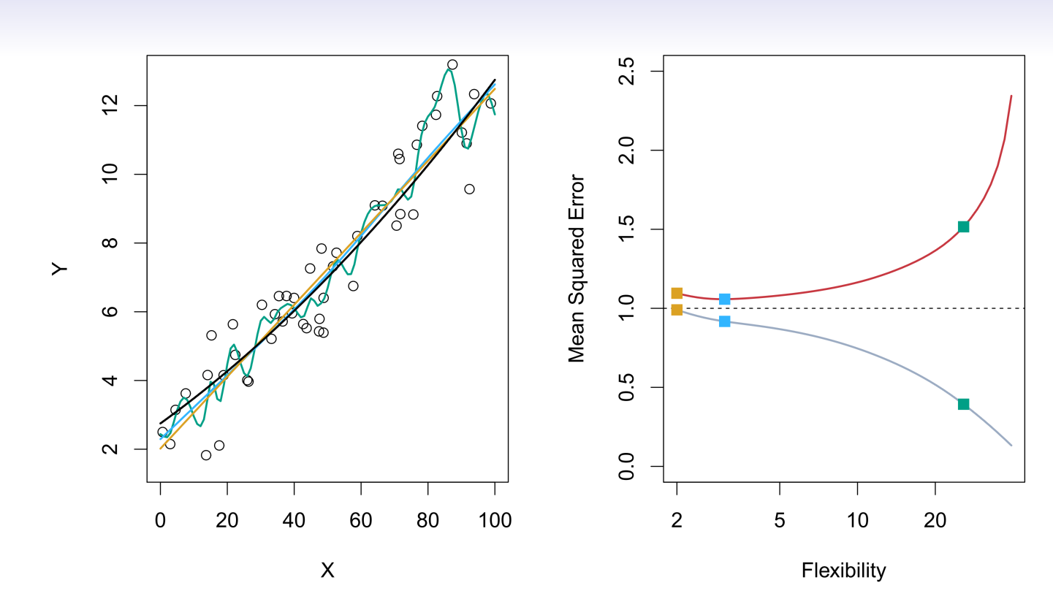
Do We Need Test Data?

Slide 4
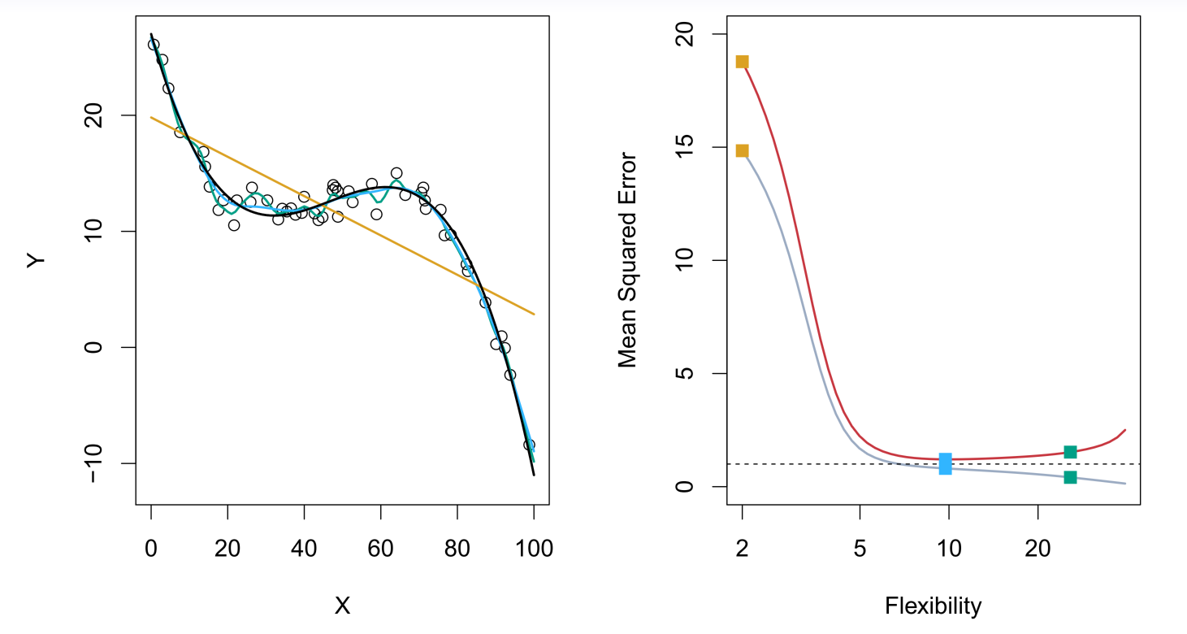
Do We Need Test Data?

Slide 5

Bias-Variance Trade-off
Tr₁
Tr₂
Tr₃
X | Y
10 | 1
12 | 2
19 | 1
X | Y
9 | 1.1
11.1 | 2.2
13 | 3
X | Y
9 | 1.1
11.1 | 2.2
13 | 3.4

Slide 6

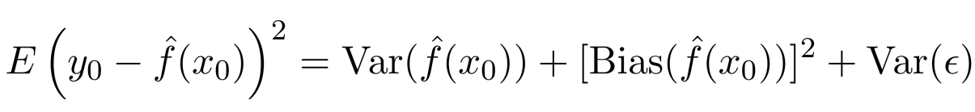


Bias-Variance Trade-off
Suppose we have ﬁt a model to some training data Tr_{1.}
If we have another set of training data Tr₂ to fit a model, will be the same?
Let be a test observation drawn from the population. If the true model is
We have
The expectation average over the variability of and Tr.
Typically as the ﬂexibility of increases, its variance increases, and its bias decreases. Selecting the ﬂexibility based on average test error amounts to a bias-variance trade-oﬀ.
Bias: if you have many sets of training data, the average prediction from the truth.

Slide 7
Study Groups: Meeting Time
Turtle | Wed 4-6 pm
Phoenix | Mon 6-8 pm
Dragon | Tue 6-8 Wed 4-6
Tiger | Tue, Thurs 6:30 pm – 7:30pm

Slide 8
Study Groups: Attendance
1. Students can attend other teams' group meeting if they couldn't make the study group in their own team occasionally.
2. Attending office hours is also counted as attending study-groups.
3. Interacting with teammates via text channel is also counted as participation.

Slide 9
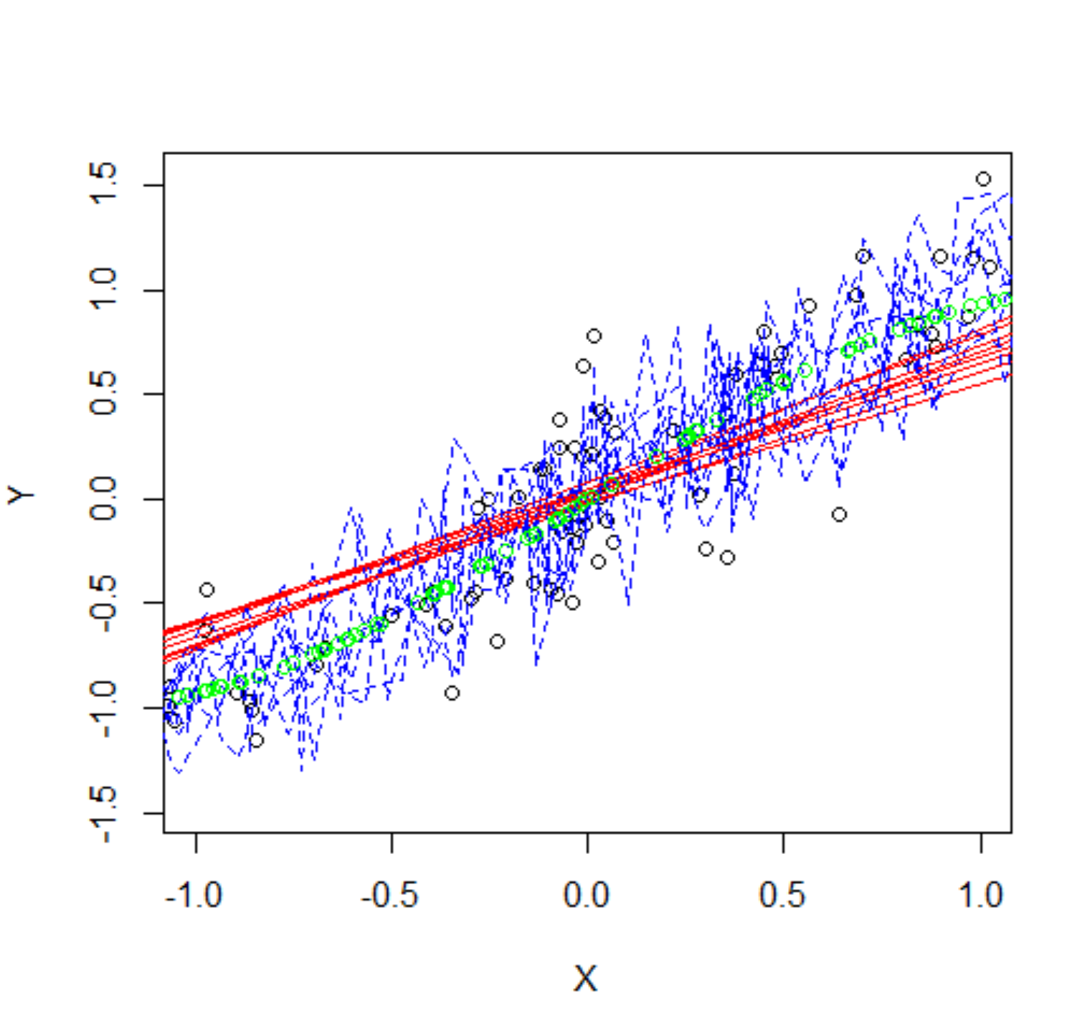
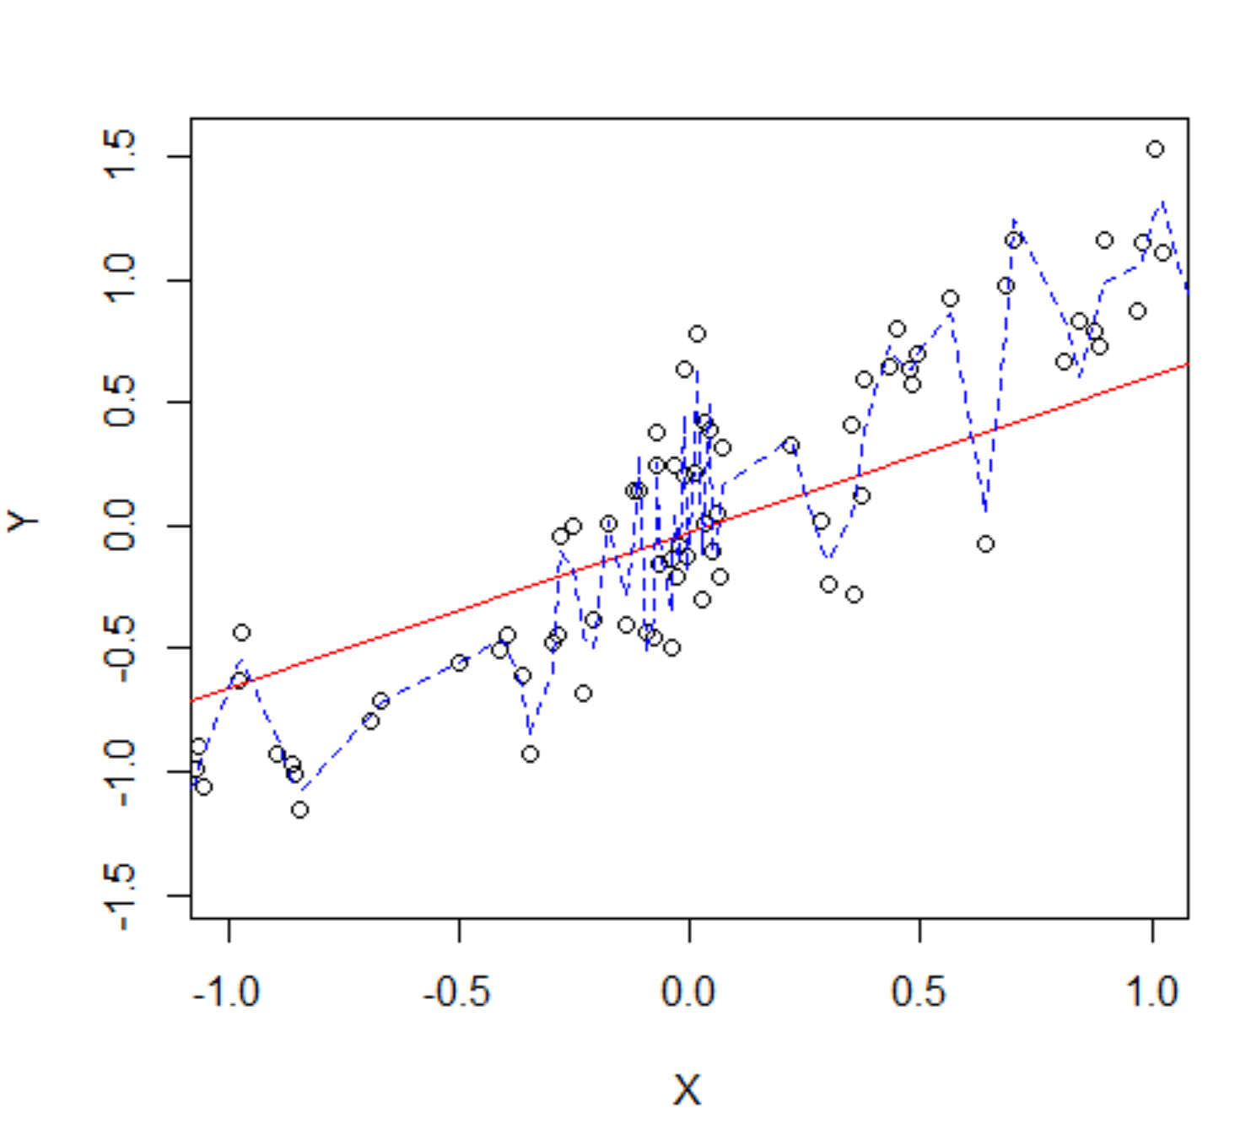
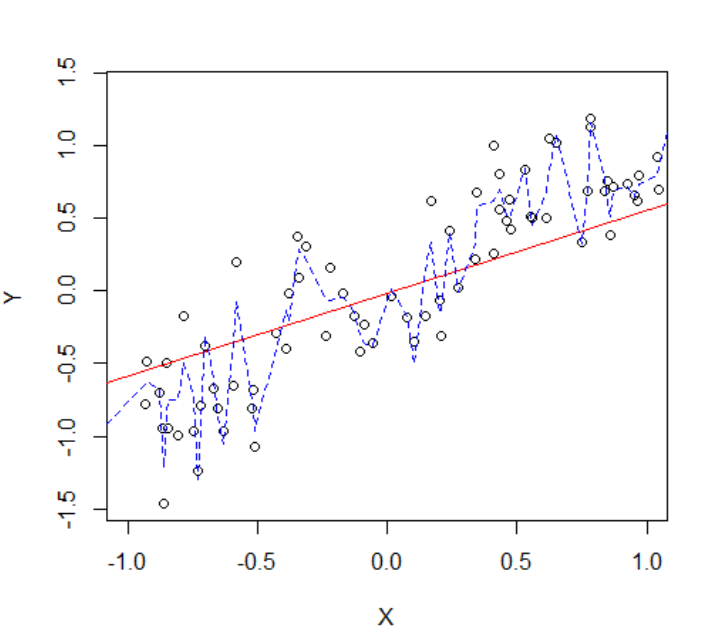
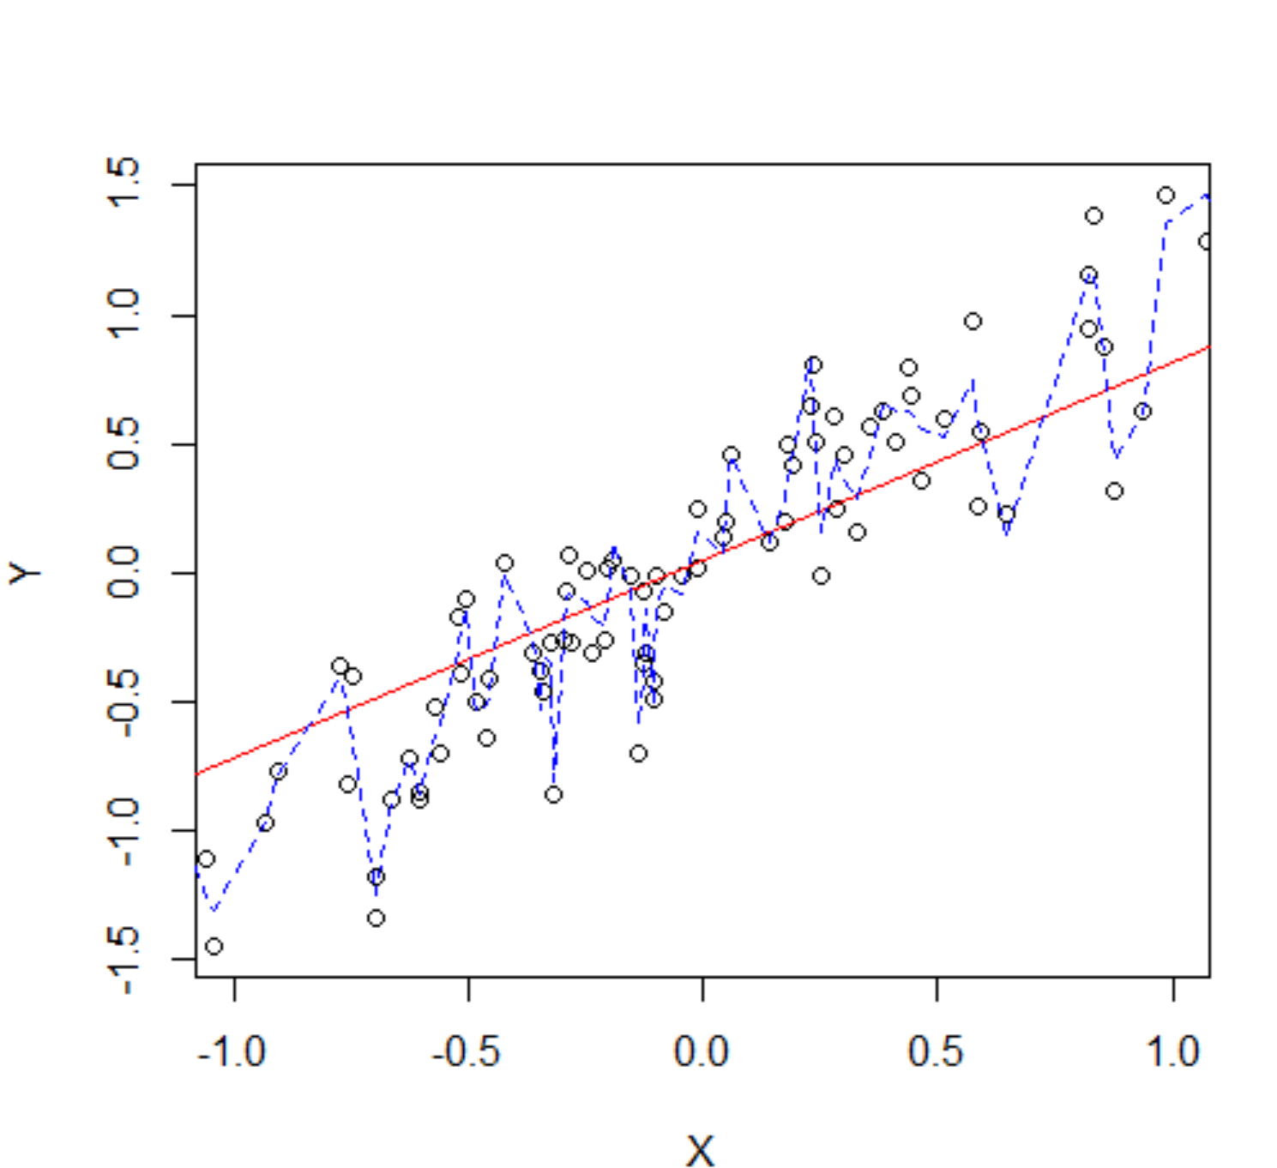
Do We Need Test Data?

Slide 10
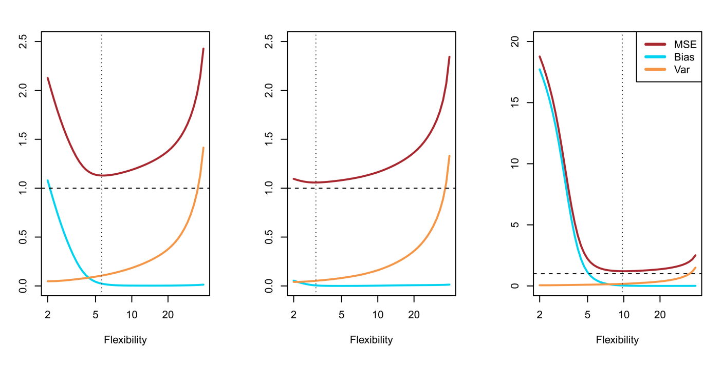

Slide 11



Classification Problems
Here the response variable Y is qualitative — e.g. email is one of
(ham=good email), digit class is one of . Our goals are to:
Build a classifier C(X) that assigns a class label to a feature unlabeled observation X.
Assess the uncertainty in each classification.
Understand the roles of the different predictors among

Slide 12
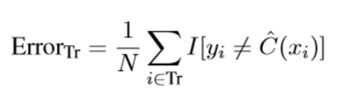


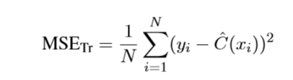


Classification: some details
How to measure the performance of a classifier in a training dataset Tr? We use the misclassification error rate:
where is an indicator variable that equals 1 if and 0 otherwise
Can we define it as ? ?
As in the regression setting, we are most interested in the testing errors associated
with a testing set :
.

Slide 13

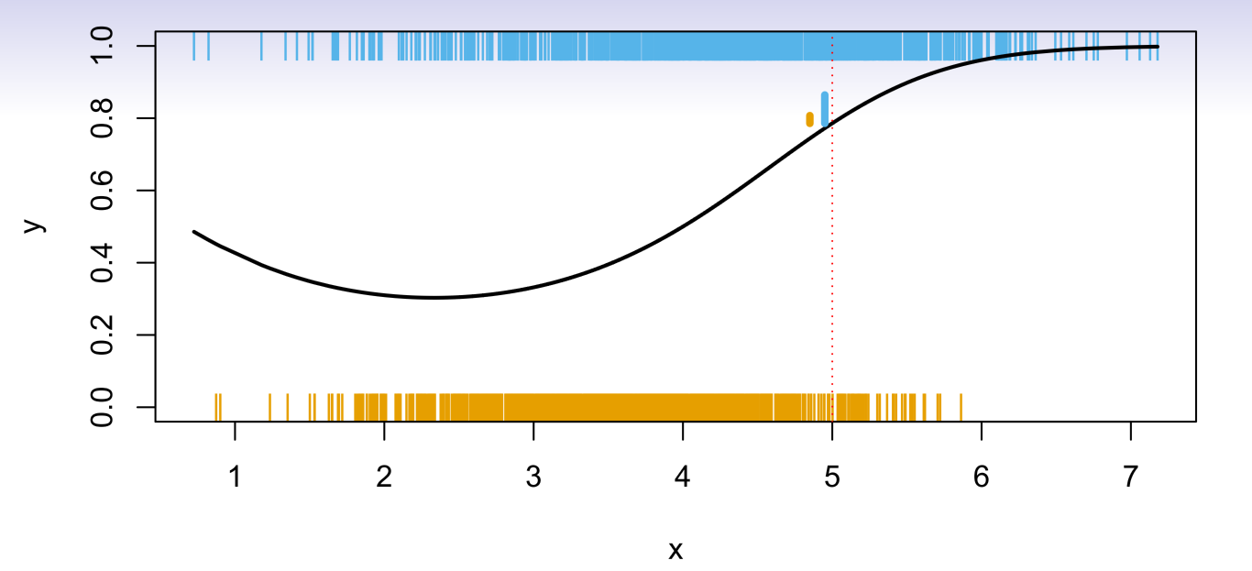
Ideal Classifier
Is there an ideal C(X)?
Suppose the K elements in are numbered 1, 2, …, K. Let
These are the conditional class probabilities at x;
Then the Bayes classifier at x is
, which is the optimal classifier.

Slide 14
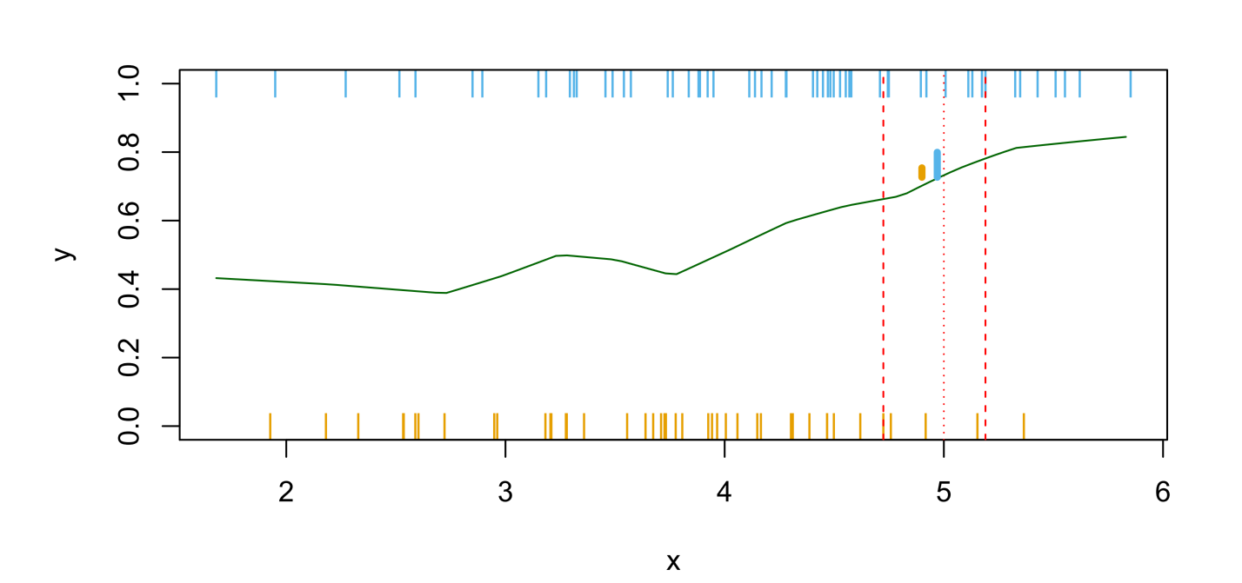
Ideal Classifier
Nearest-neighbor averaging can be used as before.
Also breaks down as dimension grows.

Slide 15
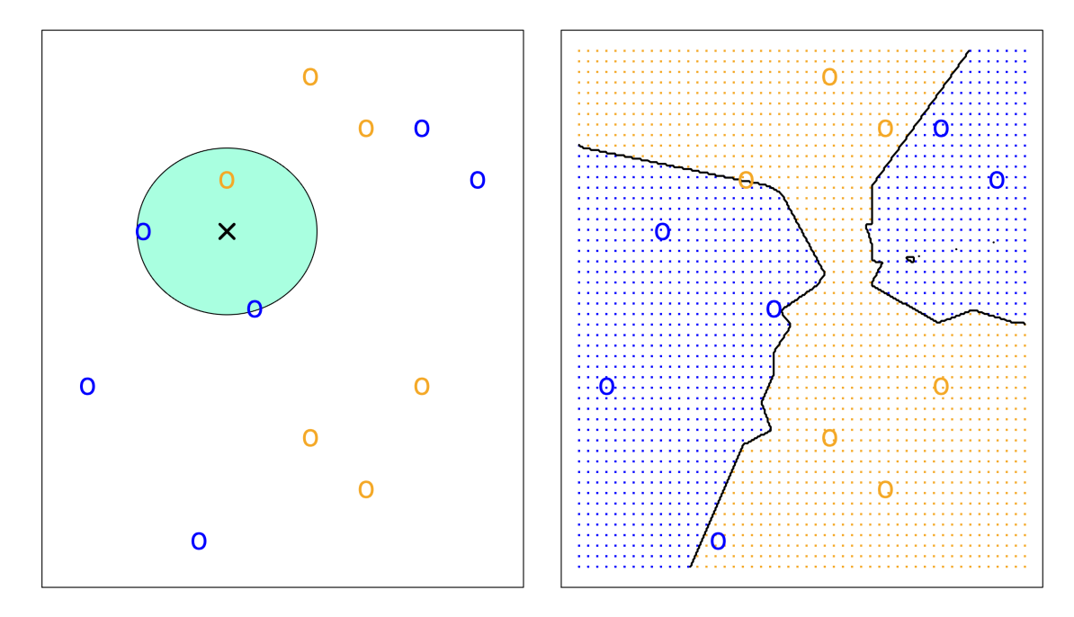
K-nearest neighbors in two dimensions
Idea: Use similar training points when making predictions
What is/are the parameters?
Is it parametric or non-parametric?

Slide 16
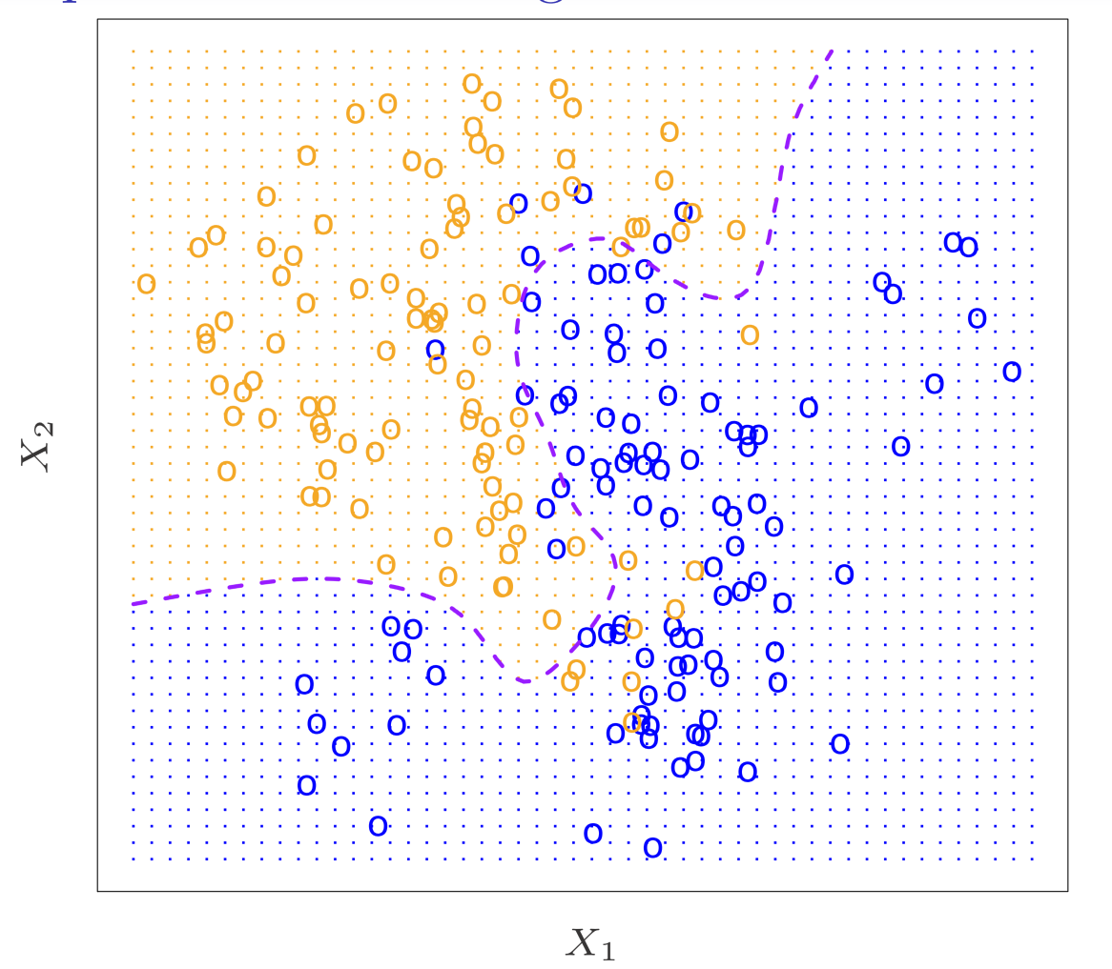
K-nearest neighbors in two dimensions

Slide 17
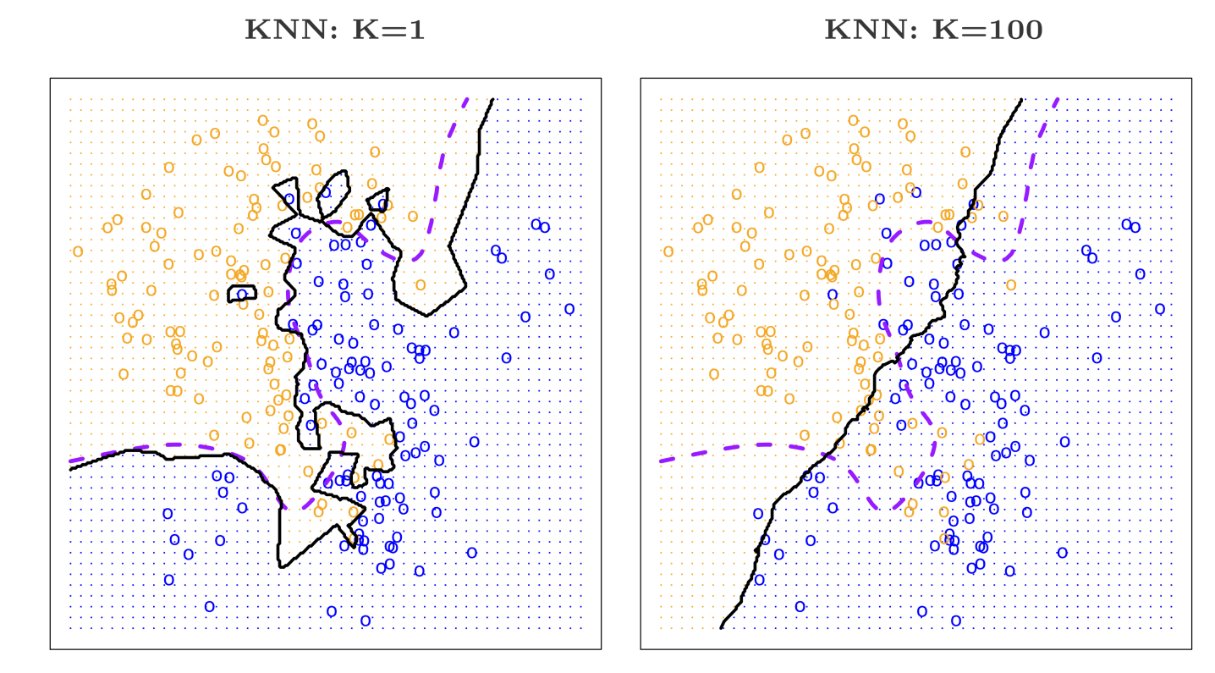
K-nearest neighbors in two dimensions

Slide 18
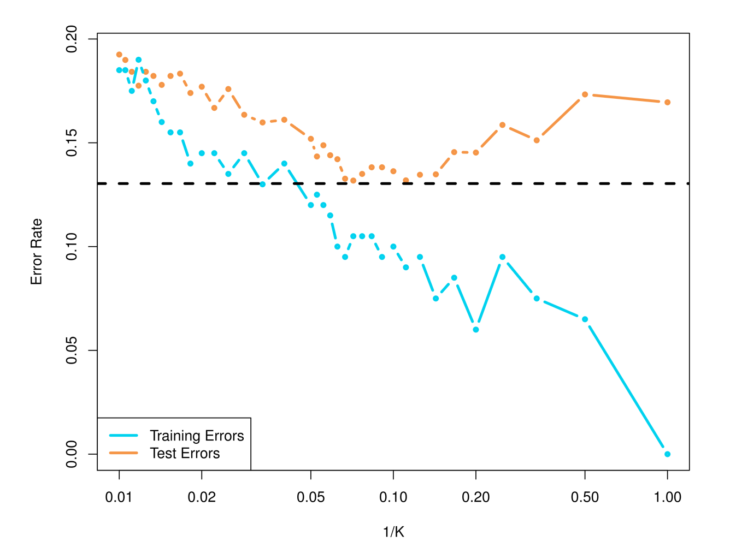
KNN: Training and Test Errors

Slide 19
Bonus Quiz 4: If we are fitting a linear regression model, do we need to have a Testing set to evaluate the performance of the model? Namely, will the testing set change your choice of the linear model?

