Slide 1

Module 3: Linear Regression
Lecture 4
Jan 19th, 2023

Slide 2
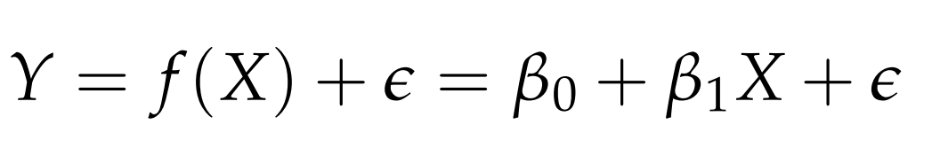

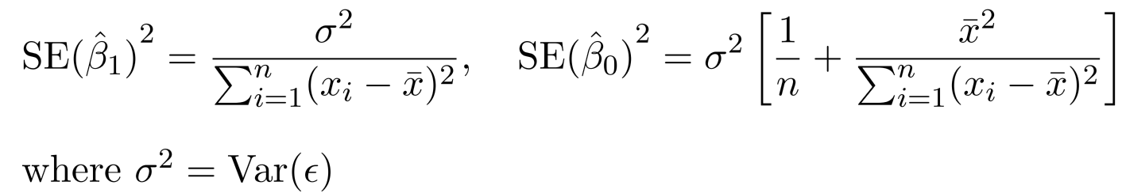

Recap
Simple Linear Regression
Residual sum of squares (RSS)
Confidence interval.

Slide 3
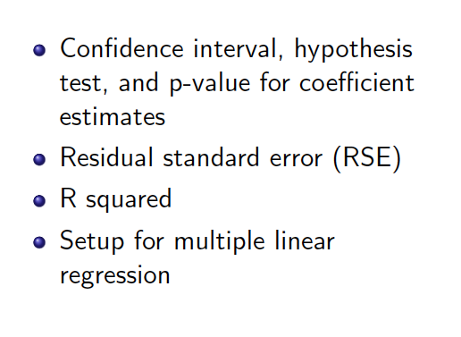
Topics

Slide 4
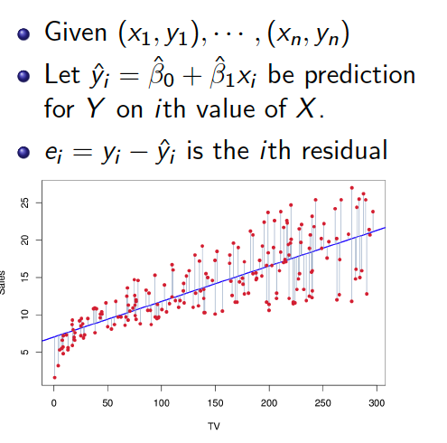
Set up

Slide 5
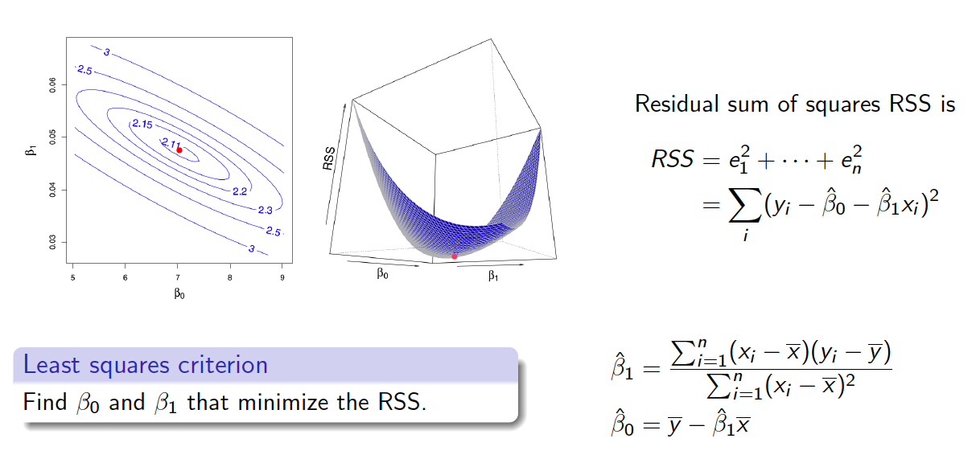
Ordinary Least Squares Regression

Slide 6
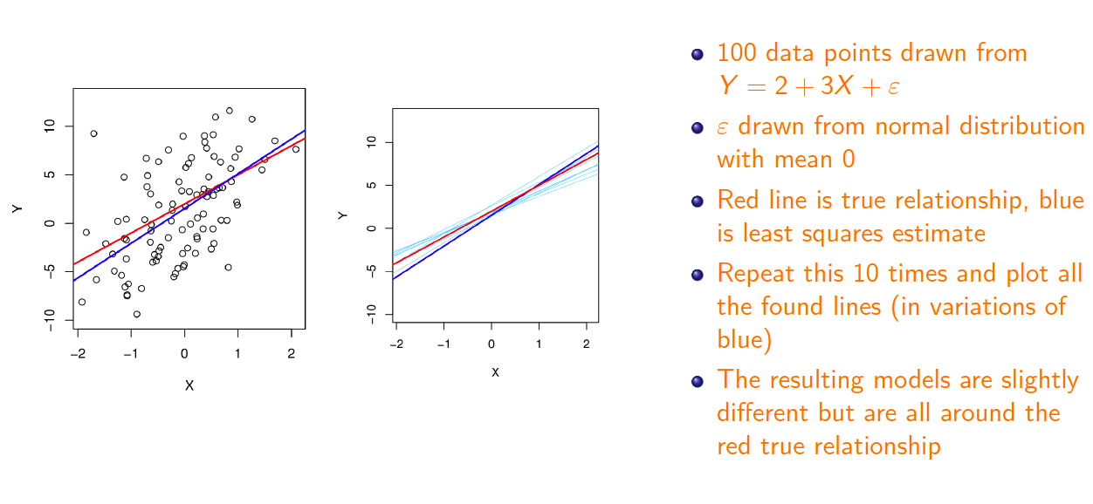
Ordinary Least Squares

Slide 7
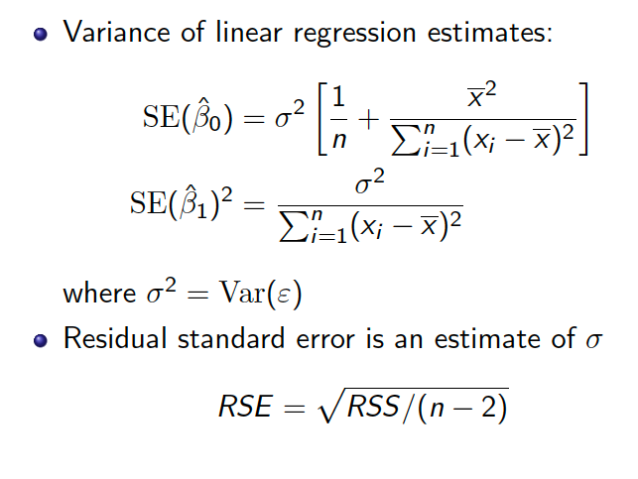
Variance of OLS estimates

Slide 8
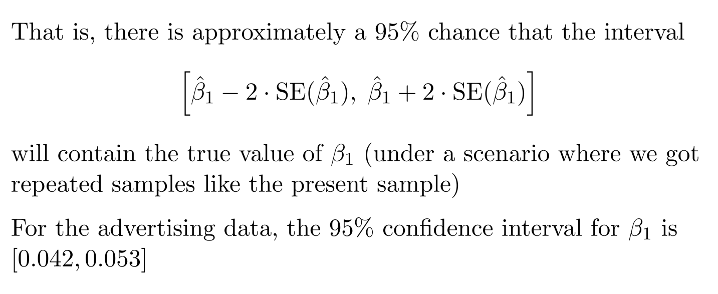
Confidence Interval

Slide 9
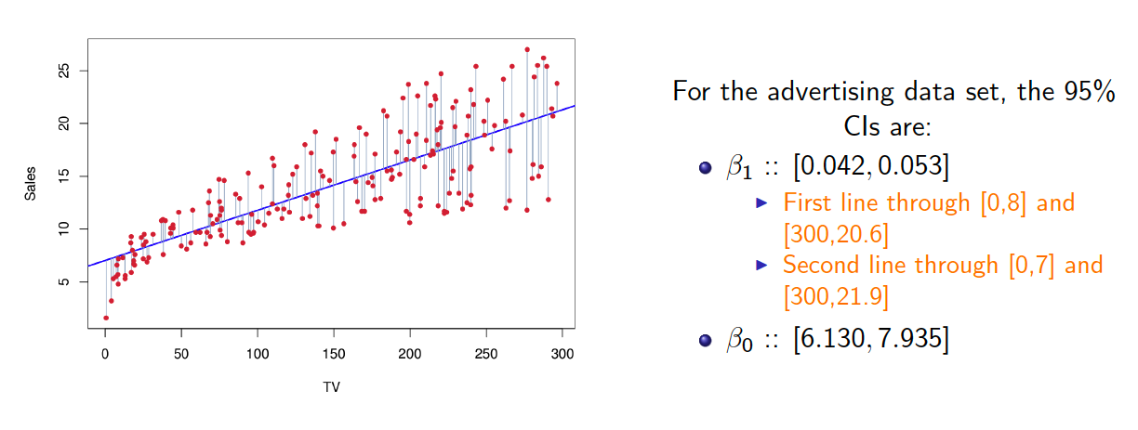
Confidence Interval: Ad data

Slide 10
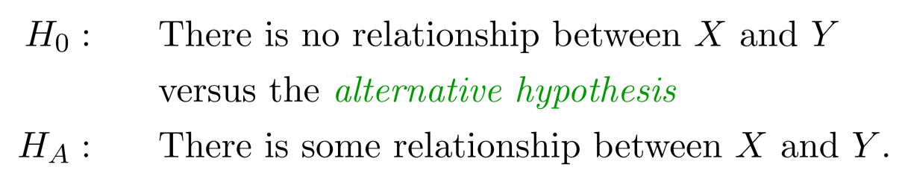
Hypothesis Testing
Standard errors can also be used to perform hypothesis
tests on the coeﬃcients. The most common hypothesis test
involves testing the null hypothesis of

Slide 11
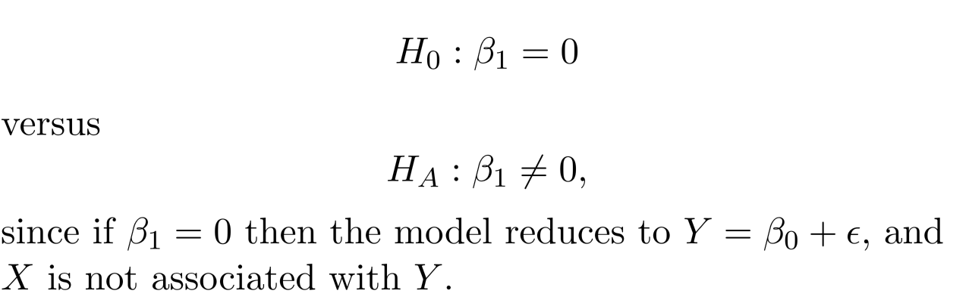
Hypothesis Testing
Standard errors can also be used to perform hypothesis
tests on the coeﬃcients. The most common hypothesis test
involves testing the null hypothesis of
Mathematically, it is

Slide 12

Hypothesis Testing
Mathematically, it is
We have from data and want to test whether it is far from 0. But how far?

Slide 13
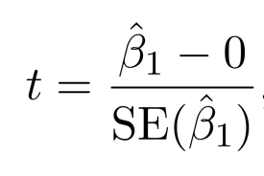

Hypothesis Testing
Mathematically, it is
We have from data and want to test whether it is far from 0. But how far?
This will have a t-distribution with n-2 degrees of freedom, assuming
Using statistical software, it is easy to compute the probability of observing any value equal to |t| or larger. We call this probability the p-value.
We will specify an alpha value (0.05) before Hypothesis testing. If p-value less than the alpha value, we will reject the null hypothesis.

Slide 14
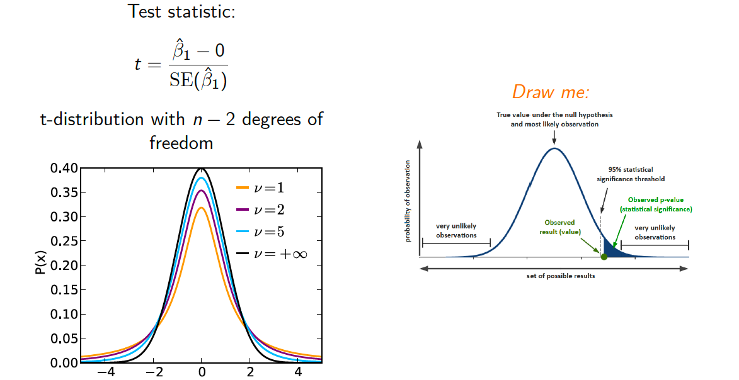
Test Statistic and p-value

Slide 15
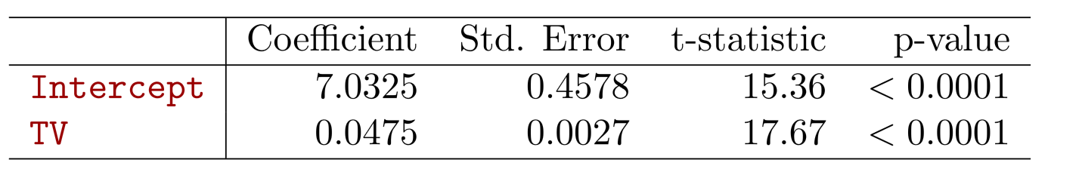
Results for the Advertising Data
Since p-value < 0.05, we reject the null hypothesis and conclude that TV is related to sale.

Slide 16
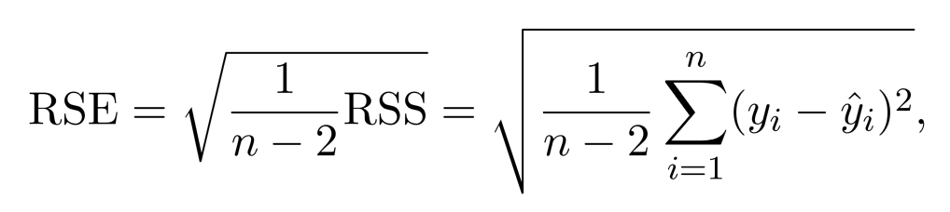
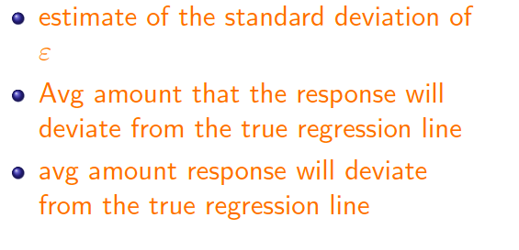
Assessing the Accuracy of the Model
Residual Standard Error

Slide 17
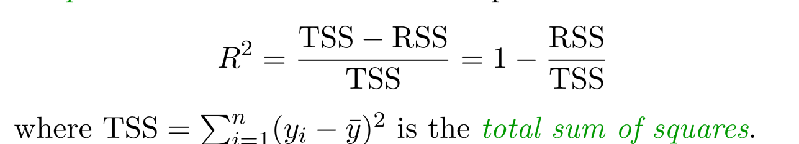

Assessing the Accuracy of the Model
Residual Standard Error
R-square: fraction of variance explained by the linear model
where is the total sum of squares

Slide 18
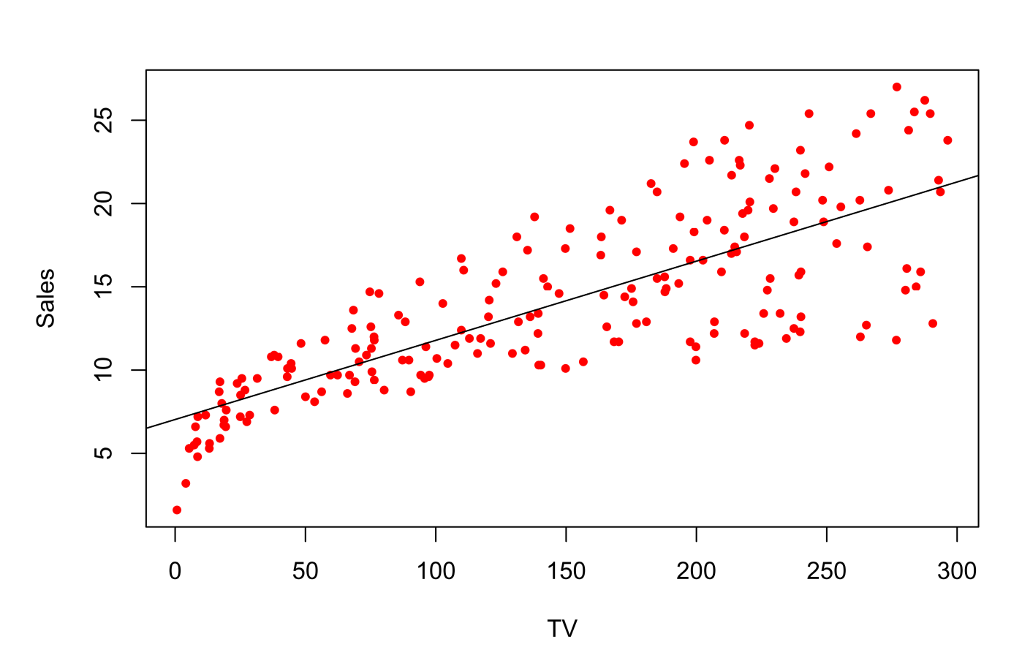
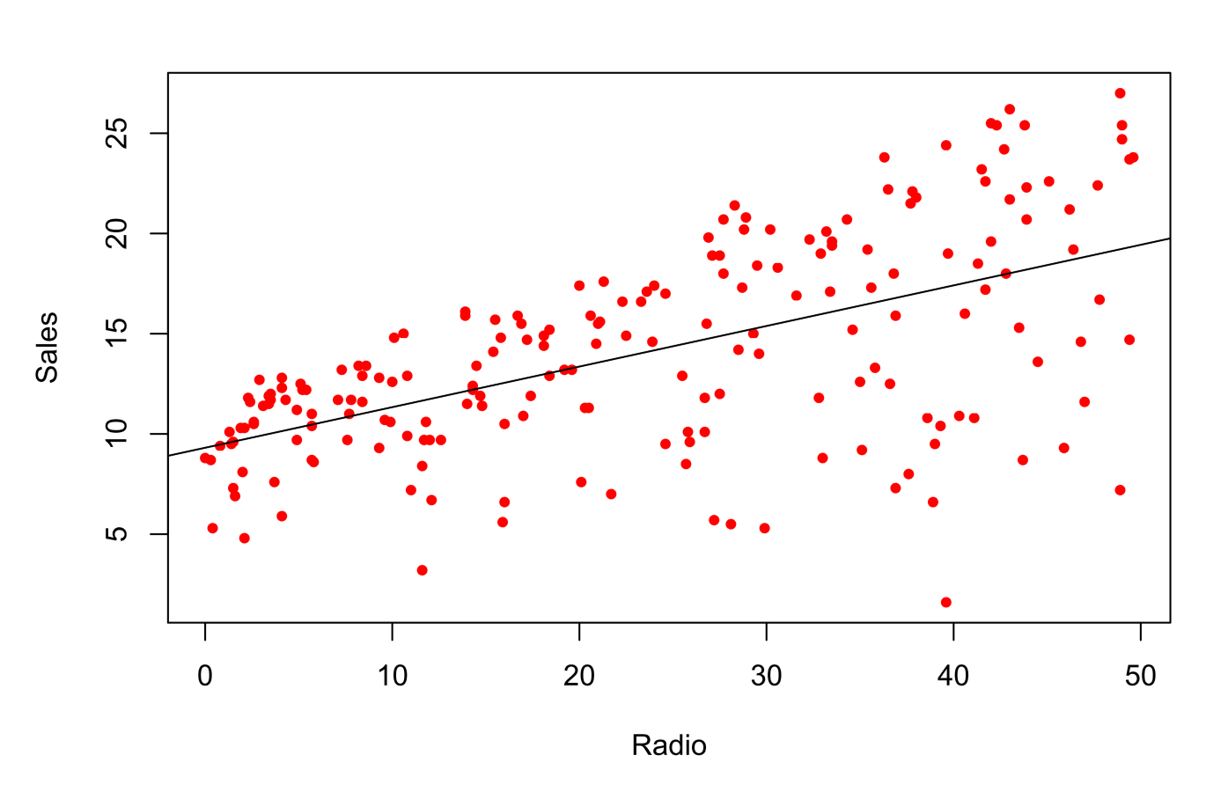
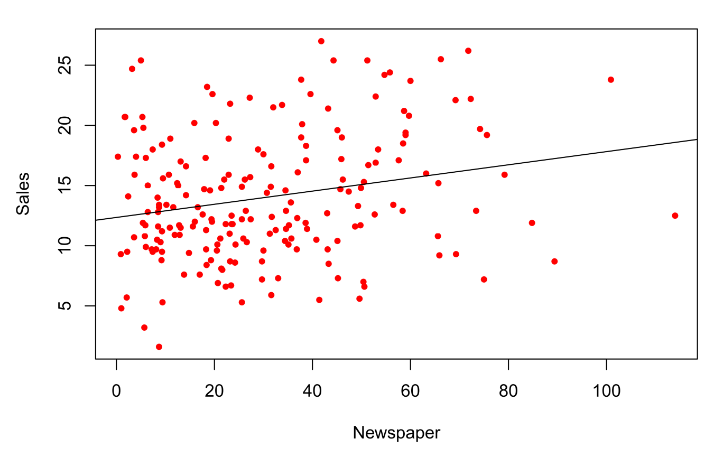
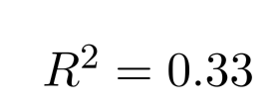


Advertisement Data

Slide 19
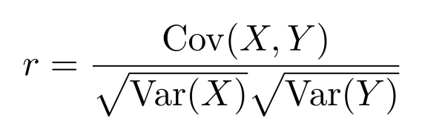
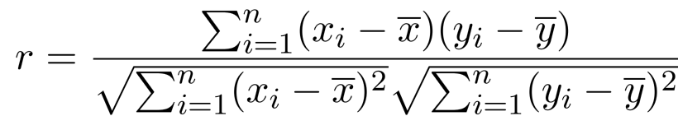

Correlation Coefficient
Measures dependence between two random variables X and Y
Correlation coefficient r is between [-1, 1]
0: Variables are not linearly related
1: Variables are perfectly related (same)
-1: Variables are negatively related (different)

Slide 20
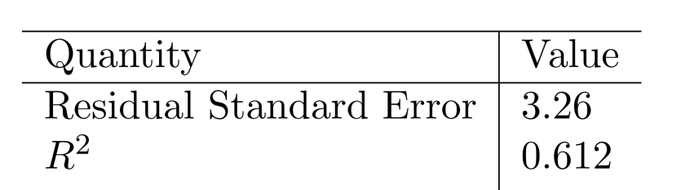
Advertising data results

Slide 21



Multiple Linear Regression
Usually more than one feature is available
In general
We interpret as the average eﬀect on Y of a one unit increase in,
holding all other predictors ﬁxed.
Claims of causality should be avoided for observational data.

Slide 22



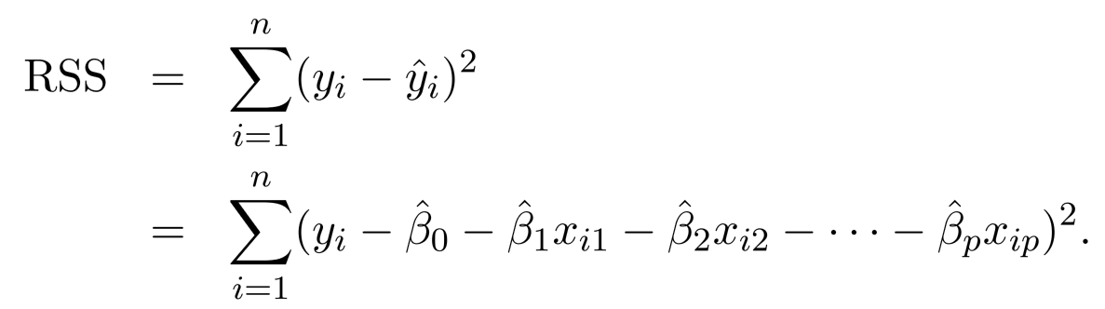
Estimation and Prediction
Given estimates we can make predictions using
We estimate by minimizing the sum of squared residuals

Slide 23
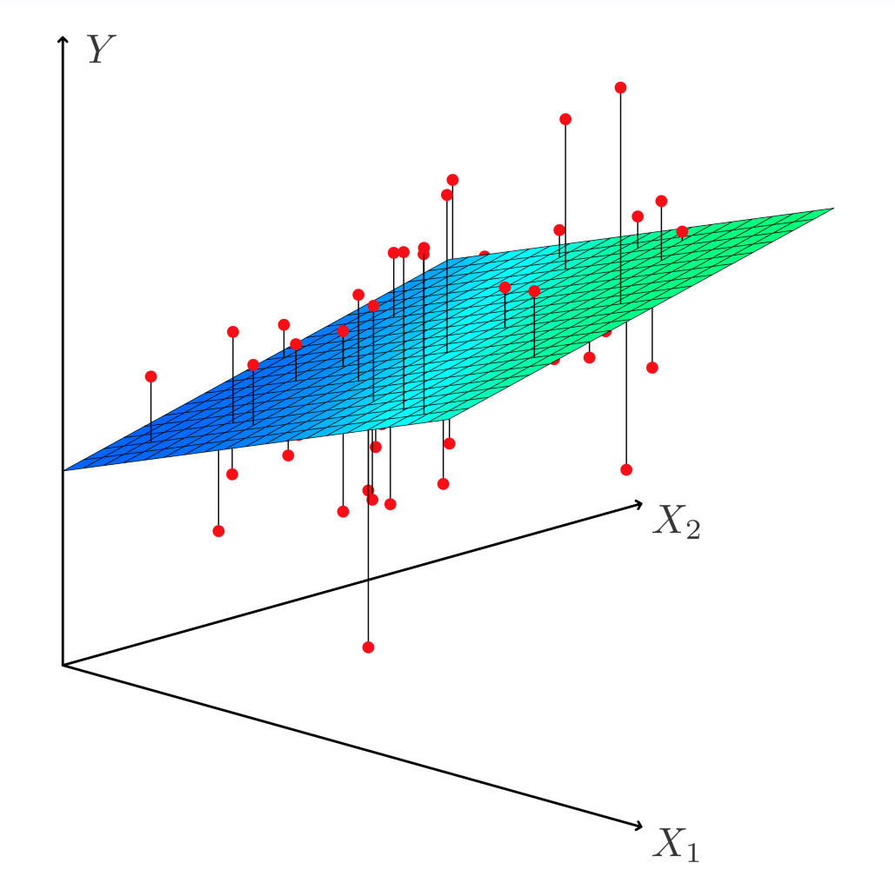
Estimation and Prediction

Slide 24
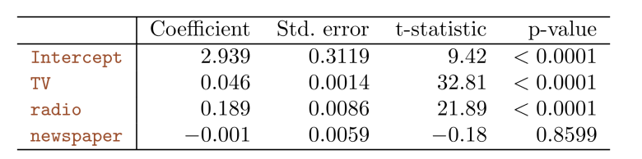
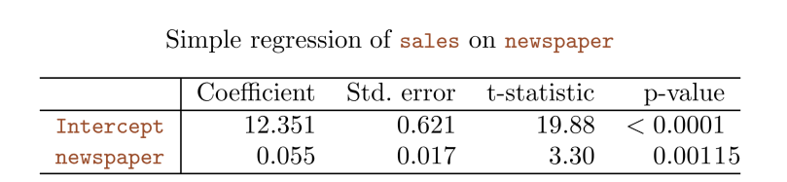
Results for Ad. Data

Slide 25
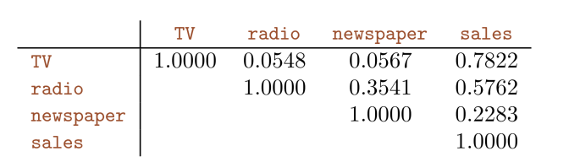
Results for Ad. Data

Slide 26
Some Important Questions
Is at least one of the predictors useful in predicting the response?
Do all the predictors help to explain Y, or is only a subset of the of the predictors useful?
How well does the linear model fit the data?
Given a set of predictor values, what response value should we predict, and how accurate is our prediction?

Slide 27
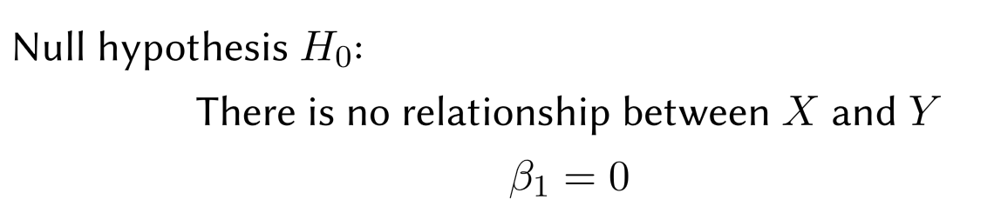

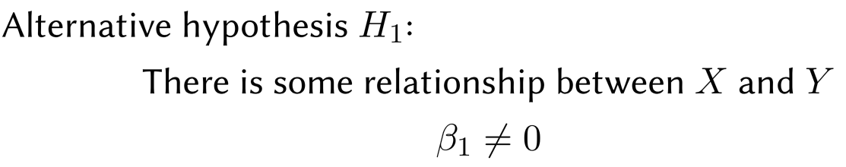

Inference 1
Is at least one of the predictors useful in predicting the response?
Seek to reject hypothesis H₀ with small p-value

Slide 28
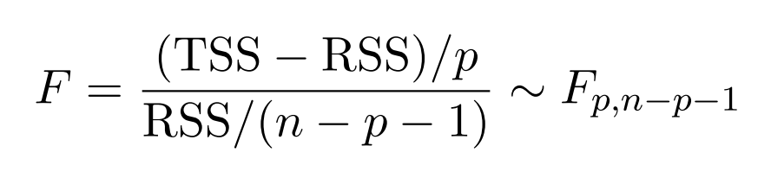
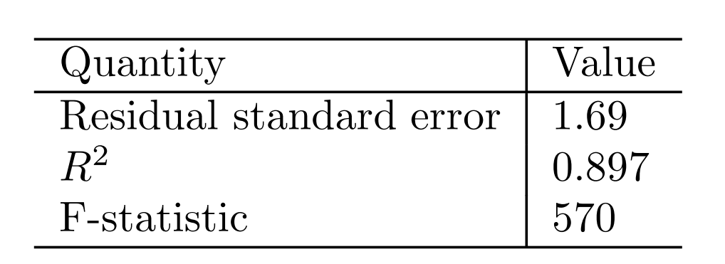
Inference 1
We will use the following random variable

Slide 29
Inference 2:Deciding on the important variables
The most direct approach is called all subsets or best subsets regression: we compute the least squares ﬁt for all possible subsets and then choose between them based on some criterion that balances training error with model size.
However, we often can’t examine all possible models, since they are xxx of them; for example, when p = 40 there are over a billion models!
Instead，we need an automated approach that searches through a subset of them. We discuss two commonly use approaches next.

Slide 30
Forward selection
Begin with the null model — a model that contains an intercept but no predictors.
Fit p simple linear regressions and add to the null model the variable that results in the lowest RSS.
Add to that model the variable that results in the lowest RSS amongst all two-variable models.
Continue until some stopping rule is satisﬁed, for example when all remaining variables have a p-value above some threshold.

Slide 31
Backward selection
Start with all variables in the model.
Remove the variable with the largest p-value — that is, the variable that is the least statistically signiﬁcant.
The new (p − 1)-variable model is ﬁt, and the variable with the largest p-value is removed.
Continue until a stopping rule is reached. For instance, we may stop when all remaining variables have a signiﬁcant p-value deﬁned by some signiﬁcance threshold.

Slide 32
Model selection
Other methods including Mallow C_{p}, AIC, BIC, adjust R2 and Cross-validation (CV)

Slide 33
Confidence Interval and Prediction Interval

Slide 34
Other Considerations
Qualitative Predictors
Some predictors are not categorical predictors or factor variables.
For example: gender, student (student status), status (marital status), and ethnicity (Caucasian, African American (AA) or Asian).

Slide 35
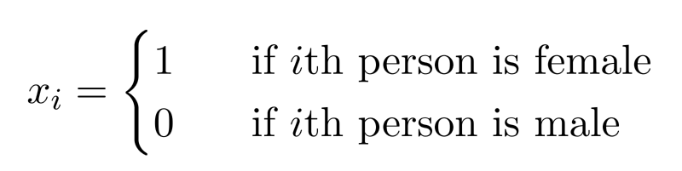
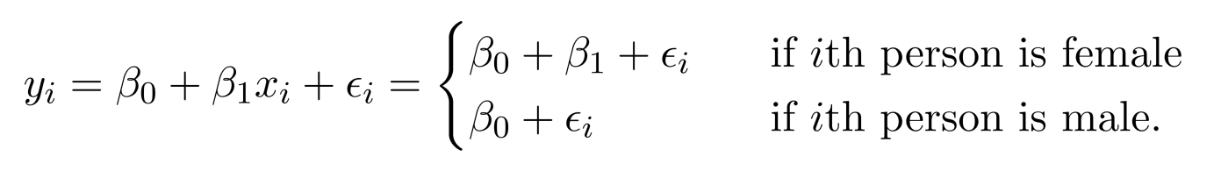
Qualitative Predictors
Example: investigate diﬀerences in credit card balance between males and females, ignoring the other variables.
We create a new variable
Resulting model:
Interpretation?

Slide 36
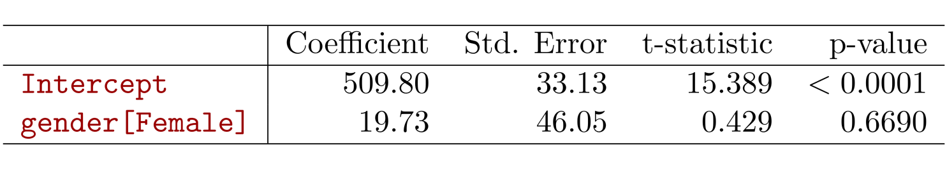
Credit card data

Slide 37
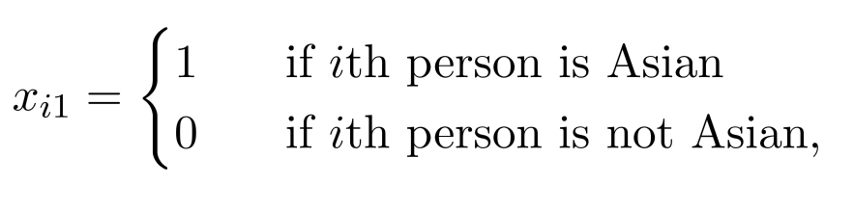
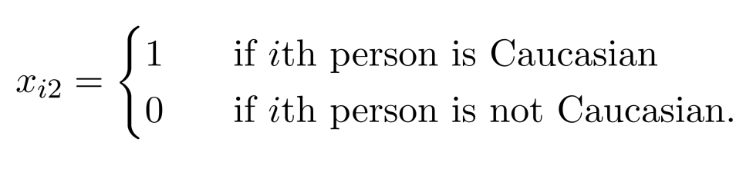
More than two levels?
For the ethnicity: Asian, Caucasian, African American
We will create two dummy variables.

Slide 38
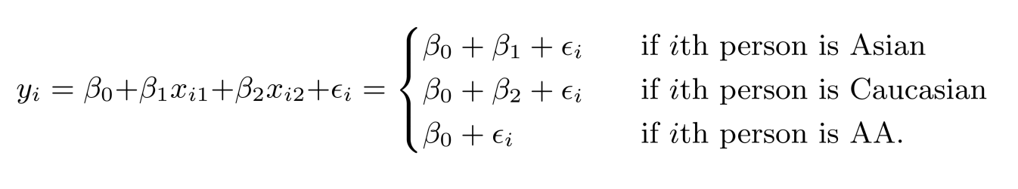
More than two levels?
Then we have the following model
There will always be one fewer dummy variable than the number of levels. The level with no dummy variable African American in this example — is known as the baseline.

Slide 39
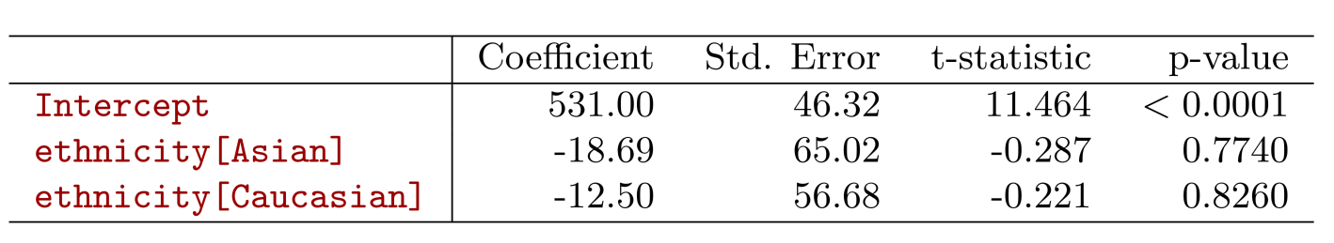
More than two levels?

Slide 40

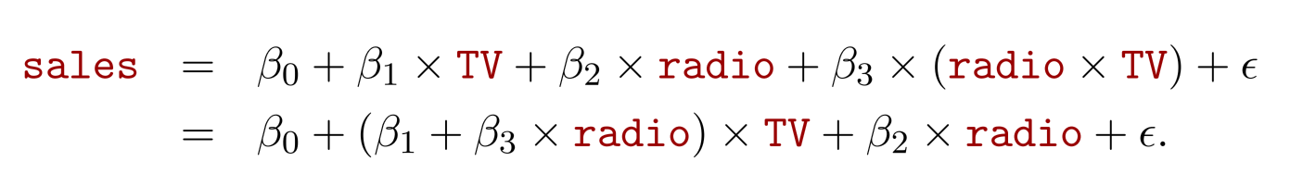
Extensions of the Linear Model
Interactions
In the advertising data, we assume the effect on sales of increasing one medium is independent of other media.
But suppose that spending money on radio advertising increases the effectiveness of TV advertising. How to model it?
This is called an interaction effect.

Slide 41
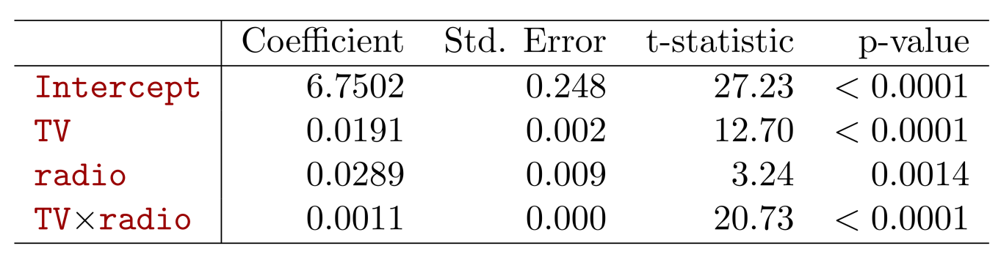

Interpretation
The p-value for the interaction term TV × radio is extremely low, indicating that there is strong evidence for
The R² for the interaction model is 96.8%, compared to only 89.7% for the model that predicts sales using TV and radio without an interaction term.
This means that (96.8 − 89.7)/(100 − 89.7) = 69% of the variability in sales that remains after ﬁtting the additive model has been explained by the interaction term.

Slide 42
Interpretation
The coeﬃcient estimates in the table suggest that an increase in TV advertising of $1, 000 is associated with increased sales of
An increase in radio advertising of $1, 000 will be associated with an increase in sales of

Slide 43
Hierarchy
Sometimes it is the case that an interaction term has a very small p-value, but the associated main eﬀects (in this case, TV and radio) do not.
The hierarchy principle:
If we include the interaction term, we should include the main effects no matter what!

Slide 44
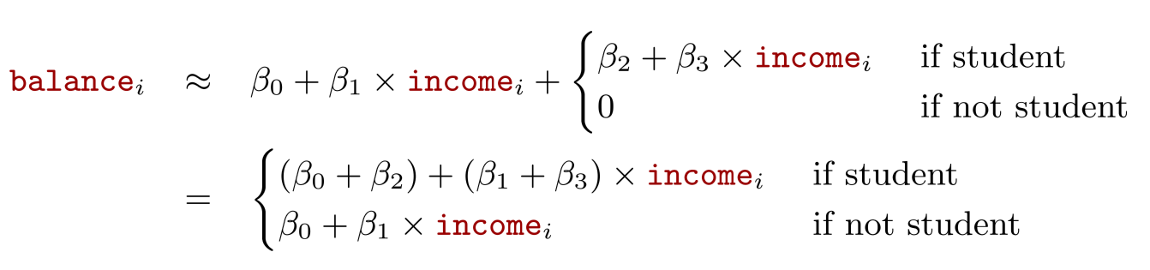
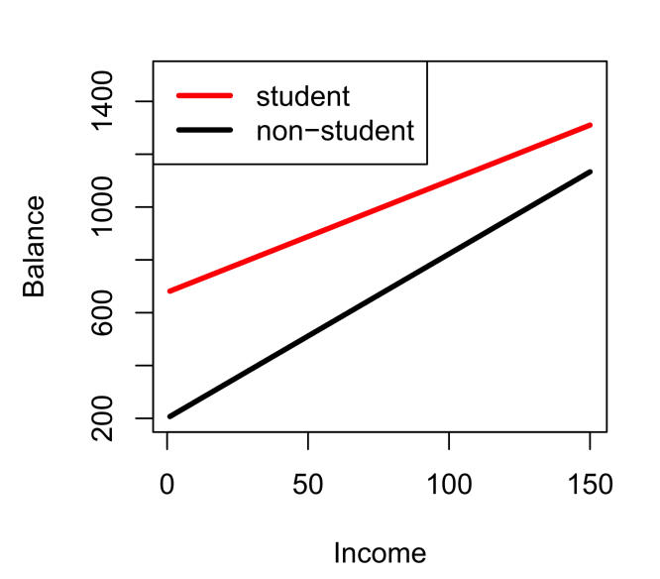
Qualitative and quantitative variables?
Consider the Credit data set, and suppose that we wish to predict balance using income (quantitative) and student (qualitative). With interactions, we have

Slide 45
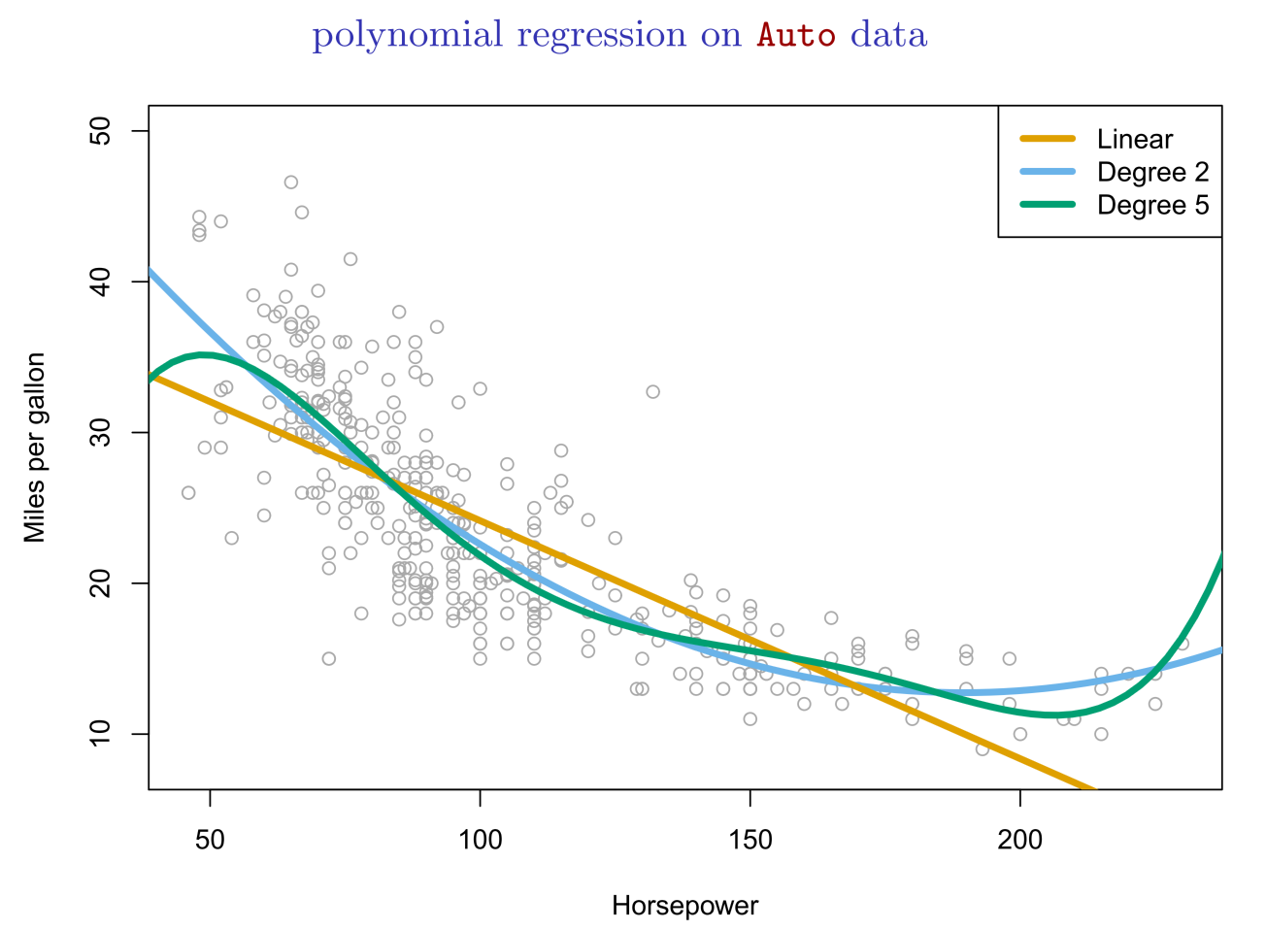
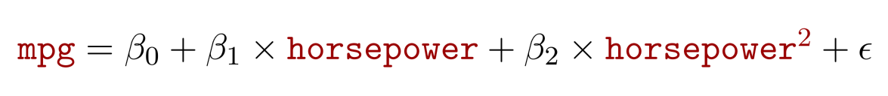
Non-linear eﬀects of predictors

Slide 46
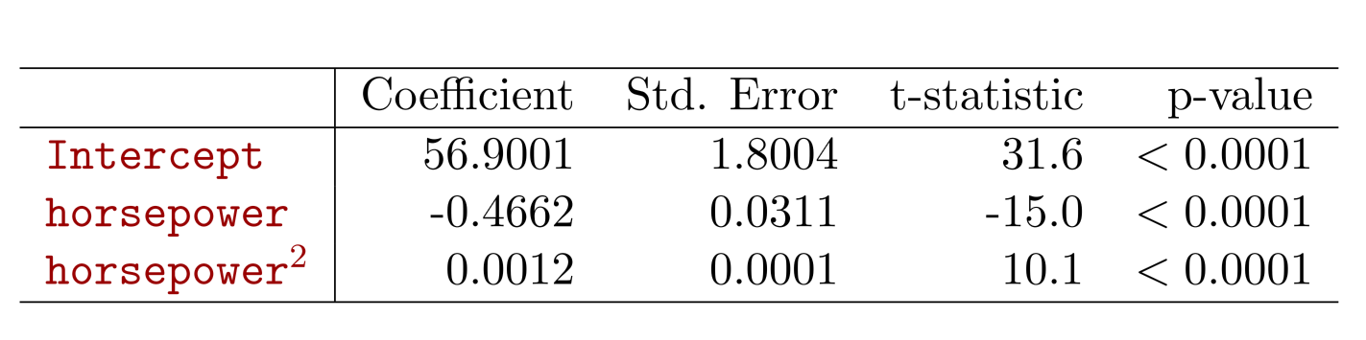
Non-linear eﬀects of predictors

Slide 47
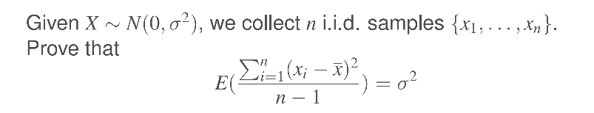
Bonus Quiz 6

Slide 48
Bonus Quiz 7
Given n = 100 and the following table, what is the TSS?

