Slide 1

Module 6: Shrinkage – Ridge Regression |
Lecture 15
Feb 22th, 2023
Ch 6.2-

Slide 2
Bonus Quiz 11
We have two training points (x1 = 1, x2 = 1, y = 1) and (x1 = 2, x2 = 3, y = 2). We want to fit a linear model to minimize the MSE
What is the minimun MSE? What is the corresponding model?

Slide 3
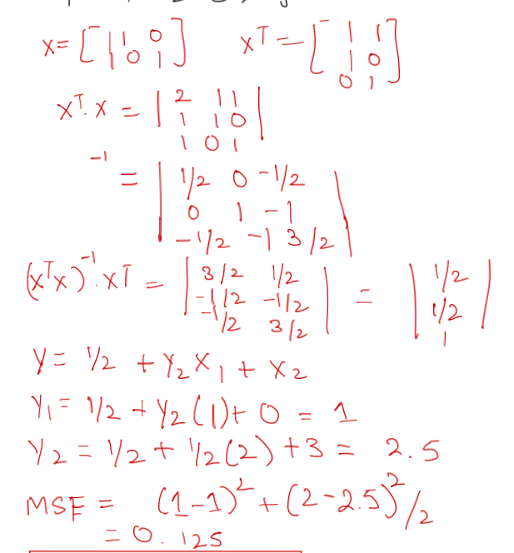
Bonus Quiz 11
(x1 = 1, x2 = 1, y = 1) and (x1 = 2, x2 = 3, y = 2).

Slide 4
1. Best subset selection 2. Forward/Backward Selection 3. Cp, AIC, BIC: approximate test error
Recap

Slide 5
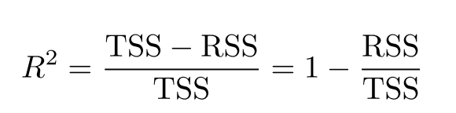
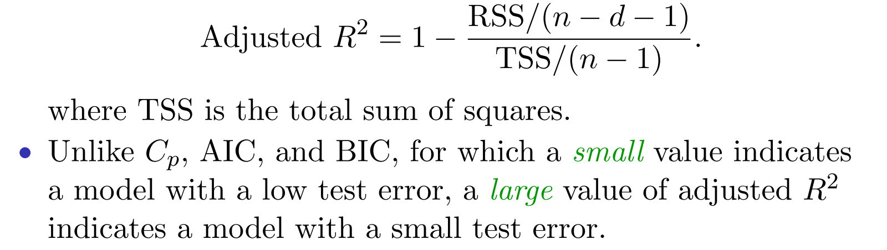
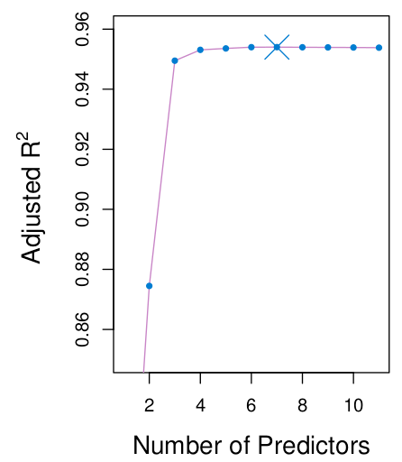
Adjusted R²

Slide 6
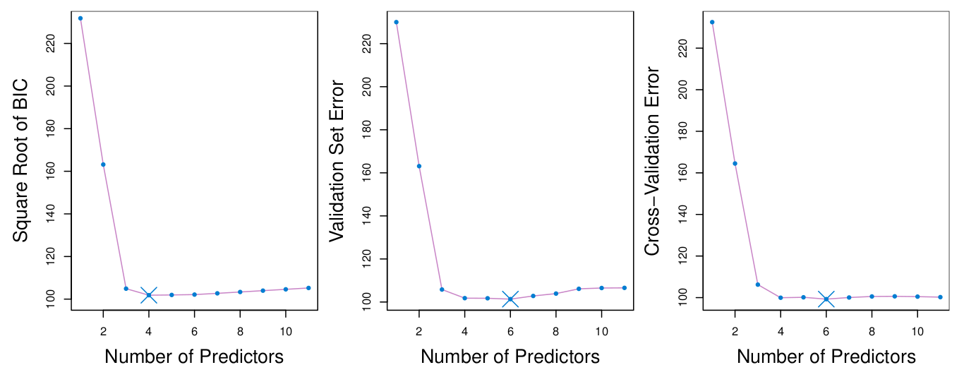
Comparisons

Slide 7
Ridge Regression

Slide 8
Goal
1. Fit model using all p predictors. Problem: Bias or Variance?
2. Aim to constrain (regularize) coefficient estimates
3. Shrink the coefficient estimates towards 0

Slide 9
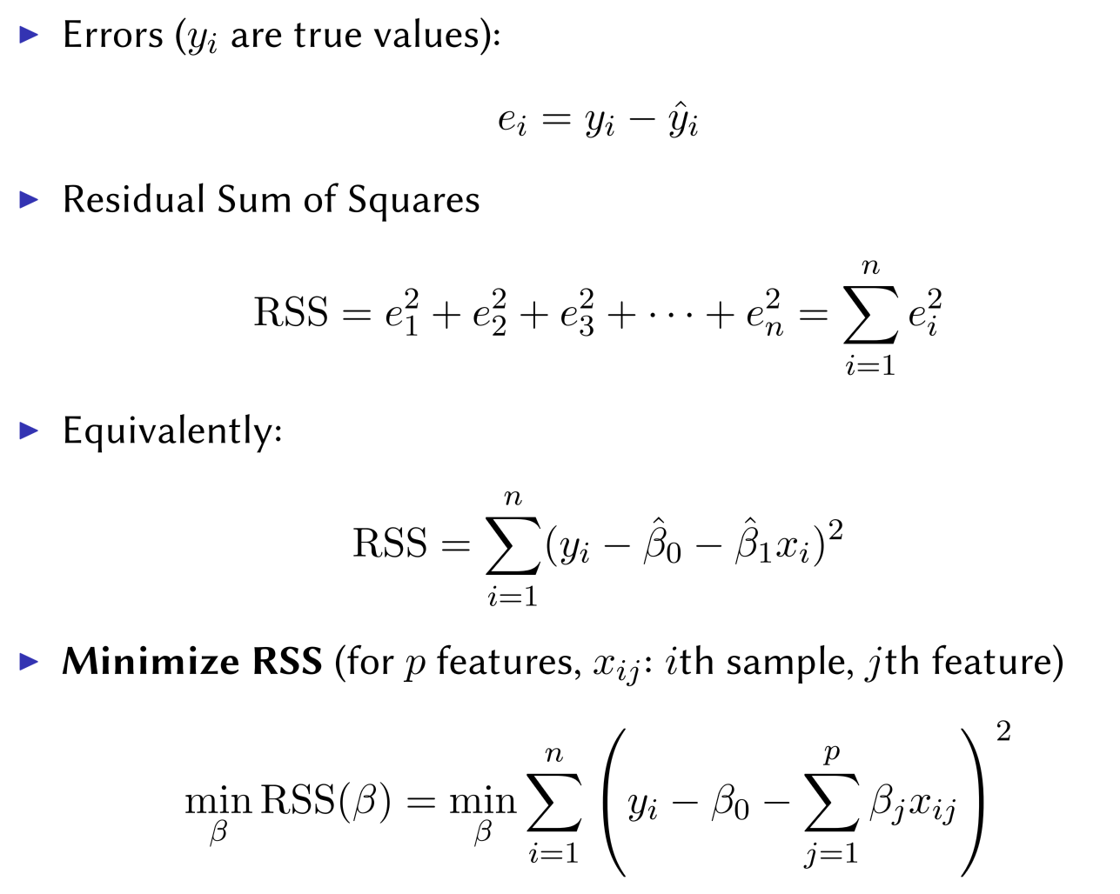
Recall: Linear Regression

Slide 10

The Natural Way
This L0 norm is hard to optimize since it is not continuous.

Slide 11

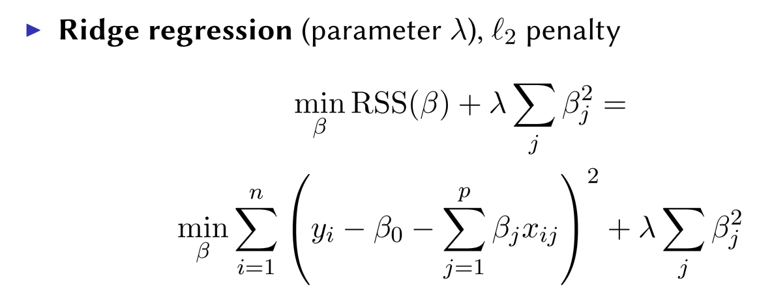
The Natural Way
Here
This L0 norm is hard to optimize since it is not continuous.
Relaxation the L0 norm

Slide 12
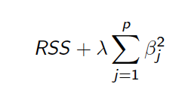
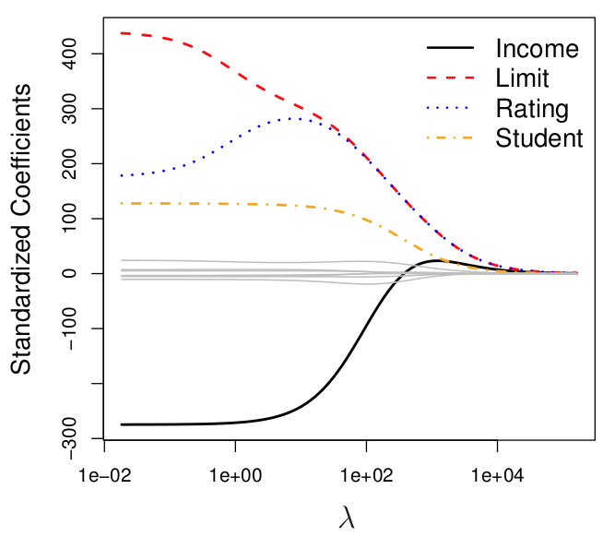
Example Credit Data

Slide 13
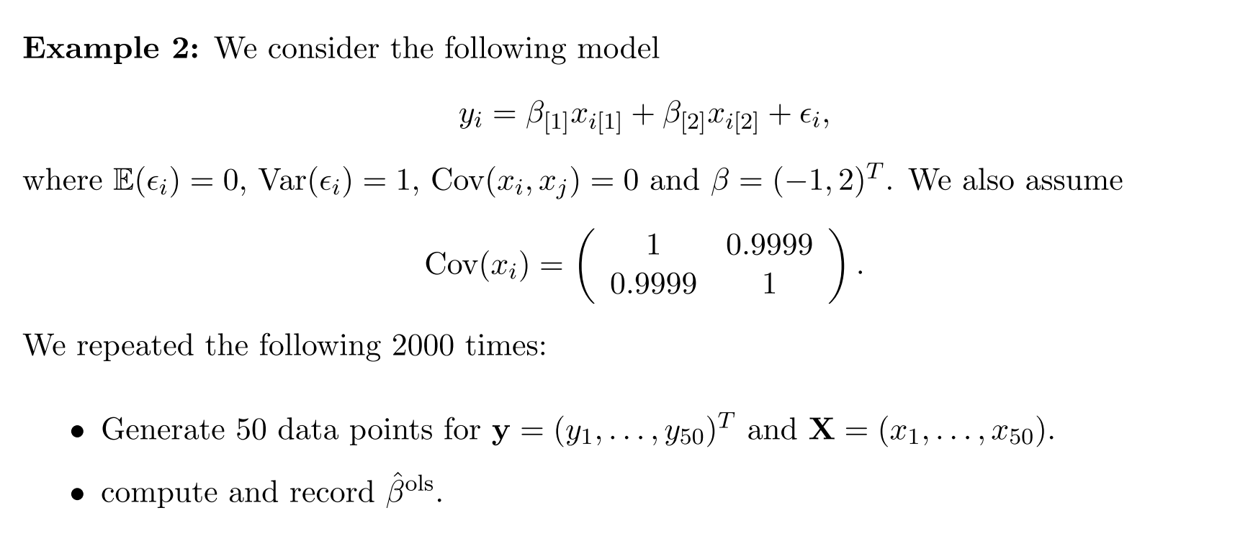
Ridge Regression for Estimates

Slide 14
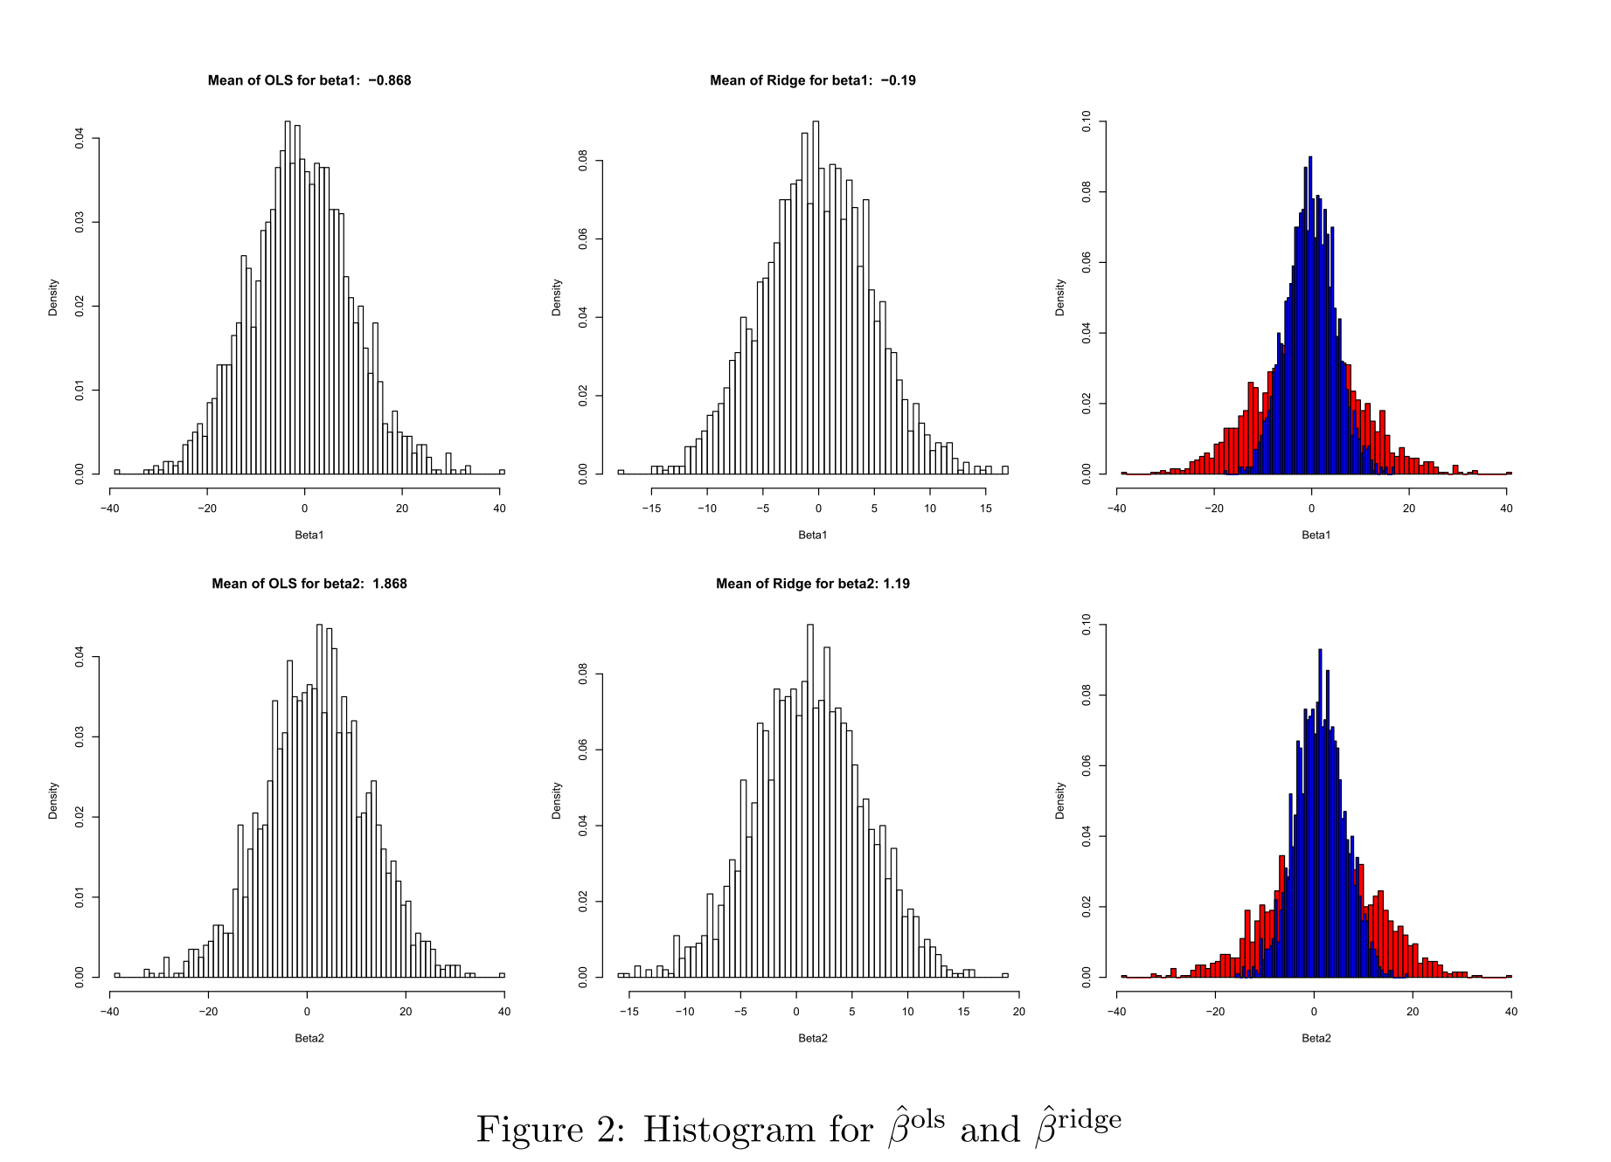
Ridge Regression for Estimates

Slide 15
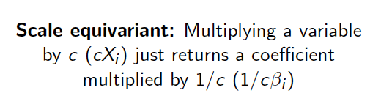
Scale equivavariance

Slide 16
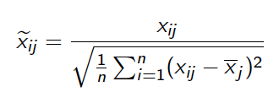
Solution: Standardize predictors

Slide 17
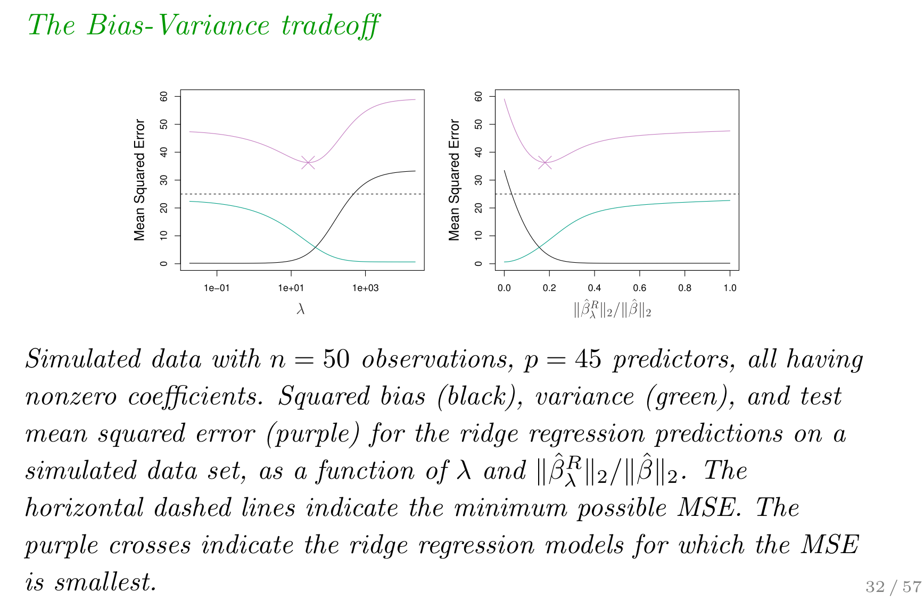
Ridge Regression: Simulation

Slide 18
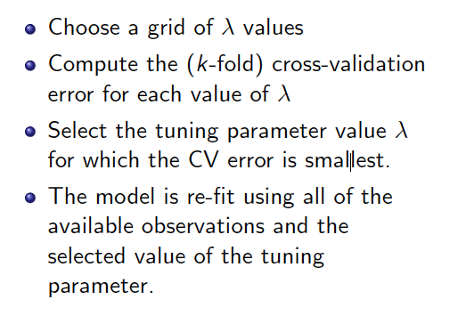
Finding tuning parameter

Slide 19
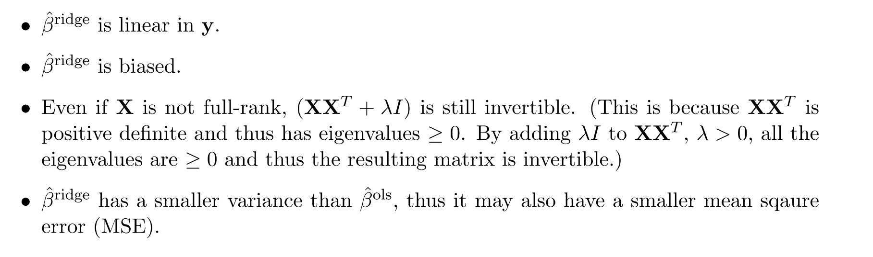
Ridge Regression

Slide 20
Advantages of Ridges

Slide 21
Coding

Slide 22

Bonus Quiz 12
Compute and record for lambda = 0.01
Count how many times ridge estimates have a smaller error than the least square estimates.

