Slide 1

Module 5: Resampling Methods
Lecture 10
Feb 1st, 2023
Ch 5.1.1-2:

Slide 2
Recap
Logistic Regression
How to estimate Logistic Regression Model?
Confusion Matrix

Slide 3
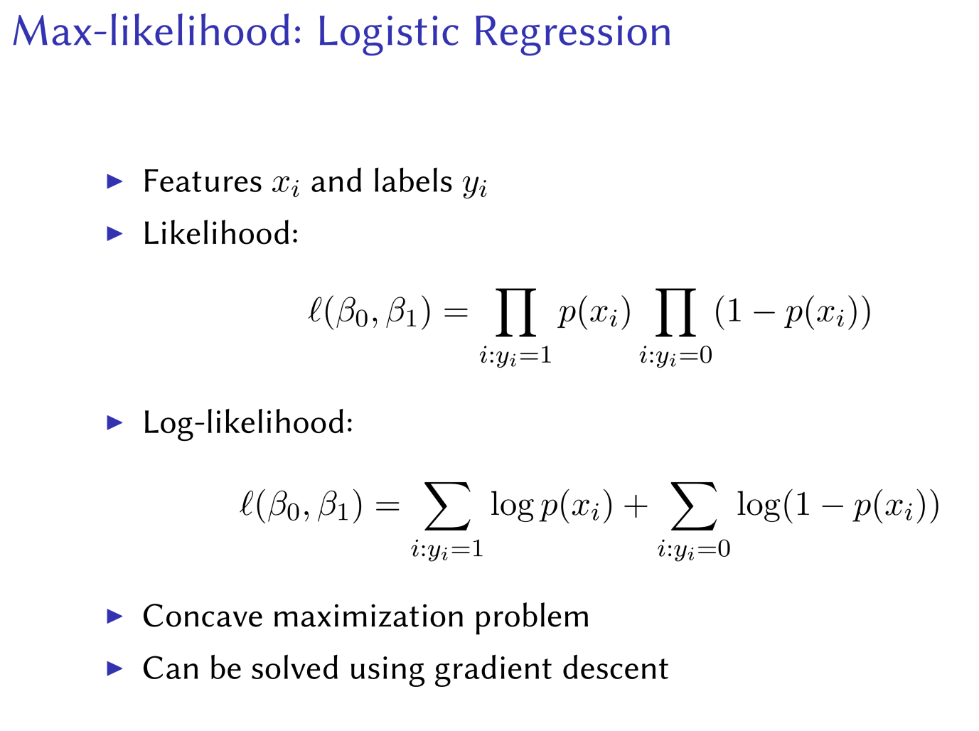

Slide 4
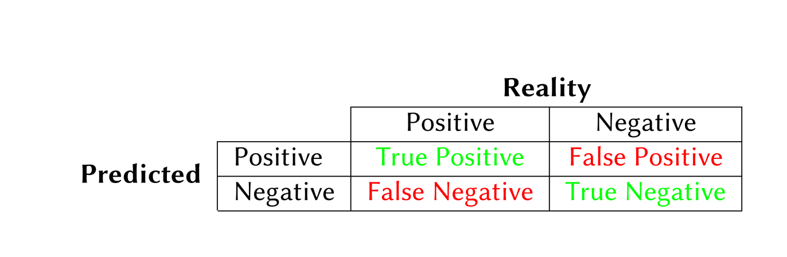
Recap
Logistic Regression
How to estimate Logistic Regression Model?
Confusion Matrix

Slide 5
Problems
1. How well is the machine learning method doing? (model assessment)
2. Which method is the best for our data?
3. How many features (which ones) to use？ （model selection）
4. What is the uncertainty in the learned parameters?
Methods;
Cross-validation and Bootstrap

Slide 6
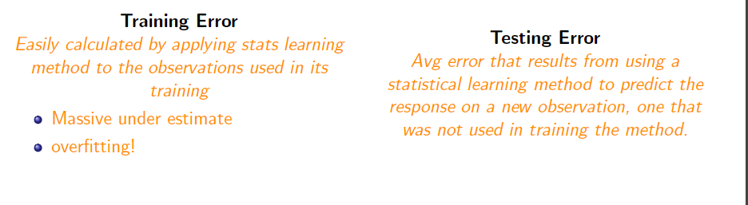
Training Error vs Test Error

Slide 7
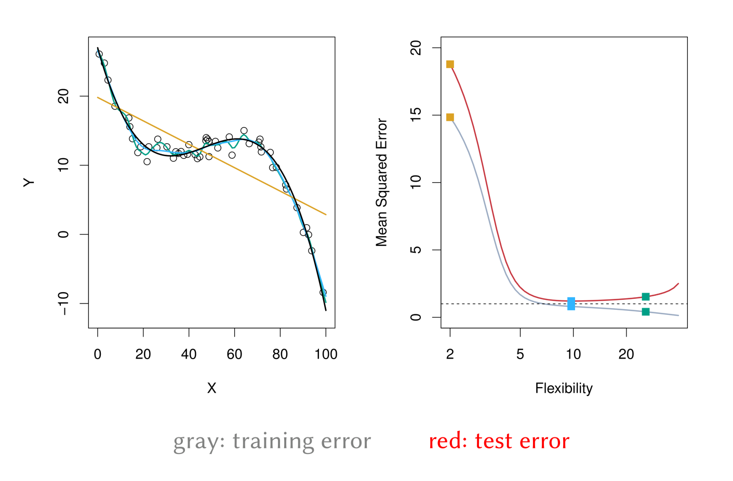
Training Error versus Test Error

Slide 8
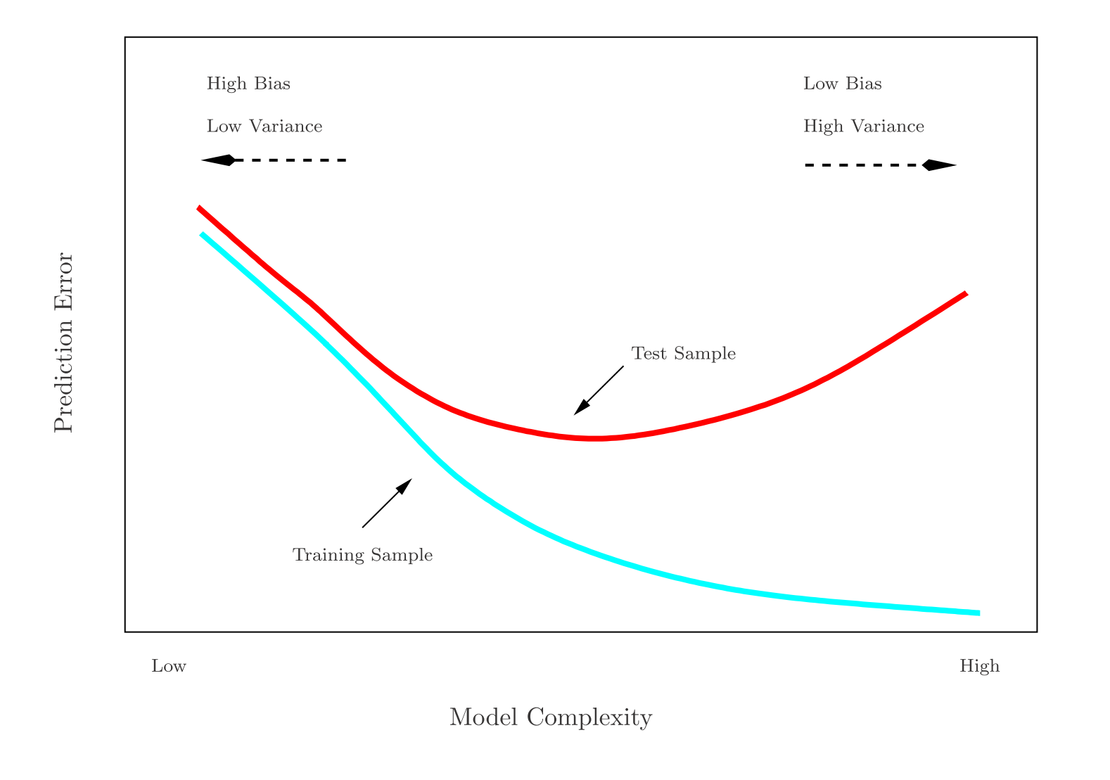
Training- versus Test-Set Performance

Slide 9
Estimate Prediction-error
Best: a large test set. If …, but..
Some methods make a mathematical adjustment to the
training error rate in order to estimate the test error rate.
These include the Cp statistic, AIC and BIC.
Estimate the test error by holding out a subset of the training observations from the ﬁtting process, and then applying the statistical learning method to those held out observations

Slide 10
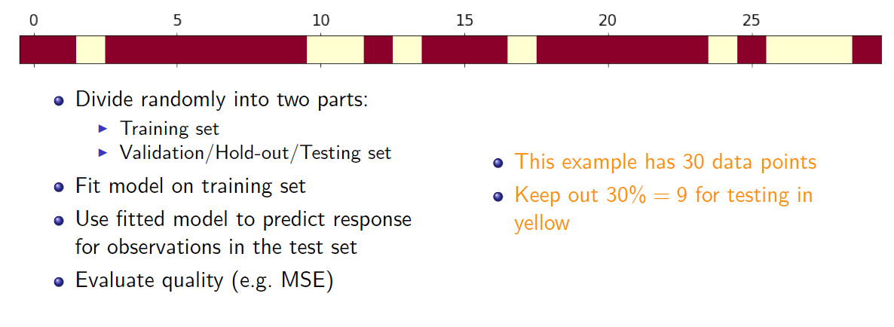
Validation-set Approach

Slide 11
Coding example in Jupyter Notebook

Slide 12
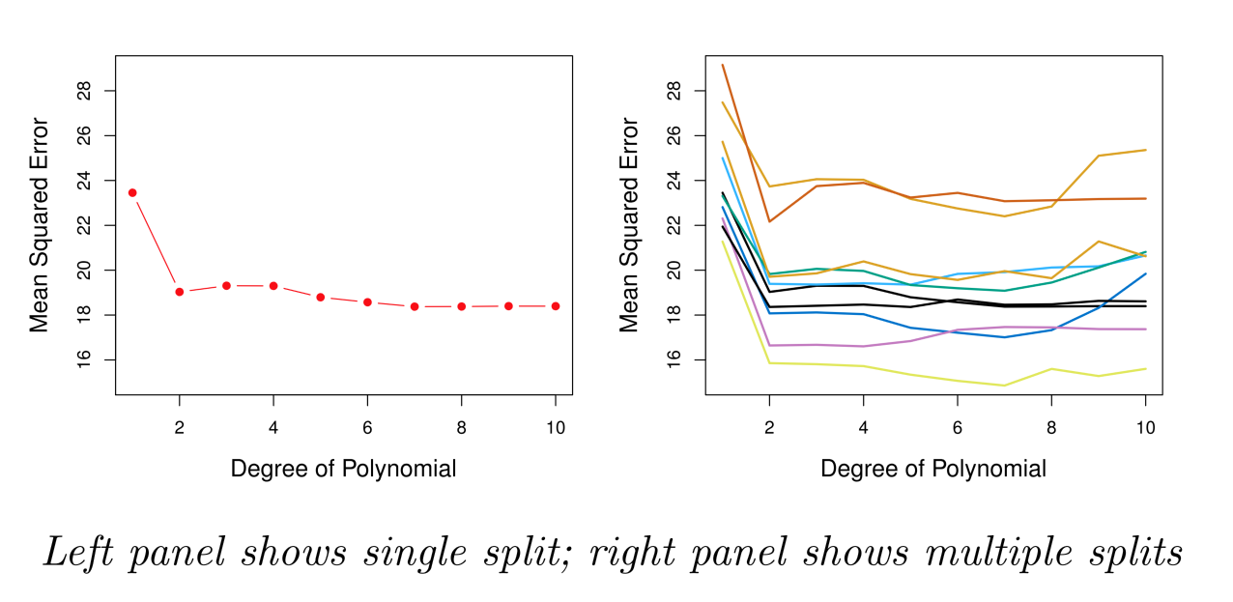
Example: Automobile Data
Sample size n = 392. Training set 196 obs, and validation set 196 obs.
Linear or higher-order polynomial term?

Slide 13
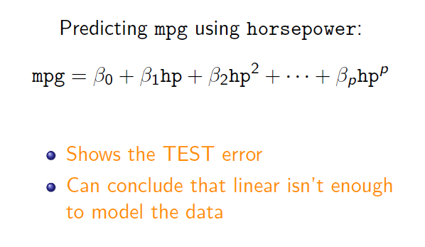
Example: Automobile Data
Sample size n = 392. Training set 196 obs, and validation set 196 obs.
Linear or higher-order polynomial term?

Slide 14
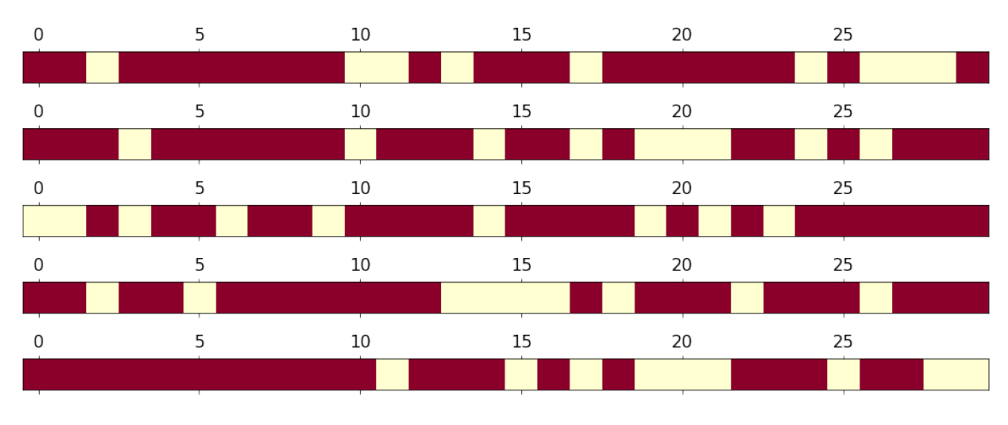
Rinse and repeat

Slide 15
Example: Automobile Data

Slide 16
Drawbacks of Validation Set Approach
Highly variable (imprecise) estimates : Each line shows validation error for one possible division of data
Only subset of data is used (validation set is excluded – only about half of data is used)
This suggests that the validation set error may tend to overestimate the test error for the model ﬁt on the entire data set. Why?

Slide 17
Leave-One-Out Cross-Validation (LOOCV)

Slide 18
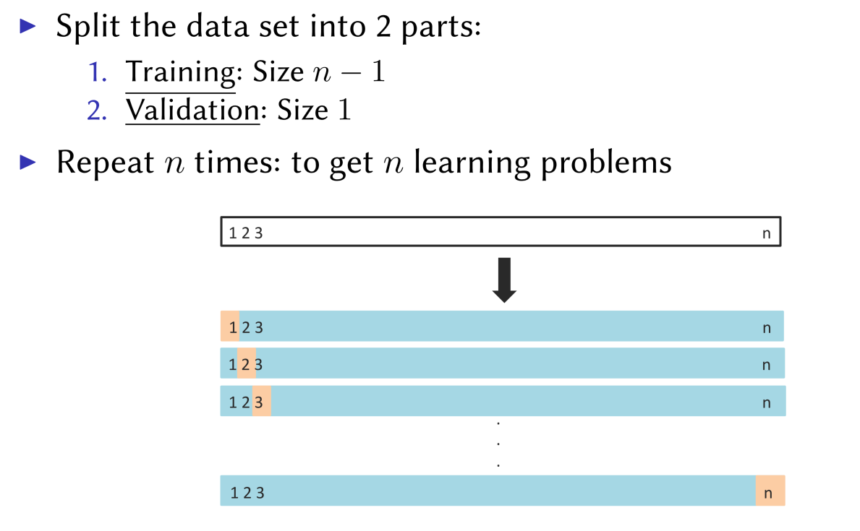
Leave-One-Out Cross-Validation (LOOCV)

Slide 19
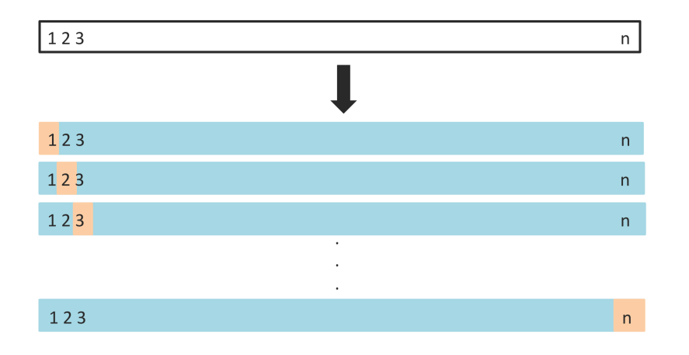

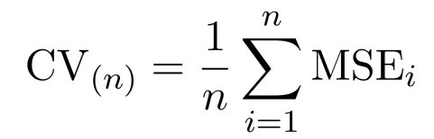
Leave-one-out
Get n learning problems
Train on n-1 instances (blue)
Test on 1 instance (orange)
LOOCV estimate

Slide 20
Leave-one-out vs Validation Set
Advantages
Using almost all data not just half
Stable results
Evaluation is performed with more testing data
Disadvantages
Can be very computationally expensive: fit the model n times
LOOCV typically doesn’t shake up the data enough. The estimates from each fold are highly correlated.

Slide 21
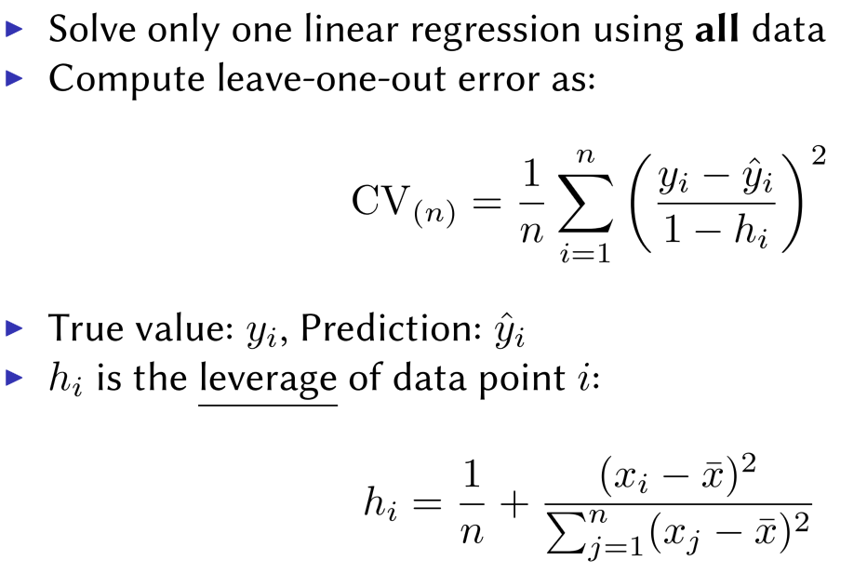
Speeding Up Leave-One-Out
Solve each fit independently and distribute the computation.
Linear regression

Slide 22
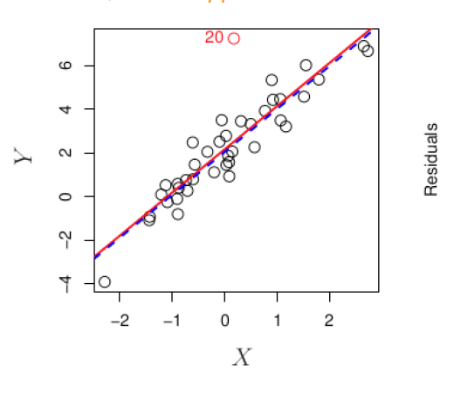
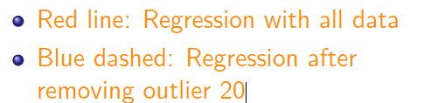
Outliers
An outlier is a point for which yi is far from the value predicted by the model.

Slide 23
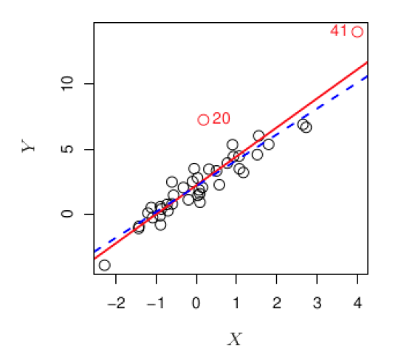
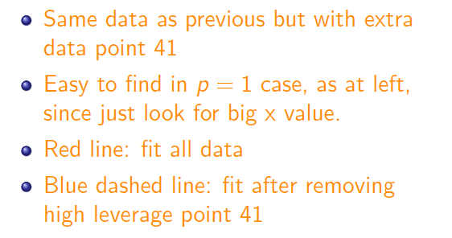
High Leverage
Observations with high leverage have an unusual value for x.

Slide 24
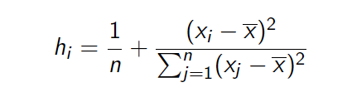
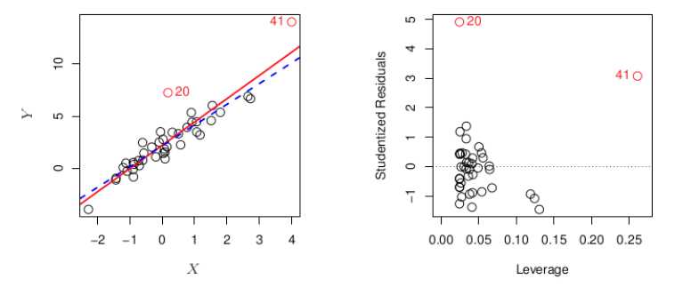
How to measure Leverage
Observations with high leverage have an unusual value for x.

Slide 25
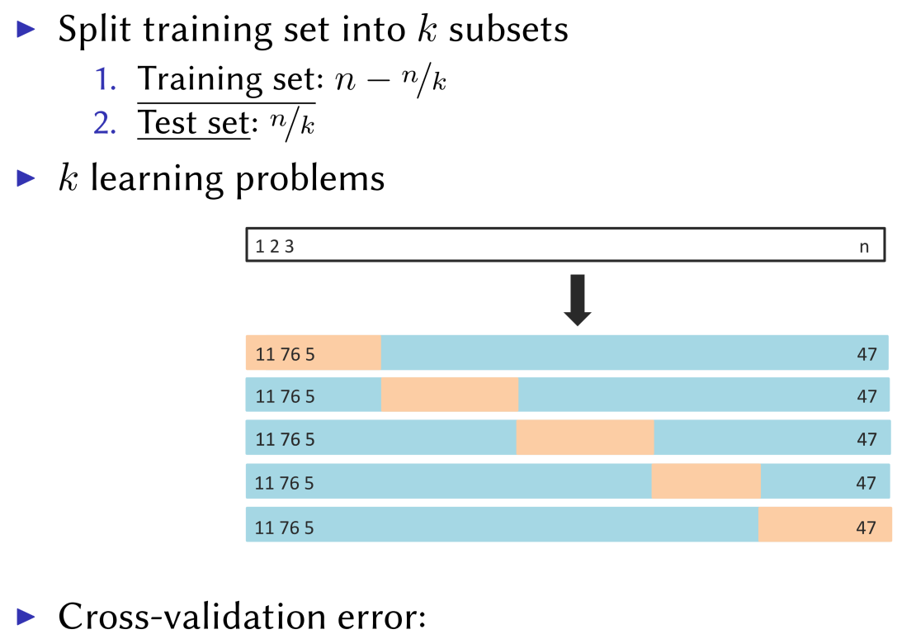
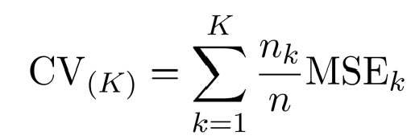
K-fold Cross-validation
Hybrid between validation set and LOOCV

Slide 26
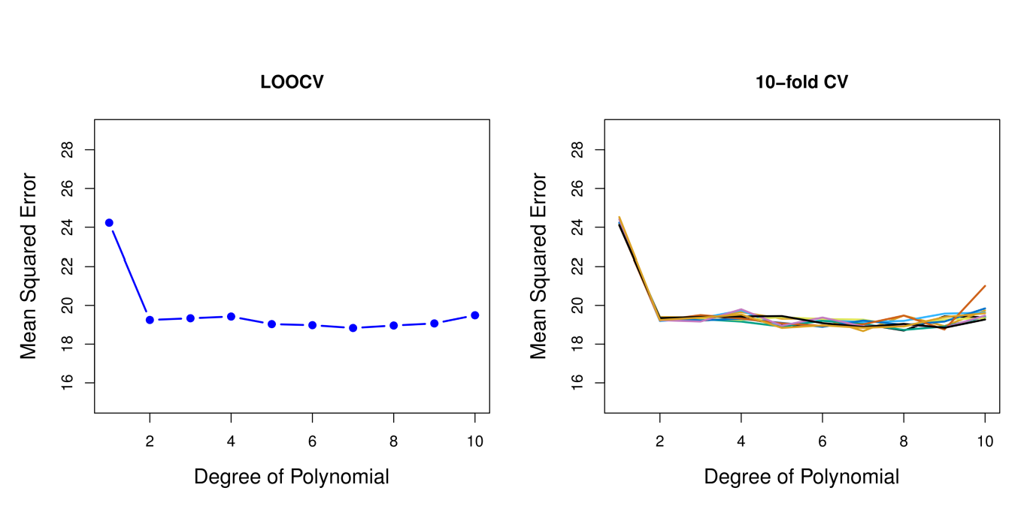
Cross-validation vs LOOCV

Slide 27
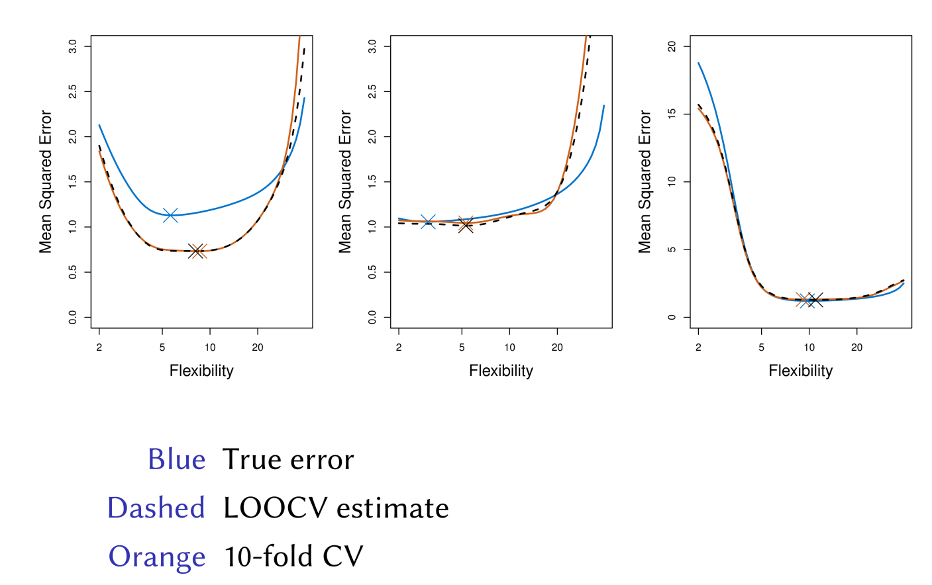
Simulated Results

Slide 28
Other Issues with Cross-validation
Since each training set is only (K − 1)/K as big as the original training set, the estimates of prediction error will typically be biased upward. Why?
This bias is minimized when K = n (LOOCV), but this estimate has high variance.
K = 5 or 10 are common choices

Slide 29
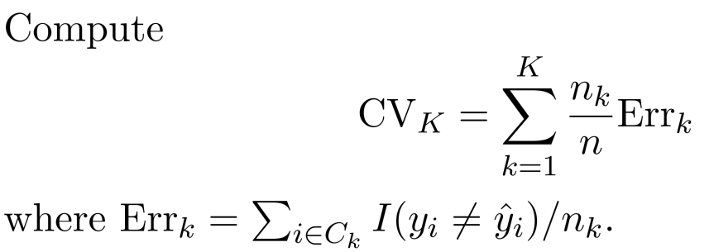
CV for Classification
We divide the data into K roughly equal-sized parts

Slide 30
Example: GWAS
Sample size n = 50, number of predictors (SNPs) p = 5000; Predictor heart attach after age of 60.
Step 1: Select the top 100 predictors having the largest correlation with the class labels
Step2: We then apply a classifier (logistic regression) using only these 100 predictors
How do we estimate the test set performance of this classifier?

Slide 31
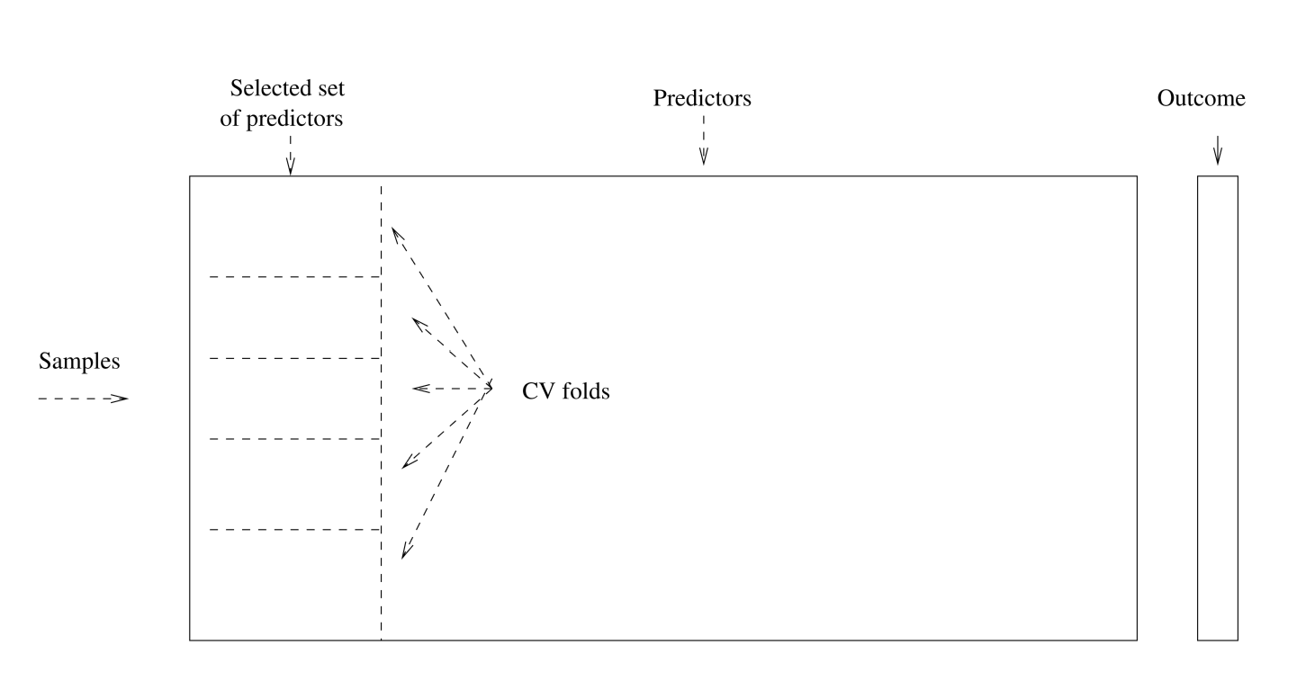
Example: GWAS
No ！！！

Slide 32
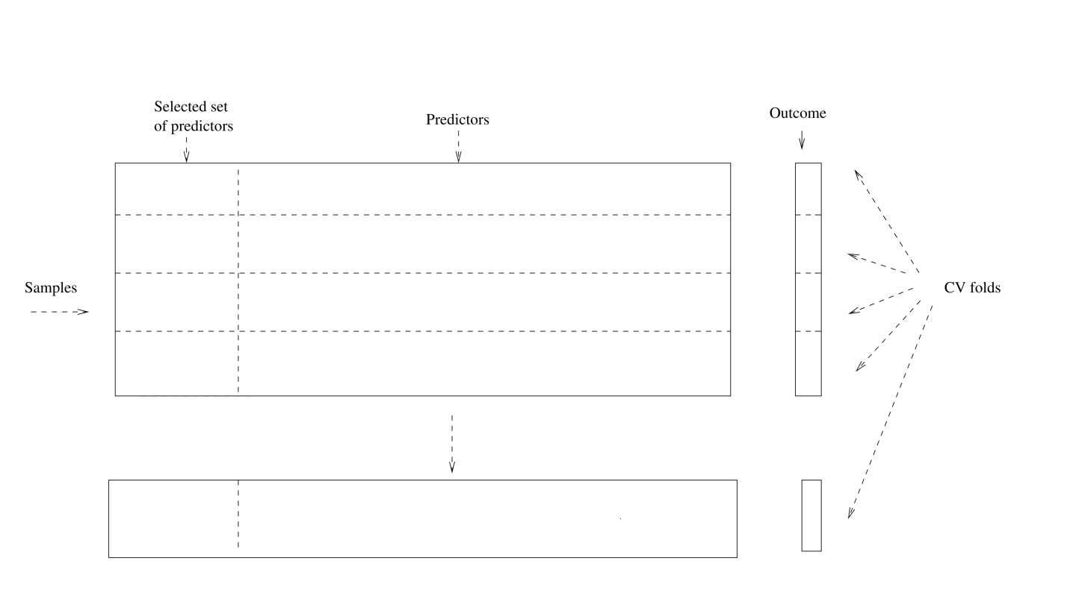
Example: GWAS ------Right Way

Slide 33
Bootstrap is used to quantify the uncertainty associated with an estimator or machine learning method. It can provide an estimate of the standard error of a coefficient. Then we can du hypothesis test and confidence interval.
Bootstrap

Slide 34

Bootstrap： Finance Example
To invest two stocks that yield return of X and Y, where X and Y are random.
We will invest a fraction of our money in X and the rest in Y.
Assume both stock have the same average return over the years. What criteria should we use for allocate the investment?

Slide 35

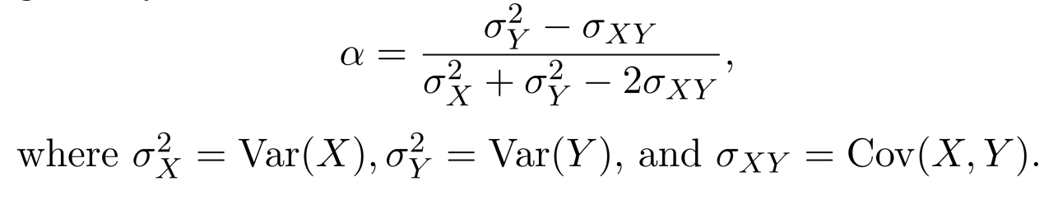
Bootstrap： Finance Example
We want to minimize the total risk or variance of our investment.
The solution is

Slide 36
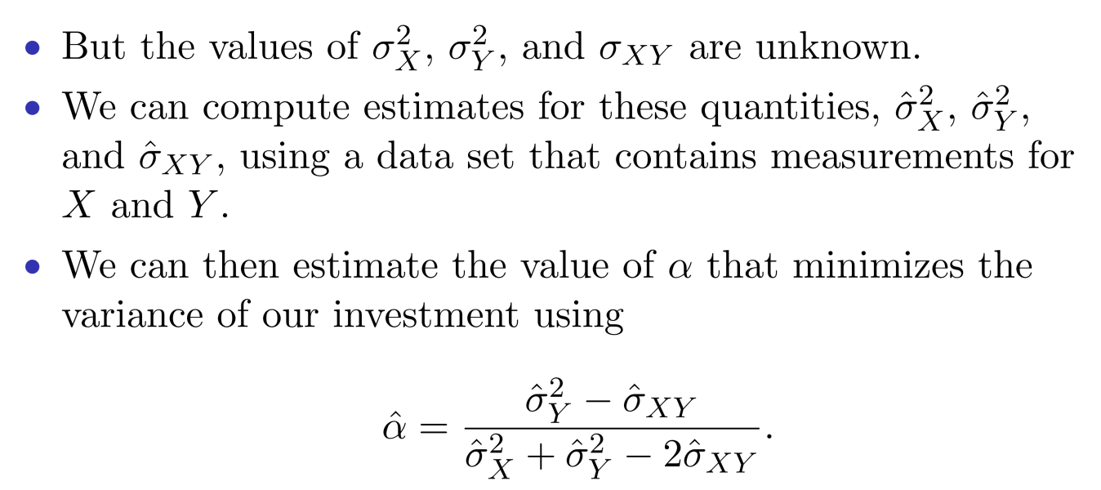
Finance Example: Simulations

Slide 37
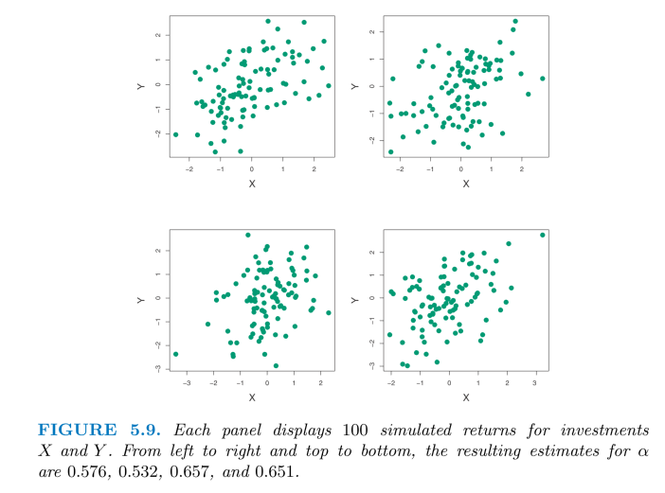
Finance Example: Simulations

Slide 38
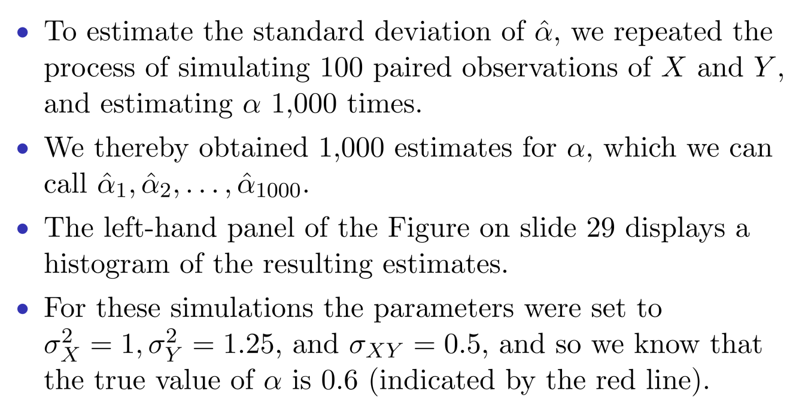
Finance Example: Simulations

Slide 39
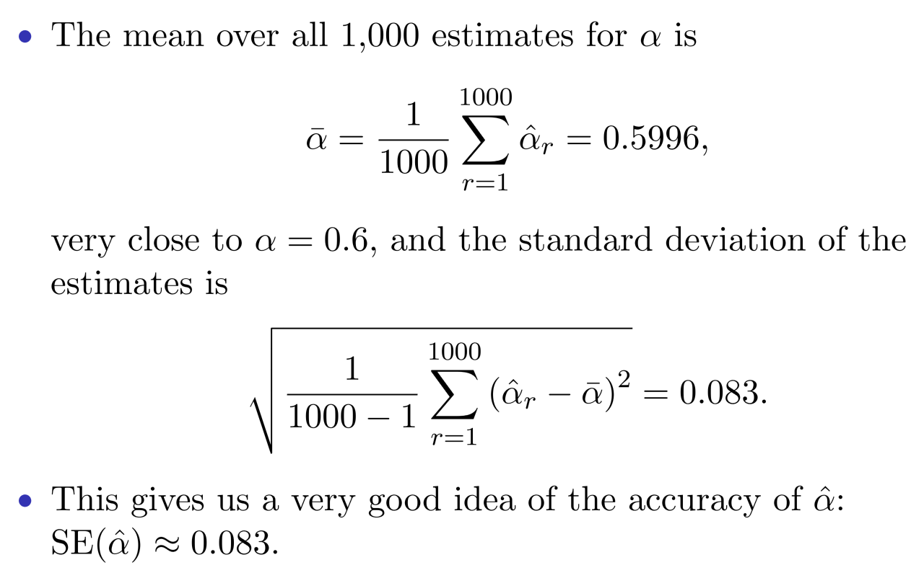
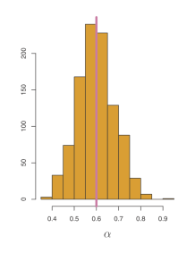

Slide 40
Finance Example: Reality
The procedure outlined above cannot be applied, because for real data we cannot generate new samples from the original population.
The bootstrap approach allows us to use a computer to mimic the process of obtaining new data sets.
Rather than repeatedly sampling from the population, we instead obtain distinct data sets by repeatedly sampling observations from the original data set with replacement.
Each of these “bootstrap data sets” is created by sampling with replacement, and is the same size as our original dataset. Some observations may appear more than once in a given bootstrap data set and some not at all.

Slide 41
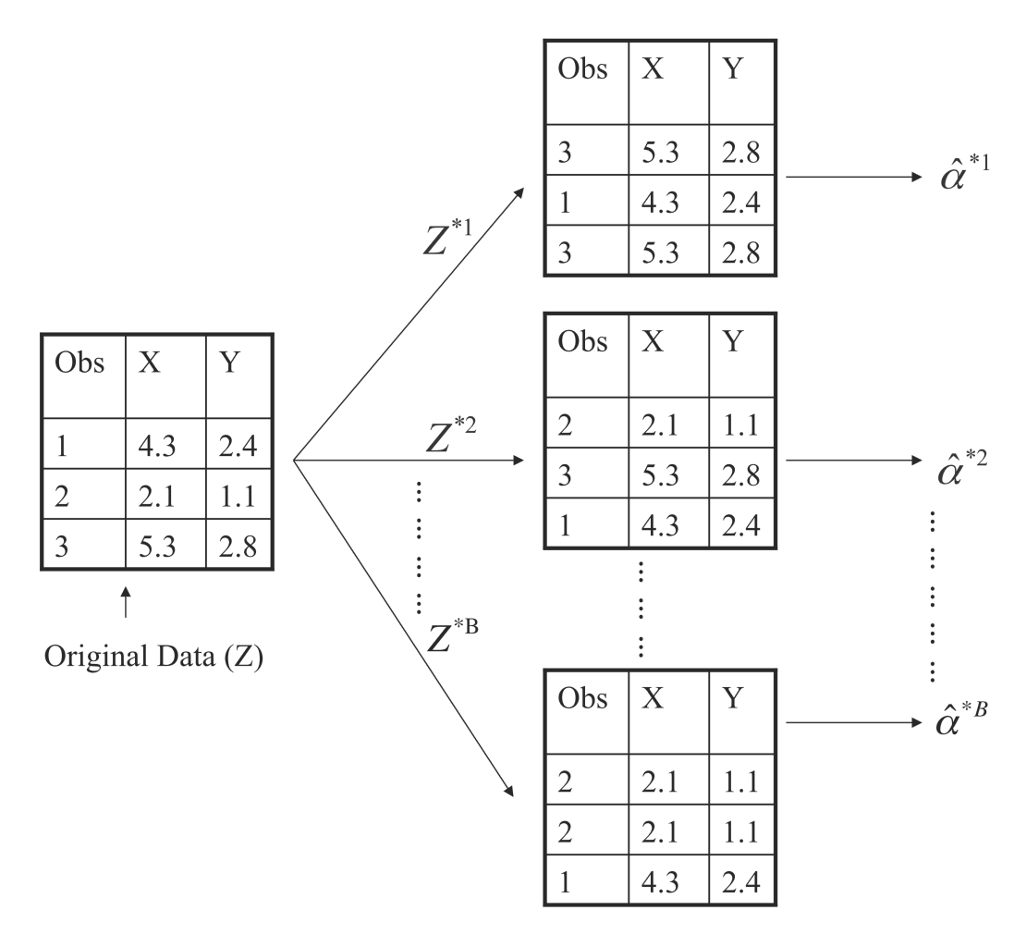
Boostrap Illustration

Slide 42
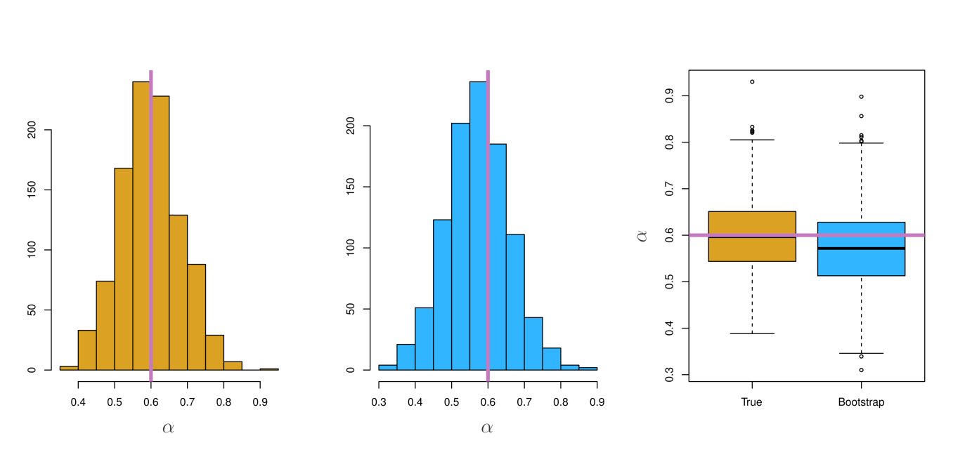
Boostrap Results

Slide 43
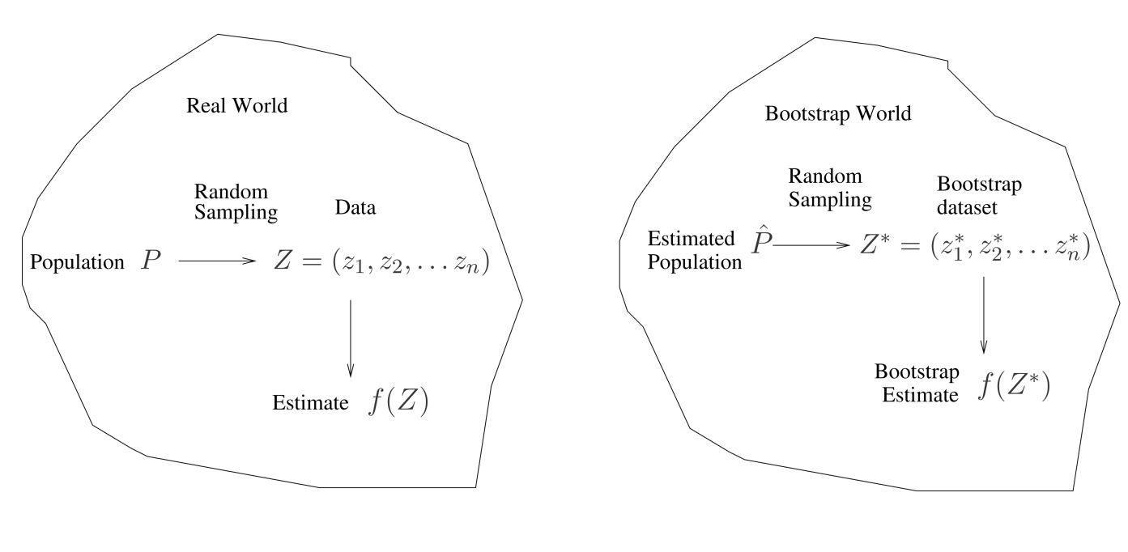
A General Picture for the Bootstrap

Slide 44
Boostrap for Prediction Error?
Can we use one boostrap dataset as training and the original data set as test set?

Slide 45
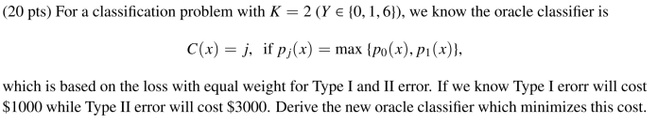
Bonus Quiz 13

Slide 46
Bonus Quiz 15
When sample size n is large，we know a bootstrap dataset will contain 1 – e⁻¹ = 63.2% of original data. Write a code to demonstrate it using n = 1000000

