Slide 1

Module 5: Resampling Methods
Lecture 11
Feb 6st, 2023
Ch 5.1.1-2:

Slide 2
Recap
Cross-validation

Slide 3
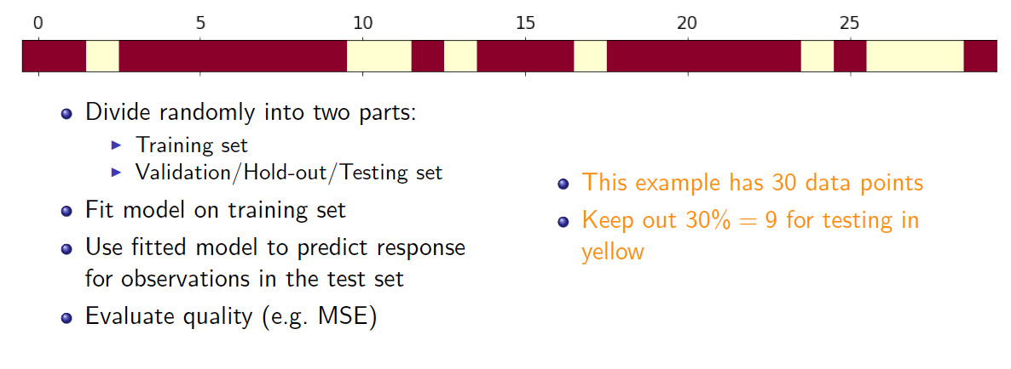
Validation-set Approach

Slide 4
Coding example in Jupyter Notebook

Slide 5
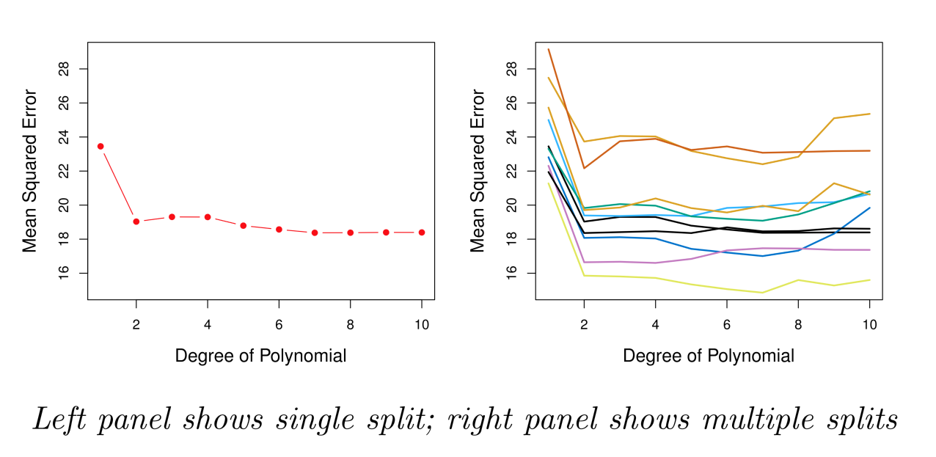
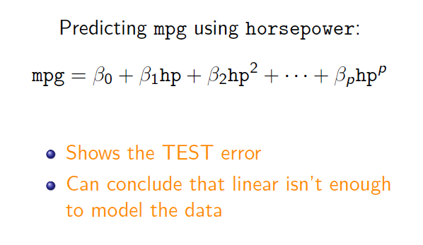
Example: Automobile Data
Sample size n = 392. Training set 196 obs, and validation set 196 obs.
Linear or higher-order polynomial term?

Slide 6
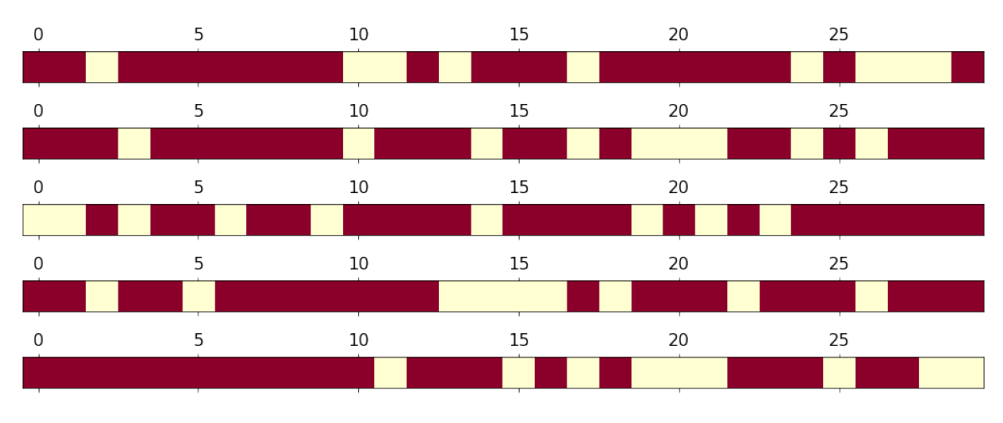
Rinse and repeat

Slide 7
Example: Automobile Data

Slide 8
Drawbacks of Validation Set Approach
Highly variable (imprecise) estimates : Each line shows validation error for one possible division of data
Only subset of data is used (validation set is excluded – only about half of data is used)
This suggests that the validation set error may tend to overestimate or underestimate? the test error for the model ﬁt on the entire data set. Why?

Slide 9
Leave-One-Out Cross-Validation (LOOCV)

Slide 10
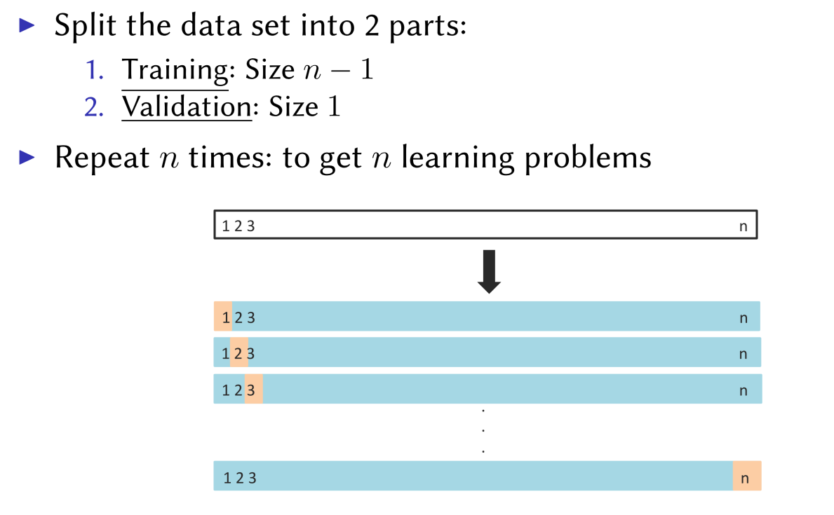
Leave-One-Out Cross-Validation (LOOCV)

Slide 11
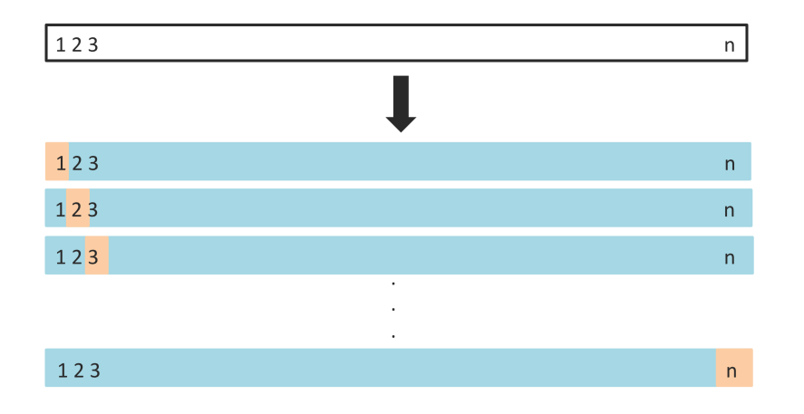

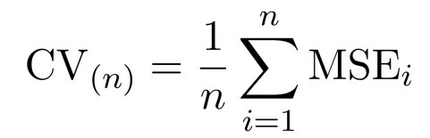
Leave-one-out
Get n learning problems
Train on n-1 instances (blue)
Test on 1 instance (orange)
LOOCV estimate

Slide 12
Leave-one-out vs Validation Set
Advantages
Using almost all data not just half
Stable results
Evaluation is performed with more testing data
Disadvantages
Can be very computationally expensive: fit the model n times
LOOCV typically doesn’t shake up the data enough. The estimates from each fold are highly correlated.

Slide 13
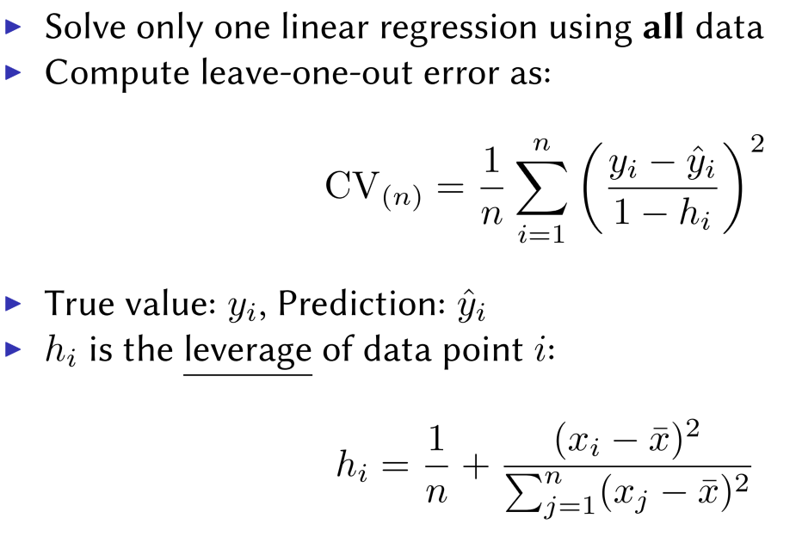
Speeding Up Leave-One-Out
Solve each fit independently and distribute the computation.
Linear regression

Slide 14
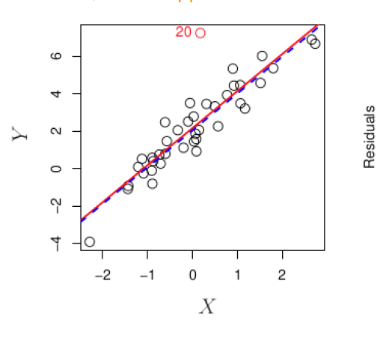
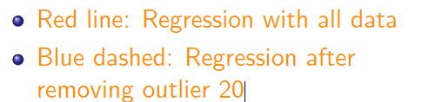
Outliers
An outlier is a point for which y_{i} is far from the value predicted by the model.

Slide 15
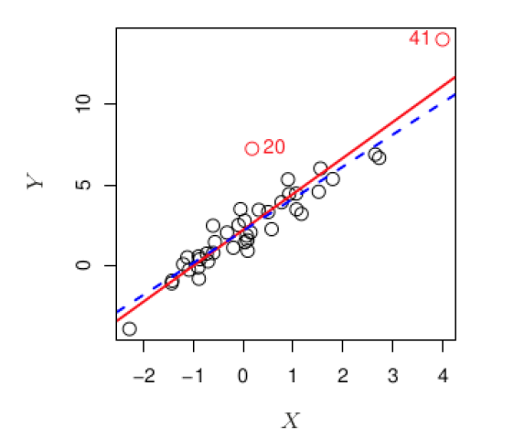
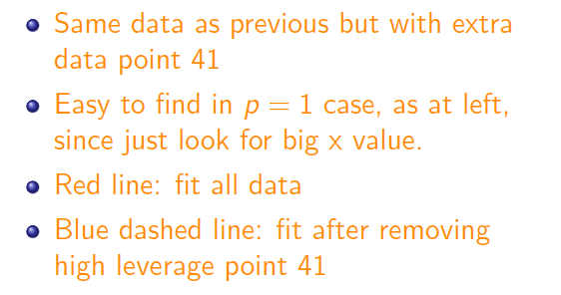
High Leverage
Observations with high leverage have an unusual value for x.

Slide 16
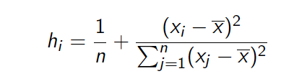
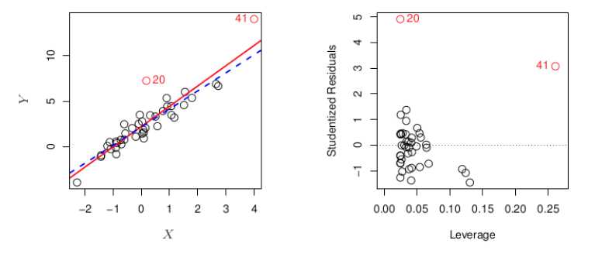
How to measure Leverage
Observations with high leverage have an unusual value for x.

Slide 17
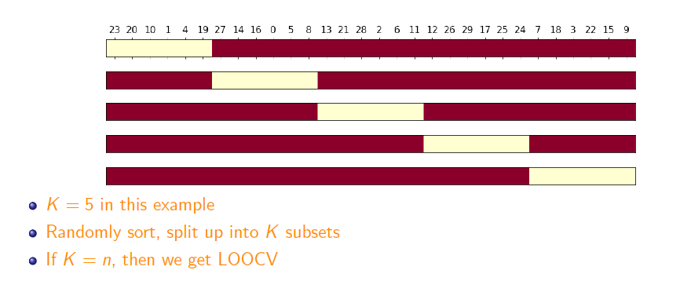
K-fold Cross-validation
Hybrid between validation set and LOOCV

Slide 18
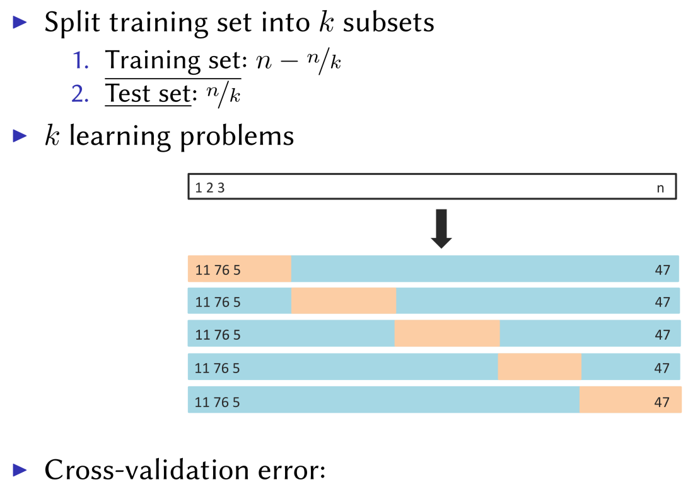
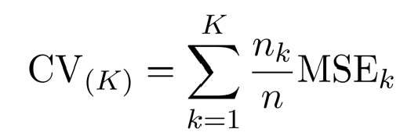
K-fold Cross-validation
Hybrid between validation set and LOOCV

Slide 19
Coding – Building k-fold CV

Slide 20
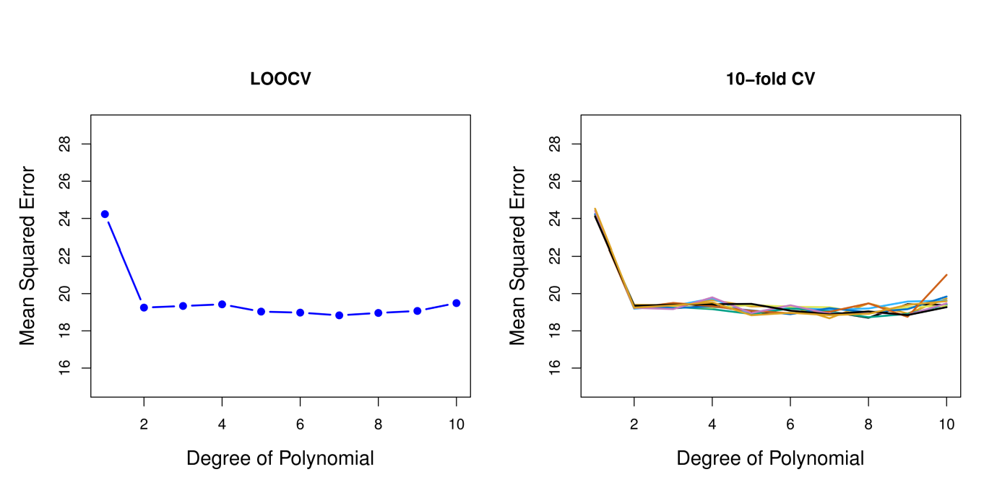
Cross-validation vs LOOCV

Slide 21
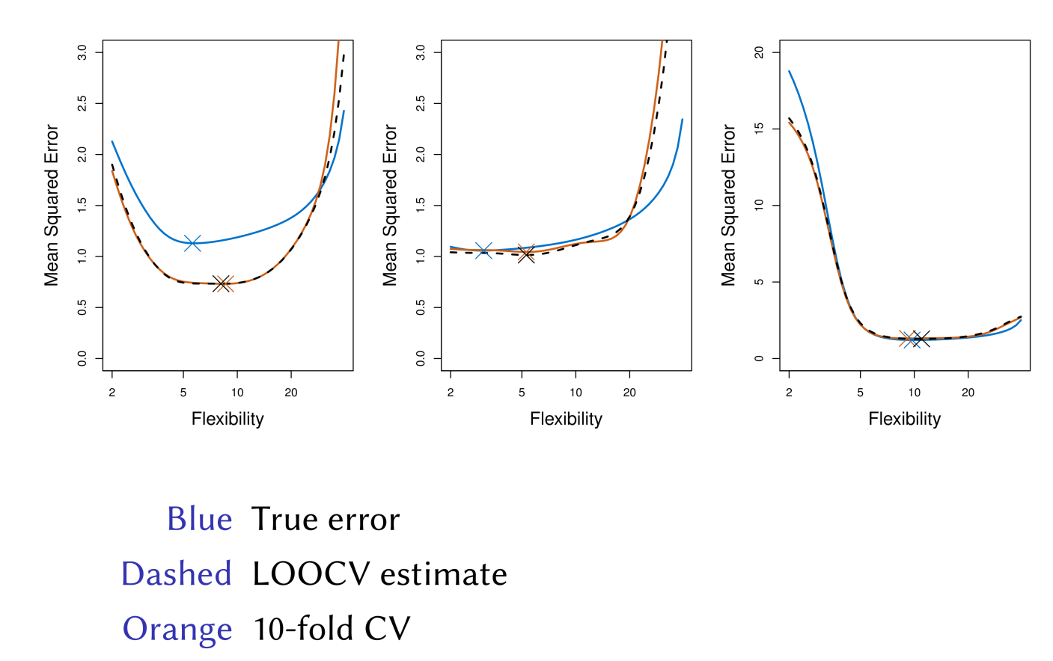
Simulated Results

Slide 22
Other Issues with Cross-validation
Since each training set is only (K − 1)/K as big as the original training set, the estimates of prediction error will typically be biased upward. Why?
This bias is minimized when K = n (LOOCV), but this estimate has high variance.
K = 5 or 10 are common choices

Slide 23
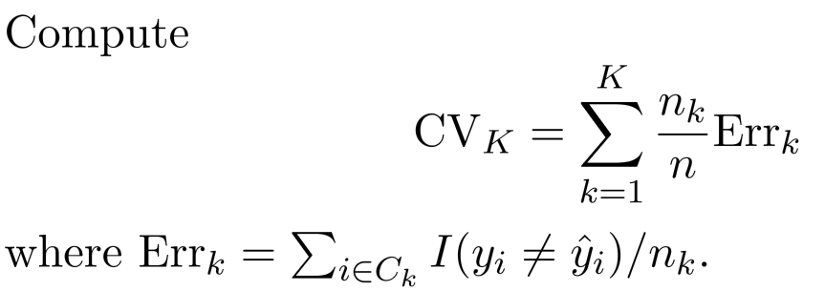
CV for Classification
We divide the data into K roughly equal-sized parts

Slide 24
Example: GWAS
Sample size n = 50, number of predictors (SNPs) p = 5000; Predictor heart attach after age of 60.
Step 1: Select the top 100 predictors having the largest correlation with the class labels
Step2: We then apply a classifier (logistic regression) using only these 100 predictors
How do we estimate the test set performance of this classifier?

Slide 25
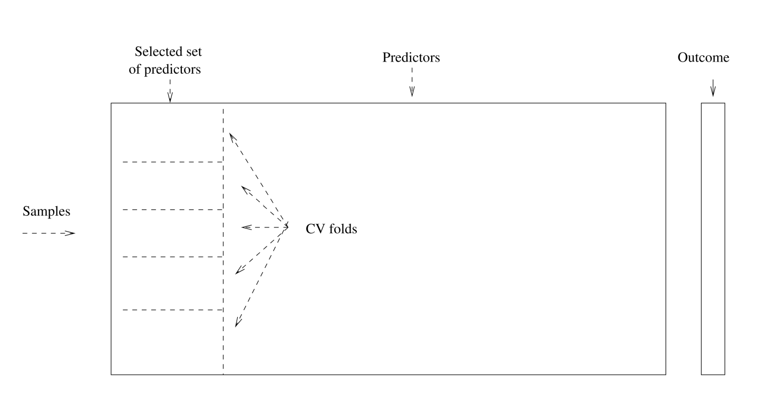
Example: GWAS
No ！！！

Slide 26
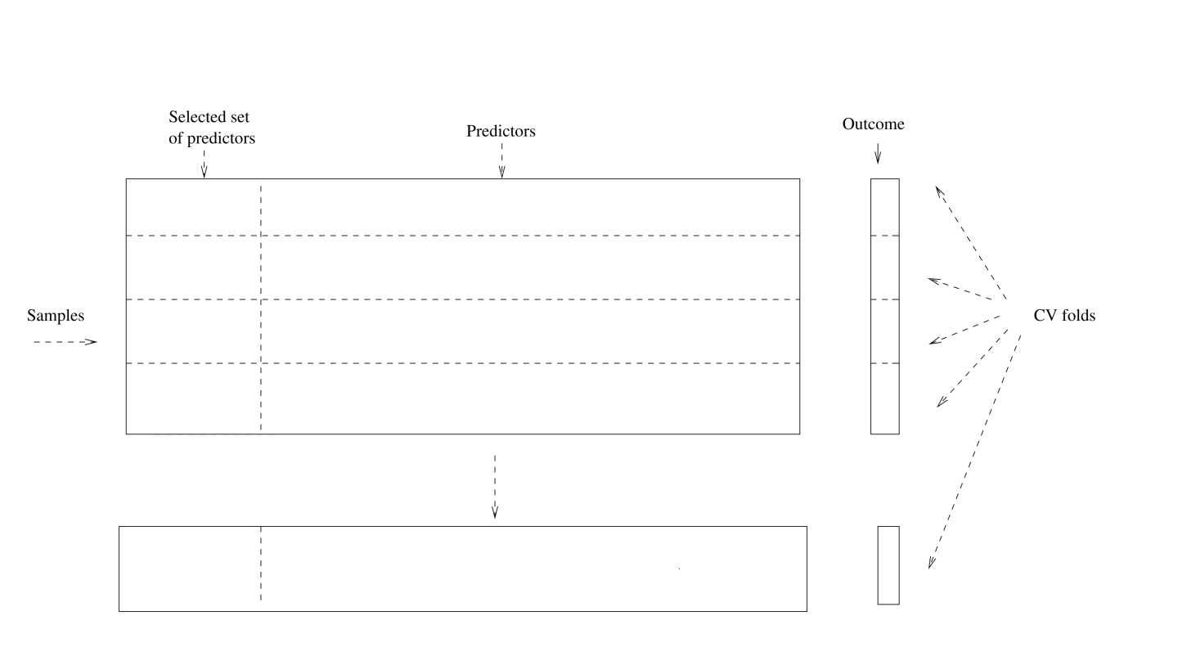
Example: GWAS ------Right Way

Slide 27
Bootstrap is used to quantify the uncertainty associated with an estimator or machine learning method. It can provide an estimate of the standard error of a coefficient. Then we can du hypothesis test and confidence interval.
Bootstrap

Slide 28

Bootstrap： Finance Example
To invest two stocks that yield return of X and Y, where X and Y are random.
We will invest a fraction of our money in X and the rest in Y.
Assume both stock have the same average return over the years. What criteria should we use for allocate the investment?

Slide 29

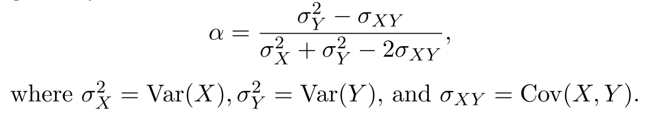
Bootstrap： Finance Example
We want to minimize the total risk or variance of our investment.
The solution is

Slide 30
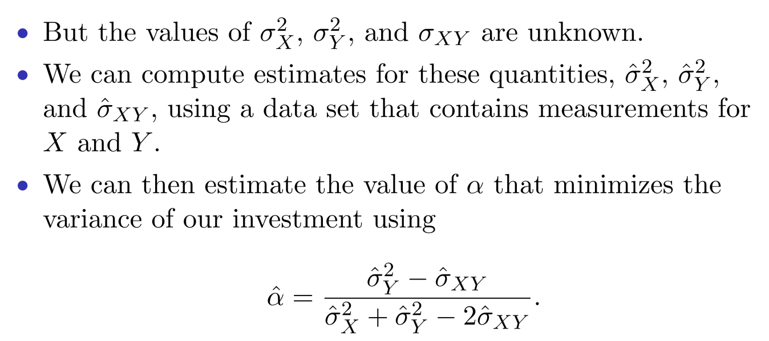
Finance Example: Simulations

Slide 31
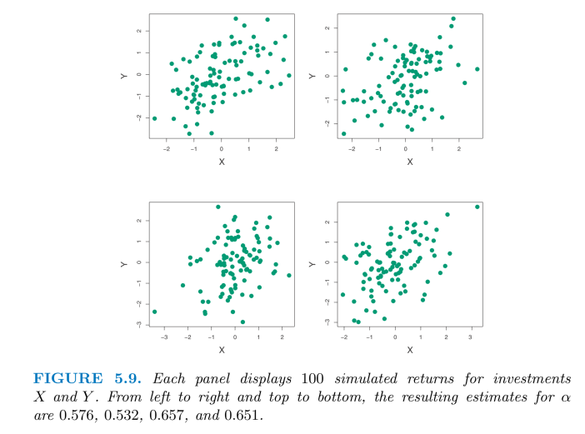
Finance Example: Simulations

Slide 32
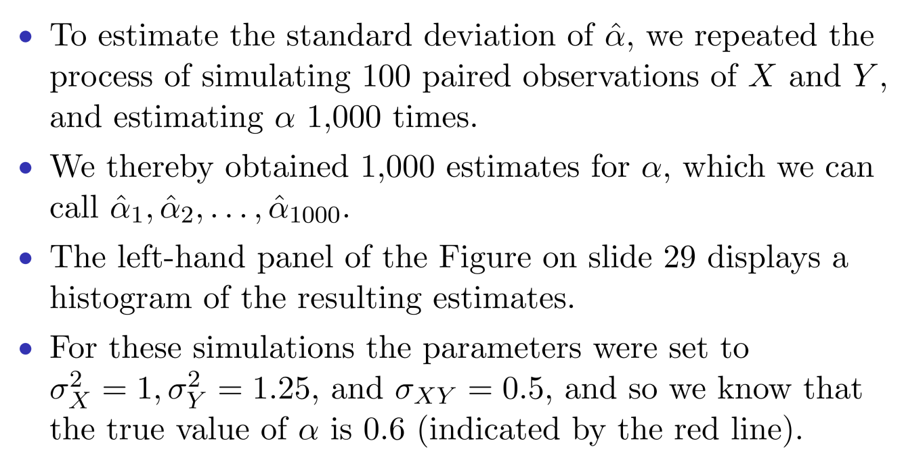
Finance Example: Simulations

Slide 33
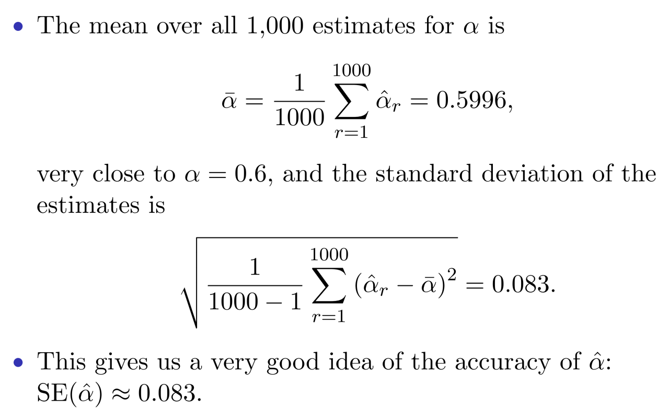
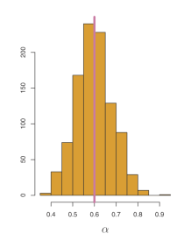

Slide 34
Finance Example: Reality
The procedure outlined above cannot be applied, because for real data we cannot generate new samples from the original population.
The bootstrap approach allows us to use a computer to mimic the process of obtaining new data sets.
Rather than repeatedly sampling from the population, we instead obtain distinct data sets by repeatedly sampling observations from the original data set with replacement.
Each of these “bootstrap data sets” is created by sampling with replacement, and is the same size as our original dataset. Some observations may appear more than once in a given bootstrap data set and some not at all.

Slide 35
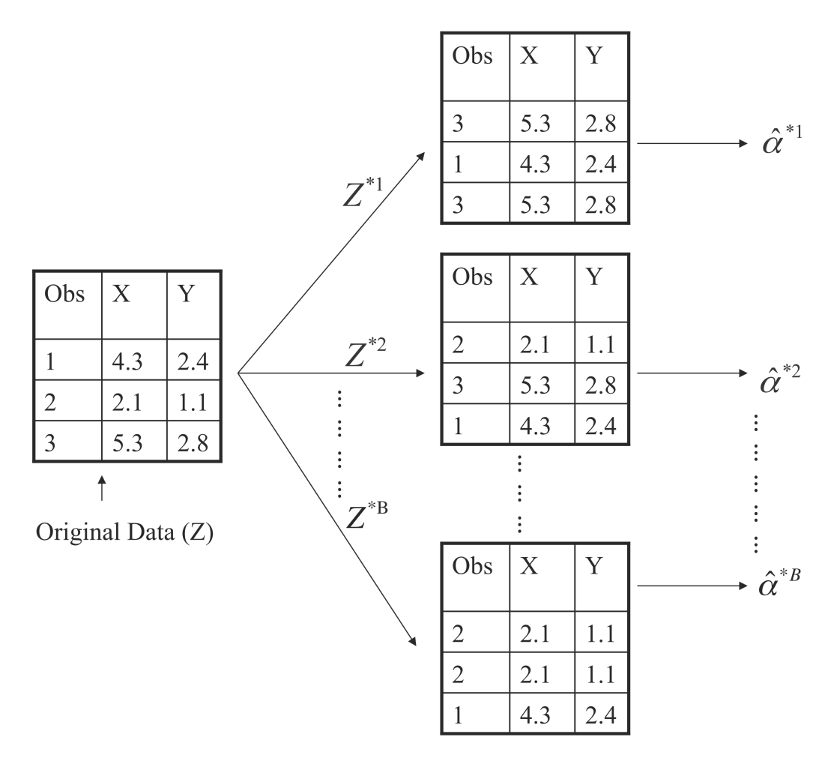
Boostrap Illustration

Slide 36
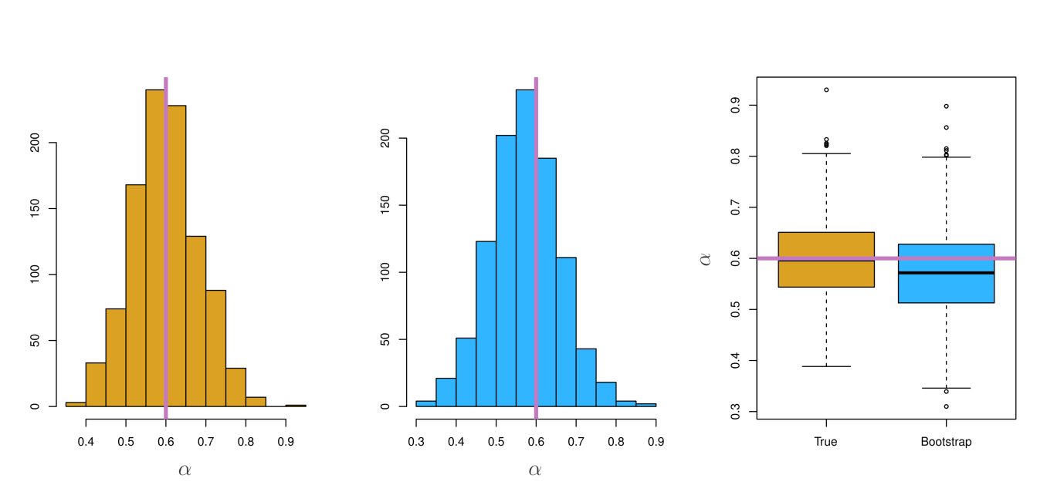
Boostrap Results

Slide 37
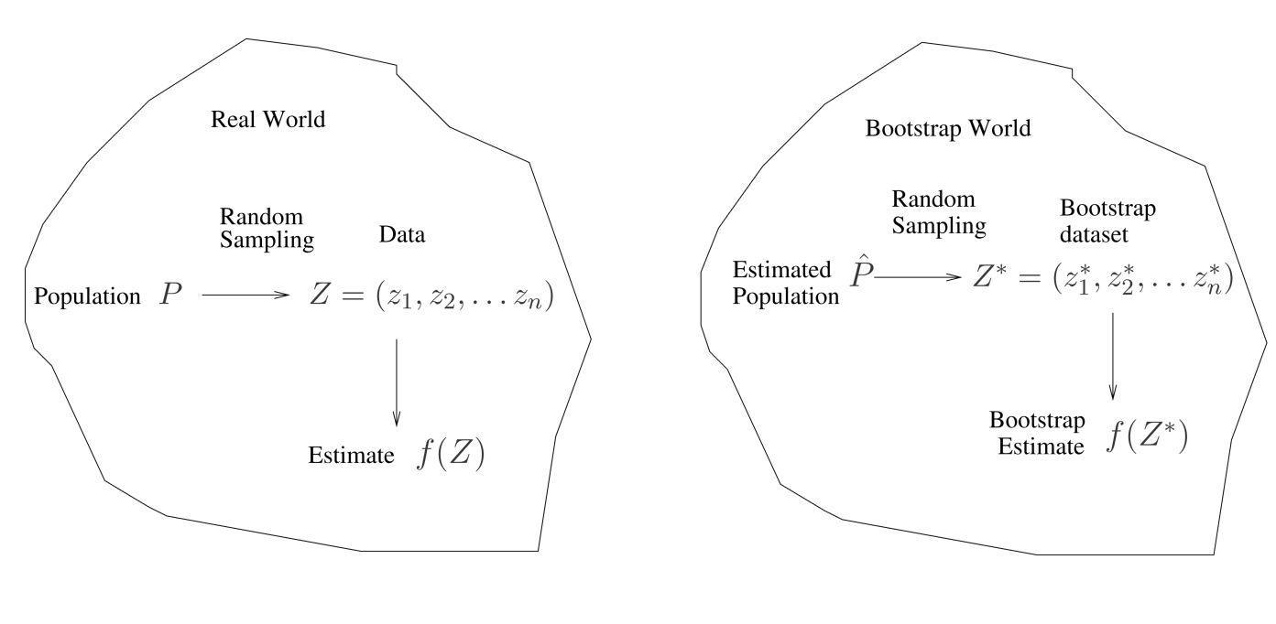
A General Picture for the Bootstrap

Slide 38
Boostrap for Prediction Error?
Can we use one boostrap dataset as training and the original data set as test set?

Slide 39
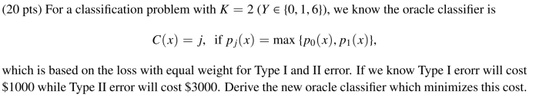
Bonus Quiz 13

Slide 40
Bonus Quiz 15
When sample size n is large，we know a bootstrap dataset will contain 1 – e⁻¹ = 63.2% of original data. Write a code to demonstrate it using n = 1000000

