Slide 1

Module 3: Linear Regression
Lecture 5
Jan 23th, 2023

Slide 2
Recap
Confidence interval.
R square

Slide 3



Multiple Linear Regression
Usually more than one feature is available
In general
We interpret as the average eﬀect on Y of a one unit increase in,
holding all other predictors ﬁxed.
Claims of causality should be avoided for observational data.

Slide 4



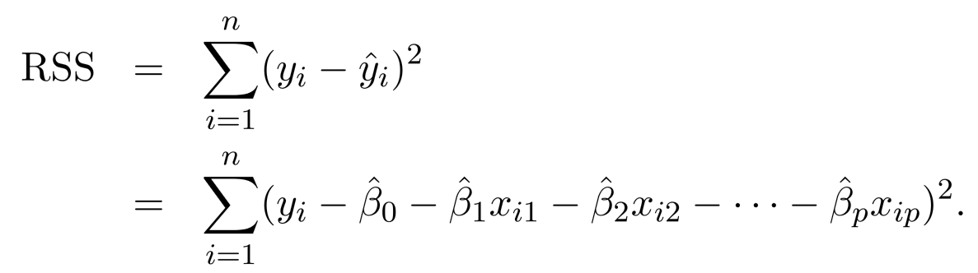
Estimation and Prediction
Given estimates we can make predictions using
We estimate by minimizing the sum of squared residuals

Slide 5
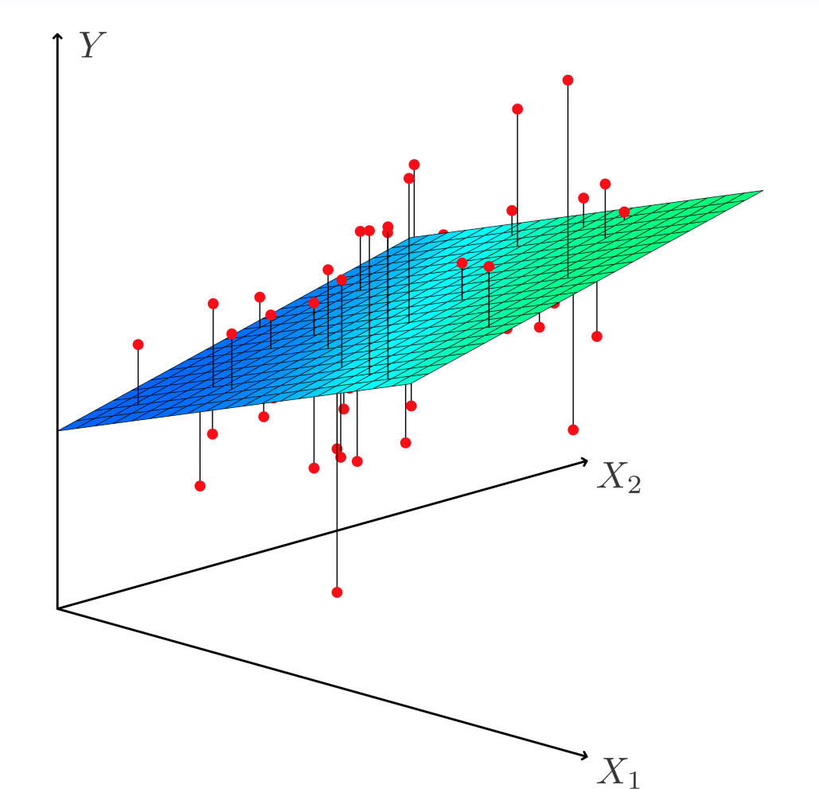
Estimation and Prediction

Slide 6
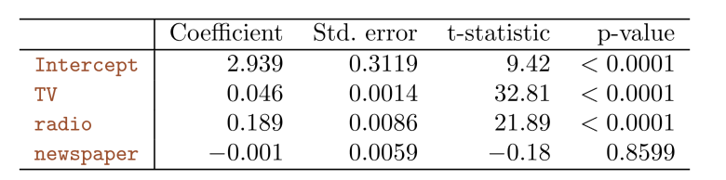
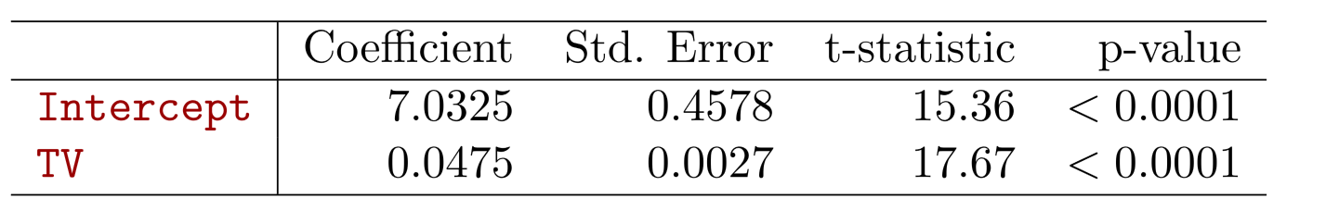
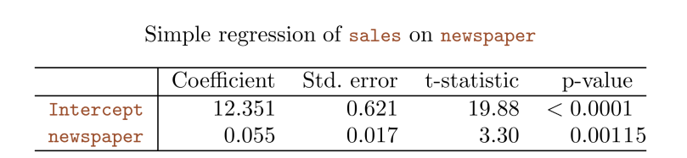
Results for Ad. Data

Slide 7
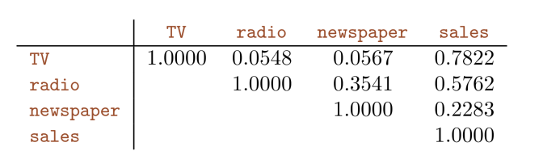
Results for Ad. Data

Slide 8
Some Important Questions
Is at least one of the predictors useful in predicting the response?
Do all the predictors help to explain Y, or is only a subset of the of the predictors useful?
Given a set of predictor values, what response value should we predict, and how accurate is our prediction?

Slide 9
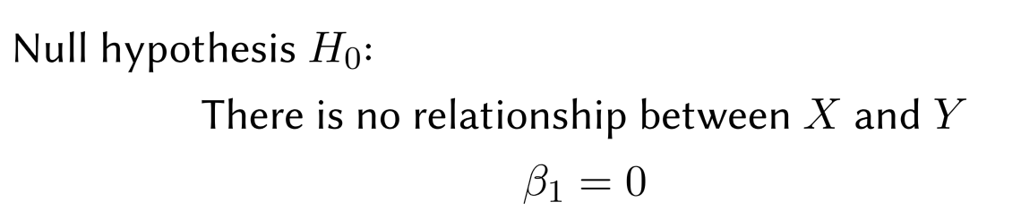

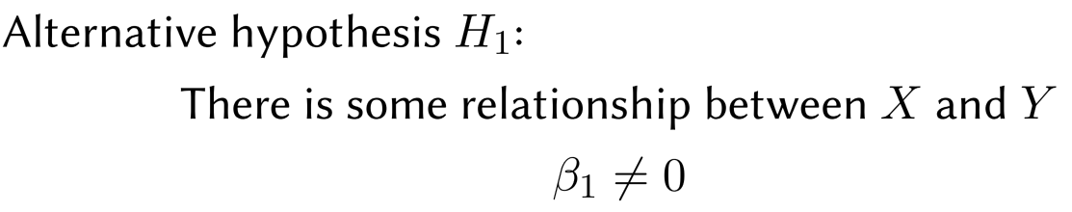

Inference 1
Is at least one of the predictors useful in predicting the response?
Seek to reject hypothesis H₀ with small p-value

Slide 10
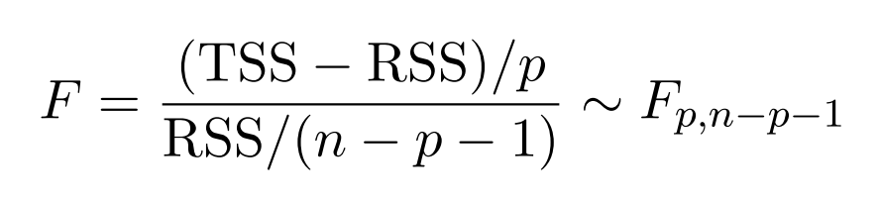
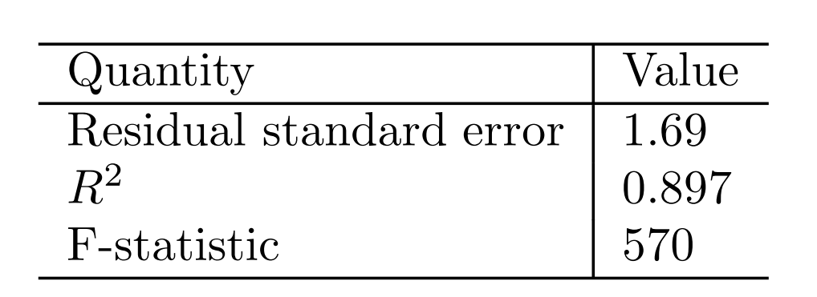
Inference 1
We will use the following random variable

Slide 11
Some Important Questions
Is at least one of the predictors useful in predicting the response?
Do all the predictors help to explain Y, or is only a subset of the of the predictors useful?
Given a set of predictor values, what response value should we predict, and how accurate is our prediction?

Slide 12
Inference 2:Deciding on the important variables
The most direct approach is called all subsets or best subsets regression: we compute the least squares ﬁt for all possible subsets and then choose between them based on some criterion that balances training error with model size.

Slide 13
Inference 2:Deciding on the important variables
The most direct approach is called all subsets or best subsets regression: we compute the least squares ﬁt for all possible subsets and then choose between them based on some criterion that balances training error with model size.
However, we often can’t examine all possible models, since they are xxx of them; for example, when p = 40 there are over a billion models!
Instead，we need an automated approach that searches through a subset of them. We discuss two commonly use approaches next.

Slide 14
Forward selection
Begin with the null model — a model that contains an intercept but no predictors.
Fit p simple linear regressions and add to the null model the variable that results in the lowest RSS.
Add to that model the variable that results in the lowest RSS amongst all two-variable models.
Continue until some stopping rule is satisﬁed, for example when all remaining variables have a p-value above some threshold.

Slide 15
Backward selection
Start with all variables in the model.
Remove the variable with the largest p-value — that is, the variable that is the least statistically signiﬁcant.
The new (p − 1)-variable model is ﬁt, and the variable with the largest p-value is removed.
Continue until a stopping rule is reached. For instance, we may stop when all remaining variables have a signiﬁcant p-value deﬁned by some signiﬁcance threshold.

Slide 16
Model selection
Other methods including Mallow C_{p}, AIC, BIC, adjust R2 and Cross-validation (CV)
Shrinkage method (LASSO, etc)

Slide 17
Some Important Questions
Is at least one of the predictors useful in predicting the response?
Do all the predictors help to explain Y, or is only a subset of the of the predictors useful?
Given a set of predictor values, what response value should we predict, and how accurate is our prediction?

Slide 18
Confidence Interval and Prediction Interval

Slide 19
Other Considerations
Qualitative Predictors
Some predictors are not categorical predictors or factor variables.
For example: gender, student (student status), status (marital status), and ethnicity (Caucasian, African American (AA) or Asian).

Slide 20
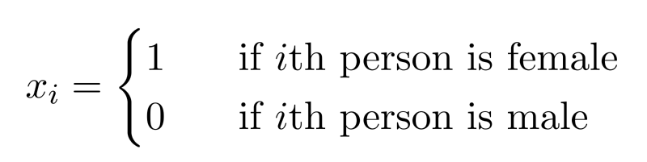
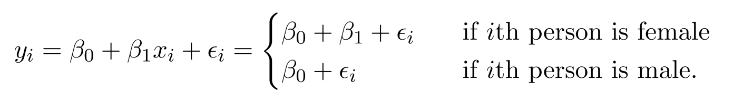
Qualitative Predictors
Example: investigate diﬀerences in credit card balance between males and females, ignoring the other variables.
We create a new variable
Resulting model:
Interpretation?

Slide 21
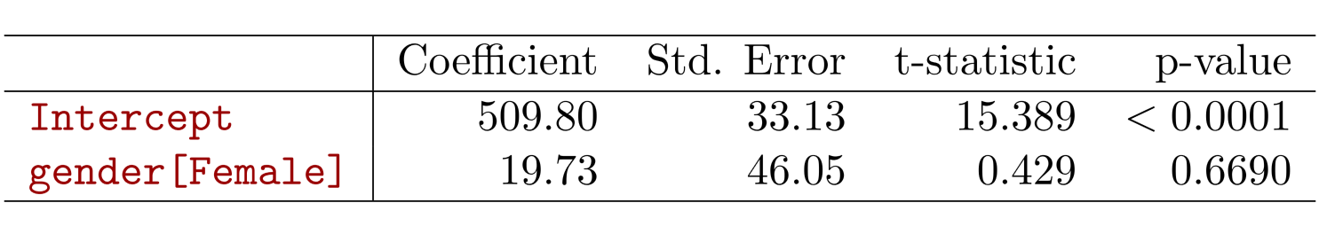
Credit card data

Slide 22
More than two levels?
For the ethnicity: Asian, Caucasian, African American

Slide 23
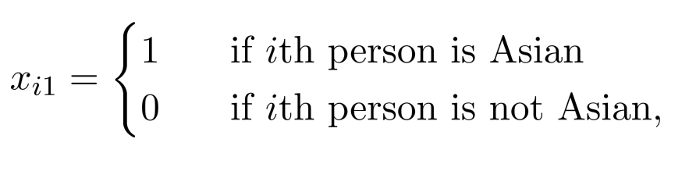
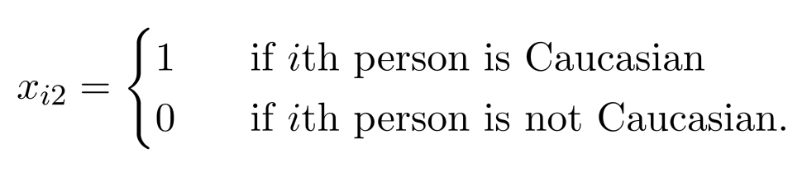
More than two levels?
For the ethnicity: Asian, Caucasian, African American
We will create two dummy variables.

Slide 24
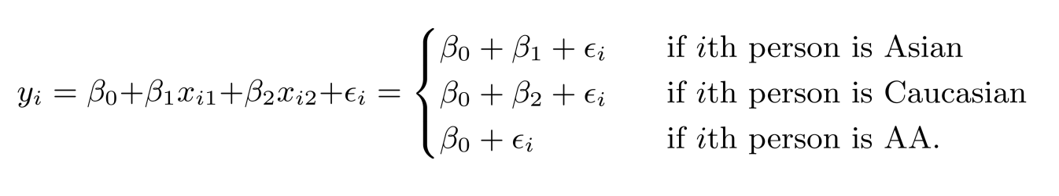
More than two levels?
Then we have the following model
There will always be one fewer dummy variable than the number of levels. The level with no dummy variable African American in this example — is known as the baseline.

Slide 25
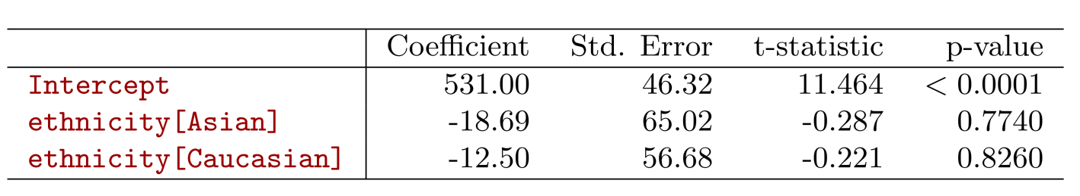
More than two levels?

Slide 26

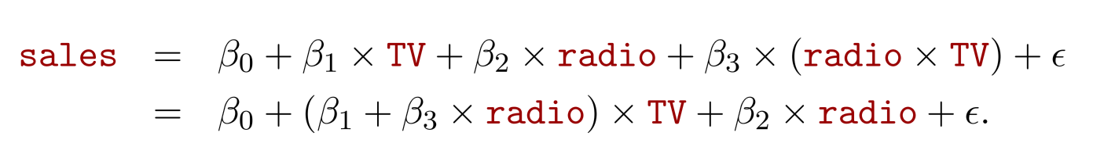
Extensions of the Linear Model
Interactions
In the advertising data, we assume the effect on sales of increasing one medium is independent of other media.
But suppose that spending money on radio advertising increases the effectiveness of TV advertising. How to model it?
This is called an interaction effect.

Slide 27
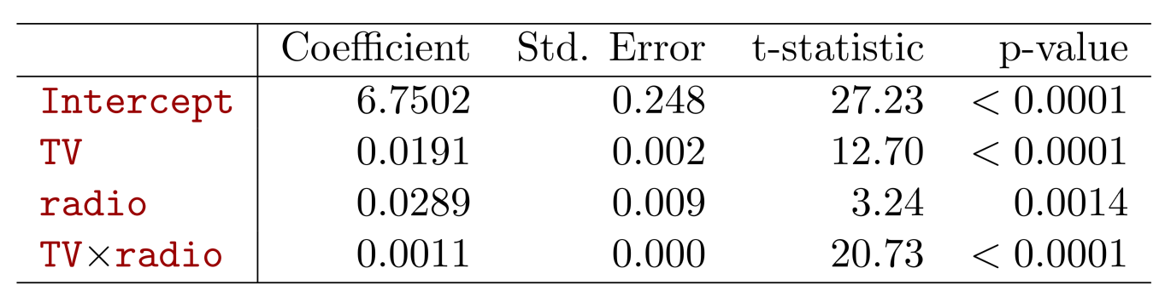

Interpretation
The p-value for the interaction term TV × radio is extremely low, indicating that there is strong evidence for
The R² for the interaction model is 96.8%, compared to only 89.7% for the model that predicts sales using TV and radio without an interaction term.
This means that (96.8 − 89.7)/(100 − 89.7) = 69% of the variability in sales that remains after ﬁtting the additive model has been explained by the interaction term.

Slide 28
Interpretation
The coeﬃcient estimates in the table suggest that an increase in TV advertising of $1, 000 is associated with increased sales of
An increase in radio advertising of $1, 000 will be associated with an increase in sales of

Slide 29
Hierarchy
Sometimes it is the case that an interaction term has a very small p-value, but the associated main eﬀects (in this case, TV and radio) do not.
The hierarchy principle:
If we include the interaction term, we should include the main effects no matter what!

Slide 30
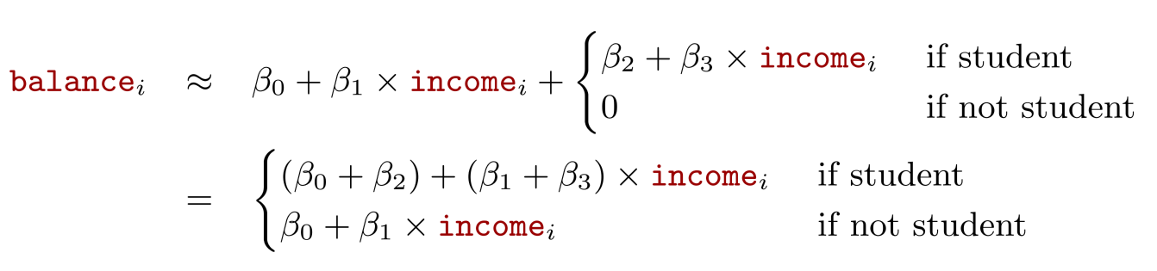
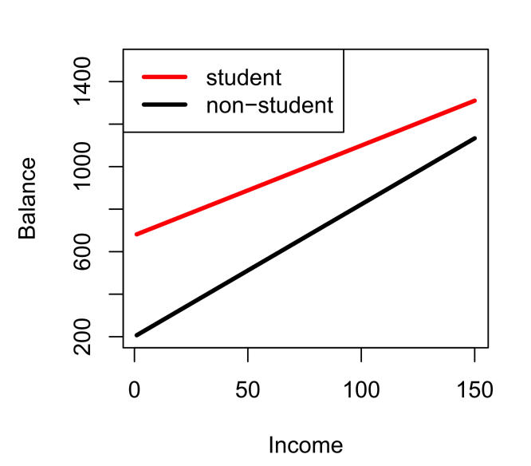
Qualitative and quantitative variables?
Consider the Credit data set, and suppose that we wish to predict balance using income (quantitative) and student (qualitative). With interactions, we have

Slide 31
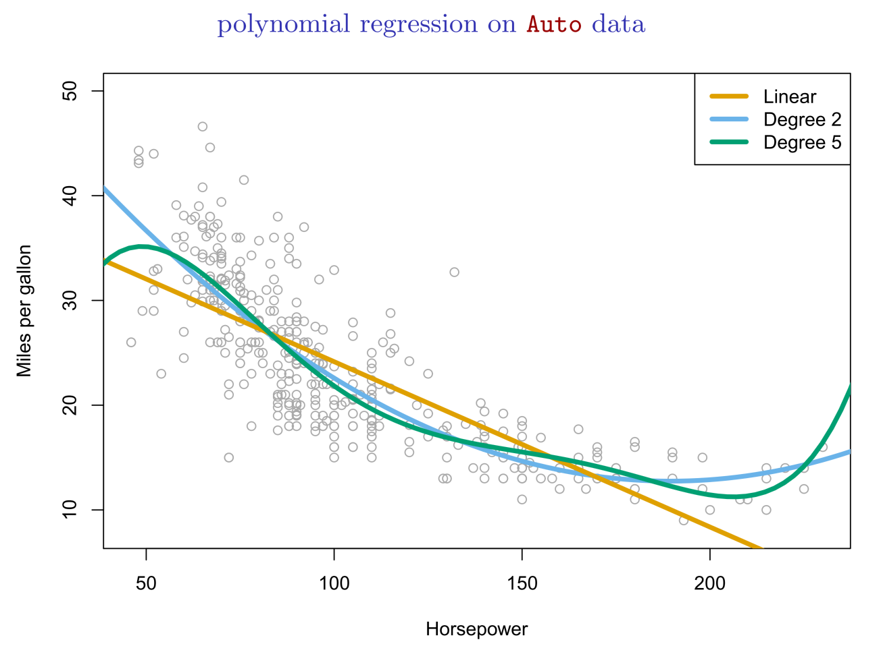
Non-linear eﬀects of predictors

Slide 32
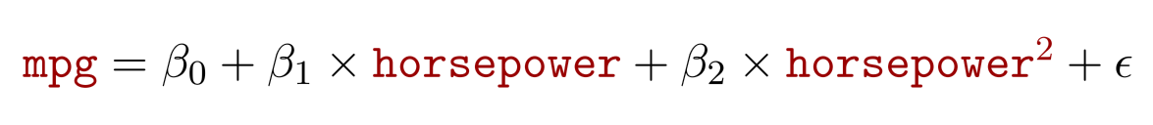
Non-linear eﬀects of predictors

Slide 33
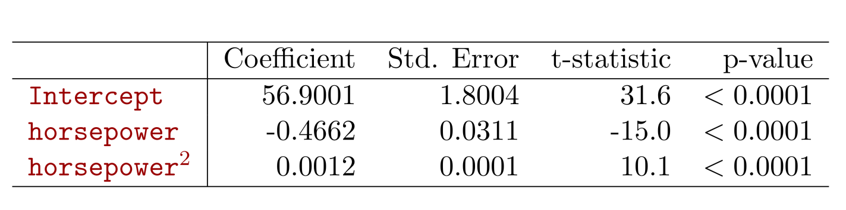
Non-linear eﬀects of predictors

Slide 34



Bonus Quiz 8
Assume we have the following model
Here X is height with unit of meter.
Now we can have another model
Here X* is also height with unit of centimeter. What is the relationship between

