Slide 1

Module 1: Statistical Learning
Lecture 3
Jan 13th, 2023

Slide 2
Recap
Prediction vs Inference
Oracle function for prediction
Reducible and irreducible error

Slide 3
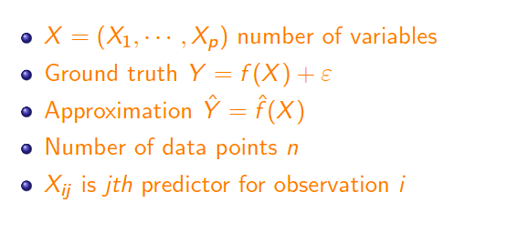
Notation

Slide 4

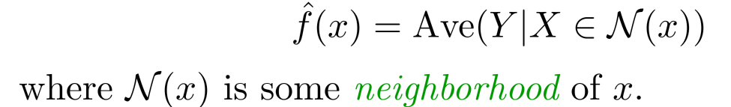
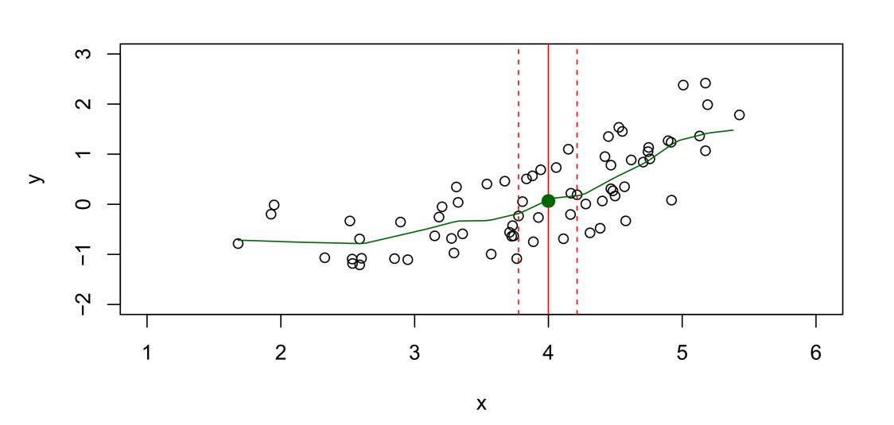
How estimate f?
Training Data:
However,….we have few if any data points with X = 4 exactly.
So..we can’t compute
Relax the definition and let

Slide 5
How estimate f?
Can we use y value to calculate the neighbors?

Slide 6
Nearest neighbor averaging can be pretty good for small p (p ≤ 4, p is the number of features) and large N (sample size).
Nearest neighbor methods is not good for large p.
Reason: the curse of dimensionality. Nearest neighbors tend to be far away in high dimensions.
We need to get a reasonable fraction of the data to average— e.g. 10%. Why?
A 10% neighborhood in high dimensions need no longer be local, so we lose the spirit of estimating E(Y | X = x) by local averaging.

Slide 7
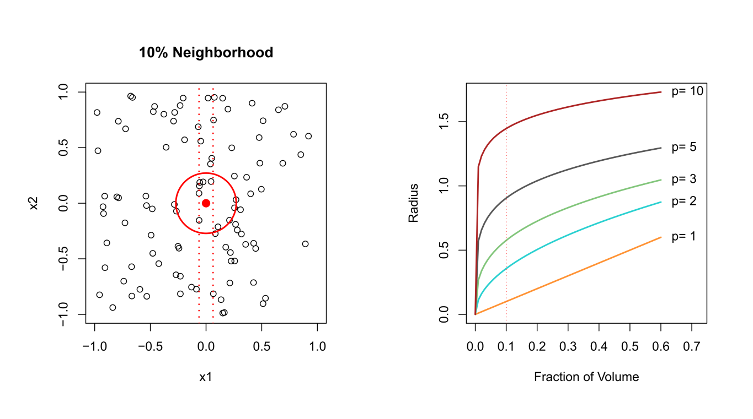
The Curse of Dimensionality

Slide 8
Any other Drawback?

Slide 9

Parametric Methods
What assumption do we make for Nearest neighbor method? Any thing about f?
It is a Non-Parametric Methods.
What additional assumptions can we make?
The linear model is an important example of a parametric model:
A linear model is determined by the p + 1 parameters
A linear model often serves as a good and interpretable approximation to the unknown true function. Who knows. Why not try.
The structure-based approach just described is referred to as parametric. Reduce the search space.

Slide 10
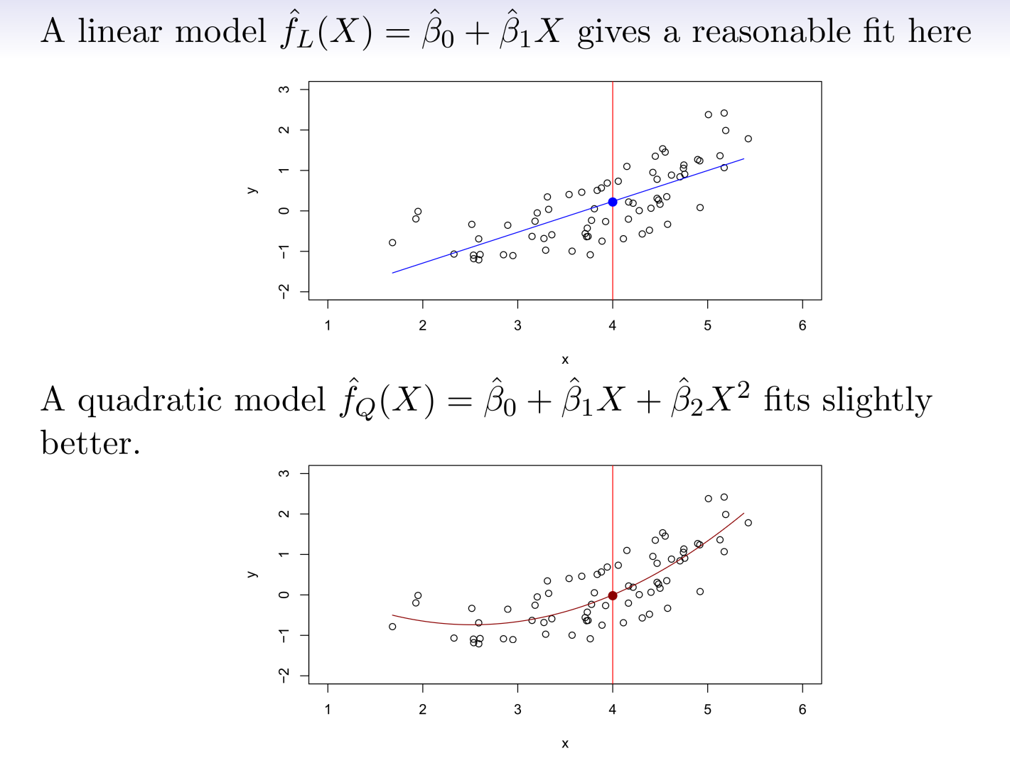
Which is better?

Slide 11
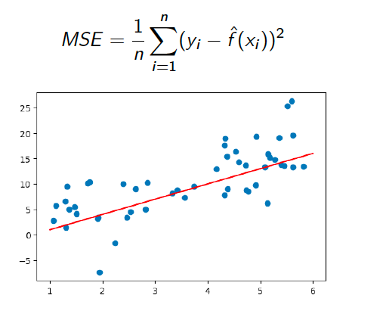
Mean Squared Error (MSE)

Slide 12
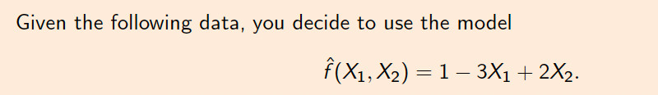
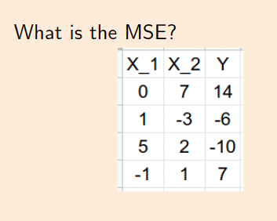
Group Work

Slide 13
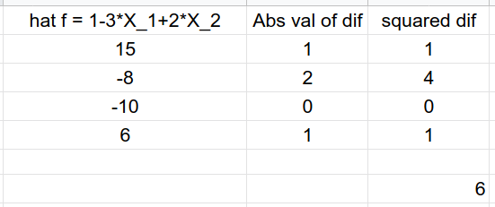
Group Work

Slide 14
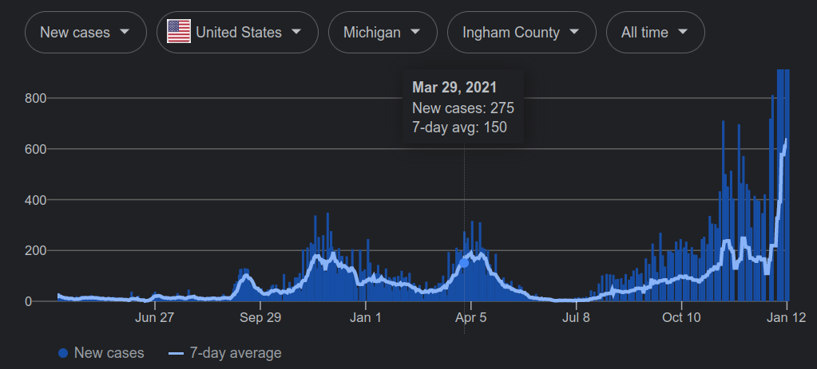
Training MSE

Slide 15
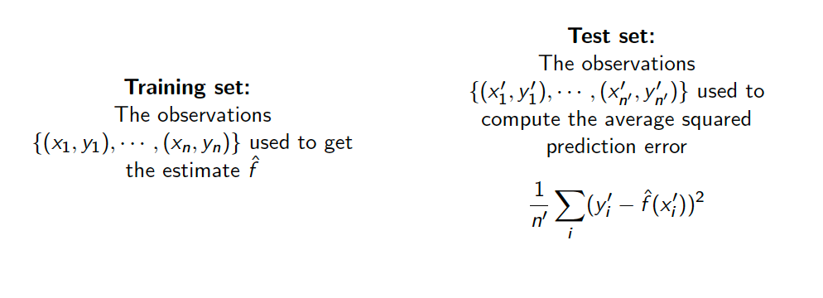
Train vs Test
Important: the training and testing sample are iid.(Independent and identically distributed. )

Slide 16
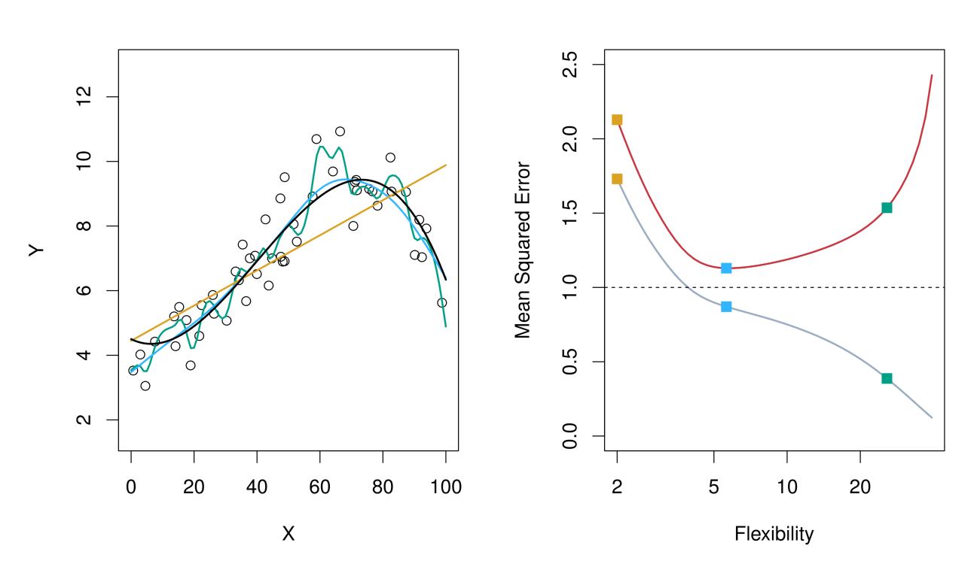
Do We Need Test Data?
Why not just test on the training data?
Gray line: training error, red line: testing error
Black line: truth; Orange, blue and green curves correspond to fits of different flexibility.

Slide 17
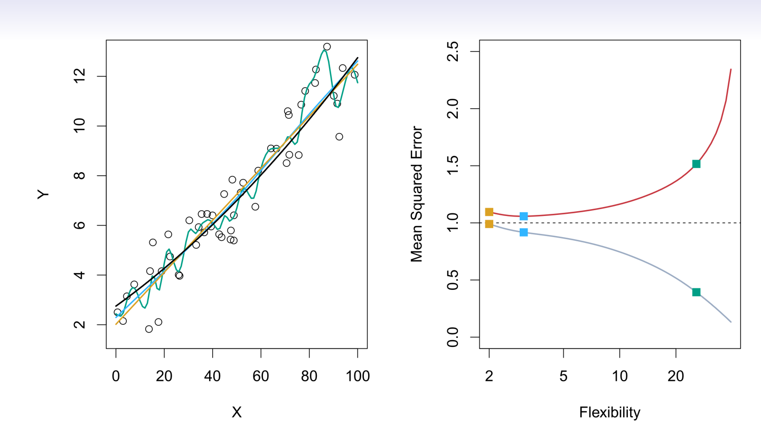
Do We Need Test Data?

Slide 18
A simple solution: Train/Test Split

Slide 19

Bias-Variance Trade-off
Tr₁
Tr₂
Tr₃
X | Y
10 | 1
12 | 2
19 | 1
X | Y
9 | 1.1
11.1 | 2.2
13 | 3
X | Y
9 | 1.1
11.1 | 2.2
13 | 3.4

Slide 20

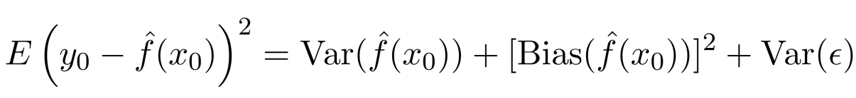


Bias-Variance Trade-off
Suppose we have ﬁt a model to some training data Tr_{1.}
If we have another set of training data Tr₂ to fit a model, will be the same?
Let be a test observation drawn from the population. If the true model is
We have
The expectation average over the variability of and Tr (training data).
Typically, as the ﬂexibility of increases, its variance increases, and its bias decreases. Selecting the ﬂexibility based on average test error amounts to a bias-variance trade-oﬀ.
Bias: if you have many sets of training data, the average prediction differs from the truth.

Slide 21

Bias-Variance

Slide 22
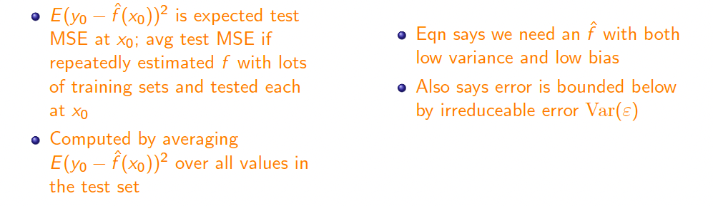
Bias-Variance

Slide 23
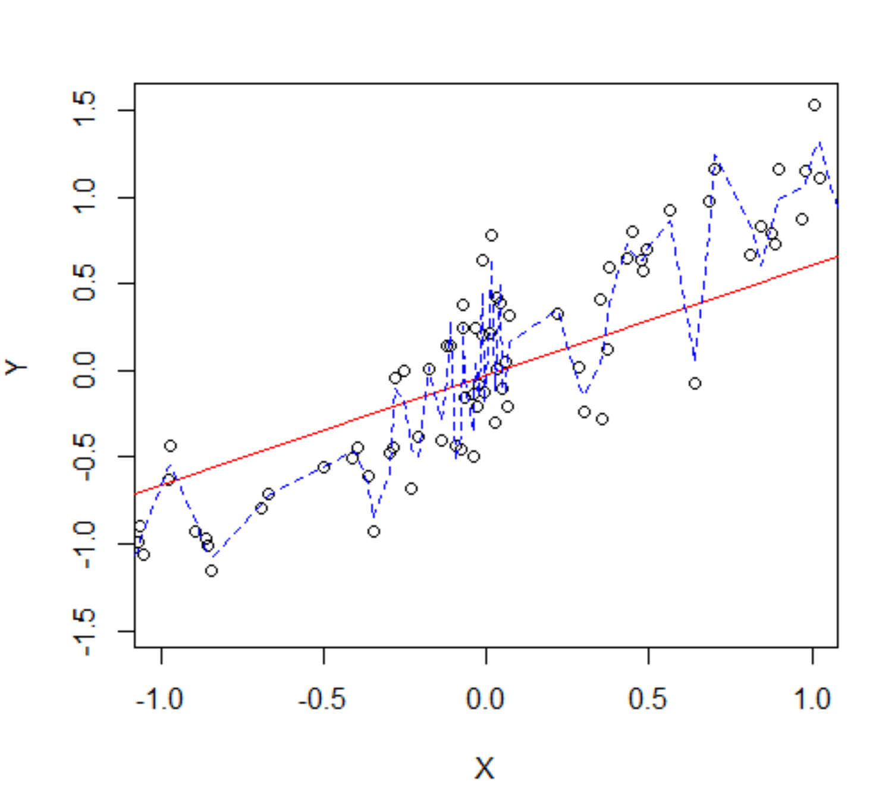
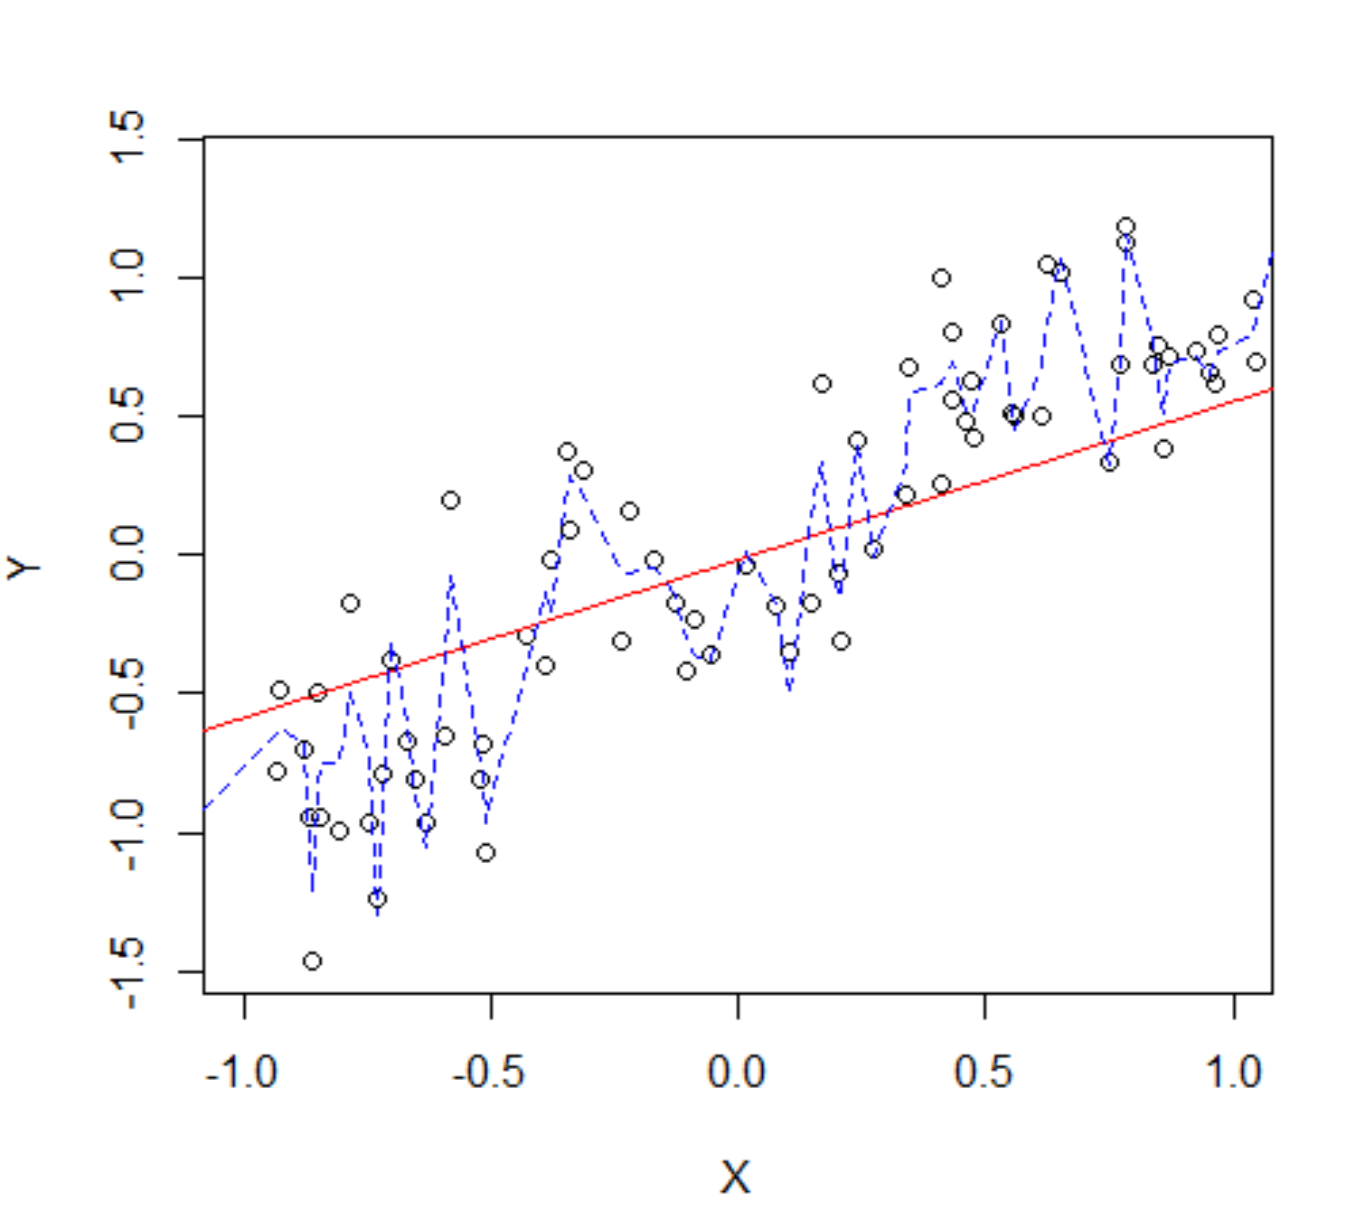
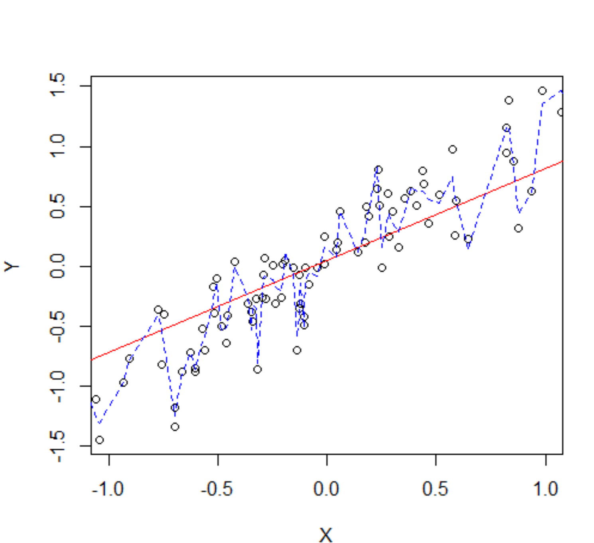
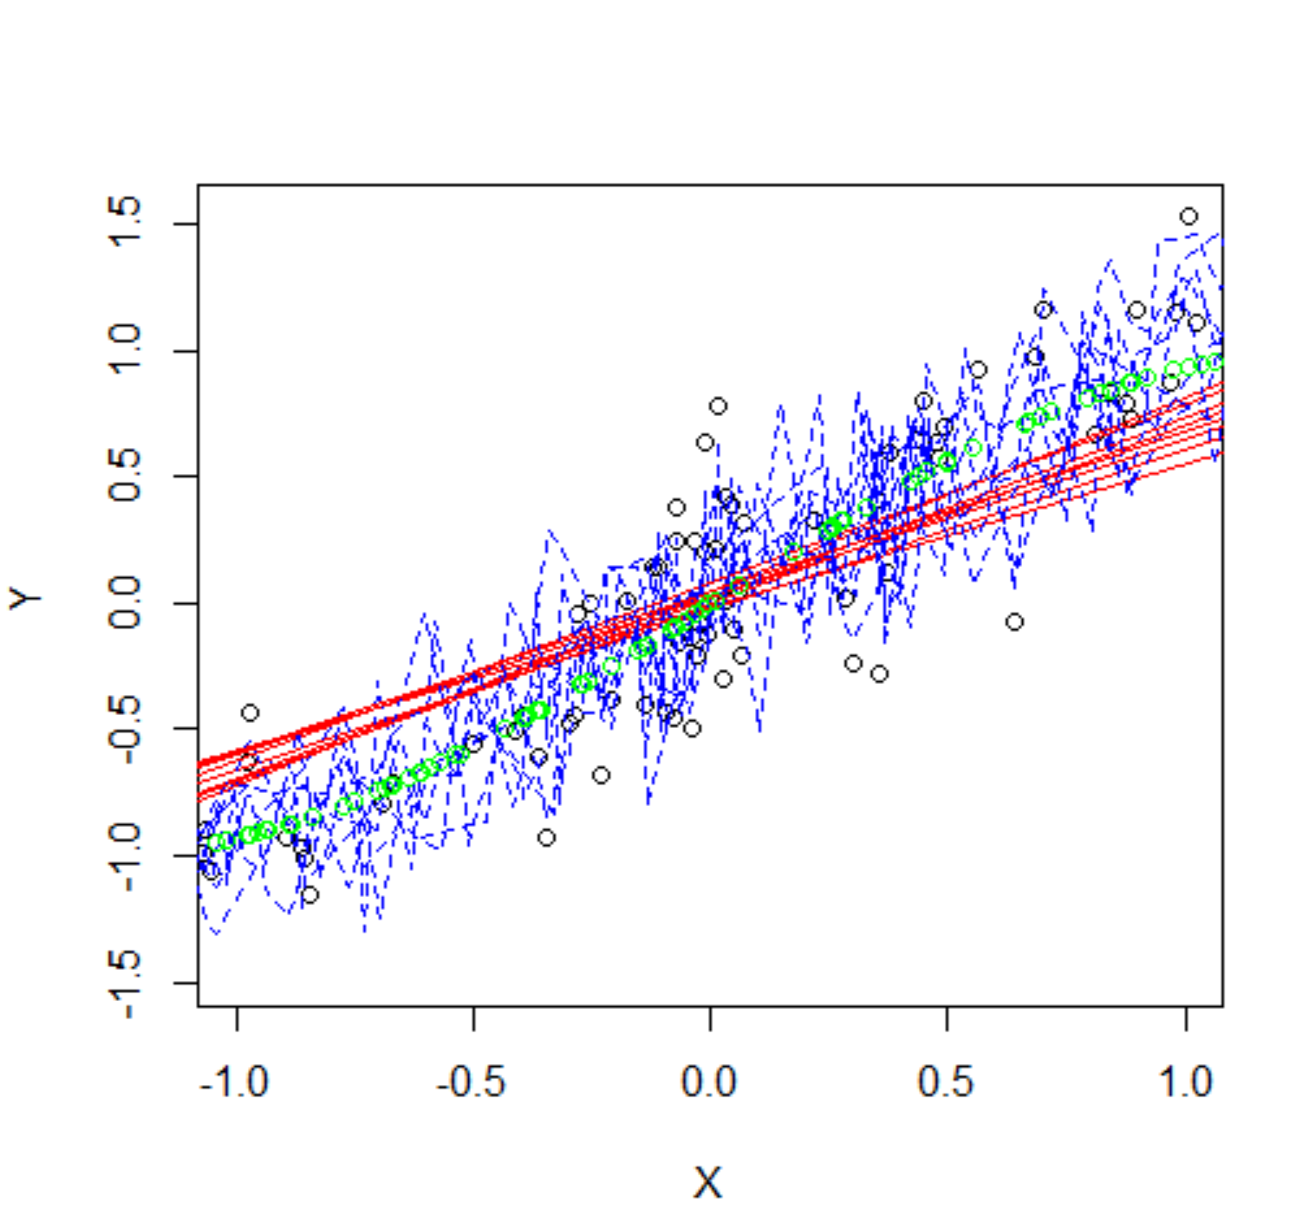
Do We Need Test Data?

Slide 24
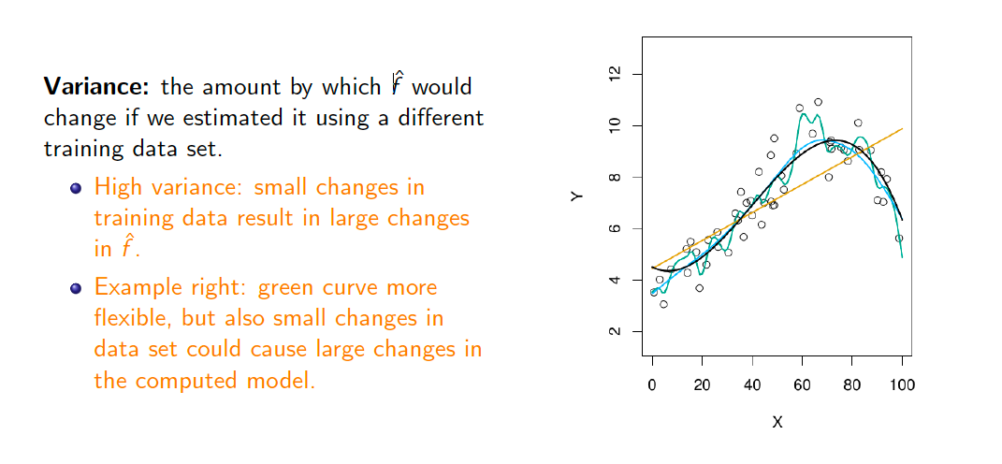
Variance

Slide 25
Bias
Bias: if you have many sets of training data, the average prediction differs from the truth.

Slide 26
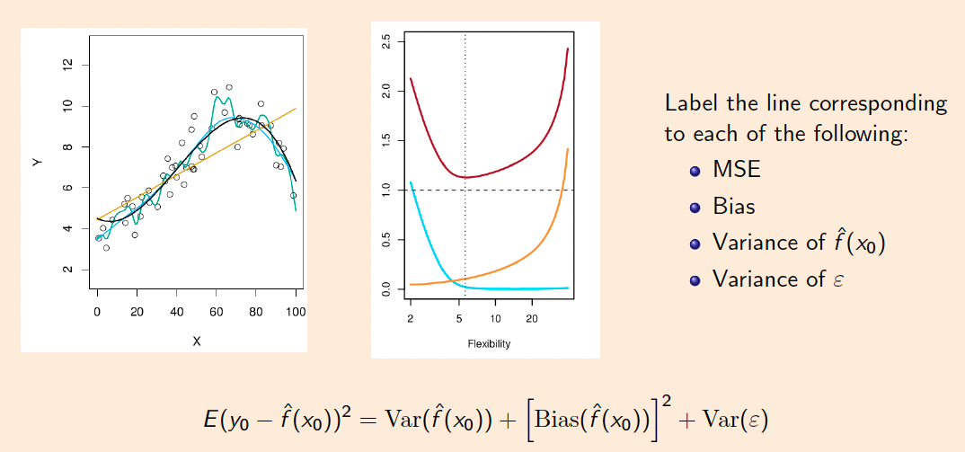
Group Work :

Slide 27
Group Work: Coding

