Slide 1
Key point analysis and explanations for quantitative text analysis
Master Lab Course – Explainable AI for Machine Learning
Daniel Schroter
Yuyin Lang
Hannes Schroter
08.02.2021

Slide 2




Agenda
Argument Keypoint Matching
Prior Research
Our Models
Explainability

Slide 3

Key Point Matching
Topics
Arguments
Key Points
Children can not learn to interact with their peers when taught at home.
It is impossible to ensure that homeschooled children are being taught properly.
Homeschooling a child denies them valuable lifeskills, particularly interaction with their own age group and all experiences stemming from this.
Parents are usually not qualified to provide a suitable curriculum for their children. additionally, children are not exposed to the real world.
Mainstream schools are essential to develop social skills.
Parents are not qualified as teachers.
Homeschools cannot be regulated/standardized.

Slide 4
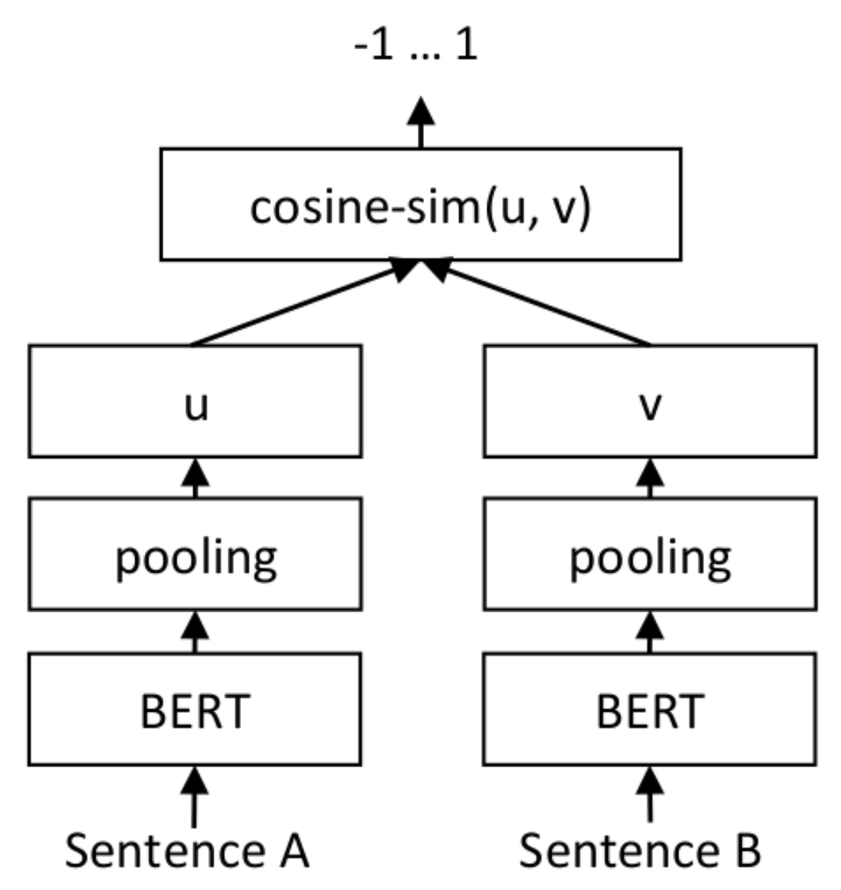
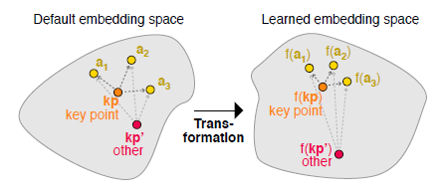
Prior Research: SMatchToPageRank
Model
Siamese Neural Network
Idea
Learn embeddings where similar pairs of inputs are close to each other and dissimilar inputs are far away. Contrastive Loss.
Strict
Relaxed
0.864
0.950
Result: Mean Average Precision

Slide 5
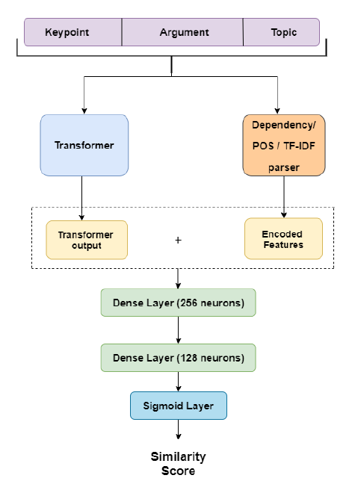
Prior Research: ENIGMA
Model
Classification
Idea
Use Additional features like PoS, TF-IDF, Dependency to capture similarity, Keypoints, Arguments and Topics are a concatenated input
Strict
Relaxed
0.844
0.931
Result: Mean Average Precision

Slide 6
Models: Overview
Data
Pretraining
Model
Dataset
Unsupervised Learning
Supervised Learning
KPM data
Arguments, Topics, Keypoints
Transformer Based Denoising AutoEncoder
Siamese Neural Network with Contrastive Loss
Unsupervised Learning
Dataset
Supervised Learning
Masked Language Modeling
Siamese Neural Network with Contrastive Loss and Additional Features
STS, Arg30k
Unsupervised Learning
Simple Contrastive Learning of Sentence Embeddings
Dataset
Supervised Learning
Web Crawler collecting articles for the topics in the KPA dataset
Unsupervised Learning
Enigma Model with similarity score and finetuned Embedding
Semantic Re-Tuning with Contrastive Tension

Slide 7
Models: Overview
Data
Pretraining
Model
Dataset
Unsupervised Learning
Supervised Learning
KPM data
Arguments, Topics, Keypoints
Transformer Based Denoising AutoEncoder
Siamese Neural Network with Contrastive Loss
Unsupervised Learning
Dataset
Supervised Learning
Masked Language Modeling
Siamese Neural Network with Contrastive Loss and Additional Features
STS, Arg30k
Unsupervised Learning
Simple Contrastive Learning of Sentence Embeddings
Dataset
Supervised Learning
Web Crawler collecting articles for the topics in the KPA dataset
Unsupervised Learning
Enigma Model with similarity score and and finetuned Embedding
Semantic Re-Tuning with Contrastive Tension

Slide 8
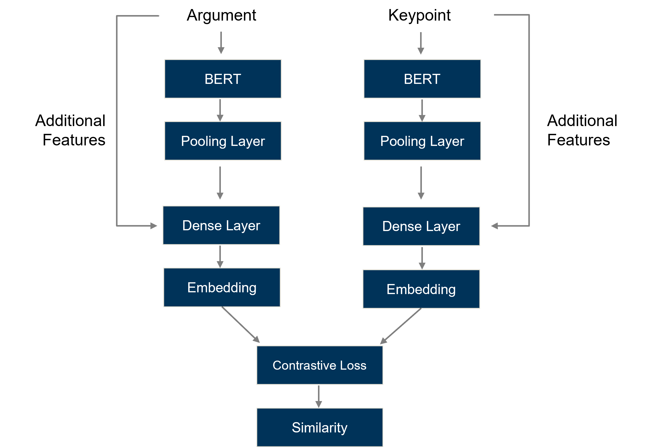
Model 1: PoS SNN
Idea 1
Siamese Neural Networks can approriately learn similarity score between a pair of Inputs
Idea 2
Additional Features like PoS can capture the structural information of a sentence beyond it‘s implicit meaning
PoS SNN
Enigma
SNN
0.912
0.844
0.864

Slide 9
Models: Overview
Data
Pretraining
Model
Dataset
Unsupervised Learning
Supervised Learning
KPM data
Arguments, Topics, Keypoints
Transformer Based Denoising AutoEncoder
Siamese Neural Network with Contrastive Loss
Unsupervised Learning
Dataset
Supervised Learning
Masked Language Modeling
Siamese Neural Network with Contrastive Loss and Additional Features
STS, Arg30k
Unsupervised Learning
Simple Contrastive Learning of Sentence Embeddings
Dataset
Supervised Learning
Web Crawler collecting articles for the topics in the KPA dataset
Unsupervised Learning
Enigma Model with similarity score and and finetuned Embedding
Semantic Re-Tuning with Contrastive Tension

Slide 10
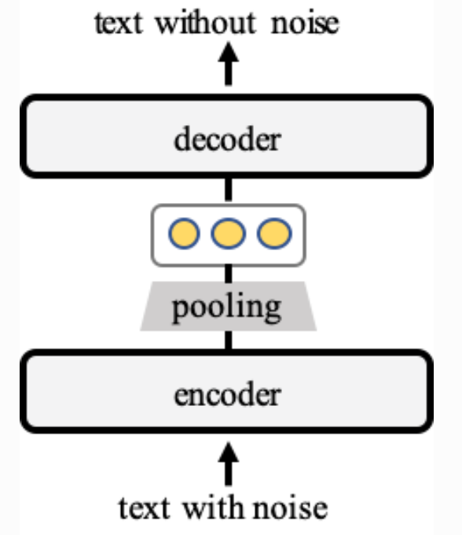
Model 2: TSDAE SNN
Transformer Based Denoising Autoencoder
Learn sentence embeddings by reconstructing the original sentence from it‘s damaged version (noise).
TSDAE
Transformer Based Denoising Autoencoder
MLM
Masked Language Modeling
SimCSE
Simple Contrastive Learning of Sentence Embeddings
Semantic Re-Tuning with Contrastive Tension
CT

Slide 11
Model 2: TSDAE SNN
Dataset
Unsupervised Learning
Supervised Learning
KPM data:
Arguments, Topics, Keypoints
Transformer Based Denoising AutoEncoder
Siamese Neural Network with Contrastive Loss
SNN
PoS SNN
TSDAE SNN
Enigma
0.864
0.912
0.921
0.844

Slide 12
Explainability
Task
Model predicts the similarity between arguments and keypoints
Explainability Problem of Siamese Neural Networks
No global prediction – No Regression – No Classification
Local Explanation
Why is an argument similar to a keypoint or why are they dissimilar?

Slide 13
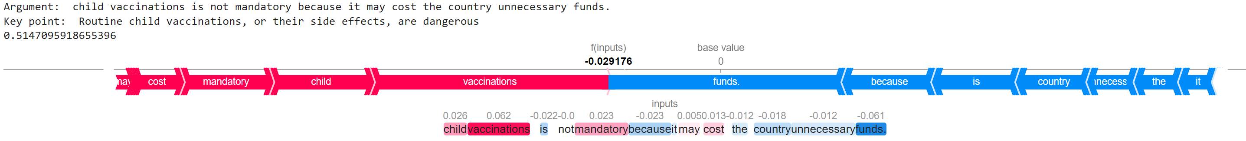
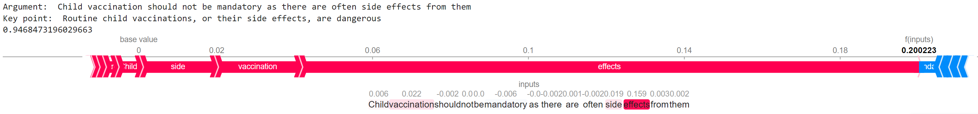
LeaveOneOut Explanations
Idea
Marginal contribution of each word to the similarity score

Slide 14
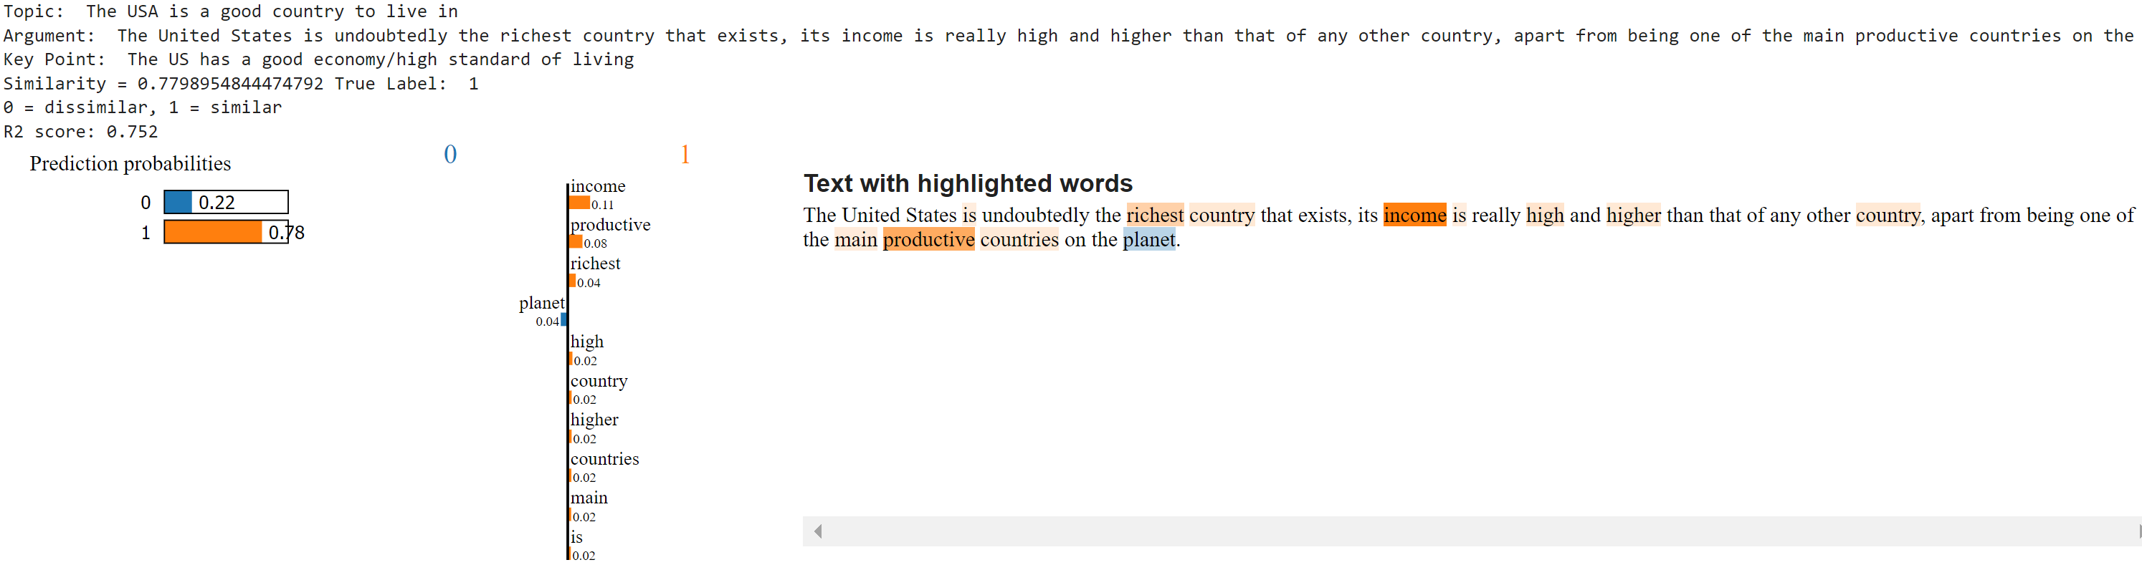
Local interpretable model-agnostic explanations (LIME)
Idea
Approximate a prediction locally by training a simple, interpretable model
Problem
Siamese Neural Networks don‘t perform a regression/classification task since the outcome depends on a pair of inputs
Solution
Zoom in to one keypoint and reformulate the prediction as a classification between similar/dissimilar

Slide 15
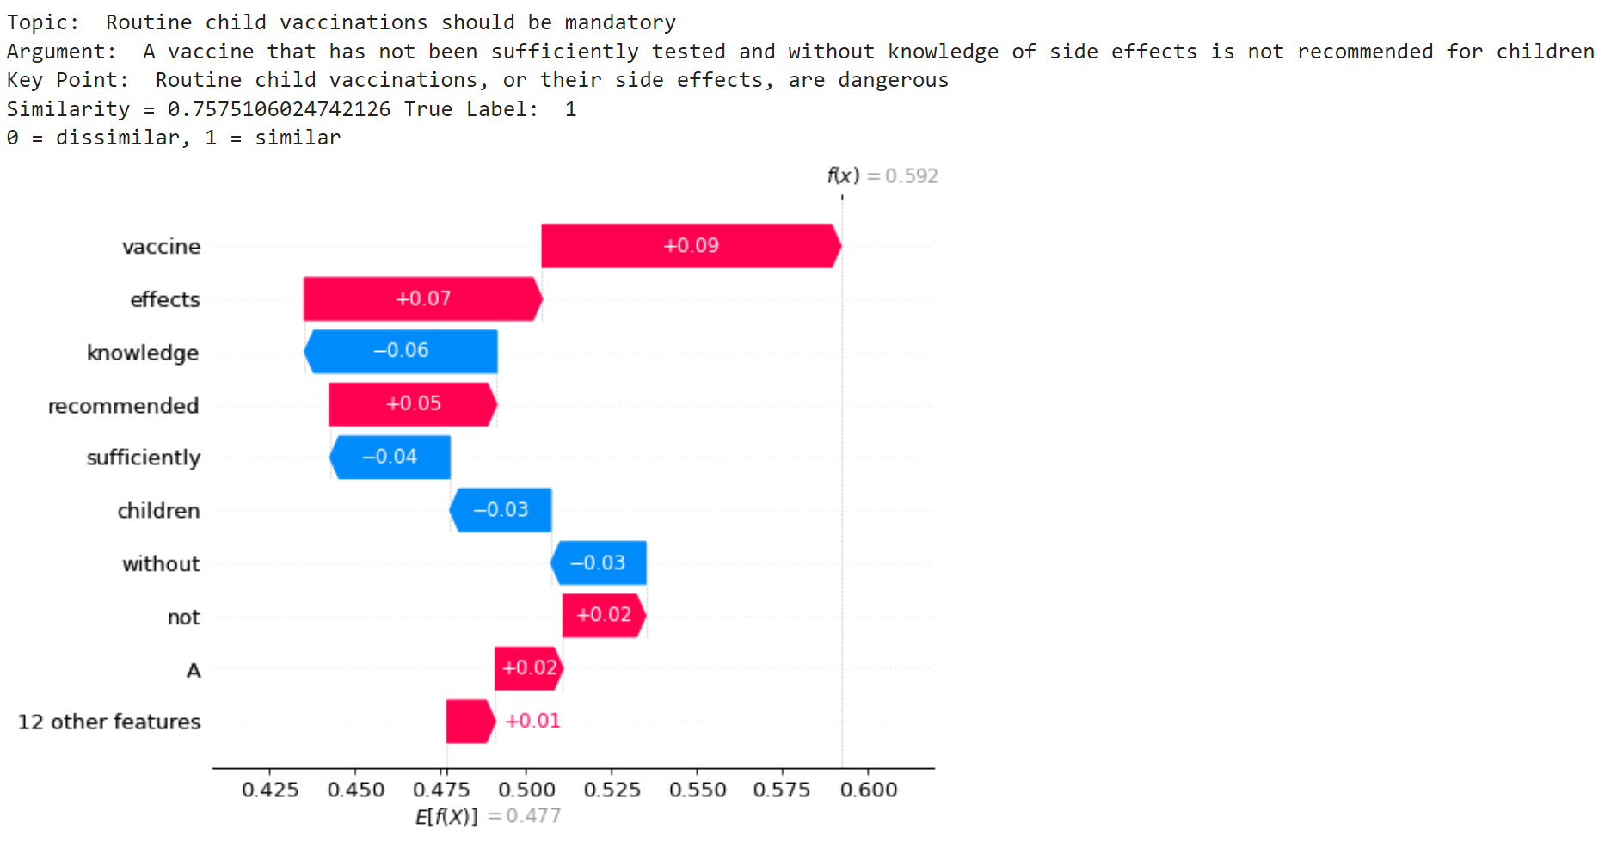
SHAP – A Local Perspective
Idea
Calculate the feature importance of each token by using Shapley values

Slide 16
SHAP – A Global Local Perspective
Before
How important are the tokens of an specific argument for the similarity to a specific keypoint
Now
How important are tokens across all arguments for the similarity to a specific keypoint
Idea
Average the Shapley values across all arguments (global) for a specific keypoint (local).

Slide 17
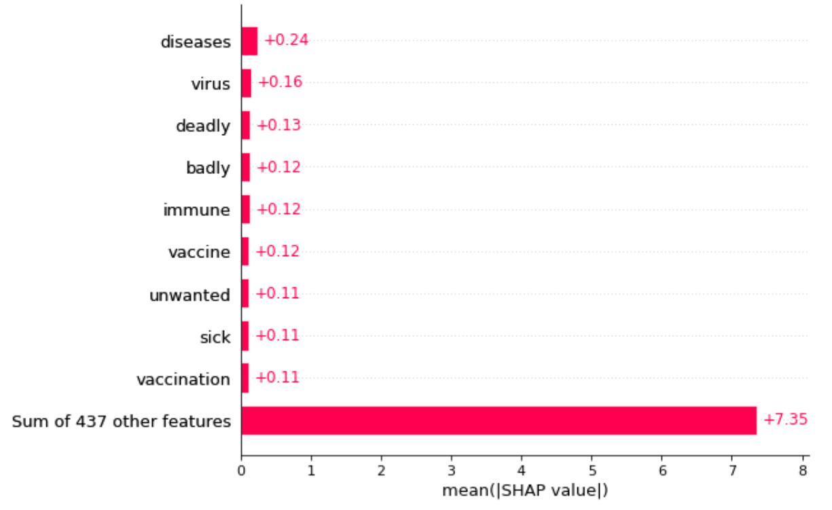
SHAP – A Global Local Perspective
Idea
Average the Shapley values across all arguments (global) for a specific keypoint.

Slide 18
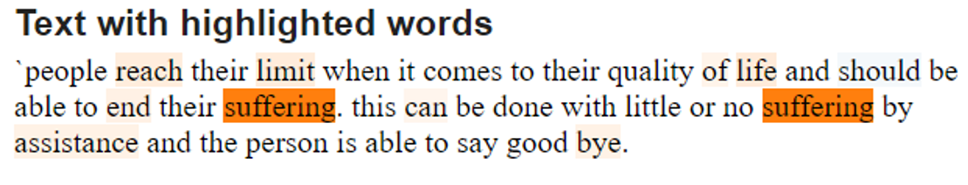
Take Aways
Occams Razor
Simple model has superior performance
Overfitting
Model are likely to overfit
Explainability
Use multiple explainability methods
LOO
Suffering appears twice
LIME
Strong contribution of suffering

Slide 19
Thank You.
Happy to answer your questions!

Slide 20
Selected Results
Data | Unsupervised Learning | Supervised Learning | Map Strict
KPM | TSDAE | SNN | 0.921
KPM |  | PoS SNN | 0.912
KPM | MLM | SNN | 0.903
Crawled | TSDAE | SNN | 0.900
KPM | SimCSE | SNN | 0.899
KPM | TSDAE | Pos SNN | 0.895
KPM |  | ENIGMA + SIM | 0.869
KPM |  | SNN | 0.864
KPM |  | ENIGMA + SNN | 0.861
KPM,STS,30K |  | ENIGMA + SIM | 0.858
KPM |  | ENIGMA | 0.844

