Slide 1
Model Selection

Slide 2
Data Set

Slide 3
Data Set
Train/Test Split
Training Set
Test Set
70%
30%

Slide 4
Data Set
Training Set
70%

Slide 5
K-fold Cross Validation
Training Set

Slide 6
10-fold Cross Validation
1 | 2 | 3 | 4 | 5 | 6 | 7 | 8 | 9 | 10

Slide 7
10-fold Cross Validation
1 | 2 | 3 | 4 | 5 | 6 | 7 | 8 | 9 | 10
validation set

Slide 8
10-fold Cross Validation
1 | 2 | 3 | 4 | 5 | 6 | 7 | 8 | 9 | 10
1 | 2 | 3 | 4 | 5 | 6 | 7 | 8 | 9 | 10
validation set

Slide 9
10-fold Cross Validation
1 | 2 | 3 | 4 | 5 | 6 | 7 | 8 | 9 | 10
1 | 2 | 3 | 4 | 5 | 6 | 7 | 8 | 9 | 10
1 | 2 | 3 | 4 | 5 | 6 | 7 | 8 | 9 | 10
validation set

Slide 10
10-fold Cross Validation
1 | 2 | 3 | 4 | 5 | 6 | 7 | 8 | 9 | 10
1 | 2 | 3 | 4 | 5 | 6 | 7 | 8 | 9 | 10
1 | 2 | 3 | 4 | 5 | 6 | 7 | 8 | 9 | 10
1 | 2 | 3 | 4 | 5 | 6 | 7 | 8 | 9 | 10
1 | 2 | 3 | 4 | 5 | 6 | 7 | 8 | 9 | 10
1 | 2 | 3 | 4 | 5 | 6 | 7 | 8 | 9 | 10
1 | 2 | 3 | 4 | 5 | 6 | 7 | 8 | 9 | 10
1 | 2 | 3 | 4 | 5 | 6 | 7 | 8 | 9 | 10
1 | 2 | 3 | 4 | 5 | 6 | 7 | 8 | 9 | 10
1 | 2 | 3 | 4 | 5 | 6 | 7 | 8 | 9 | 10

Slide 11
10-fold Cross Validation
1 | 2 | 3 | 4 | 5 | 6 | 7 | 8 | 9 | 10
.69
1 | 2 | 3 | 4 | 5 | 6 | 7 | 8 | 9 | 10
.64
1 | 2 | 3 | 4 | 5 | 6 | 7 | 8 | 9 | 10
.73
1 | 2 | 3 | 4 | 5 | 6 | 7 | 8 | 9 | 10
.82
1 | 2 | 3 | 4 | 5 | 6 | 7 | 8 | 9 | 10
.64
1 | 2 | 3 | 4 | 5 | 6 | 7 | 8 | 9 | 10
.70
1 | 2 | 3 | 4 | 5 | 6 | 7 | 8 | 9 | 10
.68
1 | 2 | 3 | 4 | 5 | 6 | 7 | 8 | 9 | 10
.71
1 | 2 | 3 | 4 | 5 | 6 | 7 | 8 | 9 | 10
.70
1 | 2 | 3 | 4 | 5 | 6 | 7 | 8 | 9 | 10
.69

Slide 12
10-fold Cross Validation
1 | 2 | 3 | 4 | 5 | 6 | 7 | 8 | 9 | 10
.69
1 | 2 | 3 | 4 | 5 | 6 | 7 | 8 | 9 | 10
.64
1 | 2 | 3 | 4 | 5 | 6 | 7 | 8 | 9 | 10
.73
1 | 2 | 3 | 4 | 5 | 6 | 7 | 8 | 9 | 10
.82
1 | 2 | 3 | 4 | 5 | 6 | 7 | 8 | 9 | 10
.64
1 | 2 | 3 | 4 | 5 | 6 | 7 | 8 | 9 | 10
.70
1 | 2 | 3 | 4 | 5 | 6 | 7 | 8 | 9 | 10
.68
1 | 2 | 3 | 4 | 5 | 6 | 7 | 8 | 9 | 10
.71
1 | 2 | 3 | 4 | 5 | 6 | 7 | 8 | 9 | 10
.70
1 | 2 | 3 | 4 | 5 | 6 | 7 | 8 | 9 | 10
.69

Slide 13
Logistic Regression
Fold 1 | Fold 2 | Fold 3 | Fold 4 | Fold 5 | Fold 6 | Fold 7 | Fold 8 | Fold 9 | Fold 10 | Mean
.69 | .64 | .73 | .82 | .64 | .70 | .68 | .71 | .70 | .69 | .70

Slide 14
Logistic Regression
Fold 1 | Fold 2 | Fold 3 | Fold 4 | Fold 5 | Fold 6 | Fold 7 | Fold 8 | Fold 9 | Fold 10 | Mean
.69 | .64 | .73 | .82 | .64 | .70 | .68 | .71 | .70 | .69 | .70

Slide 15
Logistic Regression
Fold 1 | Fold 2 | Fold 3 | Fold 4 | Fold 5 | Fold 6 | Fold 7 | Fold 8 | Fold 9 | Fold 10 | Mean
.69 | .64 | .73 | .82 | .64 | .70 | .68 | .71 | .70 | .69 | .70

Slide 16
Logistic Regression
Fold 1 | Fold 2 | Fold 3 | Fold 4 | Fold 5 | Fold 6 | Fold 7 | Fold 8 | Fold 9 | Fold 10 | Mean
.69 | .64 | .73 | .82 | .64 | .70 | .68 | .71 | .70 | .69 | .70

Slide 17






















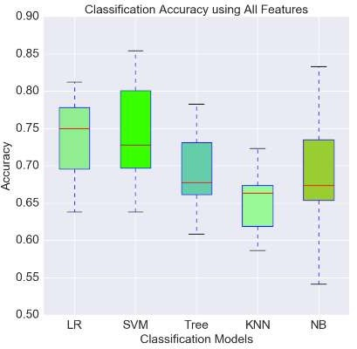

0.705

Slide 18
Hyperparameter Tuning

Slide 19
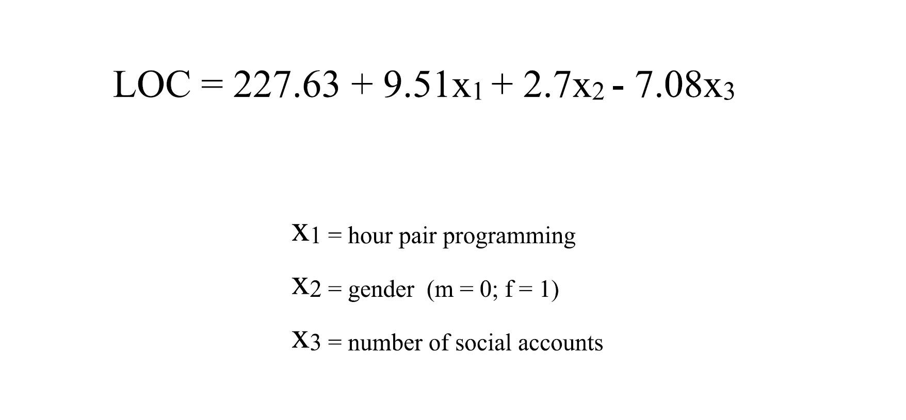
Logistic Regression

Slide 20
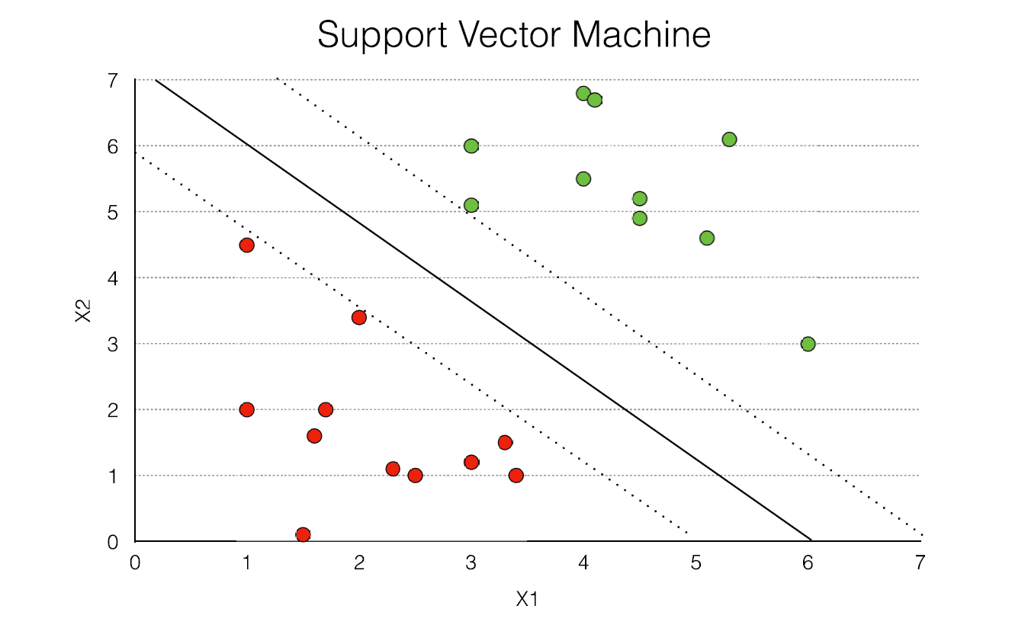

Slide 21
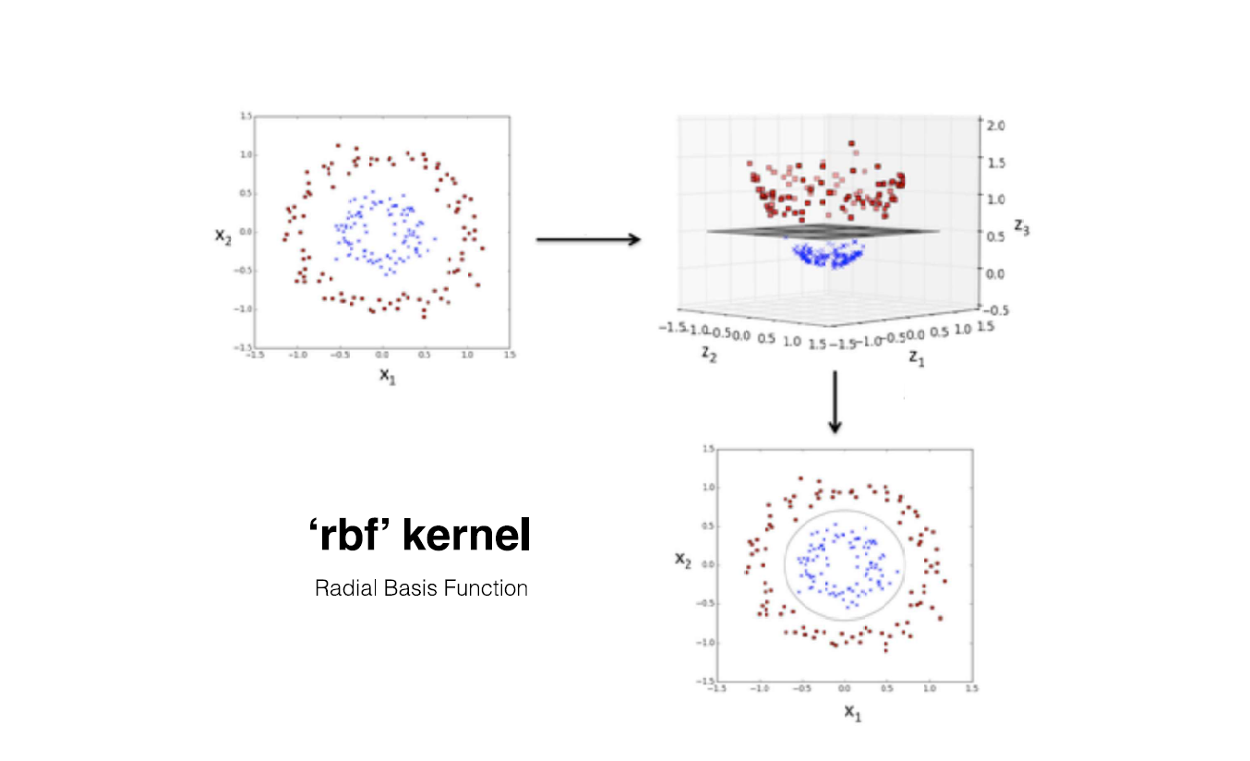

Slide 22
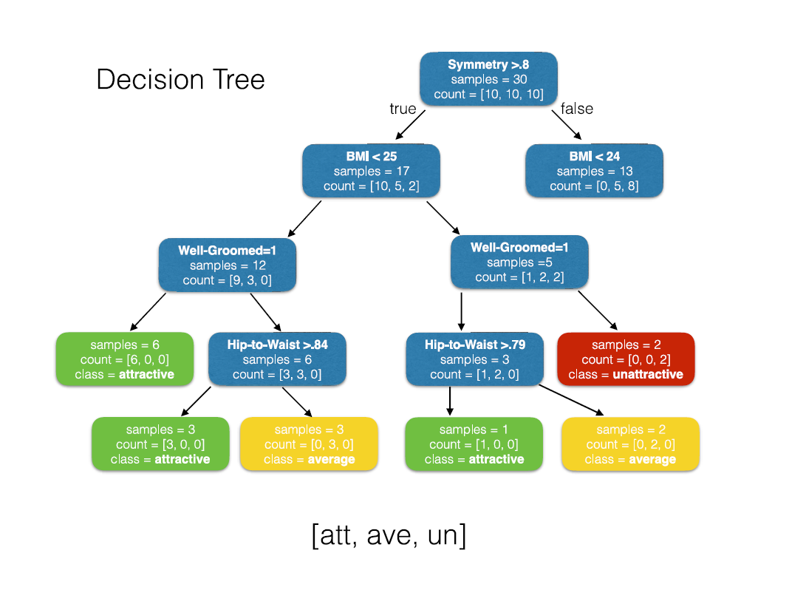

Slide 23
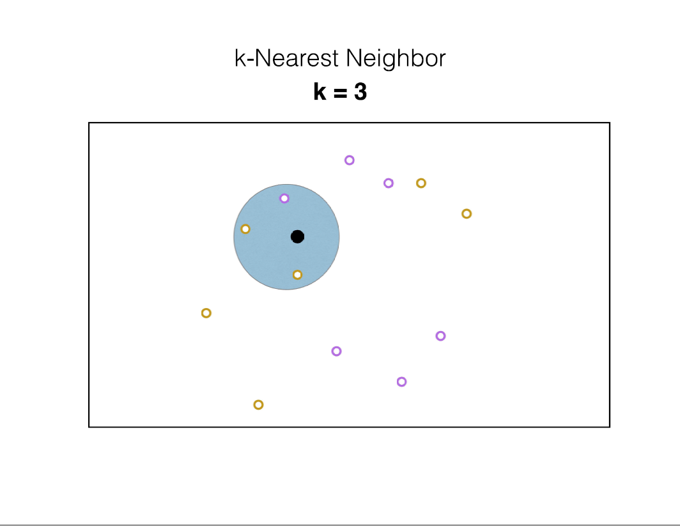

Slide 24
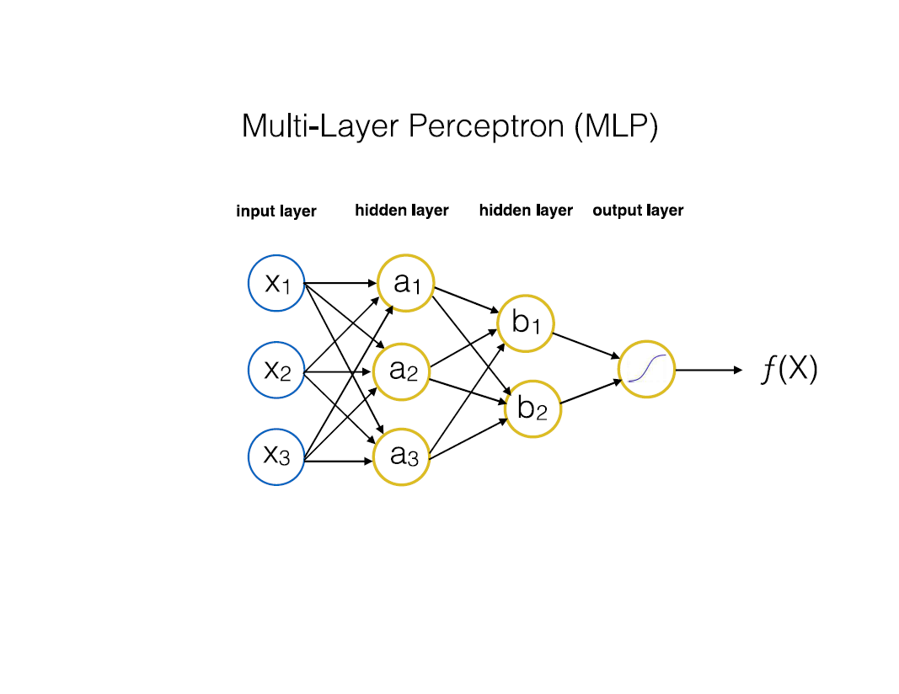

Slide 25
Grid Search

Slide 26
Grid Search
Support Vector Machine

Slide 27
Grid Search
Support Vector Machine
param_grid=[{‘C’: [.1, 1.0, 10], ‘kernel’: [‘linear’, ‘rbf’]}]

Slide 28
Grid Search
Support Vector Machine
param_grid=[{‘C’: [.1, 1.0, 10], ‘kernel’: [‘linear’, ‘rbf’]}]
‘C’ | ‘kernel’

Slide 29
Grid Search
Support Vector Machine
param_grid=[{‘C’: [.1, 1.0, 10], ‘kernel’: [‘linear’, ‘rbf’]}]
‘C’ | ‘kernel’
0.1 | ‘linear’
1.0 | ‘linear’
10 | ‘linear’
0.1 | ‘rbf’
1.0 | ‘rbf’
10 | ‘rbf’

Slide 30
Grid Search
Support Vector Machine
param_grid=[{‘C’: [.1, 1.0, 10], ‘kernel’: [‘linear’, ‘rbf’]}]
‘C’ | ‘kernel’
0.1 | ‘linear’
1.0 | ‘linear’
10 | ‘linear’
0.1 | ‘rbf’
1.0 | ‘rbf’
10 | ‘rbf’
Best
Hyperparameter Combination

Slide 31
Model Evaluation Metrics

Slide 32


































Slide 33
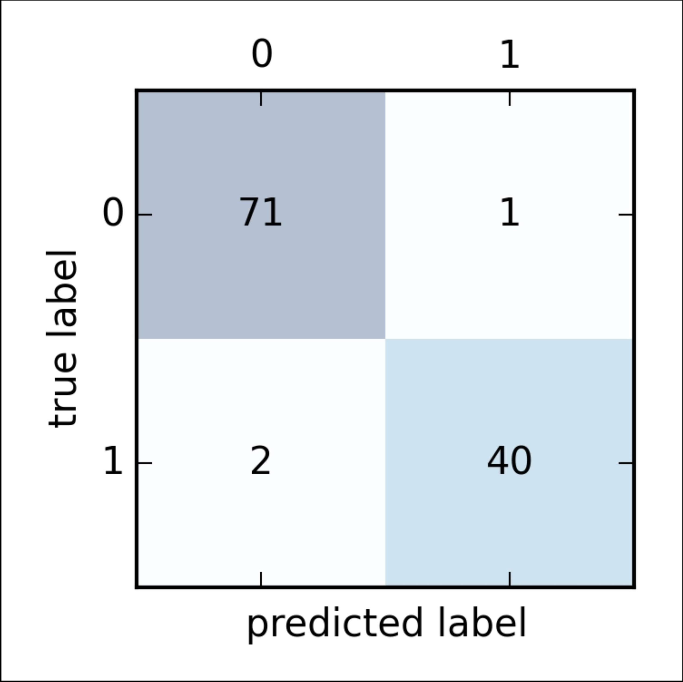
true class

Slide 34










true class

Slide 35









true class

Slide 36
Accuracy
true class

Slide 37
Precision
true class

Slide 38
Recall
true class

Slide 39








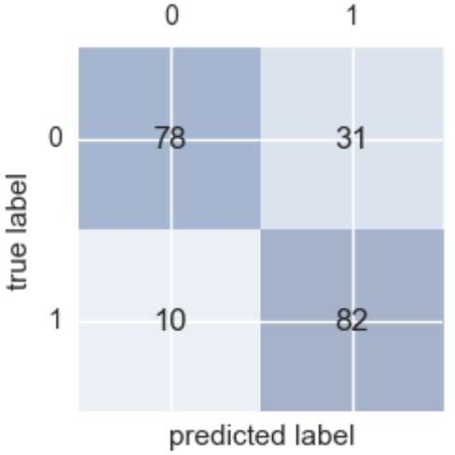




Slide 40




Slide 41




Slide 42
















Slide 43
Fraudulent Transactions

Slide 44
Fraudulent Transactions
The average merchant experiences 156 successful fraudulent transactions per month.
The average value of a fraudulent transaction is $114

Slide 45

Fraudulent Transactions

Slide 46

Fraudulent Transactions

Slide 50
Accuracy

Slide 51
Accuracy
99%

Slide 53
Precision

Slide 54
Precision
20%

Slide 55
Precision
20%
Recall

Slide 56
Precision
20%
Recall
100%

Slide 57
Precision
20%
Recall
100%

Slide 58
Online Dating

Slide 59
Online Dating
1 in 5 relationships (20%) begins online
17% of marriages in the U.S. begin online
The most popular online dating site is match.com with 23.5 million users
eHarmony is responsible for 4% of all marriages in the U.S.

Slide 60


Slide 61


Slide 63
Precision

Slide 64
Precision
50%

Slide 65
Precision
50%
Recall

Slide 66
Precision
50%
Recall
33%

Slide 67
Precision
50%
Recall
33%

Slide 68
Data Set
Training Set
Test Set
70%

Slide 69
Data Set
Training Set
Test Set
30%

Slide 70
Data Set
Training Set
Test Set
100%

