Slide 1
Underfitting vs. Overfitting

Slide 2
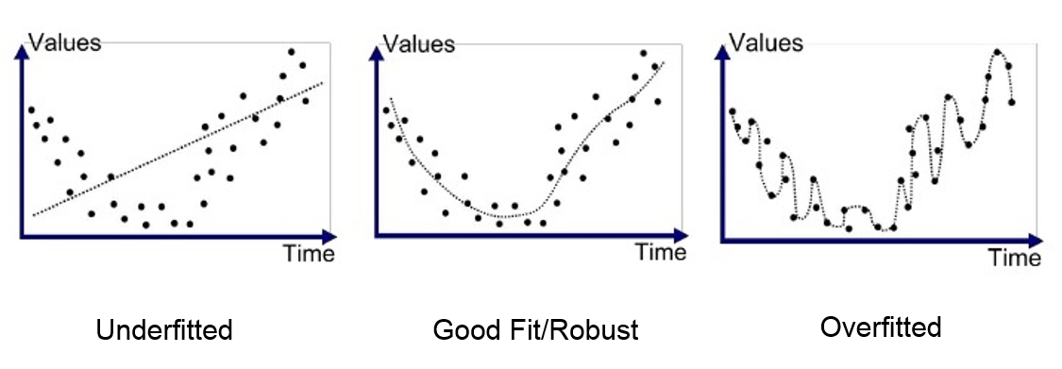
Regression
High Bias
Low Variance
Low Bias
High Variance
Underfit
Balanced
Overfit

Slide 3
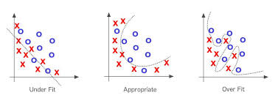
Classification
High Bias
Low Variance
Low Bias
High Variance
Underfit
Balanced
Overfit

Slide 4
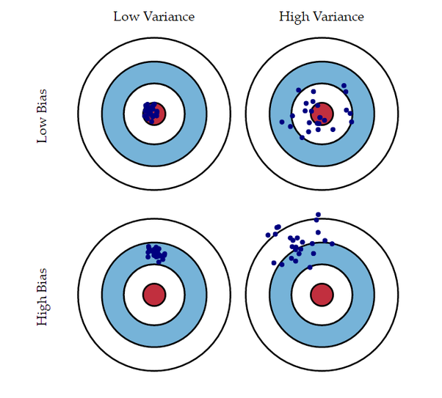
Low Variance
High Variance
Low Bias
High Bias

Slide 5
Low Variance
High Variance
test set
Low Bias
error
error
training set
test set size
test set size
High Bias
error
error
test set size
test set size

Slide 6
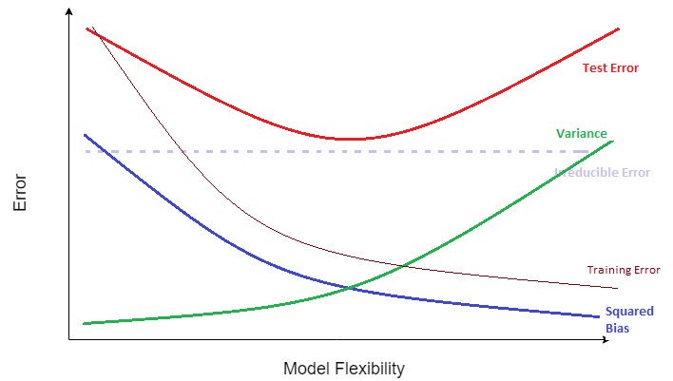
Bias-Variance Tradeoff
Model Complexity

