Slide 1
COMP9311 - Database Systems
Week 1
Introduction, Data Modeling,
and ER Notation

Slide 2
School of Computer Science and Engineering (CSE)
Lecturer: Dr. Rachid Hamadi
Email: rhamadi@cse.unsw.edu.au
Course Website:
http://www.cse.unsw.edu.au/~cs9311

Slide 3
Course Information
Lectures: Wednesdays 15:00 - 18:00
Location: ChemScM17
Labs: Weeks 2 – 13, 2 hours per week in labs
Consultation: Wednesdays 14:00 - 15:00
Location: K17-203

Slide 4
Course Information (cont’d)
This semester, there will be three (3) assignments and a final exam
Assignments are worth 40%:
Assignment 1: ER Diagram / Relational Mapping (10%) (due Week 5)
Assignment 2: SQL Queries and Functions (15%) (due Week 8)
Assignment 3: Normalisation / Relational Algebra / Transaction (15%) (due Week 11)
Penalty for late submission: 10% reduction of the total mark for each day late.

Slide 5
Course Information (cont’d)
Final Exam:
Two (2) hours written exam
Worth 60% during exam period
Final Mark:
FinalMark = A1Mark + A2Mark + A3Mark + ExamMark
Hurdle:
To pass this course, you must obtain at least 40% in the final exam with a combined total of at least 50%

Slide 6
Course Information (cont’d)
Textbook:
Fundamentals of Database Systems , Elmasri and Navathe, 7th edition, 2016, Addison-Wesley
Reference books:
Database System Concepts , Silberschatz, Korth, Sudarshan, 6th edition, 2010, McGraw-Hill
Database Management Systems , Ramakrishnan and Gehrke, 3rd edition, 2003, McGraw-Hill
Database Systems: The Complete Book , Garcia-Molina, Ullman, Widom, 2nd edition, 2008, Prentice-Hall
Database Systems: An Application-Oriented Approach Kifer, Berstein, Lewis, 2nd edition (Complete Version), 2006, Addison-Wesley
Note: Earlier editions are fine for this course

Slide 7
Course Schedule
The following is an approximate guide to the sequence of topics in this course.

Slide 8
Databases in CSE
COMP9311 introduces foundations & technology of databases
Skills: how to build database-backed applications
Theory: how do you know that what you built was any good
After COMP9311 you can go on to study ...
COMP9315: how to build relational DBMSs (write your own Oracle)
COMP9318: techniques for data mining (discovering patterns in DB)
COMP6714: information retrieval, web search (dealing with text data)
COMP9319: web search and data compression (dealing searching compressed web data)
COMP932(1|2|3): service-oriented computing, which relies on DB background

Slide 9
Introduction
Database Applications:
Banking System,
Stock Market,
Transportation,
Social Network,
Marine Data Analysis,
Criminal Analysis and Control,
Now, Big Data ...

Slide 10
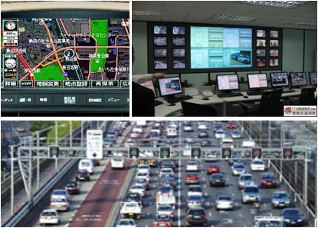




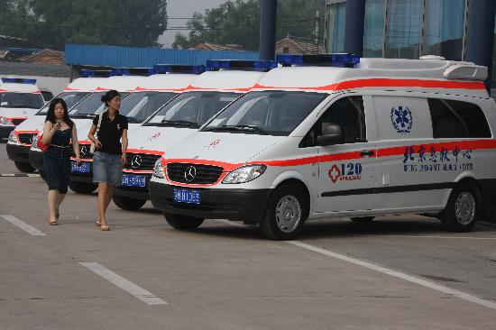
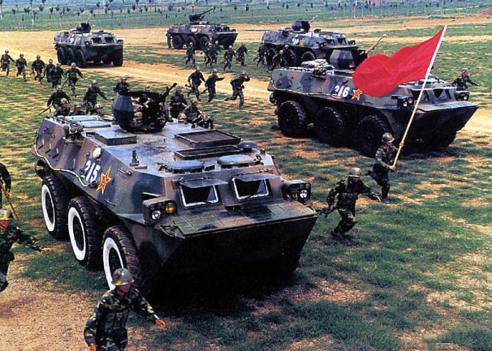

Introduction (cont’d)
Intelligent Transportation
Business Services
Natural Disasters
Public Health
Modern Military
Tourism Development
Notes:
商业服务：手机加新浪微博

Slide 11


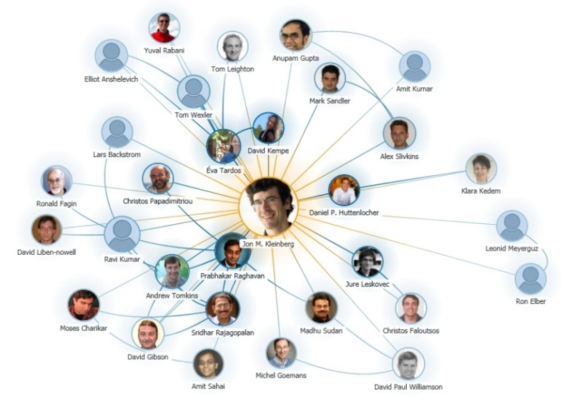
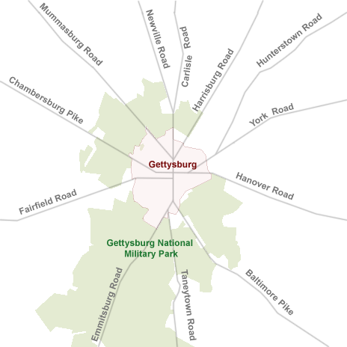
More Applications
Chemical Compounds
Social Network
Collaboration Graph
Road Network

Slide 12


Graphs Could be Big!
Big Graphs
1.23 billon active users in 2013
117 billion friendships in 2013
645 million users in 2013
1.7 billion tweets/month in 2013

Slide 13
Databases: Important Themes
The field of databases deals with:
Data ... representing application scenarios
Relationships ... amongst data items
Constraints ... on data and relationships
Redundancy ... one source for each data item
Data manipulation ... declarative, procedural
Transactions ... multiple actions, atomic effect
Concurrency ... multiple users sharing data
Scale ... massive amounts of data

Slide 14
What is data?
Data (Elmasri/Navathe)
Known facts that can be recorded and have explicit meaning
Example - a student records database
Contains information identifying students, courses they are enrolled in, results from past courses, …
Item | Type of data | Stored as
Family name | String | Character strings?
Birthdate | Date | 3 integers?
Weight | Real number | Floating point number?
…

Slide 15
What is a database?
Database (Elmasri/Navathe)
. . . a collection of related data . . .
Data items alone are relatively useless
We need the data to have some structure
Database can be manipulated by a database management system

Slide 16
What is a database management system (DBMS)?
Elmasri/Navathe
DBMS: … a collection of programs that enables users to create and maintain a database …
Database system: … the database and DBMS together …

Slide 17
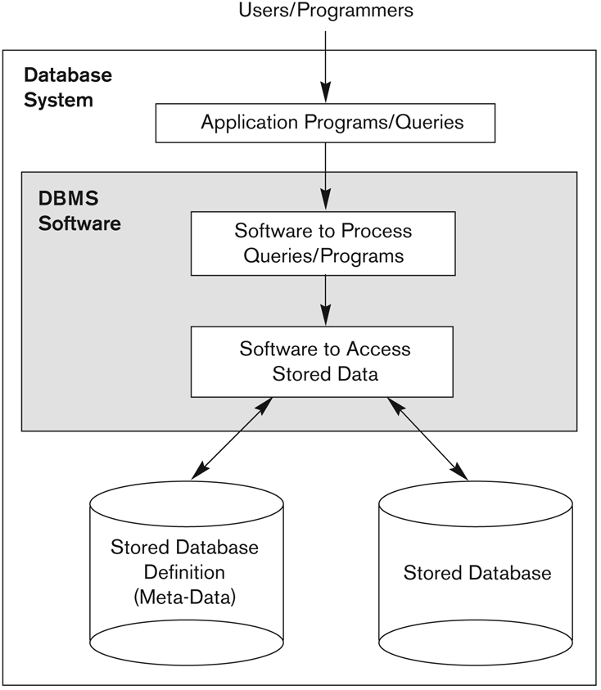
Simplified Database System Environment (Elmasri/Navathe)

Slide 18
Database Users
Database Administrator (DBA)
Responsible for authorizing access to the database, coordinating and monitoring its use, acquiring software and hardware resources, controlling its use and monitoring efficiency of operations
Database Designer
Responsible for defining the structure, the constraints, and transactions. Must communicate with the end-users and understand their needs

Slide 19
Database Users (cont’d)
End Users - Use the data for queries, reports and some of them update the database content. They can be categorized into:
Casual: access database occasionally when needed
Naive (or Parametric): they make up a large section of the end-user population.
They use previously well-defined functions in the form of “canned transactions” against the database.
Examples are bank-tellers or reservation clerks who do this activity for an entire shift of operations.

Slide 20
Categories of End-Users (cont’d)
Sophisticated: these include business analysts, scientists, engineers, others who are thoroughly familiar with system capabilities. Many use tools in the form of software packages that work closely with the stored database.
Stand-alone: mostly maintain personal databases using ready-to-use packaged applications. An example is a user who maintains her/his own address book

Slide 21
Database Management Systems
DBMS for practical work
PostgreSQL 9.3.3 (open-source, free, full-featured)
Comments on using a specific DBMS:
the primary goal is to learn SQL (a standard)
the specific DBMS is not especially important
but, each DBMS implements non-standard features
we will use standard SQL as much as possible
an exception is PL/pgSQL (but close to Oracle's PL/SQL)
PostgreSQL documentations describe all deviations from standard

Slide 22
Database Management Systems (cont’d)
Comments on PostgreSQL vs Oracle
Oracle is resource hungry (>800MB vs <200MB for PostgreSQL)
PostgreSQL is a commercial-strength (ACID) RDBMS … but, being open source, you can see how it works
PostgreSQL has been object-relational longer than Oracle … and its extensibility model is better than Oracle's
PostgreSQL is more flexible than Oracle … allows stored procedures via a range of programming languages
But note: PostgreSQL and Oracle have very close SQL and PL/SQL languages

Slide 23
Database Management Systems (cont’d)
Comments on PostgreSQL vs MySQL
both open source* and reasonably efficient
most Web/DB developers use MySQL
until v4/5, MySQL lacked many serious DB concepts
no transactions, foreign keys, subselects, views, procedures, …
MySQL's SQL often ignores SQL standards
MySQL is hacked together from "imported components"
multiple storage engines (some still w/o transactions)
PostgreSQL is better engineered; MySQL is more popular
* But Oracle now controls MySQL ⇒ open-source status unclear

Slide 24
Working from Home
PostgreSQL has very good on-line documentation
This semester we will be using PostgreSQL 9.3.3
If you install them at home
Get a version "close to" that (the latest stable is 9.6)
Test all assignment work at CSE before submitting
Alternative to installing at home
Run them on CSE servers (grieg) as you would do in labs
Use, e.g., Putty to log in to a CSE server from home
PostgreSQL via Putty ok, since command-line based

Slide 25
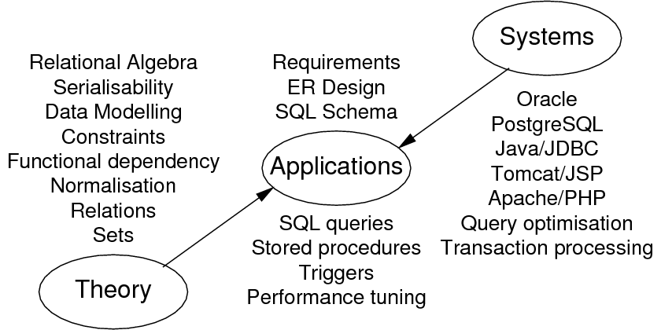
Overview of the Database Areas

Slide 26
Database Application Development
A variation on standard software engineering process
analyse application requirements
develop a data model to meet these requirements
define operations (transactions) on this model
implement the data model as relational schema
implement transactions via SQL and PLs
construct a web interface to these transactions
At some point, populate the database (via interface?)

Slide 27
Database System Languages
Requests to DBMS
queries, updates in data manipulation language (DML) (e.g. SQL)
data structures, constraints in data definition language (DDL) (e.g. SQL)
create and drop databases, indexes, functions (e.g. PL/pgSQL)
Results/effects from DBMS requests
tuples (typically, sets of tuples)
changes to underlying data store

Slide 28
Data Modeling
Aims of data modeling
describe what information is contained in the database (e.g., entities: students, courses, accounts, branches, patients, …)
describe relationships between data items (e.g., John is enrolled in COMP9311, Paul's account is held at Coogee)
describe constraints on data (e.g. 7-digit IDs, students can enrol in no more than 30UC per semester)
Data modelling is a design process
converts requirements into a data model

Slide 29
Data Modeling (cont’d)
Kinds of data models:
logical: abstract, for conceptual design e.g., Entity Relationship (ER), Object Definition Language (ODL)
physical: record-based, for implementation e.g., relational
Strategy: design using abstract model; map to physical model

Slide 30
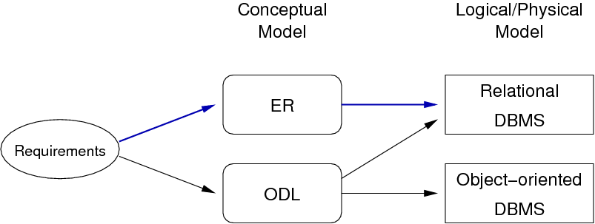
Data Modeling (cont’d)

Slide 31
Some Design Ideas
Consider the following while modeling data:
start simple … evolve design as problem better understood
identify objects (and their properties), then relationships
most designs involve kinds (classes) of people
keywords in requirements suggest data/relationships (rule-of-thumb: nouns → data, verbs → relationships)
don't confuse operations with relationships (operation: he buys a book; relationship: the book is owned by him)
consider all possible data, not just what is available

Slide 32
Exercise: Gmail Data Model
Consider the Gmail system
Develop an informal data model for it by identifying:
the data items involved (objects and their attributes)
relationships between these data items
constraints on the data and relationships

Slide 33
Quality of Designs
There is no single "best" design for a given application
Most important aspects of a design (data model)
correctness (satisfies requirements accurately)
completeness (all requirements covered, all assumptions explicit)
consistency (no contradictory statements)
Potential inadequacies in a design
omits information that needs to be included
contains redundant information (⇒ inconsistency)
leads to an inefficient implementation
violates syntactic or semantic rules of data model

Slide 34
Entity-Relationship (ER) Model
The world is viewed as a collection of inter-related entities
ER has three major modelling constructs:
attribute: data item describing a property of interest
entity: collection of attributes describing object of interest
relationship: association between entities (objects)
The ER model is not a standard. Hence, many variations exist
Lecture notes use notation from SKS and GUW books (simple)

Slide 35
Entity-Relationship (ER) Diagrams
ER diagrams are a graphical tool for data modelling
An ER diagram consists of:
a collection of entity set definitions
a collection of relationship set definitions
attributes associated with entity and relationship sets
connections between entity and relationship sets
Terminology abuse: "entity" means "entity set" or "entity instance"?

Slide 36
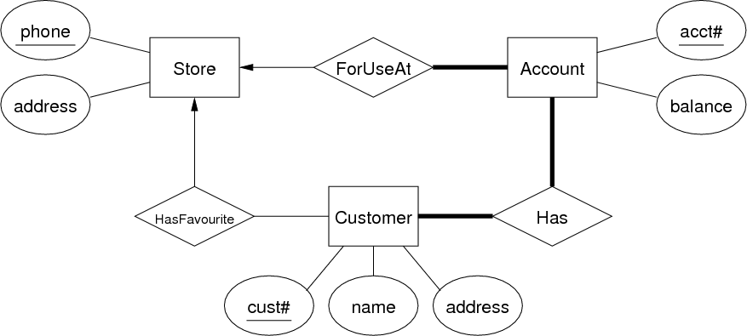
Entity-Relationship (ER) Diagrams (cont’d)
ER Diagram Example

Slide 37
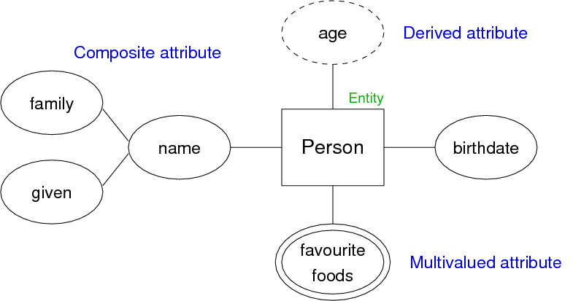
Entity-Relationship (ER) Diagrams (cont’d)
Attribute Notations Example

Slide 38
Entity Sets
An entity set can be viewed as either:
a set of entities with the same set of attributes (extensional view of entity set)
an abstract description of a class of entities (intentional view of entity set)
An entity may belong to more than one entity sets
"Data" in a database ≅ collection of (extensional) entity sets

Slide 39
Keys
Key (superkey): any set of attributes
whose set of values are distinct over entity set
natural (e.g., name+address+birthday) or artificial (e.g., SSN)
A candidate key is any superkey such that
no proper subset of its attributes is also a superkey
A primary key:
is one candidate key chosen by the database designer
Keys are indicated in ER diagrams by underlining

Slide 40
Relationship Sets
Relationship: an association among several entities E.g., Customer(9876) is the owner of Account(12345)
Relationship set: collection of relationships of the same type
Degree = # entities involved in relationship (in ER model, ≥ 2)
Cardinality = # associated entities on each side of relationship
Participation = must every entity be in the relationship

Slide 41
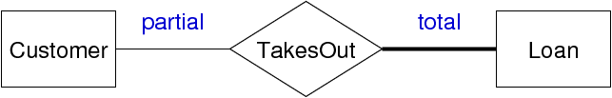
Relationship Sets (cont’d)
Example: relationship participation

Slide 42
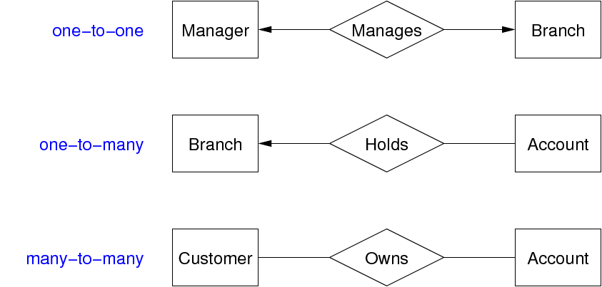
Relationship Sets (cont’d)
Example: relationship cardinality

Slide 43
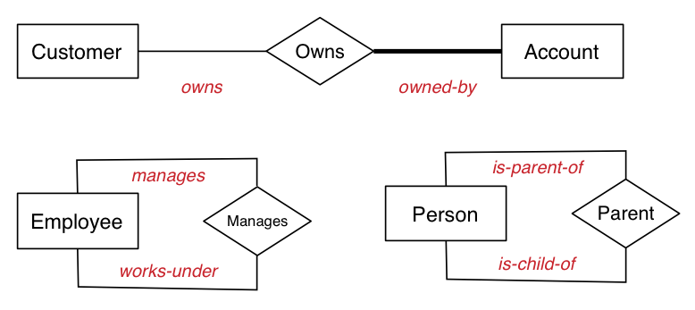
Relationship Sets (cont’d)
The role of each entity in a relationship is usually implicit.
If ambiguity arises, can explicitly name the role.
Role names become more important when developing SQL schemas

Slide 44
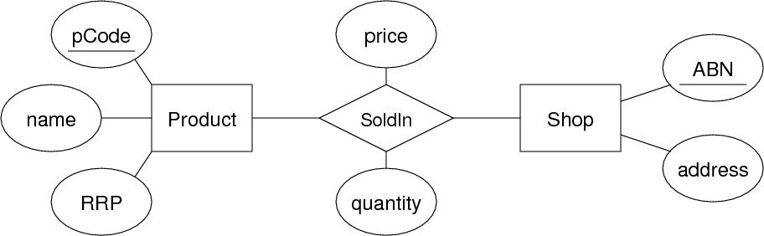
Relationship Sets (cont’d)
In some cases, a relationship needs associated attributes.
Example:
(Price and quantity are related to products in a particular shop)

Slide 45
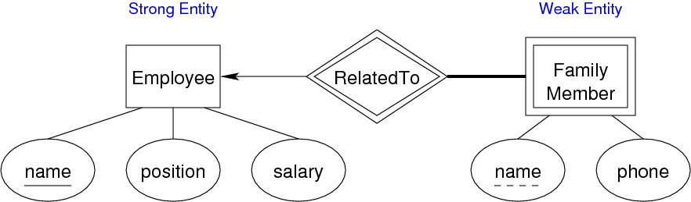
Weak Entity Sets
Weak entities
exist only because of association with strong entities
have no key of their own; have a discriminator
Example:

Slide 46
Subclasses and Inheritance
A subclass of an entity set A is a set of entities:
with all attributes of A, plus (usually) its own attributes
that is involved in all of A's relationships, plus its own
Properties of subclasses:
overlapping or disjoint (can an entity be in multiple subclasses?)
total or partial (does every entity have to also be in a subclass?)
Special case: entity has one subclass ("B is-a A" specialisation)

Slide 47
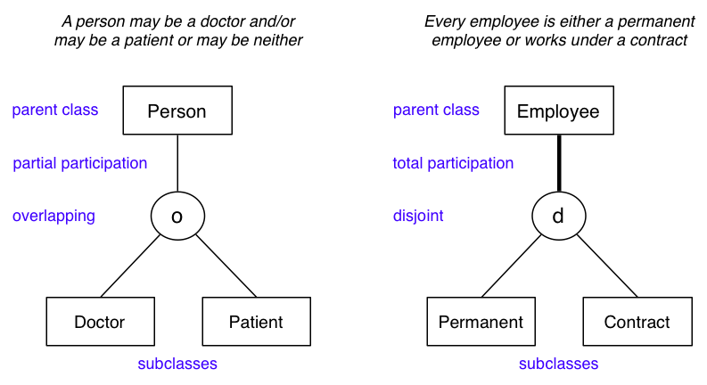
Subclasses and Inheritance (cont’d)
Example:

Slide 48
Design Using the ER Model
ER model: simple, powerful set of data modelling tools
Some considerations in designing ER models:
should an "object" be represented by an attribute or entity?
is a "concept" best expressed as an entity or relationship?
should we use n-way relationship or several 2-way relationships?
is an "object" a strong or weak entity? (usually strong)
are there subclasses/superclasses within the entities?
Answers to above are worked out by thinking about the application domain

Slide 49
Design Using the ER Model (cont’d)
ER diagrams are typically too large to fit on a single screen (or a single sheet of paper, if printing)
One commonly used strategy:
define entity sets separately, showing attributes
combine entities and relationships on a single diagram (but without entity attributes)
if very large design, may use several linked diagrams

Slide 50
Exercise: Medical Information
Patients are identified by an SSN, and their names, addresses and ages must be recorded.
Doctors are identified by an SSN. For each doctor, the name, specialty and years of experience must be recorded.
Each pharmacy has a name, address and phone number. A pharmacy must have a manager.
A pharmacist is identified by an SSN, he/she can only work for one pharmacy. For each pharmacist, the name, qualification must be recorded.
For each drug, the trade name and formula must be recorded.
Every patient has a primary physician. Every doctor has at least one patient.
Each pharmacy sells several drugs, and has a price for each. A drug could be sold at several pharmacies, and the price could vary between pharmacies.
Doctors prescribe drugs for patients. A doctor could prescribe one or more drugs for several patients, and a patient could obtain prescriptions from several doctors. Each prescription has a date and quantity associated with it.

