Slide 1
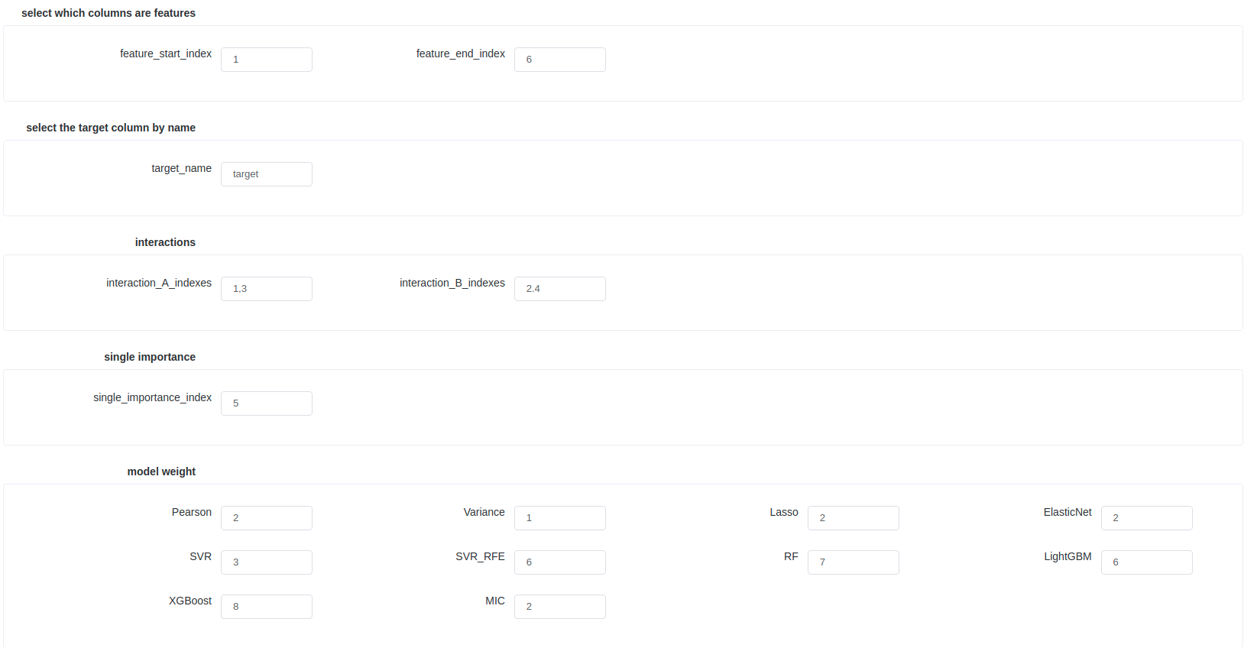
Please enter the index of the beginning and the end of the feature (starting from 1), the feature index must be consecutive.
Please enter the column name of the target column
Please enter the index of the feature for which you need to calculate the correlation, using the ',' split .
(As shown in the figure will calculate the correlation between 1 and 2, 3 and 4 index features)
Please enter the index for which you need to calculate the importance of a single feature (you can enter more than one, using the ',' split)
Please input features to select the weight of the model output score (recommended default value)

Slide 2
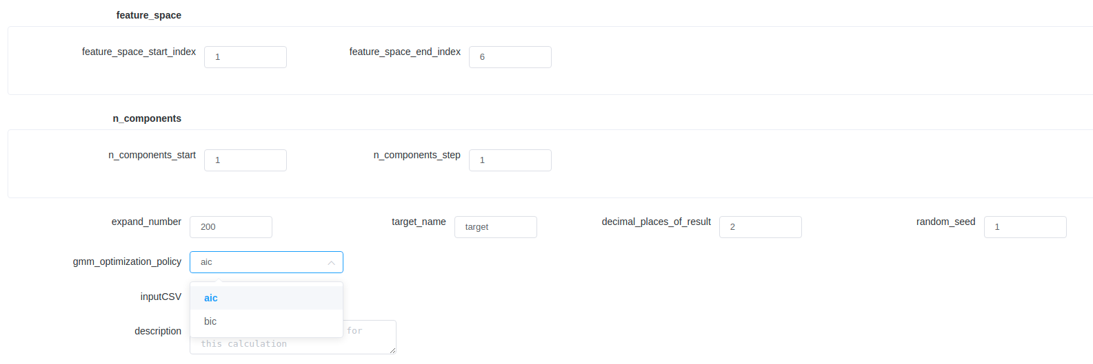
Please enter the index of the beginning and the end of the feature (starting from 1), the feature index must be consecutive.
If a target is included, it will be treated as a feature to extend the data.
Grid search parameters.
Entropy-based(aic/bic) approach to find hybrid Gaussian models consisting of multiple Gaussians.

