Slide 1

2021.12.03 组会汇报
汇报人：于烨泳
学号 ：21820236
汇报日期： 2021.12.03

Slide 2
原始实验结果
Target | Max R2 | Average R2 | Max R2(scheduler α) | Average R2(schedulerα) | ZY | SVR | RFR
疲劳强度 | 0.9189513396680401 | 0.9120479977429743 | 0.9223260787462038 | 0.9214011455945695 | 0.9137 | 0.7821698852361179 | 0.911370625326628
抗拉强度 | 0.9533261229531854 | 0.9406813356267222 | 0.9530576654581051 | 0.9454082208144711 | 0.9448 | 0.7859893593885802 | 0.9397066004423241
断裂强度 | 0.9236637896857909 | 0.9224613438443363 | 0.9215236703589123 | 0.9102559099480958 | 0.9181 | 0.8593007106390008 | 0.9206576905447157
硬度 | 0.9402179673785047 | 0.9357071422844651 | 0.9467511404374395 | 0.9221354811116853 | 0.9448 | 0.7839053506903382 | 0.9214985822556397

Slide 3
period | icsd_volume | mendeleev_number | electron_affinity | electron_negativity | en_allen | gs_bandgap | gs_energy
atomic_radius | atomic_radius_rahm | atomic_number | en_ghosh | en_pauling | specific_heat | gs_est_bcc_latcnt | gs_est_fcc_latcnt
atomic_weight | atomic_volume | lattice_constant | first_ion_en | fusion_enthalpy | evaporation_heat | gs_mag_moment | gs_volume_per
vdw_radius | vdw_radius_alvarez | density | heat_of_formation | heat_capacity_mass | heat_capacity_molar | num_d_unfilled | num_d_valence
 |  |  |  |  |  | num_unfilled | num_valance
vdw_radius_mm3 | vdw_radius_uff | c6_gb | boiling_point | bulk_modulus | melting_point | num_f_unfilled | num_f_valence
covalent_radius_pyykko_double | covalent_radius_pyykko_triple | covalent_radius_bragg | Polarizability | molar_volume | thermal_conductivity | num_p_unfilled | num_p_valence
covalent_radius_pyykko | covalent_radius_slater | dipole_polarizability | hhi_p | hhi_r | sound_velocity | num_s_unfilled | num_s_valence
因为num_f_unfilled
全部为0，所以删除

Slide 4
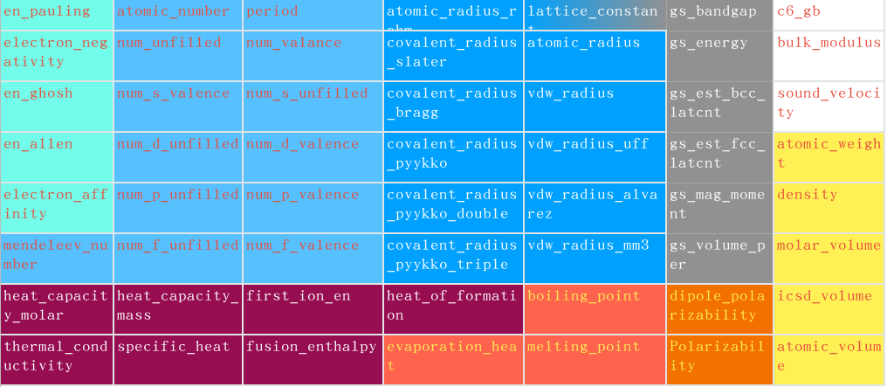
sum | 0 | var
gmean | ave | hmean
max | 0 | min
删除hhi_p和hhi_r，与材料无关

Slide 5
疲劳数据
Target | Multimodal-hwt | Multimodal-my | Multimodal-zy | SVR | RFR | Ridge | Lasso | SGD | DT
Fatigue | 0.940 | 0.936 | 0.919 | 0.89 | 0.903 | 0.909 | -0.002 | 0.897 | 0.795
Tensile | 0.947 | 0.975 | 0.953 | 0.925 | 0.919 | 0.939 | -0.004 | 0.921 | 0.819
Fracture | 0.920 | 0.940 | 0.924 | 0.905 | 0.913 | 0.894 | -0.010 | 0.887 | 0.856
Hardness | 0.955 | 0.962 | 0.940 | 0.907 | 0.927 | 0.927 | -0.004 | 0.910 | 0.881

Slide 6





Fatigue
Fracture
Hardness
Tensile

Slide 7





Fatigue
Fracture
Hardness
Tensile

Slide 8





Fatigue
Fracture
Hardness
Tensile

Slide 9
非晶合金数据
特征 | 类别 | 精度 | 召回率 | F1-score | 样本数
纯数值特征 | BMG | 0.8119 | 0.4767 | 0.5846 | 208
 | RMG | 0.7977 | 0.9121 | 0.8511 | 1241
 | CRA | 0.7423 | 0.6156 | 0.6730 | 510
纯图片特征 | BMG | 0.6813 | 0.6682 | 0.6763 | 208
 | RMG | 0.7676 | 0.8874 | 0.8218 | 1241
 | CRA | 0.7208 | 0.4588 | 0.5604 | 510
多模态特征 | BMG | 0.9585 | 0.8894 | 0.9226 | 208
 | RMG | 0.8809 | 0.9363 | 0.9078 | 1241
 | CRA | 0.8322 | 0.7294 | 0.7774 | 510

Slide 10
target | NN | SVR
屈服强度 | 0.9112121255040538 | 0.9601137238797062
延伸率 | 0.91055924545526 | 0.9623714430748136
抗拉强度 | 0.8793068563236458 | 0.8348637394219788
断面收缩率 | 0.6014997183504696 | 0.3819611362875961

