Slide 1

2021.10.22 组会汇报
汇报人：于烨泳
学号 ：21820236
汇报日期： 2021.10.22

Slide 2
Co-Crystal Graph Network (CCGNet)
1

Slide 3
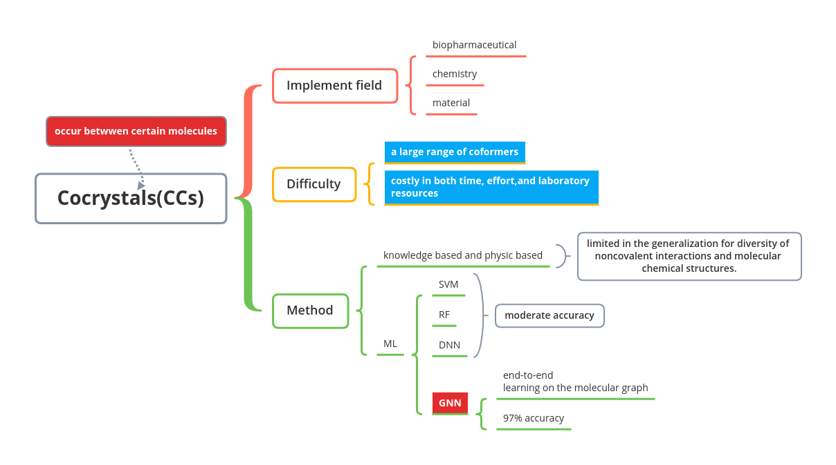
Cocrystals(CCs)
共晶体或共晶（英语：cocrystal）是晶体学中的概念，人们对其定义有着争议，一种认为共晶体是由至少两种组分组成的晶体，其组分可以是原子分子或离子。
另一种认为共晶体是由至少两种组分组成的、具有独特性质的晶体。也有认为液相合金通过共晶凝固同时结晶出两个固相，这样两相的混合物成为共晶组织或共晶体。
共晶体的组分通过非共价相互作用，如氢键、离子键、范德华力或π相互作用结合。分子间相互作用让晶体产生了和原来各自组分不同的物理及化学性质。

Slide 4
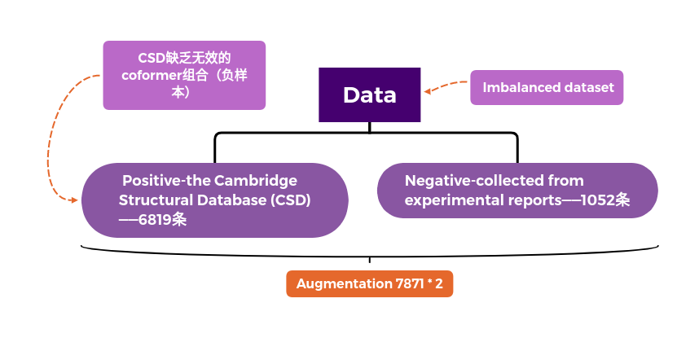
Data

Slide 5
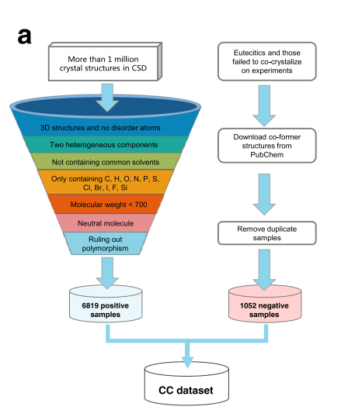
Data
Only containing two chemically different polyatomic units.
Having 3D structures and no disorder atoms to avoid lowquality structures.
Not containing any of a set common solvents or small molecule, which are liquid/gaseous at room temperature, as listed in the Supplementary Table 1.
Only containing C, H, O, N, P, S, Cl, Br, I, F, and Si elements, ruling out metal elements.
Molecular weight of each component <700, considering the fact that most organic CCs are generally small molecules.
Being neutral components to exclude salts because most functional CCs are neutral/quasineutral.
Ruling out polymorphism to remove duplicate samples, considering that different crystal structures can be formed between the two same co-formers when the crystallization conditions change.

Slide 6
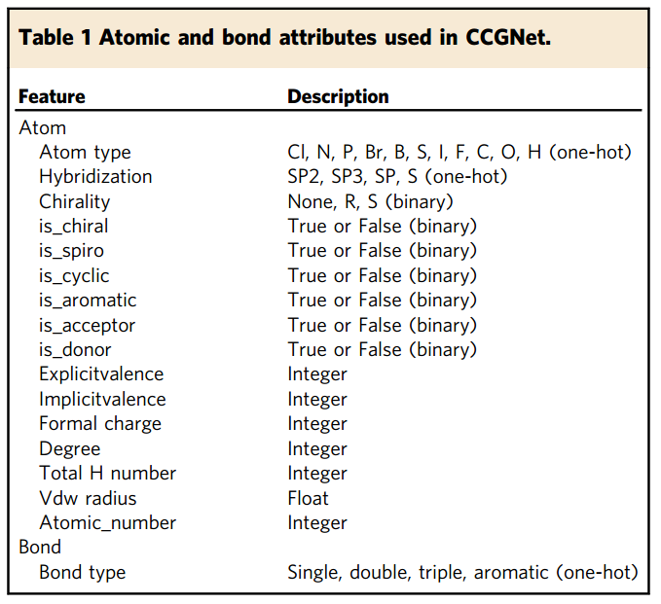
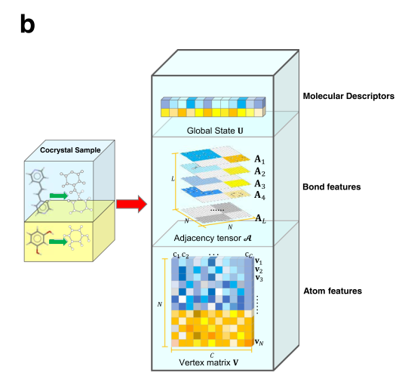
Representation of samples

Slide 7
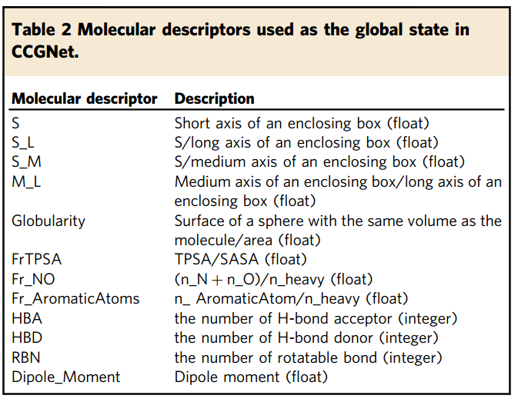
Representation of samples
3D
2D
3D

Slide 8
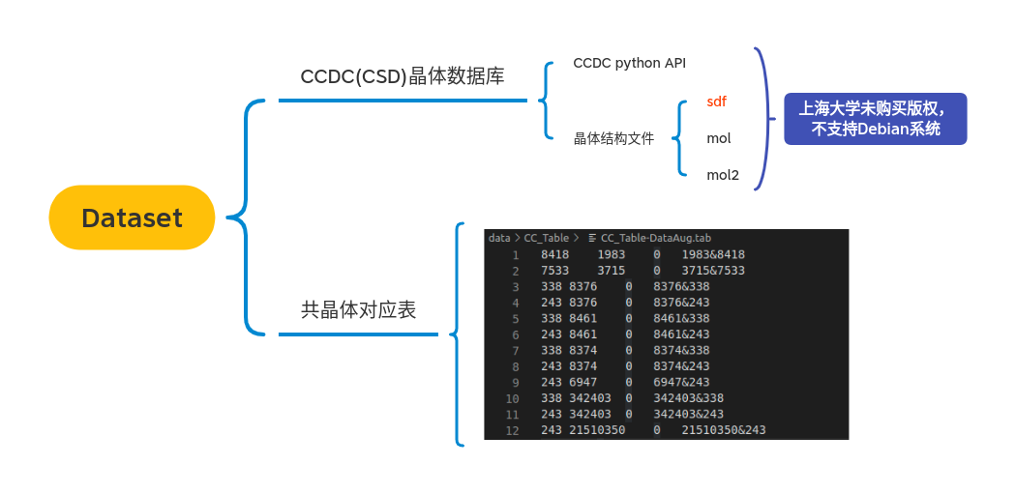
Dataset

Slide 9
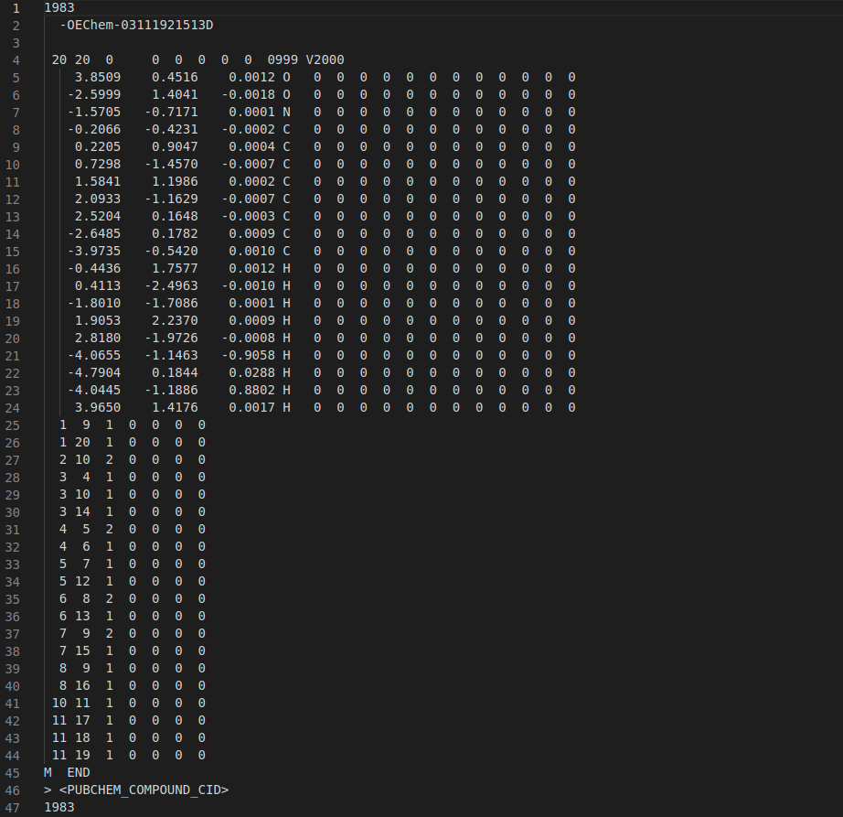

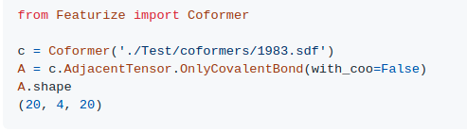



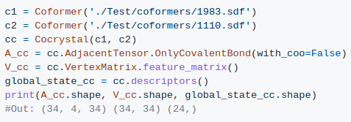
Data

Slide 10
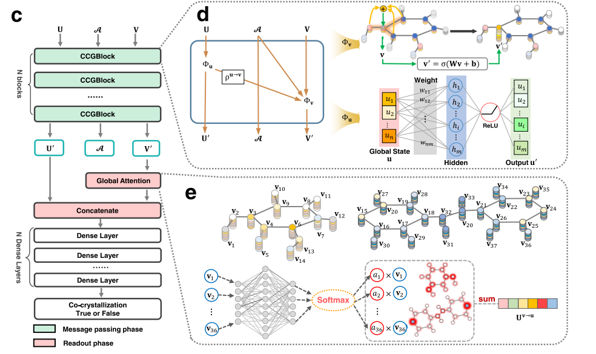
Construction of CCGNet model.

Slide 11
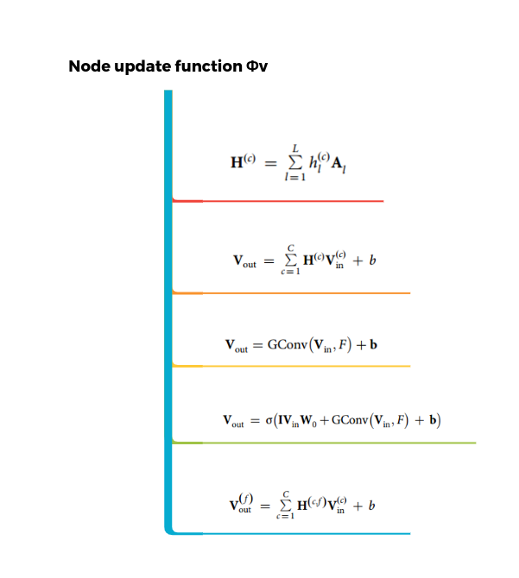
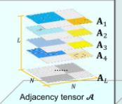
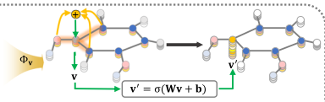
N*N

Slide 12
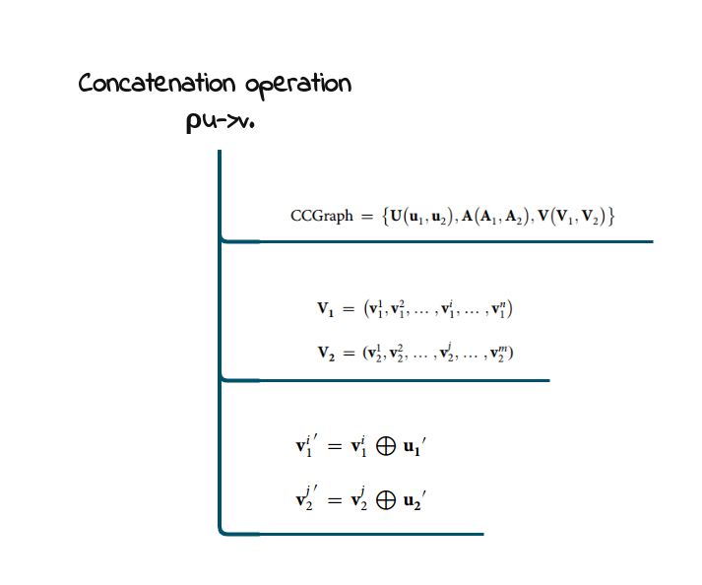
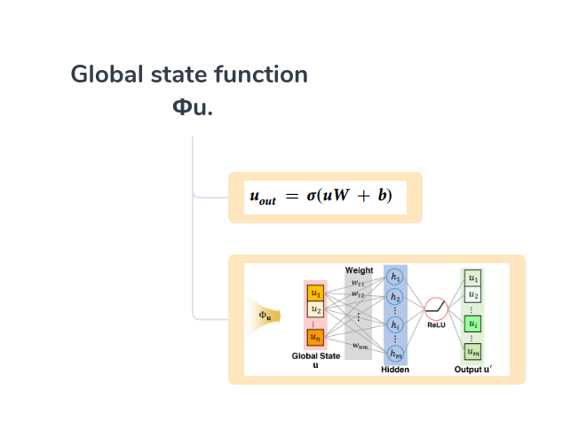
Method

Slide 13
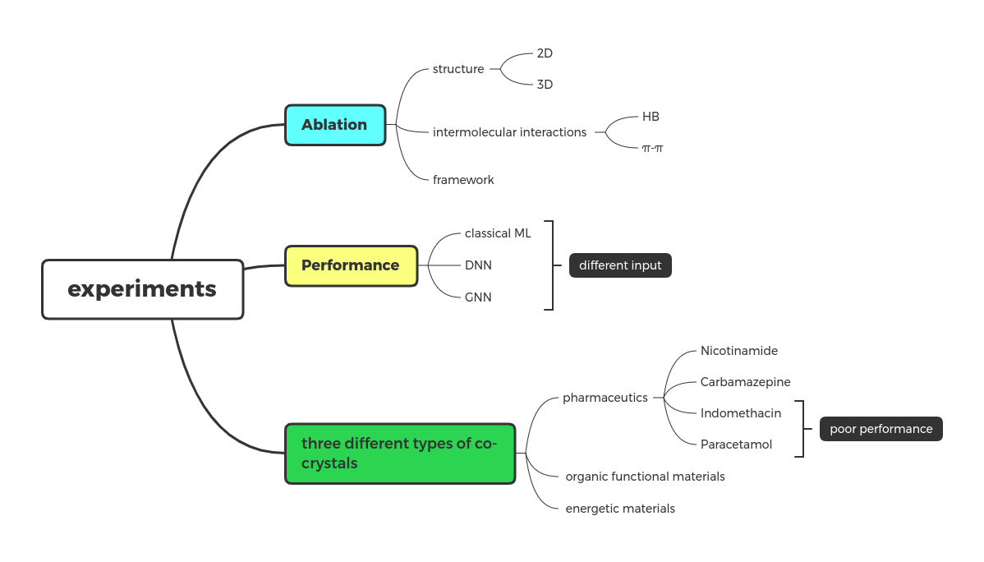
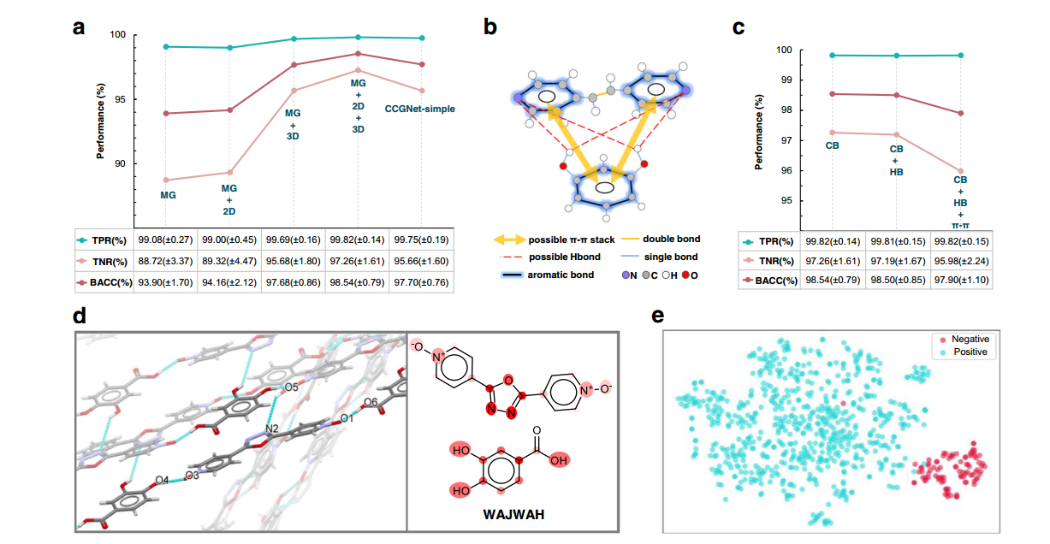
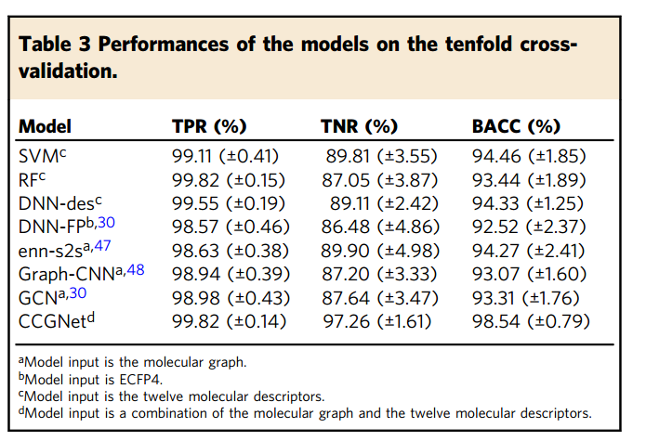
Experiments

Slide 14
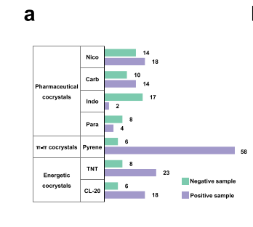
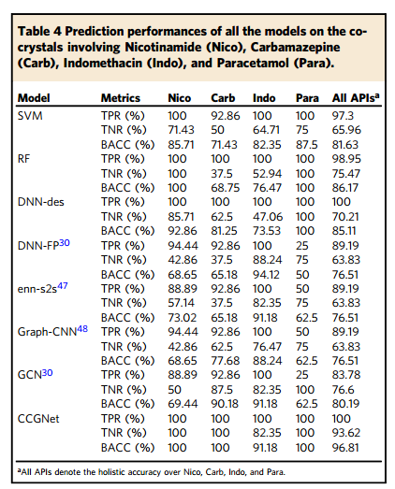
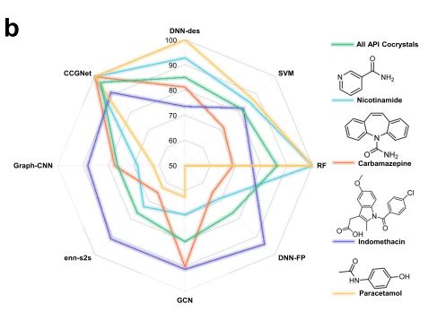
Test——Pharmaceutical co-crystals

Slide 15
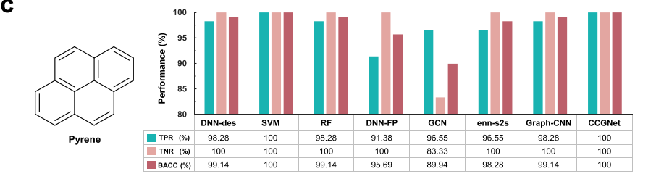
Test——π–π co-crystals

Slide 16
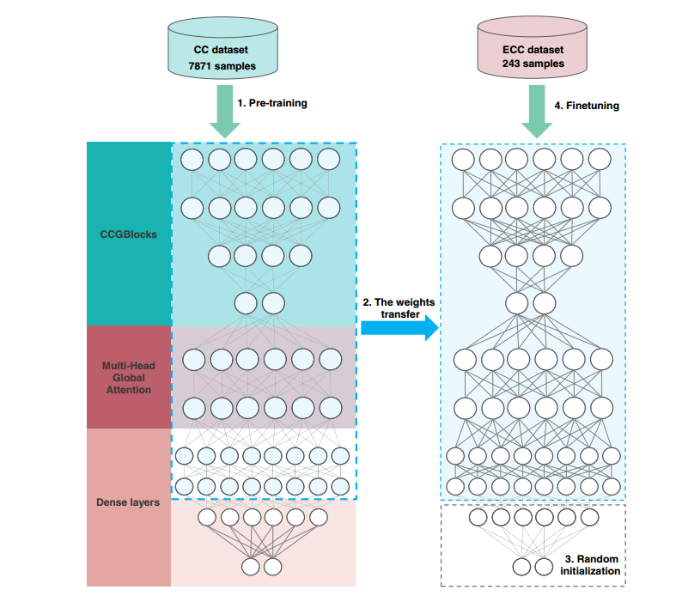
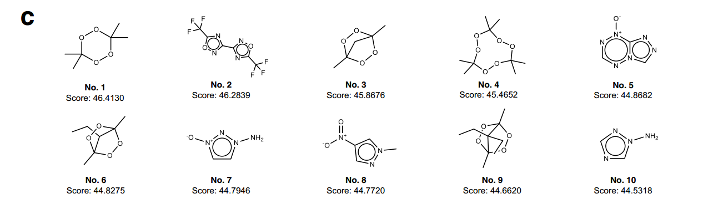
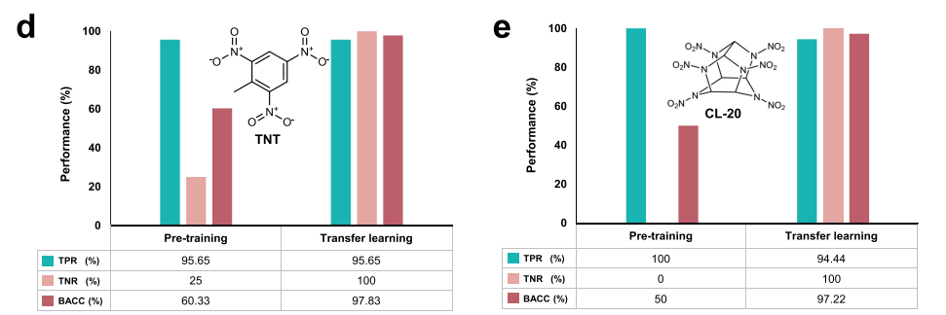
Test——energetic cocrystals (ECCs)

Slide 17
谢谢~！
汇报人：于烨泳
学号 ：21080236
汇报日期： 2021.10.08

