Slide 1


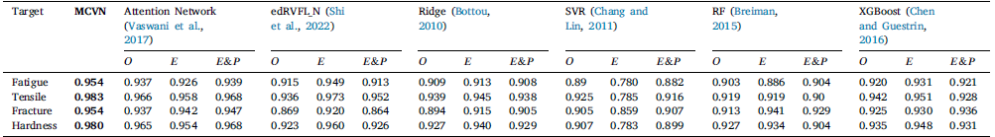
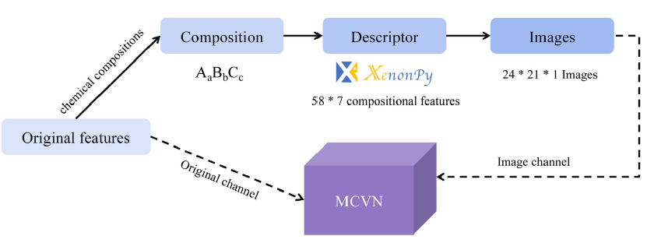
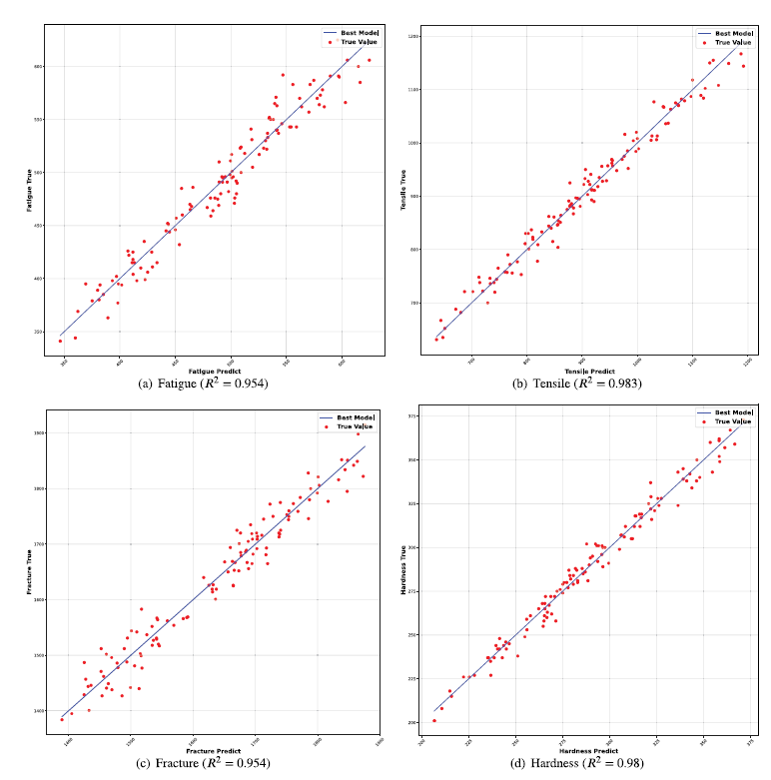

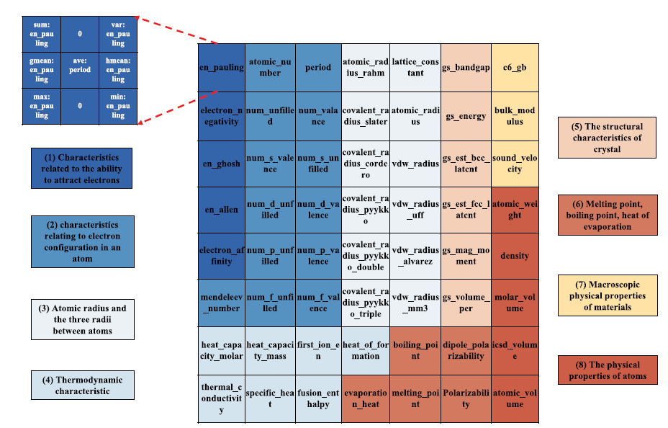

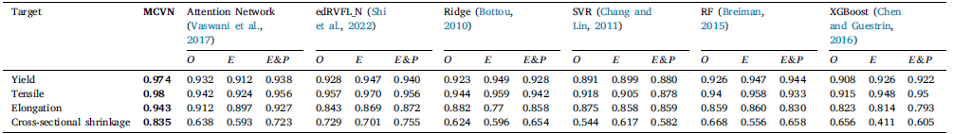
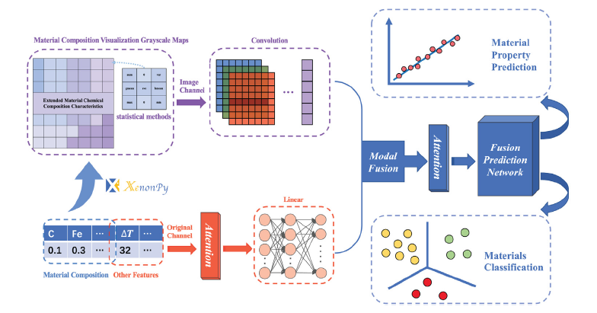
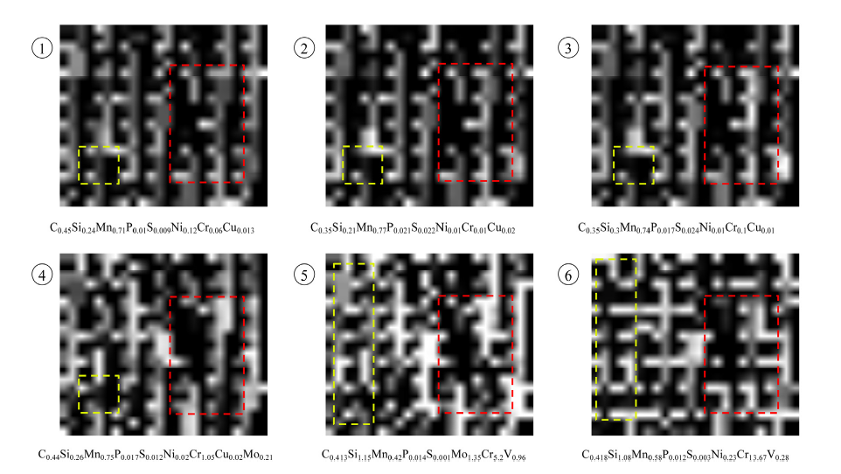
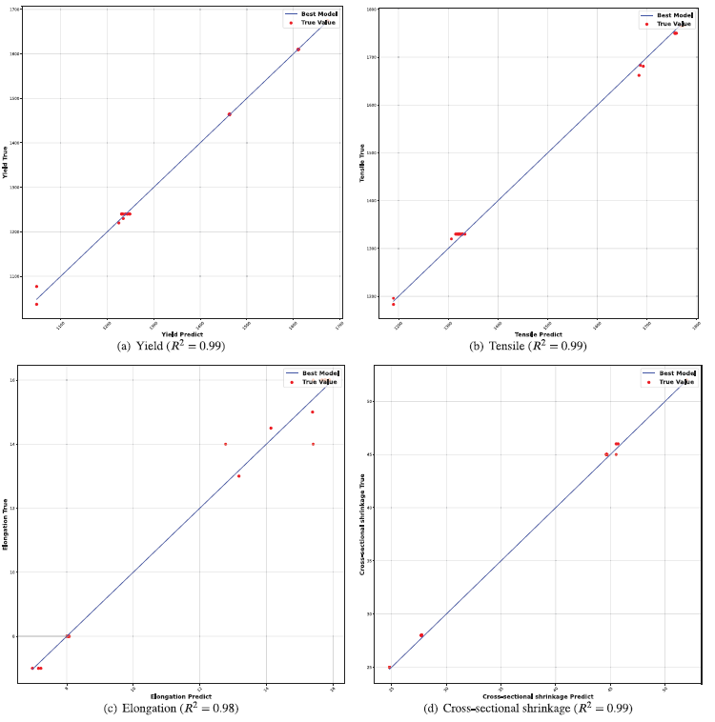
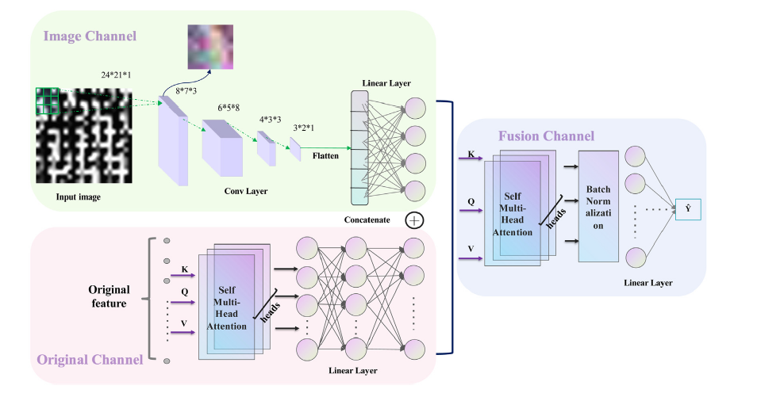
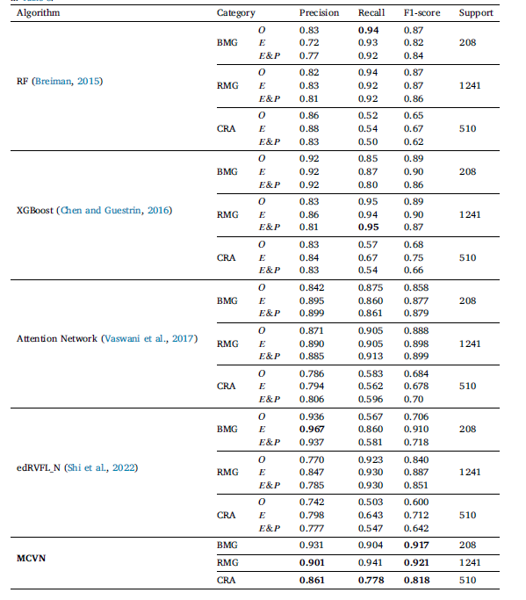
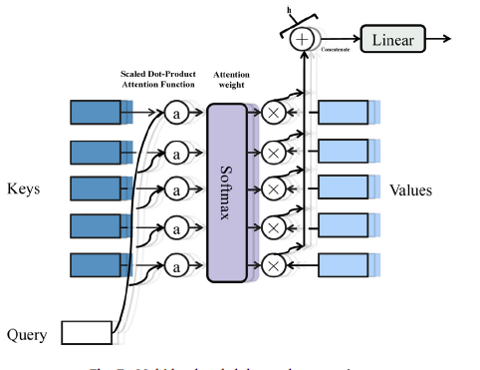





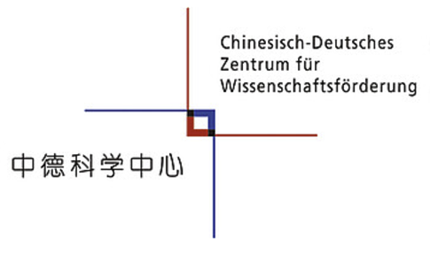

Enhancing Materials Property Prediction: A Multimodal Learning via Image Mapping of Material Compositions
Yu Yeyong ª, Wu Xing ^{a,c}, Zhang Huiran^{a,c} , Qian Quan ^{a, b, c,}*
^{a.} School of Computer Engineering and Science, Shanghai University
^{b.} Materials Genome Institute, Shanghai University, Shanghai
^{c.} Zhejiang Laboratory, Hangzhou
International Workshop on Data-driven Computational and Theoretical Materials Design (DCTMD)
“ Unlocking the AI Future of Materials Science ”
Email: qqian@shu.edu.cn
Introduction
Modal Translation
Regression Task
Complex material datasets challenge mach-ine learning due to sparse features.
Composition crucial: composition proporti-ons overlooked.
Compositional features present: Atomic info missing.
Image mapping: Using XenonPy expand 58 elemental points, 406 extended dimensions.
Grayscale images for CNN extraction.
Process Flow: Feature Enhancement with Xenonpy.
Methods
Densification and Prediction: Atomic features for 2D grayscale images; MCVN predicts steel properties, classifies amorphous alloys. [See Figure A]
Expert-based visualization: Enhances compositional features in material ML tasks.
Multimodal deep-network model: Integrates visualization images & raw features, improves accuracy. [See Figure B]
Arrangement: Template of compositional features.
NIMS's steel dataset: 4% 𝑅² improvement (0.92 avg. 𝑅²)
Grayscale Image: Element-level description of features
Figure A. Better utilization of composition for material property prediction using the MCVN.
Results
Classification Task
SRIM's steel dataset: 𝑅² = 0.835 on EL (vs 0.64 avg. 𝑅²).
Conclusion
This approach enhances model performances on small sparse matrix samples by expanding material composition data, offering a universal paradigm for predicting material properties.
Feature Enhancement: Densifies sparse composition, boosts generalization.
Modal Translation: XenonPy, element-level features, multimodal grayscale dataset.
Multimodal Learning: MCVN enhances material property predictions.
Figure B. Material composition visualization network architecture.
Self-attention Mechanism: Reduces external info reliance, captures internal relevance effectively.
Unbalanced amorphous alloy dataset: Increased avg. 𝑅𝑒𝑐𝑎𝑙𝑙 (CRA small-class) from 0.58 to 0.78.
Reference
Better utilization of materials’ compositions for predicting their properties: Material composition visualization network[J]. Engineering Applications of Artificial Intelligence
FTAP: Feature transferring autonomous machine learning pipeline[J]. Information Sciences
Organizer
Materials Genome Institute, Shanghai University
Shanghai, China October 9-13, 2024
Partners and Sponsors

