Slide 1

Computer Vision Homework 3
TA：林敬倫
Email：baron890830@gmail.com
Robot Vision Lab (Room 122)

Slide 2
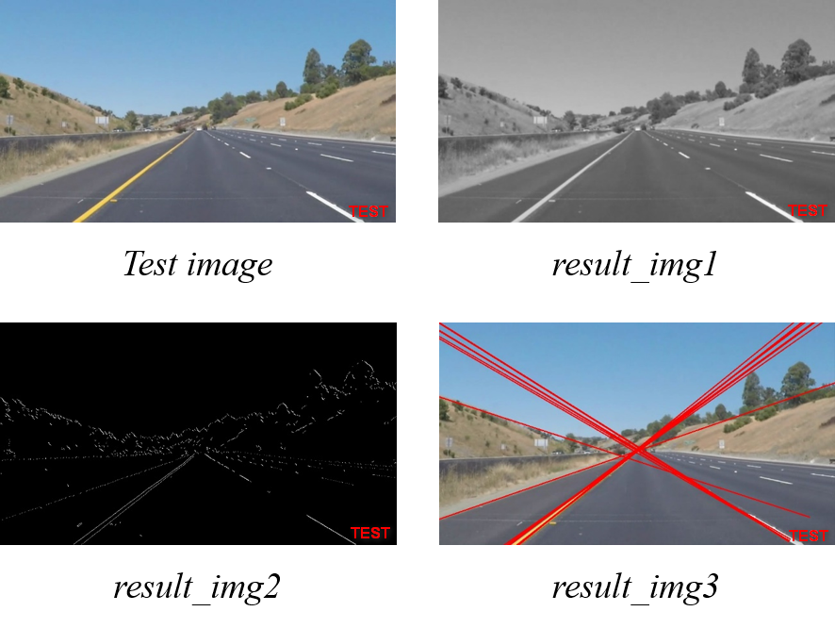
Homework 3
Lane Detection
There are three functions that you need to implement.
Gaussian Blur (result_img1)
Canny Edge Detection (result_img2)
Hough Transform (result_img3)
There are totally 4 test images.
For each test image, you will get 3 result images.

Slide 3
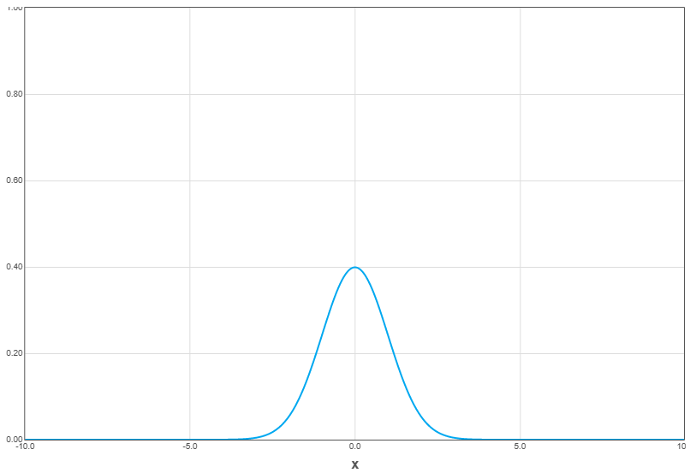
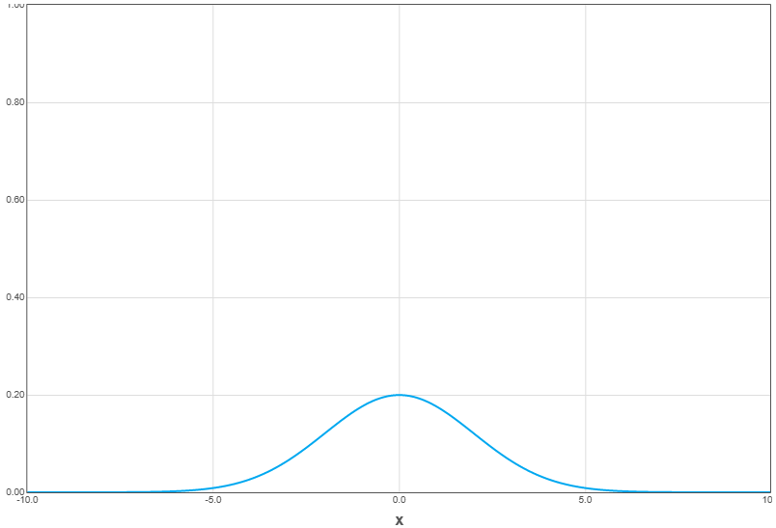
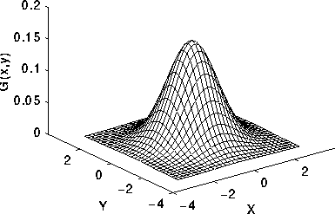



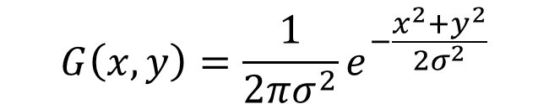
Gaussian Filter
Kernel Size
Standard Deviation：$σ$
$$σ=1.0$$
$$G\left(x, y\right)=\frac{1}{2πσ^{2}}e^{−\frac{x^{2}+y^{2}}{2σ^{2}}}$$
$$σ=2.0$$

Slide 4


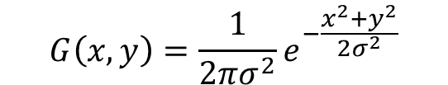
Gaussian Filter
(-1, -1) | (0, -1) | (1, -1)
(-1, 0) | (0, 0) | (1, 0)
(-1, 1) | (0, 1) | (1, 1)
0.0585 | 0.0965 | 0.0585
0.0965 | 0.1591 | 0.0965
0.0585 | 0.0965 | 0.0585
$$G\left(x, y\right)=\frac{1}{2πσ^{2}}e^{−\frac{x^{2}+y^{2}}{2σ^{2}}}$$
(x, y)
$$σ=1.0$$

Slide 5
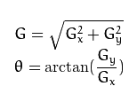
Canny Edge Detection
Noise reduction You can use Gaussian Filter. (The result of question 1)
Gradient calculation You can use Sobel operator to get x and y direction gradient. Then calculate the magnitude and angle of gradient.
Non-maximum suppression
Consider in 4 directions and compare with neighbor pixels.
Double threshold Define low and high threshold.
Edge Tracking by Hysteresis Link the edge points depend by the neighbor pixels.
-1 | 0 | 1
-2 | 0 | 2
-1 | 0 | 1
-1 | -2 | -1
0 | 0 | 0
1 | 2 | 1
Sobel x
Sobel y
strong
High threshold
candidate
Low threshold
weak

Slide 6
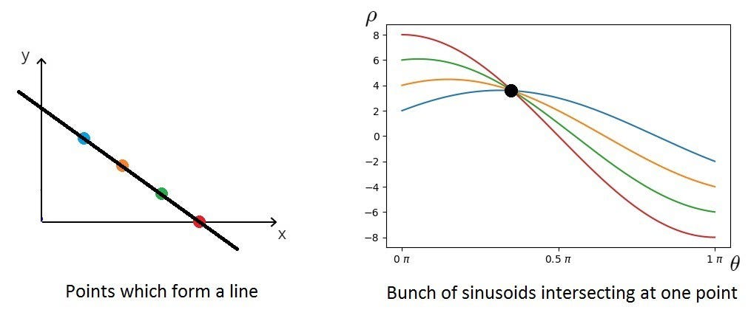

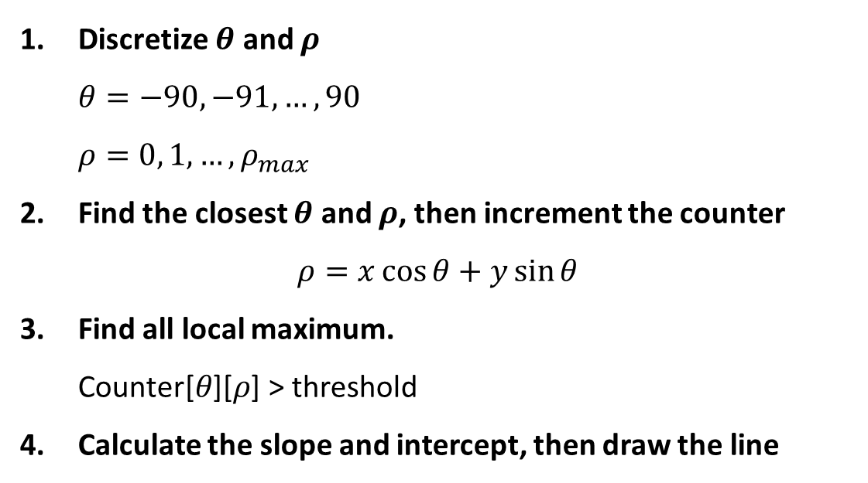

Hough Transform
$$θ$$
Discretize $θ$ and $ρ$ $θ=−90, −91, …, 90$ $ρ=0, 1, …, ρ_{max}$
Find the closest $θ$ and $ρ$, then increment the counter $ρ=x\cos{θ}+y\sin{θ}$
Find all local maximum. $\text{Counter}\text{[}θ\text{][}ρ\text{] > }\text{threshold}$
Calculate the slope and intercept, then draw the line
$$ρ$$
Counter

Slide 7
Grading
Program (80%)
Gaussian Filter (10%)
Canny Edge Detection (35%)
Hough Transform (35%)
Report (20%)
Please explain your code.
Please paste 4 input images and 12 output images in your report.

Slide 8
Deadline
2023/12/15 (Fri) 23:59:59
Please compress your folder to a zip file. (For example：611415047_hw3.zip)
For each hour late, 10% of the total score will be deducted.
Please submit to eCourse2.
Please finish your homework independently.

Slide 9
Thanks for your attention

