Slide 1
논리회로
AES

Slide 2
목차
입출력
FSM
구조 설계
SubByte
Shift Row
Mix Column
Add Round Key
Key Expansion

Slide 3
입출력
i_Text
AES
i_Key
o_Text
i_fEnc
이름 | 입/출력 | Bit | 설명
i_Text | 입력 | 128 | 암호화에 사용될 평문 / 복호화 할 암호문
i_Key |  | 128 | 암/복호화에 사용될 사용자 비밀 키
i_fEnc |  | 1 | 암/복호화 여부를 선택
o_Text | 출력 | 128 | 암호화된 암호문 / 복호화된 평문

Slide 4
FSM
Next Clk
IDLE
DONE
fStart
Next Clk
Round < 10
Next Clk
FIRST
MIDDLE
FINAL
Round == 10

Slide 5

구조 설계
AES
i_$Text$(128 bit)
i_fEnc (1 bit)
SubByte & ShiftRow
i_Key (128 bit)
Key Expansion
Mix Column
n_Text (128 bit)
n_Key (128 bit)
Add Round Key
o_Text (128 bit)

Slide 6































SubByte
SubByte
S BOX
$i_Data$(128-bit)
o$_Data$(128-bit)
$$out$$
S BOX module
o_Data(8-bit)
$i_Data$(8-bit)
Routing
$$63$$
$$7c$$
$$77$$
$$7b$$
o_Data(8-bit)
$i_Data$(8-bit)
Encryption
$$f2$$
$$6b$$
$$6f$$
$$c5$$
o_Data(8-bit)
$i_Data$(8-bit)
$i_Data$(8-bit)
o_Data(128-bit)
i_Data(128-bit)
$i_Data$(8-bit)
$$b0$$
$$54$$
$$bb$$
$$16$$
o_Data(8-bit)
$$52$$
$$09$$
$$6a$$
$$d5$$
o_Data(8-bit)
Decryption
$$30$$
$$36$$
$$a5$$
$$38$$
$i_Data$(8-bit)
o_Data(8-bit)
$i_Data$(8-bit)
o_Data(8-bit)
$i_Data$(8-bit)
$$55$$
$$21$$
$$0c$$
$$7d$$

Slide 7























Shift Row
$$00$$
$$01$$
$$02$$
$$03$$
$$00$$
$$01$$
$$02$$
$$03$$
$$04$$
$$05$$
$$06$$
$$07$$
$$05$$
$$06$$
$$07$$
$$04$$
$$08$$
$$09$$
$$0a$$
$$0b$$
$$0a$$
$$0b$$
$$08$$
$$09$$
$$0c$$
$$0d$$
$$0e$$
$$0f$$
$$0f$$
$$0c$$
$$0d$$
$$0e$$

Slide 8



















































Mix Column
$$00$$
$$01$$
$$02$$
$$03$$
Mix Column
$$04$$
$$05$$
$$06$$
$$07$$
$$≪1$$
$i_Data$(8-bit)
o$_Data$(8-bit)
$$08$$
$$09$$
$$0a$$
$$0b$$
$i_Data$(8-bit)
$o_Data$(8-bit)
$i_Data$(8-bit)
$$≪1$$
$o_Data$(8-bit)
$$0c$$
$$0d$$
$$0e$$
$$0f$$
$i_Data$(8-bit)
$o_Data$(8-bit)
$$OverFlow Check$$
S 1
S 2
S 3
S 4
$$00$$
$$01$$
$$02$$
$$03$$
$$04$$
$$05$$
$$06$$
$$07$$
$$08$$
$$09$$
$0$a
$$0b$$
$$0c$$
$$0d$$
$$0e$$
$$0f$$
$$00$$
$$08$$
$$X$$
(00 * 2) ^ (04 * 3) ^ (08 * 1) ^ (0c * 1)
$$08$$
0e
0b
0d
09
$$00$$
2
3
1
1
= 00 ^ (04 * (2 + 1)) ^ 08 ^ 0c
$$04$$
X
1
2
3
1
=
$$1c$$
$$X$$
$$1c$$
09
0e
0b
0d
$$04$$
= {(04 * 2) ^ 04} ^ 08 ^ 0c
X
=
$$08$$
1
1
2
3
$$00$$
$$X$$
= (08 ^ 04) ^ 04 = 08
$$00$$
0d
09
0e
0b
$$08$$
$$0c$$
3
1
1
2
$$14$$
0b
0d
09
0e
$$0c$$
$$14$$
$$X$$
Encryption
* X는 S 4와 행렬의 계산 결과 *
Decryption

Slide 9









































Add Round Key
$$00$$
$$01$$
$$02$$
$$03$$
$$01$$
$$01$$
$$01$$
$$01$$
$$01$$
$$00$$
$$03$$
$$02$$
$$04$$
$$05$$
$$06$$
$$07$$
⊕
$$02$$
$$02$$
$$02$$
$$02$$
=
$$06$$
$$07$$
$$04$$
$$05$$
Round 0
$$08$$
$$09$$
$$0a$$
$$0b$$
$$03$$
$$03$$
$$03$$
$$03$$
$$0b$$
$$0a$$
$$09$$
$$08$$
$$0c$$
$$0d$$
$$0e$$
$$0f$$
$$04$$
$$04$$
$$04$$
$$04$$
$$08$$
$$09$$
$$0a$$
$$0b$$
i_Text
i_Key
Round 0 State
$$XX$$
$$XX$$
XX
$$XX$$
$$XX$$
$$XX$$
XX
$$XX$$
$$XX$$
$$XX$$
XX
$$XX$$
$X$X
$$XX$$
$$XX$$
$$XX$$
⊕
$X$X
$$XX$$
$$XX$$
$$XX$$
=
$X$X
$$XX$$
$$XX$$
$$XX$$
Round 10
$$XX$$
$$XX$$
$$XX$$
$$XX$$
$$XX$$
$$XX$$
$$XX$$
$$XX$$
$$XX$$
$$XX$$
$$XX$$
$$XX$$
$$XX$$
$$XX$$
$$XX$$
$$XX$$
$$XX$$
$$XX$$
$$XX$$
$$XX$$
$$XX$$
$$XX$$
$$XX$$
$$XX$$
Round 9 State
Round 9 Key
Round 10 State

Slide 10
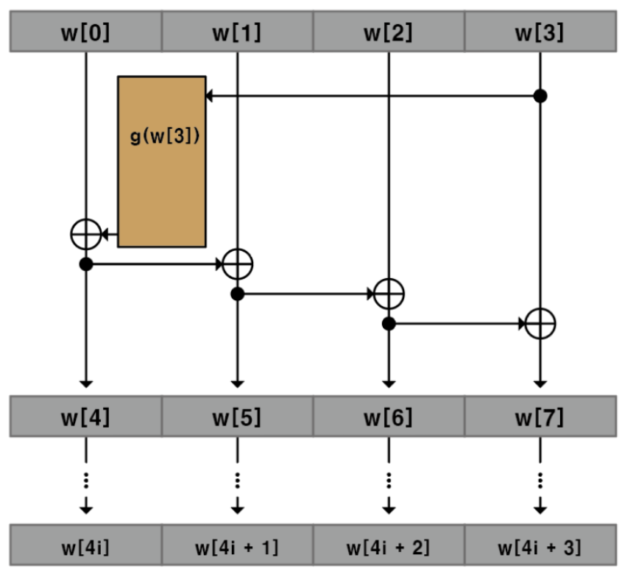



Key Expansion
KeyExpansion
Expansion
$i_fEnc$(1 bit)
$i_Key$(128 bit)
Expansion
Byte0 (32 bit)
Byte0 (32 bit)
Byte0 (32 bit)
Byte0 (32 bit)
Byte0 (32 bit)
Byte0 (32 bit)
Byte0 (32 bit)
Byte0 (32 bit)
o$_Key$(128 bit)

Slide 11



























g Function
i_Key
R 0
R 1
R 2
R 3
R 4
R 5
R 6
R 7
R 8
R 9
S 0
S 1
S 2
S 3
0x01 | 0x02 | 0x04 | 0x08 | 0x10 | 0x20 | 0x40 | 0x80 | 0x1B | 0x36
0x00 | 0x00 | 0x00 | 0x00 | 0x00 | 0x00 | 0x00 | 0x00 | 0x00 | 0x00
0x00 | 0x00 | 0x00 | 0x00 | 0x00 | 0x00 | 0x00 | 0x00 | 0x00 | 0x00
0x00 | 0x00 | 0x00 | 0x00 | 0x00 | 0x00 | 0x00 | 0x00 | 0x00 | 0x00
$$01$$
$$01$$
$$01$$
$$01$$
$$02$$
$$02$$
$$02$$
$$02$$
$$03$$
$$03$$
$$03$$
$$03$$
Round Constants
* Round에 따라 Round Constants는 다르게 적용됨 *
$$04$$
$$04$$
$$04$$
$$04$$
RotWord
SubWord
Rcon
$$01$$
$$04$$
$$f2$$
$$f2$$
$$01$$
$$f3$$
$$02$$
$$01$$
$$7c$$
$$7c$$
⊕
$$00$$
=
$$7e$$
S-Box
output
$$03$$
$$02$$
$$77$$
$$77$$
00
$$74$$
$$04$$
$$03$$
$$7b$$
$$7b$$
00
$$7b$$

Slide 12

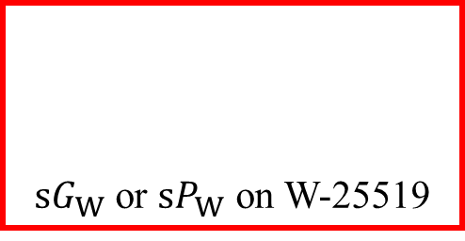













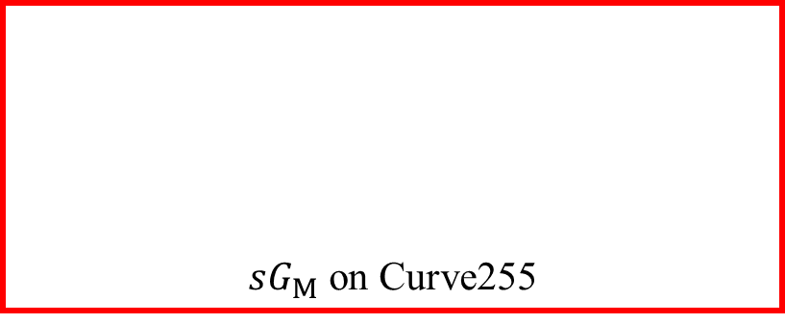
$sP_{M}$ on Curve255
$sP_{M}$ on Curve255
$sP_{M}$ on Curve255
$sG_{M}$ on Curve255
$sG_{W}$ or $sP_{W}$ on W-25519
$$P_{E}$$
$$f_{E→M}^{′}$$
$$P_{M}$$
$$f_{M→W}$$
$$P_{W}$$
$$×s$$
$$Q_{W}$$
$$f_{W→M}$$
$$P_{M}$$
$$f_{M→W}^{′}$$
$$P_{W}$$

Slide 13

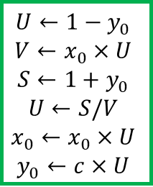




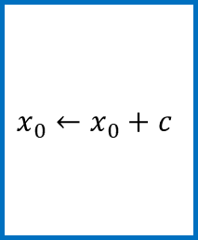






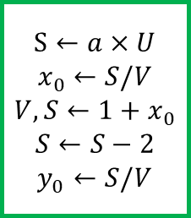

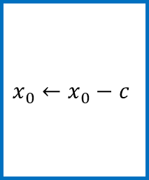



$$−f_{E→M}$$
$$f_{M→W}$$
$$f_{W→M}$$
$$−f_{M→E}$$
$$U←1−y_{0}$$
$$V←x_{0}×U$$
$$S←1+y_{0}$$
$$U←S/V$$
$$x_{0}←x_{0}×U$$
$$y_{0}←c×U$$
$$x_{0}←x_{0}+c$$
$$x_{0}←x_{0}−c$$
$$S←a×U$$
$$x_{0}←S/V$$
$$V,S←1+x_{0}$$
$$S←S−2$$
$$y_{0}←S/V$$
$$P_{E}$$
$$−f_{E→M}$$
$$P_{M}$$
$$f_{M→W}$$
$$P_{W}$$
$$×s$$
$$Q_{W}$$
$$f_{W→M}$$
$$Q_{M}$$
$$−f_{M→E}$$
$$Q_{E}$$
E
M, E
W, M, E
M, E
E
Point multiplication of a base point
Point multiplication of an arbitrary point

Slide 14
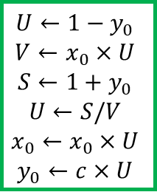

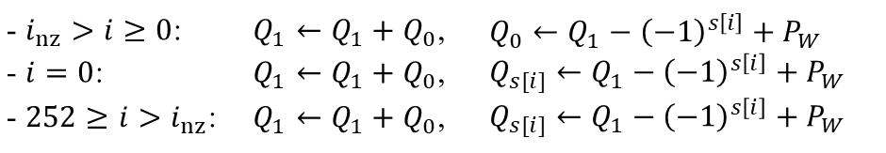




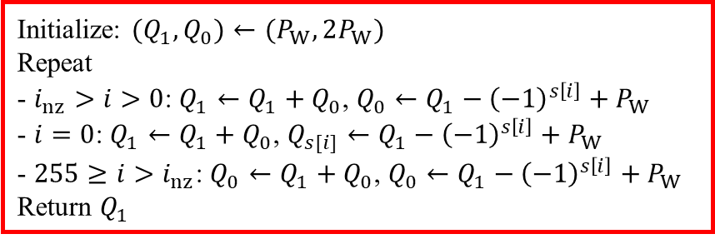




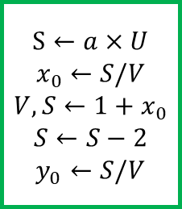



Point multiplication of a base point
Point multiplication of an arbitrary point
$$P_{E}$$
E
$$P_{M}$$
M, E
$$P_{W}$$
W, M, E
$$Q_{W}$$
M, E
$$Q_{M}$$
E
$$Q_{E}$$
$$−f_{E→M}$$
$$f_{M→W}$$
$$f_{W→M}$$
$$−f_{M→E}$$
$$U←1−y_{0}$$
$$V←x_{0}×U$$
$$S←1+y_{0}$$
$$U←S/V$$
$$x_{0}←x_{0}×U$$
$$y_{0}←c×U$$
$$x_{0}←x_{0}+c$$
$$x_{0}←x_{0}−c$$
$$S←a×U$$
$$x_{0}←S/V$$
$$V,S←1+x_{0}$$
$$S←S−2$$
$$y_{0}←S/V$$
$$sP_{W}$$
Initialize: $(Q_{1},Q_{0})←(P_{W},2P_{W})$
Repeat
- $i_{nz}>i>0$: $Q_{1}←Q_{1}+Q_{0}$, $Q_{0}←Q_{1}−{\left(−1\right)}^{s\left[i\right]}+P_{W}$
- $i=0$: $Q_{1}←Q_{1}+Q_{0}$, $Q_{s[i]}←Q_{1}−{\left(−1\right)}^{s\left[i\right]}+P_{W}$
- $255≥i>i_{nz}$: $Q_{0}←Q_{1}+Q_{0}$, $Q_{0}←Q_{1}−{\left(−1\right)}^{s\left[i\right]}+P_{W}$
Return $Q_{1}$
- $i_{nz}>i≥0$: | $Q_{1}←Q_{1}+Q_{0}$, | $Q_{0}←Q_{1}−{\left(−1\right)}^{s\left[i\right]}+P_{W}$
- $i=0$: | $Q_{1}←Q_{1}+Q_{0}$, | $Q_{s[i]}←Q_{1}−{\left(−1\right)}^{s\left[i\right]}+P_{W}$
- $252≥i>i_{nz}$: | $Q_{1}←Q_{1}+Q_{0}$, | $Q_{s[i]}←Q_{1}−{\left(−1\right)}^{s\left[i\right]}+P_{W}$

Slide 15


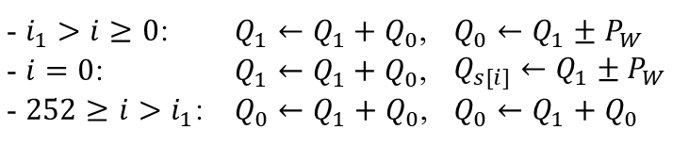



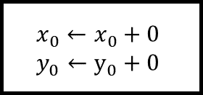

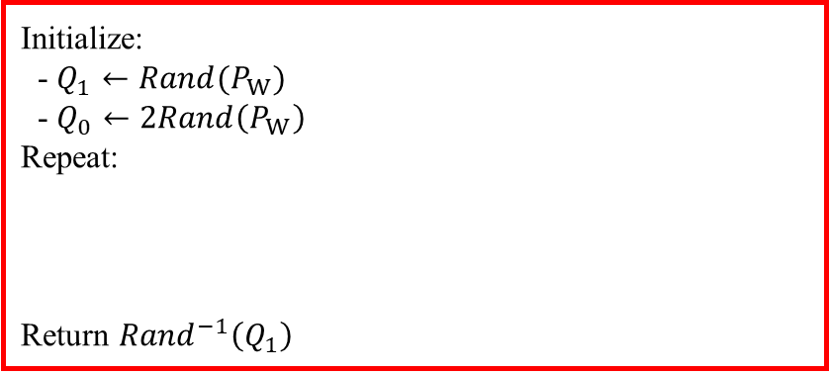




















Point multiplication of a base point
Point multiplication of an arbitrary point
$$P_{E}$$
E
$$P_{M}$$
M, E
$$P_{W}$$
W, M, E
$$Q_{W}$$
M, E
$$Q_{M}$$
E
$$Q_{E}$$
$$P_{W}=f_{M→W}(P_{M})$$
$$Q_{M}=f_{W→M}(Q_{W})$$
Data-out
$$P_{M}=−f_{E→M}(P_{E})$$
$$x_{0}←x_{0}+c$$
$$x_{0}←x_{0}−c$$
$$Q_{E}=−f_{M→E}(Q_{M})$$
$$U←1−y_{0}$$
$$V←x_{0}×U$$
$$S←1+y_{0}$$
$$U←S/V$$
$$x_{0}←x_{0}×U$$
$$y_{0}←c×U$$
$$S←a×U$$
$$x_{0}←S/V$$
$$V,S←1+x_{0}$$
$$S←S−2$$
$$y_{0}←S/V$$
$$sP_{W}$$
Initialize:
- $Q_{1}←{Rand(P}_{W})$
- $Q_{0}←2Rand\left(P_{W}\right)$
Repeat:
Return ${Rand}^{−1}\left(Q_{1}\right)$
$Q_{1}−{\left(−1\right)}^{s\left[i\right]}+P_{W}$
- $i_{1}>i≥0$: | $Q_{1}←Q_{1}+Q_{0}$, | $Q_{0}←Q_{1}±P_{W}$
- $i=0$: | $Q_{1}←Q_{1}+Q_{0}$, | $Q_{s[i]}←Q_{1}±P_{W}$
- $252≥i>i_{1}$: | $Q_{0}←Q_{1}+Q_{0}$, | $Q_{0}←Q_{1}+Q_{0}$
Data-out
$$x_{0}←x_{0}+0$$
$$y_{0}←y_{0}+0$$
$i_{1}$: Maximum $i$ such that $s[i]=1$
$$2Rand\left(P_{W}\right)$$
$$Q_{0}←$$
$$V←y_{0}+y_{0}$$
$$S←x_{0}+x_{0}$$
$$U←S+x_{0}$$
$$T←x_{0}×U$$
$$T←x_{0}+x_{0}$$
$$U←a−T$$
$$S←r×U$$
$$U,V←t_{S}/V$$
$$t_{S}←V×U$$
$$T←t_{S}−T$$
$$U←t_{S}−x_{0}$$
$$t_{S}←V×U$$
$$U←t_{S}−y_{0}$$
$$Q_{0}=\left(T,U\right)$$
$$Q_{1}=\left(x_{0},y_{0}\right)$$
$${Rand}^{−1}\left(Q_{1}\right)$$
$$Q_{1}←Rand\left(P_{W}\right)$$
$$Q_{1}+Q_{0}$$
$$V←r+0$$
$$t_{S}←1+0$$
$$U←t_{S}/V$$
$$y_{0}←y_{0}×U$$
$$U←U×U$$
$$x_{0}←x_{0}×U$$
$$y_{0}←y_{0}×U$$
$$U←r+0$$
$$y_{0}←y_{0}×U$$
$$U←U×U$$
$$x_{0}←x_{0}×U$$
$$y_{0}←y_{0}×U$$
$$V←x_{0}−T$$
$$T←x_{0}+T$$
$$t_{S}←U−y_{0}$$
$$Q_{1}←$$
$$P_{W}=\left(x_{1},y_{1}\right)$$
$$U,V←t_{S}/V$$
$$t_{S}←V×U$$
$$x_{0}←t_{S}−T$$
$$U←t_{S}−x_{0}$$
$$t_{S}←V×U$$
$$y_{0}←t_{S}−y_{0}$$
$$Q_{1}±P_{W}$$
$$V←x_{1}−x_{0}$$
$$T←x_{1}+x_{0}$$
$$t_{S}←y_{0}∓y_{1}$$

Slide 16









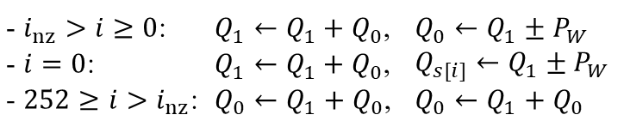


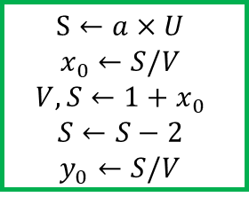






Point multiplication of a base point
Point multiplication of an arbitrary point
$$P_{E}$$
E
$$P_{M}$$
M, E
$$P_{W}$$
W, M, E
$$Q_{W}$$
M, E
$$Q_{M}$$
E
$$Q_{E}$$
$$P_{M}=−f_{E→M}(P_{E})$$
$$P_{W}=f_{M→W}(P_{M})$$
$$Q_{M}=f_{W→M}(Q_{W})$$
$$Q_{E}=−f_{M→E}(Q_{M})$$
$$U←1−y_{0}$$
$$V←x_{0}×U$$
$$S←1+y_{0}$$
$$U←S/V$$
$$x_{0}←x_{0}×U$$
$$y_{0}←c×U$$
$$x_{0}←x_{0}+c$$
$$x_{0}←x_{0}−c$$
$$S←a×U$$
$$x_{0}←S/V$$
$$V,S←1+x_{0}$$
$$S←S−2$$
$$y_{0}←S/V$$
$$sP_{W}$$
Initialize:
- $Q_{1}←{Rand(P}_{W})$
- $Q_{0}←2Rand\left(P_{W}\right)$
Repeat:
Return ${Rand}^{−1}\left(Q_{1}\right)$
$Q_{1}−{\left(−1\right)}^{s\left[i\right]}+P_{W}$
- $i_{nz}>i≥0$: | $Q_{1}←Q_{1}+Q_{0}$, | $Q_{0}←Q_{1}±P_{W}$
- $i=0$: | $Q_{1}←Q_{1}+Q_{0}$, | $Q_{s[i]}←Q_{1}±P_{W}$
- $252≥i>i_{nz}$: | $Q_{0}←Q_{1}+Q_{0}$, | $Q_{0}←Q_{1}+Q_{0}$
$$2Rand\left(P_{W}\right)$$
$$Q_{0}=\left(T,U\right)$$
$$Q_{1}=\left(x_{0},y_{0}\right)$$
$$Q_{1}←$$
$$V←y_{0}+y_{0}$$
$$S←x_{0}+x_{0}$$
$$U←S+x_{0}$$
$$T←x_{0}×U$$
$$T←x_{0}+x_{0}$$
$$U←a−T$$
$$S←r×U$$
$$U,V←t_{S}/V$$
$$t_{S}←V×U$$
$$x_{0}←t_{S}−T$$
$$U←t_{S}−x_{0}$$
$$t_{S}←V×U$$
$$y_{0}←t_{S}−y_{0}$$
$$Q_{1}+Q_{0}$$
$$V←x_{0}−T$$
$$T←x_{0}+T$$
$$t_{S}←U−y_{0}$$
$${Rand}^{−1}\left(Q_{1}\right)$$
$$V←r+0$$
$$t_{S}←1+0$$
$$U←t_{S}/V$$
$$y_{0}←y_{0}×U$$
$$U←U×U$$
$$x_{0}←x_{0}×U$$
$$y_{0}←y_{0}×U$$
$$Q_{1}←Rand\left(P_{W}\right)$$
$$U←r+0$$
$$y_{0}←y_{0}×U$$
$$U←U×U$$
$$x_{0}←x_{0}×U$$
$$y_{0}←y_{0}×U$$
$$P_{W}=\left(x_{1},y_{1}\right)$$
$$Q_{1}±P_{W}$$
$$Q_{0}←$$
$$V←x_{1}−x_{0}$$
$$T←x_{1}+x_{0}$$
$$t_{S}←y_{0}∓y_{1}$$
$$U,V←t_{S}/V$$
$$t_{S}←V×U$$
$$T←t_{S}−T$$
$$U←t_{S}−x_{0}$$
$$t_{S}←V×U$$
$$U←t_{S}−y_{0}$$

Slide 17
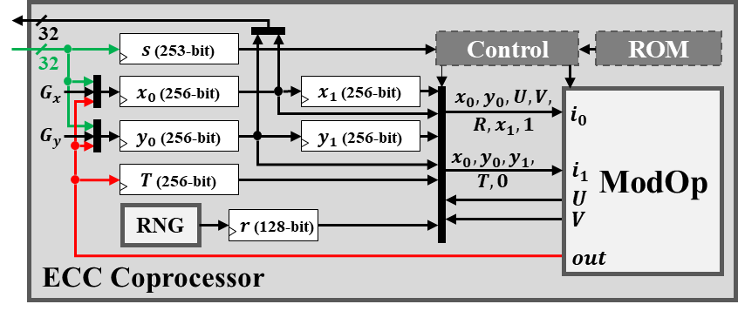
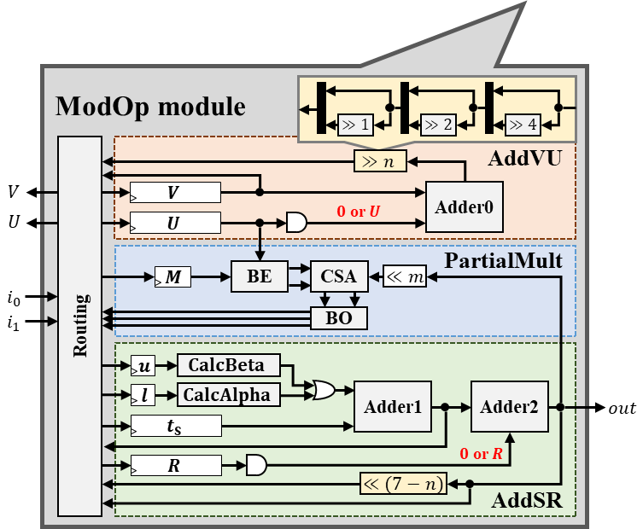



















ECC Coprocessor
32
$s$ (253-bit)
Control
ROM
32
$$G_{x}$$
$x_{0}$ (256-bit)
$x_{1}$ (256-bit)
$x_{0},y_{0},$ $U,V,$
$$R,x_{1}, 1$$
ModOp
$$i_{0}$$
$$G_{y}$$
$y_{0}$ (256-bit)
$y_{1}$ (256-bit)
$$x_{0},y_{0},y_{1},$$
$$T,0$$
$$i_{1}$$
$T$ (256-bit)
$$U$$
RNG
$r$ (128-bit)
$$V$$
$$out$$
ModOp module
⊕
$$≫1$$
$$≫2$$
$$≫4$$
Routing
AddVU
$$≫n$$
$$V$$
$$V$$
$0$ or $U$
Adder0
$$U$$
$$U$$
PartialMult
$$M$$
BE
CSA
$$≪m$$
$$i_{0}$$
$$i_{1}$$
BO
AddSR
$u$
$$CalcBeta$$
$l$
$$CalcAlpha$$
Adder1
Adder2
$$out$$
$$t_{S}$$
$$R$$
$0$ or $R$
$$≪(7−n)$$

