Slide 1
Input
images
Detection Model
output
bboxes
SSD
Faster R-CNN
labels
scores

Slide 2
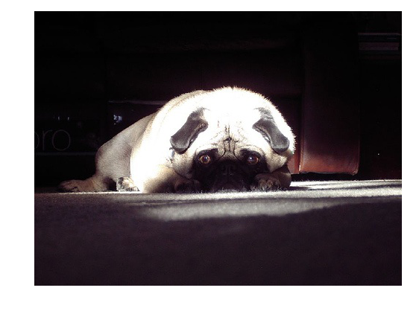
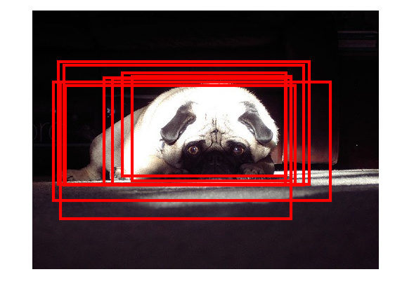
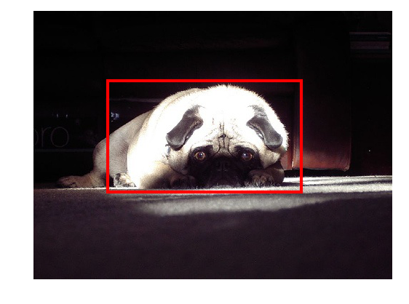
Preprocessing
and
CNN
Postprocessing

Slide 3
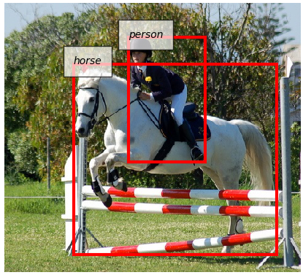
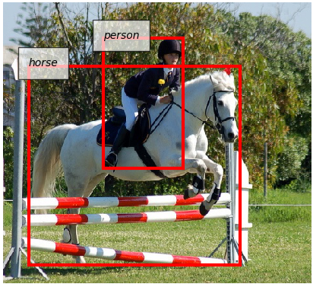
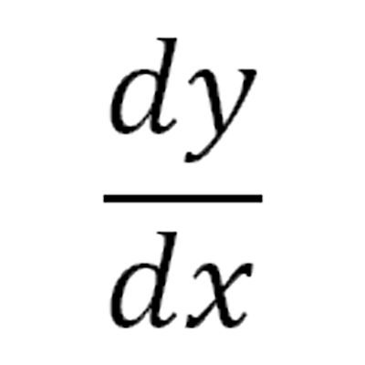
Data Preprocessing
Model Forward
Data Loader
Backprop. &
Weight update
Evaluation
mAP=0.69
AP (horse) = 0.71

