Slide 1
images
Object Detection Model
bboxes
labels
SSD
Faster R-CNN
scores

Slide 2
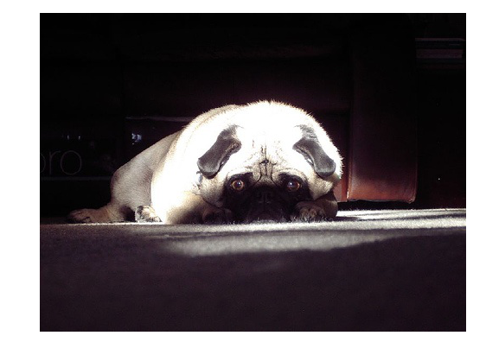
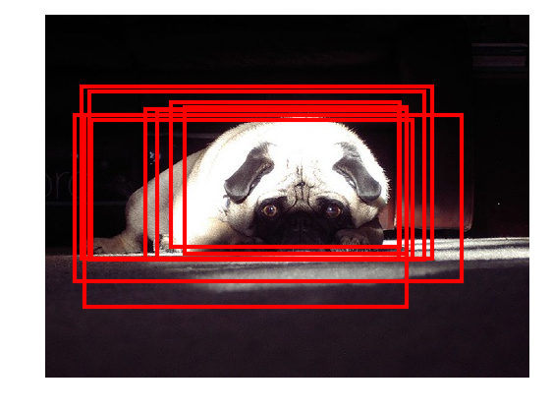
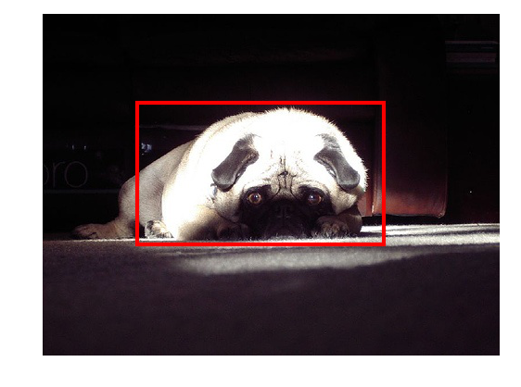
Preprocessing
And
CNN
Postprocessing

