Slide 1
images
Object Detection Model
bboxes
labels
SSD
Faster R-CNN
scores

Slide 2
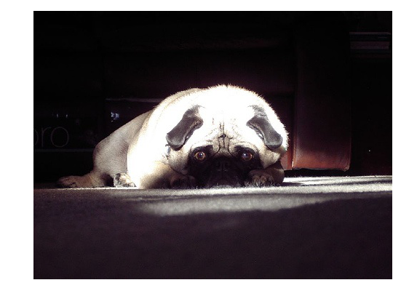
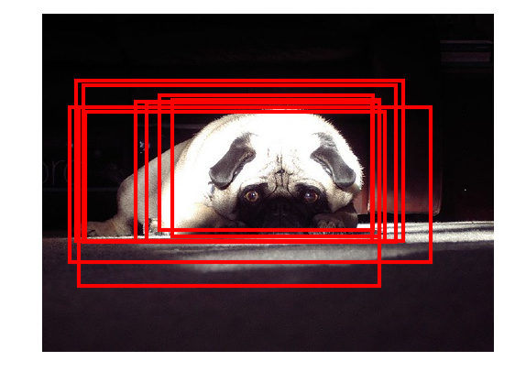
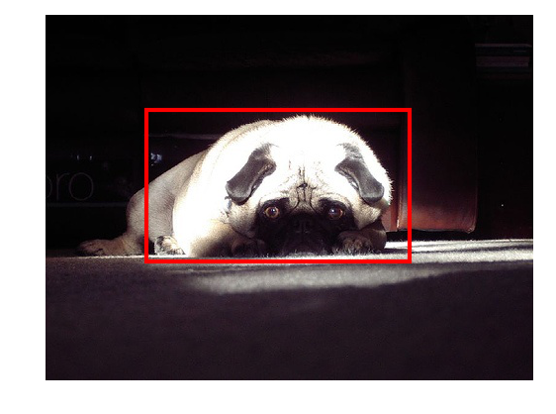
Preprocessing
And
CNN
Postprocessing

Slide 3
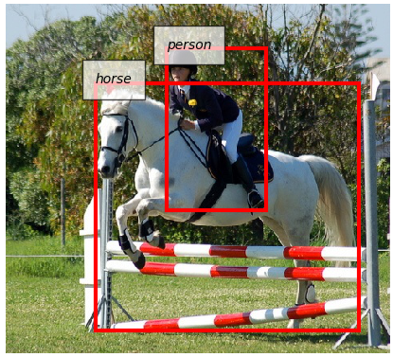
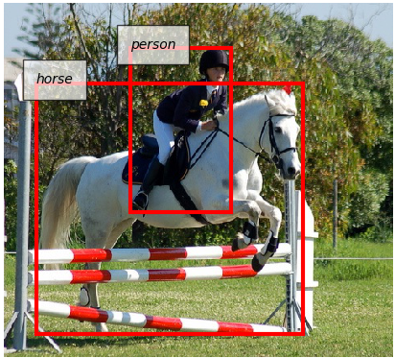
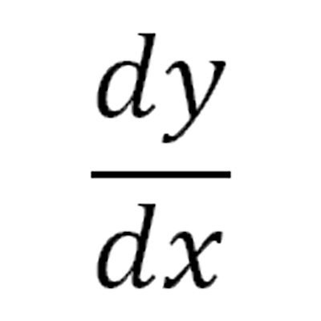
Data Preprocessing
Model Forward
Data Loader
Backprop. &
Weight update
Evaluation
mAP=0.69
AP (horse) = 0.71

