Slide 1

University Of Computer Studies , Mandalay
Title : Sentiment Analysis of Tweets Using SVM and Adaboost with SVM
Classifier
Supervisor : Dr. Thinn Mya Mya Swe
Name : Ma Nan Yu Yu Maw

Slide 2
Content
Abstract
Objectives
Introduction
Overview of the System
Dataset
System Architecture
Text Preprocessing
Feature Extraction
TF-IDF Vectorization
Methodology
Linear SVM
Adaboost SVM
Performance Evaluation
Experimental Result
Conclusion
References

Slide 3
Abstract
The explosive increasing of the social media on the Web promoted the development of the social media big data mining using machine learning techniques
Micro blogging websites like Twitter and Facebook, in this new era, user is loaded with their different thoughts and opinions about the products, reviews of movies, booking services, etc
The system is to classify and to predict user‘s opinions as either positive or negative sentiment
The system implement Twitter datasets using supervised machine learning techniques Support Vector Machine (SVM)

Slide 4
Abstract(Cont’d)
And Ensemble Method, Adaboost is used to improve the performance of classification method SVM
The input will be training texts and test texts
The output will be two types of sentiment classification called Positive and Negative
The system also show the compare accuracy of two methods ,SVM and AdaboostSVM

Slide 5
Objectives
To automatically and instantly know the user respond from a huge amount of user tweets with this sentiment analysis
To apply machine learning techniques , SVM and Adaboost with SVM Classifier
To show how Adaboost can improve the performance of classification method, SVM in this system

Slide 6
Introduction
Sentiment analysis is the best solution of social network websites by exploring and extracting the humans’ thoughts and feeling upon what are interests.
Millions of users share their opinions on various topics on social networking sites.
The limit of 280 characters for messages in twitter micro-blogging sites forces the users to be concisely expressive in their comments or opinions.
The system is applied Twitter data for sentiment analysis to produce two categories
(1) positive and (2) negative
Then, the system show the compare result of SVM and Adaboost SVM .
This system is implemented by Python programming language.

Slide 7
Overview of the System
Training Tweets
Feature Vectors
Label
(positive, negative)
Apply Classification methods
SVM, AdaboostSVM
Positive
Testing Tweets
Feature Vectors
Classifier
Negative
Figure 1: Overview of the System

Slide 8
Datasets
In the system, Twitter Airline dataset and Twitter Apple dataset are used which is freely available in Kaggle Inc
The system uses 80 % of training data and 20 % of testing data of dataset.
Dataset contains following attributes : Label and Text
Tweets Label can be categorized into positive and negative.
Twitter Airline dataset includes 8000 instances.
The dataset contains 1850 positives and 6150 negatives labels.
Twitter Apple dataset also includes 3802 instances.
The dataset also contains 2584 positives and 1218 negatives labels.

Slide 9
Datasets(Cont’d)
 | Label | Text
1 | Positive | @united thanks http://t.co/QDebyaHqfM
2 | Positive | @united is best in the world
3 | Positive | @united favorite airline in the world
4 | negative | @united is the worst airline in the world
5 | negative | @united is by far the worst airline.
6 | negative | @united is the worst airline
Table 1 : Twitter Airline dataset

Slide 10
System Architecture

Slide 11
start
Input dataset
Retrieve 80 % of training data and 20 % of test data from dataset
Dataset
Preprocessing Tweets
(Remove URL , stop word, , punctuation, Convert lower case, stemming, etc)
Feature Extraction
Apply Classification methods
SVM , AdaboostSVM
Result( Positive ,Negative)
Compare Accuracy
End
Figure 2: System Flow Diagram

Slide 12
Text Preprocessing
Text preprocessing is the process of removing irrelevant information for classification and prepare the relevant information to feed into SVM model.
A lot of words in tweets are irrelevant and missing values which need to be remove with before performing any kind of analysis
Therefore, the following preprocessing steps are applied to reduce the amount of noise in the tweets
Removing URL
Remove the URLs (Convert www.* or https? ://* to 'URL') which do not contain
useful information. Example : http://t.co/QDebyaHqfM ➔ ' '
Removing Usernames
Texts in twitter dataset contain the names of user,which are not clearly expressive or
say meaning ,so need to be removed. Example : Remove @united ➔ ' '

Slide 13
Text Preprocessing(Cont’d)
Replacing Hashtags
Hashtags mostly contain useful information, so replacing #hashtag with its word written
without the hash. Example : #happy ➔ happy
Replacing Repeated characters
In informal conversations, a person often uses repeating characters.
By replacing characters with a frequency greater than two with that character repeated twice
Example : happyyyyyyyy ➔ ‘happy’
Emoticon to positive or negative
Identify a set of emoticons and replace them with the representative sentiment i.e.
'positive' or 'negative'. [14][15]
Example , ☺ ==> positive , ☹ ==> negative

Slide 14
Text Preprocessing(Cont’d)
Convert lowercase
The texts in tweets can include the upper characters. So, Tweets are converted to
lower case. Example : HAPPY ➔ happy
Removing Stopword
Some words used more and more time such words are called stop word.
Example , a, am ,the, is, etc. ,they have no specific meaning
Removing Punctuation and Number
The tweets are a form of human expression it may contain number and punctuations which are eliminated . Example , 1,2,3 , ? , ! , etc.

Slide 15
Text Preprocessing(Cont’d)
Trimming
Trimming is a string manipulation in which leading and trailing whitespace is
removed from a string. By doing so, the text is structured.
Example : still response ➔ still response
Stemming
Stemming are used to search the “root” or base word of a given word
The system used the Porter Stemmer
Example , “teach”,”teacher”,”teaching”,”teached”,”teaches” to root word teach

Slide 16
Text Preprocessing(Cont’d)
 | Before Text Preprocessing | After Text Preprocessing
1 | @united thanks http://t.co/QDebyaHqfM | thank
2 | @united is best in the world | best world
3 | @united favorite airline in the world | favorit airlin world
4 | @united is the worst airline in the world | worst airlin world
5 | @united is by far the worst airline. | far worst airlin
6 | @united is the worst airline | worst airlin
Table 2: Text Preprocessing

Slide 17
Feature Extraction
The texts input will be converted to vectors that can be used for classification.
The words need to be encoded as integer or floating point values for use as input to a machine learning called feature extraction or vectorization.
Feature extraction involves extracting the more informative feature for the task of sentiment classification and the accuracy of the various algorithms depends on feature set generated.
The number of feature vector will become too large and naive as the dataset grows and hence the system use TF-IDF weighting to restrict it and be more relevant.

Slide 18
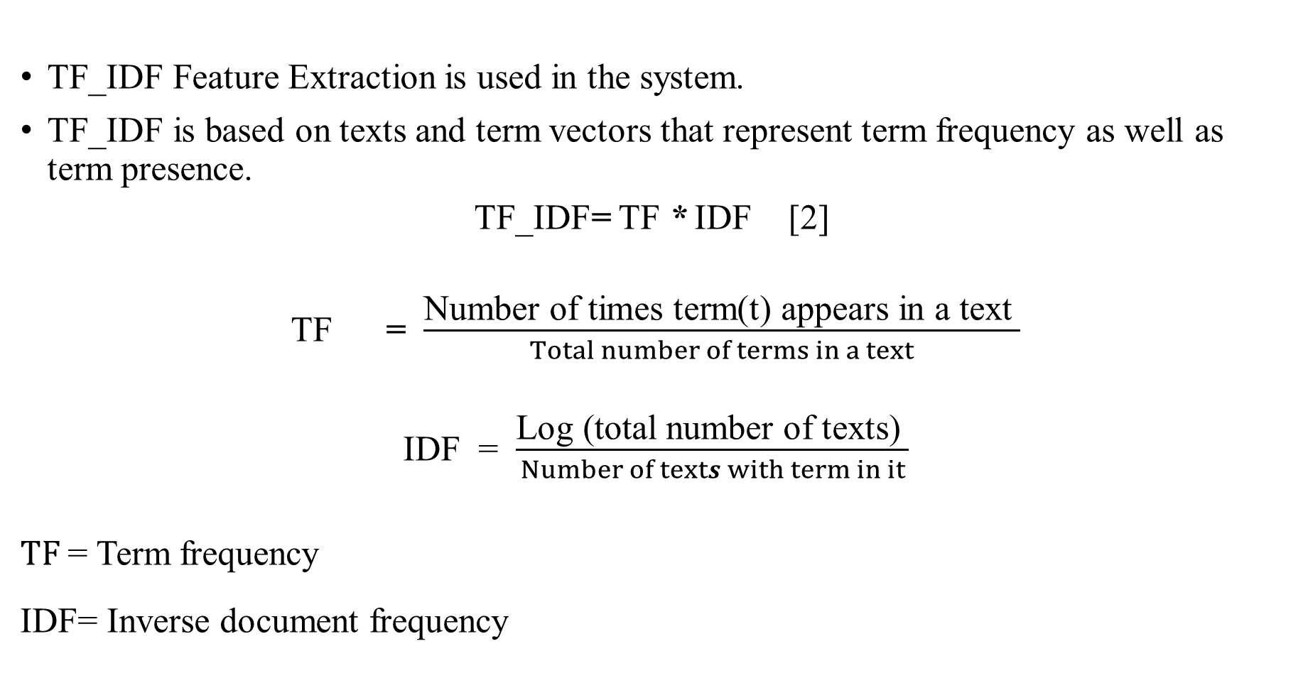
Feature Extraction (Cont’d)
TF_IDF Feature Extraction is used in the system.
TF_IDF is based on texts and term vectors that represent term frequency as well as term presence.
$\text{TF}\text{_}\text{IDF}$=$\text{TF}$ *$\text{IDF}\text{ [2] }$
$\text{TF}$ = $\frac{\text{Number} \text{of} \text{times} \text{term}\text{(}\text{t}\text{) }\text{appears} \text{in} \text{a} \text{text} }{Total number of terms in a text}$
$\text{IDF}$= $\frac{\text{Log}\text{ (}\text{t}\text{otal} \text{number} \text{of} \text{texts}\text{) }}{Number of texts with term in it}$
$TF$= Term frequency
$\text{IDF}$= Inverse document frequency

Slide 19
Support Vector Machine

Slide 20
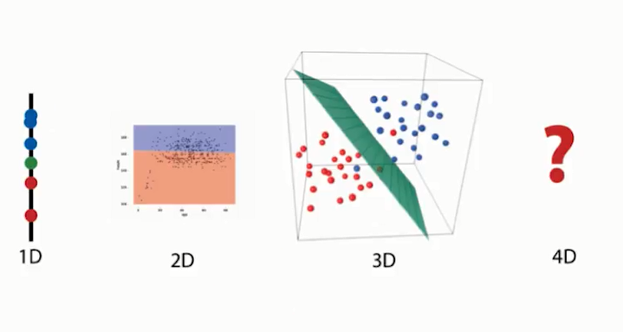
Support Vector Machine
Support Vector Machine (SVM) is a supervised machine learning algorithm which can be used for both classification or regression challenges.
SVM performs classification by finding the hyper-plane that differentiate the classes in n-dimensional space.
In other words, given labeled training data, the algorithm outputs an optimal hyperplane which categorizes new samples.
A hyper plane in 1-dimensional space is a point , a hyperplane in 2-dimensional space is a line, and 3-dimensional space is a plane .
Figure 3 : N-dimensional

Slide 21
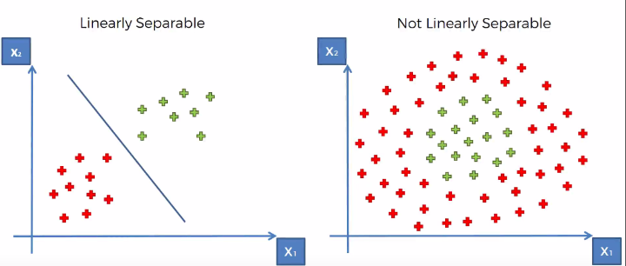
Support Vector Machine(Cont’d)
There are two kinds of SVM classifiers:
1.Linear SVM classifier
2. Non-linear SVM classifier
Figure 4 : N-dimensional
SVM draws that hyperplane by transforming data with the help of mathematical functions called “Kernels”.
There are different types of kernels called “linear”, “sigmoid”, “rbf”, “polynomial” etc.
The different kernels can be used for different kinds of data to classify.

Slide 22
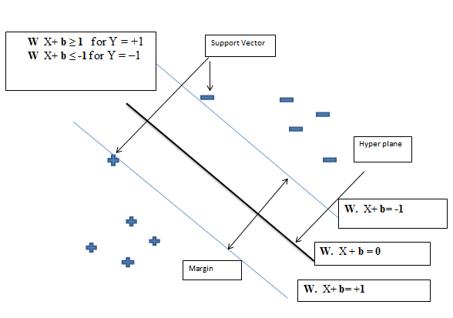
Support Vector Machine(Cont’d)
Figure 5: Defining the separating Hyper-plane
The optimal hyper-plane has maximum margin.
The point that lies nearest to hyper-plane is called support vector.

Slide 23
Support Vector Machine(Cont’d )
The distance between nearest data point and hyper plane is called as margin.
The hyper-plane is found by using the support vectors and margins.
To find the maximum margin between two classes, two support planes are determined.
Decision function that separates classes is defined as
h(x) = w . x + b [7][10]
w= weight vector, x=input vector , b = the intercept of hyper plane (bias)

Slide 24
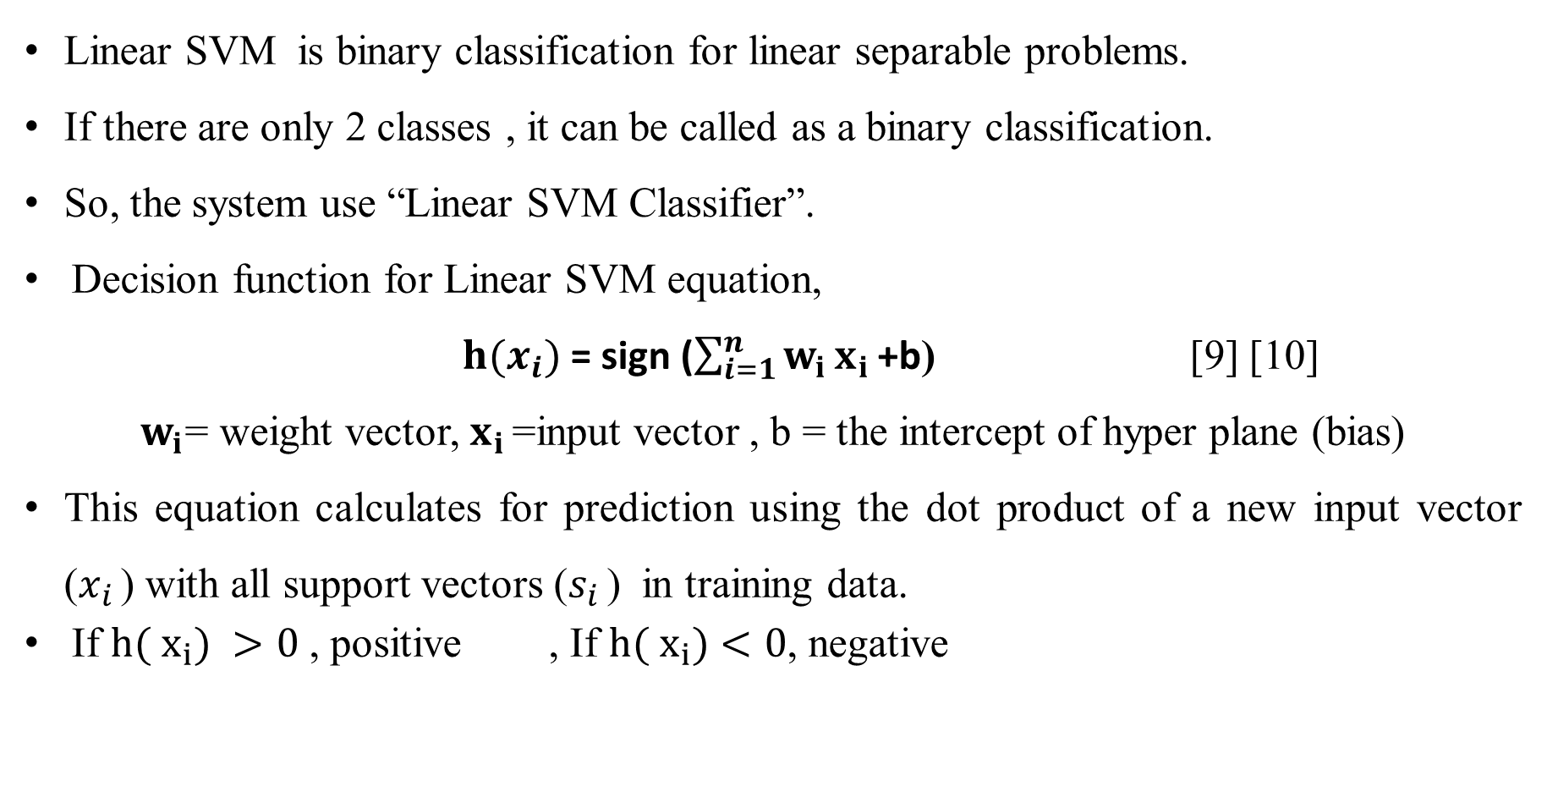
Linear SVM
Linear SVM is binary classification for linear separable problems.
If there are only 2 classes , it can be called as a binary classification.
So, the system use “Linear SVM Classifier”.
Decision function for Linear SVM equation,
$h(x_{i})$ = sign ($\sum_{i=1}^{n}{w_{i}}x_{i }$+b) [9] [10]
$w_{i}$= weight vector, $x_{i }$=input vector , b = the intercept of hyper plane (bias)
This equation calculates for prediction using the dot product of a new input vector ($x_{i }$) with all support vectors ($s_{i }$) in training data.
If $h( x_{i})$ $>0$ , positive , If $h( x_{i})$ $<0$, negative

Slide 25
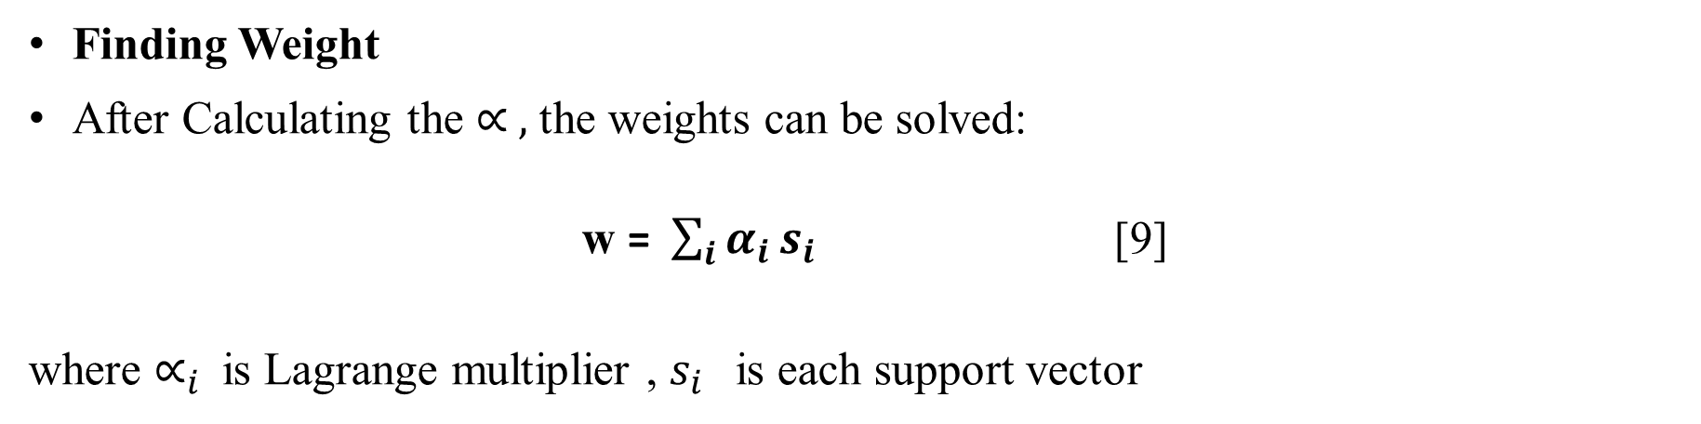
Linear SVM (Cont’d)
Finding Weight
After Calculating the $∝ ,$ the weights can be solved:
w = $\sum_{i}{α_{i }s_{i }}$ [9]
where $∝_{i}$is Lagrange multiplier , $s_{i }$ is each support vector
SVM Calculation

Slide 26
Adaboost Algorithm

Slide 27
Adaboost (Adaptive Boosting) Algorithm
The system use Adaboost algorithms to show how boosted algorithms improve the accuracy of classification method SVM .
Adaboost is a collection of weak classifiers into strong classifier by weighting over training samples and adjusting them adaptively after each boosting iteration .
In this system , Adaboost used to train SVM as a weak classifier and then combined several weak classifiers SVM is called strong classifier.

Slide 28
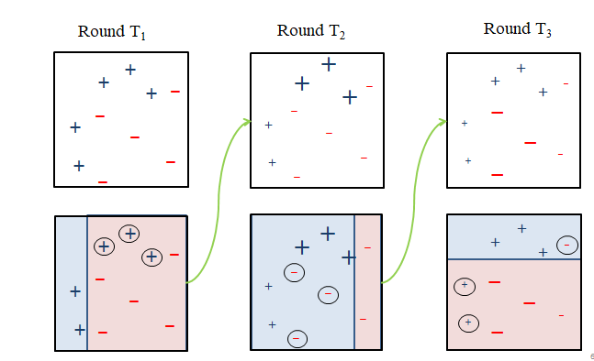
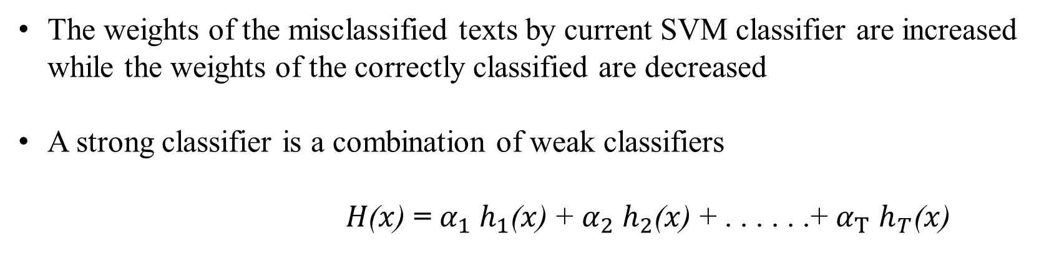



Cont’d
The weights of the misclassified texts by current SVM classifier are increased while the weights of the correctly classified are decreased
A strong classifier is a combination of weak classifiers
$H\text{(}x\text{)}$ = $α_{1}$ $h_{1}\text{(}x\text{)}$ + $α_{2}$ $h_{2}\text{(}x\text{)}$ + . . . . . .+ $α_{T}$ $h_{T}\text{(}x\text{)}$
+
_
+
+
_
+
_
_
_
+
$$h_{1}\text{(}x\text{)}$$
$h_{2}\text{(}x\text{)}$
$h_{3}\text{(}x\text{)}$
Figure 6: Adaboost Classifier

Slide 29
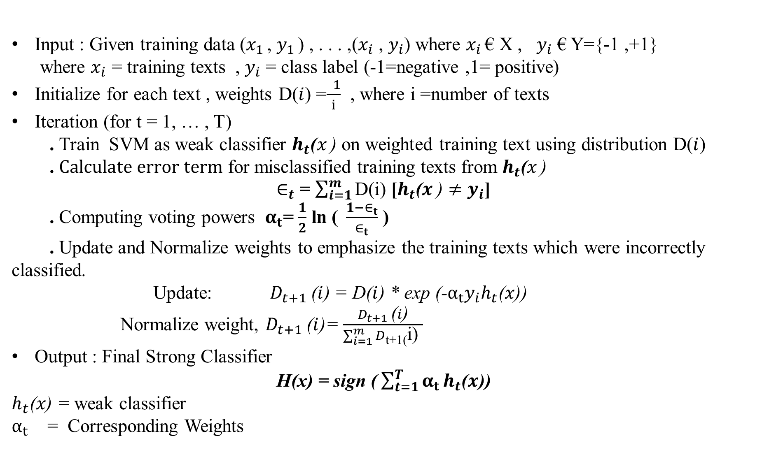
Ada-boost Algorithm
Input : Given training data ($x_{1 }$, $y_{1 }$) , . . . ,($x_{i}$ , $y_{i}$) where $x_{i }$€ X , $y_{i}$ € Y={-1 ,+1}
where $x_{i}$ = training texts , $y_{i}$ = class label (-1=negative ,1= positive)
Initialize for each text , weights D($i$) =$\frac{ 1}{i}$ , where i =number of texts
Iteration (for t = 1, … , T)
. Train SVM as weak classifier $h_{t}\text{(}x_{ }\text{)}$ on weighted training text using distribution D($i$)
. $Calculate error term$ for misclassified training texts from $h_{t}\text{(}x_{ }\text{)}$
$∈_{t}$ = $\sum_{i=1}^{m}{\text{D}\text{(}\text{i}\text{)}}$ [$h_{t}\text{(}x_{ }\text{)}≠$ $y_{i}$]
. Computing voting powers $α_{t}$= $\frac{1}{2}$ ln ($\frac{1−∈_{t}}{∈_{t}}$ )
. Update and Normalize weights to emphasize the training texts which were incorrectly classified.
Update: $D_{t+1}$($i$) = D($i$) * exp (-$α_{t}y_{i}h_{t}\text{(}x\text{)}$)
Normalize weight, $D_{t+1}$($i$)= $\frac{D_{t+1} \text{(}i\text{)}}{\sum_{i=1}^{m}{D}\text{t}\text{+1(}\text{i}\text{) }}$
Output : Final Strong Classifier
H(x) = sign ($\sum_{t=1}^{T}{α_{t}}h_{t}\text{(}x\text{)}$)
$h_{t}\text{(}x\text{)}\text{ =}$ weak classifier
$α_{t}$ = Corresponding Weights
Adaboost Calculation

Slide 30
Performance Evaluation
The confusion matrix is a metric that is used to measure the performance of a classification algorithm.
The predicted classes are represented in the columns of the matrix, whereas the actual classes are in the rows of the matrix.
 | Predicted: Positive | Predicted: Negative
Actual: Positive | True Positives (TP) | False Negatives (FN)
Actual: Negative | False Positives (FP) | True Negatives (TN)
Table 3 : Confusion Matrix

Slide 31
Performance Evaluation (Cont’d)
True positives (TP): the cases for which the classifier predicted ‘positive’ and the texts were actually ‘positive’.
True negatives (TN): the cases for which the classifier predicted ‘negative’ and the texts were actually ‘negative’.
False positives (FP): the cases for which the classifier predicted ‘positive’ but the texts were actually ‘negative’.
False negatives (FN): the cases for which the classifier predicted ‘negative’ but the texts were actually ‘positive’.

Slide 32
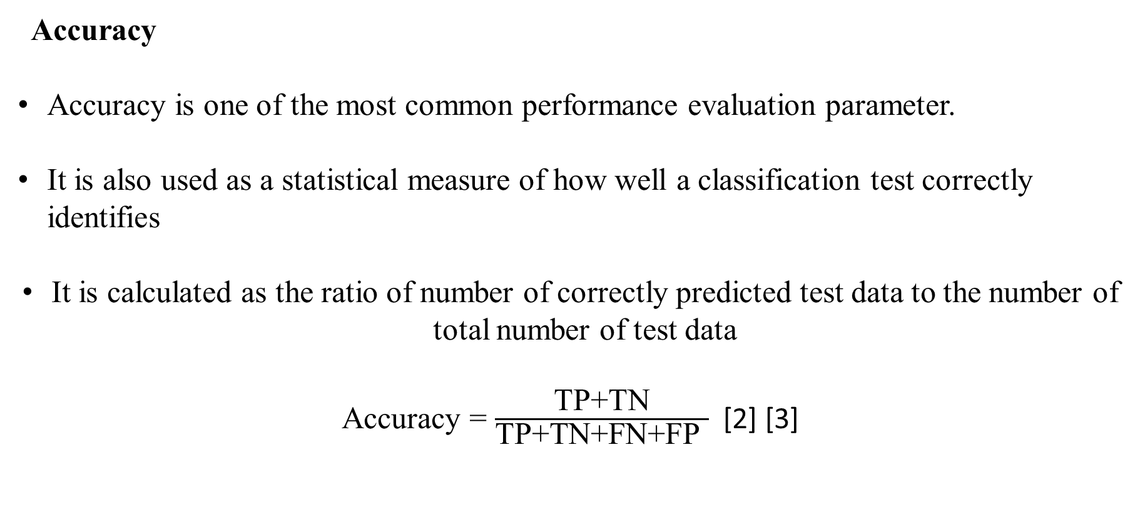
Cont’d
Accuracy
Accuracy is one of the most common performance evaluation parameter.
It is also used as a statistical measure of how well a classification test correctly identifies
It is calculated as the ratio of number of correctly predicted test data to the number of total number of test data
Accuracy = $\frac{\text{TP}\text{+}\text{TN}}{\text{TP}\text{+}\text{TN}\text{+}\text{FN}\text{+}\text{FP} }$ [2] [3]

Slide 33
Experimental Results

Slide 34
Experimental Result
The main purpose of this system is to compare the results of two methods and two different twitter datasets are applied.
The system is to classify the tweets whether they are positive or negative by using classification two methods, SVM and Adaboost with SVM classifier.
The system used Twitter Airline and Twitter Apple datasets as input.
In training tweets, the eighty percent of dataset are used and for testing, twenty percent of dataset are used.
Firstly, Twitter ariline dataset is used to compare the accuracy of two methods
And then apple twitter dataset is also used.

Slide 35
Experimental Result I
Experiment I is conducted with tweet airline dataset, different preprocessing step, feature extraction methods (unigram) using SVM and Adaboost with SVM classifier.
Accuracy of tweet airline dataset with two methods classification are shown in table 6
In classification stage, the system train 6400 tweets with 1485 positives and 4915 negatives labels. In testing, 1600 tweets are used.
This table provided the accuracy values which are varied according to the datasets and the classification methods.
The system by SVM has achieved the overall accuracy of 89.2% , while Adaboot with SVM performed 89.6%as shown in table 6

Slide 36
Experimental Result I
(1) Tweets Airline dataset (8000 tweets)
Training tweets = 6400 , Test tweets = 1600
 | Predicted: Positive | Predicted: Negative
Actual: Positive | 1151 | 84
Actual: Negative | 88 | 277
 | Predicted: Positive | Predicted: Negative
Actual: Positive | 1155 | 80
Actual: Negative | 87 | 278
Table 4: Confusion Matrix for SVM
Table 5: Confusion Matrix for AdaboostSVM
No | Datasets | SVM | AdaboostSVM
1 | Tweets Airline dataset | 89.2% | 89.6%
Table 6: Experimental Result of SVM and AdaboostSVM on Tweets Airline dataset

Slide 37
Experimental Result II
Experiments II is conducted with tweet apple dataset, different preprocessing step, feature extraction methods (unigram) using SVM and Adaboost with SVM classifier.
Accuracy of tweet apple dataset with two methods classification are shown in table 9
In classification stage, the system train 3041 tweets with 2066 positives and 975 negatives labels. In testing, 761 tweets are used.
This table provided the accuracy values which are varied according to the datasets and the classification methods.
The system by SVM has achieved the overall accuracy of 76.5 % , while Adaboot with SVM performed 81.1% as shown in table 9

Slide 38
Cont’d
(2) Tweets Apple dataset (3802 tweets)
Training tweets = 3041 , Test tweets = 761
 | Predicted: Positive | Predicted: Negative
Actual: Positive | 185 | 58
Actual: Negative | 121 | 397
 | Predicted: Positive | Predicted: Negative
Actual: Positive | 166 | 77
Actual: Negative | 67 | 451
Table 7: Confusion Matrix for SVM
Table 8: Confusion Matrix for AdaboostSVM
No | Datasets | SVM | AdaboostSVM
1 | Tweets Apple dataset | 76.5% | 81.1%
Table 9: Experimental Result of SVM and AdaboostSVM on Tweets Apple Dataset

Slide 39
Conclusions
Sentiment Analysis is the process of computationally determining whether a piece of writing is positive, negative.
It’s also known as opinion mining, deriving the opinion or attitude of a speaker.
In this system, SVM and Aaboost with SVM Classifier are applied in the classification of tweets .
Applying preprocessing techniques so that accurate data is fed as an input to the training process.
The system classified the tweets as Positive and Negative based on twitter dataset.
The comparative results are taken against SVM and Adaboost with SVM classifier.
Adaboost with SVM Classifier gives a better generalization performance and works well with unbalanced class datasets

Slide 40
Future Work
In Sentiment analysis, the classification categories have positive, negative and neutral sense.
But, this system only classify the tweets as positive and negative tweets which can be further classified to positive, negative and neutral
The system can also be applied aspect based classification .
SVM algorithm classifies opinionated text vectors by separating it into positive and negative classes with a hyperplane, which can be further extended to non-linear decision boundaries using various kernels

Slide 41
References
[1] Chintan Dedhia and Mrs Jyoti Ramteke , " Ensemble model for Twitter Sentiment Analysis “, IEEE 2017
[2] Sheeba Naz , Aditi Sharan and Nidhi Malik
, " Sentiment Analysis of Product Reviews using Support Vector Machine Learning Algorithm”, IEEE 2018
[3] Bhumika M. Jadav and Vimalkumar B Vaghela , " Sentiment Analysis using Support Vector Machine based on Feature Selection and Semantic Analysis “
[4] Megha Rathi, Aditya Malik, Daksh Varshney, Rachita Sharma, Sarthak Mendiratta , " Sentiment Analysis of Tweets using Machine Learning Approach "
[5] https://sefiks.com/2018/11/02/a-step-by-step-adaboost-example/
[6] https://www.quora.com/How-do-I-train-a-SVM-classifier-from-text-examples
[7] Cortes, C.; Vapnik, V. (1995). "Support-vector networks". Machine Learning. 20 (3): 273–297.

Slide 42
Cont’d
[8] AdaBoost, Jiri Matas and Jan Sochman
[9] SVM Example, Dan Ventura March 12, 2009
[10] “Support Vector Machine “, By Alexander Kowalczyk , Foreword by Daniel Jebaraj
[11] Boosting Foundations and Algorithms Robert E. Schapire Yoav Freund The MIT
[12] A Short Introduction to Boostring ,Yoav Freund and Robert E. Schapire
[13] A Boosted SVM based Ensemble Classifier for Sentiment Analysis of Online Reviews
[14] https://en.wikipedia.org/wiki/List_of_emoticons
[15] https://positivepsychology.com/positive-negative-emotions/

Slide 43
Thank You For Your Attention !

