Slide 1
Digital IC Design Training
Jun 28, 2018
TA: Jen-Hao Hsiao, Yu-Fen Wu
Professor: Wen-Long Chin

Slide 2
Outline
Description of Verilog
Blocking and Nonblocking
Asynchronous Reset and Synchronous Reset

Slide 3
Description of Verilog
Verilog allows three kinds of descriptions for circuits:
Structural description
Data flow description
Behavioral description

Slide 4
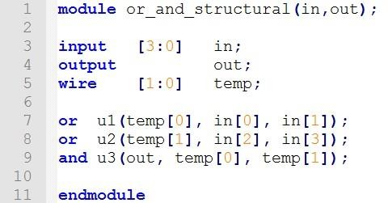
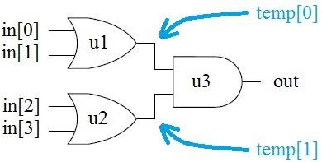
Description of Verilog
Structural description

Slide 5
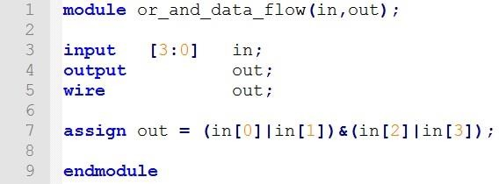
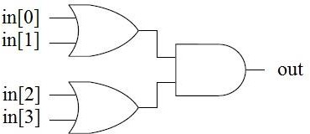
Description of Verilog
Data flow description

Slide 6
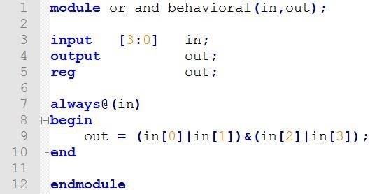
Description of Verilog
Behavioral description

Slide 7
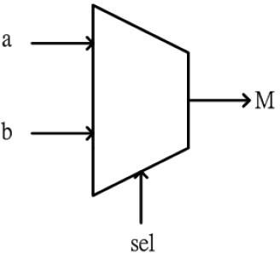
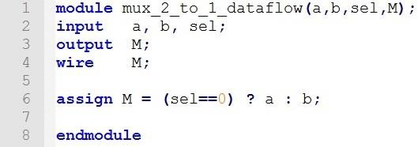
Description of Verilog
Implement multiplexer in data flow description

Slide 8
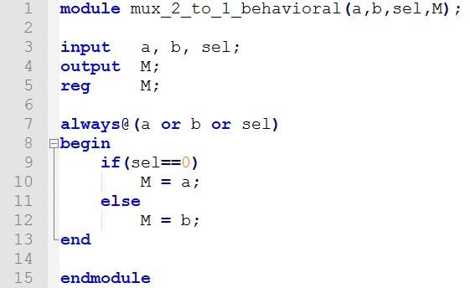
Description of Verilog
Implement multiplexer in behavioral description

Slide 9
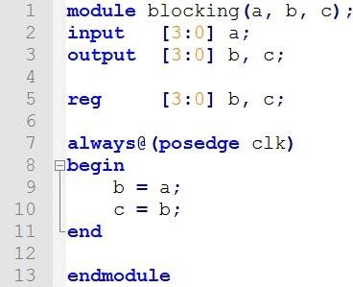
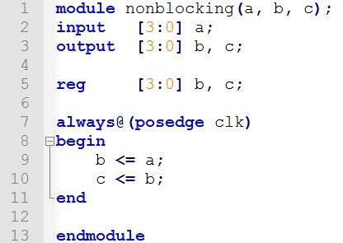


Blocking and Nonblocking

Slide 10
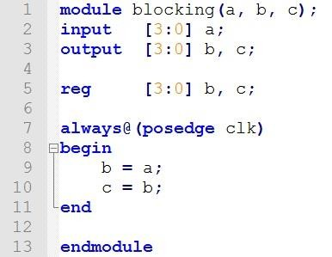
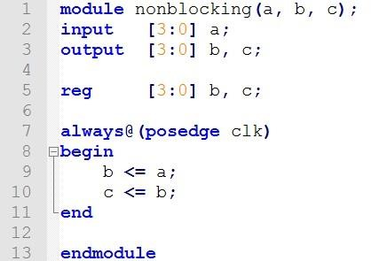
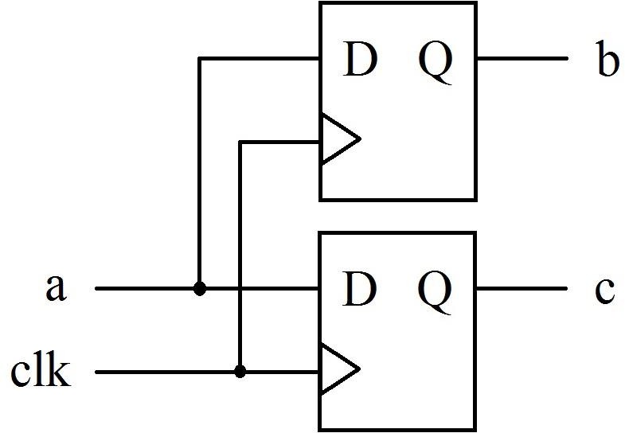
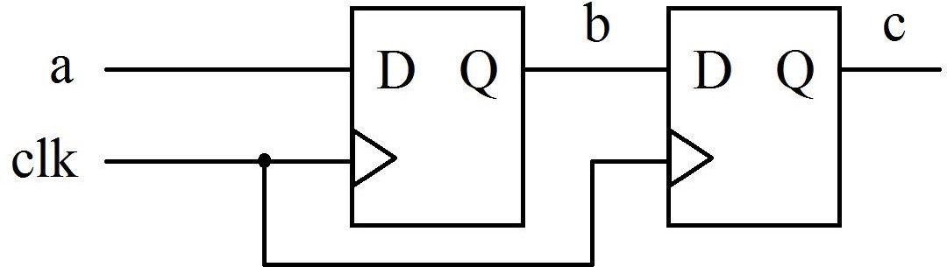

Slide 11

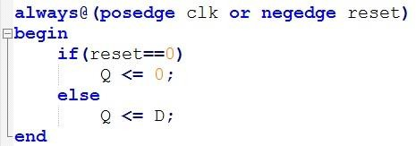
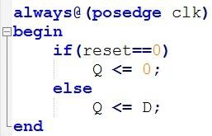
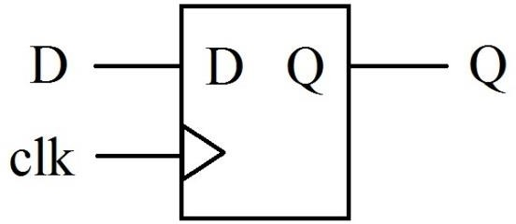
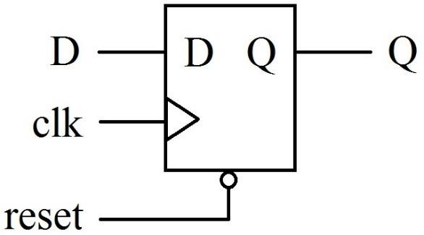
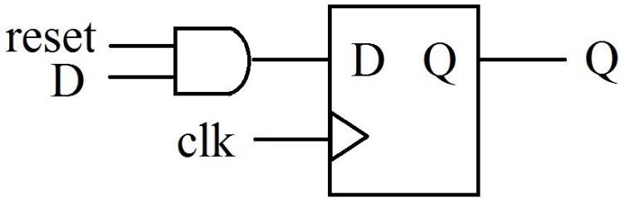
Asynchronous Reset and Synchronous Reset
Register  Synchronous reset
Asynchronous reset

Slide 12
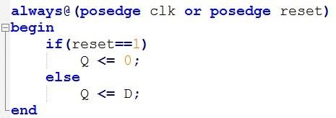
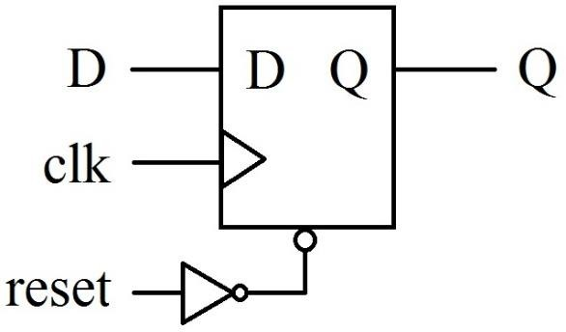
Asynchronous Reset and Synchronous Reset
Asynchronous reset (active low)  Asynchronous reset (active high)

