Slide 1
Digital IC Design Training
Jan 11, 2019
Student: Jen-Hao Hsiao, Yu-Fen Wu
Professor: Wen-Long Chin

Slide 2
Outline
「.synopsys_dc.setup」for IC Contest
Synthesis with Design Compiler
Gate-level Simulation

Slide 3

「.synopsys_dc.setup」for IC Contest
把「synopsys_dc.setup」放到工作站上，跟design同資料夾內，再把名字改成「.synopsys_dc.setup」
mv synopsys_dc.setup .synopsys_dc.setup
再檢查是否有修改成功
ls -al

Slide 4
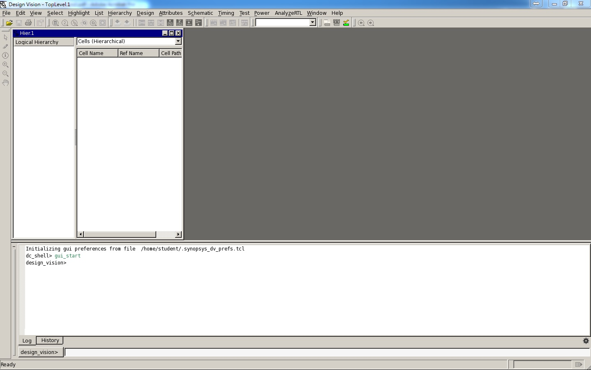
Synthesis with Design Compiler
開啟design compiler
dv &

Slide 5
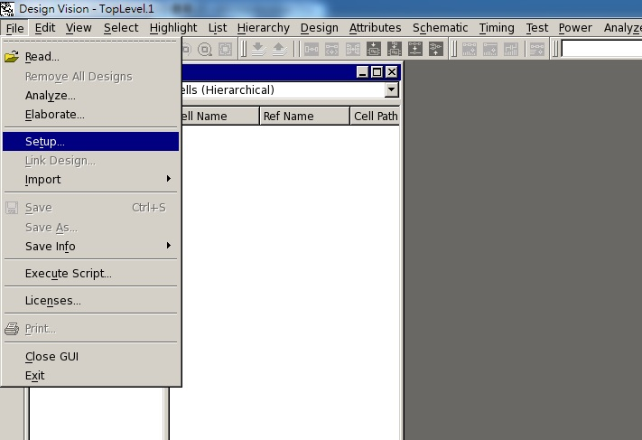
Synthesis with Design Compiler
檢查library設定是否正確

Slide 6
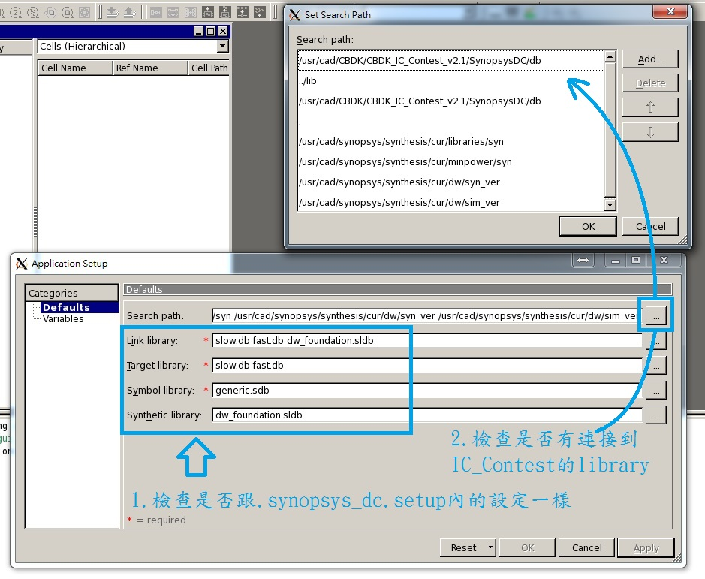

Slide 7
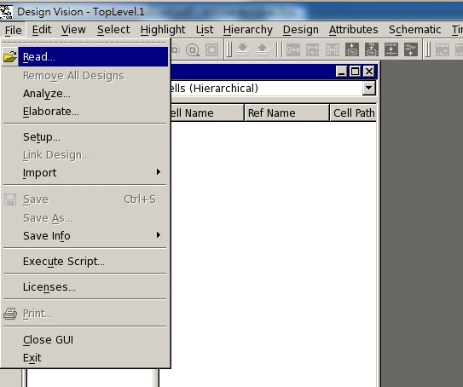
Synthesis with Design Compiler
將自己的設計讀進來

Slide 8
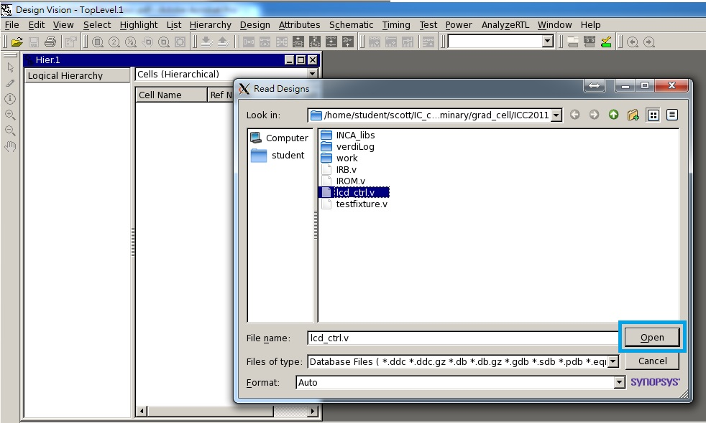
選你的design

Slide 9
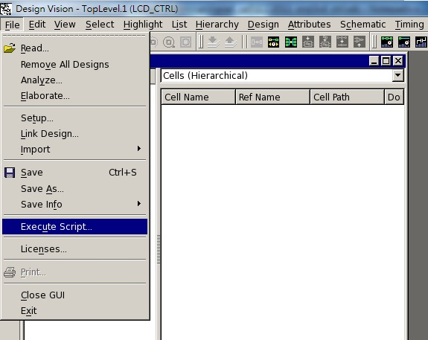
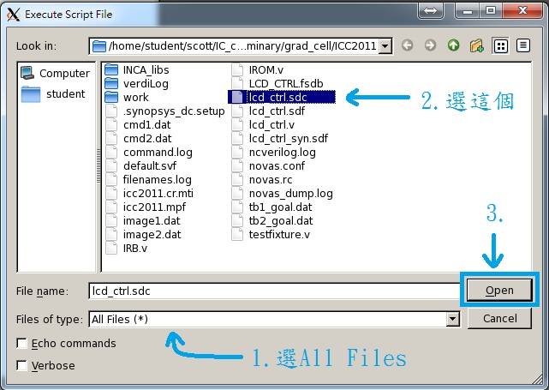
Synthesis with Design Compiler
將 IC contest 提供的 constraint 指令讀進 design compiler
(等同於操作DesignCompiler_I_2012(new).pdf 的第 7~13 頁)
IC contest 提供的xxx.sdc

Slide 10
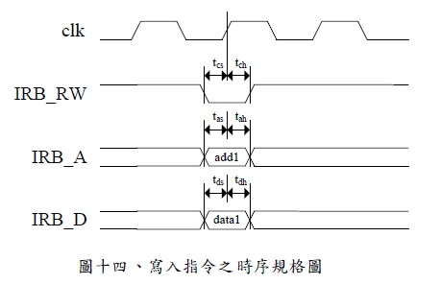
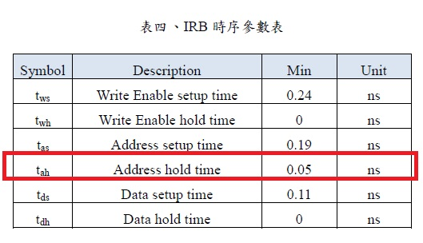
Synthesis with Design Compiler
自己下其他的constraint (題目有特定要求的Spec.才需要下，以2011年IC競賽 lcd_ctrl的IRB address hold time為例)

Slide 11
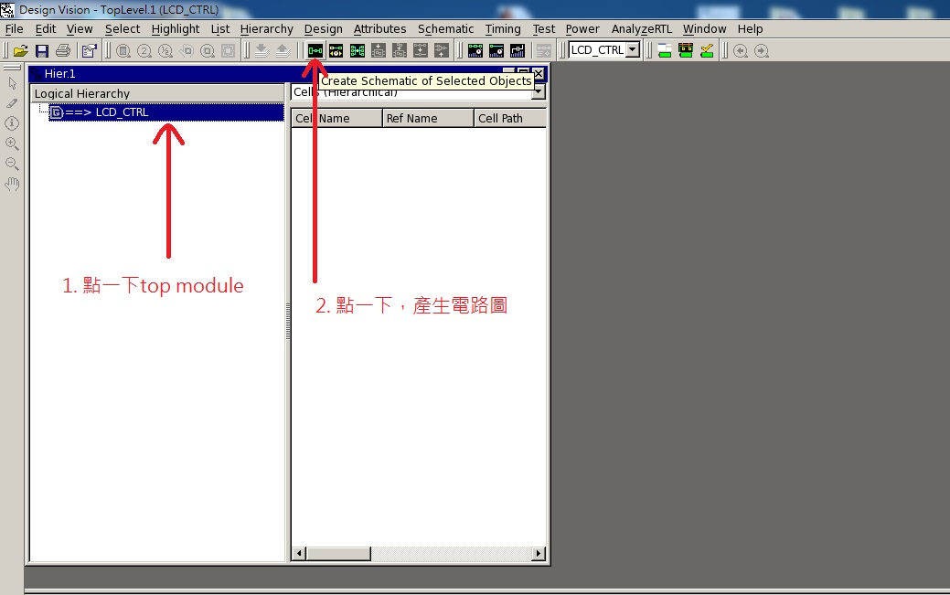
Synthesis with Design Compiler
自己下其他的constraint (以2011年IC競賽 lcd_ctrl為例)

Slide 12
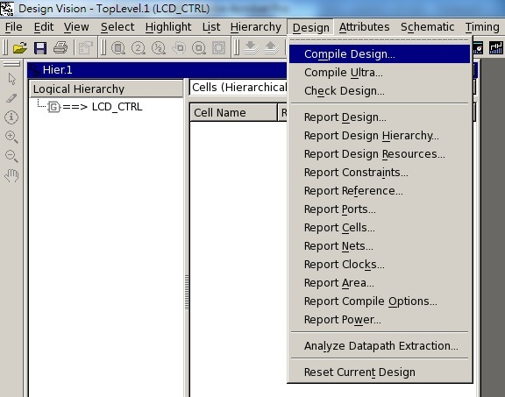
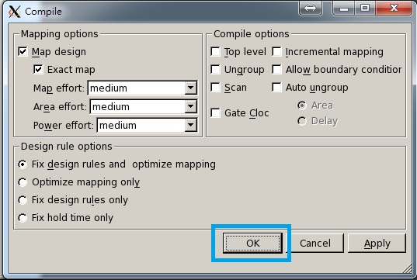
Synthesis with Design Compiler
開始合成

Slide 13
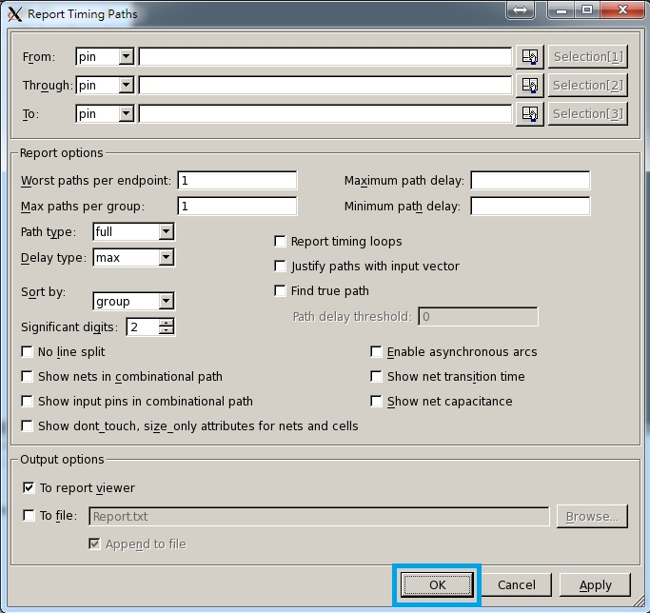
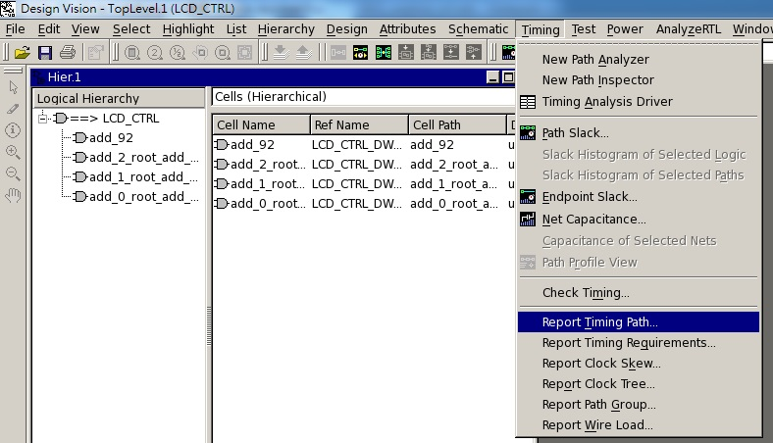
Synthesis with Design Compiler
確認 timing 是否達到需求 (setup time)

Slide 14
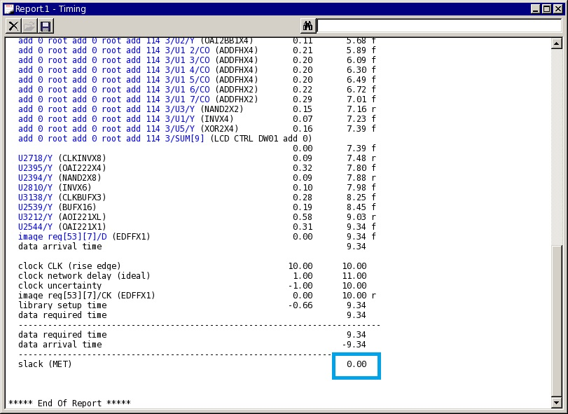
Synthesis with Design Compiler
確認 timing 是否達到需求
(slack要大於0)

Slide 15
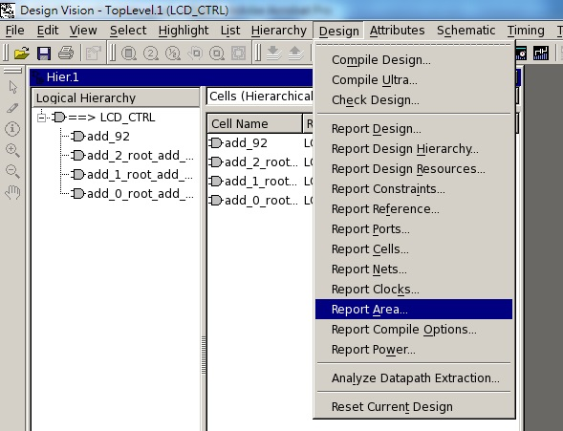
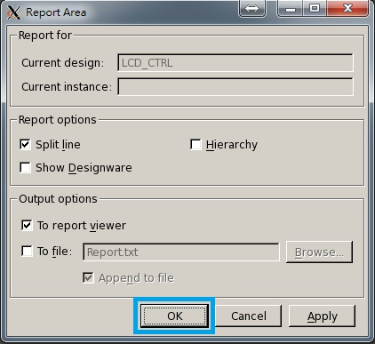
Synthesis with Design Compiler
Report area

Slide 16
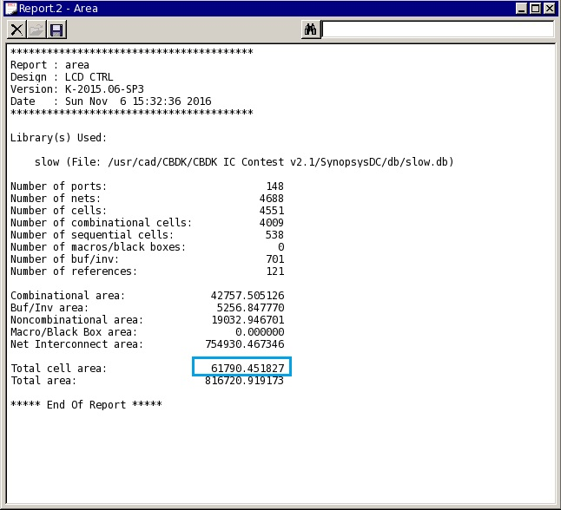
Synthesis with Design Compiler
Report area

Slide 17
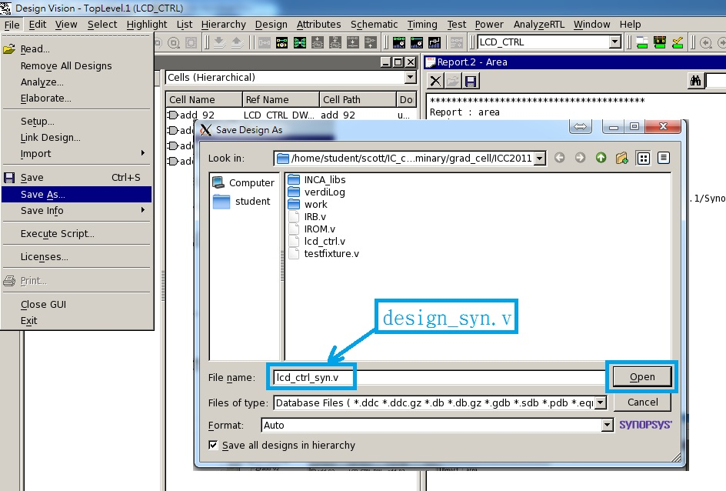
Synthesis with Design Compiler
Save gate-level netlist generated by Synopsys Design Compiler.

Slide 18
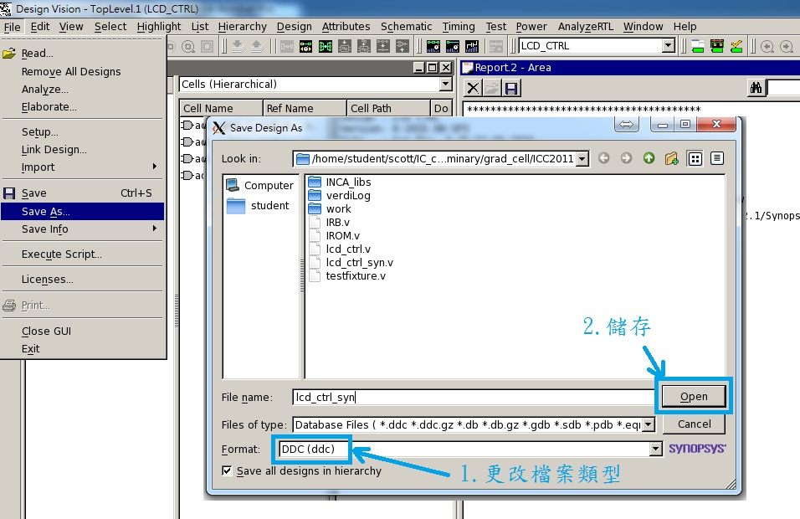
Synthesis with Design Compiler
Save ddc format
(design database generated by Synopsys Design Compiler)

Slide 19
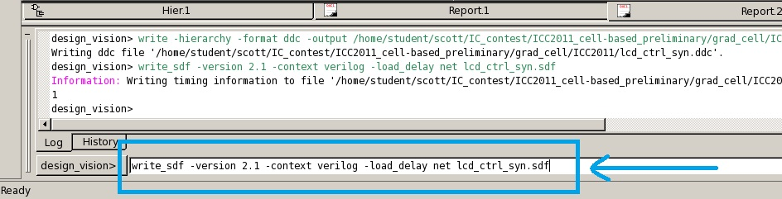
Synthesis with Design Compiler
Save SDF timing information generated by Synopsys Design Compiler
write_sdf -version 2.1 -context verilog -load_delay net lcd_ctrl_syn.sdf
(xxx_syn.sdf)

Slide 20
Gate-level Simulation
將製程的gate檔案複製到自己的資料夾
cp /usr/cad/CBDK/CBDK_IC_Contest_v2.1/Verilog/tsmc13_neg.v .
開始gate-level simulation
ncverilog testfixture.v lcd_ctrl_syn.v -v tsmc13_neg.v +access+r +define+SDF

