Slide 1
DUCA PAPER RETROSPECTIVE
DUCA: a post-paper research retrospective
Offline temporal action detection | task-aware temporal de-redundancy
Scope: motivation, method, version evolution, evidence, negative results, and current scientific verdict
Status: experiment_running | NOT empirically supported | NOT paper-ready

Slide 2
THESIS
02
The paper question: where should expensive temporal computation go?
Dense / uniform
Actionness Top-K
DUCA hypothesis
Spends heavy computation nearly evenly across a video.
Tends to concentrate inside broad action plateaus.
Use cheap state-transition evidence to protect action boundaries under a fixed budget.
Scientific claim to test: lower total cost AND preserved high-IoU localization.
Source: research-wiki/duca_paper_story_theory_figure_contract.md

Slide 3
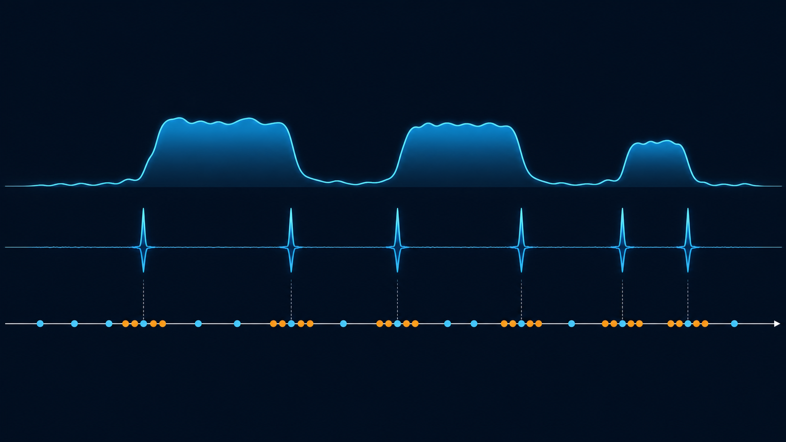
VISUAL INTUITION
03
Why transition evidence, not actionness alone?
Actionness may be high throughout an action; state change is expected near starts and ends. DUCA seeks bilateral micro-clusters near these transition peaks while retaining global context.
Conceptual mechanism only; official mAP remains the deciding evidence.

Slide 4
NETWORK ARCHITECTURE
04
Paper-level network structure: coarse evidence -> constrained acquisition -> detector
Input video
Low-cost coarse probe
Transition / boundary utility
Exact-K / max-gap DP
VideoMAE + AdaTAD
Proposals + mAP
768 candidate positions -> K hard observations; constraints prevent collapse into a few action interiors.
Invariant: the official-derived detector head, loss, NMS, and terminal evaluator remain on the downstream path.
Current model is offline; validation/test GT, teacher, cache and checkpoint selection are excluded from inference.

Slide 5
OPTIMIZATION PRINCIPLE
05
What the selector optimizes, and what it does not promise
max U(z) = transition anchors + bilateral burst utility + residual context - redundant concentration
constraints: sum(z)=K; max unselected hole=G; chronological, unique selected positions
Transition anchors
Bilateral burst
Residual context
State change is a boundary proxy.
Both sides disambiguate before/after state.
Coverage prevents boundary-only collapse.
DP optimality is only within its declared feasible K/G family; it is not an mAP guarantee.

Slide 6
PROTOCOL
06
Training / inference separation and evidence hygiene
TRAIN
SELECT
DETECT
AUDIT
coarse action + transition labels
hard exact-K policy
VideoMAE + AdaTAD
geometry + cost
train-only
deploy-visible
terminal metric
post-hoc only
Prohibited at deployment: validation/test GT, teacher signals, raw prediction cache, and mAP-based checkpoint selection.
A proxy improvement is not allowed to stand in for official terminal mAP.

Slide 7
VERSION EVOLUTION
07
Version lineage: each branch tested one bounded hypothesis
V1
V2
V5
V8
Boundary-burst
T1/MobileNet
transition-only
CellCF
global learned bridge
P0 curriculum
bilateral / quota
time / frozen priors
weak positive signal
below transition baseline
all learned < uniform
mechanism hold
current R0-R5
diagnostic negative
Version discipline: a terminal negative result retires the corresponding claim; it is not repaired by renaming or more epochs.
Source: research-wiki/duca_model_version_registry.md

Slide 8
NEGATIVE RESULTS
08
What the retired versions taught us
V2 CellCF
Local-cell choice
64.061 < transition 64.276
Local residual geometry did not win.
V5 direct
Detector bridge
63.710 < uniform 64.458
Gradient route did not rescue allocation.
V8 P0
Coarse-to-selector mechanism
winner=null; AUROC max 0.619653
Evidence did not beat simple delta.
Fast-only
Frozen motion prior
63.530 vs uniform 64.490
High-IoU loss; not a main route.
T1 actual
True-time residual
64.020 vs uniform 64.490
No positive support yet.
These are evidence-bearing negative findings, not failed engineering noise.

Slide 9
OFFICIAL RESULTS
09
Current comparable terminal evidence: uniform remains the reference
Method | Avg | @0.3 | @0.4 | @0.5 | @0.6 | @0.7
Exact-uniform | 64.49 | 79.59 | 75.42 | 67.71 | 57.27 | 42.45
Fast-only R2Q3 | 63.53 | 79.91 | 74.52 | 66.37 | 54.75 | 42.09
T1 actual-time | 64.02 | 79.15 | 74.44 | 67.16 | 56.94 | 42.41
MobileNet fusion | 64.33 | - | - | - | - | 42.73
No candidate meets the primary GO condition: Avg-mAP >= 65.00 and >= +0.20 pp over matched uniform.
THUMOS14 validation / OpenTAD official evaluator / terminal EMA / single seed diagnostic.

Slide 10
HIGH-IoU INTERPRETATION
10
The observed deficit is concentrated where localization is hardest
Fast-only minus matched uniform (pp)
0.32
-0.36
-0.90
@0.3
@0.4
@0.5
@0.6
@0.7
-1.34
Only tIoU=0.3 is slightly positive; the largest degradation is at tIoU=0.6.
-2.52
This is a diagnostic comparison, not a multi-seed publication claim.

Slide 11
TRAINING-ARM RESULT
11
Historical V5 contract: all learned arms finished below uniform
64.458
Interpretation
63.710
63.693
The companion recovered some loss, but no learned route exceeded uniform. These arms are sealed negative evidence.
63.060
Uniform
Direct
Homotopy
Companion
V5 epoch-59 EMA; source: duca-global-curriculum-official60.md

Slide 12
EVIDENCE LADDER
12
Do not mix reachability, mechanism quality, and paper performance
Official terminal mAP
Mechanism diagnostics
Internal Oracle
Can support result claims
Can explain a result
Can bound feasibility
same protocol / full validation
AUROC / endpoint distance / selection
not test accuracy; not deployable
Rule: proxy gains cannot be promoted into a TAD accuracy or efficiency claim.
Internal R0 93-94 mAP is deliberately excluded from the primary performance table.

Slide 13
CURRENT EVIDENCE DAG
13
The R0-R5 program translates into five scientific questions
R0
R2
R3
R4
R5
Reachability
Learnability
Effectiveness
Attribution
Efficiency / generality
Does feasible boundary geometry have headroom?
Can coarse evidence approach the geometry?
Does learned DUCA beat matched U?
Does feedback add real mAP?
Does the Pareto hold across budgets/backends?
Only a completed R3/R5 evidence chain can support the final accuracy-efficiency paper claim.
Current status: R0/R1 evidence; downstream claims remain gated.

Slide 14
POST-PAPER VERDICT
14
What this retrospective supports, and what must remain HOLD
SUPPORTED
HOLD
Uniform remains the matched reference. Several plausible mechanisms failed transparently. Boundary-aware allocation is a precise, falsifiable hypothesis. The current protocol makes future outcomes interpretable.
DUCA has not beaten matched uniform. High-IoU protection is not established. End-to-end cost reduction is not measured. Multi-seed, budget, and second-backend claims are open.
Correct scientific posture: a complete research retrospective, not a completed method paper.
Decision rule: no result claim without official terminal mAP and full-stack cost.

