Slide 1

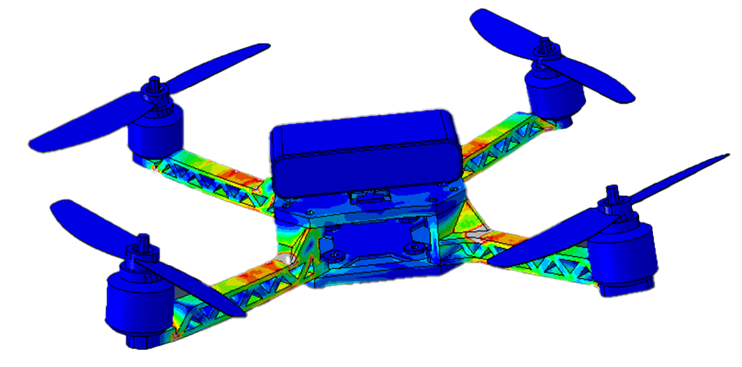
ME314 Finite Element Theory
Takeoff and Strength Analysis
of a Quadcopter Frame
using Abaqus
Presenter : Yuzhen Song
Group Members : Jiacan Li, Jiayi Yan
Presentation Date : 04/06/2026

Slide 2
Outline
01
Motivation and Background
02
Modeling Process in Abaqus
03
FEA Result Analysis
04
Difficulties Encountered and Solutions
05
Conclusion and Future Work

Slide 3
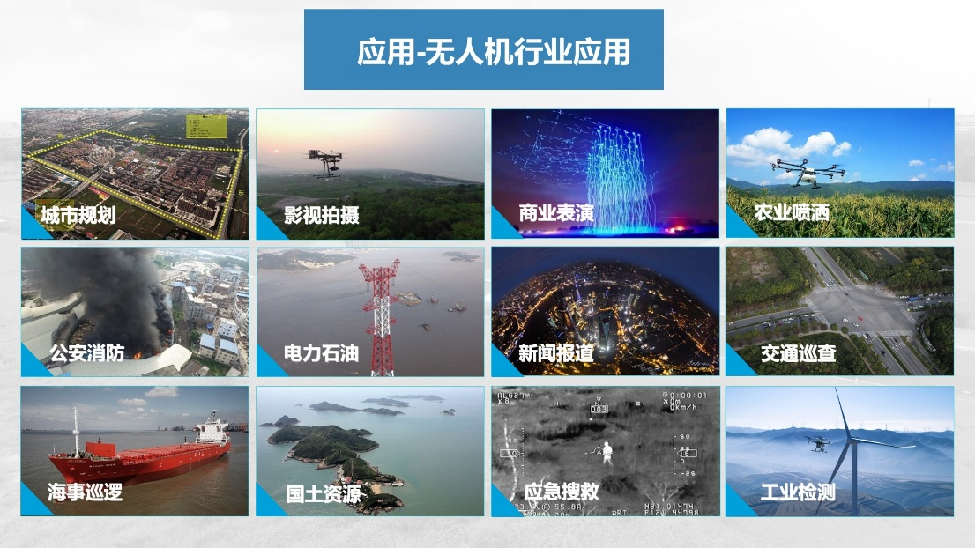
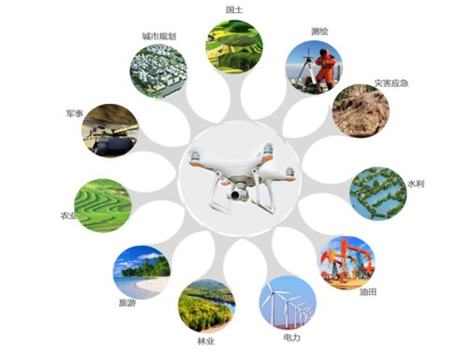
Motivation
and
Background
Modeling
Process
in Abaqus
FEA
Result
Analysis
Validation
and
Discussion
Conclusion
and
Future Work
1.1 The Importance of UAV Reliability
More UAVs in delivery, agriculture, surveillance, and disaster rescue.
Problem: Mid-air structural failures lead to severe safety hazards in urban environments.
Goal: Achieving a high payload-to-weight ratio. Drones must be extremely lightweight to maximize battery life, but strong enough to survive complex aerodynamic loads.
Notes:
我们选择小型无人机机架作为FEA项目，首先是基于宏观的社会需求。现在无人机在物流配送、农业和救援中应用极其广泛。但是，如果无人机在空中发生结构断裂，不仅会导致昂贵的设备（如相机、货物）坠毁，如果在城市上空，甚至会威胁人身安全。因此，无人机工业界一直面临一个终极挑战：我们必须把飞机做得很轻（为了增加续航），但同时又必须足够结实。这就需要我们引入精确的有限元仿真来代替传统的经验设计。

Slide 4
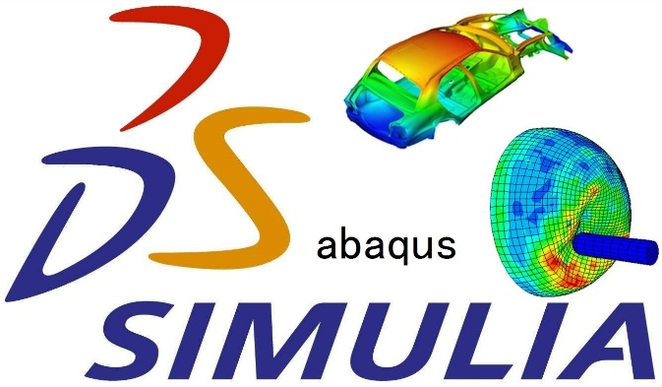
Motivation
and
Background
Modeling
Process
in Abaqus
FEA
Result
Analysis
Validation
and
Discussion
Conclusion
and
Future Work
1.2 Microscopic Mechanical Problems
Structural Behavior: Cantilever Mechanics
Drone arms function as dynamic cantilever beams.
Motors at the tips act as concentrated loads, causing high bending moments at the arm roots.
Loading Severity: Extreme Flight Conditions
Severe Thrust & Torque demands.
Maximum take-off and aggressive maneuvers generate critical forces that threaten structural integrity.
Critical Failure Point: Stress Concentration
High Stress Concentration risks at junctions.
The transition zone between arm root and central body is the most susceptible area for structural yield failure.
Why FEA is Mandatory?
Analytical limitations of traditional beam theory.
Complex geometries (fillets, ribs, thin walls) render Euler-Bernoulli calculations inaccurate; FEA (Abaqus) is essential for precise validation.
Notes:
从微观力学角度来看，无人机的悬臂实际上是一个非常复杂的悬臂梁结构（Cantilever）。在起飞或急加速瞬间，螺旋桨在悬臂最末端产生巨大的推力和反扭矩。这会导致巨大的弯矩，使得机臂根部与机身连接的地方产生极高的应力集中。
为什么我们一定要用Abaqus算？因为真实的机架充满了复杂的曲面、加强筋和倒角（就像我们前面讨论的只能用Tet网格划分的几何一样）。传统的材料力学手算公式完全失效了。我们必须依靠FEA来寻找结构的薄弱点，确保起飞时的应力远低于材料的屈服强度。

Slide 5
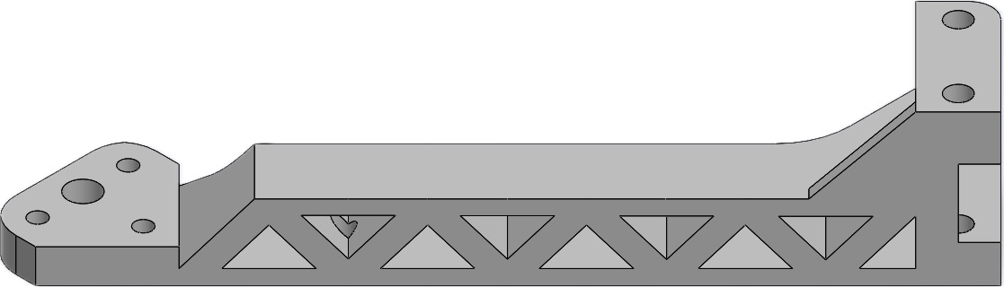
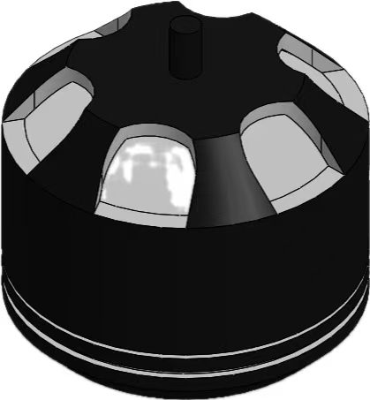
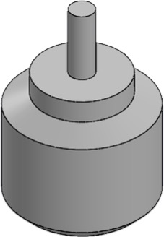
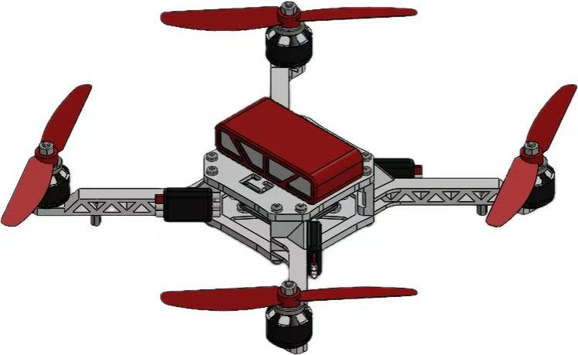
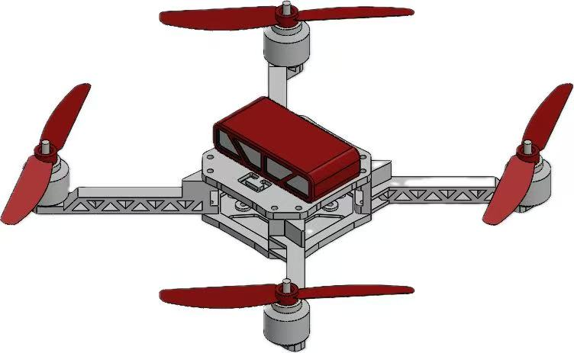
Motivation
and
Background
Modeling
Process
in Abaqus
FEA
Result
Analysis
Validation
and
Discussion
Conclusion
and
Future Work
2.1 Geometry Simplification
Removed: Non-structural parts (screws, wires).
Retained: Load-bearing arms & motors.
Goal: Higher computational efficiency.

Slide 6
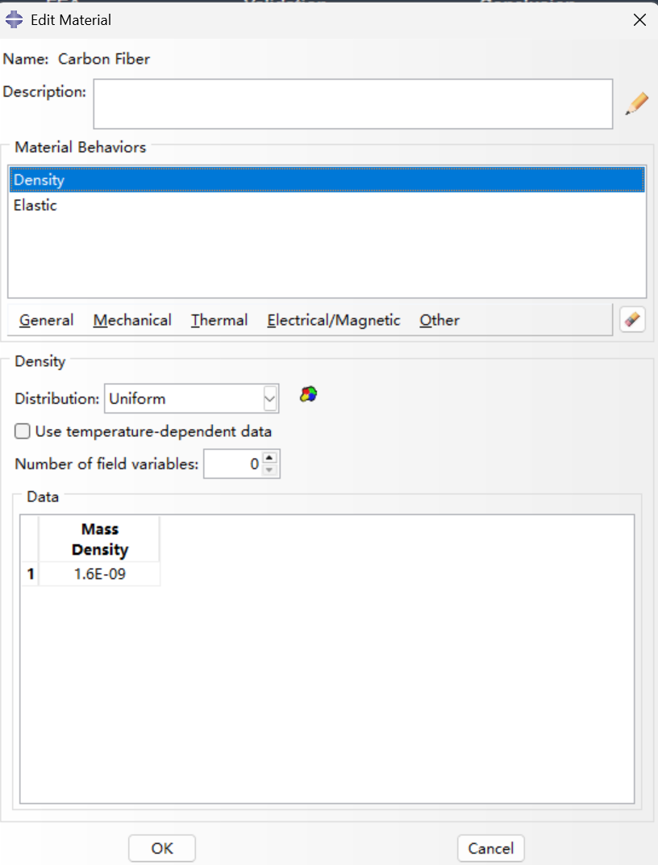
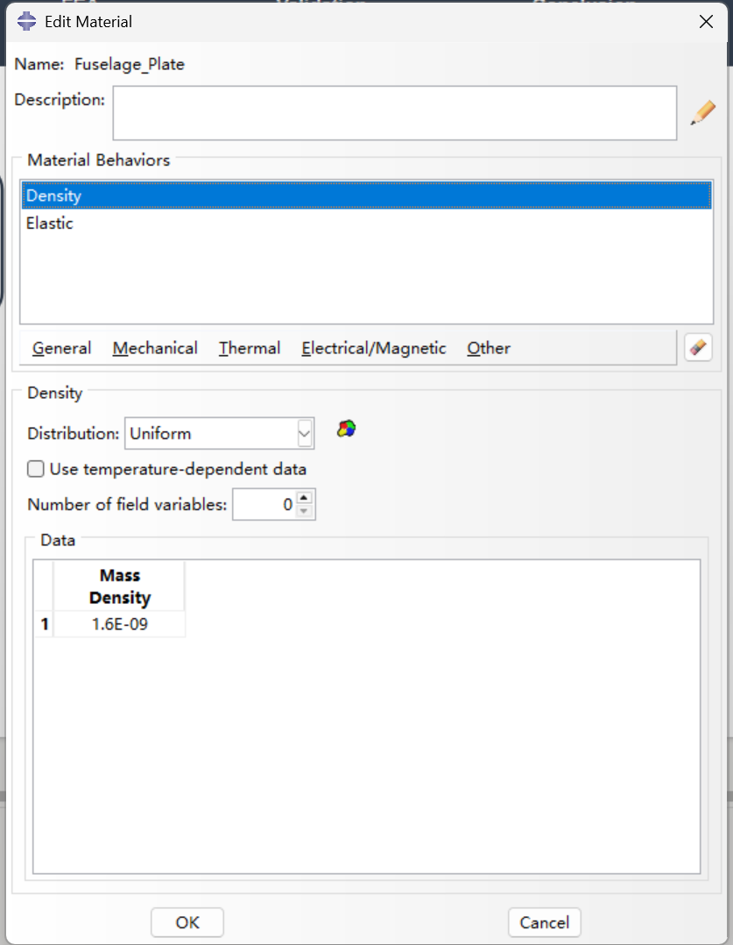
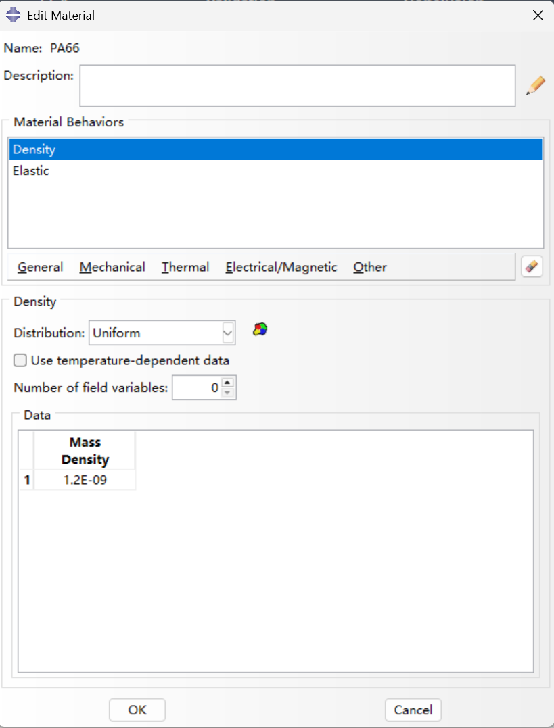
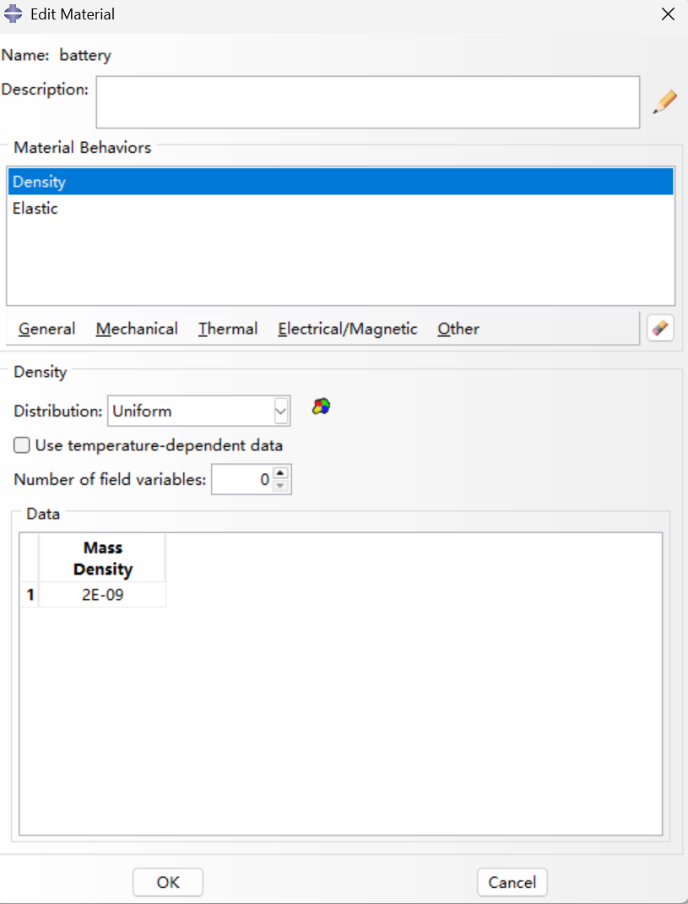
Motivation
and
Background
Modeling
Process
in Abaqus
FEA
Result
Analysis
Validation
and
Discussion
Conclusion
and
Future Work
2.2 Material Assignment
Structural Parts: Carbon Fiber, PA66, Steel.
Equivalent Mass: PCB board & Battery.

Slide 7
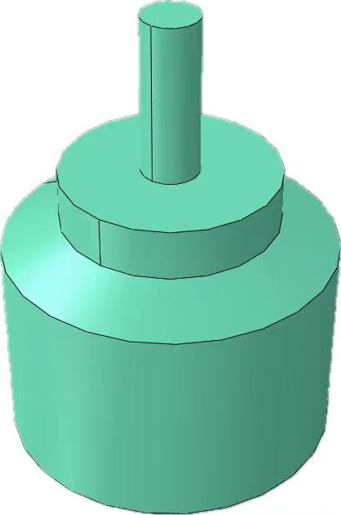
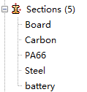
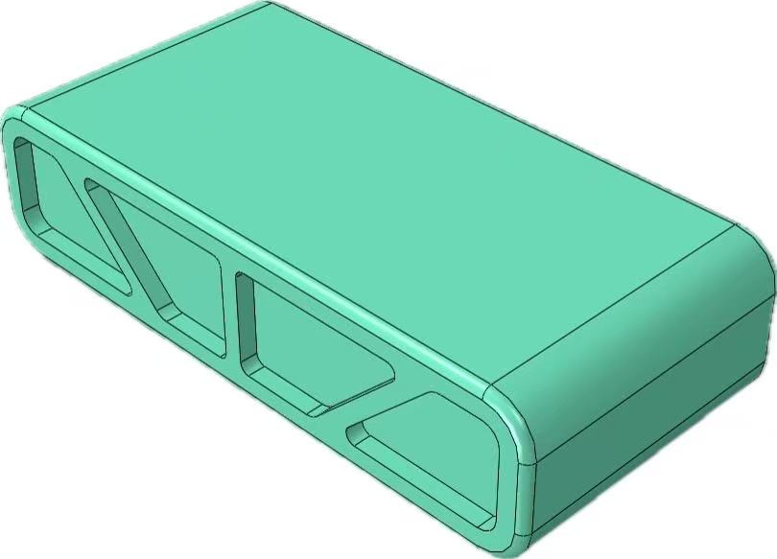
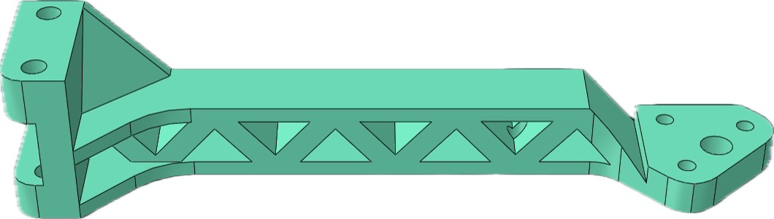
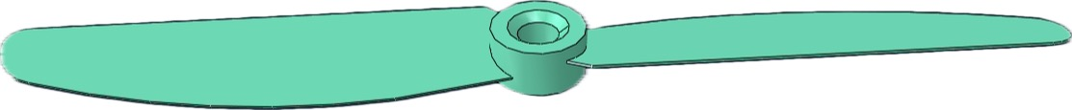
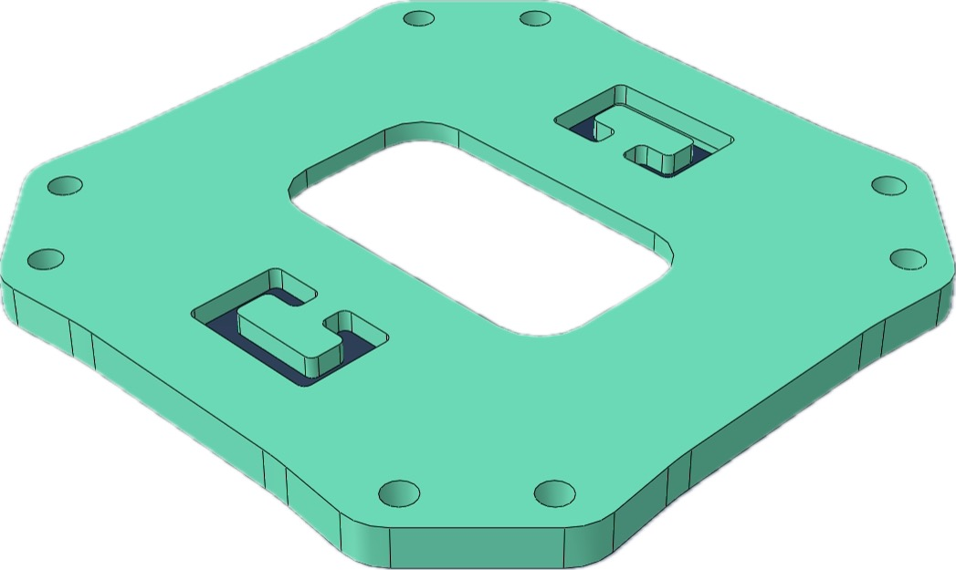
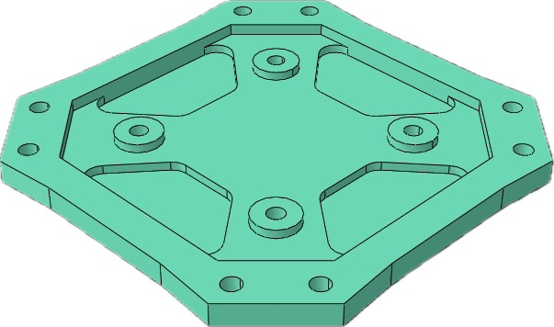
Motivation
and
Background
Modeling
Process
in Abaqus
FEA
Result
Analysis
Validation
and
Discussion
Conclusion
and
Future Work
2.3 Section Assignment
Action: Created Solid Sections.
Assigned to: Corresponding 3D parts.
Ensures: Accurate component stiffness.

Slide 8
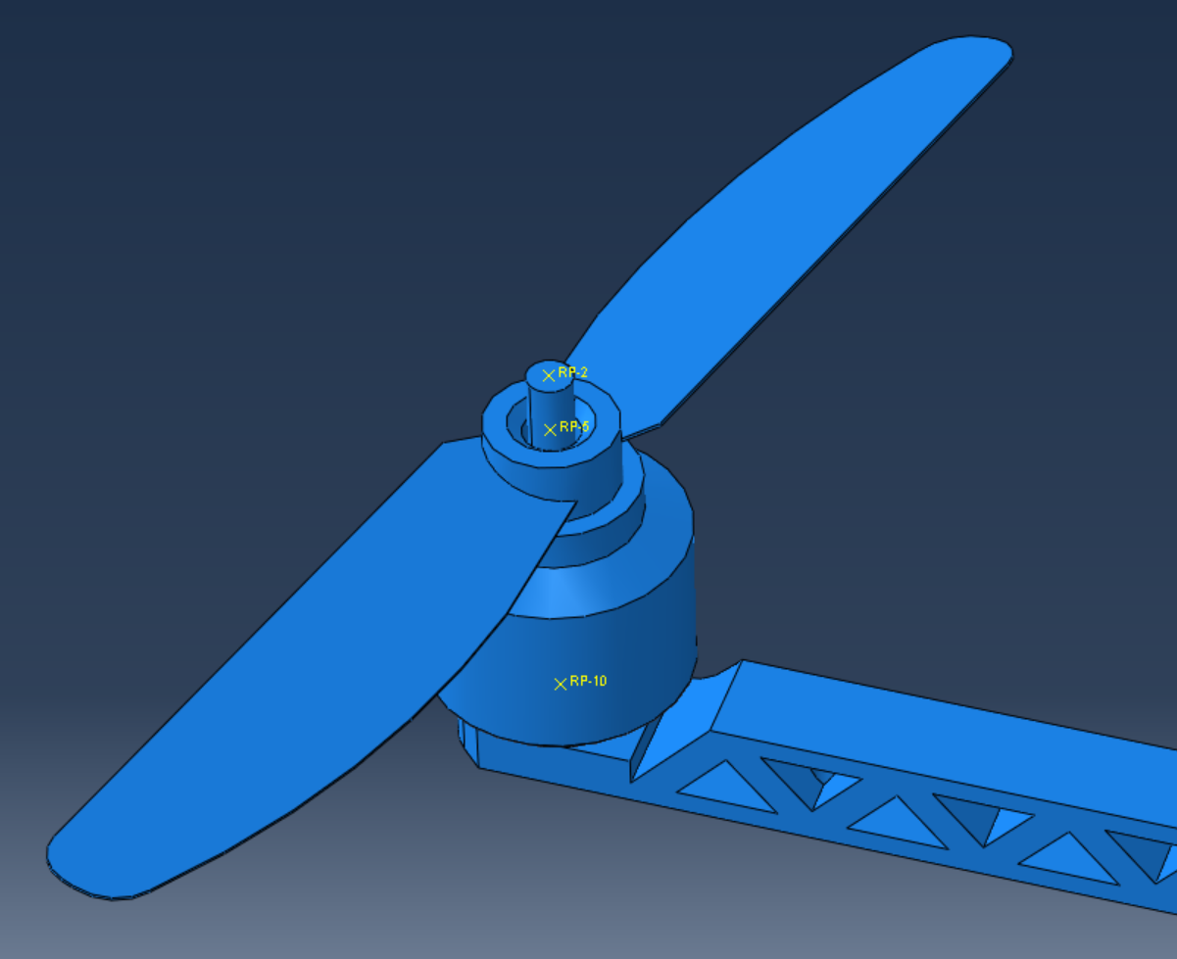
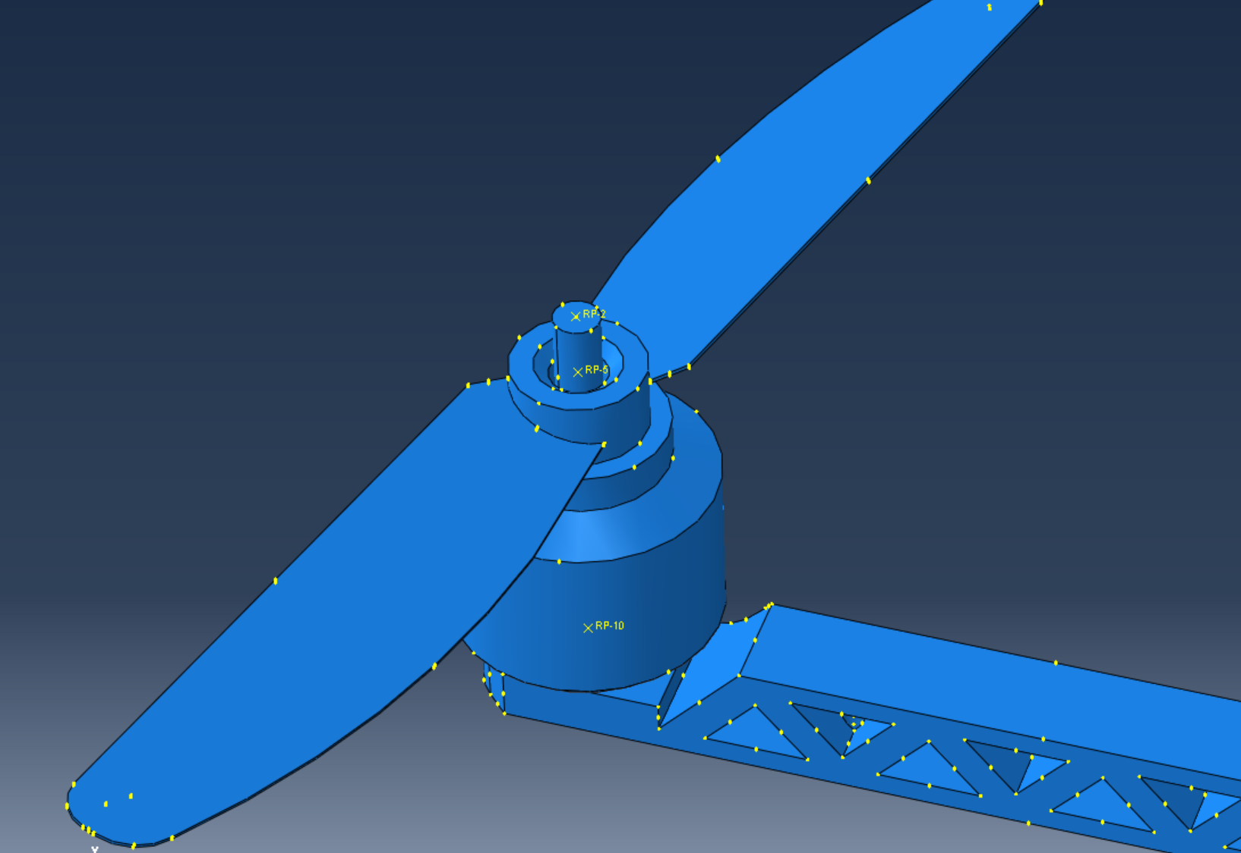
Motivation
and
Background
Modeling
Process
in Abaqus
FEA
Result
Analysis
Validation
and
Discussion
Conclusion
and
Future Work
2.4 Reference Points
Location: Central axis of motors & propellers.
Purpose 1: Target points for couplings.
Purpose 2: Exact thrust loading points.
Tools —— Reference Point

Slide 9
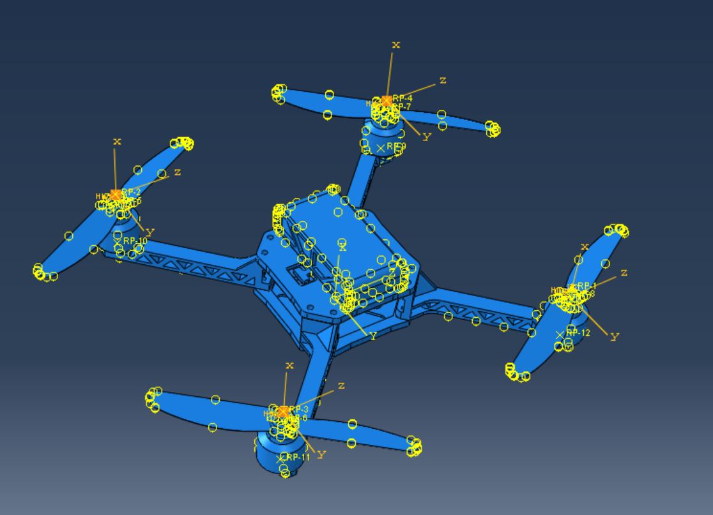
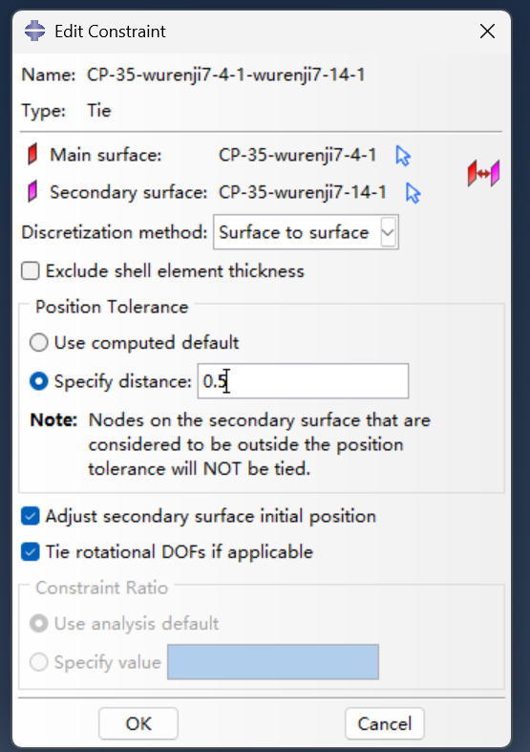

Motivation
and
Background
Modeling
Process
in Abaqus
FEA
Result
Analysis
Validation
and
Discussion
Conclusion
and
Future Work
2.5 Constraints & Rigid Bodies
Assembly: 'Tie' constraints (simulating bolts).
Simplification: Propellers set as Rigid Bodies.
Benefit: Bypasses thin-wall meshing issues.
Interaction —— Create Constraint

Slide 10
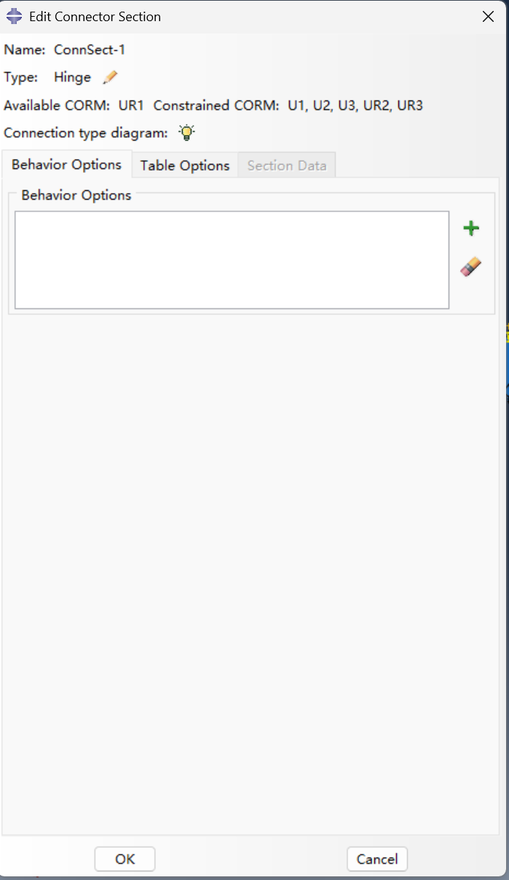
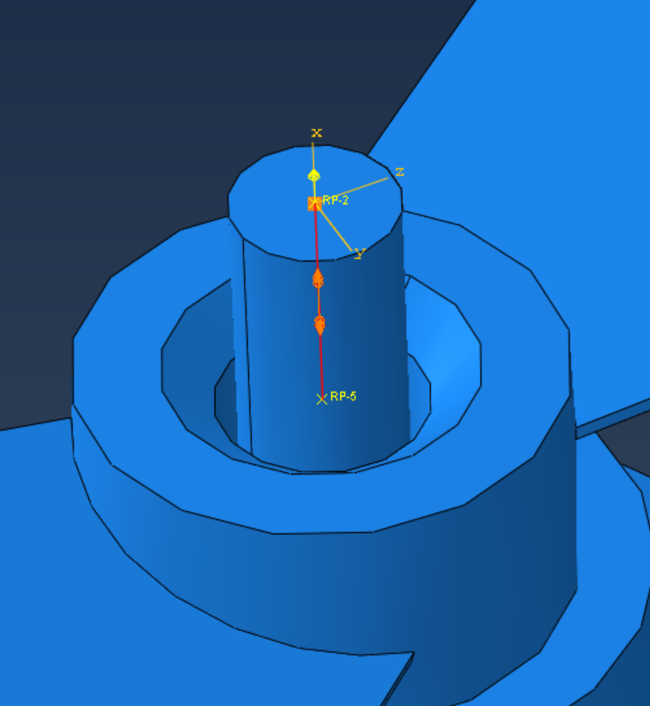
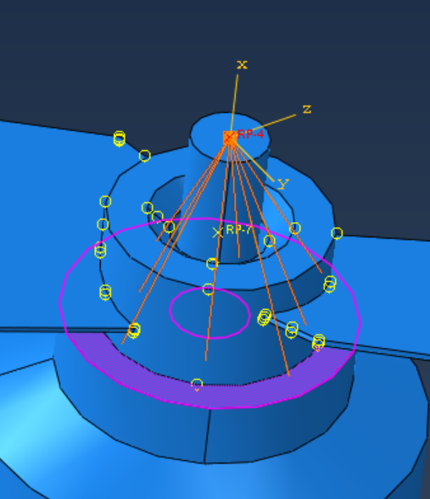
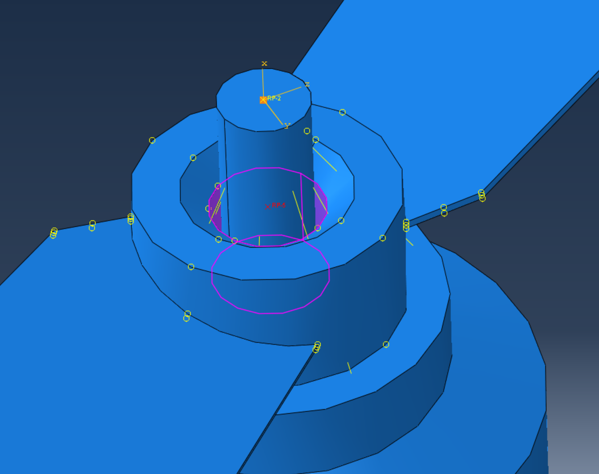
Motivation
and
Background
Modeling
Process
in Abaqus
FEA
Result
Analysis
Validation
and
Discussion
Conclusion
and
Future Work
2.5 Constraints & Rigid Bodies
Assembly: 'Tie' constraints (simulating bolts).
Simplification: Propellers set as Rigid Bodies.
Benefit: Bypasses thin-wall meshing issues.

Slide 11
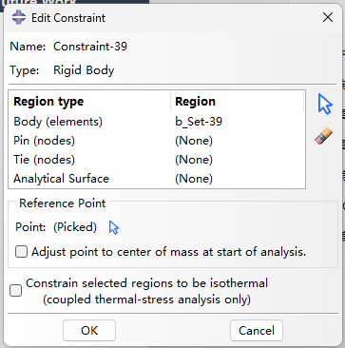
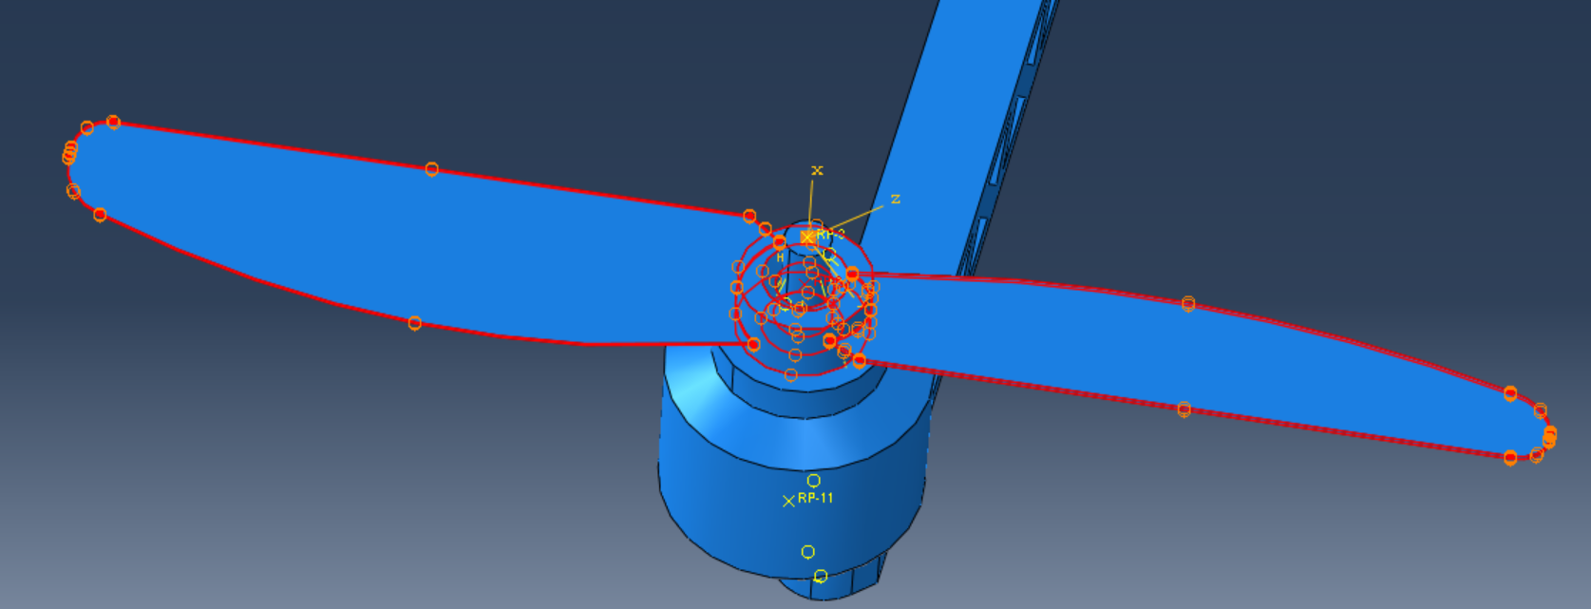
Motivation
and
Background
Modeling
Process
in Abaqus
FEA
Result
Analysis
Validation
and
Discussion
Conclusion
and
Future Work
2.5 Constraints & Rigid Bodies
Assembly: 'Tie' constraints (simulating bolts).
Simplification: Propellers set as Rigid Bodies.
Benefit: Bypasses thin-wall meshing issues.

Slide 12
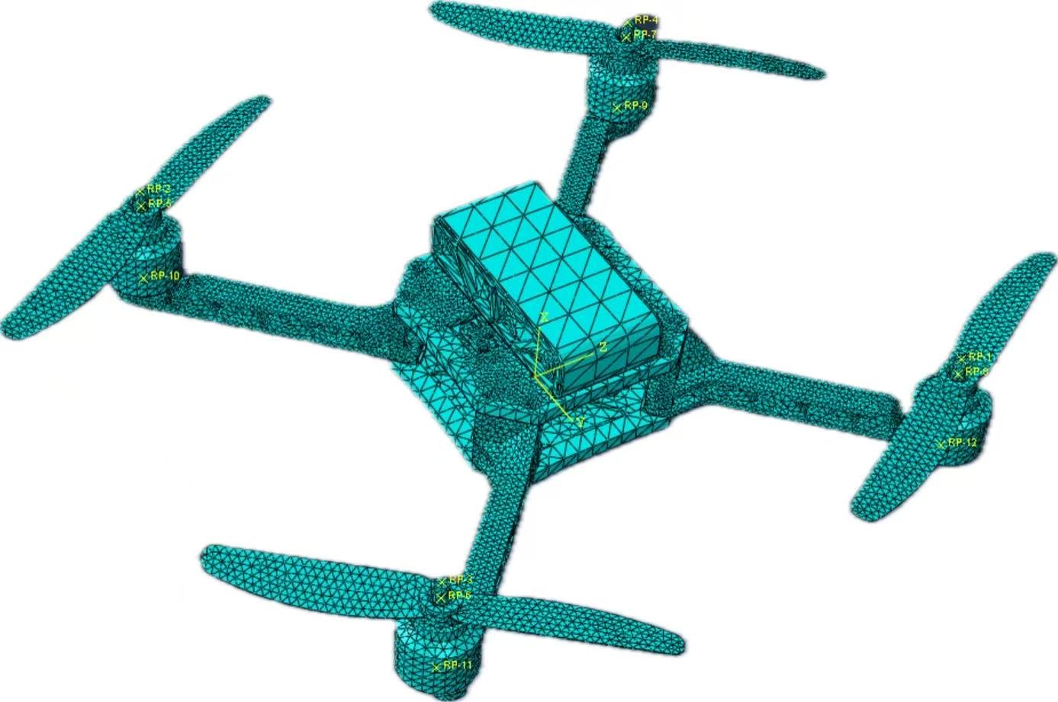
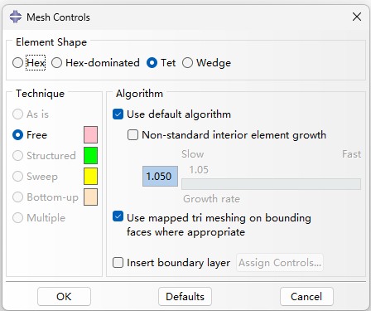
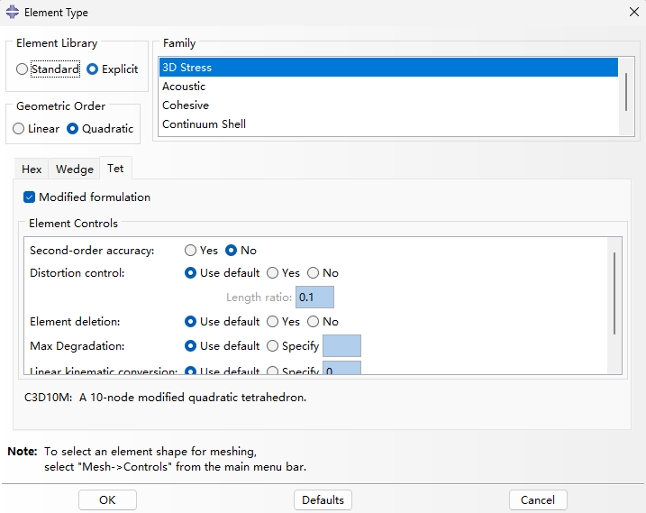
Motivation
and
Background
Modeling
Process
in Abaqus
FEA
Result
Analysis
Validation
and
Discussion
Conclusion
and
Future Work
2.6 Meshing Strategy
Mesh Type: Unstructured Tet Mesh.
Element: C3D10M (Modified Quadratic).
Reason: Handles complex geometry, high stress accuracy.

Slide 13
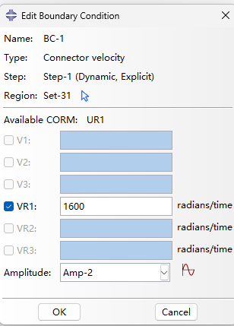
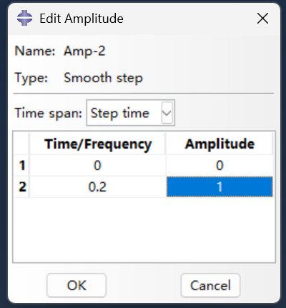
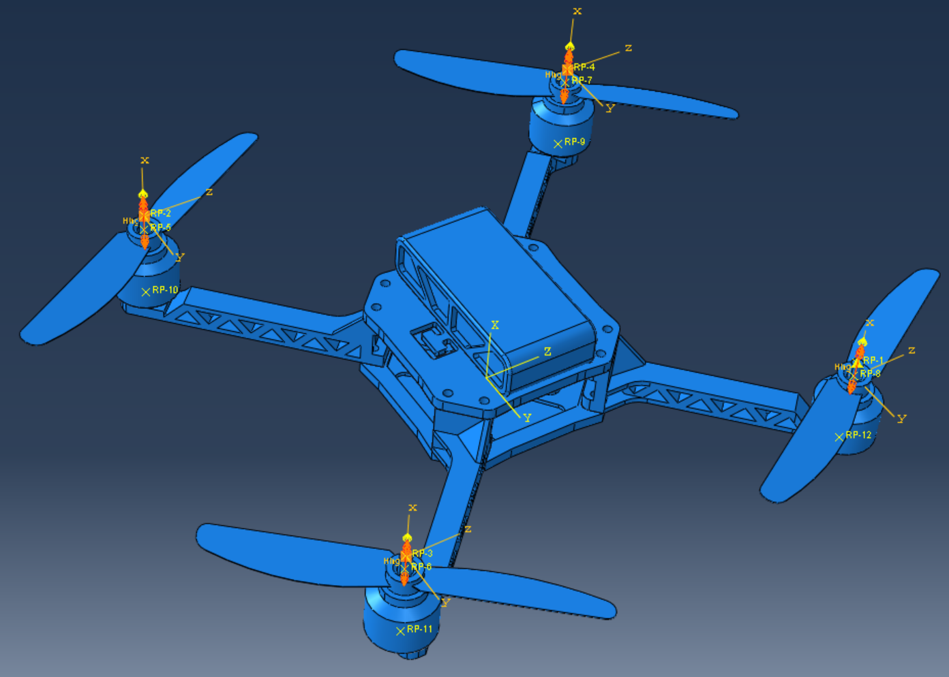
Motivation
and
Background
Modeling
Process
in Abaqus
FEA
Result
Analysis
Validation
and
Discussion
Conclusion
and
Future Work
2.7 Boundary Conditions
Physical Fixes: Simulating flight state.
Connections: Kinematic couplings.
Motion: Connector velocity (motor rotation).

Slide 14
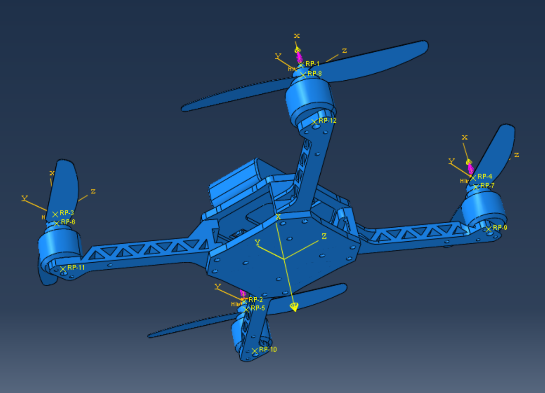
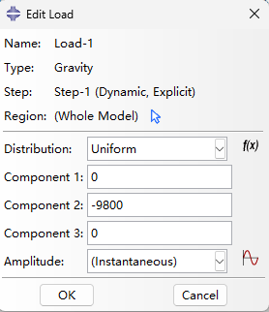
Motivation
and
Background
Modeling
Process
in Abaqus
FEA
Result
Analysis
Validation
and
Discussion
Conclusion
and
Future Work
2.8 Loads & Amplitude
Loads: Gravity (down) + Lift/Thrust (up at RPs).
Control: Amplitude curve applied.
Benefit: Smooth loading, prevents artificial shocks.

Slide 15
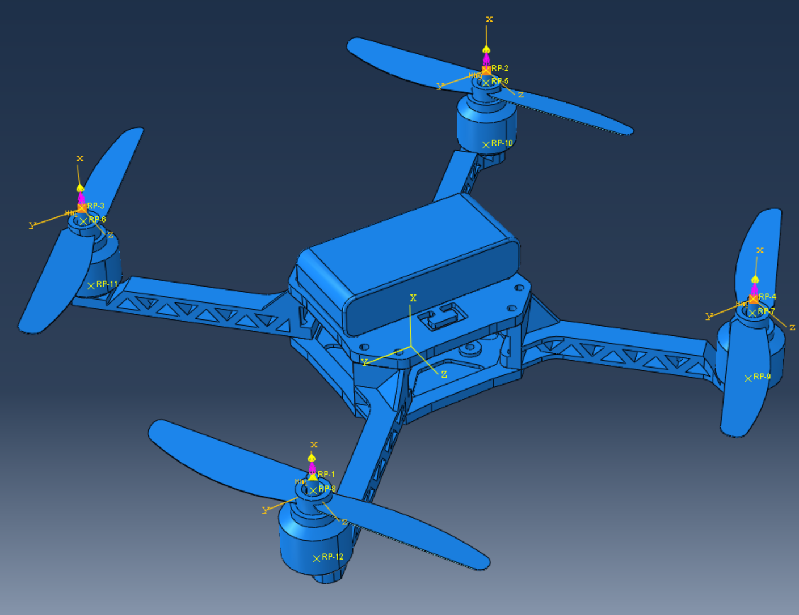
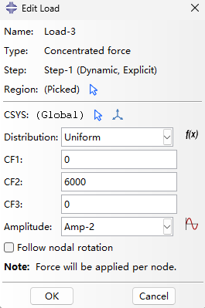
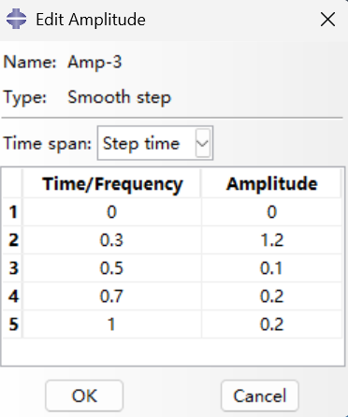
Motivation
and
Background
Modeling
Process
in Abaqus
FEA
Result
Analysis
Validation
and
Discussion
Conclusion
and
Future Work
2.8 Loads & Amplitude
Loads: Gravity (down) + Lift/Thrust (up at RPs).
Control: Amplitude curve applied.
Benefit: Smooth loading, prevents artificial shocks.

Slide 16
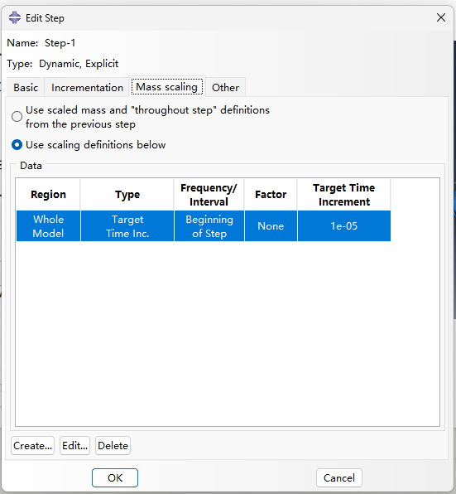
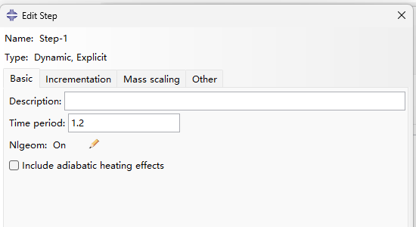
Motivation
and
Background
Modeling
Process
in Abaqus
FEA
Result
Analysis
Validation
and
Discussion
Conclusion
and
Future Work
2.9 Step Setting
Time Step: 1e-5
Time Period :1.2s
Benefit: Faster

Slide 17
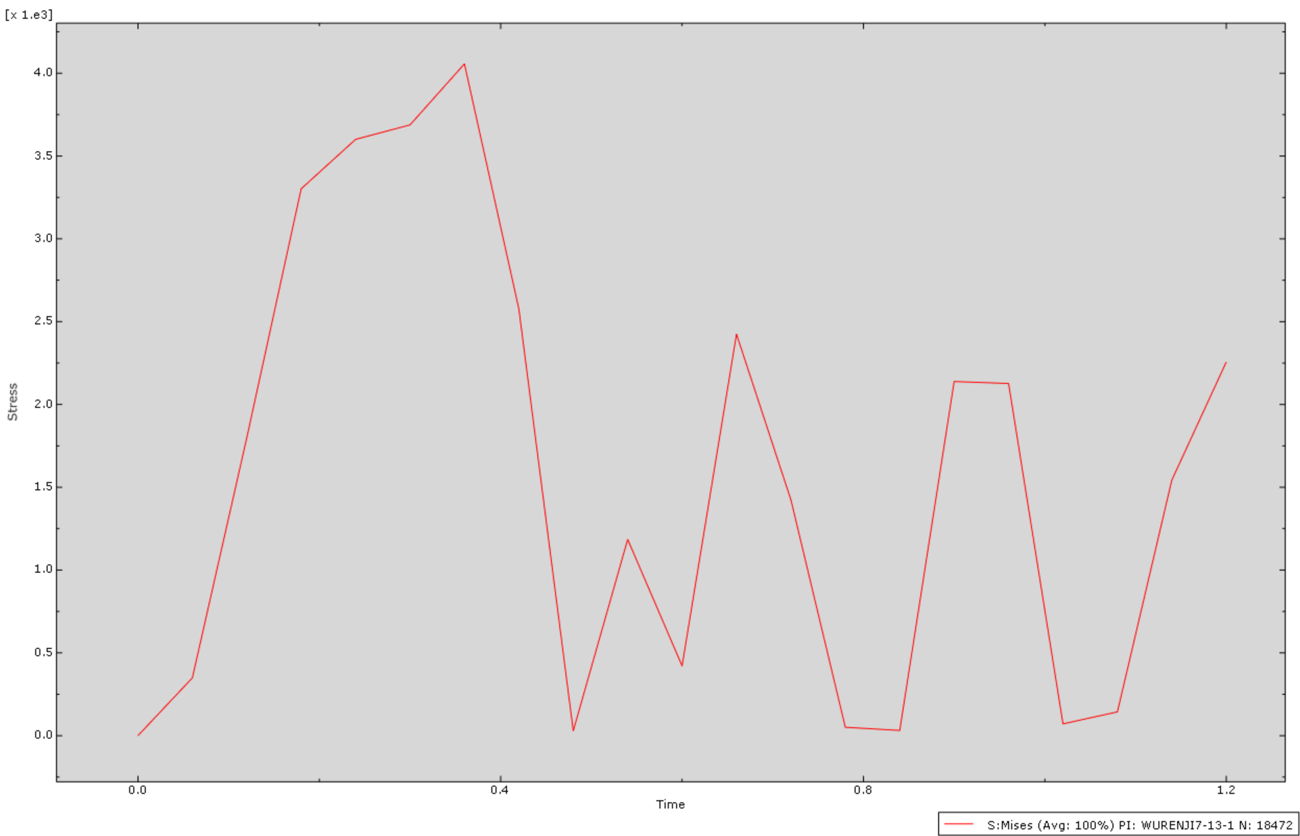
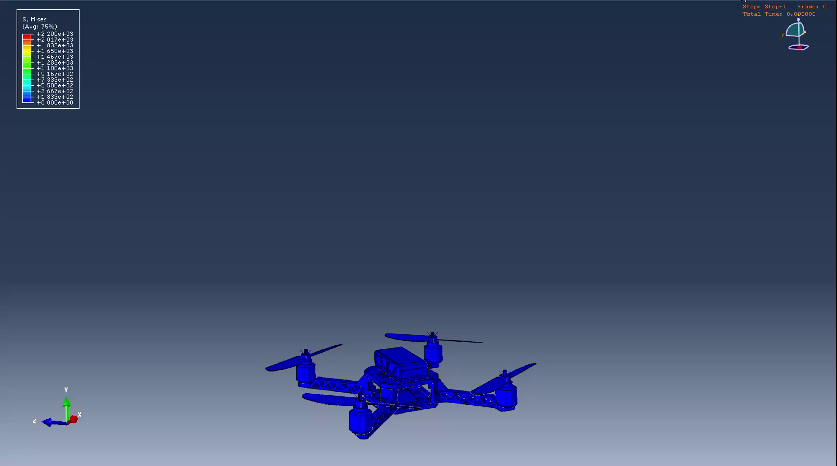
Motivation
and
Background
Modeling
Process
in Abaqus
FEA
Result
Analysis
Validation
and
Discussion
Conclusion
and
Future Work
3.1 Stress Distribution
Peak Stress Region: Identified at the arm-body junction (root).
Von Mises Stress: Concentrated due to cantilever bending.
Notes:
峰值应力区：在臂体连接处（根部）确定。冯·米塞斯应力：由于悬臂弯曲而集中。

Slide 18
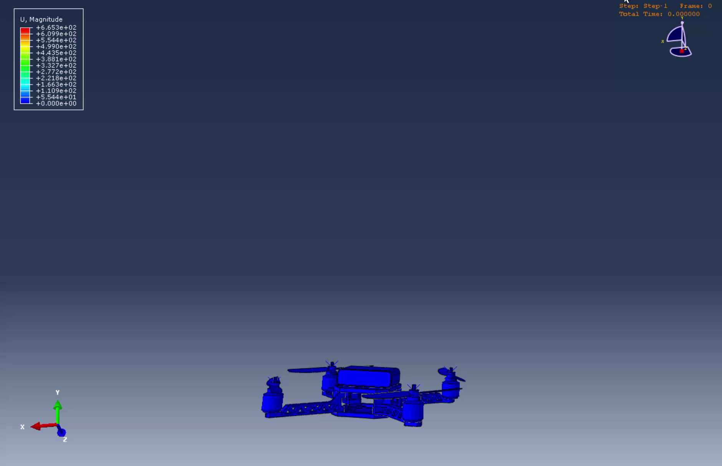
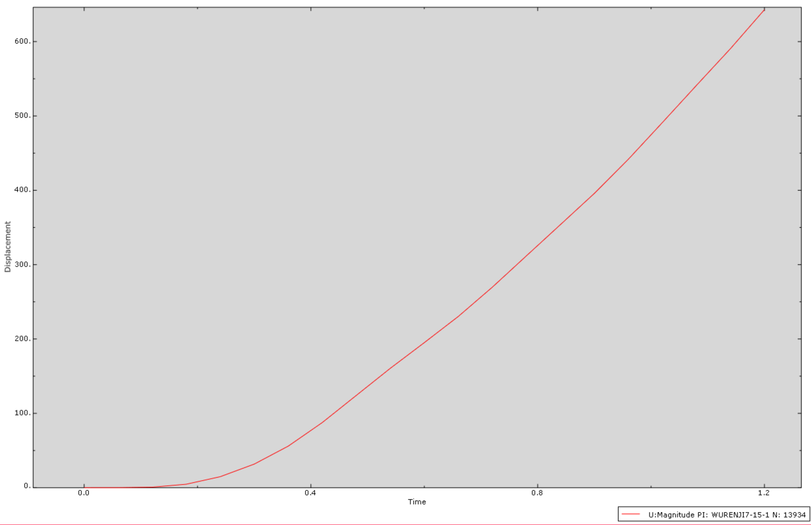
Motivation
and
Background
Modeling
Process
in Abaqus
FEA
Result
Analysis
Validation
and
Discussion
Conclusion
and
Future Work
3.2 Displacement & Deformation
Max Tip Displacement: Quantified at the motor mounting position.
Deformation Scale: Magnified for visual clarity.

Slide 19
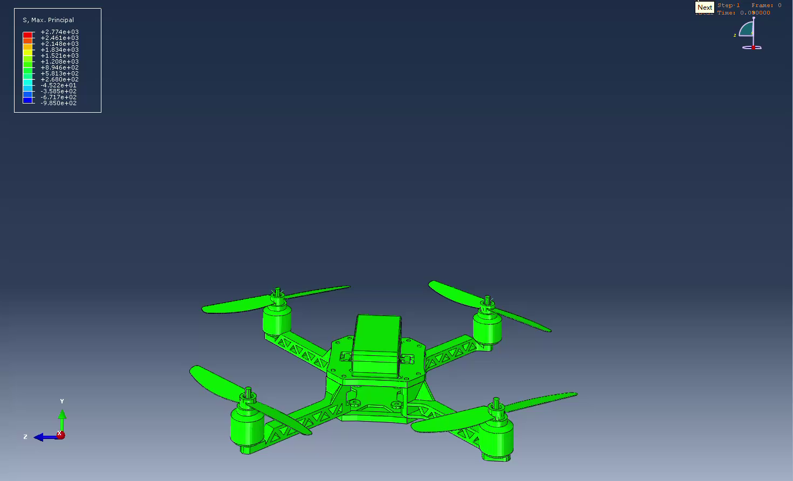
Motivation
and
Background
Modeling
Process
in Abaqus
FEA
Result
Analysis
Validation
and
Discussion
Conclusion
and
Future Work
3.2 Force Flow

Slide 20
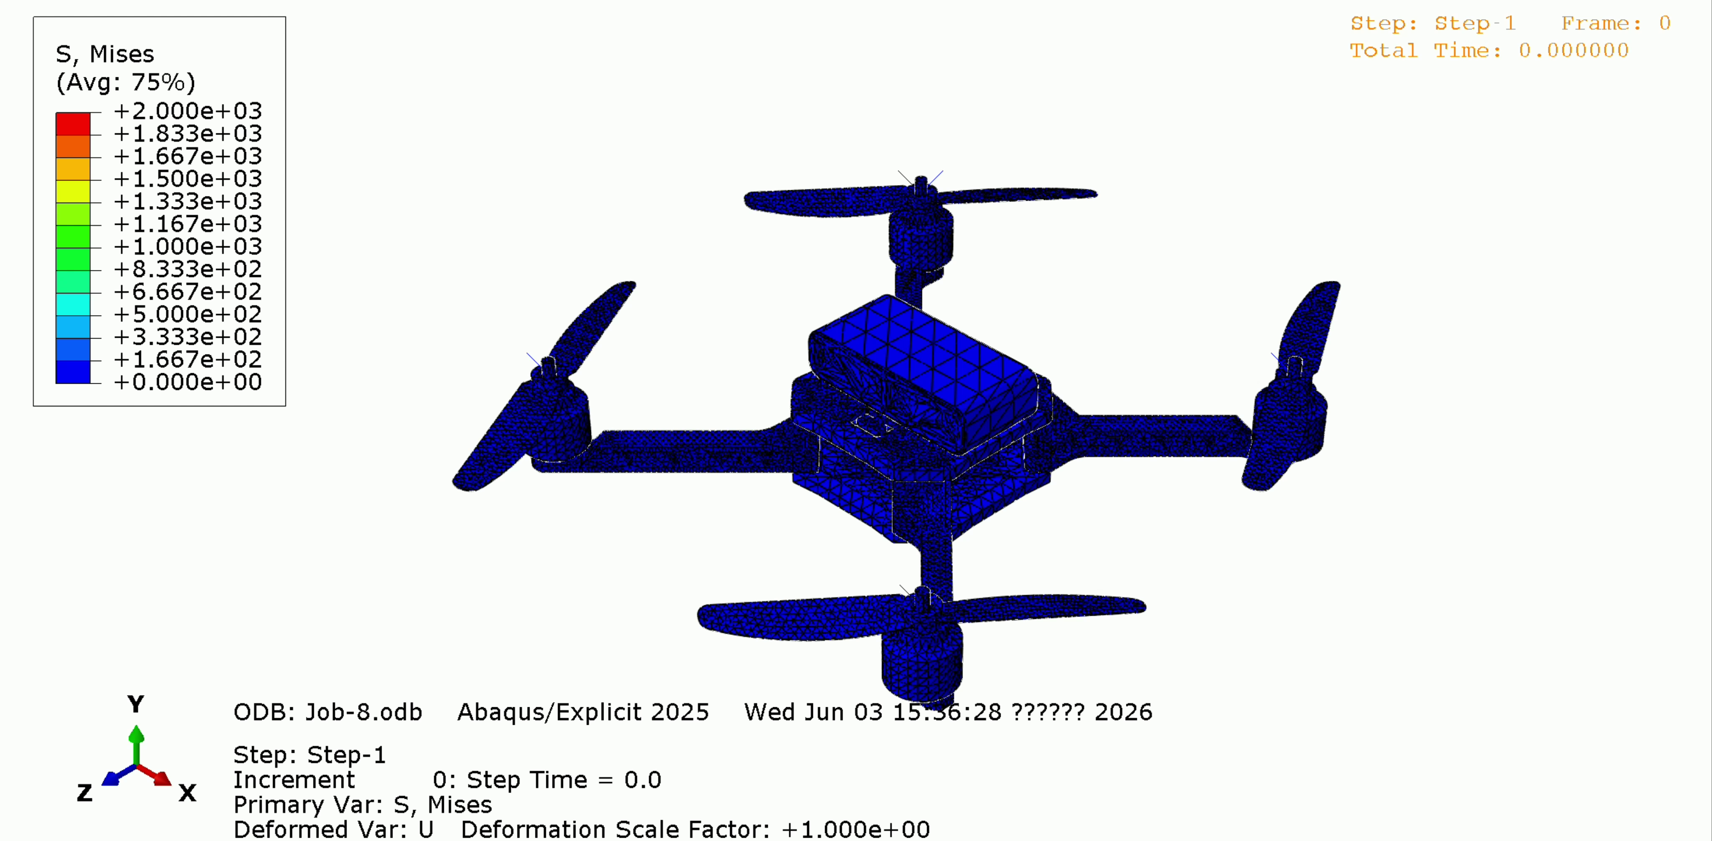
Motivation
and
Background
Modeling
Process
in Abaqus
FEA
Result
Analysis
Validation
and
Discussion
Conclusion
and
Future Work
3.3 Videos&Pictures

Slide 21
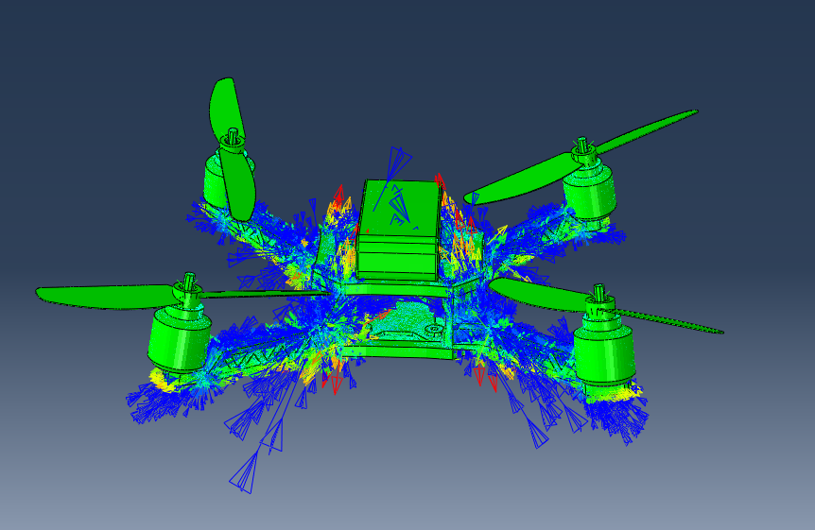



Motivation
and
Background
Modeling
Process
in Abaqus
FEA
Result
Analysis
Validation
and
Discussion
Conclusion
and
Future Work
3.3 Videos&Pictures

Slide 22
Motivation
and
Background
Modeling
Process
in Abaqus
FEA
Result
Analysis
Difficulties Encountered and Solutions
Conclusion
and
Future Work
4.1 Geometry & Meshing
Difficulty 1: Thin-Walled Complexity
Difficulty 2: Complex Arbitrary Geometry
Challenge: Thin propeller blades lead to poor aspect ratio and mesh instability.
Solution: Defined as Discrete Rigid Bodies; bypassed meshing for
non-load-bearing thin geometries.
Challenge: Standard Hex-mesh failed due to irregular ribs and fillets.
Solution: Employed Unstructured Tet Mesh with high-order C3D10M elements, ensuring stress accuracy.

Slide 23
Motivation
and
Background
Modeling
Process
in Abaqus
FEA
Result
Analysis
Difficulties Encountered and Solutions
Conclusion
and
Future Work
4.2 Numerical Stability
Difficulty 3: Computational Cost vs. Time Step
Difficulty 4: Aerodynamic Load Approximation
Challenge: Excessive calculation time due to extremely small stable time increments.
Solution: Switched from Explicit to Static General analysis, eliminating physical time-step limitations.
Challenge: Abaqus cannot perform CFD for real-time thrust calculation.
Solution: Implemented Equivalent Thrust Loads applied to RPs, validated against theoretical maximum take-off performance.

Slide 24
Motivation
and
Background
Modeling
Process
in Abaqus
FEA
Result
Analysis
Validation
and
Discussion
Conclusion
and
Future Work
4.1 Conclusion
Structural Vulnerability
Loading Behavior
Model Validation
Successfully implemented a high-fidelity FEA model using C3D10M elements, accurately capturing stress distribution in complex drone geometry.
Identified the arm-body root as the critical stress concentration region; peak stress levels are verified to be within the material's elastic limit.
Confirmed a linear relationship between thrust loading and structural deformation, validating the design stability for standard take-off conditions.
Methodology Success:
Demonstrated that Static General analysis with Amplitude control is an efficient and accurate approach for drone structural integrity assessment.
Notes:
总结一下，我们通过高阶 C3D10M 单元构建了高保真模型，成功定位了机臂根部这一结构弱点，并验证了在起飞推力下，整体应力水平处于材料的弹性范围内。我们的方法证明了使用静力学结合幅值控制是评估无人机结构强度的最优工程方案。

Slide 25
Motivation
and
Background
Modeling
Process
in Abaqus
FEA
Result
Analysis
Validation
and
Discussion
Conclusion
and
Future Work
4.2 Future Work
Refined Meshing
Perform Mesh Convergence Studies on high-stress junctions and thin-walled regions to eliminate numerical uncertainty.
Material Characterization
Conduct individual stress-range analysis for each component (e.g., PA66 vs. Carbon Fiber) to optimize local material usage.
Dynamic Response
Dynamic Response: Extend the study to transient dynamics by simulating maximum acceleration take-off to identify the vibration-induced fatigue failure threshold.

Slide 26
ME314 Finite Element Theory
Thanks！
Presenter : Yuzhen Song
Group Members : Jiacan Li, Jiayi Yan
Presentation Date : 04/06/2026

