Slide 1
Debian 修包简介(RISC-V)
tsu.yubo@gmail.com 2022/08/17

Slide 2
内容
准备环境
修包
补充

Slide 3
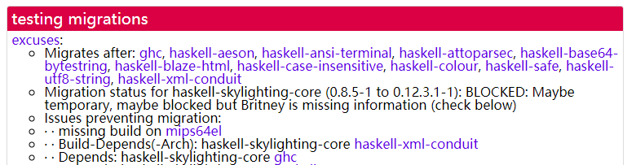
准备环境
sid(unstable)、testing、stable
sid
migrations
testing
stable

Slide 4
Upgrade to sid
change /etc/apt/source.list
sudo apt update && sudo apt dist-upgrade
deb http://deb.debian.org/debian sid main contrib non-free
deb-src http://deb.debian.org/debian sid main contrib non-free

Slide 5
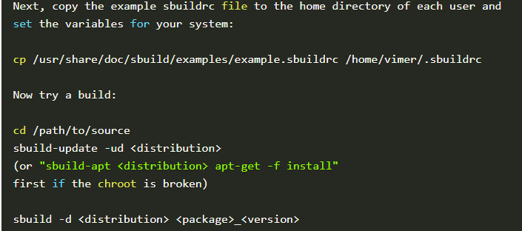
创建chroot
安装依赖
apt install sbuild buildd qemu-system-misc qemu-user-static binfmt-support ..
命令
sudo sbuild-createchroot --debootstrap=mmdebstrap --arch=riscv64 \
--include=debian-ports-archive-keyring
--make-sbuild-tarball=/srv/sid-riscv64-sbuild.tgz \
sid /tmp/chroots/sid-riscv64-sbuild/ \
http://ftp.ports.debian.org/debian-ports/

Slide 6
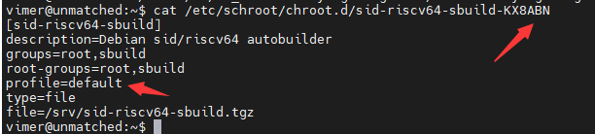

修改sbuild配置
配置chroot(两种方式)
sudo sbuild-apt sid-riscv64-sbuild apt-get install vim.tiny
sudo sbuild-shell sid-riscv64-sbuild

Slide 7
修包
包的来源
https://buildd.debian.org/status/architecture.php?a=riscv64&suite=sid
https://udd.debian.org/cgi-bin/ftbfs.cgi?arch=riscv64

Slide 8
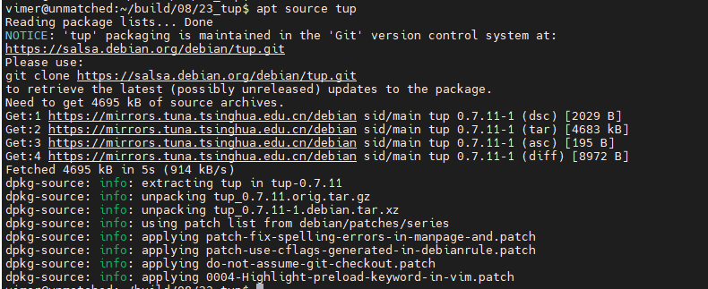
下载源码（以tup为例）
apt source tup

Slide 9
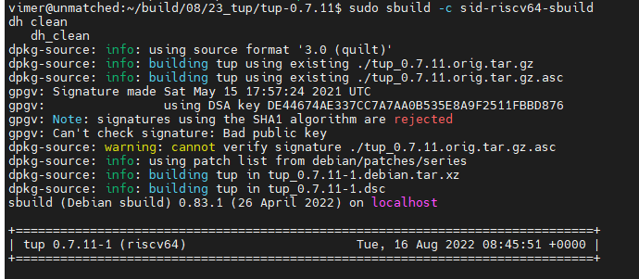
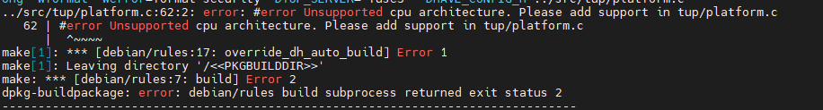
编译源码（以tup为例）
sudo sbuild -c sid-riscv64-sbuild [--no-clean-source]
sudo sbuild --arch=riscv64 -c sid-riscv64-sbuild [--no-clean-source](non-riscv64)

Slide 10
生成patch
quiltrc配置
vimer@unmatched:~$ cat ~/.quiltrc
QUILT_PATCHES=debian/patches
QUILT_NO_DIFF_INDEX=1
QUILT_NO_DIFF_TIMESTAMPS=1
QUILT_REFRESH_ARGS="-p ab"
QUILT_DIFF_ARGS="--color=auto" # If you want some color when using `quilt diff`.
QUILT_PATCH_OPTS="--reject-format=unified"
QUILT_COLORS="diff_hdr=1;32:diff_add=1;34:diff_rem=1;31:diff_hunk=1;33:diff_ctx=35:diff_cctx=33"
d=. ; while [ ! -d $d/debian -a `readlink -e $d` != / ]; do d=$d/..; done
if [ -d $d/debian ] && [ -z $QUILT_PATCHES ]; then
# if in Debian packaging tree with unset $QUILT_PATCHES
QUILT_PATCHES="debian/patches"
if ! [ -d $d/debian/patches ]; then mkdir $d/debian/patches; fi
fi
quilt用法
* quilt push -a
* quilt new fix-issue.patch
* quilt add source-code-file(out of the d/*)
* quilt refresh
* quilt header -e [--dep3]
* quilt pop -a

Slide 11
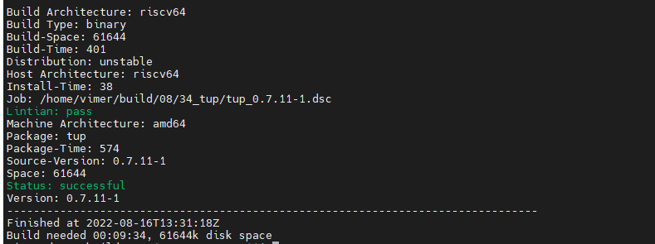
发送patch 以#1010381为例：
To: Debian Bug Tracking System <submit@bugs.debian.org>
Subject: commons-daemon: FTBFS on riscv64: error: Unsupported CPU architecture "riscv64"
Source: commons-daemon
Version: 1.0.15-8
Severity: normal
Tags: ftbfs patch
User: debian-riscv@lists.debian.org
Usertags: riscv64
X-Debbugs-Cc: debian-riscv@lists.debian.org
Dear Maintainer, blabla...

Slide 12
补充
Bug Severity
wishlist minor normal important
修包的种类
add support for riscv64
fix ftbfs issue
patch的另一种形式
debdiff debdiff tup_0.7.11-1.dsc ../tup_0.7.11-1.dsc >> tup-add-support-riscv64.debdiff
# debdiff old-dsc new-dsc
其他build方式
gbp buildpackage --git-builder=sbuild -d sid --no-clean-source --source --git-debian-branch=debian/main --git-export-dir=../build-area/ --git-ignore-new --verbose
dpkg-buildpackage --sanitize-env -us -uc -b -rfakeroot
apt install devscripts
避免重复提交
查看BTS
充分验证
Forward upstream

Slide 13
Thanks

