Slide 1
Gender
Spectrum

Slide 2
Gender
Spectrum

Slide 3

Introduction
The Difference Between Sex Assigned at Birth and Gender Identity
The Difference Between Gender Identity and Sexual Orientation
Gender-Affirming Management Options for Transgender Individuals
Non-Binary Gender Identity
Interview: Ben Barres

Slide 4




Slide 5
Notes
“Gender is in your mind, not between your legs”
Sex Assigned at Birth
Cisgender
Transgender
Gender Identity
Sexual Orientation
Gender-Affirming
Gender Expression
Non-Binary
Gender was a socially-constructed thing ?
“Just be who you are, make sure you focus on, all your talents and your passion, the rest will follow.”

Slide 6
Notes

Slide 8





Notes

Slide 10

Notes

Slide 12

Notes

Slide 14

Notes

Slide 16

Notes

Slide 17
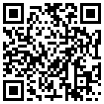
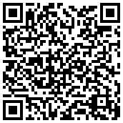
Thank you
Notes
Ref: https://www.coursera.org/learn/health-gender-spectrum
PowerPoint: By @yuzuki
Project: yuzukicat/gender-spectrum
Copyright Notice: Licensed under CC BY-NC-SA 4.0 unless stating additionally.

