Slide 1


Accounting Fraud Analysis
of 300159.SZ Xinyan Holding
Simple, Complex, and Cost-Inflating Fraud Patterns
Jingwei Liu 2253336

Slide 2
Table of Contents
01
Background and Fraud Overview
02
Simple Fraud Pattern
03
Complex Fraud Pattern
04
Cost-inflating Pattern
05
Flow Charts, Conclusion, and References

Slide 3
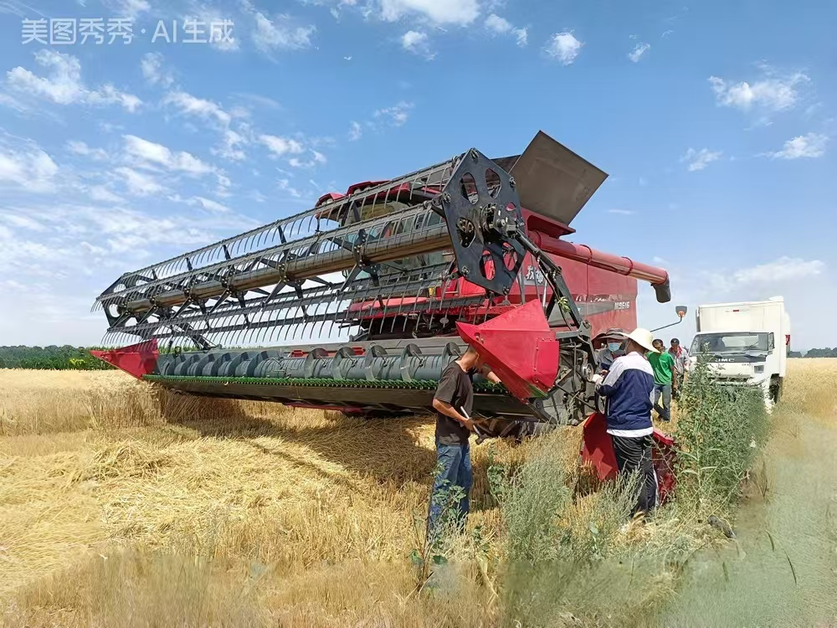
Background and Fraud Overview
This section sets the context for the case and focuses on the fraud period from 2017 to 2019.
PART 01

Slide 4
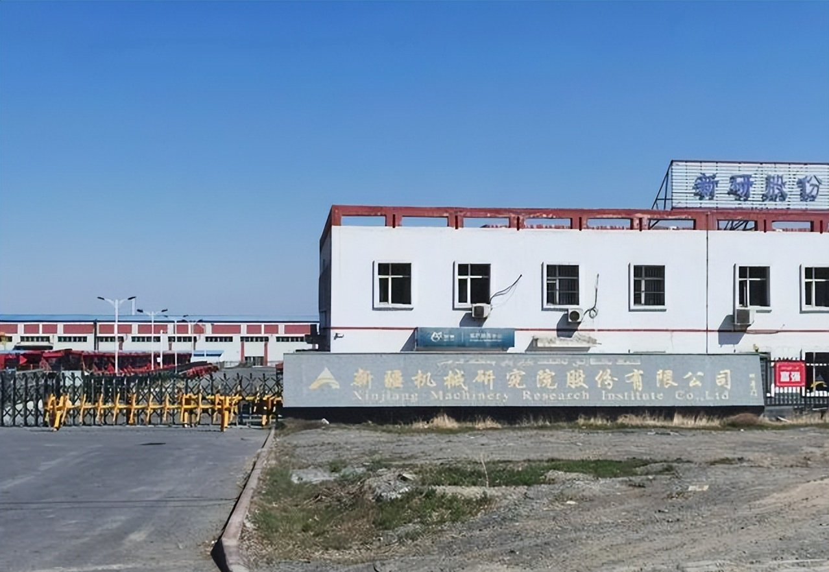
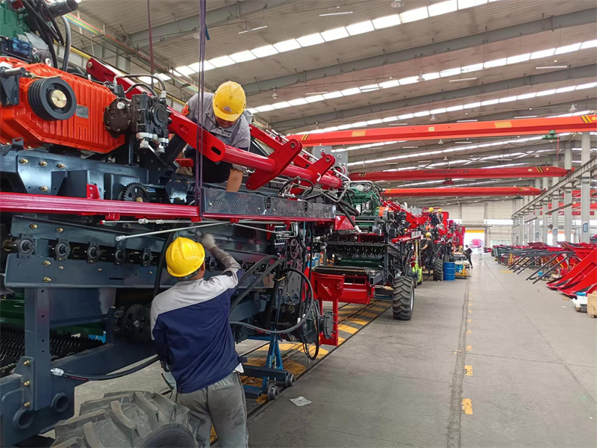
Company Background
Xinyan Holding (300159.SZ)
Originally focused on agricultural and pastoral machinery
Later expanded into aviation-related operations
Mingri Aviation consolidated from 1 November 2015
Jingwei Liu 2253336

Slide 5
Fraud Overview
2017-2018:
2019:
Fictitious sales contracts
Overstated revenue
Inflated accounts receivable
Premature revenue and cost recognition
Inflated accounts receivable
Overall effect: overstated revenue and accounts receivable
Jingwei Liu 2253336

Slide 6

Simple Fraud Pattern
PART 02
This section examines whether inflated sales are reflected in abnormal accounts receivable patterns.
PART 02

Slide 7
1. Growth in Accounts Receivable VS. Growth in Sales
Growth in Accounts Receivable (AR) = (AR in year t / AR in year t-1) – 1
Growth in Sales = (Sales in year t / Sales in year t-1) – 1
Figure description:
AR growth > Sales growth
Especially clear in 2017 and 2018
2018: AR +43.8% vs Sales +1.4%
Interpretation:
Inflated sales may be recorded as AR
No corresponding cash collection
AR grows faster than Sales → abnormal
Initial support for the simple fraud pattern
Jingwei Liu 2253336

Slide 8
2. Compare Accounts Receivable Turnover Ratio with Gross Margin
Accounts Receivable Turnover Ratio ≈ Sales / Average Accounts Receivable
Gross Margin = (Sales - Cost of goods sold) / Sales
Figure description:
AR turnover declined sharply
2017-2019: 1.43 → 0.65
Gross margin also declined
Trend divergence was limited
Interpretation:
Lower AR turnover → slower collection
Receivable quality may be weakening
Provides moderate support for the simple fraud pattern
Not the strongest evidence on its own
Jingwei Liu 2253336

Slide 9
3. Check the ratio of Net Cash Flow from operations over Net Profits
Net Cash_Profit ratio = Net Cash Flow from operations / Net Profits
Figure description:
Net Cash_Profit ratio remained weak in 2017-2019
Mean value was around 0.08
Significantly below 1
Cash-profit conversion was very weak
Interpretation:
Reported profits were not supported by operating cash flow
Inflated sales may increase profit, but not real cash inflow
Net profit was not converted into cash
Strong support for the simple fraud pattern
Jingwei Liu 2253336

Slide 10
4. Check Accounts Receivable Bad Debt ratio
Accounts Receivable Bad Debt ratio = Allowance for Doubtful Accounts / Total Accounts Receivable
Figure description:
AR bad debt ratio increased later
2017-2020: 10% → 46%
The rise was significant
This is a lagging indicator
Interpretation:
Fake receivables may not be impaired immediately
Higher provisions appeared in later years
Receivable risk increased significantly
Strong support for the simple fraud pattern
Jingwei Liu 2253336

Slide 11
Conclusion
The simple fraud pattern (inflating Accounts Receivable) of inflating Sales exists.
AR growth > Sales growth → abnormal
AR Turnover Ratio → declined significantly
Mean Net Cash_Profit ratio → far below 1
AR bad debt ratio → increased later
Jingwei Liu 2253336

Slide 12

Complex Fraud Pattern
PART 03
This section explores whether cash recycle through outside parties supports inflated sales.
PART 03

Slide 13
5 (1). Check the growth in Other Receivable
Growth in Other Receivable (OR) = (OR in year t / OR in year t-1) – 1
Figure description:
OR growth increased dramatically
Especially obvious in 2018 and 2019
2018: OR growth ≈ 523%
The increase was highly abnormal
Interpretation:
Cash outflow may be recorded as Other Receivable
Significant OR growth → abnormal
May indicate fund transfers through outside parties
Strong support for the complex fraud pattern
Jingwei Liu 2253336

Slide 14
5 (2). Check the Other Receivable Turnover Ratio
Other Receivable Turnover Ratio = Sales / Average Other Receivable
Average Other Receivable = (Previous year + Current year Other Receivable) / 2
Figure description:
OR turnover ratio declined sharply
2017-2019: 288.6 → 9.8
The decline was very dramatic
Indicates rapid OR accumulation
Interpretation:
Cash flow may accumulate in Other Receivable
Falling OR turnover ratio → abnormal
May indicate hidden fund transfers through outside parties
Strong support for the complex fraud pattern
Jingwei Liu 2253336

Slide 15
6 (1). Check the growth in Prepayment
Growth in Prepayment = (Prepayment in year t / Prepayment in year t-1) – 1
Figure description:
Prepayment growth spiked in 2017
Turned negative in 2018 and 2019
The pattern was not consistently strong
Interpretation:
Cash outflow may be recorded as Prepayment
A spike in Prepayment may indicate advance cash transfer
Limited to moderate support for the complex fraud pattern
Jingwei Liu 2253336

Slide 16
6 (2). Check the Prepayment Turnover Ratio
Prepayment Turnover Ratio = Cost of goods sold / Average Prepayment
Average Prepayment = (Previous year + Current year Prepayment) / 2
Figure description:
Prepayment turnover ratio declined slightly
2017-2019: 6.25 → 5.20
The decline was not very dramatic
Interpretation:
Lower turnover may indicate slower prepayment turnover
The evidence was relatively weak
Weaker than the Other Receivable evidence
Limited support for the complex fraud pattern
Jingwei Liu 2253336

Slide 17
Conclusion
The complex fraud pattern (cash recycle) of inflating Sales exists.
Other Receivable growth → highly abnormal
Other Receivable turnover ratio → declined sharply
Prepayment growth → spiked in 2017 only
Prepayment turnover ratio → weak but declining
Jingwei Liu 2253336

Slide 18

Cost-Inflating Fraud Pattern
PART 04
This section analyzes whether abnormal accounts payable and inventory patterns suggest inflated costs.
PART 04

Slide 19
7 (1). Growth in Account Payable VS. Growth in COGS
Growth in Account Payable (AP) = (AP in year t / AP in year t-1) – 1
Growth in COGS = (COGS in year t / COGS in year t-1) – 1
Figure description:
AP growth exceeded COGS growth in 2017 and 2019
The gap was most obvious in 2019
2019: AP +56.2% vs. COGS -27.5%
The pattern was not consistently strong
Interpretation:
AP grew much faster than COGS → abnormal
May indicate inflated purchases recorded through AP
Part of inflated purchases may be transferred to COGS
Moderate support for the cost-inflating pattern
Jingwei Liu 2253336

Slide 20
7 (2). Check the Account Payable Turnover Ratio
Account Payable Turnover Ratio = Cost of goods sold (COGS) / Average Account Payable
Average Account Payable = (Previous year + Current year Account Payable) / 2
Figure description:
AP turnover ratio fluctuated at first
But declined clearly in the later fraud period
Indicates faster AP accumulation
Interpretation:
Falling AP turnover ratio → abnormal
AP accumulated faster than COGS
May indicate inflated purchases / inflated COGS
Limited to moderate support
Jingwei Liu 2253336

Slide 21
8 (1). Growth in Inventory VS. Growth in Sales
Growth in Inventory = (Inventory in year t / Inventory in year t-1) – 1
Growth in Sales = (Sales in year t / Sales in year t-1) – 1
Figure description:
Inventory growth exceeded Sales growth
The gap became more obvious in the later fraud period
Inventory accumulated abnormally during 2017-2019
The pattern was strong
Interpretation:
Inventory grew faster than Sales → abnormal
May indicate inflated ending Inventory
Part of inflated purchases may be transferred to Inventory
Strong support for the cost-inflating pattern
Jingwei Liu 2253336

Slide 22
8 (2). Check the Inventory Turnover Ratio
Inventory Turnover Ratio = Cost of goods sold (COGS) / Average Inventory
Average Inventory = (Previous year + Current year Inventory) / 2
Figure description:
Inventory turnover ratio kept declining
2017-2019: 2.56 → 1.60
The decline became more obvious later
Indicates abnormal inventory accumulation
Interpretation:
Falling inventory turnover → abnormal
Inventory accumulated faster than COGS
May indicate inflated ending Inventory
Strong support for the cost-inflating pattern
Jingwei Liu 2253336

Slide 23
Conclusion
The cost-inflating fraud pattern exists.
AP growth → abnormal
AP turnover ratio → weak but declining
Inventory growth → abnormal
Inventory turnover ratio → declined significantly
Jingwei Liu 2253336

Slide 24

PART 05
PART 05
Flow Charts, Conclusion, and References
This section presents the fraud mechanisms, final assessment, and reference sources.

Slide 25
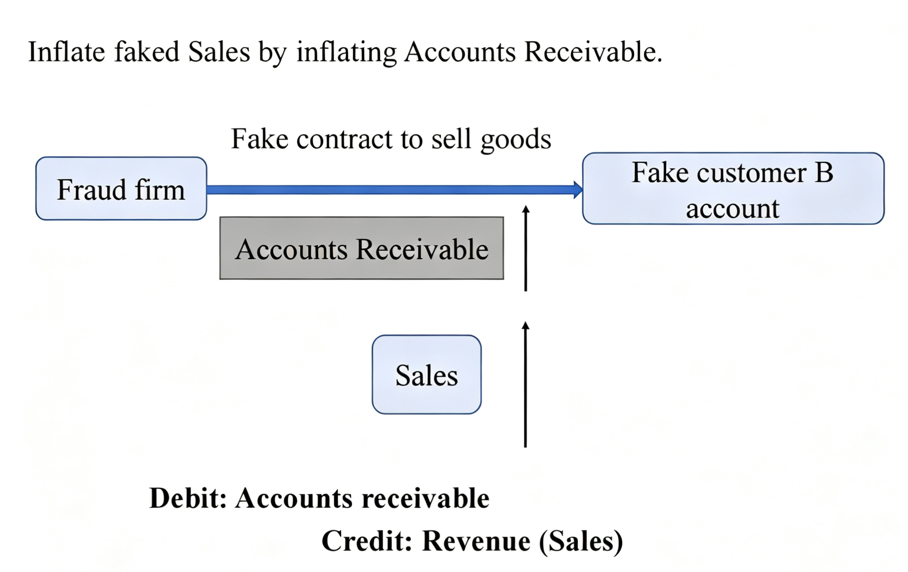
Flow Chart: Simple Fraud Pattern
Original illustration from lecture slides:
Jingwei Liu 2253336

Slide 26
Flow Chart: Simple Fraud Pattern
Reconstructed mechanism:
Fictitious Sales Contract
Fraud Firm
Fictitious Customer
No corresponding cash collection
Dr. Accounts Receivable ↑
Cr. Revenue ↑
Jingwei Liu 2253336

Slide 27
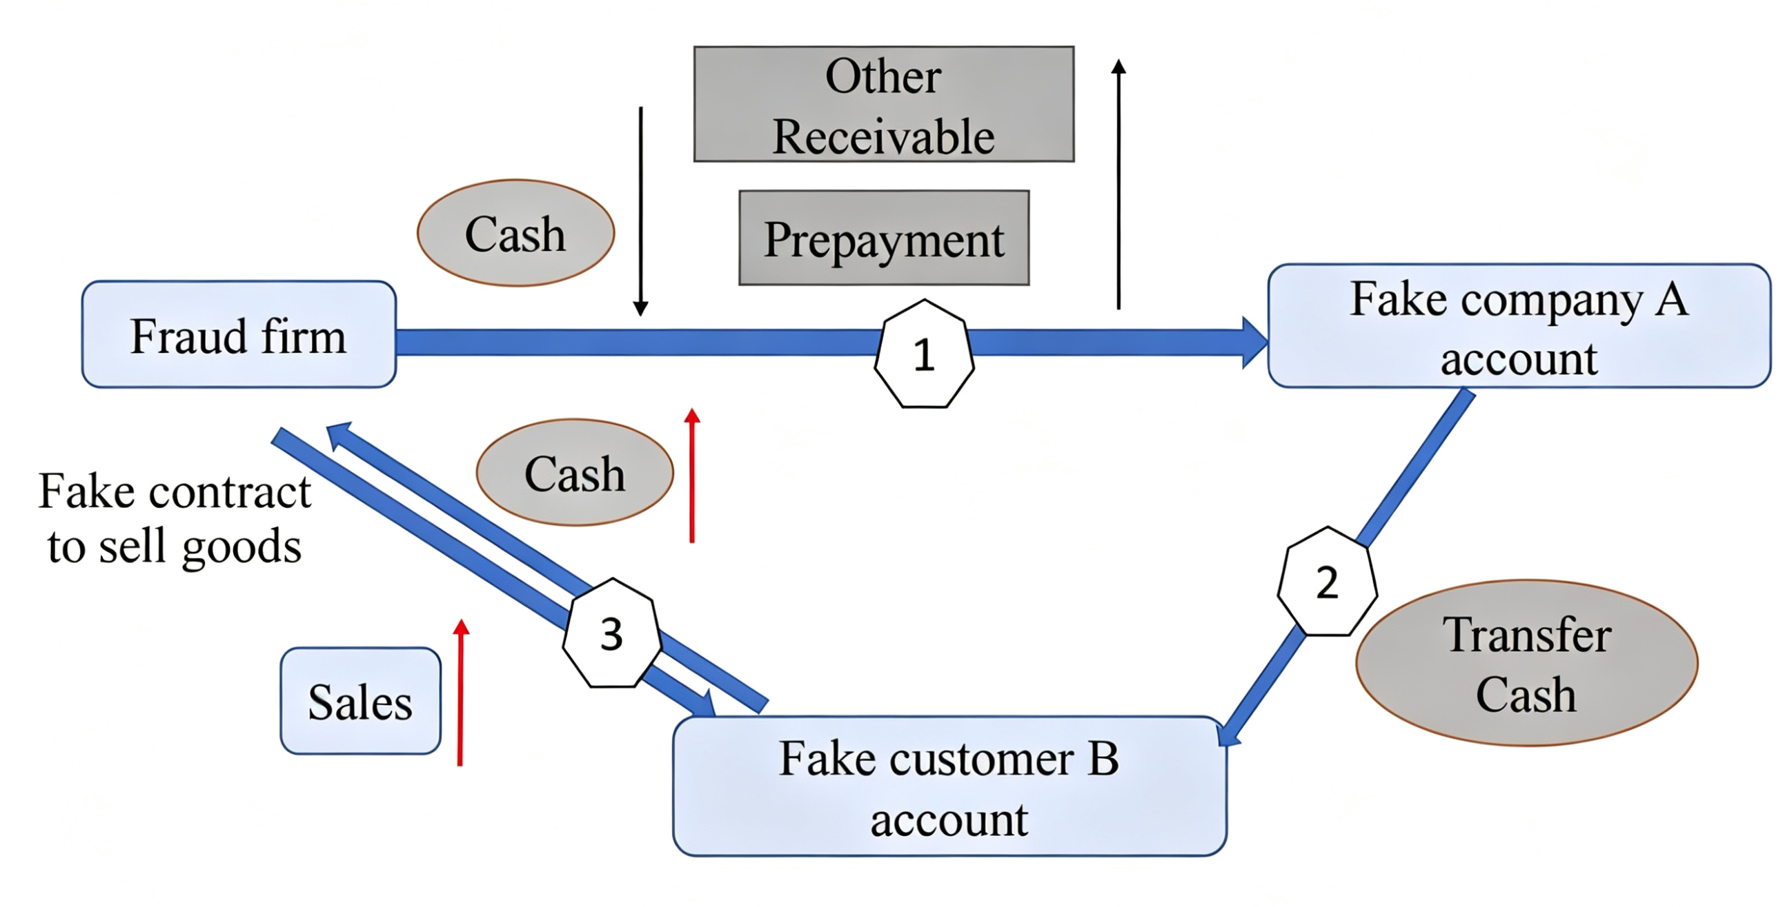
Flow Chart: Complex Fraud Pattern
Original illustration from lecture slides:
Jingwei Liu 2253336

Slide 28
Flow Chart: Complex Fraud Pattern
Reconstructed mechanism:
Fraud Firm
Dr. Cash ↑
Cr. Revenue ↑
Dr. Other Receivable / Prepayment ↑
Cr. Cash ↓
Step 3: Cash returns as sales
Step 1: Cash transferred out
Fictitious Customer
Fictitious Company
Step 2: Cash routed through a third party
Jingwei Liu 2253336

Slide 29
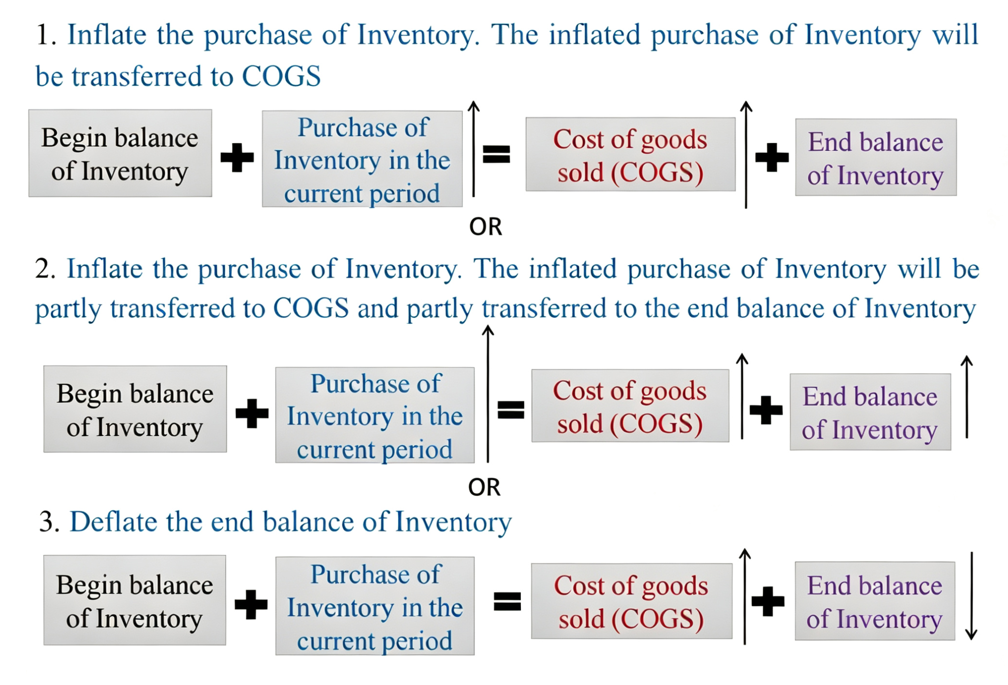
Flow Chart: Cost-Inflating Fraud Pattern
Original illustration from lecture slides:
Jingwei Liu 2253336

Slide 30
Flow Chart: Cost-Inflating Fraud Pattern
Reconstructed mechanism:
Inventory Equation: Beginning Inventory + Purchase of Inventory = COGS + Ending Inventory
Path 1: Inflate purchase only
Path 2: Inflate purchase and ending inventory
Path 3: Deflate ending inventory
Purchase of Inventory ↑
Purchase of Inventory ↑
Ending Inventory ↓
COGS ↑
COGS ↑
Ending Inventory ↑
COGS ↑
Jingwei Liu 2253336

Slide 31
Final Assessment of Fraud Patterns
Simple fraud pattern → clearly supported
Complex fraud pattern → supported, with stronger evidence from Other Receivable
Cost-inflating pattern → supported, with stronger evidence from Inventory-related indicators
Overall → Xinyan shows a combination of multiple fraud patterns during 2017-2019
Jingwei Liu 2253336

Slide 32
References
CNINFO Information Network (2026) 300159 Xinyan Holding: Company profile. Available at: https://www.cninfo.com.cn/new/disclosure/stock?orgId=9900016190&stockCode=300159#companyProfile (Accessed: 13 April 2026).
Jiang, J. (2026) ACC310 Accounting Fraud Detection and Analytics: lecture slides, Weeks 2-4.
Xinjiang Machinery Research Institute Co., Ltd. (2023) Announcement on receiving the ‘Administrative Penalty Decision’ and the ‘Market Ban Decision’ issued by the China Securities Regulatory Commission. Available at: https://www.cninfo.com.cn/new/disclosure/detail?plate=szse&orgId=9900016190&stockCode=300159&announcementId=1215651210&announcementTime=2023-01-19 (Accessed: 13 April 2026).
Annual reports (2016-2022), accessed via CNINFO:
Xinjiang Machinery Research Institute Co., Ltd. (2017) Annual report 2016. Available at: https://www.cninfo.com.cn/new/disclosure/detail?plate=szse&orgId=9900016190&stockCode=300159&announcementId=1203209065&announcementTime=2017-03-28 (Accessed: 13 April 2026).
Xinjiang Machinery Research Institute Co., Ltd. (2018) Annual report 2017. Available at: https://www.cninfo.com.cn/new/disclosure/detail?plate=szse&orgId=9900016190&stockCode=300159&announcementId=1204697067&announcementTime=2018-04-24 (Accessed: 13 April 2026).
Xinjiang Machinery Research Institute Co., Ltd. (2019) Annual report 2018. Available at: https://www.cninfo.com.cn/new/disclosure/detail?plate=szse&orgId=9900016190&stockCode=300159&announcementId=1206021572&announcementTime=2019-04-16 (Accessed: 13 April 2026).
Xinjiang Machinery Research Institute Co., Ltd. (2020) Annual report 2019. Available at: https://www.cninfo.com.cn/new/disclosure/detail?plate=szse&orgId=9900016190&stockCode=300159&announcementId=1207674950&announcementTime=2020-04-29 (Accessed: 13 April 2026).
Xinjiang Machinery Research Institute Co., Ltd. (2021) Annual report 2020. Available at: https://www.cninfo.com.cn/new/disclosure/detail?plate=szse&orgId=9900016190&stockCode=300159&announcementId=1209871694&announcementTime=2021-04-30 (Accessed: 13 April 2026).
Xinjiang Machinery Research Institute Co., Ltd. (2022) Annual report 2021. Available at: https://www.cninfo.com.cn/new/disclosure/detail?plate=szse&orgId=9900016190&stockCode=300159&announcementId=1213165841&announcementTime=2022-04-28 (Accessed: 13 April 2026).
Xinjiang Machinery Research Institute Co., Ltd. (2023) Annual report 2022. Available at: https://www.cninfo.com.cn/new/disclosure/detail?plate=szse&orgId=9900016190&stockCode=300159&announcementId=1216593647&announcementTime=2023-04-26 (Accessed: 13 April 2026).
Jingwei Liu 2253336

Slide 33
Thank you for listening!
Jingwei Liu 2253336

