Slide 1


React JS

Slide 2
Before Start…
switch operator
  an alternative to if
  is a control flow construct in JavaScript that to execute allows you one of several possible operations depending on the of an value expression.
  It ’s especially useful when you need to compare a single value against multiple possible options and execute the corresponding code.

Slide 3
Array methods:
Add/Remove
  Push(), Pop(), unshift(), shift()
Interating
  forEach(), map(), filter(), reduce()
Searching
  Find(), findIndex(), includes(), indexOf()
Modifying
  Slice(), splice(), concat(), join()
Condition checking
  Every(), some()
Sort
  Sorts the elements of an array alphabetically

Slide 4
Object methods:
Methods for Retrieving Object Information:
  Object.keys() – Returns an array containing the names of all enumerable proper ties of the object.
  Object.values() – Returns an array containing the values of all enumerable proper ties of the object.
  Object.entries() – Returns an array of key-value pair arrays for all enumerable proper ties of the object.
Methods for Working with Object Prototypes:
  Object.create() – Creates a new object with the specified prototype and proper ties.
  Object.getPrototypeOf() – Returns the prototype of the specified object.
  Object.setPrototypeOf() – Sets the prototype (i.e., the internal [[Prototype]] proper ty) of the specified object.
Methods for Defining Object Proper ties:
  Object.defineProperty() – Defines or modifies a proper ty directly on an object.
  Object.defineProperties() – Defines or modifies multiple proper ties on an object.
  Object.getOwnPropertyDescriptor() – Returns the proper ty descriptor for a specific proper ty.
  Object.getOwnPropertyDescriptors() – Returns all proper ty descriptors for an object.
Methods for Working with Object Proper ties:
  Object.hasOwn() – Checks if a proper ty exists directly on the object (not inherited).
  Object.propertyIsEnumerable() – Returns true if the specified proper ty is enumerable using for...in .
  Object.is() – Determines whether two values are the same.
Methods for C re a ting and Cloning Objects:
  Object.assign() – Copies enumerable proper ties from one or more source objects to a target object.
  Object.freez () – Freez es the object so proper ties can ’ t be changed or deleted.
  Object.seal() – Seals the object, preventing new proper ties and making existing ones non- configurable.

Slide 5
String methods:
Methods for Modif ying Strings:
• toLowerCase() – Converts the string to lowercase.
• toUpperCase() – Converts the string to uppercase.
• trim() – Removes whitespace from both ends of the string .
• trimStart() / trimLeft() – Removes whitespace from the beginning of the string .
• trimEnd() / trimRight() – Removes whitespace from the end of the string .
• padStart() – Pads the beginning of the string to the specified length.
• padEnd() – Pads the end of the string to the specified length.
• repeat() – Returns a new string with a specified number of copies.
• replace() – Replaces a substring or pattern match with a new value.
• replaceAll() – Replaces all instances of a substring or pattern match with a new value.
Methods for Searching and Extracting Substrings:
charAt() – Returns the character at a specified index.
char CodeAt() – Returns the Unicode value of the character at a specified index.
concat() – Combines the specified strings into one.
includes() – Checks if one string is found within another.
indexOf() – Returns the index of the first occurrence of a specified value or -1 if not found.
lastIndexOf() – Returns the index of the last occurrence of a specified value or -1 if not found.
localeCompare() – Compares two strings according to the current locale and returns a number indicating their order.
match() – Retrieves the result of matching a string against a regular expression.
matchAll() – Returns an iterator of all results matching a regular expression, including capture groups.
search() – Executes a search for a match between a regular expression and the string .
slice() – Extracts a section of the string and returns it as a new string .
split() – Splits a string into an array of substrings using a specified separator.
substring() – Returns a substring between two indexes or from a star t index to the end.
substr() – Returns a substring star ting at a specified index with a specified length.

Slide 6
Number methods:
Number prototype Methods:
toExponential() – Returns a string representing the number in exponential notation.
toFixed() – Returns a string with the number rounded to a fixed number of decimal places.
toLocaleString() – Returns a string with the number formatted according to locale.
toPrecision() – Returns a string with a number formatted to a specified precision.
toString() – Returns a string representing the number in the specified base.
valueOf() – Returns the primitive value of a Number object.
Methods of the Number Object:
Number.isFinite() – Determines if the passed value is a finite number.
Number.isInteger() – Determines if the passed value is an integer.
Number.isNaN() – Determines if the passed value is NaN (Not-a-Number).
Number.isSafeInteger() – Checks if the passed value is a safe integer (within the safe integer range).
Number.parseFloat() – Conver ts a string to a floating-point number.
Number.parseInt() – Conver ts a string to an integer using the specified radix.
Global Number Methods:
isNaN() – Determines if the value is NaN.
isFinite() – Determines if the value is a finite number.
parseInt() – Parses a string and returns an integer using the specified radix.
parseFloat() – Parses a string and returns a floating-point number.
Proper ties of the Number Object:
Number.EPSILON – The smallest interval between two representable numbers.
Number. MAX _ SAFE_ INTEGER – The maximum safe integer in JavaScript.
Number. MAX _VALUE – The largest representable number in JavaScript.
Number. MIN_ SAFE_ INTEGER – The minimum safe integer in JavaScript.
Number. MIN _VALUE – The smallest positive number in JavaScript.
Number.NaN – Represents the Not-a-Number value.
Number.NEGATIVE _ INFINITY – Represents negative infinity .
Number.POSITIVE _ INFINITY – Represents positive infinity .

Slide 7
Some More topics…
Destructure
Asynchronicity
Closures

Slide 8
Creating a new React Project

Slide 9
Vite
— It is a modern build tool for JavaScript projects. Its main goal is to provide fast and efficient development, especially for modern frameworks such as Vue, React, Svelte, and others.
How to create a new Vite Project
Open a directory
Run Command
npm create vite
Install package
Configure Eslint
Clean Up
Start the project
npm run dev
Stop the project

Slide 10
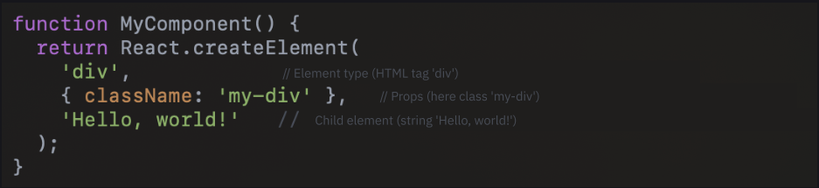
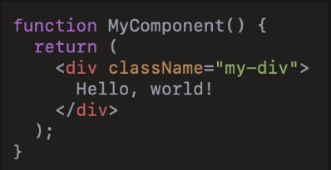
React.createElement
-- It’s the function that React uses to create elements.
React.createElement --This function is the foundation of the entire React element concept, and it's what React uses to build and update the virtual DOM.
Without JSX , you could write a component like this:
This is equivalent to the following JSX:

Slide 11

React.createElement
-- More on how it works
Syntax of React.createElement
Arguments:
Type:
  the type of element to create
  A string representing an HTML tag.
  A function or class for a react component
Props
  An object containing all the element’s attribute, if there are none, null can be passed.
Children
  The childern of the element, can be
    Text
    Other React component
    An array of element

Slide 12
JSX
-- JavaScript XML

Slide 13

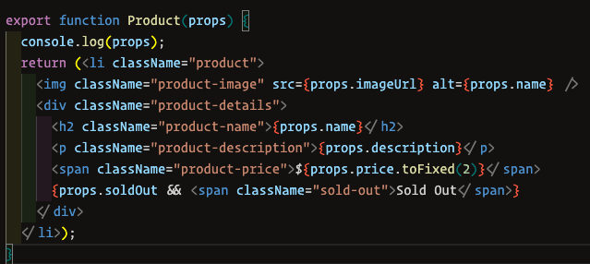
JSX – It is a language extension. Javascript
-- Which allows you to write elements that look like HTML or XML directly in your React code
Or, JSX is a syntax that lets you write HTML, CSS and JS all in one place.
JSX syntax without JS.
JSX syntax with JS:
Example of a react component with JSX:

Slide 14
JSX.CSS
-- Working with CSS

Slide 15
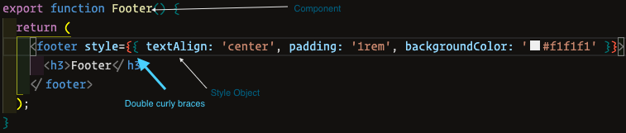
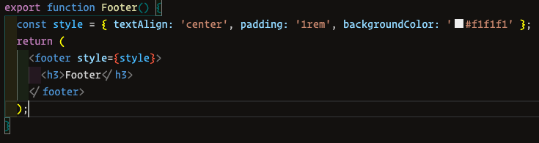
CSS in JSX
-- How CSS works in a React component
Styles are written as a JavaScript object, of CSS proper ties, and the values are where the keys are camelCase versions either strings or numbers. For numeric values like width, padding , etc., the default unit is pixels.
Values such as colors, URLs, and other CSS proper ties that are typically written in quotes must also be specified as strings.
We can also create a separate variable whose value is a style object and then apply it to an element using the style attribute.

Slide 16
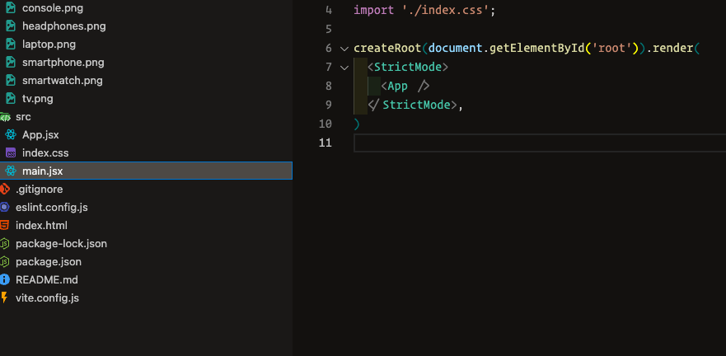
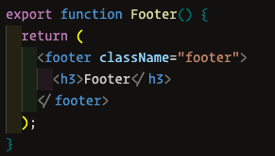
CSS in JSX
-- Using a CSS file with predefined styles for specific classes
Need to import style file into required JS file, and then class and styles from external CSS file can be used directly.

Slide 17
Props
-- props (abbreviation of properties)

Slide 18
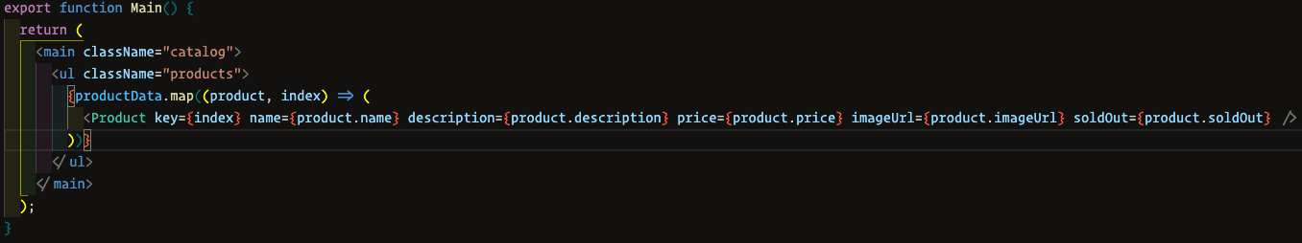
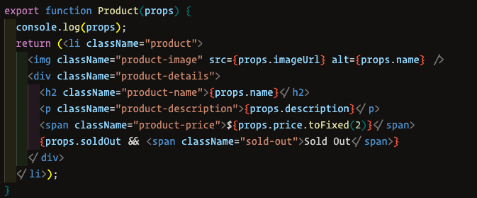
Props
-- A way to pass data from parent components to child components.
Props make components more reusable and modular . Components receive props as a them to display data or adjust their behavior depending on the input.
The parent component, in which the child component is used, is the control center that sends instructions on what the element should be, with which proper ties, and in what quantity.
The child component is the description of the element (a template): what its structure is and what it can have. proper ties In React, data is passed from the props.
The opposite is not possible. parent component to the child through The child component receives data as it can use but cannot modify.

Slide 19
useState
-- State Management

Slide 20
useState
-- This is one of the React hooks that allows components to have their own state.
The useState hooks takes an initial state and returns an array with two elements
Example

Slide 21
State Update
-- State can only be changed through setState().
In React, you cannot update state directly, because React uses a special mechanism to track state changes, which is based on the setState method.
Automatic rendering management
react tracks when state changes through setState, and knows it need to re-render the component.
Immutability of state
React relies on immutable state for better performance. When state is updated via setState, React creates a new copy of the state instead of modifying the existing one, thus allow react to quickly detect changes by comparing the new and old state.
Asynchronous updates
State updated in react can be asynchronous, and they are often batched for performance. setState ensure React processes updates in order and with latest data.

Slide 22
When to use
-- UseState – and how exactly

Slide 23
useState
-- When to use
What useState does
Preserves values between renders: A value created with useState is retained across re-renders of the component.
Triggers re -rendering on change: When the state is updated through setState, the component automatically re -renders to display the new data .
Maintains immutability: new values for optimized rendering. Updating state with setState creates a new version of the state, allowing React to compare old and
Use useStae when you need to:
Track state for rendering: If a value created with useState changes, the component automatically re -renders, showing the updated value in the UI.
Preserve values between renders: Variables declared with useState keep their value across renders, unlike normal variables which reset.

Slide 24
The data of a regular variable does not change during the program’s execution…
No
Regular variable
Yes
When new data of a useState variable depends on its old data
We create a useState
No
Yes

Slide 25
React is Declarative
-- But what does that mean??

Slide 26
Declarative and
Imperative
Declarative and Imperative
-- These are two approaches to writing code that describe different styles of interacting with programs. These styles are often mentioned in programming and UI development, especially in React and other modern libraries.
Declarative
The declarative style focuses on what the program should do, not how to do it. In declarative code, we describe the desired end result, and the system decides how to achieve it. This is a higher level of abstraction, making code easier to write and understand since it ’s closer to natural language.
In React, using JSX , we write declarative code to describe how the UI should look:
Imperative
The imperative style focuses on how the program should per form a task. The developer provides exact instructions, describing the process step by step. This is a lower level of abstraction, where the developer manages specific operations.
Declarative code describes what should happen and focuses more on the final result.
Imperative code describes how to make it happen, focusing on the step -by-step process.

Slide 27
Component Composition
-- But what does that mean??

Slide 28
useEffect-- Hook

Slide 29
useEffect
-- Is used to manage side effect in functional components.
It allows executing code that should run after the component render, as well as managing side effect that occur due to state or prop changes.

Slide 30
useEffect
-- How does it work
useEffect runs after ever y render of the component. This means it works both on (the first render) and on updating the mounting component(re -render).
You can pass a dependency array as the second argument to useEffect.
If the dependency array is empty ([]), useEffect runs only when the component is mounted.
If the dependency array includes specific values, useEffect will run only when those values change.
Example

Slide 31
useEffect Vs Events
--What to Choose ?

Slide 32
useEffect
-- What to use for working with side effects?
Use useEffect when you need automation.
Use useEffect when a side effect should happen automatically under certain conditions of the programs.
Events with side effects
When executing a side effect, is only needed after a user triggered event.
When there is no need to run a side effect on the first load of the application.
When there is no need to run a cleanup function.

Slide 33
Class vs Functional Components
-- And their differences

Slide 34
Class vs Function
-- Class and Functional components are two ways to create components in React
Class Components
Class components in react were in the main way of creating components before the introduction of the hooks in React version 16.8 (2019).
Main feature of class components:
State: In class component, state is stored in the state objects, which can be changes using the setState method.
LifeCycle methods:
Instances: For each class components, React creates an instance of the class, which stores state and methods.

Slide 35
Class vs Function
-- Class and Functional components are two ways to create components in React
Functional Components
Functional components in react are simpler way to create components, Earlier they were also known as “stateless”, however after introduction of hooks functional components become more powerful and now can perform all the same task as class-based components.
Main feature of Functional components:
Simplicity.
Hooks.
No lifecycle methods.

Slide 36
Rendering
-- How it works

Slide 37
Component Rendering in React
-- is the process where React calls the component function to get a description of the interface in the form of react elements.
These elements are used to create and update the virtual dom, which is then synchronized with the real dom.
Rendering Includes:
  Calling the components and getting elements
  Building and updating the virtual dom.
  Comparing the virtual dom with the previous dom.
Rendering is not drawing on the screen but drawing under the hood of react.
Internal rendering: When we talk about rendering in React, we often mean the process of calling the, which returns React elements (via JSX). These elements form the virtual DOM — component the internal representation of the interface that React works with.
Drawing: After rendering , React compares the new virtual DOM with the previous one to determine the minimal changes that need to be applied to the real DOM (this process is called “diffing ”). Only after that are then changes synchronized with the real DOM, which leads to visible updates on the screen.
And the actual drawing on the screen is the next step that react performs after rendering, Technically, it is called the commit phase.

Slide 38
Rendering
-- When is rendering triggered?
Components rendering is triggered in two cases:
Initial Rendering:
Re-Render:

Slide 39
Virtual DOM
-- What does it look like?

Slide 41
Virtual DOM
-- How it Works?

Slide 43
Fiber Tree
-- How it Works?

Slide 45
Fiber Tree Vs Virtual DOm
-- What’s the difference ?

Slide 47
Rendering scheme
-- How React updates the application ?

Slide 48
Lets try

Slide 49
Lets try

Slide 50
Memoization
-- Application performance optimization ?

Slide 51
Re- Render
-- Re -rendering of child components always happens if the parent component re -renders, even if the child component ’s dependencies received from the parent (props) have not changed.
  Such and approach often wastes extra resources on re-drawing and re-rendering.
Memoization to the rescue
Memoization
Is an optimization technique that consist of caching the result of computation.

Slide 52
Commit phase
-- ?

Slide 53
Commit Phase
-- The final state of rendering.
  In this phase react applies all the changes calculated during the render phase to the real dom.
This phase includes
Updating the real dom
Executing effect
Unlike the Render Phase, which can be paused, the Commit Phase is always executed synchronously. This ensures that the interface is fully updated and all necessary changes are applied in real time.

Slide 54
Diffing
-- How it works?

