Slide 1

UniCon: The Anonymous University Communication Platform
The Team: Sumant Deswal (S24CSEU2358)
Vaibhav Yadav (S24CSEU2340)
Aadarsh Dangi (S24CSEU2332)
Parth Sharma (S24CSEU2370)
Mentor: Dr. Chandra Bhushan

Slide 2
Why UniCon?
University/College is a whole new chapter on one’s life.
You have to find and form new connections.
It is not easy to express your interests publicly to find people with the same.
Avoiding judgement from others all the while is very difficult.

Slide 3

Our Goal
Enable safe anonymous communication between students
Encourage open discussions around topics
Build a campus specific digital community
Maintain accountability despite anonymity
Help students find their people

Slide 4
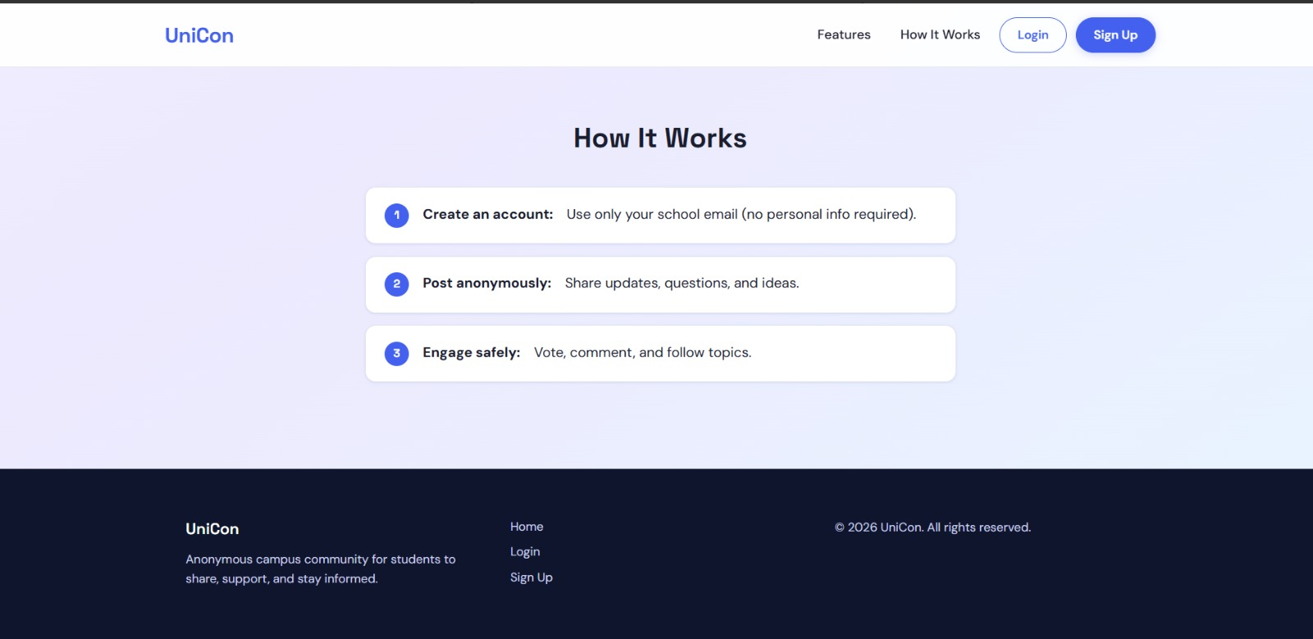
What we provide:
Anonymous user profiles
Flair system
Direct messaging system
Moderation system

Slide 5
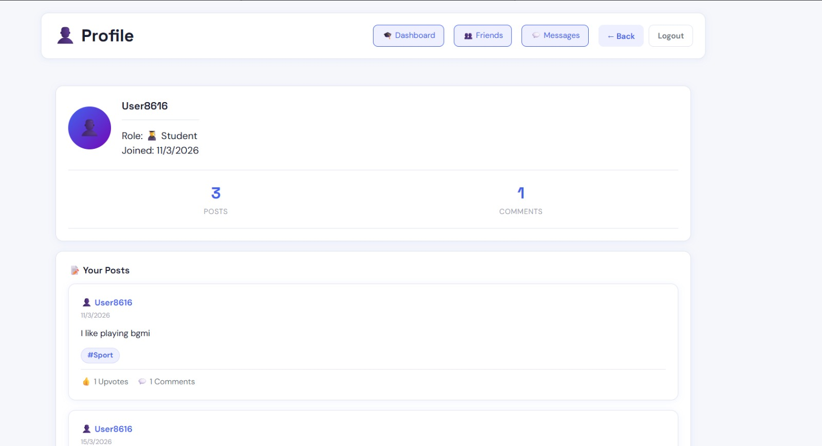
The Anonymity
The ability to post anonymously gives our users the confidence of not being judged for who they are and prevents online abuse which is so prevalent in the age of social media.
Students are only identified by the topics they are interested in, only their role is visible to other users.

Slide 6
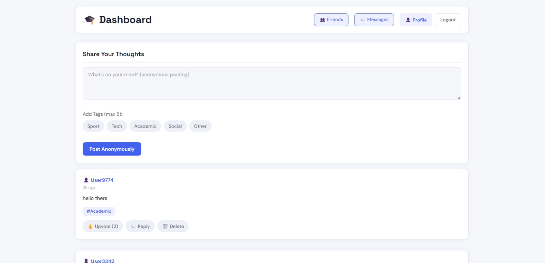
The system:
How do you actually communicate with others? Easy, just post what is on your mind and let the platform do the rest. Use the tags to find your community!

Slide 7
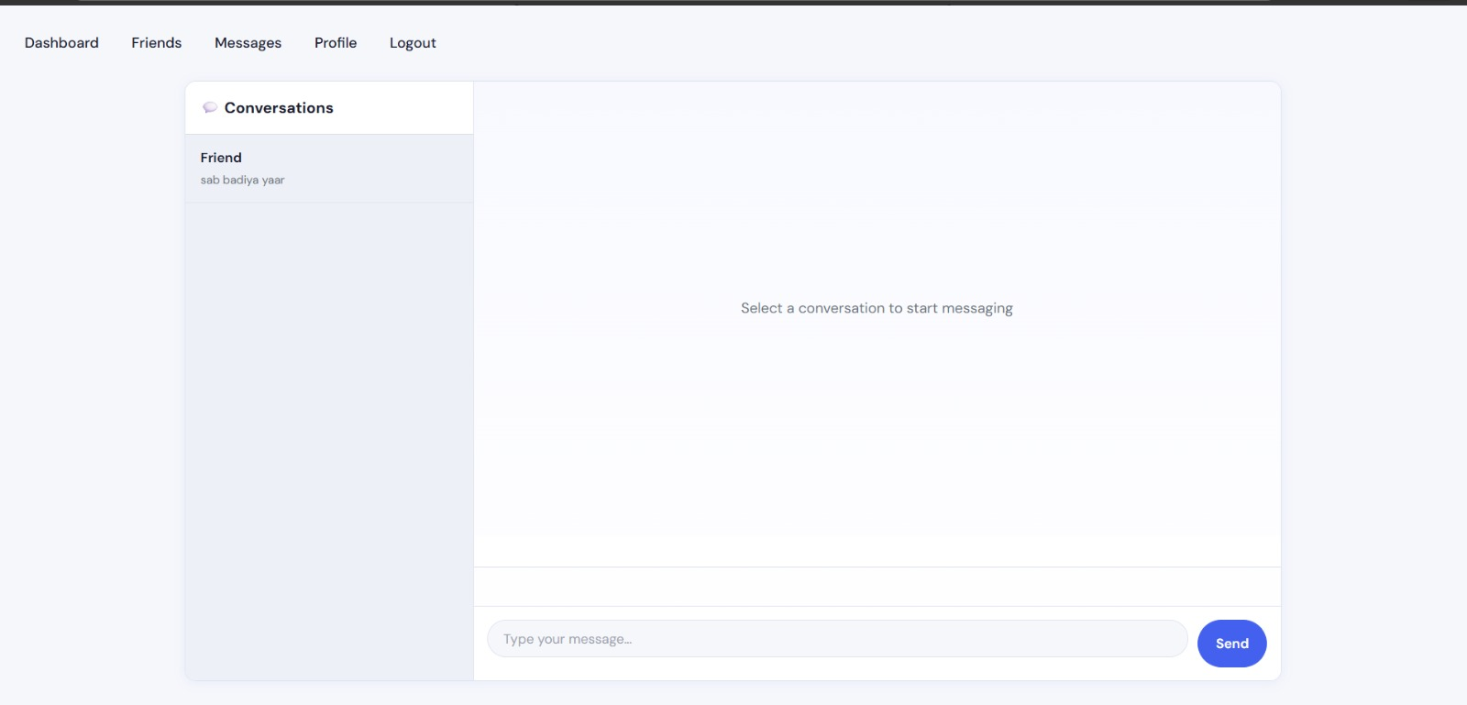
How to form your connections?
Talk to them! You found someone with similar interests and want to talk directly to them then use the private messaging system and make new friends!

Slide 8
Accountability
With anonymity we must ensure accountability.
How will we deal with bad actors who misuse the system? We will have moderators appointed which will have access to the students personal information such as their university email to act upon reports of them misusing the platform. This helps us create a civil and healthy environment.

Slide 9
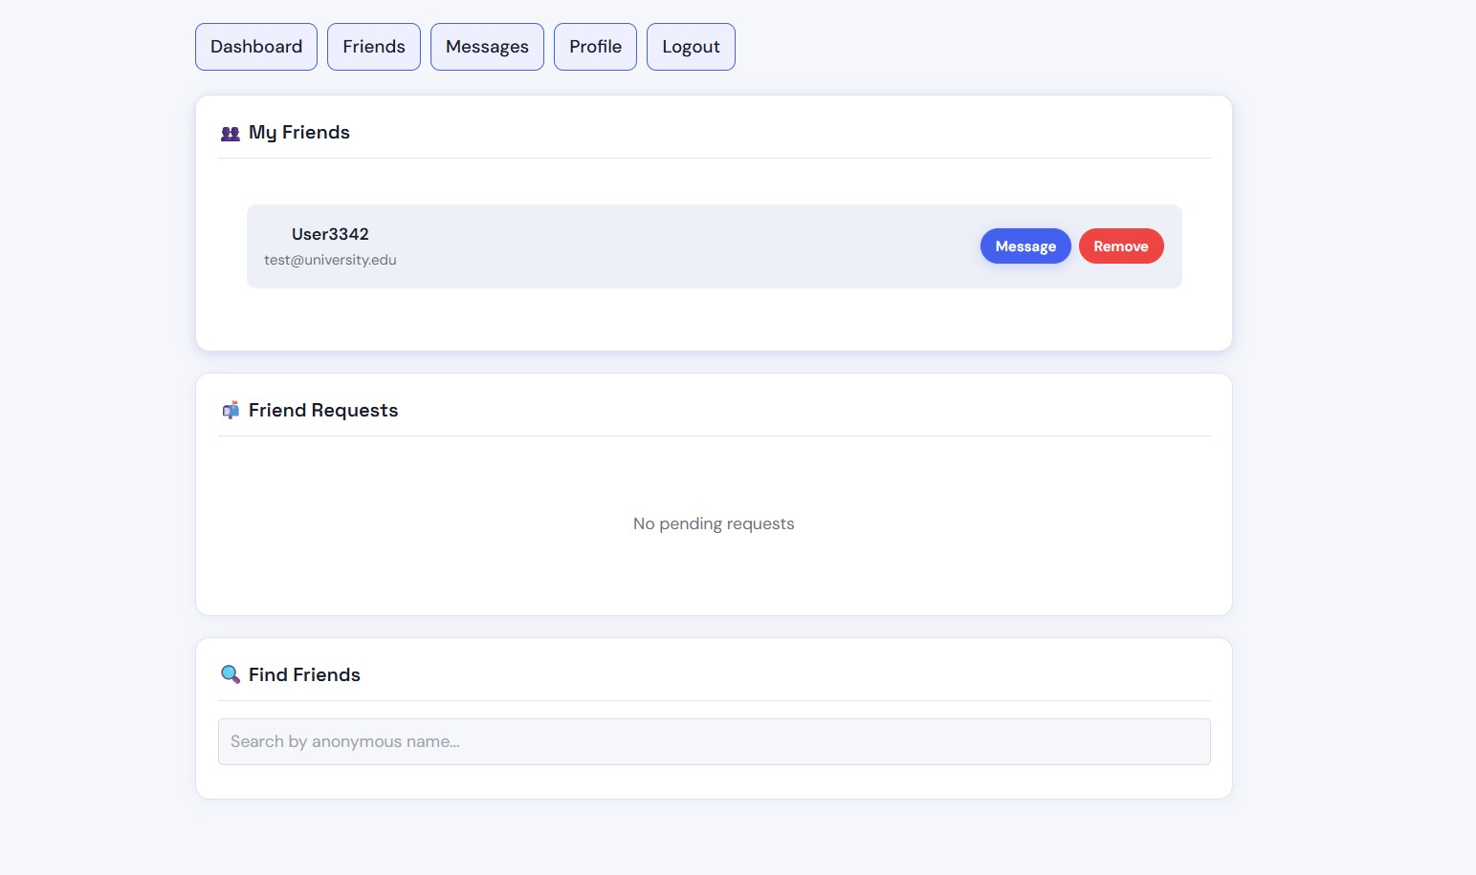
What does the future hold?
A notification system
AI moderation to reduce manual labour
Mobile app version
General UI improvements with time.

Slide 10
Thank you
Liked it? Try it yourself! Find here.

