Slide 1
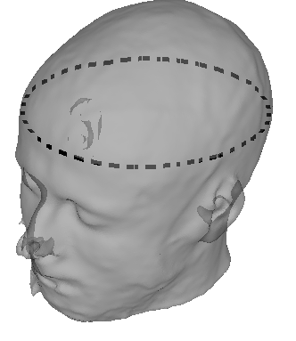
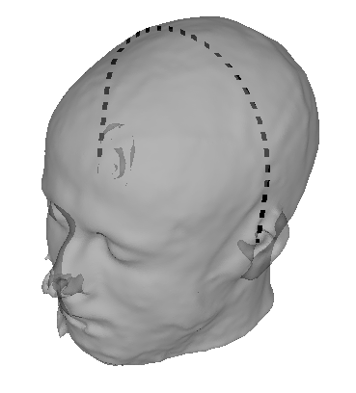
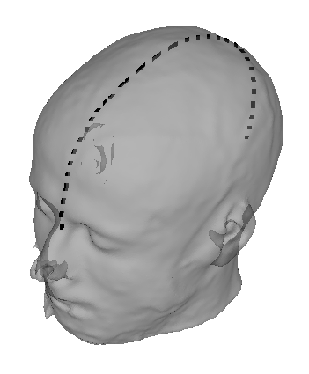
Head Circumference
Tragus-Tragus Distance
Vertex
Tragus
Tragus
Nasion-Inion Distance
Vertex
Inion
Nasion

