Slide 1
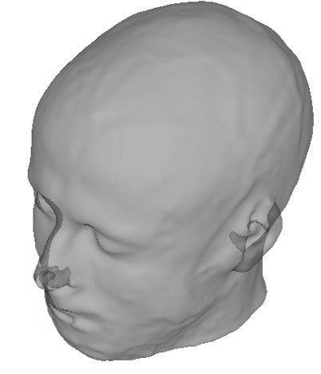
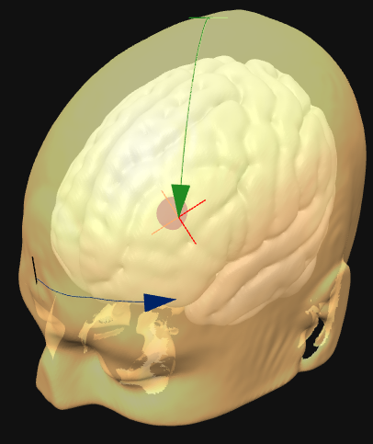
Vertex
Vertex
Distance from Vertex
Midline
Distance along circumference from midline

Slide 2
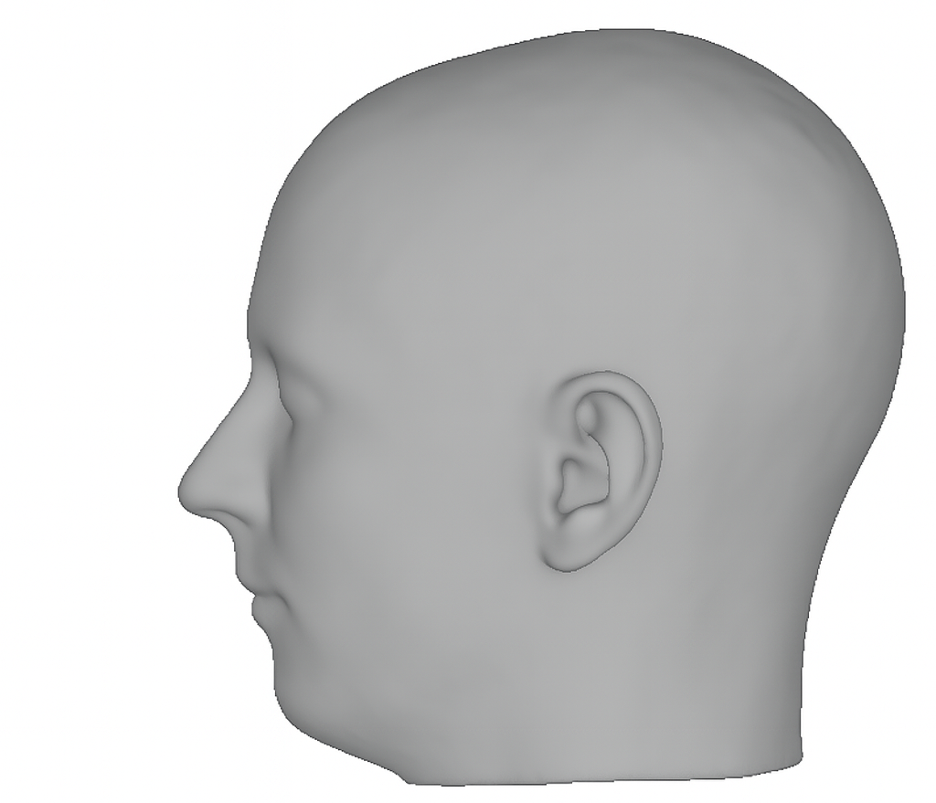
Vertex (Cz)
}
}
Fz
Pz
}
20%
20%
}
Fpz
20%
20%
}
Head Circumference
Oz
}
10%
10%
Nasion
(Nz)
Inion
(Iz)

Slide 3
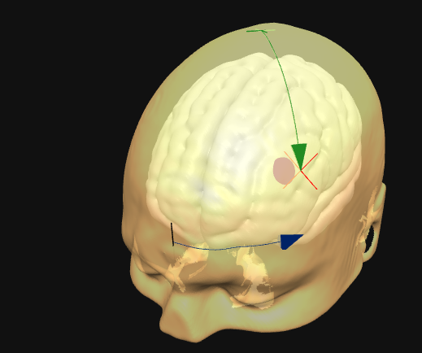
Vertex
Distance
from vertex
Distance along
circumference
from midline

Slide 4
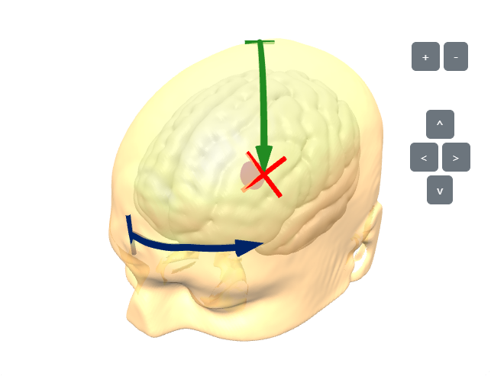
Vertex
Distance
from vertex
Distance along
circumference
from midline

Slide 5
