Slide 1

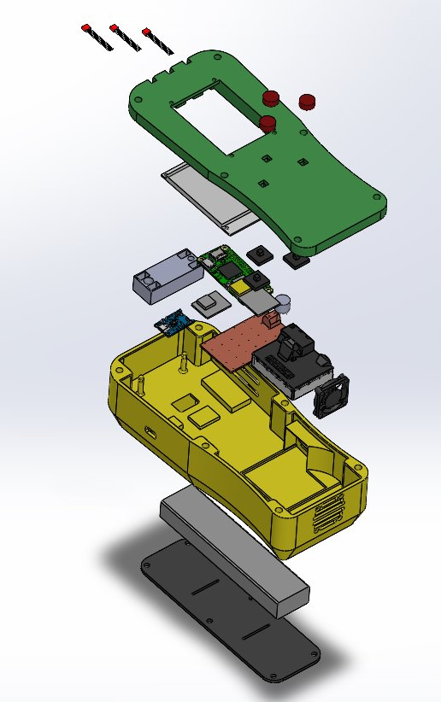
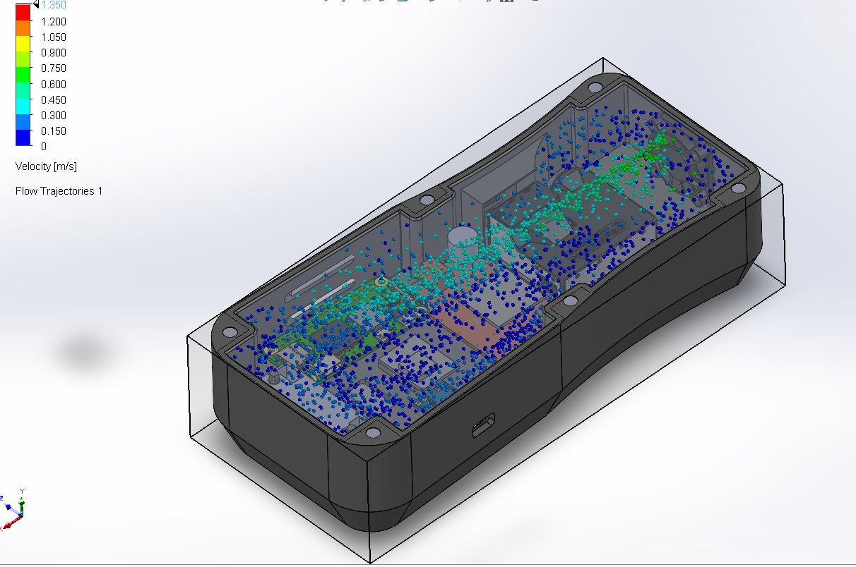
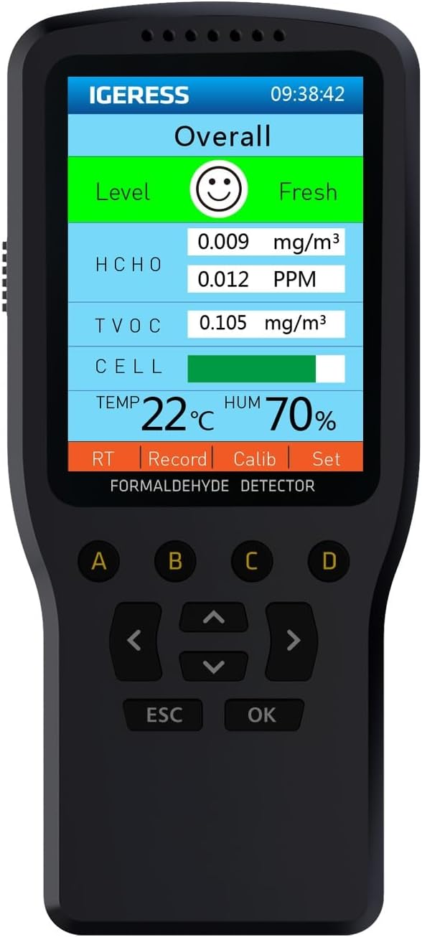
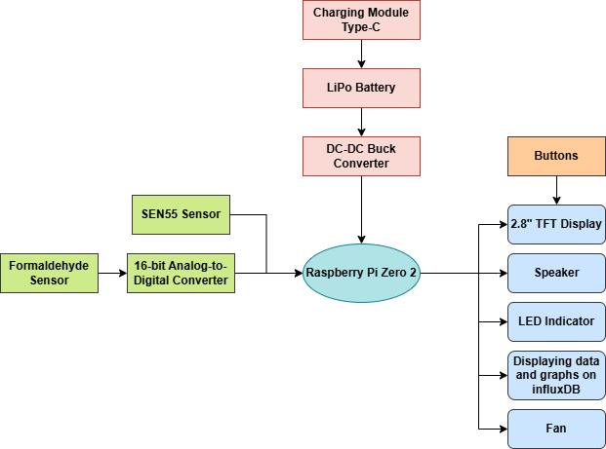
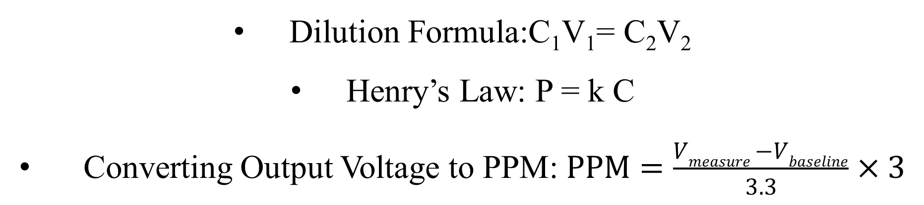
The Portable Emissions Tracer
Anh Phung, Forrest Austin, Bota Yvan Brillant, Wilfred Talle, Leanna Wildes and Professor Daren Wilcox
The Southern Polytechnic College of Engineering and Engineering Technology (SPCEET)
Introduction
Results
3D printing is a widely used technology that has found more popularity, being utilized in other areas outside of industrial settings such as schools and inside homes for hobbyists. One of the more concerning problems that stems from using 3D Printer is the emission emitted from the process which are microscopic and unperceivable to the eye. Among these, formaldehyde - a volatile organic compound (VOC)—is of particular interest due to its potential health risks even at low concentrations. Low-cost formaldehyde sensors offer an accessible solution for monitoring air quality; however, their accuracy and reliability are often limited without proper calibration.
This research focuses on developing and evaluating calibration methods for a custom-designed formaldehyde sensor referred to as the Portable Emission Tracer (PET) to improve its measurement accuracy. By establishing a reliable relationship between sensor output and actual formaldehyde concentration, this work aims to enable more effective detection of hazardous emissions and support safer indoor environments where 3D printing is used.
Formaldehyde Concentration in Air (ppm) | Average for Commercial Sensor (ppm) | Average for Fermion Sensor (ppm)
0.030811 | 0.045171 | 0.009136131
0.010270 | 0.010038 | 0.007069211
0.005135 | 0.060228 | 0.007243351
0.001027 | 0.030114 | 0.007141339
0.000514 | 0.000000 | 0.005705817
0.000205 | 0.000000 | -0.001078557
Table 2: Measurement of Commercial and PET Sensor
Figure 1: Exploded View of PET Sensor
Figure 2: Air Flow Simulation of PET Sensor
Methodology
In this study, a commercial air quality monitor that has the capability to measure formaldehyde concentration and the micro-electro-mechanical system (MEMS) metal-oxide semiconductor (MOS) formaldehyde sensor in the PET system was used. Both were exposed to a formaldehyde source placed within a sealed enclosure inside a fume hood. The data obtained by the commercial and PET sensor were compared to establish a model representing the sensor behavior. Serial dilution was done to get six different concentration (0.02, 0.05, 0.1, 0.5, 1, 3 ppm) from a 37% formaldehyde solution. The temperature and relative humidity was relatively constant throughout the testing. Both sensors were turned on and left to warm up for at least 30 minutes before introducing them to formaldehyde source. 1 mL of each concentration was put onto a weight boat and placed inside the sealed enclosure for 30 minutes. After which the enclosure was opened up to let the fume hood flush in fresh air for 10 minutes, and the process was repeated [1]. These six concentrations were chosen because according to Table 1, the acute limit of exposure from CDC is 0.04 ppm so the highest gas concentration should be less than 0.04 ppm, which is 0.03 ppm, as anything above this is considered hazardous.
Figure 5: Measurement of Commercial and PET Sensor
Note: Measurement were not taken for 2 and 4 ppm
Conclusions
Figure 3: Functional block diagram
Figure 4: EG Air Quality Monitor
This research shows that the custom-designed PET sensor performed better at lower ranges than the commercial sensor. The data of the two correlated well, but the PET sensor reading in the lower ranges was more stable and consistent than the commercial sensor. At 0.02 ppm and 0.05 ppm range, the commercial sensor could not detect formaldehyde but the PET sensor could. The custom-designed PET sensor is suitable for the supplemental monitoring of formaldehyde VOC emissions at the level listed in Table 1.
Calculation
Dilution Formula:C₁V₁= C₂V₂
Henry’s Law: P = k C
Converting Output Voltage to PPM: $PPM=\frac{Vmeasure −Vbaseline}{3.3}×3$
References
[1] Alonso M. J, Madsen H, Liu P, Jørgensen R. B, Jørgensen T. B, Christiansen E. J, Myrvang O. A, Bastien D, Mathisen H. M, Evaluation of low-cost formaldehyde sensors calibration, Building and Environment, Volume 222, 2022, 109380, ISSN0360-1323, https://doi.org/10.1016/j.buildenv.2022.109380.
[2] Pei Z, Balitskiy M, Thalman R, Kelly KE. Laboratory Performance Evaluation of a Low-Cost Electrochemical Formaldehyde Sensor. Sensors (Basel). 2023 Aug 26;23(17):7444. doi: 10.3390/s23177444. PMID: 37687899; PMCID: PMC10490822.
[3] ATSDR, “Minimal Risk Levels for Hazardous Substances | ATSDR,”wwwn.cdc.gov. https://wwwn.cdc.gov/TSP/MRLS/mrlslisting.aspx
[4] Sander R. Henry’s Law Constant. Max-Planck Institute for Chemistry Mainz, Germany https://www.henrys-law.org/henry/.
Guidelines
Acknowledgement
Formaldehyde
Inhalation | Acute (1-14 days) | 0.04 ppm
Inhalation | Intermediate (4-364 days) | 0.03 ppm
Inhalation | Chronic (365 days and longer) | 0.008 ppm
Professor Javad Khazaii – Mechanical Engineering Technology Department
Professor Diane Diatta - Chemistry and Biochemistry Department
Alex Lehocky – KSU Environmental Health & Safety
Professor Richard Kennedy – Mechanical Engineering Technology Department
Table 1: Minimum Risk Levels for Hazardous Substances [3]

